Slide 1
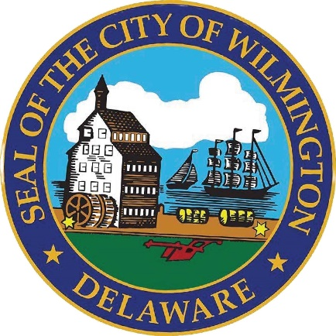
Affordable Housing Development Plan
Office of Mayor Carney
Delivered: May 5, 2026

Slide 2
Defining Affordable Housing
Regulated Affordability: The unit is priced based on the mandate determined by law or program rules. Terms are defined by HUD and tied to the Area Median Income (AMI). I.e. 80% AMI
OUR PROPOSAL
Office of the Mayor | 2

Slide 3
Wilmington Area Median Income (AMI)
 | Household Income as Percentage of AMI | Maximum Monthly Cost Based on Percentage of AMI
Percentage of AMI | New Castle / Wilmington | New Castle / Wilmington
30% AMI | $28,650 | $717
50% AMI | $47,800 | $1,195
60% AMI | $57,360 | $1,434
80% AMI | $76,400 | $1,910
Office of the Mayor | 3

Slide 4
How is Affordable Housing Developed
Components
Site Acquisition
Permitting and Approvals
Construction
Pre-Development
Financing and Capital
Site Acquisition: land purchase, environmental due diligence, surveys, title work
Pre-development: architecture and engineering, legal, community engagement, and financial modeling
Permitting and Approvals: site plan review, building permits, etc.
Financing and Capital: building a financing that will support the creation of the development
Construction: site work, foundation, framing, accessibility, etc.
Office of the Mayor | 4

Slide 5
Affordable Housing Fund Plan
The proposal addresses multiple factors in affordable housing development at once.
$2M - Water and Sewer Connection / Site Work
$500,000 – Wilmington Land Bank
$16.8M - Direct Affordable Housing Subsidy
$200,000 - Architectural and Engineering
Office of the Mayor | 5

Slide 6
Affordable Housing Fund Plan
$2M – Water and Sewer Connection / Site Work
Targeting vacant lots and will fund site surveying and water and sewer connections.
Decreases the overall pre-development cost of vacant lots.
$200,000 – Architectural and Engineering
Funds the creation of shelf-ready designs.
Decreases the overall cost of permitting and approvals.
$500,000 – Wilmington Land Bank
Funds the continued operations to ensure site acquisition.
$16.8M – Direct Affordable Housing Subsidy
Reduces the cost of affordable housing construction projects.
Leverages private money to ensure development projects include affordable housing units.
units.
Office of the Mayor | 6

Slide 7
Impact on Affordable Development
Components
Permitting and Approvals
Construction
Pre-Development
Financing and Capital
Site Acquisition
Affordable Housing Plan
Water and Sewer Connection / Site Work
Architectural and Engineering
Direct Affordable Housing Subsidy
Wilmington Land Bank
Office of the Mayor | 7

Slide 8
Cost to Build Affordable Housing
Each affordable housing unit will be eligible for up to $100,000.
The amount is based on the level of AMI that the development targets.
The $16.8M will enable us to leverage between ~$30M and ~$60M in private investment.
Office of the Mayor | 8

Slide 9
Direct Affordable Housing Subsidy
$16.8M will be leveraged to directly subsidize construction to bring units within the targeted affordability range for both homeownership and rentals.
Development of units at or below 80% of AMI
Projected to develop 200 affordable housing units
Units are eligible for up to $100,000 in subsidy
All development is required to be affordable for at least 10 years
Does not fund the acquisition of land
Funding will leverage existing funds in order to ensure affordability
Office of the Mayor | 9

Slide 10
Direct Affordable Housing Subsidy
Homeownership
Rental
Targeting households at or below 80% AMI
Owner-occupied resale restriction for at least 10 years
Deed restrictions
Fee waivers
Eligible for up to $100,000 in subsidy
Targeting households at or below 80% AMI
Forgivable gap financing loan at zero percent interest
Forgiven after 10 years if affordability is maintained
Fee waivers
Eligible for up to $100,000 in subsidy
Stacked funding (federal or state) and they already have capital committed
Office of the Mayor | 10

Slide 11
Get-a-lot Program
Leveraging existing vacant lots to allow for small development to occur
Roughly 200 lots controlled by the City of Wilmington and Land Bank
Ideal for subsidy for water and sewer connection
Use will vary by size – Land Use and Planning is doing an assessment
Ideal locations for preapproved designs
Office of the Mayor | 11

Slide 12

Thank you

