Slide 1

DTRN360: Building a Front Door to Behavioral Health Care
Michelle Twyman, Director of Operations
March 2026
Notes:
Speaker Notes:
Thank you for the opportunity to share DTRN360 with the Overdose System of Care Committee. As a psychiatric nurse with over 25 years of experience across levels of behavioral health care in the tristate area joining DSAMH to embark upon the care coordination journey is a career highlight. After two Requests for proposal we are happy to announce this project in collaboration with Bamboo Health and FindHelp…. DTRN360 has arrived.
DRAFT – PRESENTATION TEMPLATE

Slide 2
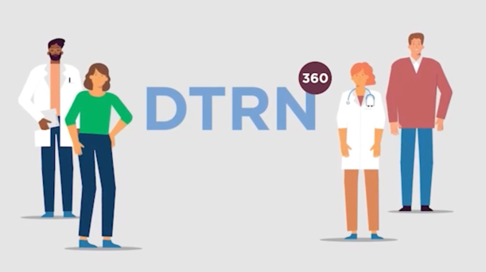
Building a Front Door to Behavioral Health Care
The Wilmington Community often see the same residents with behavioral health disorders across multiple systems:
Emergency rooms
Crisis response
Outreach teams
Shelters
But these systems historically do not share information or coordinate care in real time.
DTRN360 is Delaware’s statewide care coordination platform designed to connect those providers.
DTRN360 is Delaware’s statewide care coordination platform designed to connect those care organizations.

Slide 3

Addressing the whole person
Many Wilmington residents experiencing behavioral health challenges are also dealing with:
Housing instability
Food insecurity
Transportation barriers
Employment disruption
Providers often know what someone needs but struggle to connect them to services quickly.
DTRN360 allows providers to make direct referrals to the community safety nets, including housing supports, mental health and substance use care, and social services.
This helps stabilize individuals before situations escalate to crisis or law enforcement involvement.

Slide 4


Slide 5
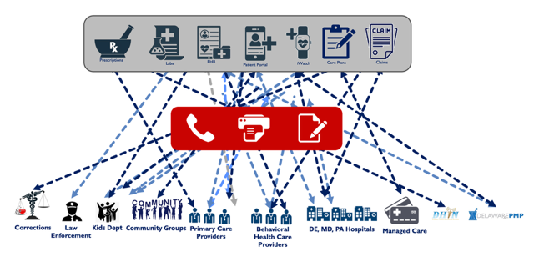
Closed Loop referrals
Historically, referrals between providers often relied on:
Fax
Phone calls
Paper forms
Once a referral was made, there was often no visibility into what happened next.
DTRN360 allows providers to:
Send electronic referrals
Track whether someone connects to care
Coordinate follow-up services
This creates true continuity of care, rather than disconnected interactions

Slide 6



Delaware Behavioral Health Future Environment
Behavioral Health Care Providers
Primary Care Providers
DE, MD, PA Hospitals
Health Summary
Care Plans
Health Summary
EMRs
PDMP Apriss
DTRN eReferral
DHIN
Health Summaries
EMRs
PDMP Appriss
DTRN eReferral
DHIN
EMRs
PDMP Apriss
DTRN eReferral
DHIN
Kids Dept
Care Plans
Case Mgt
DTRN eReferral
Discrete Data
Analytics
Prescriptions
Messaging, Document Exchange, Consent Management, Alerts, eReferral, Closing Gaps in Care, Risk Stratification
PDMP Apriss
DHIN
Care Plans
Care Plan
Health Summaries
Claims
Care Plan
Health Summaries
Claims
Deljis
Care Plans
Care Plans
Case Mgt
DTRN eReferral
Health Summaries
Claims
Prescriptions
Alerts
LEISS
Case Mgt
DTRN eReferral
EMRs
Case Mgt
DTRN eReferral
HIE
Corrections
Law Enforcement
Community Groups
Managed Care
DSAMH
Notes:
Speaking Notes
Now, let’s look at what things would look like using our platform and solutions.
The point of this slide is to illustrate who we connect to and utilize services
While this looks really streamlined, there is a lot of complexity behind this
•Instead of client information being siloed at the provider/agency EHR DTRN360 is at the core of bidirectional information sharing
This premise is based on each provider agencies input into the platform
For example hospital systems agreeance to share ADL is transmitted as an alert to providers their client is admitted to an inpatient level of care

Slide 7

What This Means for Wilmington
While DTRN360 is primarily a provider coordination platform, its impact reaches the broader community.
Better coordination can help:
Reduce repeat emergency room visits
Connect individuals to housing and social supports
Stabilize residents before crises escalate
Over time, this strengthens the entire behavioral health ecosystem serving Wilmington.

Slide 8
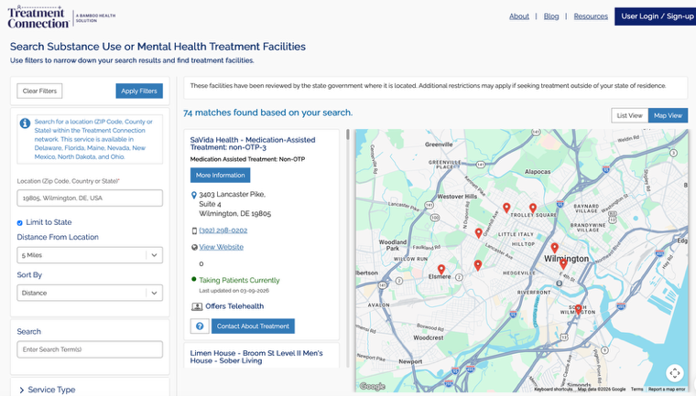

TreatmentConnection.com: A Resource for the Community
Public-facing website to make referrals for behavioral health care and services
Residents, families, and community stakeholders can:
Search verified providers
Identify services in real time
Connect directly with treatment resources
The City of Wilmington can help amplify this resource through:
Community outreach
City websites
Public safety and housing initiatives
This makes it easier for residents to find help before a crisis occurs.

Slide 9


Partnering with the city
Opportunities for collaboration include:
Help residents and community organizations learn about TreatmentConnection.com
Encourage Wilmington-based social service providers to participate in the network
Continue conversations about how coordinated data can support public health planning

Slide 10
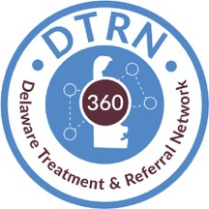
Contact DSAMHCares360@Delaware.gov

Slide 11
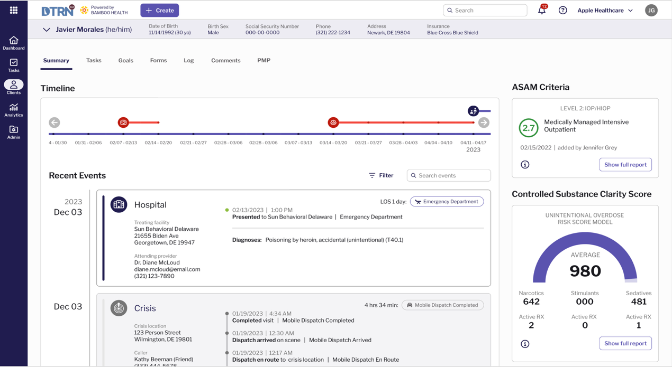





Current Programs:
PROMISE CONEXIO ACT 1
eReferral
RideShare
Justice
CRISIS
SDOH Referral
Notes:
Speaker Notes: (Michelle)
Click Link to access demo

Slide 12
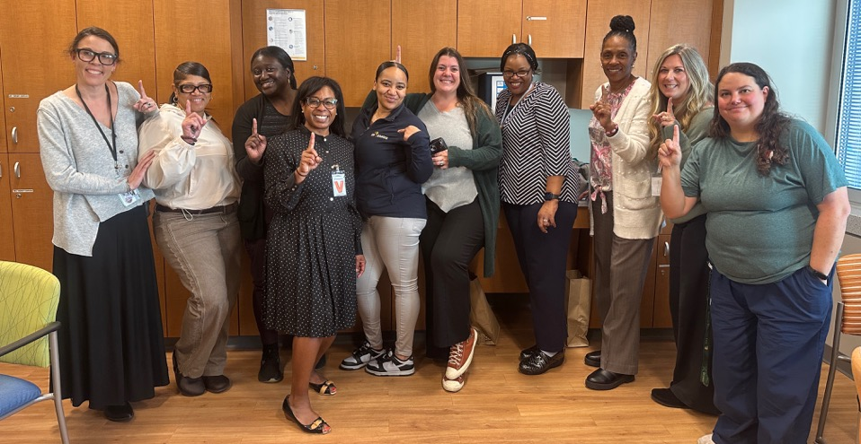
DTRN360 community Go-Live
Notes:
The list for our next Go-Live Organizations. Go-Live is scheduled for 11/12

