Slide 1
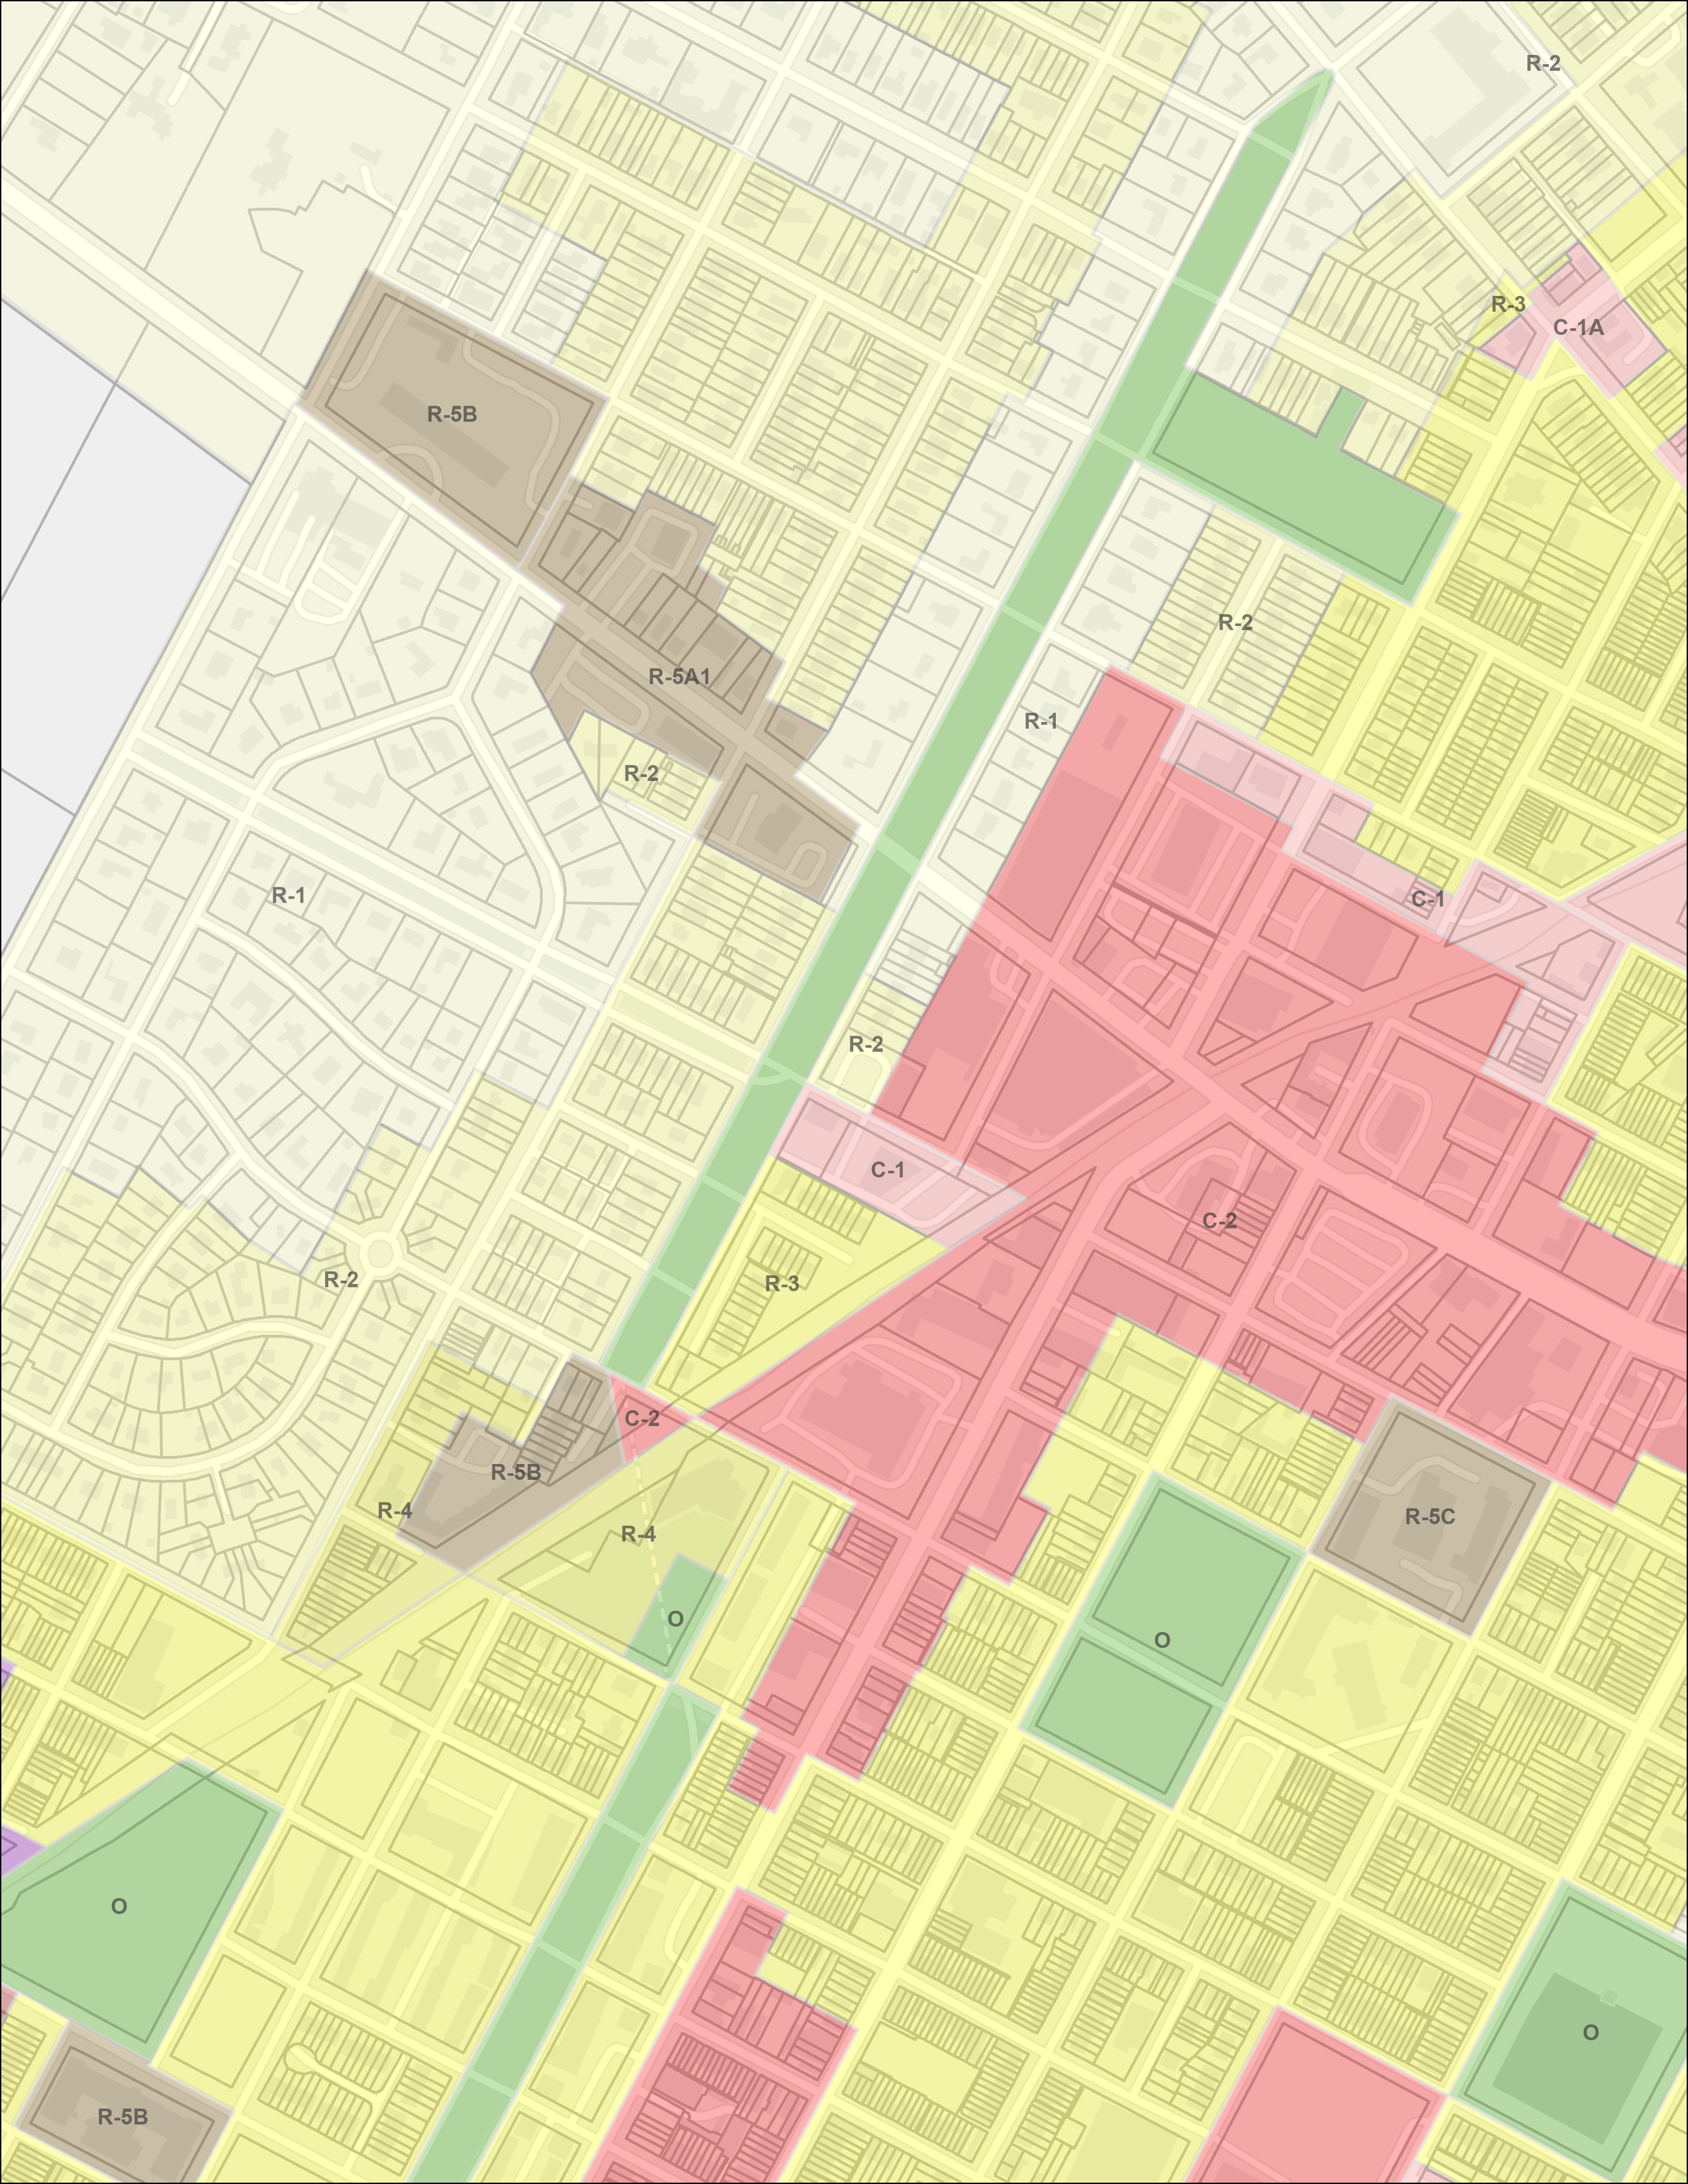
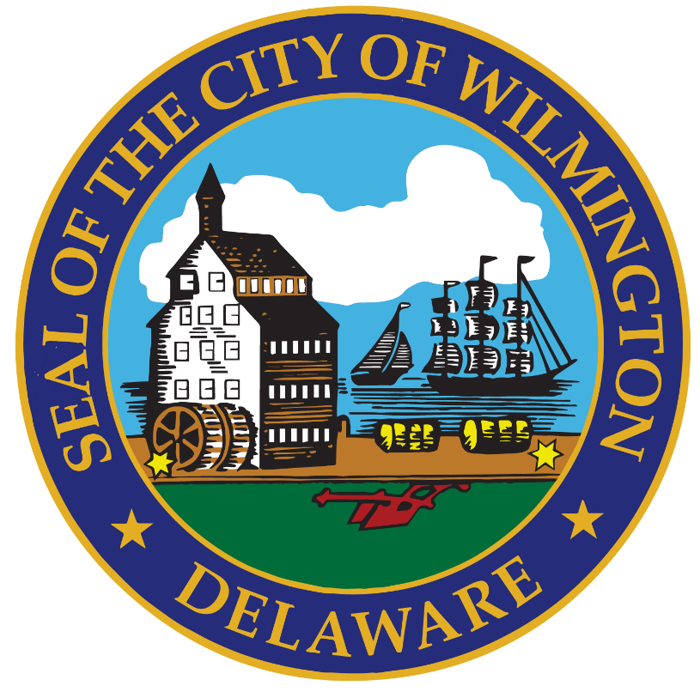
Ordinance 26-048; MS-26-08: Major Subdivision application entitled “2510 Northeast Boulevard – REACH Riverside” submitted by VanDemark & Lynch, Inc., on behalf of the owner, REACH Riverside, to dedicate a 179.71-foot long by 15-foot wide portion of 2510 Northeast Boulevard to the City of Wilmington to allow the 1200 Block of East 26th Street to be rebuilt as a 65-foot wide boulevard.
Community Development & Urban Planning Committee October 21, 2026

Slide 2
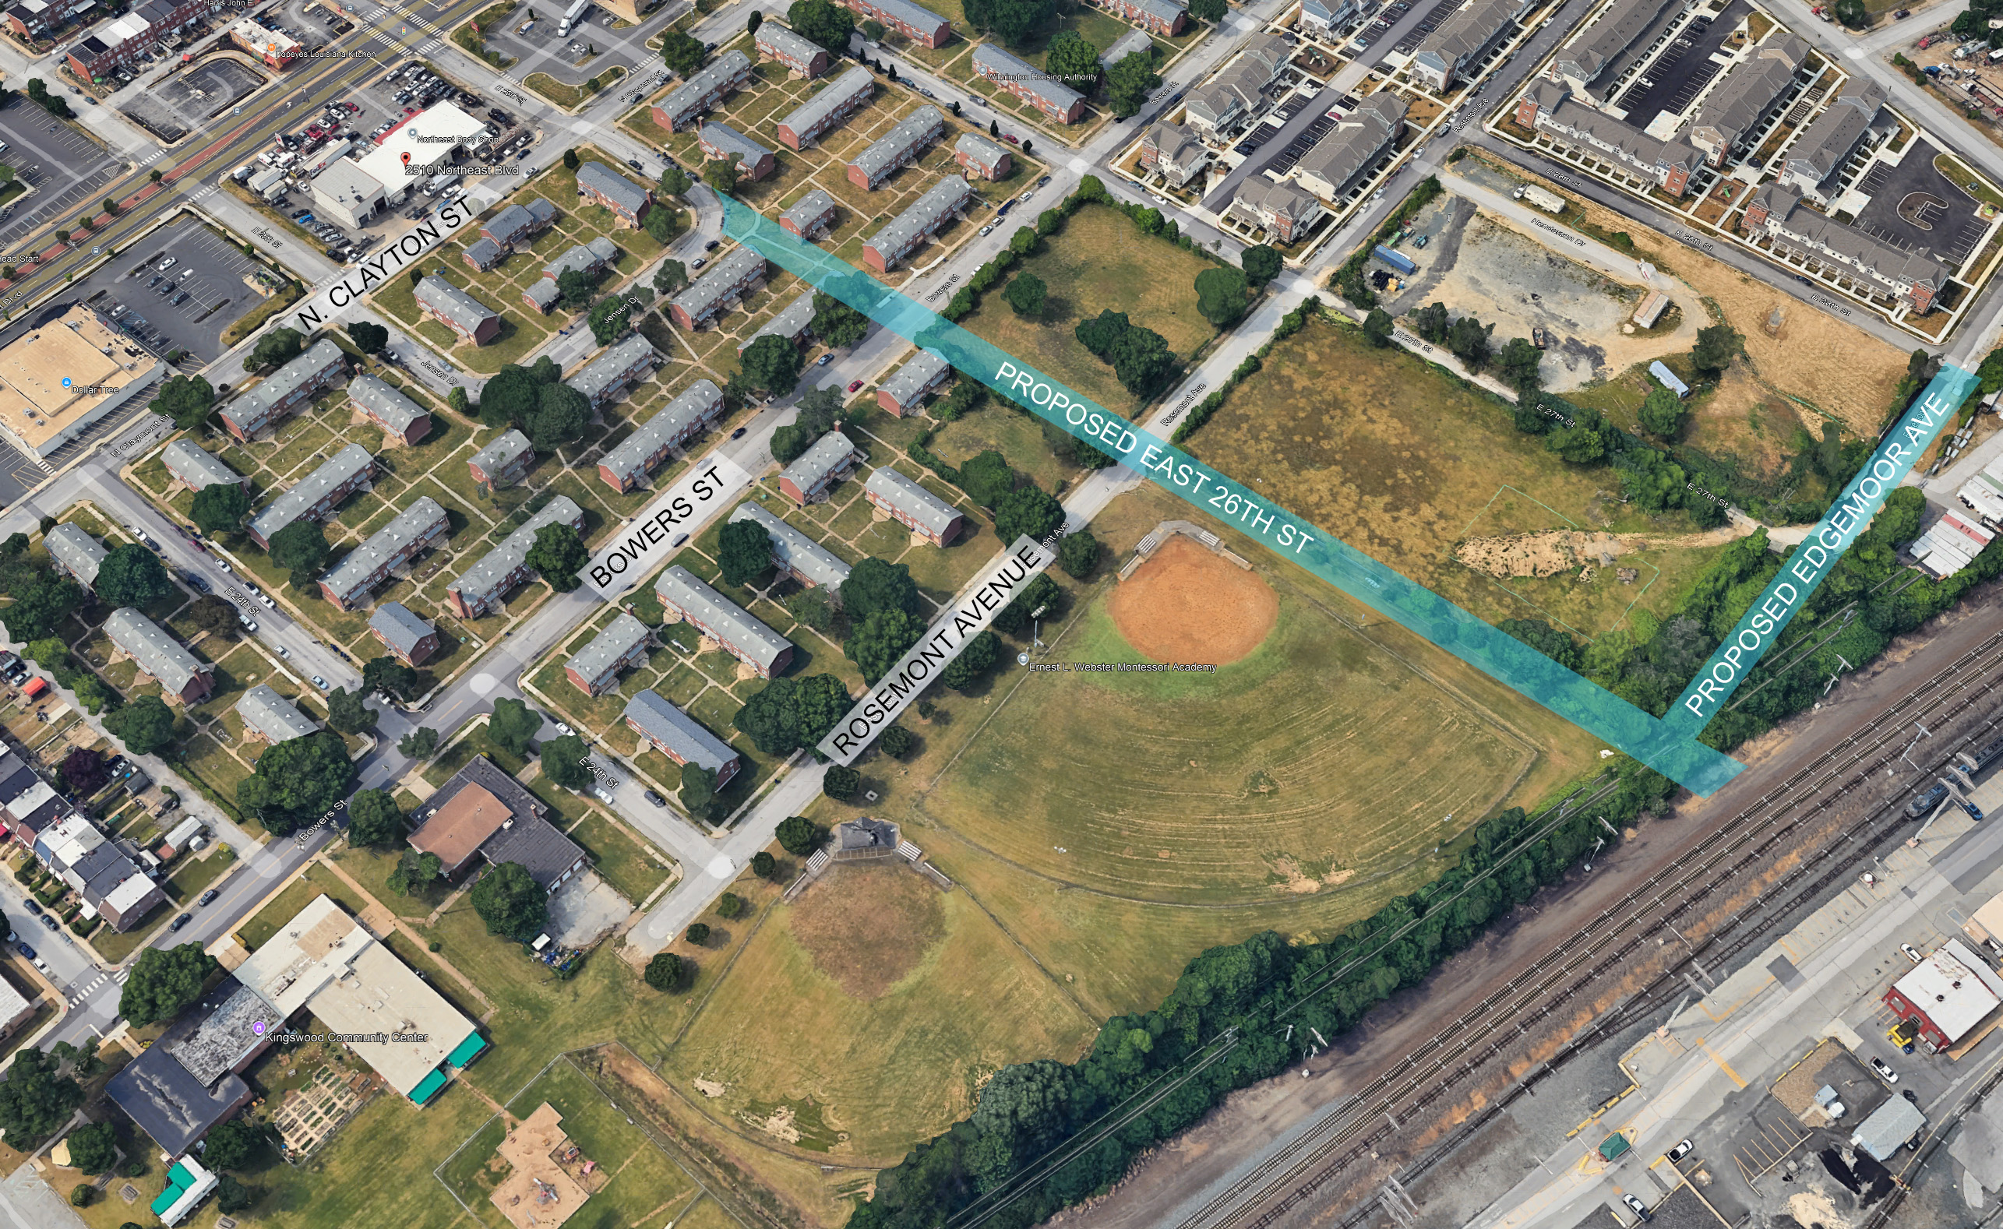
Aerial View of Proposed Street Extension

Slide 3
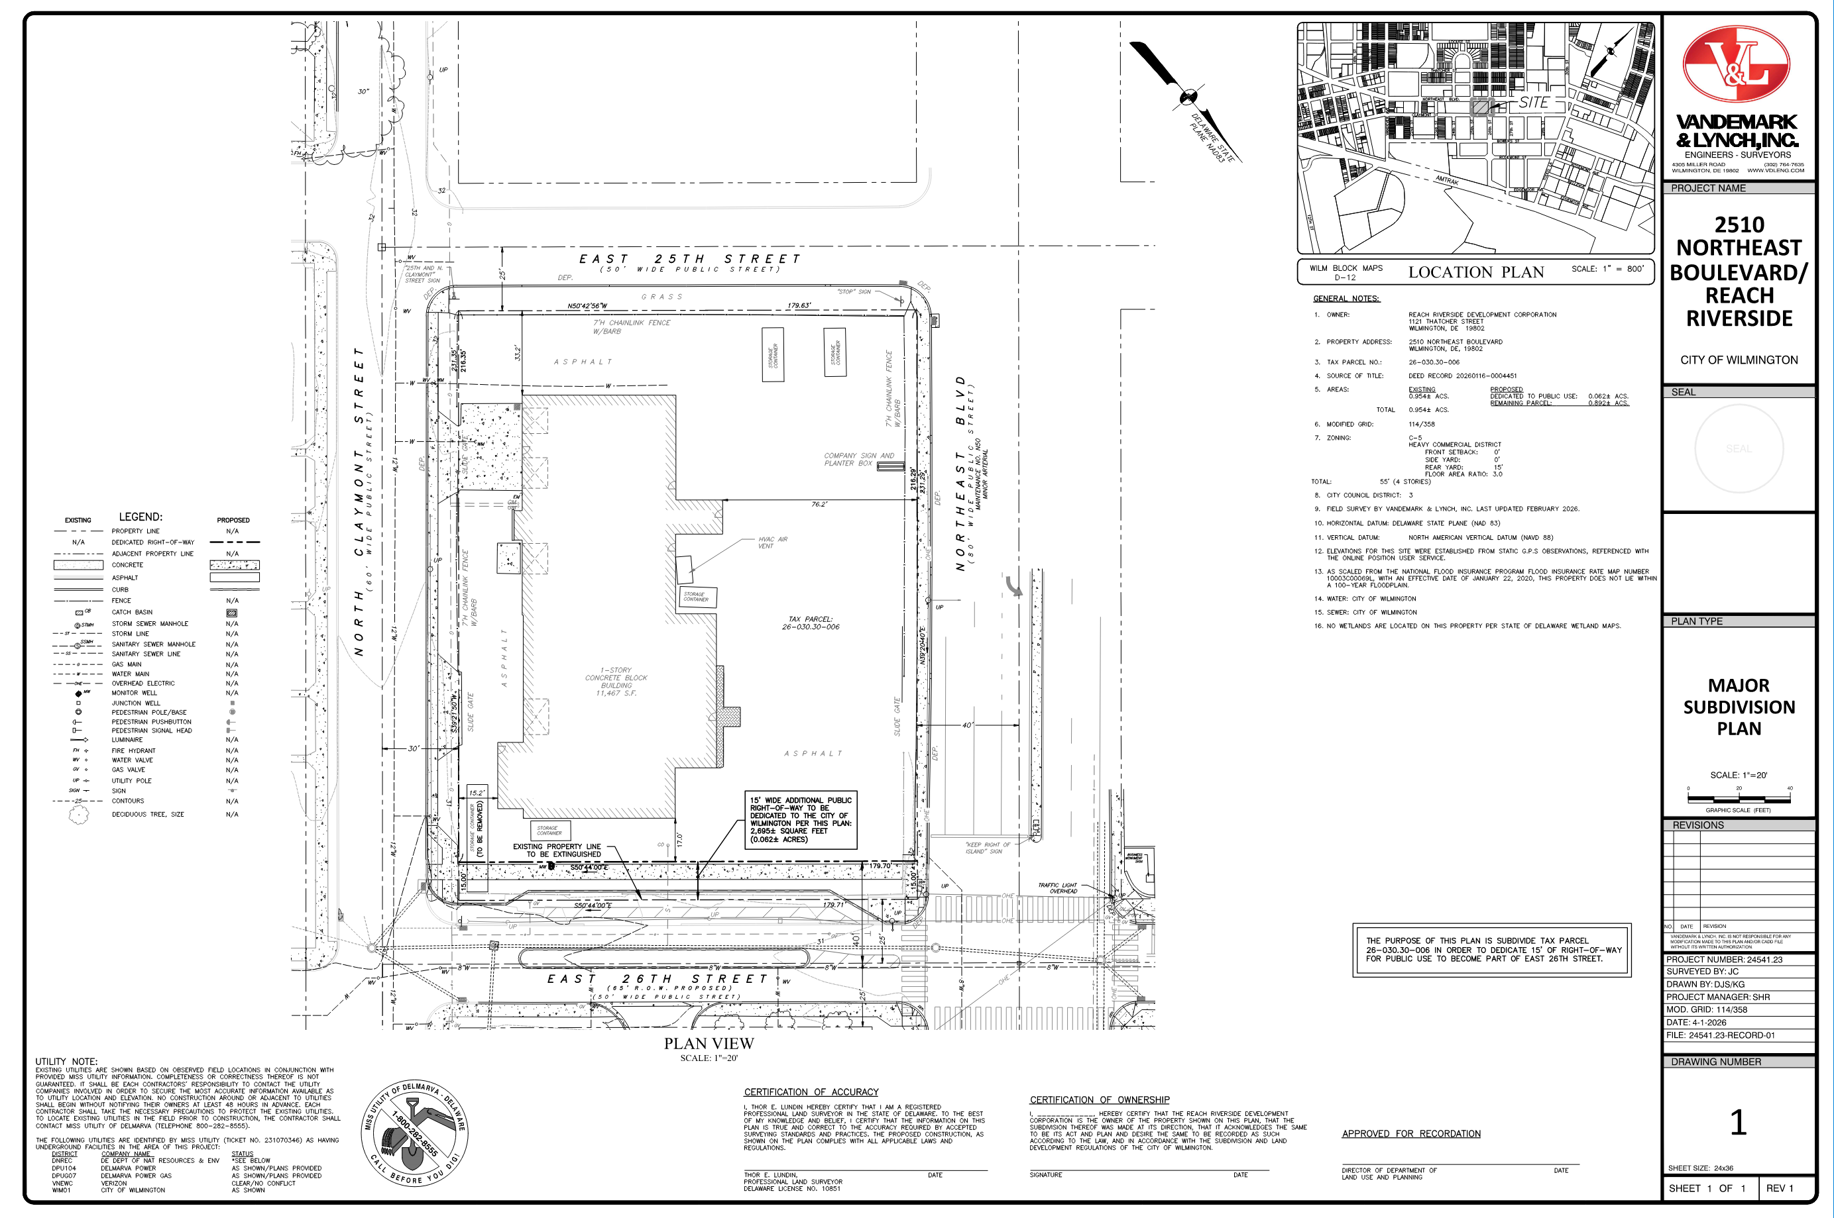

Slide 4
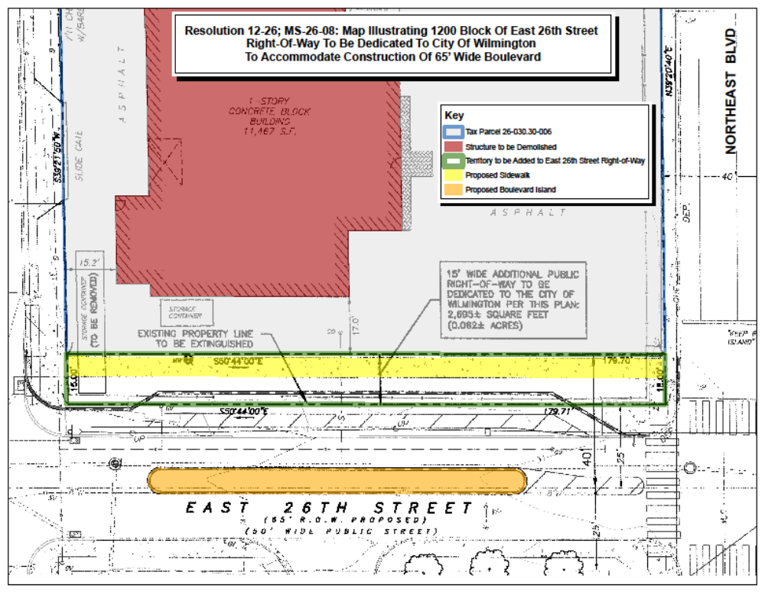

Slide 5
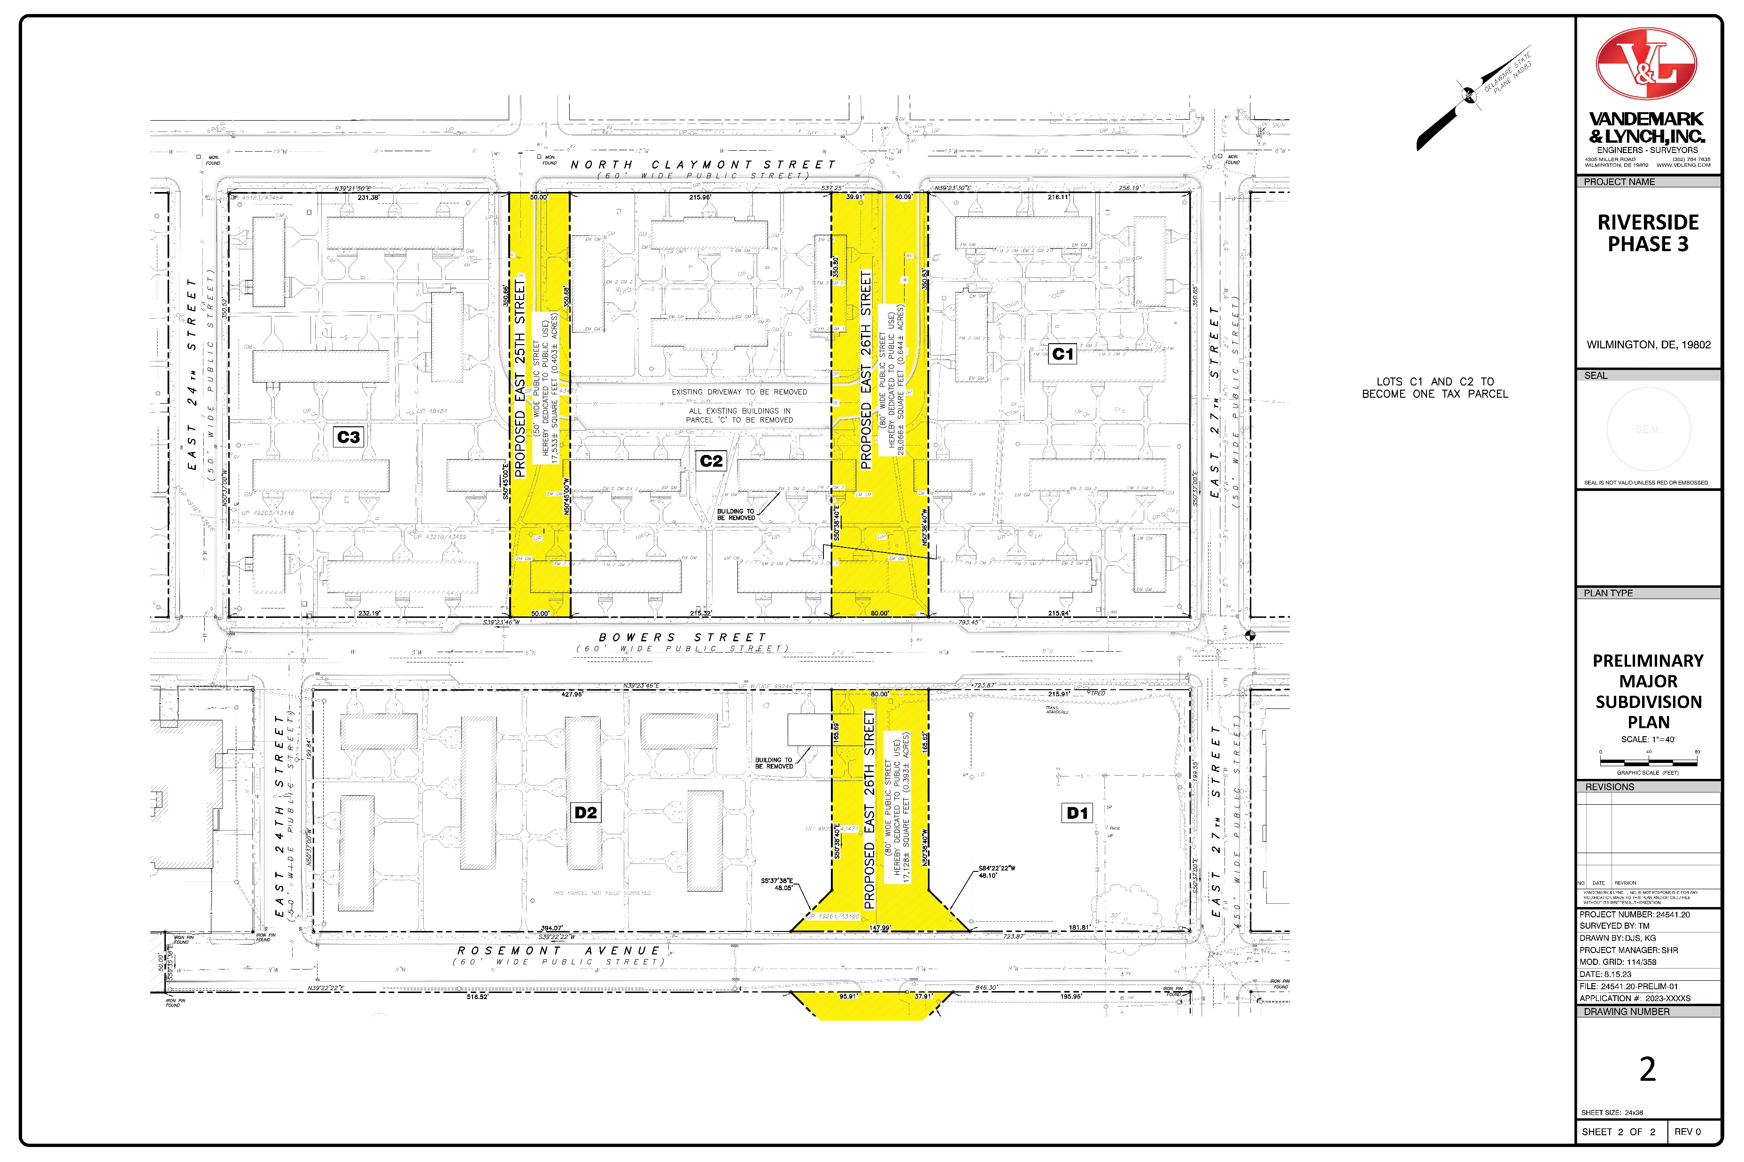

Slide 6
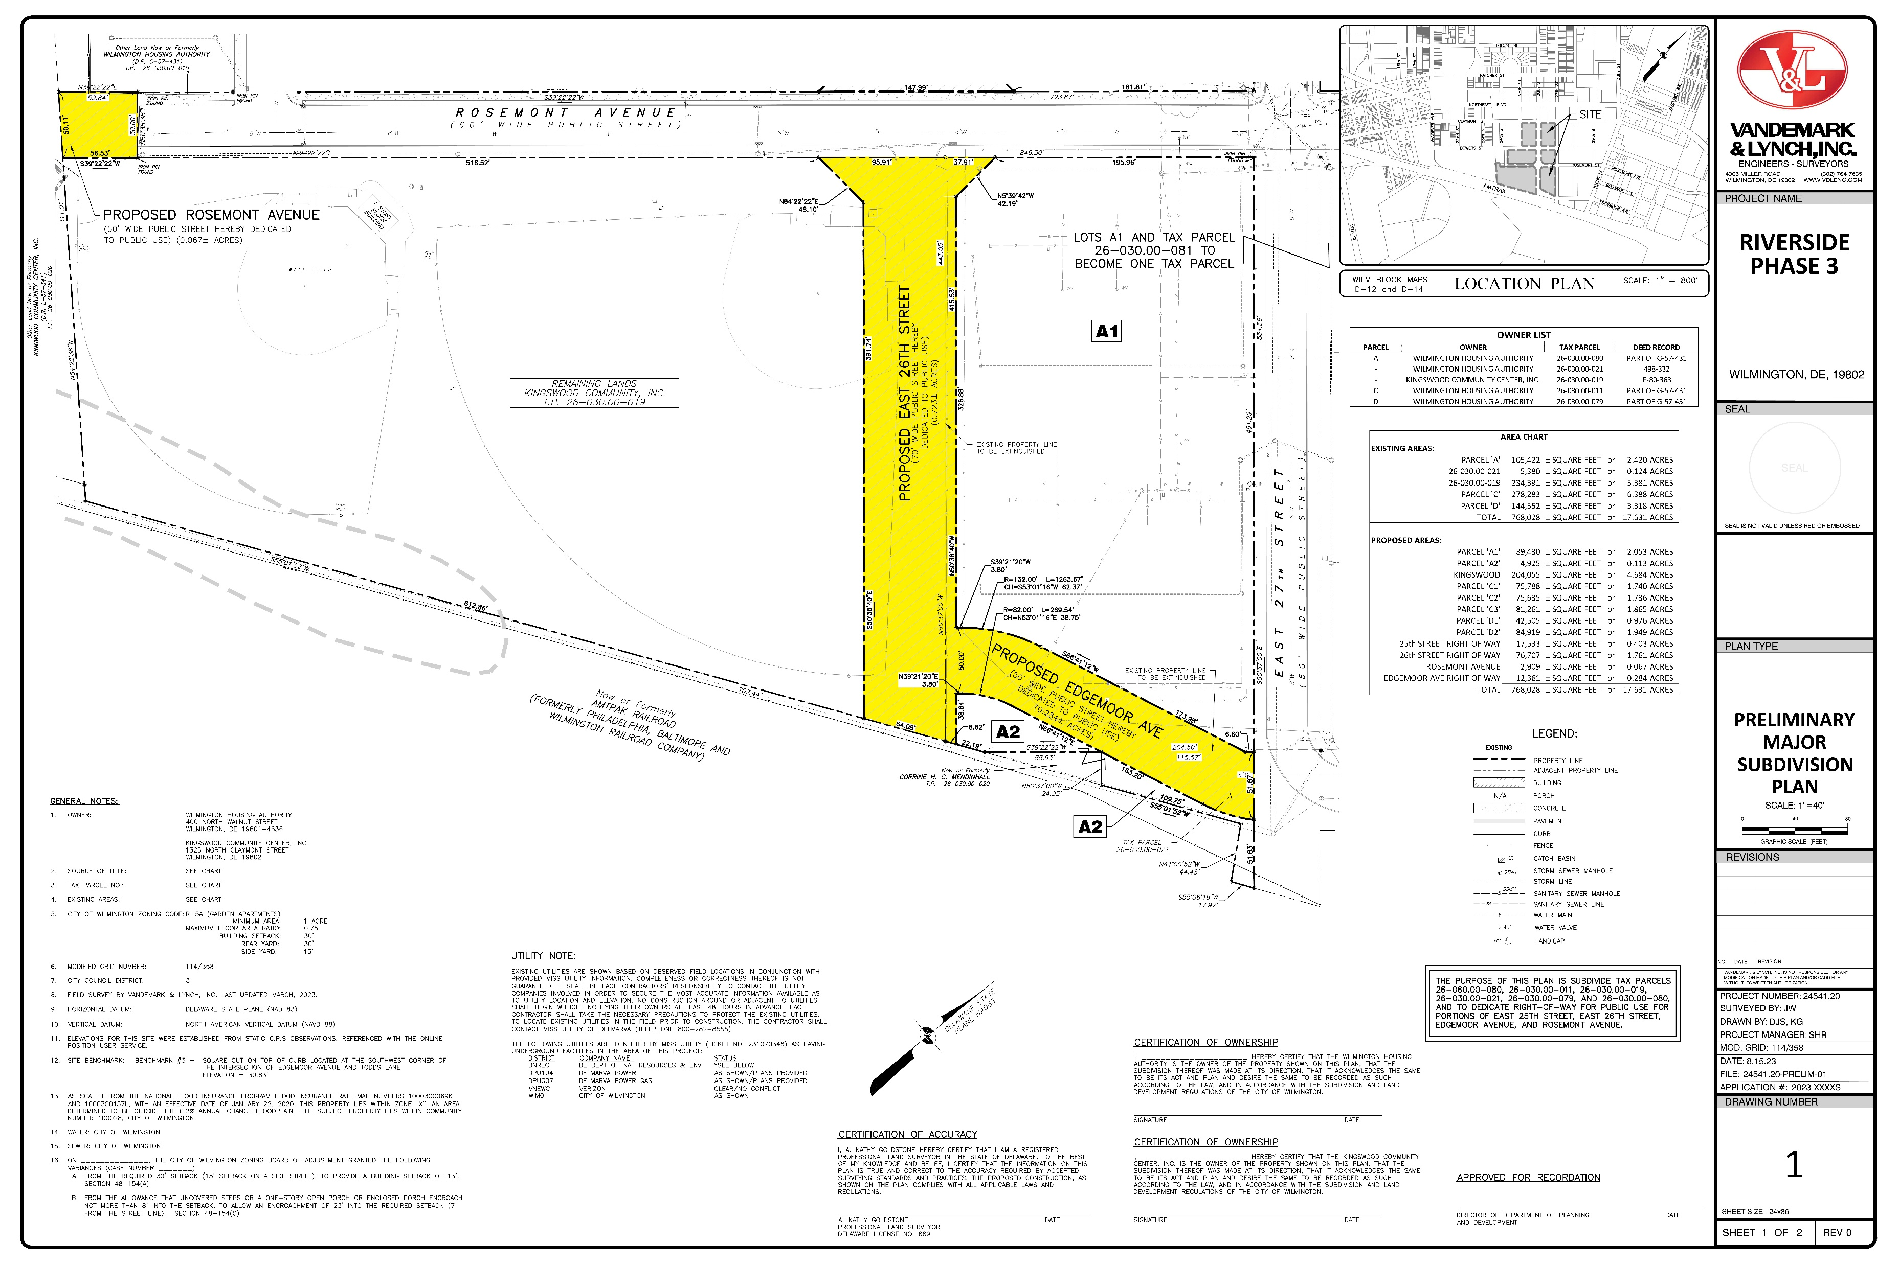
LOCATION

Slide 7
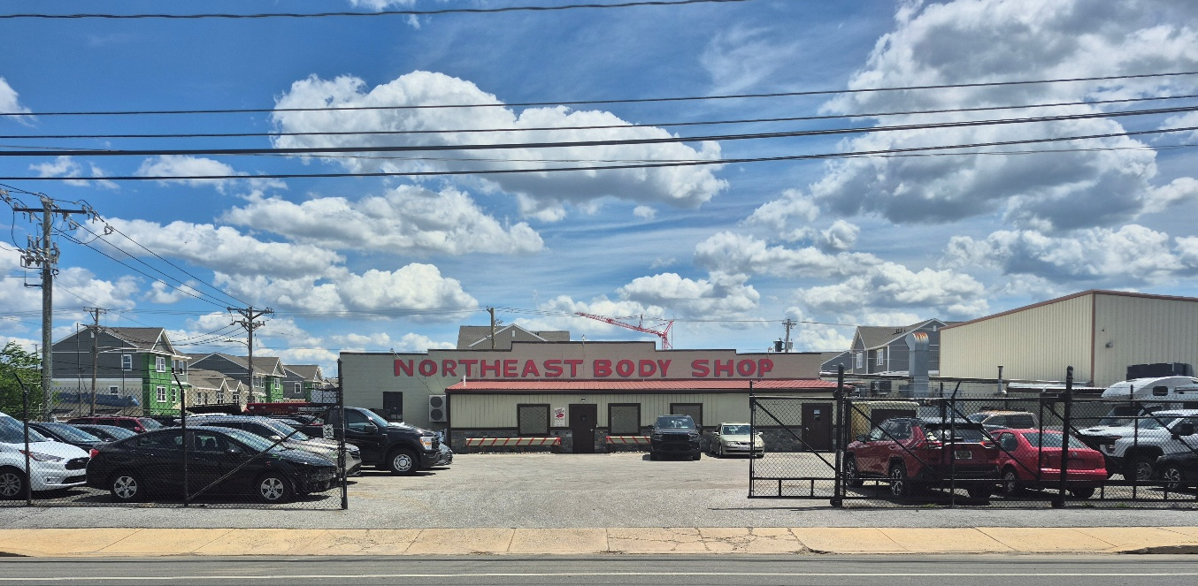
2510 Northeast Boulevard - Site of Major Subdivision - View East From Northeast Boulevard

Slide 8
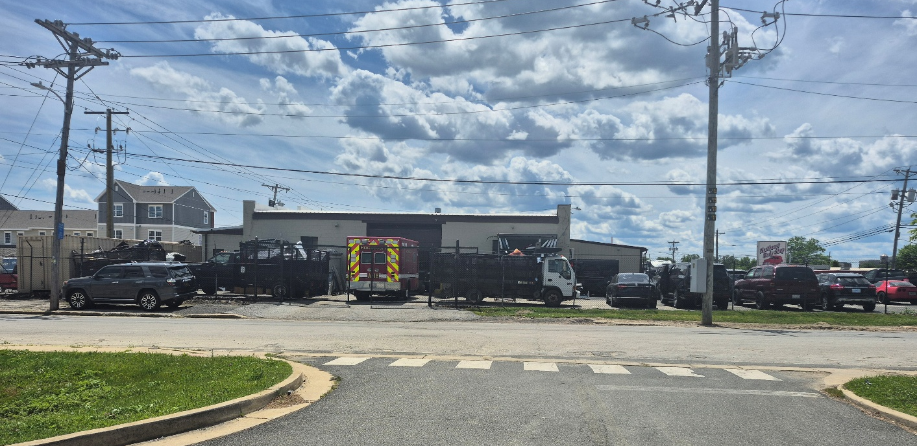
1200 Block of East 26th Street - View South Toward 2510 Northeast Boulevard Parking Lot

Slide 9
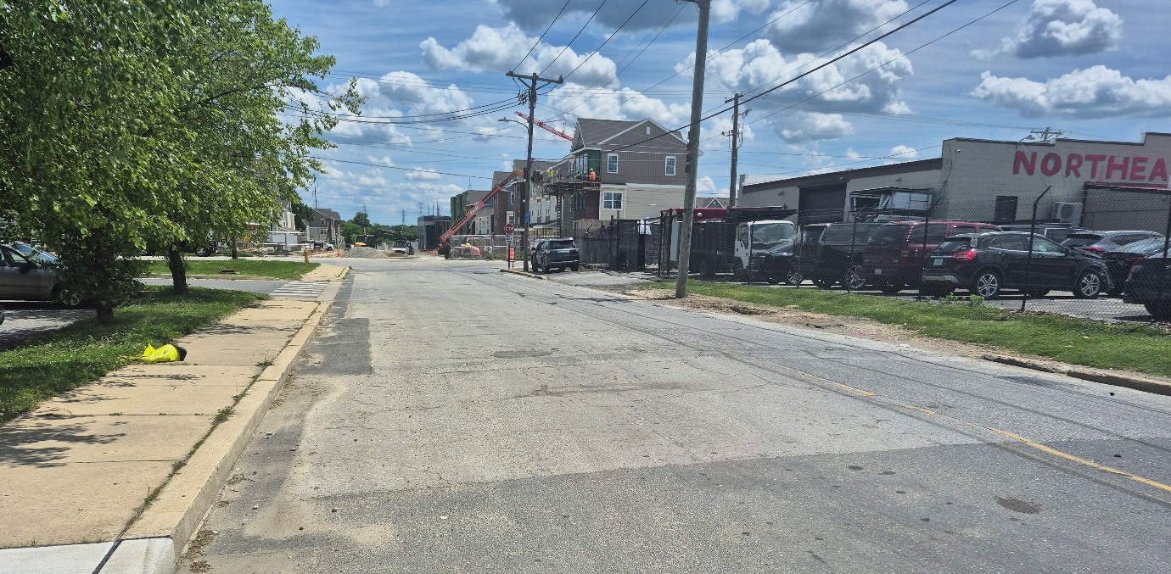
1200 Block of East 26th Street, View East From Intersection with Northeast Boulevard

Slide 10
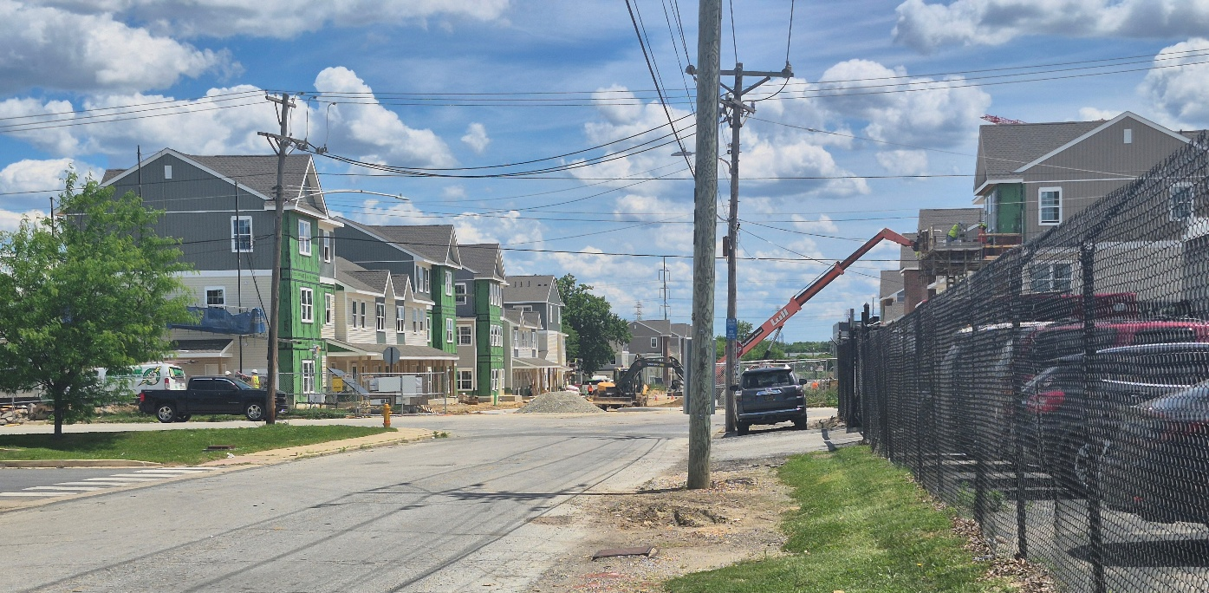
View of 1200 Block of East 26th Street - Looking East Toward North Claymont Street

Slide 11
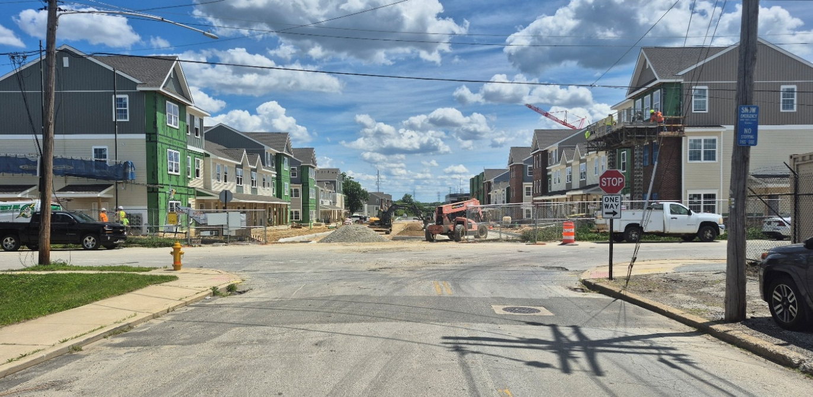
View of Intersection of East 26th Street and North Claymont Street

Slide 12
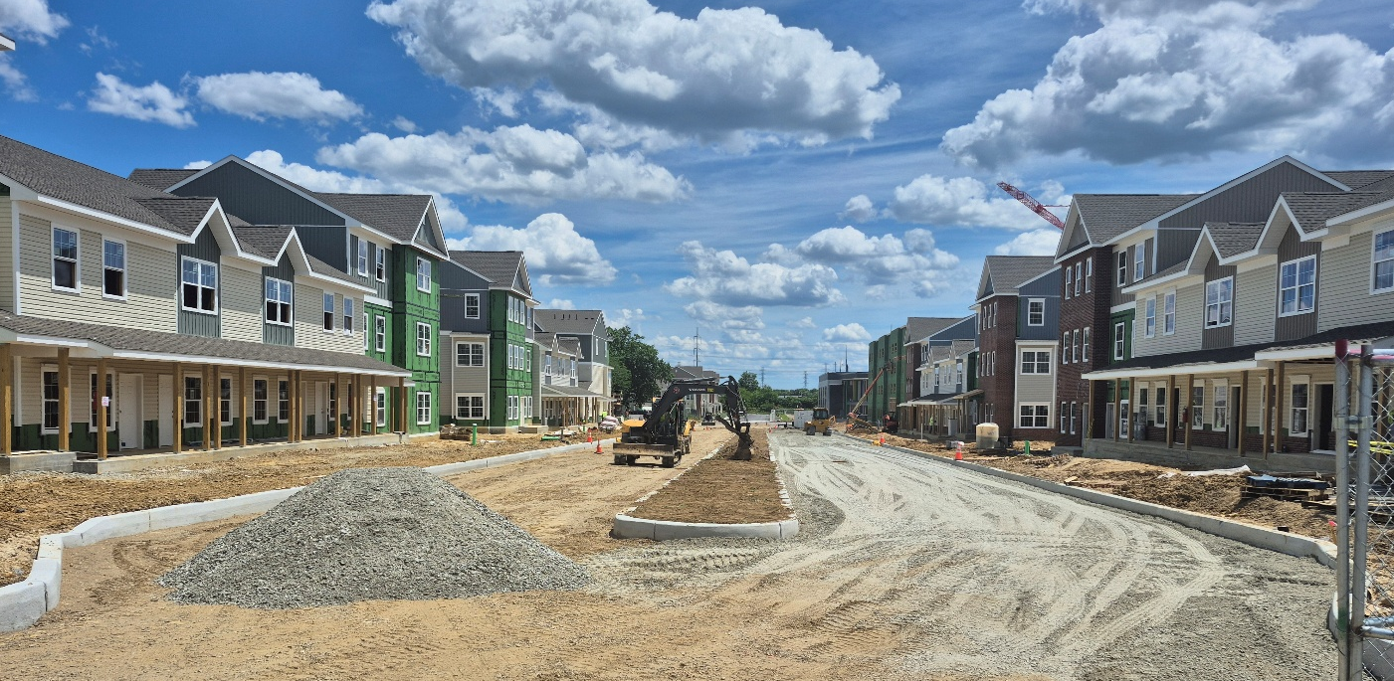
Current Construction at 1300 Block of East 26th Street - 75’ to 80’ Wide Boulevard – Riverside Phase III

Slide 14
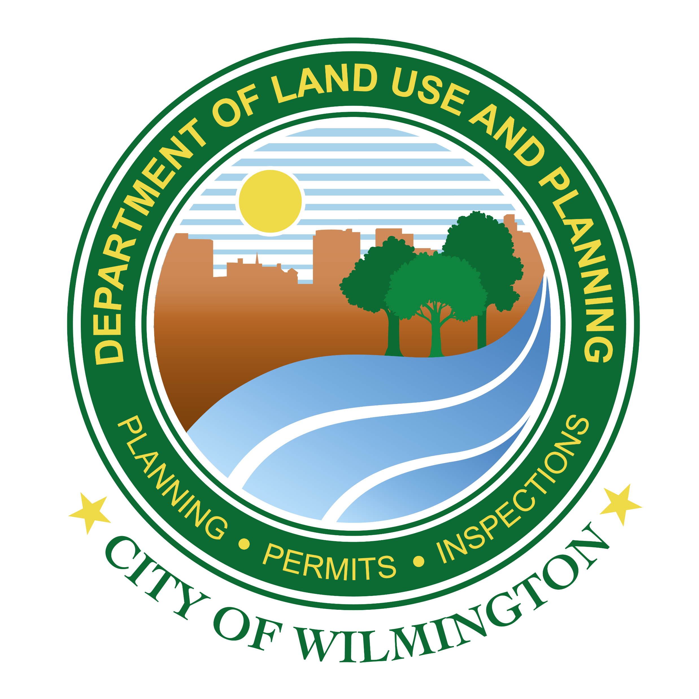
Thank You

