Slide 1

Mayor Carney’s Affordable Housing Subsidy Program
Presented by Javier Horstmann, Director of Special Projects for Mayor John Carney
October 5, 2026

Slide 2

Affordable Housing for Wilmington
FY 2027 budget included an infusion of $13 million in affordable housing
$8.4 million was earmarked to create the first-of-its-kind program
At least a (10) year affordability period
$20M one-time investment into creating an afforable housing fund
Units for households at or below 80% of the AMI

Slide 3
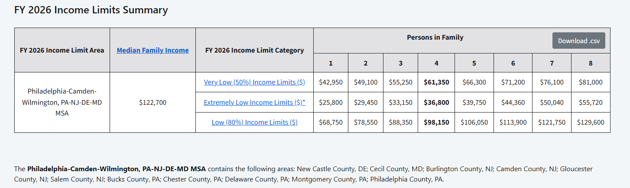
Wilmington’s Area Median Income
*Source: HUD Income Limits Documentation System*

Slide 4
Scoring Committee
Scoring Committee
Scoring Committee Meeting Dates
  Cerron Cade
  Javier Horstmann
  Commissioner Gabriel Pabon
  Director Sean Park
  Tom Ford
  Kevin Kelley
  Paul Calistro
  Ex-Officio:
    CM Michelle Harlee
    CM Maria Cabera
  September 22nd
  September 29th
  October 1st
  October 7th

Slide 5
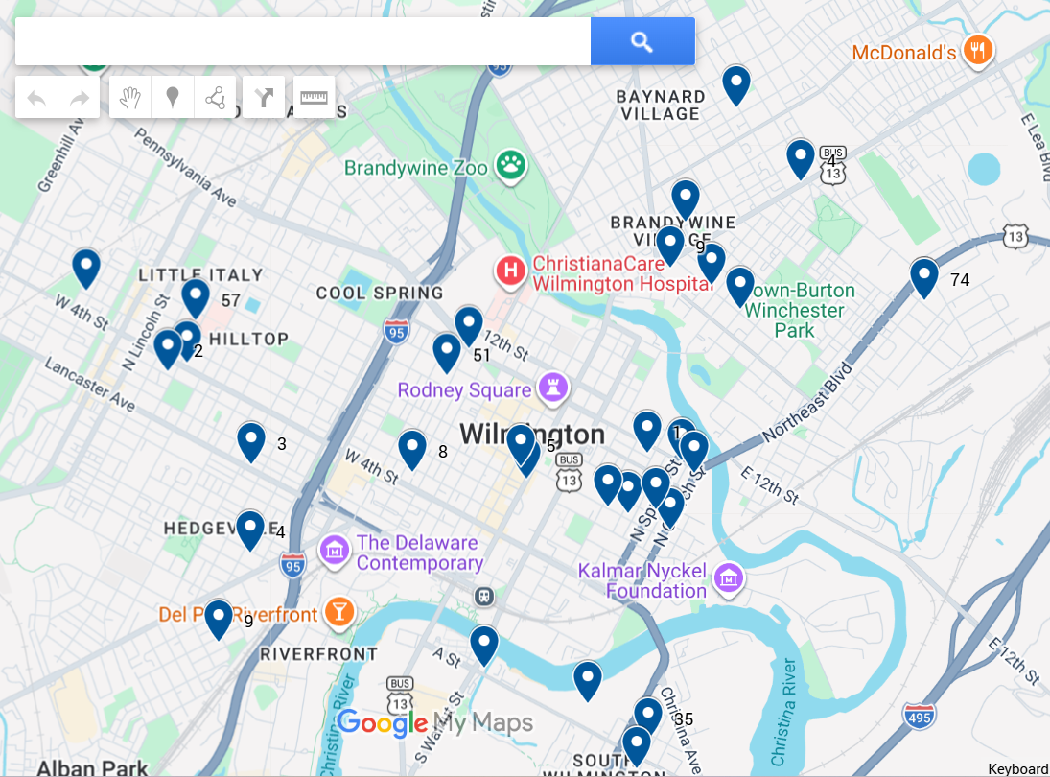
Where are these Projects?

Slide 6
Submission Statistics
What Was Received
Who Applied
Scoring Criteria
  Thirty-five (35) applications submitted
    14 “large” projects
    21 “small” projects
  $26,051,301.48 in total subsidy requested
  728 units impacted
  Project Description (10)
  Funding (15)
  Neighborhood Stabilization (20)
  Economic Need (5)
  Affordable Housing Expertise (10)
  Organizational Capacity (20)
  Benefit (10)
  Local Team Composition (10)
  Qualified affordable housing developers
  Nonprofit organizations
  Community development corporations

Slide 7

Questions?

