Slide 1

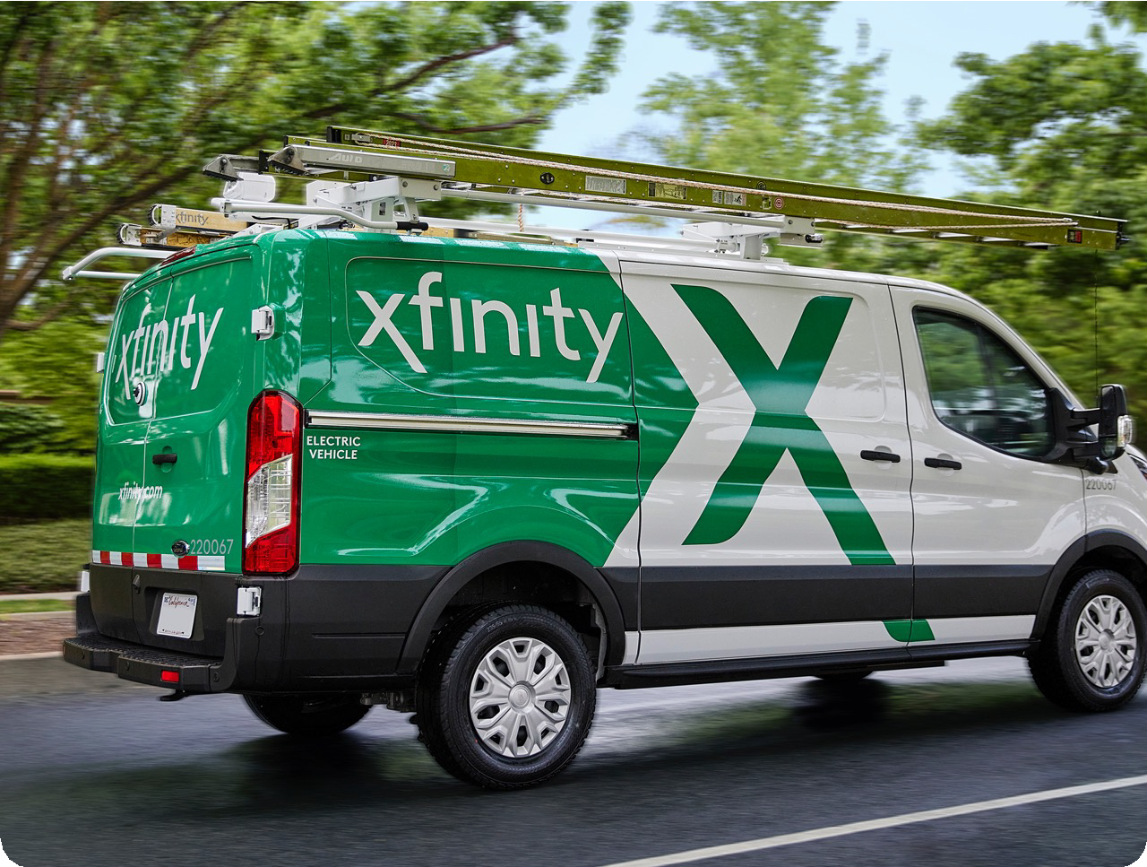



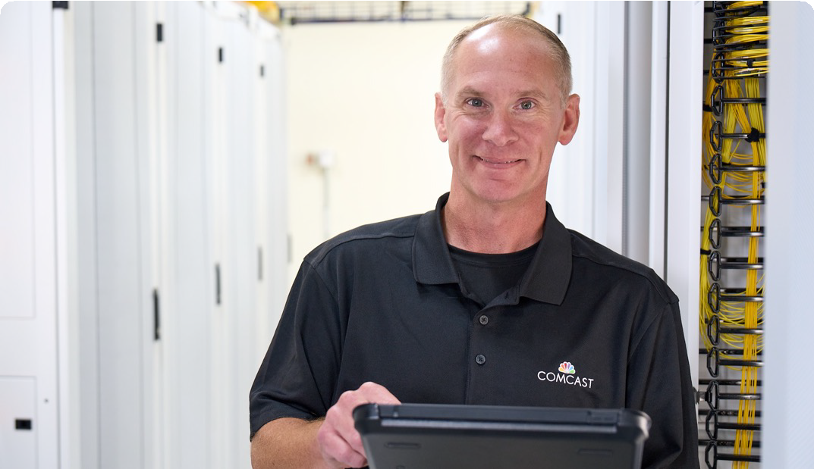
PROUDLY SERVING
WILMINGTON, DELAWARE

Slide 2




Meet the Team
Jessica Sibley Sr. Vice President Government & Regulatory Affairs Stephanie_Kosta@comcast.com
Caitlin Ganley Sr. Director Government & Regulatory Affairs Caitlin_Ganley@comcast.com
Jessica Sibley Sr. Manager Government & Regulatory Affairs Jessica_Sibley@comcast.com

Slide 3

1963
2025

Slide 4
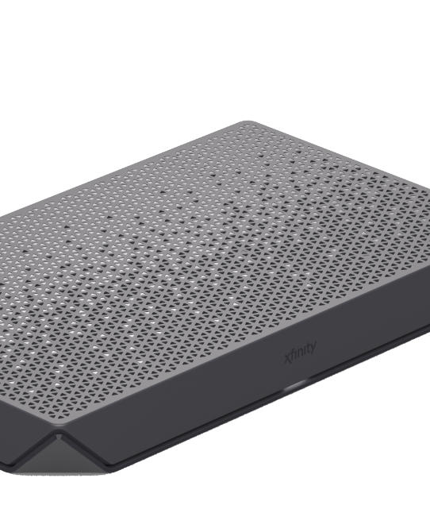
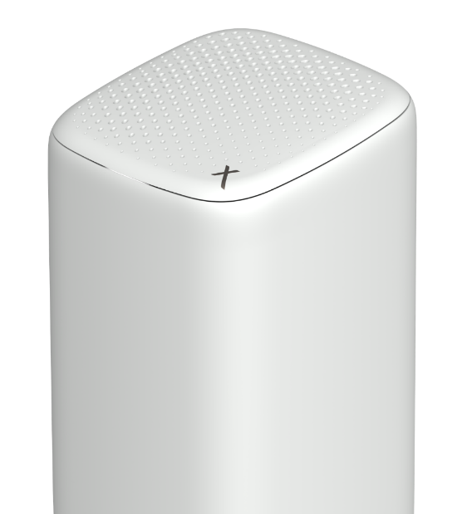
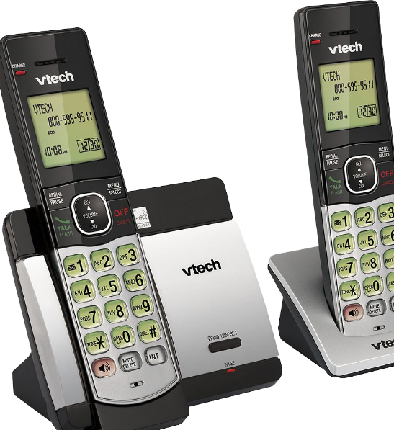
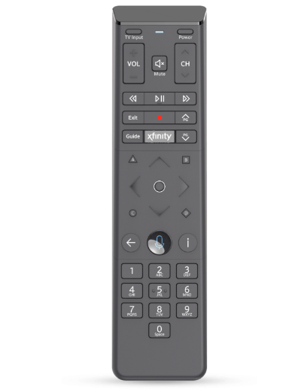
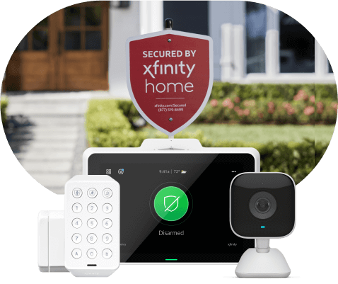
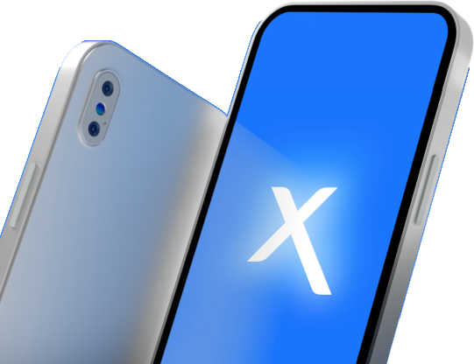
Xfinity Product Highlights
Xfinity Mobile
Xfinity Internet
Xfinity TV
Xfinity Voice
Xfinity Home
Xfinity Mobile runs on America’s best 5G network and we allow you to auto- connect to millions of Xfinity WiFi hotspots to save on data use.
Our By the Gig, Shared data plans, and Unlimited data options offer more flexibility and more savings.
Xfinity Mobile Consistently Ranks Faster Than Competitors in Comcast Markets.
We deliver the fastest Internet speeds to the most homes in the country and have increased speeds 20 times in 20 years.
The nation’s largest WiFi network – More than 22 million WiFi hotspots across the country; 3x more than any other provider.
Xumo Stream Box 4K streaming TV box included with Internet. Tons of free content, plus our Voice Remote.
Xfinity X1 and the Xumo Stream Box let you seamlessly watch your favorite content.
Our award-winning Voice Remote puts you in control and lets you search for and browse tens of thousands of shows and movies with your voice alone.
With the Xfinity Stream app, you can watch your favorite content and set recordings wherever you are, both in- and out-of-home.
Xfinity Voice gives you peace of mind with one rate, no contract, no hidden fees, and a money-back guarantee.
Xfinity Voice gives you caller ID on all your devices, unlimited calling to nearly half the world, readable voicemail, 3-way calling, and more.
Stay protected from unwanted spam calls with our innovative call blocking technology.
Xfinity Home provides 24/7 professional alarm monitoring to keep you and your family safe.
Our Xfinity Home smart motion sensors can tell the difference between humans and pets.
You can arm and disarm the Xfinity Home system, control devices, and view video from anywhere on a smart device.

Slide 5

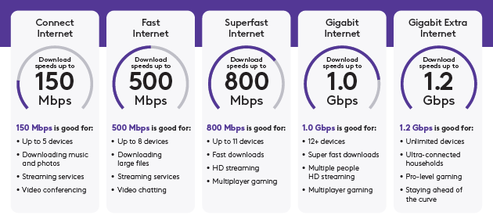
Speed. Capacity. Reliability. Security.

Slide 6


Xfinity Apps
Control your home network and any connected devices with the easiest way to manage your Xfinity experience.
Get always-on support
Experience 24/7 real time support you can count on, anytime you need it.
Manage your account
Pay your bill, view your plan details, change or upgrade your services, and more.
Never miss a moment
Troubleshoot your connection, get outage updates, and restart your modem.
Arm or disarm your home security system. Set rules. Receive real-time notifications. And access connected smart home devices.
Watch all your channels at home, top networks and live sports on the go. Schedule or download recordings to watch offline.

Slide 7

Comcast Business
Ethernet
High speed fiber network assuring private data connectivity across locations, data centers or cloud providers
Video
Xfinity TV & Entertainment for lobbies and conference rooms
IT Deployment Services
Nationwide end-to-end network support
Internet
Up to 1 Gig Internet and WAN Connectivity
Voice
Advanced voice solutions
Bank
Managed Services
Connectivity, security, business continuity, WiFi, routers and voice
IoT
Network as a Solution connecting IoT solutions
WiFi
Reliable WiFi network and IT infrastructure to support connectivity
Cybersecurity Solutions
DDoS Mitigation and Managed Security
SD-WAN
Centralized network management

Slide 8


BEYOND THE CABLE FRANCHISE
UN L I M I T E D P OS S I B I L I T I E S
$1B
committed nationally through Project UP to advance digital equity through community programs including programs in Wilmington, Delaware!

Slide 9
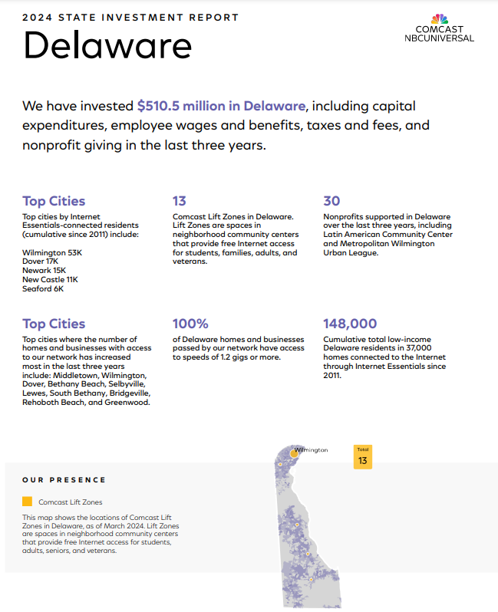
Delaware Investment
7 Comcast Lift Zone locations in Wilmington
$1.4M total cash and in-kind contributions to Delaware nonprofits in the last three years
Top city for network expansion in Delaware
100% of Wilmington has access to speeds 1.2G+

Slide 10


BEYOND THE CABLE FRANCHISE
REL I A B L E HO M E I N T ERN ET F O R A L L
10M+
low-income Americans have been connected to affordable internet over the last decade
Internet Essentials available to eligible households in Wilmington, DE for as little as $14.95/mo

Slide 11

Internet Essentials
Options
Eligibility
A household may be eligible for Internet Essentials if one of the below criteria is met:
Internet Essentials 75/10 Mbps
75 Mbps Download
$14.95/month per household
Equipment rental fees included
Internet Essentials Plus 100/20 Mbps
• 100 Mbps Download
• $29.95/month per household
• Equipment rental fees included
Federal Pell Grant recipient
Participation in:
The National School Lunch Program
USDA Community Eligibility Provision
SNAP
Medicaid
Federal Public Housing Assistance
Supplemental Security Income (SSI)
WIC
Veterans Pension or Survivor Benefits
Lifeline

Slide 12














Something for Everyone
50 100
IN C O M E C O N S TR A IN E D
UP T O
50 100 200
FE A T U R E - LI G H T W I F I
Internet Essentials
Internet Essentials+
NOW 100
WiFi Pass MBPS
200
MBPS
In addition to Xfinity and Internet Essentials, Comcast recently introduced NOW, a new line of reliable, low-cost products that consumers can purchase month-to-month, with no credit checks or additional fees.
$14.95 / mo.
$29.95 / mo.
$20 / 30 days
$30 / mo.
$45 / mo.
300
500
1G
1.2G
2G
* Promo pricing listed
300 MBPS
500 MBPS 1 GBPS
$55 / mo. $70 / mo.
1.2 GBPS
2 GBPS
$40 / mo.
$85 / mo.
$95 / mo.

Slide 13

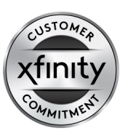


There When You Need Us
Our commitment to every customer:
Respect your time
Simplify your experience
Make things right if we fall short
30-day money-back guarantee for our Xfinity TV service
Two-hour appointment windows
There are more than a dozen other ways to contact us including chat, text, email, phone, retail and on social or other online forums.
We offer 10 language options including American Sign Language.
Find your local Xfinity Store to demo the latest products, pick up and exchange your equipment, pay bills, or subscribe to services.
Two convenient Xfinity Store locations:
5601 Concord Pike, Wilmington, DE
132 Christiana Mall #1345, Newark, DE
You can even visit a Western Union® Quick Collect® location to pay your bill with cash or money order.
Make returning equipment a breeze by bringing your rented items to your local UPS Store – they will pack and ship the items back to us free of charge.
The Xfinity App allows customers to manage all aspects of their account 24/7 on their own including reviewing account information, troubleshooting, monitor a technician arrival time, request a call from customer care, and more.
Customer Care Agents available 24/7 at (1-800-Xfinity).

Slide 14



How Can We Help?
Constituent Inquiries
Service Issues
Billing Questions
Structural Concerns
Down Lines
Business Services
Inquiries
Referrals
Comcast-related questions
Broken Pedestals
Cosmetic repairs
Speaking engagements
B4B

Slide 15
B4B
Thank You!
Questions?

