Slide 1
Presentation to Wilmington City Council Intergovernmental Committee
Matt Hartigan, Delaware Public Service Commission Executive Director
February 18, 2025

Slide 2
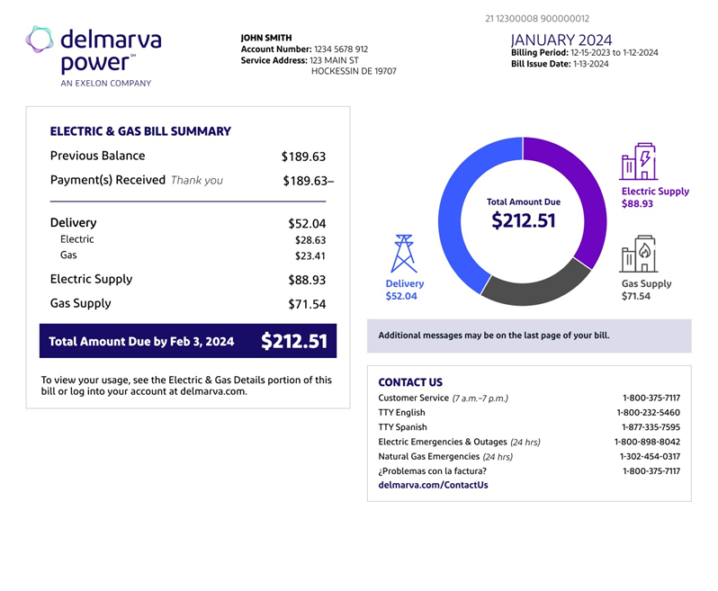

Delmarva Power High Bill Complaints
Colder December and January Compared to Previous Years.
Increased usage impacts
delivery and supply charge
Delmarva Power monthly
statement redesign called
attention to the delivery charge.
Historical high bill months.
Heat pump efficiency
in colder temps.

Slide 3
Drivers of the Rate Case Process
Exelon strategic plan to increase earnings through increasing the rate base of its distribution utilities.
  Rate base = all utility property which provides service to customers
Delmarva Power plans and builds infrastructure projects to improve reliability of their gas and electric systems.
Delmarva Power files rate cases approximately every 18-24 months to recover costs associated with projects.
Costs are rolled into the delivery charge when approved by the PSC.

Slide 4
The Rate Case Process
The Players:
  Utility - seeks rate increase to recover costs.
  PSC – seeks to balance the needs of customers and utilities.
  Public Advocate – advocates for the lowest possible prices for residential and small commercial customers.
Process: Utility application => Opening Order and Intervention Period=> Discovery => Public Comment session => Parties file testimony => Utility files rebuttal testimony => Settlement negotiations => Evidentiary Hearing => Commission deliberation, decision and final order.
Process typically takes 9-12 months for major utility rate cases.

Slide 5
PSC Considerations in Rate Cases
The PSC authorizes costs in rate cases, based on Delaware legislative statutes, guidance, and requirements. Reasonable and customary costs are allowed for utility equipment and operations (used and useful principle).
In addition to normal operations, DPL is allowed to recover costs from weather-related damage to the grid and equipment in order to restore power after outages. Delaware has experienced numerous, grid-damaging weather events over the past few years, due to climate change. (tornados, flooding, etc)
The PSC seeks to balance ‘just and reasonable’ rates with the need for public utilities to earn a reasonable return on their investments (ROI). The ROI allows public utilities to raise necessary capital in open markets, which they use to maintain the Delaware grid, maintain reliable energy supply, and expand the grid needed for the future.

Slide 6
Upward Pressure on Electric Utility Rates
Wholesale electric supply market is tight because of increased demand and decreased supply (generation resources).
In these market conditions, electric supply prices increase.
Distribution (delivery) costs are increasing as utilities complete infrastructure projects to increase reliability and deliver on corporate strategic goals to increase rate base.
Customers should focus on conservation efforts and energy efficiency to reduce costs.

Slide 7
Customer Resources
DNREC Weatherization Assistance Program- https://dnrec.delaware.gov/climate-coastal-energy/sustainable-communities/weatherization/
Sustainable Energy Utility - https://www.energizedelaware.org/
Delaware PSC Website: depsc.delaware.gov
Delaware Public Advocate Website: publicadvocate.delaware.gov
matthew.hartigan@delaware.gov

