Slide 1
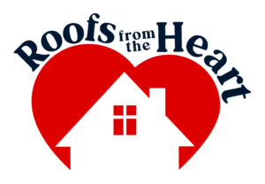
Mission
Roofs from the Heart provides quality new roofs to those who cannot maintain the basic provision of safe and secure shelter for their families, in order to keep the family healthy, in their home, and in their community.
Vision
Roofs from the Heart (RFTH) will be the go- to organization for individuals and families when they are facing any circumstance where their roof is in desperate need of replacement. RFTH envisions creating increased awareness about the importance a roof has in the health of a home and of the occupants. They want other emergency housing organizations to utilize their roofing expertise and make other repairs in collaboration. Their goal is to continually increase the amount of full roof replacement and repairs they can make annually to have positive impacts on families and communities.

Slide 2

The provision of stable shelter is considered one of the most basic needs of humanity, yet even those fortunate enough to own property often find themselves unable to meet this very need. Roofs from the Heart has seen hundreds of families in dire need of new roofs, replacement of walls, mold remediation, and other basic services that improve the quality of life, but often these families are far from being able to afford these services.
We are asking for $50,000 to go towards roof replacements for these families in Wilmington.

Slide 3
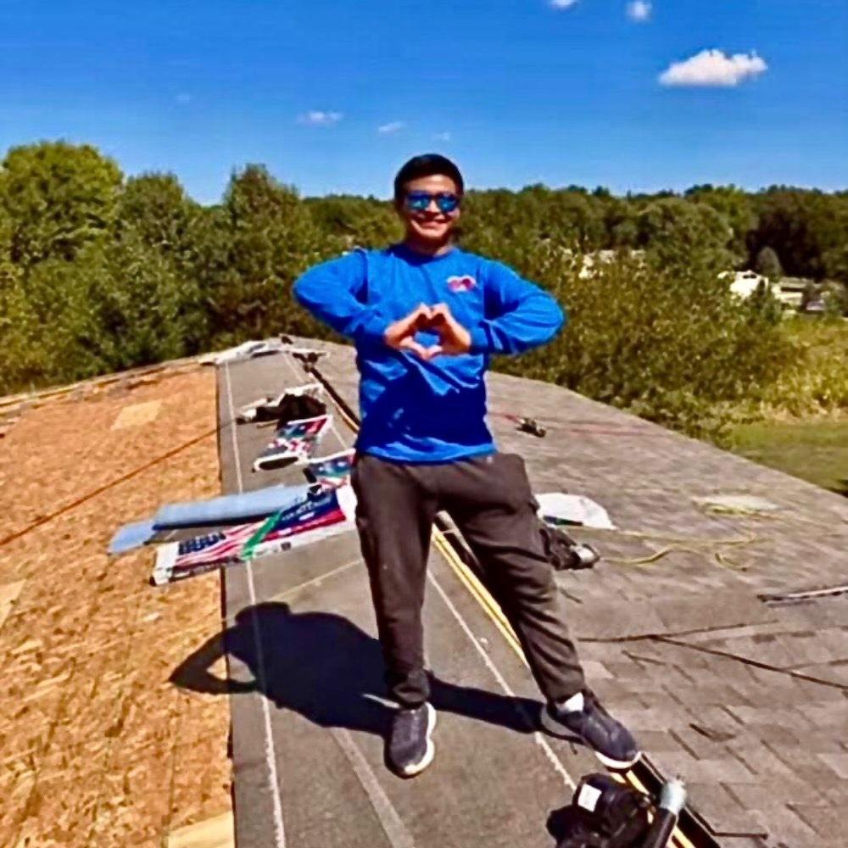
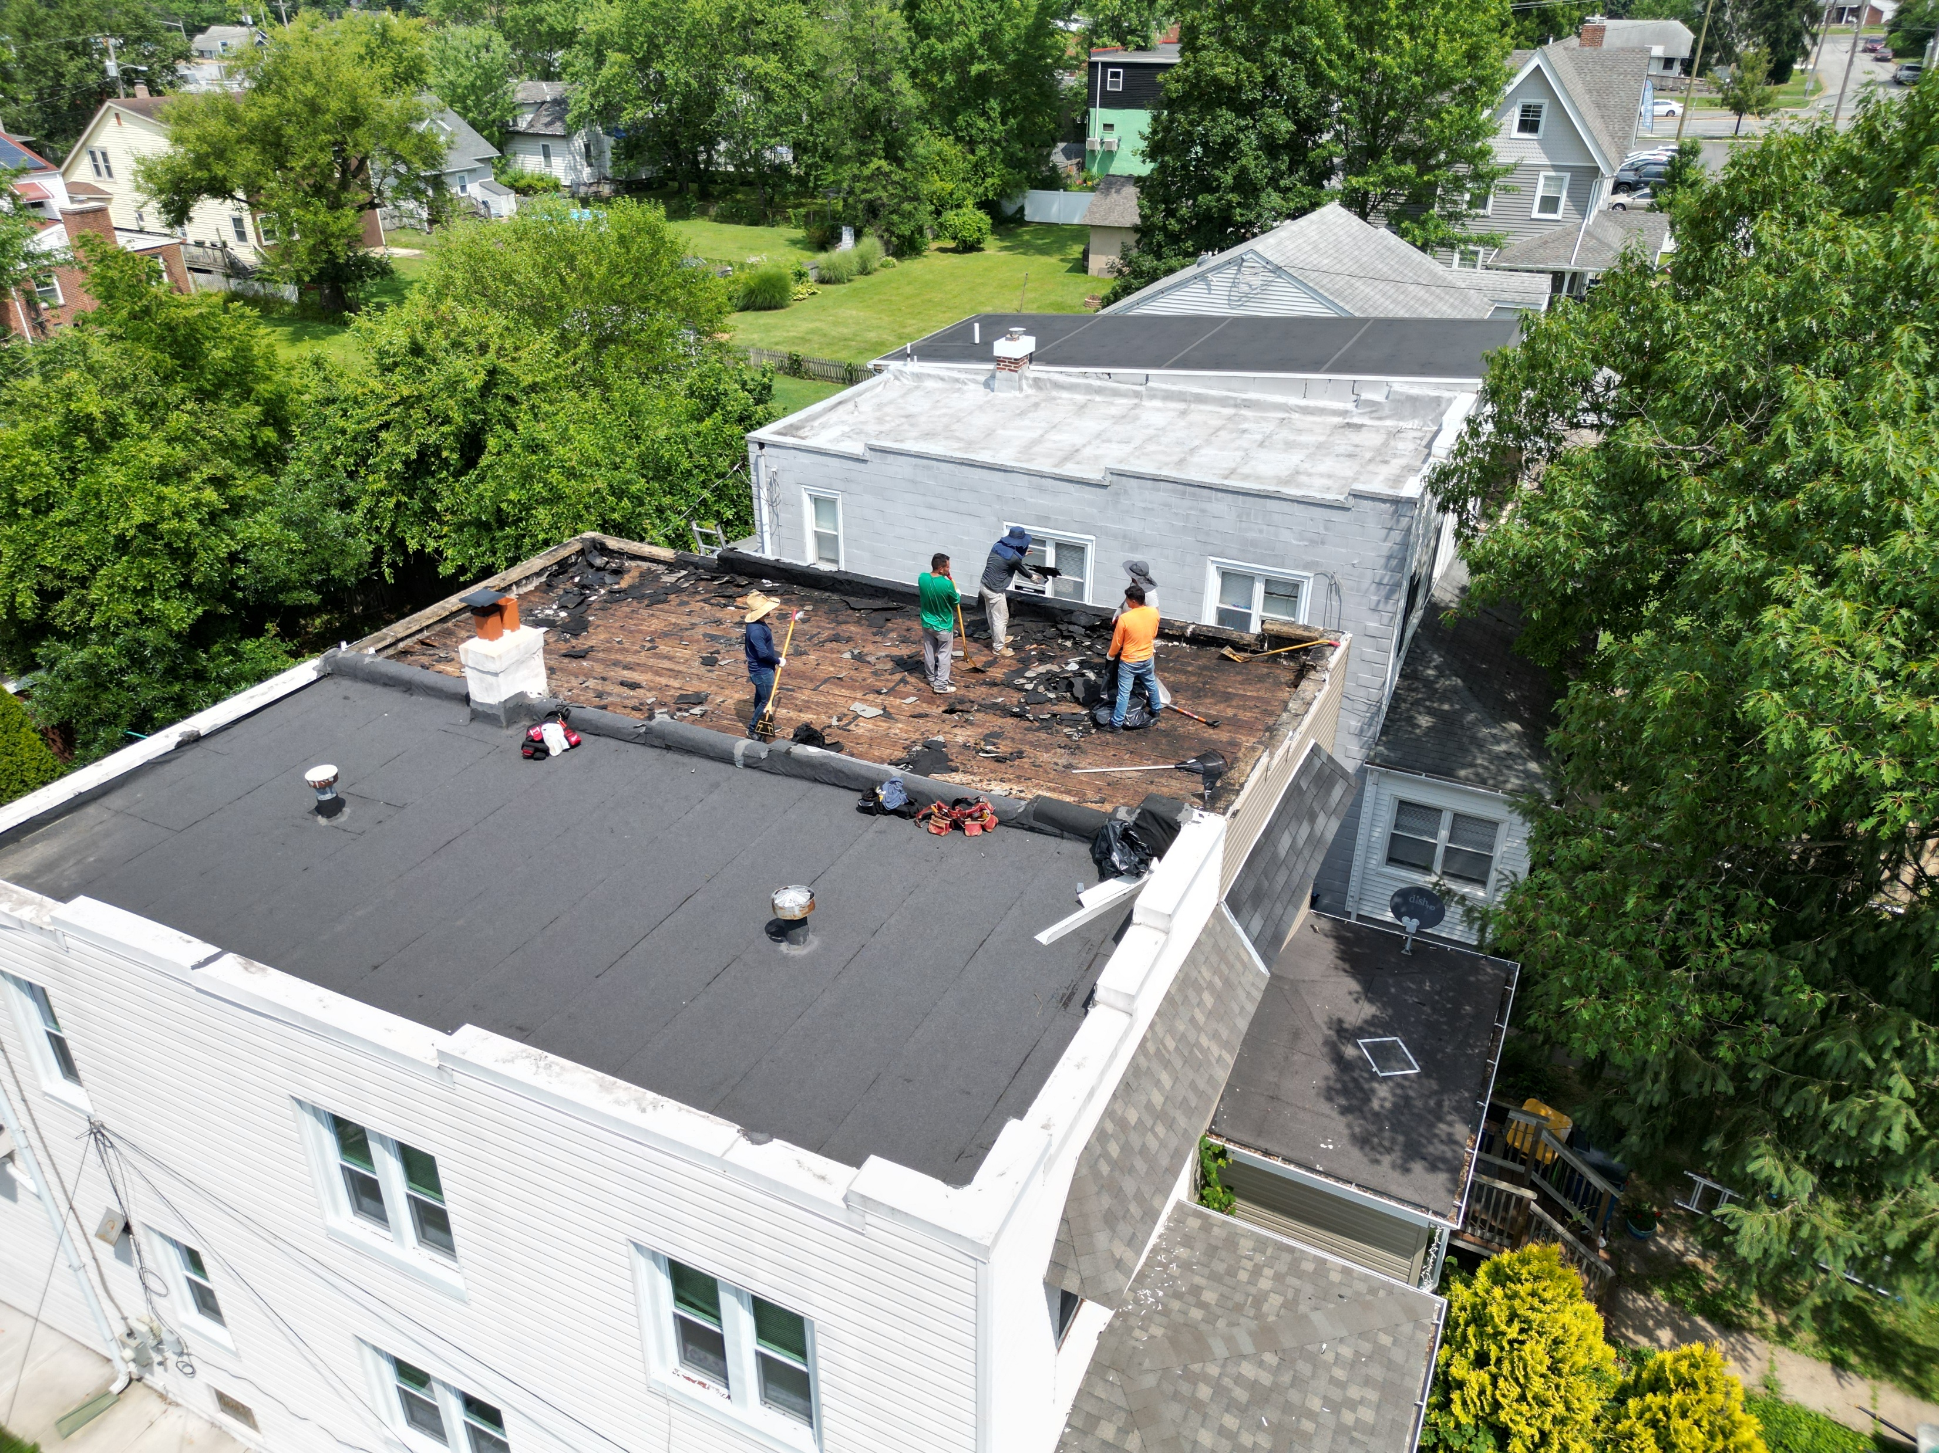
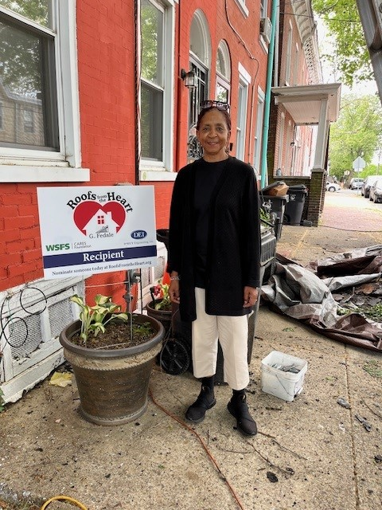
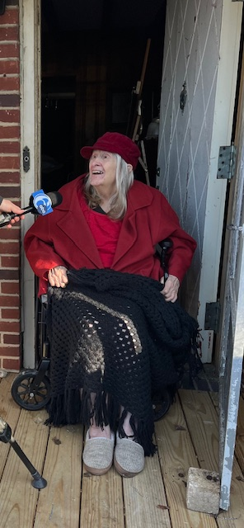
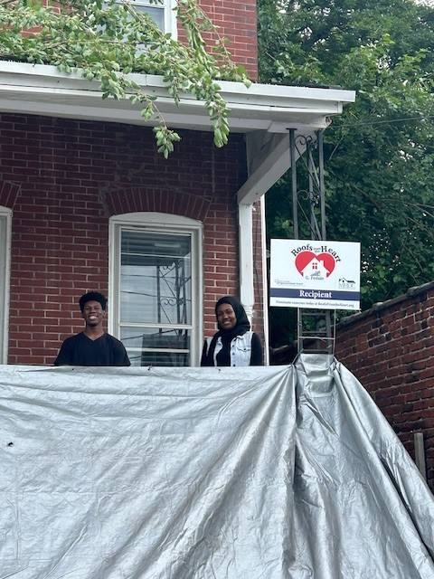
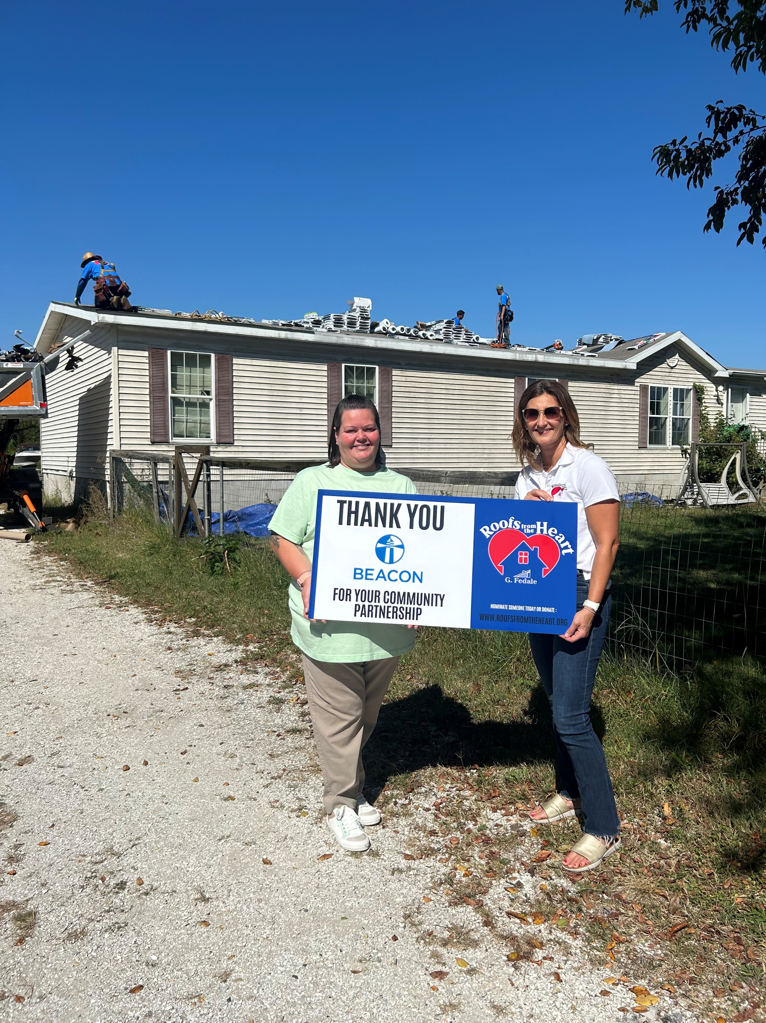
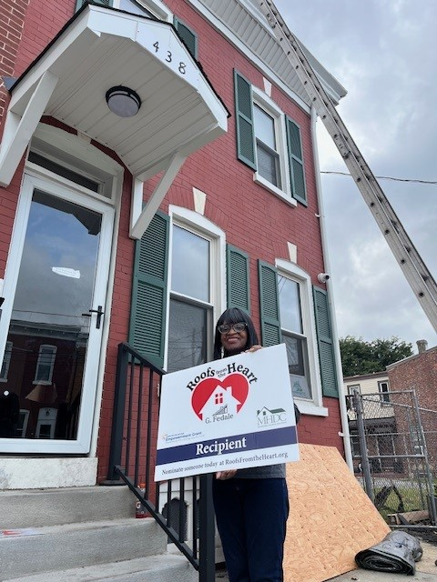
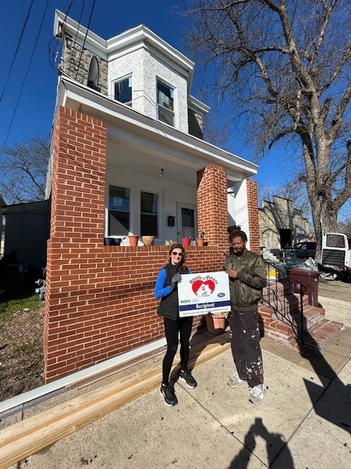
2024 IMPACT REPORT:
11 Families
9 communities
26 People

Slide 4
The Need
According to a study published in the International Journal of Environmental Research and Public Health, "housing conditions, including roof quality and maintenance, play a crucial role in determining the overall health status of a community."
Improving home conditions, including roofing, helps reduce exposure to environmental hazards and ensures that disadvantaged communities have equal access to healthy and safe living environments.
The U.S. Census Bureau's American Housing Survey reported that "approximately 7.3 million housing units in the United States have leaks or other roofing problems, with low-income households being disproportionately affected."

Slide 5
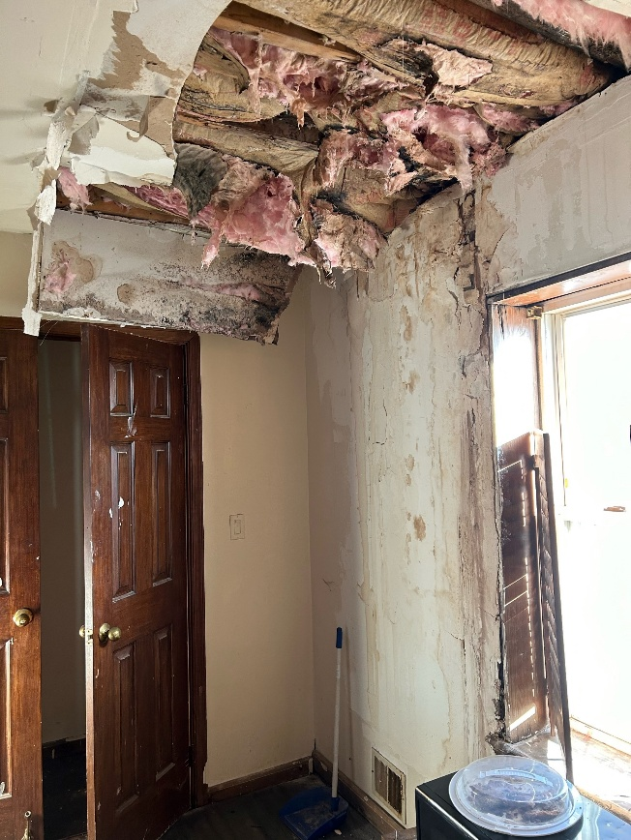
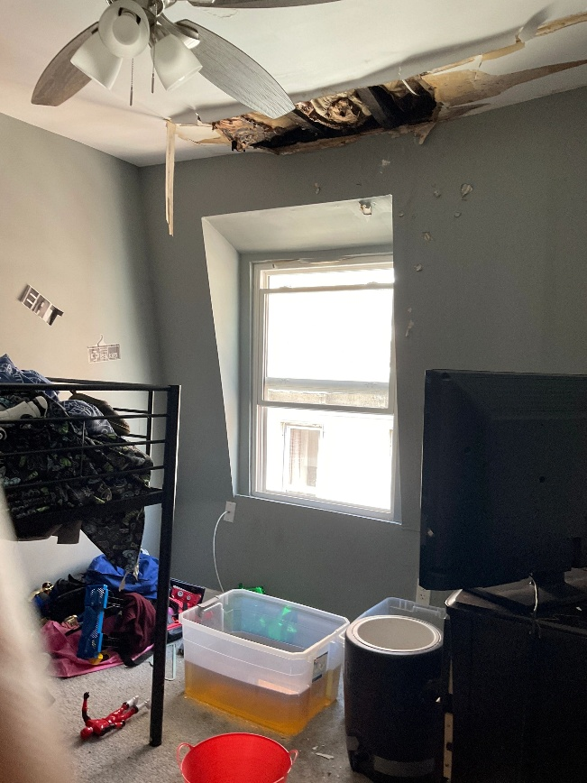
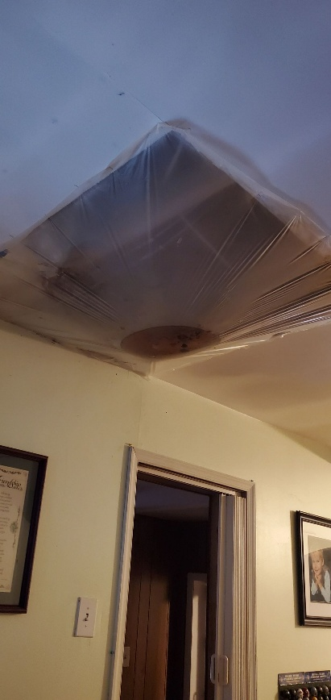
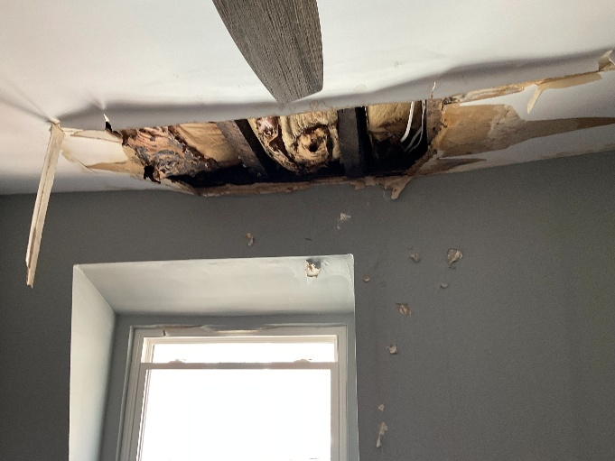
The Need
RFTH currently has 14 open applications in Wilmington.
12 of them are single mothers or single elderly women living on their own
Single women homeowners are more likely to defer necessary home repairs due to financial constraints, leading to more significant and costly problems in the long run.*
Elderly single women homeowners may struggle with physical limitations that prevent them from performing necessary home maintenance tasks, and they may lack the financial means to hire professional help.*
* https://www.urban.org/research/publication/housing-insecurity-and-health
https://www.ncbi.nlm.nih.gov/pmc/articles/PMC4830986/

Slide 6
Strategic GOALS
Increasing the positive impact on underserved and disadvantaged families in Wilmington communities
Impacts desired on individuals and families
Reduce Health Risks and Financial Burdens
Increase Energy Efficiency
Create Safety and Security
Enhance Community and Neighborhoods

Slide 7
(What) will we do with the money?
(Replace) 3-4 roofing systems for homeowners in Wilmington
Objective | Impact
Create Safe and Secure homes | Replacing the roof ensures a family has dry and safe living environment, protecting them from the weather elements Prevents accidents due to falling debris and water damage Eliminating leaks and water exposure allows other important home improvements to be done
Reduce Health Risks | Can prevent issues like mold growth, which can have serious adverse effects on a person health Will improve ventilation within the home for better breathing conditions Will lessen the stress by reducing the financial burdens providing them with mental and emotional well-being Will enable homeowner to use any extra money for prescriptions or medical attention they have been putting off
Increase Energy Efficiency | Better temperature control and insulation can lead to reduced energy consumption and lower utility bills New roofing technology and materials can reflect sunlight more effectively leading to more energy savings and sustainability Many energy needs and necessary upgrades for the inside of the home are not able to be addressed until the roof has been replaced to stop water from entering the home
Improve Community and Neighborhood infrastructure and beautification | Maintained properties can contribute to the overall improvement of the neighborhood which fosters a sense of pride and well-being Well- maintained homes with a new roof can increase the property’s value May be necessary to comply with building codes and regulations, ensuring safety

Slide 8
Measurable Outcomes
All roof recipients are asked to take a survey to measure the following 6 months after they receive their full roofing system replacement:
Have you received further home improvements on the inside of your home
Health Risk Improvements
Financial Burden reduction/Stress level improvement
Cost Savings/Energy Efficiency Improvement
Structure/home integrity advancement
Social and Emotional well-being improvement
Overall, replacing a failing roofing system for disadvantaged homeowners not only addresses their immediate housing needs, but also has a broader positive impact on their quality of life, financial stability, health, and pride in the communities in which they live.

Slide 9
Contact Us
Kate Domanski, Executive Director
302-824-2646
kate@roofsfromtheheart.org
Glenn Fedale Sr.
Board Chair, Director of Charitable Donations
302-287-2039
glenn.fedalesr@gfedale.com

