Slide 1



Notes:
Hi everyone, my name is Jason Hoover and I’m chair of Rank THe Vote Delaware. We’re a non-profit, educating and advocating for a simple upgrade to our ballot called Ranked Choice Voting.
I want to start by asking the question. Do we live in a democracy?
Introduce yourself & RTVDE -- we’re a non-partisan non-profit organization dedicated to educating Delawareans about RCV.
A quick show of hands, how many of you can explain Ranked Choice Voting?
If there is at least one hand: Great! And how many of you can explain why Ranked Choice Voting may be the one tweak to our political process that has the greatest potential to strengthen our democracy?
OR
No hands: I am going to take the next five minutes to explain to you why Ranked Choice Voting may be the one tweak to political process that has the greatest potential to strengthen our democracy.
I am not going to ask for a show of hands for the nexty question because I know that you are all just as alarmed as I am that the left and right in this country are so deeply divided that we don’t even seem to live in the same realities.
It turns out that many of the symptoms of what sometimes seems like a hopelessly broken political system - negative campaigning, fear of vote splitting, ever increasing polarization of our major parties, and legislative gridlock are actually byproducts of one minor aspect of our voting process.
Here let me show you…
(Set the tone -- We’re here because rcv is a better process and will allow us to support candidates honestly)

Slide 2
Democracy: control of an organization or group by the majority of its members.
~ Merriam-Webster Dictionary
Notes:
We’re going to start off with a simple definition. Democracy is the foundation of government. Some argue the integrity of our system ceases to exist without it.
Do we live in a democracy?
As I talk to you today I want you to keep this in the back of your mind

Slide 3
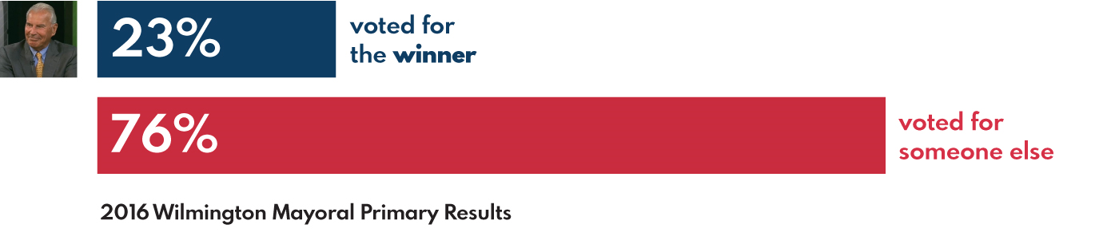
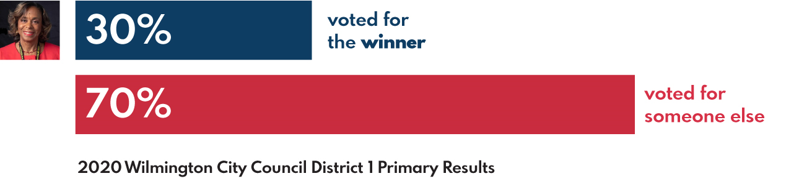
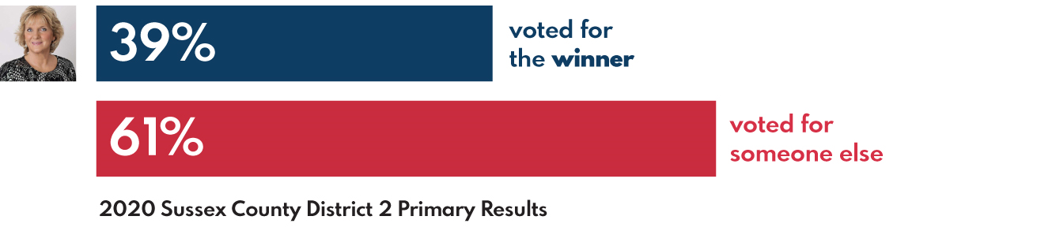
Is this Democracy?
24%
Notes:
Let’s look at three races in Delaware:
Mike Purzycki wins with 24%
Linda Gray wins with 30%
Cindy Green wins with 39%
So under our current process candidates can win with a very small percent of the vote even though the vast majority of voters prefer someone else.
This means that elected officials cannot be confident that they are leading with a majority support of the public.
So how does this happen?
Races referenced:
Incumbent mayor Dennis P. Williams ran for reelection to a second term, but was defeated in the Democratic primary on September 13, 2016 by Mike Purzycki, the former executive director of the Riverfront Development Corporation.
Linda Gray
District 2: Cindy Green, 1,431; Robert Wilson, 1,150; Lisa Hudson Briggs, 1,086.

Slide 4
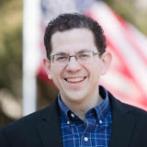
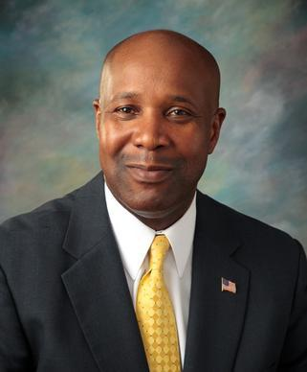
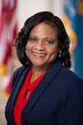
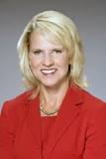



The Problem
Lt. Governor 2016 Primary
26.9%
21.9%
5.9%
Sherry Dorsey Walker
Ciro Poppiti III
Gregory Fuller Sr
Penrose Hollins
Penrose Hollins
29.6%
12.6%
3.2%
Bethany Hall-Long
Kathleen McGuiness
Bradley S Eaby
Notes:
The system we use is inadequate to guarantee a majority winner when more than two people run for office.

Slide 5
Our system is ruled by plurality, not majority
Plurality: Winner by the most votes
Majority: Winner by more than 50%
Notes:
Our system is ruled by “plurality”, not majority. And we want to change that.

Slide 6


Under Plurality: Inverse reaction to change
Approval rating: 20%
20%
16%
16%
16%
16%
16%
Notes:
Why do we want to change this? For one, the reason we run for office and become public servants is because we want to make our community a better place.
However, The problem with plurality-run systems is an inverse reaction to change. The greater the need for change, the less likely we’ll be to get it. What do I mean by that? If you have someone in office who is doing a terrible job and only has a 20% approval rating, you would think they wouldn’t make it past the next term. But what happens is, when people are unhappy with their leadership, they run for office. The American way. The more people that run office, the more the vote gets split.
Elections are the foundation of democracy, and in this system, elections are decided by small holdouts in the population rather than a representative majority of the population.

Slide 7
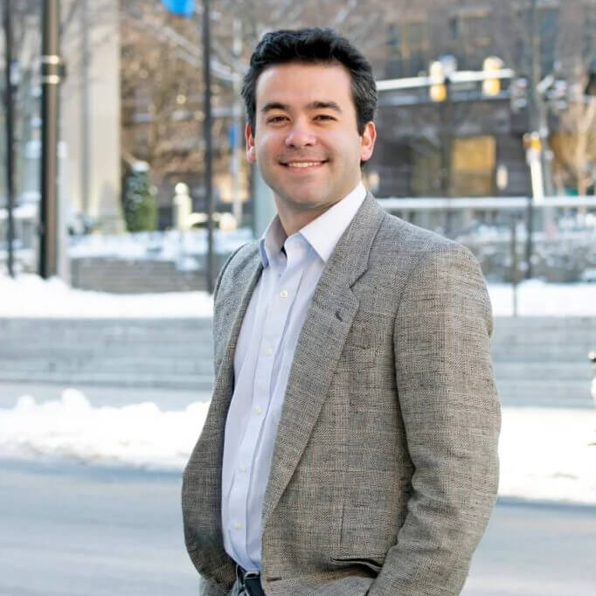



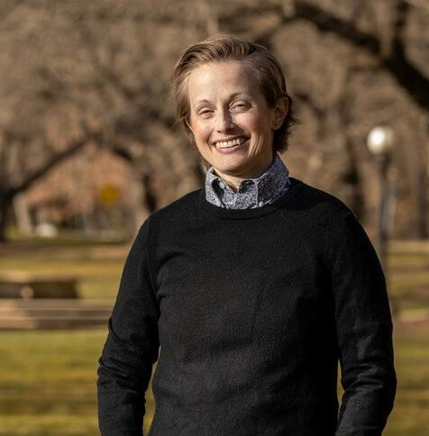
The Problem
NCC Council President 2024 Primary
27.2%
25.8%
15.4%
Monique Johns
George Frankel
Jason Hoover
Penrose Hollins
Penrose Hollins
11.2%
20.4%
Robert Williams
Val Gould

Slide 8
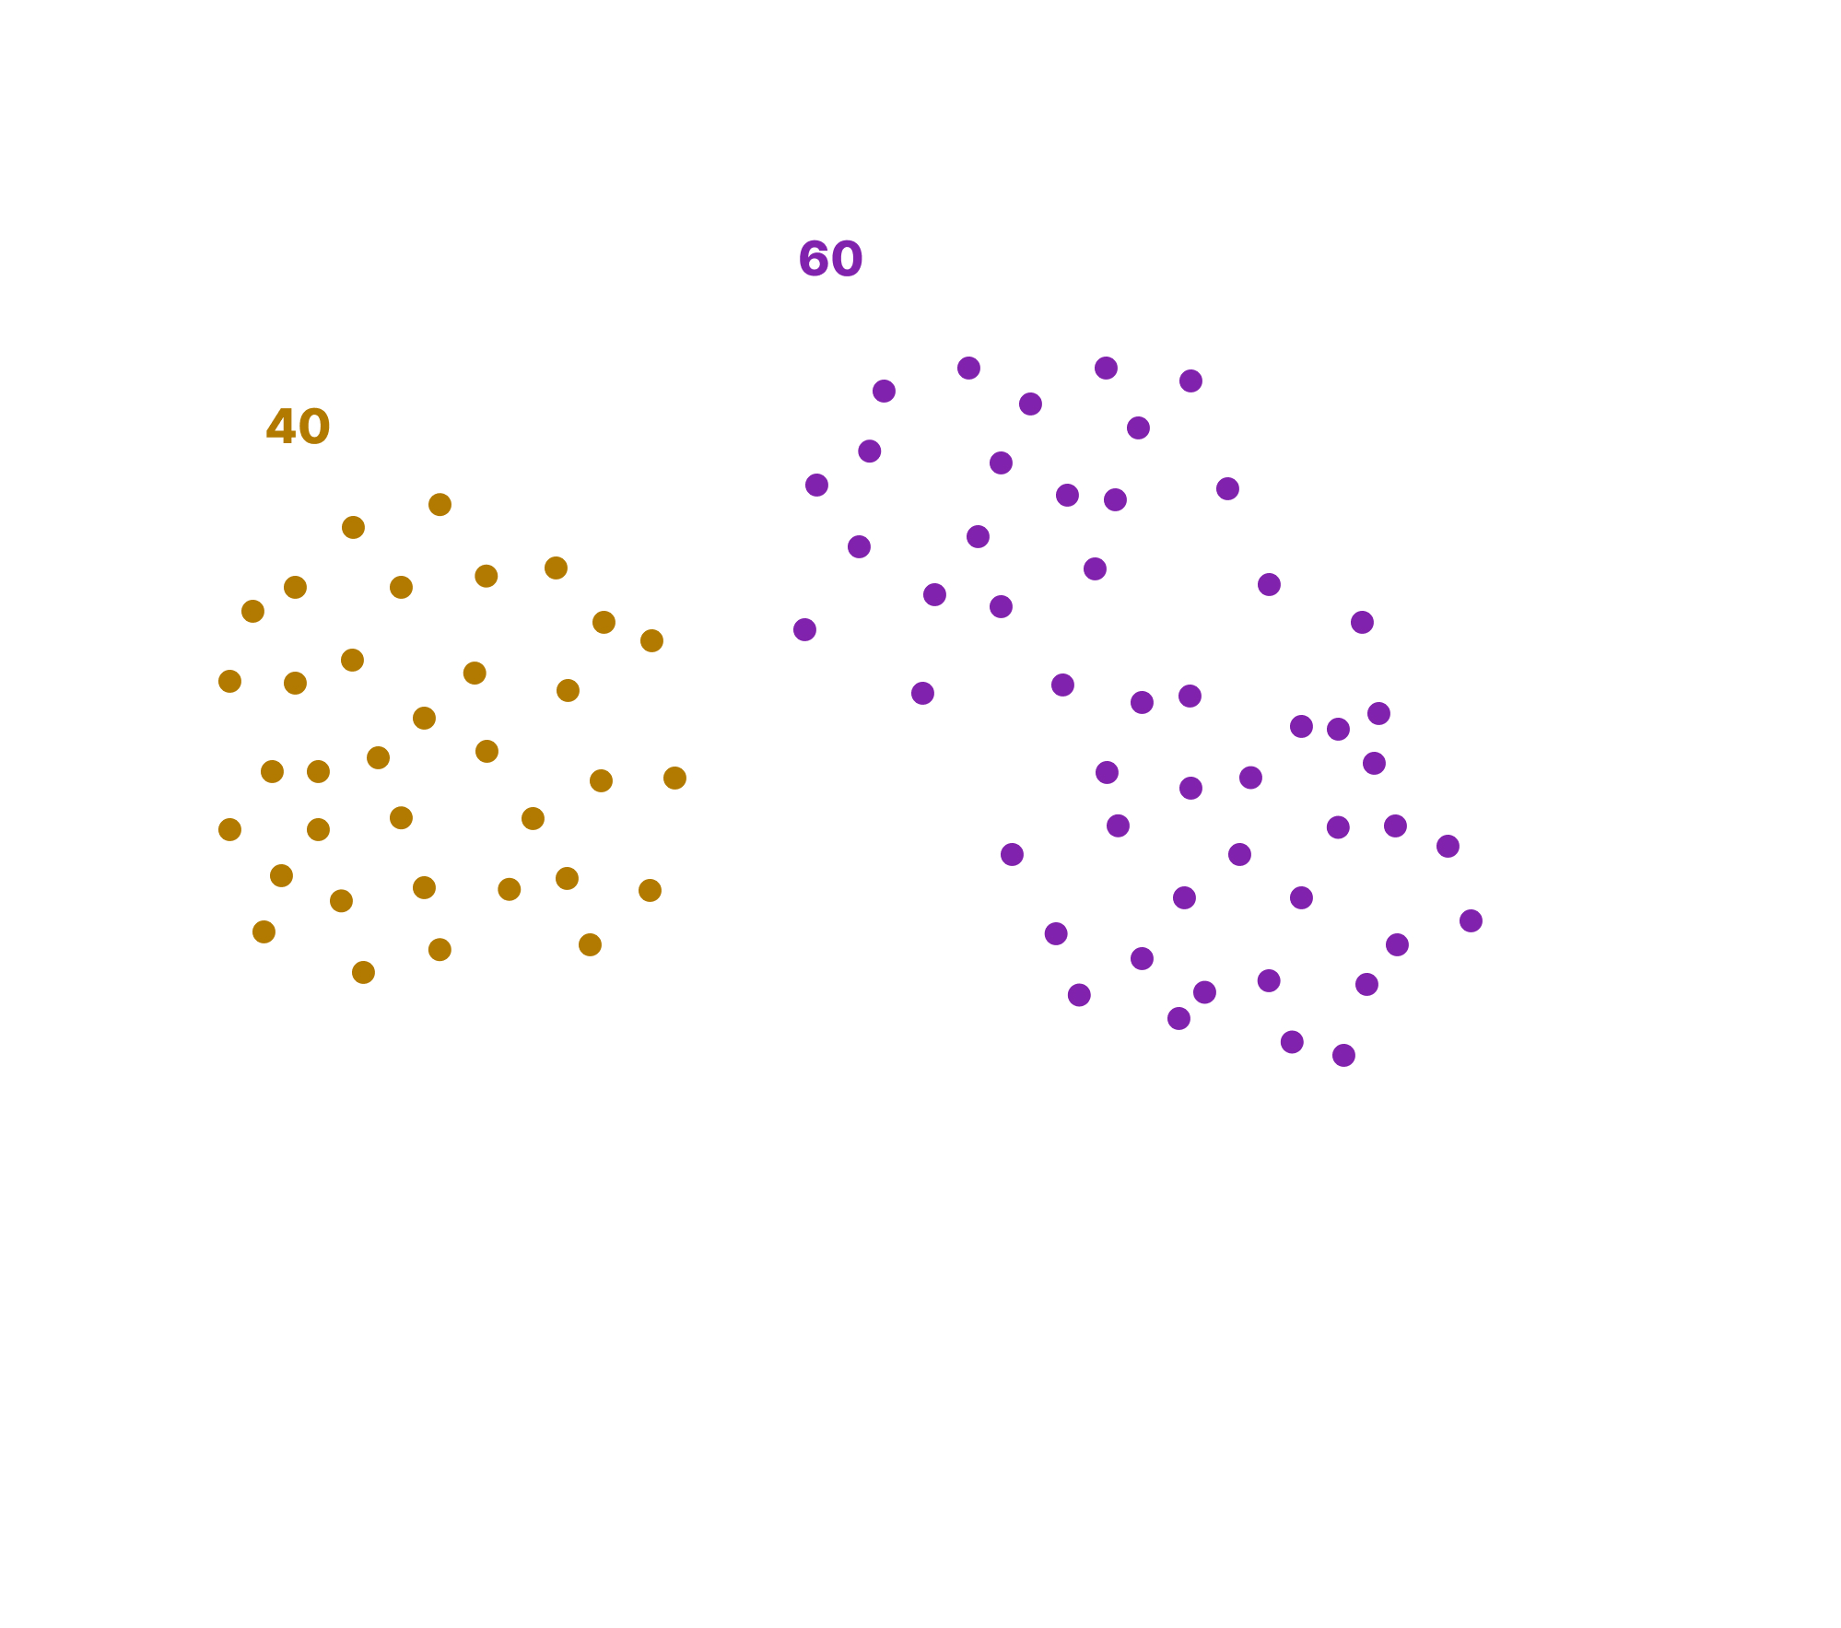
Notes:
(I’m using orange and purple as placeholders)

Slide 9
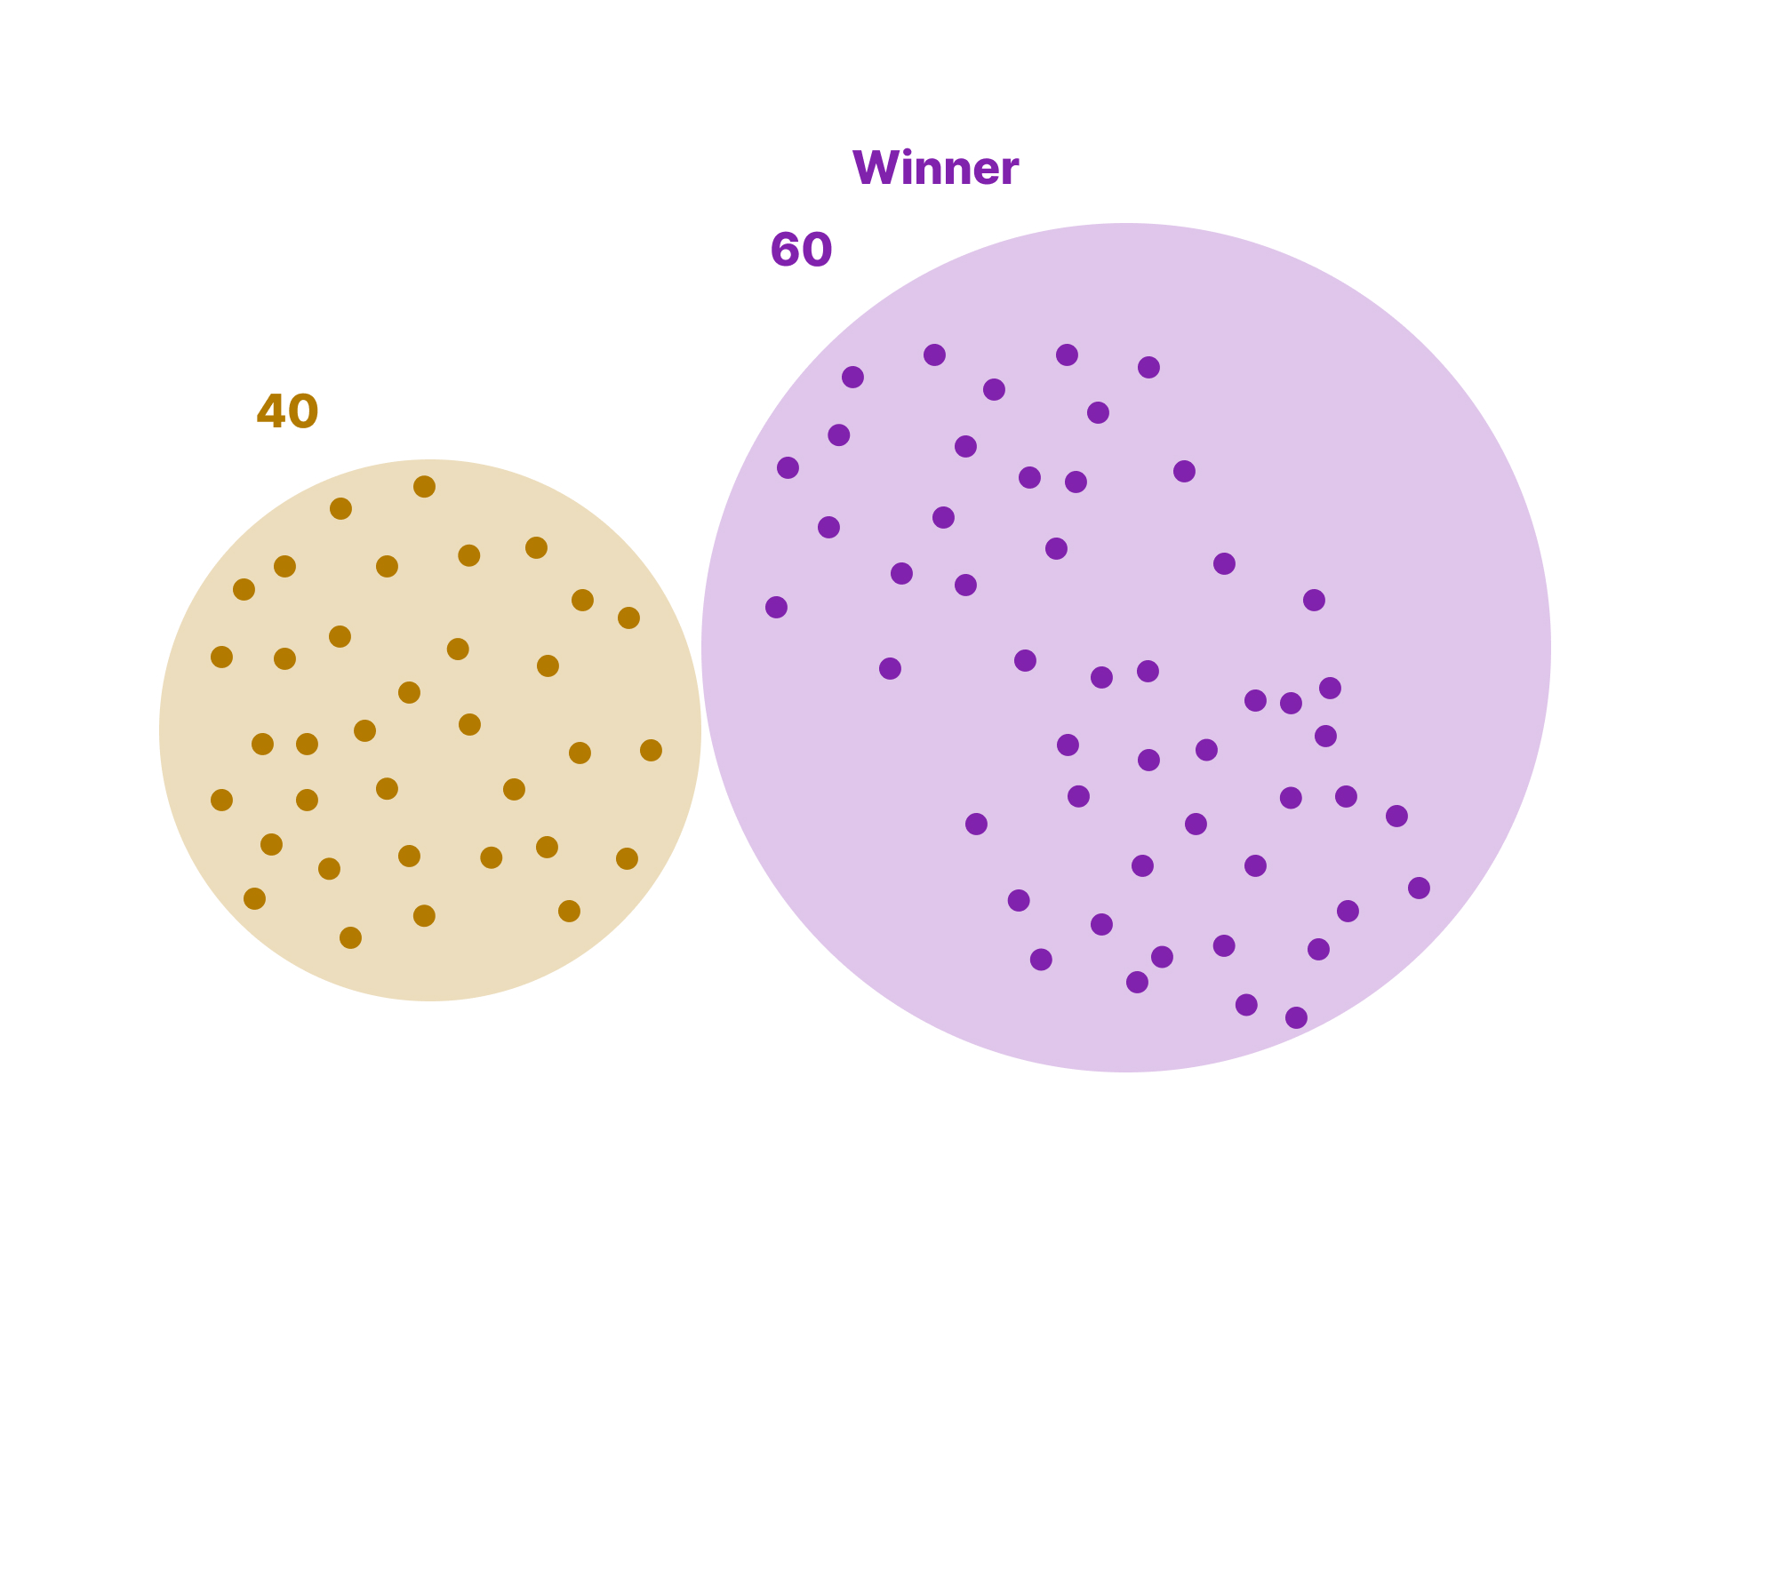

Slide 10
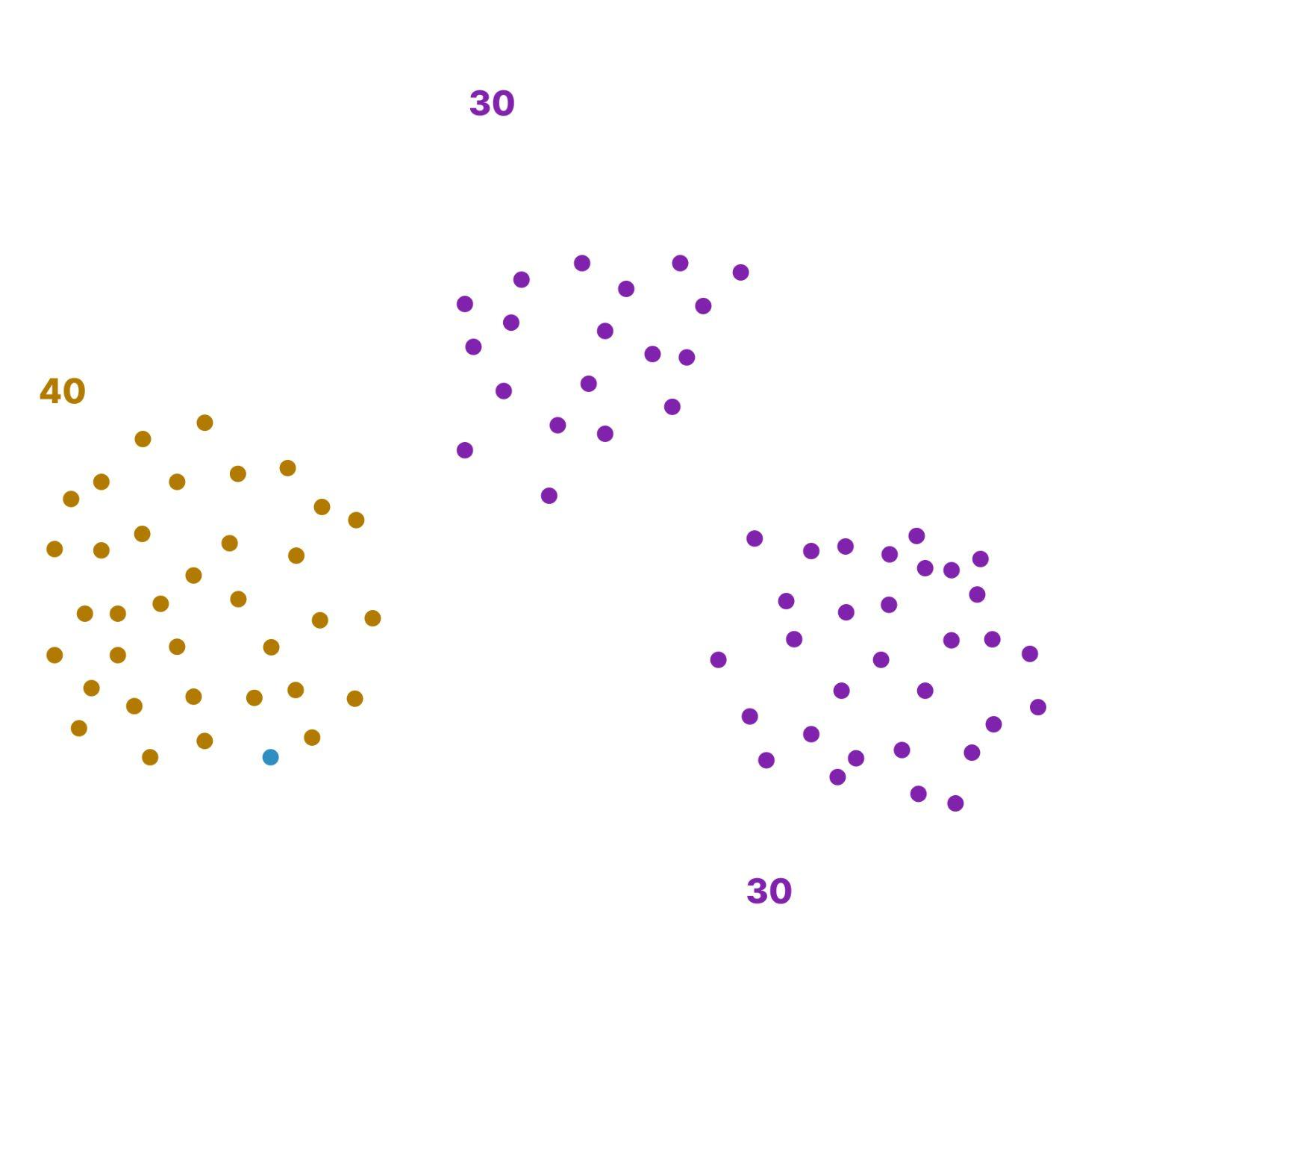

Slide 11
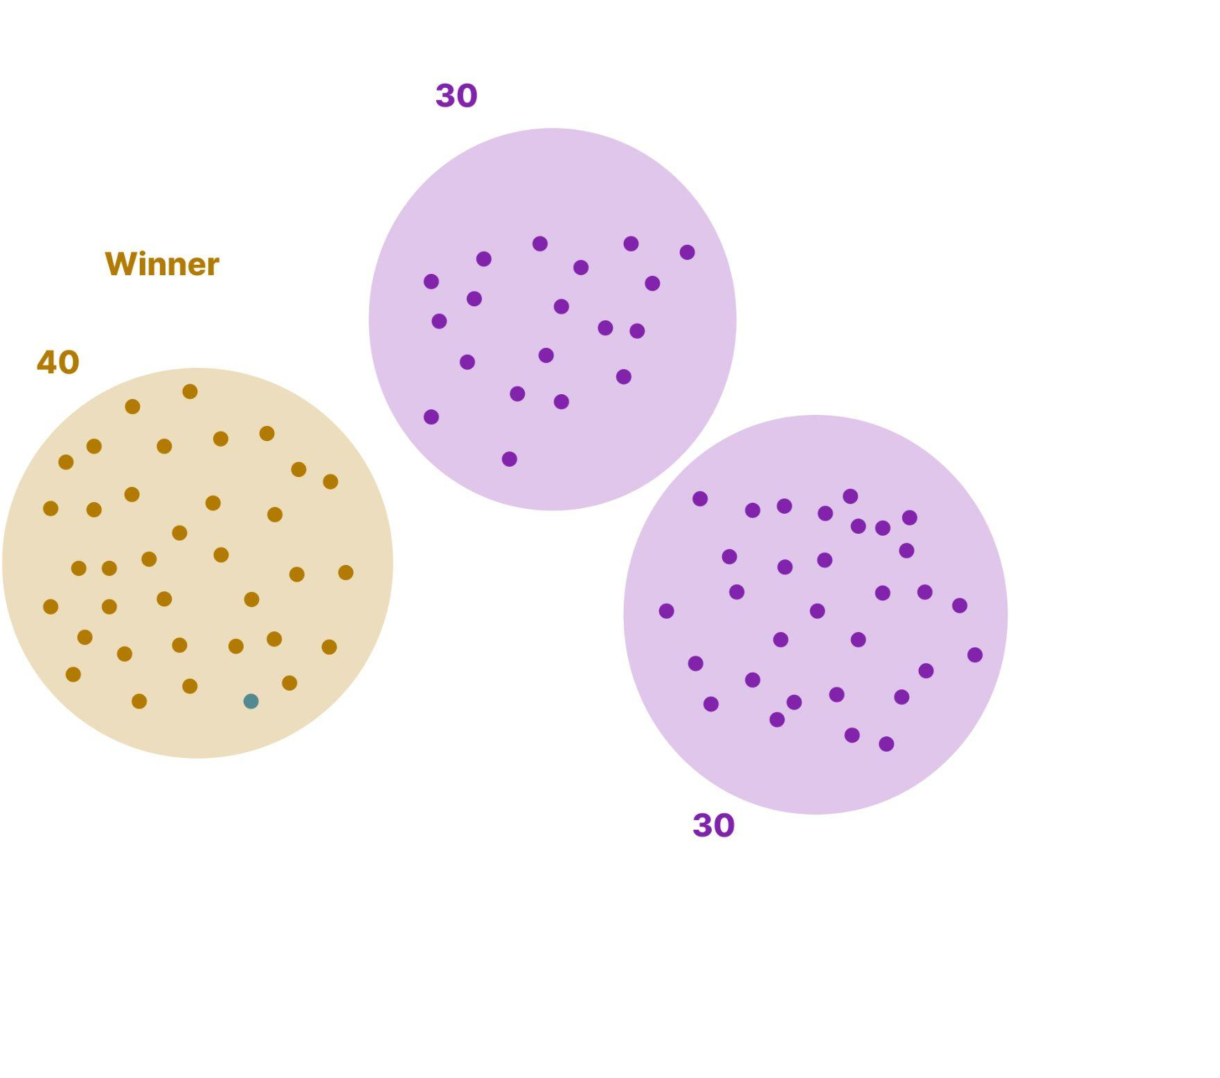

Slide 12
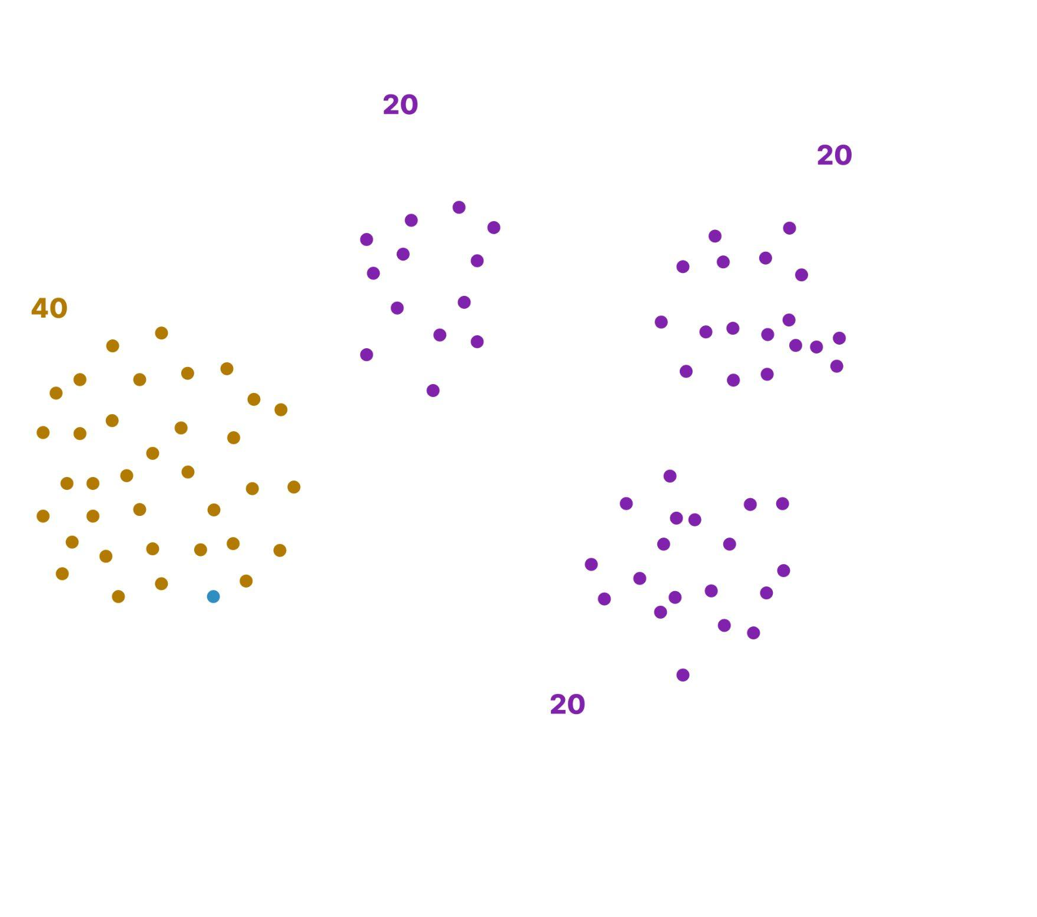

Slide 13
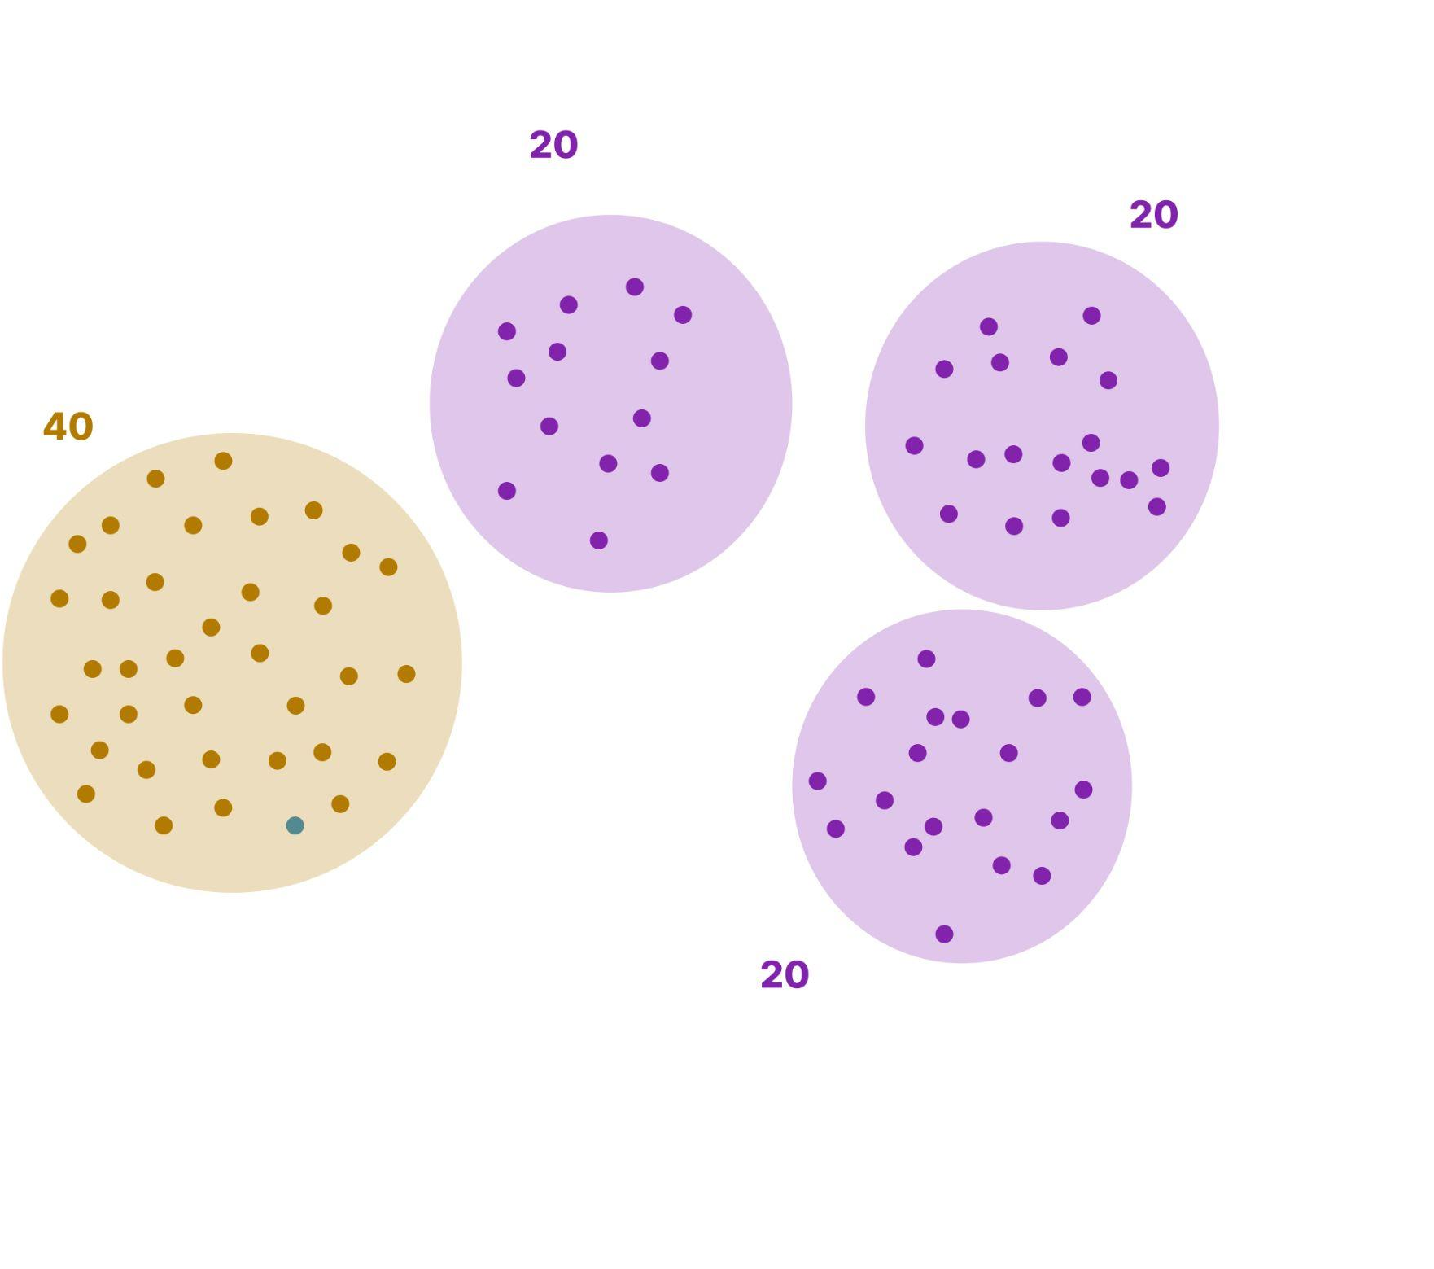
Notes:
And as you introduce more candidates, the problem just gets worse. Nothing changed within the electorate. 60% of the people still want purple representation, yet their voice gets weaker and weaker with every candidate that gets introduced.

Slide 14
The plurality system is the design flaw.
Fails to guarantee majority winners
Fails to eliminate the spoiler effect
Fails to create a democracy
What if there were a better way?
Notes:
Our founding fathers can be forgiven for choosing plurality voting because a better system had not been invented at the time, but only a few decades after the formation of the United States we had the solution.
(Key point is that the plurality system is the spoiler)

Slide 15
THE SOLUTION
Ranked Choice Voting
Instead of picking just one candidate,
Ranked Choice Voting lets you rank multiple candidates in the order you prefer them.

Slide 16
To win under Ranked Choice Voting, a candidate must get a majority of the votes (>50%), either in the
first round, or in the “instant runoff.”

Slide 17
Ranked Choice Voting is also called Instant Runoff Voting

Slide 18

Here’s how a runoff works:
X
16%
12%
22%
10%
6%
14%
20%
Notes:
Runoff Election - let’s do this manually
Exhaustive ballot runoff process

Slide 19
Here’s how a runoff works:
X
16%
12%
24%
14%
6%
14%
20%
Back to the polls for another election!
Continue until a majority winner emerges
Notes:
Runoff Election

Slide 20
Runoffs work, but they have their drawbacks
Time consuming
Expensive
Requires repeat turnout
Notes:
However, this is time consuming and requires people to turn out over and over again. There’s a simpler way.

Slide 21
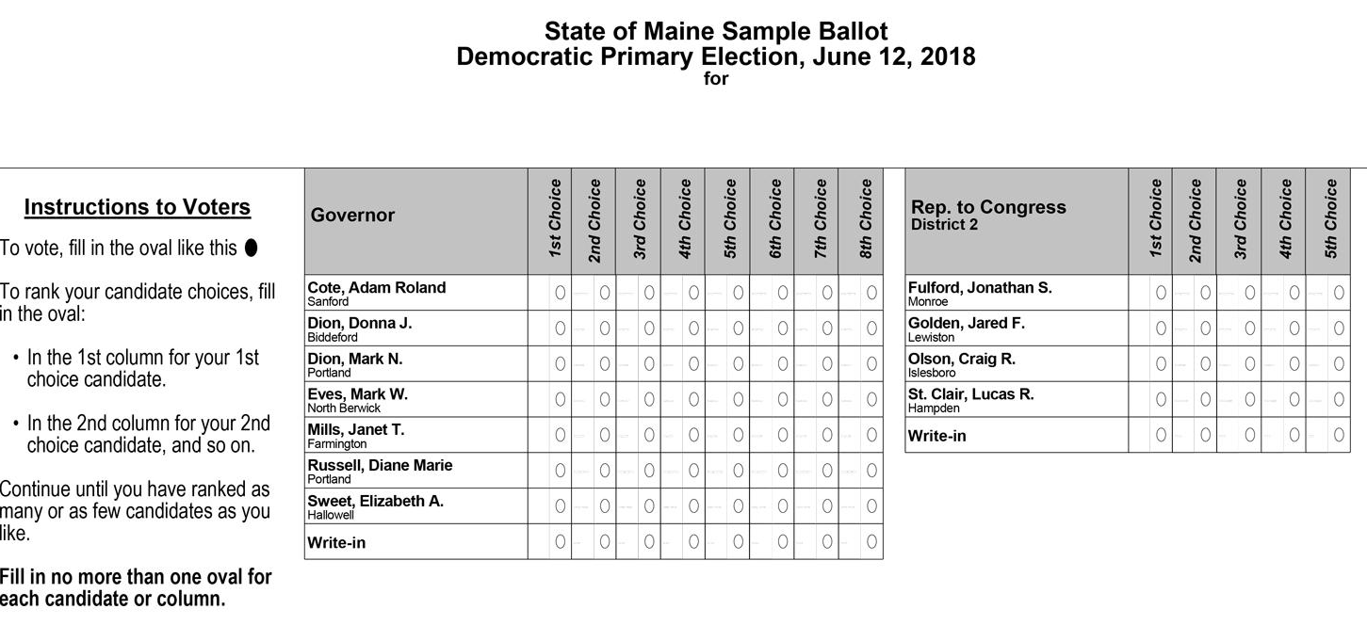
Notes:
Walk through the animation on how to use a ballot. Make the point that you don’t have to rank everyone. You can rank as many or as few as you want to.

Slide 22
This is my vote.
This is my backup choice.
This is my next backup choice.
And so on.

Slide 23
RCV is a representative voting system
It doesn’t give anyone an advantage
It doesn’t favor a particular party
It represents the electorate
Notes:
However, this is time consuming and requires people to turn out over and over again. There’s a simpler way.

Slide 24
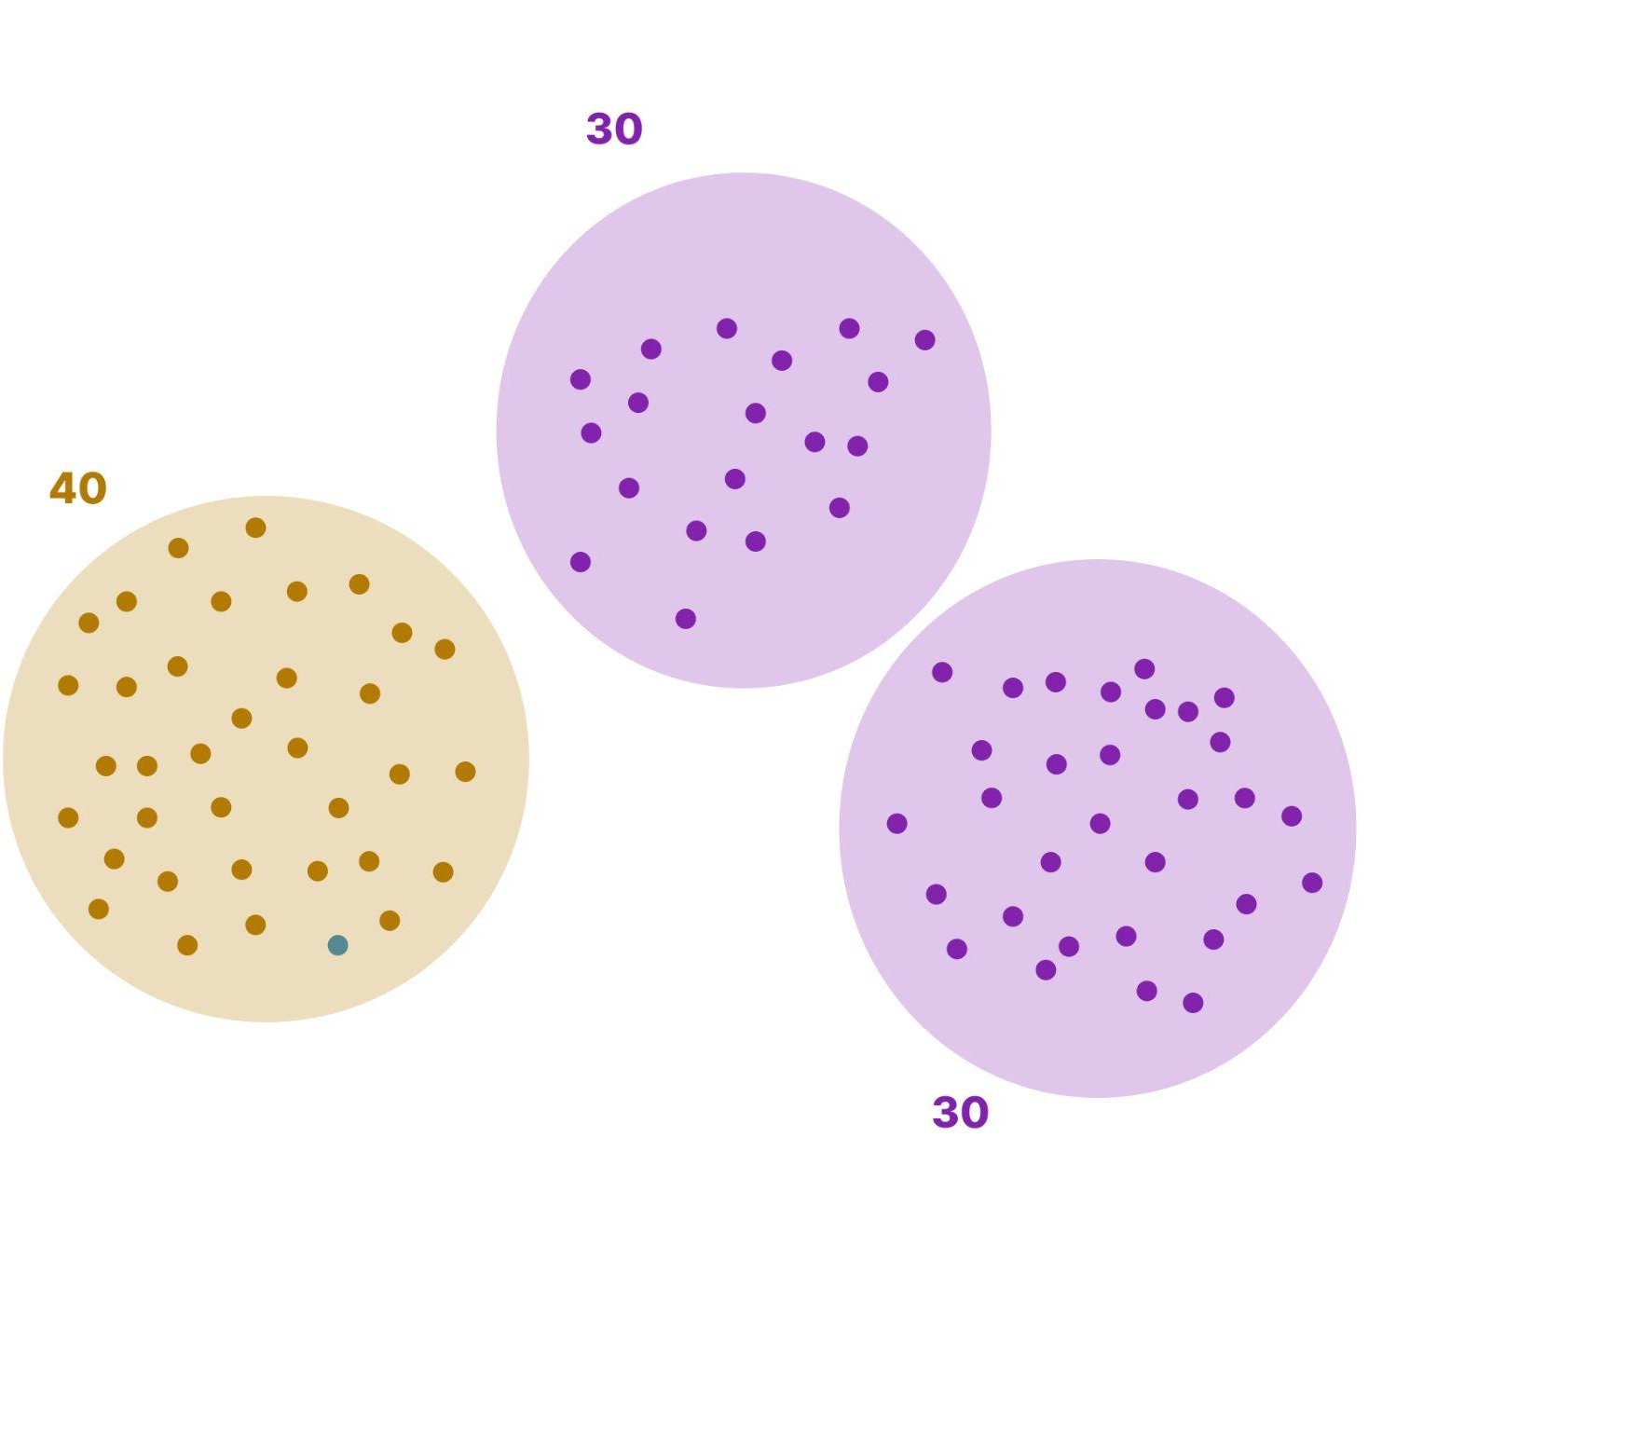
In a purple district, purple will always win
Round 1
Round 2
Round 3
Notes:
If the orange party wants to win, they’ll have to start listening to their constituents better rather than just maintaining a solid base

Slide 25
RCV has other benefits

Slide 26
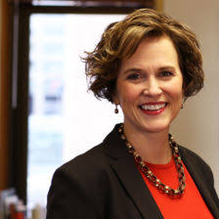
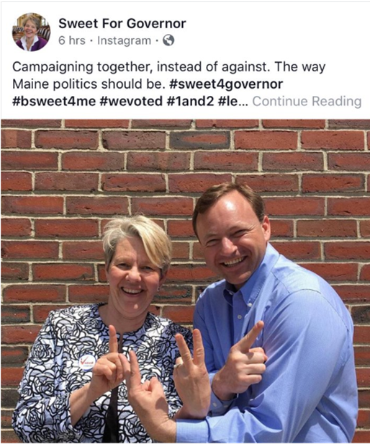
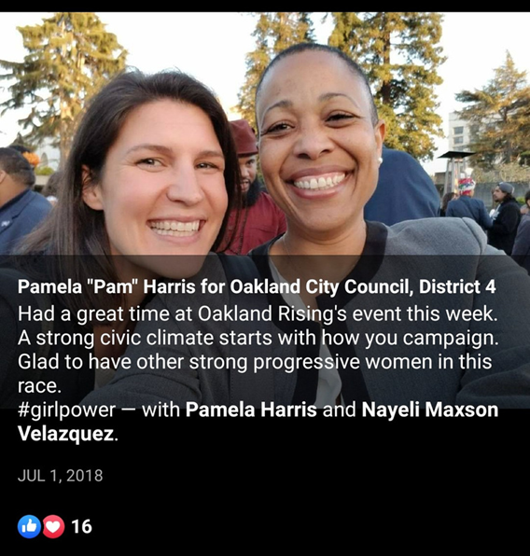
RCV Benefit: Campaign Civility
“There was relatively little elbowing and attacking because every candidate wanted to be the second choice of their opponents’ supporters.”
Former Minneapolis Mayor
Betsy Hodges
Notes:
Betsy Week and Mark Eves campaigned together for Dem Governor Candidate in Maine 2018 (see back-up slides for election results)
Pamela Harris and Nayeli Maxson campaigning together for Oakland City Cousel

Slide 27




Campaigning under Plurality
Vote For
Notes:
Who has canvassed door-to-door for a candidate?
If you see a sign for your opponent, what do you do? Skip that house?
[Click to change happy face to sad face]
With rank choice voting the purple face would still approach the home owner to find common ground as second choice
Plurality voting encourages candidates to focus on turning out their own base, rather than appealing to a broader section of the electorate

Slide 28
Campaigning under Ranked Choice
Notes:
With Ranked Choice Voting, a candidate has an incentive to engage with all voters.
Even if they know they’re not a voter’s 1st choice, they can find common ground and campaign for a 2nd-choice vote.
This to discussion around what we have in common

Slide 29
RCV is a real, practical solution.
Eliminates spoilers and vote-splitting.
Ensures Majority support
Changes the tone of our elections
Will transform politics in Delaware.
Notes:
Audience engagement here is important

Slide 30
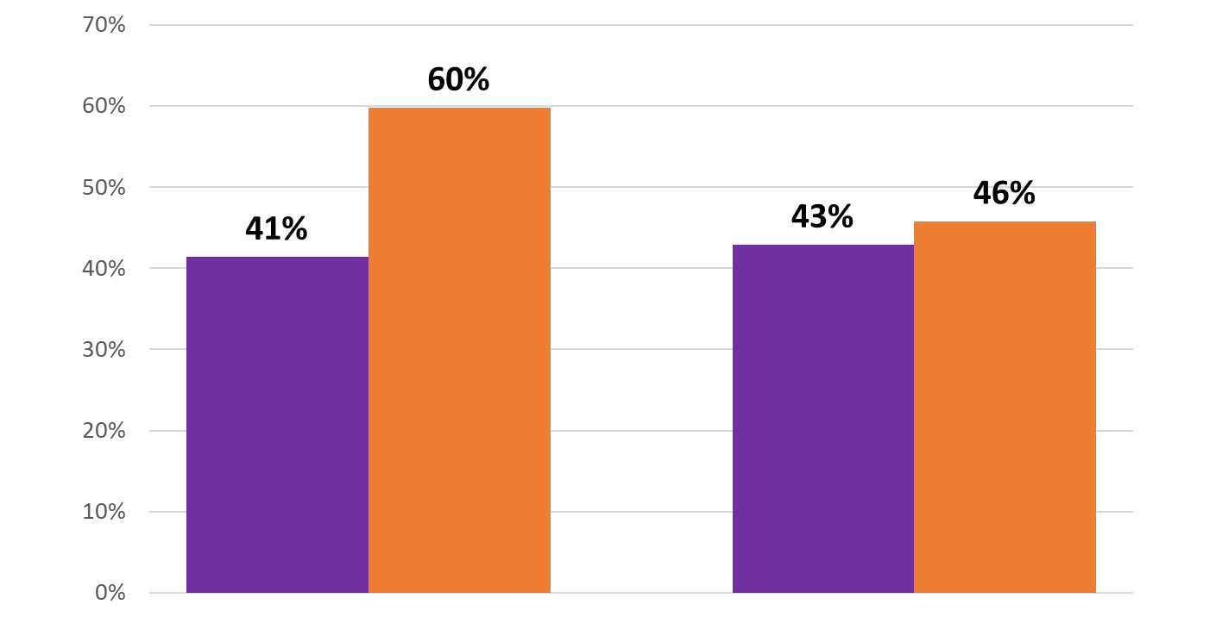
RCV Benefit: New and Diverse Voices
Percentage People of Color
Winning Office
Cities that adopted RCV
Cities that did not adopt RCV
Before RCV After RCV
Notes:
USE THESE SLIDES BASED ON AUDIENCE - Keep in mind possible fear the RCV is a threat to incumbents, even through research shows incumbents most at risk are those who were appointed and those who face scandal
With today’s plurality systems, long shot or new candidates struggle to get support because people are concerned they will be “wasting their vote”. This disadvantages groups who historically been left out of the conversations. Rank Choice Voting solves this problem because it removes the concern that you might “waste your vote” and as a result new and diverse voices are being heard.
Compares 4 Bay-Area RCV cities (San Francisco, Oakland, Berkeley, San Leandro) to 7 Bay-area plurality cities.
Specifically here we are looking at candidates of color who won races in the California bay area. Cities that adopted RCV saw candidates of color win 60% of time compared to only 40% in cities without RCV.
Why RCV may benefit women and people of color:
Discourages negative campaigning, reducing the risk of racially-charged or gendered attacks
Plurality system favors incumbents who have historically been white and men
Avoids vote-splitting so multiple candidates with similar bases can run

Slide 31
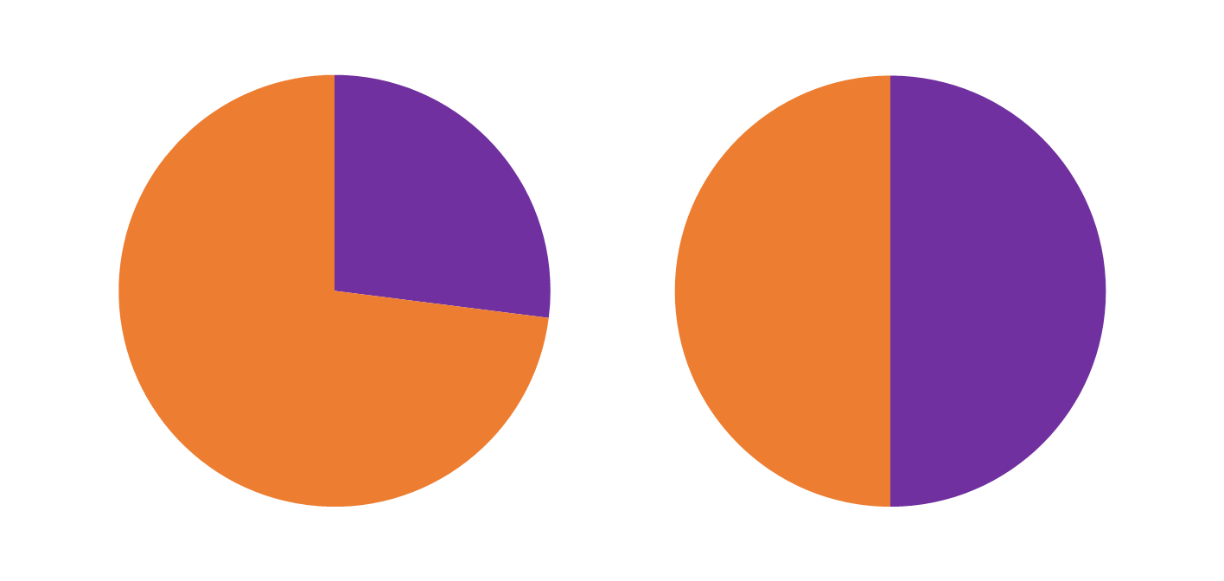
RCV Benefit: New and Diverse Voices
Women’s Representation on City Councils...
Before RCV
After RCV
Women
Men
Women
Men
Notes:
USE THESE SLIDES BASE ON AUDIENCE - Keep in possible fear the RCV is a threat to incumbents, even through research shows incumbents most at risk are those who were appointed and those who face scandal
From the 9 US cities which use RCV for city council elections (as of 2018).
Data is from last election before RCV was implemented, compared to most recent RCV election.
23% women on city councils before, 50% after.
Why RCV may benefit women and people of color:
Discourages negative campaigning, reducing the risk of racially-charged or gendered attacks
Can remove preliminary elections which are low turnout and often unrepresentative
Avoids vote-splitting so multiple candidates with similar bases can run

Slide 32
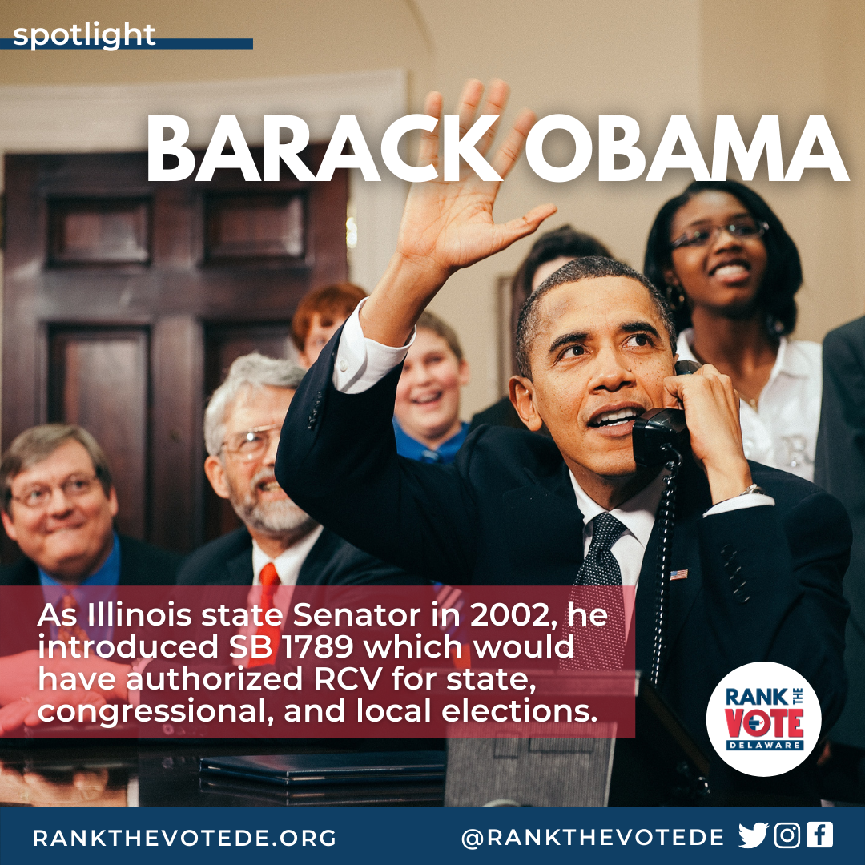
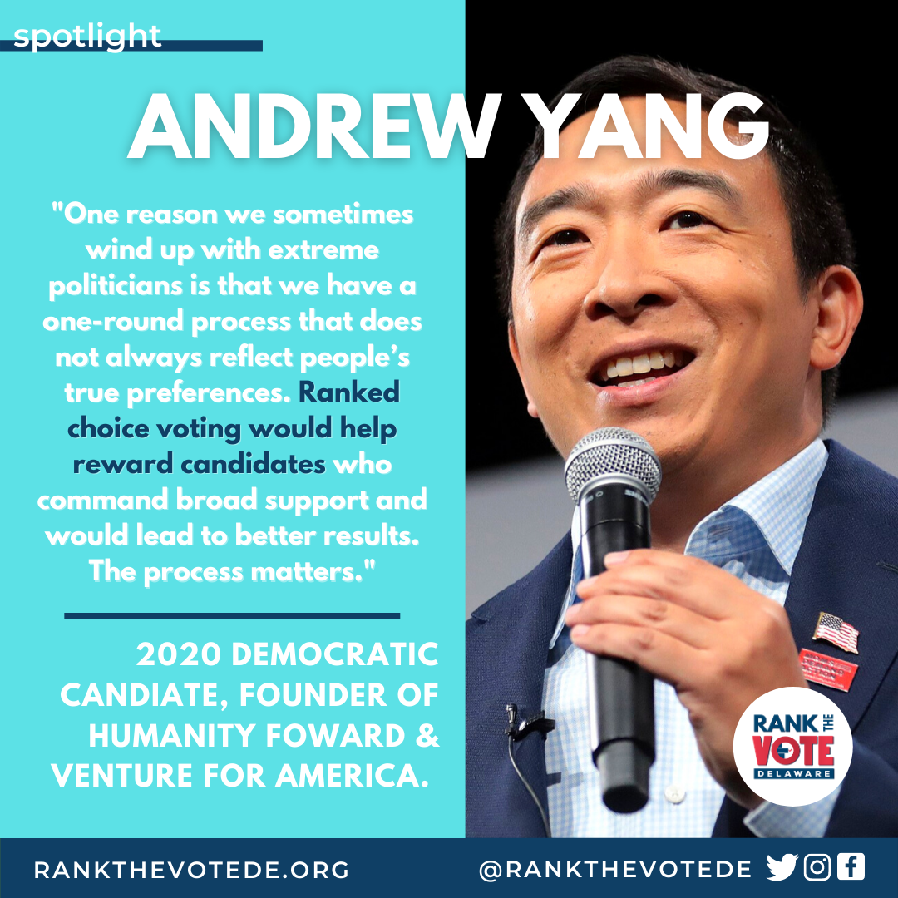
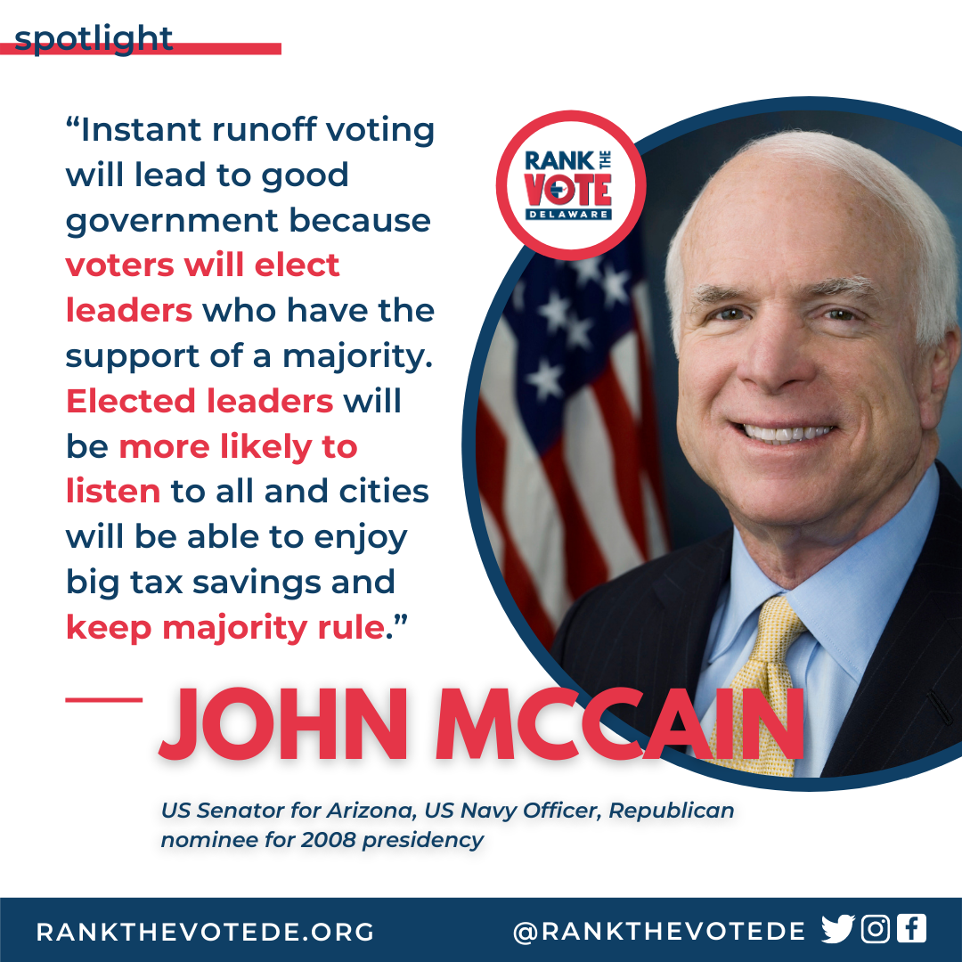


Broadly Endorsed

Slide 33







Endorsed in Delaware

Slide 34
Ranked Choice Voting Usage

Slide 35






RCV Usage Around the World
Australia
100 years!
Ireland
100 years!
Canada
Scotland
India
New Zealand
Notes:
Australia
Ireland
Canada
Scotland
India
New Zealand

Slide 36
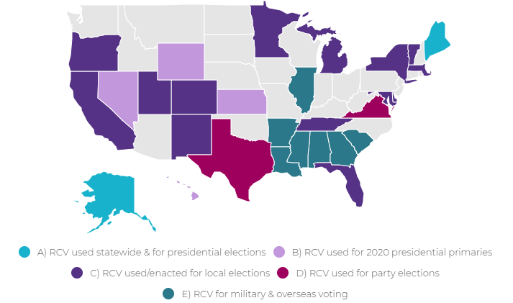
RCV Usage in the U.S.
Used/ enacted within
28 states

Slide 37
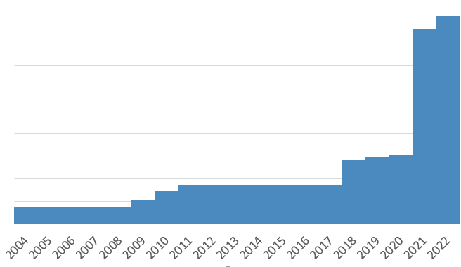
RCV Usage in the U.S.
Alaska (statewide)
Albany CA
Eureka CA
Boulder CO
9 million
8 million
New York City NY
7 million
Benton Co OR
Basalt CO
6 million
Total Population in Jurisdiction with RCV
Eastpointe MI
St. Louis Park MN
Vineyard UT
Payson UT
Las Cruces NM
5 million
4 million
St Paul MN
Portland ME
Telluride CO
Berkeley CA
Oakland CA
San Leandro CA
Maine (statewide)
Sante Fe NM
3 million
2 million
Minneapolis MN
San Francisco Cambridge MA
Arden DE
1 million
Notes:
Take note that Arden has had rank choice voting for nearly 100 years
Arden refers to RCV as the “Hare Method”

Slide 38
Voter Response
Maine first statewide primaries (League of Women Voters Survey)
94% of voters ranked multiple candidates.
90% of voters said experience was “excellent or “good”.
NYC first primaries (Edison Research poll)
83% of voters ranked multiple candidates.
95% of voters said RCV was simple to use.
Notes:
Info from Fairvote Maine https://www.fairvote.org/maine_voter_survey_shows_rcv_was_easy_to_use
NYC: https://www.fairvote.org/new_york_city_s_ranked_choice_voting_rollout_better_elections_yield_better_results

Slide 39
Notes:
We’re all here for a reason. We all want to make things better for the people that come after us.
It’s not a stretch to say people feel disenfranchised.
It’s not a stretch to say people feel uncertain in our democracy.
But RCV is one tiny change with incredible outcomes. It makes people feel like the system can still work. It empowers more people to run and more people to vote because it ensures their vote actually counts. It demonstrates that change is actually possible. And how wonderful would it be to have this change start in Newark?
Thank you. I’m happy to take any questions
Today I’m here in front of you because we all have something in common. We want to make this place (Newark, yes), and Delaware, and this country, better for all the people that come after us. This system empowers more people to run and more people to vote because it ensures their vote actually counts. It demonstrates that change is actually possible.
We can’t expect change to happen all at once from the top. It starts on a local level and builds upwards.

Slide 40
Additional slides
For use if needed

Slide 41
Delaware Primaries won with less than 50%
2016 Hall Long(Lt. Governor) won with 29%
2016 Rochester(U.S. House) won with 44%
2016 Purzycki (Wilmington mayor) won with 24%
2016 Karen Hartey-Nagle (Council President NCC) won with 48%
2018 McGuiness (auditor) won with 41%
2018 Darius Brown (senate district. 2) won with 38%
2018 Siegfried (Rep. dist. 7) won with 28%

