Slide 1




Dr. Sean E. Moriarty
Executive Director

Slide 2
What is P.O.S.T. ?
The Police Officer Standards and Training Commission (POST), a division of the Department of Safety and Homeland Security (DSHS), oversees standards and training for all police officers in Delaware. POST aims to improve the professionalism and behavior of officers by setting qualifications for new recruits, education and training requirements, and training standards. POST advises the Delaware Police Accreditation Commission (DPAC), provides guidelines for local oversight boards, and investigates potential officer misconduct relative to certification.

Slide 3
MISSION, DUTIES &
RESPONSIBILITIES
Our Mission
The mission of the Delaware Police Officer Standards and Training Commission (P.O.S.T.) is to enhance public trust and confidence in law enforcement by establishing and maintaining professional training, accountability, and certification for Delaware Police Officers.
Duties and Responsibilities
The duties and responsibilities of the Delaware Police Officer Standards and Training Commission are to encourage and increase the professional competency and conduct of police officers by establishing minimum pre-employment qualifications for police officer applicants; establishing minimum educational and training qualifications for permanent certification as a police officer; prescribing standards for in-service, reoccurring, and elective training; advising the Delaware Police Accreditation Commission regarding statewide accreditation standards; issuing guidelines for local police oversight commissions or boards, and; reviewing and examining potential misconduct of Delaware police officers by holding administrative hearings to consider possible suspensions or revocations of police certification.

Slide 4
Commission Members
The Commission has seventeen (17) members from various law enforcement and public backgrounds, supported by five staff members.
Secretary Joshua Bushweller
Chairperson (Appointed by the Governor)
Delaware Department of Safety and Homeland Security
Kathleen Jennings
Attorney General
Her proxy is Investigator Robert Irwin
Colonel William Crotty
Delaware State Police Superintendent
His proxy is Major Jeremiah Lloyd
Chief Wilfredo Campos
Chief of the Wilmington Police Department
His proxy is Major Anthony Bowers
Colonel James Leonard
Chief of the New Castle County Police Department
His proxy is Major Ben Feldmann
Chief Thomas Johnson
Chief of the Dover Police Department
Chief Mark Farrell
Chief of the Newark Police Department
His proxy is Lieutenant Andrew Rubin
Secretary Cynthia Marten
Delaware Secretary of Department of Education
Her proxy is Ms. Rosalie Morales
Mayor Nicolaus Smith, Clayton
President of the Delaware League of Governments
Mayor Robin Christiansen, City of Dover
Mayor of Kent County Municipality
New Term Starts Jan 9, 2024, and expires January 9, 2027
Mayor William Chandler, Dagsboro
Mayor of Sussex Municipality
New Term Starts February 16, 2024, and expires February 16, 2025
Chief Richard McCabe, New Castle City Police
Chair of the Delaware Police Chief’s Council
His proxy is Executive Director (Chief, Ret.) Marvin Mailey
Representative Franklin Cooke
Chair of the Delaware House of Representatives Public Safety Committee
Senator Raymond Seigfried
Chair of the Delaware Senate Corrections and Public Safety Committee
Three Public Governor Appointees:
Mr. William Collick
New Term Starts Jan 9, 2024, and expires January 9, 2027
Mr. Derrick Deadwyler
New Term Starts Jan 9, 2024, and expires January 9, 2027
Reverend Dr. Carol Boggerty
New Term Starts May 22, 2024, and expires May 22, 2027

Slide 5
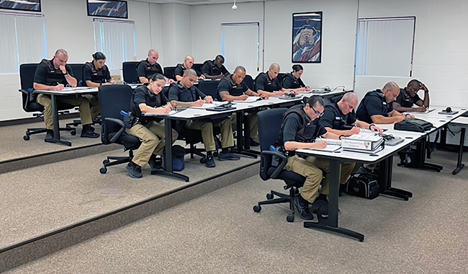
Police Officer Certification
The Police Officer Standards and Training Commission is responsible with establishing and governing police officer certification. Certification is required for anyone authorized to perform as a police officer in the State of Delaware.
INITIAL
Applicants who are seeking first time employment as a Delaware police officer
RE-ACTIVATION
Police officers who are changing employment from one Delaware Police Department to another Delaware Police Department
RECIPROCITY
Police officers employed outside of Delaware who are now seeking employment as a Delaware police officer

Slide 6
Police Officer
De-Certification
Suspend or revoke certification under any of the following circumstances:
a. A certificate was issued due to fraud, mistake, or deceit.
b. A police officer has failed to successfully complete any in-service or advanced training required by the Commission.
c. A police officer has been convicted of, or received a probation before judgment with respect to, a felony, or any local, state or federal criminal offense involving, but not limited to, theft, fraud, or violation of the public trust, or of any drug law.
d. A police officer has been found, after examination by a licensed psychologist or psychiatrist, to be psychologically or emotionally unfit to perform the duties or exercise the powers and authority of a police officer.
e. Has received a hearing or who has knowingly and voluntarily waived that individual’s right to such a hearing and:
  1. Has been discharged from employment with a law-enforcement agency for a breach of internal discipline; or
  2. Has retired or resigned prior to the entry of findings of fact concerning an alleged breach of internal discipline for which the individual could have been legitimately discharged had the individual not retired from or resigned that individual’s position prior to the imposition of discipline by the employing agency.
f. A police officer has been decertified in another jurisdiction.

Slide 7
Police Officer
TRAINING
Minimum Recruit Training
The following mandatory curriculum for police basic training, reflects 584 hours of training as approved by POST (COPT). This basic mandatory curriculum is required for all police officer appointments, except seasonal appointments.
Annual Required Training (In-Service)
Each police officer, certified by POST, will be required to complete 16 hours of in-service career related training annually. In addition to the above 16 hours, the officer must also recertify in C.P.R., AED, First Responders, and Firearms training.
Additionally, all police officers who perform uniformed patrol duties or are assigned to investigative units responsible for sex crimes shall receive at least 2 hours of training every 4 years on the detection, prevention and prosecution of sexual assault. The training shall be conducted on a staggered basis so that half of the eligible members of any law-enforcement or police organization receive the training in each 2-year period.
All police officers shall also complete 1 hour of training every 3 years in the detection, prosecution and prevention of child sexual and physical abuse, exploitation and domestic violence, and the obligations imposed by Delaware law, including §903 of Title 16.
Firearms Training emphasizes the practical application of police weapons related to actual combat conditions. The range officer of the involved training facility will attest to the qualifications of the respective officer. Officers must qualify with their departmental issued weapon or weapons. On each qualification date the officer must attain an average of 80% of the possible score while demonstrating safe weapons handling techniques.
Elective Training
Throughout their careers, Delaware police officers are encouraged and may elect to continue their professional development by attending training courses on relevant topics that are in addition to any training requirement(s).

Slide 8
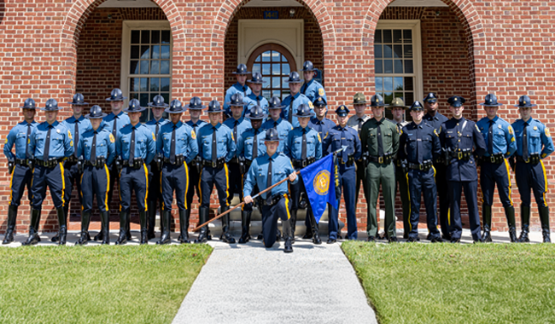
Delaware
Police Academies
Delaware Police Training Academies
Delaware Police Chiefs have the option to send their recruits and officers to any of the following police academies to complete basic, in-service, and elective training programs and courses in Delaware.
Delaware State Police Academy
Dover Police Academy
New Castle County Police Academy
Wilmington Police Academy

Slide 9
Police Accountability
Committee (PAC)
Establishment: Delaware police departments are required to establish, either individually or in combination with other departments, police accountability committees or boards (PACs), which meet quarterly or more frequently as may be needed
Purpose: to “provide advice to departments on policy, training, and other issues relating to or affecting the department and the communities served by the department.” This will result in greater transparency, information gathering and sharing, education, and community engagement. PACs are not expressly empowered to issue or overturn department-issued discipline or to promulgate any policy or departmental procedure.

Slide 10
Police Accountability
Committee (PAC)
Composition
Recommended number of members needed for an effective PAC is 5-13.
Must include a religious leader and other members of the community who have been impacted directly or are immediate family members or caregivers of those impacted by the juvenile or adult criminal justice system.
Departments are encouraged to include a diverse membership, representing multiple facets of the community, considering race, gender, age, education, demographics, experience, business owners, student leadership, criminal justice background, and at-risk populations.
Member Training
Non-officer members are required, within one year of appointment, to complete 20 hours of community training with their respective police departments. The training may include ride-a-longs or a citizen’s police academy, as well as any demonstrations or other worthwhile courses of instruction.
The required training will provide greater insight and understanding of police operations and administration to in turn provide appropriate context for anticipated advice and guidance to police leadership.
Training will also enhance greater sharing of knowledge and information with the public.

Slide 11
Delaware Police Accreditation Commission (DPAC)
The Delaware Police Accreditation Commission (DPAC) is responsible for providing policy level direction and drafting and implementing state level police accreditation standards for matters related to accreditation.
Develop a statewide police accreditation program with professional standards to ensure consistency of police operations statewide.
Promote cooperation among municipal, county, and state police agencies in addressing statewide accreditation needs in Delaware,
Provide recommendations to the Governor, Attorney General, and the Delaware General Assembly concerning issues related to state level police accreditation standards in Delaware.
The DPAC is active in its mission to advance law enforcement professionalism through the establishment of professional standards and the administration of a formal mechanism by which Delaware agencies can be systematically measured, evaluated, and updated. DPAC has implemented 108 standards related to professional policing.
House Bill 206 mandates that all police agencies must be accredited by 2028. All police departments are currently proactively working towards state accreditation through the POST/DPAC section of the DSHS.

Slide 12
DPAC Commission Members
The Commission has twelve (12) members from various law enforcement and public backgrounds, supported by five staff members.
Secretary Joshua Bushweller Chairperson (Appointed by the Governor)
Delaware Department of Safety and Homeland Security
Chief Richard McCabe, New Castle City Police
Vice-Chairperson
Chair of the Delaware Police Chief’s Council
Kathleen Jennings
Attorney General
Her proxy is Investigator Robert Irwin
Colonel William Crotty
Delaware State Police Superintendent
His proxy is Major Jeremiah Lloyd
Colonel James Leonard
Chief of the New Castle County Police Department
His proxy is Major Benjamin Feldmann
Chief Thomas Johnson
Chief of the Dover Police Department
Chief Wilfredo Campos
Chief of the Wilmington Police Department
His proxy is Major Anthony Bowers
The Honorable, David P. Sokola
President of the State Senate
Her Proxy is Senator Raymond Siegfried
The Honorable Melissa Minor-Brown
Speaker of the House of Representatives
Her proxy is Representative Franklin Cooke
Chief Thomas Spell
President of the Sussex County Police Chiefs
Chief Christopher Workman
President of the Kent County Chiefs Organization
Dr. Kevin Spence
Executive Director of the Delaware League of Governments

Slide 13
Accreditation Benefits
Improves officer and public safety
Addresses high risk management issues
Promotes operational efficiency through policy development
Provides a norm for the agency to judge its performance
Provides a basis to correct deficiencies before they become public problems
Requires agencies to commit policies and procedures to writing
Promotes accountability
Verifies compliance
Provides a means of independent evaluation of agency operations
Minimizes an agency’s exposure to liability
Potentially reduces liability insurance costs
Enhances the reputation of the agency, thereby attracting the best qualified candidates for employment
Increases public confidence

Slide 14
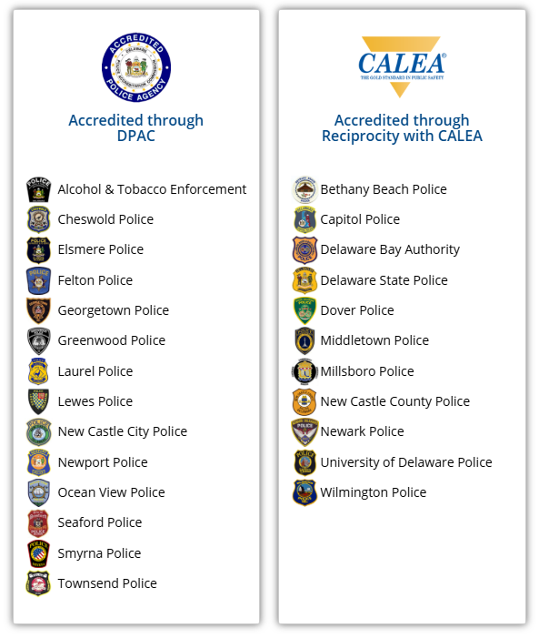
CALEA & DPAC
As of June 8, 2025

Slide 15

QUESTIONS?

Slide 16
Thank You
Police Officer Standards and Training &
Police Accreditation Commissions
1128 S. Bradford Street
Dover, Delaware 19901
(302) 244-3678
post@delaware.gov

