Slide 1

Community Development & Urban Planning Committee September 11, 2025 Ordinance 25-048 Expanding Permitted Uses in the M-1 (Light Manufacturing) District

Slide 2
Ordinance 25-048
A Proposal to amend Chapter 48 of the City Code
Expands the types of uses permitted as a matter-of-right within the M-1 (Light Manufacturing) zoning district
Creates definitions for “Commercial Recreation” and “Public Assembly” to the Zoning Code

Slide 3
Background
The current Zoning Code prohibits “Public Assembly” and “Commercial Recreation” uses in M-1 zoning districts
Developers must seek a use variance approval through the Zoning Board of Adjustment (ZBA) for these uses
Previous requests and approvals indicates a growing pattern of viability for these uses in M-1 districts
The Department of Land Use and Planning sees a clear opportunity to align our zoning with actual development trends.

Slide 4
M-1 Zoning Districts
Areas include:
Garaches Lane
Townsend Street
Green Street
New York Ave
Boston Ave
Locust Street
Taylor Street

Slide 5
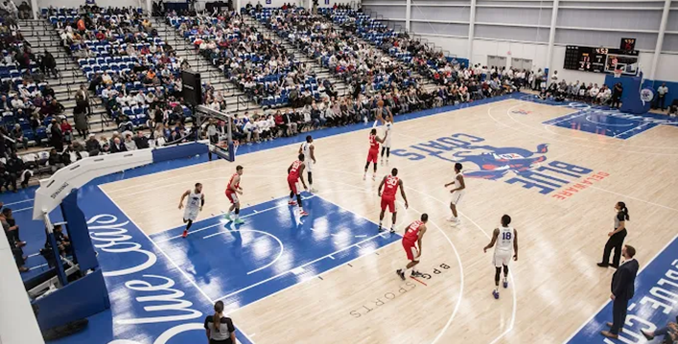
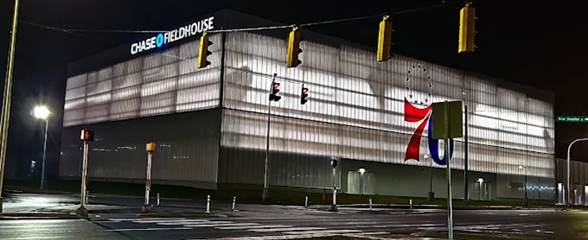
Precedent: Chase Field House (Approved via ZBA)
Located at 401 Garasches Lane, Wilmington, DE
Approved as a Public Assembly and Commercial Recreation use in M‑1 via ZBA (2017).
Drew 2.4+ million visits between 2022–2024
Created approximately 43 full-time and up to 45 part-time jobs
Will generate an estimated $195K annually in post-abatement property taxes

Slide 6
Potential Benefits of the Amendments
Activates vacant or underutilized M‑1 parcels
Attracts new investment and job opportunities
Expands access to community and recreational spaces
Streamlines zoning approvals, saving time and resources

Slide 7
Definitions: Public Assembly & Commercial Recreation
Public Assembly
An indoor or outdoor facility where people gather for civic, educational, religious, social, or cultural purposes.
Includes: assembly halls, community centers, event venues, banquet halls, stadiums, places of worship, etc.
Commercial Recreation
A private or public facility offering recreational or entertainment activities to the public.
Examples: fitness centers, bowling alleys, arcades, escape rooms, skating rinks, laser tag, paintball, indoor climbing gyms, mini golf, and similar venues.

Slide 8
Code Amendment and Regulatory Standards
Zoning Code Changes
Adds Public Assembly and Commercial Recreation as permitted uses to Section 48-246 (M‑1 district) in the Zoning Code
Establishes formal definitions for both uses in Section 48-2
Applies existing M‑1 parking ratio:
1 space per 3,000 sq. ft. of gross floor area; consistent with requirements for warehousing and industrial uses

Slide 9
Department of Land Use and Planning Recommendation
Support amending the Zoning Code to add Public Assembly and Commercial Recreation as permitted uses in the M‑1 district
Recommend adding formal definitions for both use categories in Section 48‑2
Support applying existing M‑1 parking standards (1 space per 3,000 sq. ft.)
View amendment as aligned with economic development goals and modern land use needs

