Slide 1


OUTLOUD DE & First State Youth MOVE
Empowering Delaware's youth through mental wellness advocacy and leadership development.
Presenters: Jalyn Powell (CEO, OUTLOUD DE/ Adult Support, FSYM), Mayda Berrios (President, FSYM), Taylor Rockhold (Vice President, FSYM)

Slide 2
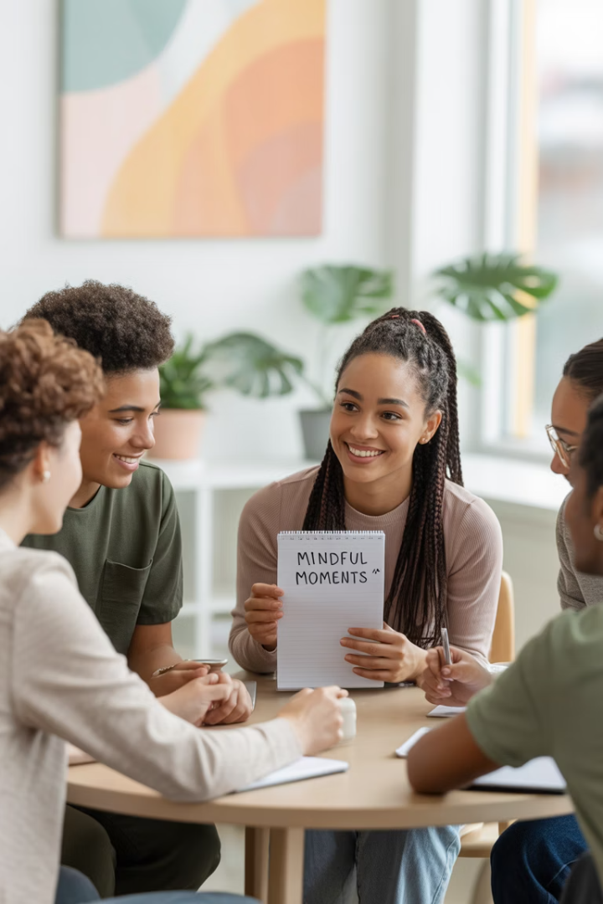




Our Mission
Amplify Youth Voices
Create platforms where young people are truly seen and heard.
Create Safe Spaces
Foster environments where youth feel empowered and supported.
Equip for Purpose
Provide resources for youth to lead lives of impact and meaning.
Invest in Leadership
Value the lived experiences of young people as catalysts for change.

Slide 3




Our Holistic Approach to Wellness
We believe in addressing the whole person through comprehensive support systems.
It Takes a Village
Parental Engagement
We engage the entire community ecosystem in supporting youth mental wellness and development.
Parents and caregivers are essential partners in creating sustainable positive outcomes for young people.
Holistic Healing Events
Seats at the Table
Our community events address mental, emotional, physical, and social wellbeing through inclusive programming.
We prioritize outreach to capture youth feedback, ensuring their voices and perspectives shape our work.

Slide 4






My Mind Matters
A transformative program dedicated to reducing mental health stigma in historically disengaged communities through culturally responsive approaches.
Community Healing
Fostering collective wellness and resilience
Healing Circles
Creating safe spaces for authentic expression
Restorative Practices
Addressing historical trauma through connection
Through culturally-affirming safe spaces and community-led healing circles, we combat generational trauma while empowering participants to reclaim their narrative and mental wellness journey.

Slide 5





Skate to Wellness Events
Fun Engagement
Skating creates a relaxed, appealing environment.
Open Conversations
Physical activity eases mental health discussions.
Peer Connections
Youth build supportive relationships naturally.
Resource Access
Connect with mental health services directly.

Slide 6

The Reason We Are Here…
FIRST STATE YOUTH MOVE

Slide 7








Youth MOVE National
National Leadership
Guiding chapters across America
Strategic Partnerships
Connecting with key stakeholders
Evidence-Based Practices
Built on proven approaches
Youth-Driven Foundation
Youth voices lead the way

Slide 8
Delaware's First Chapter
Statewide Reach
Youth-Led Structure
Mental Health Focus
First State Youth MOVE serves young people across all of Delaware. We create connections in every county.
Young leaders drive our priorities and programs. They identify what matters most.
We prioritize mental wellness education and support. Prevention comes before crisis.
Adult allies provide support when needed. The youth voice remains central to all decisions.
Our approach reduces stigma through peer connections. Open conversations create healing spaces.
Our programs bridge urban and rural communities. No young person stands alone.

Slide 9








Why Youth Leadership Matters
Fresh Perspectives
Authentic Voices
Young people bring innovative solutions to old problems.
Peers relate best to those with shared experiences.
Future Impact
System Transformation
Today's youth leaders become tomorrow's community champions.
Youth involvement improves service effectiveness.

Slide 10

Town Halls: Youth Voices Heard
Identify Community Needs
Youth share their experiences and challenges. Their stories reveal gaps in services.
Develop Action Plans
Collaborative solutions emerge from discussions. Young people take ownership of initiatives.
Create Policy Change
Youth recommendations influence decision-makers. Their advocacy leads to systemic improvements.

Slide 11
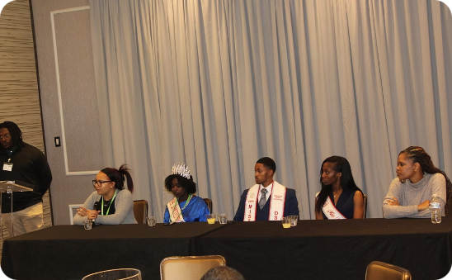
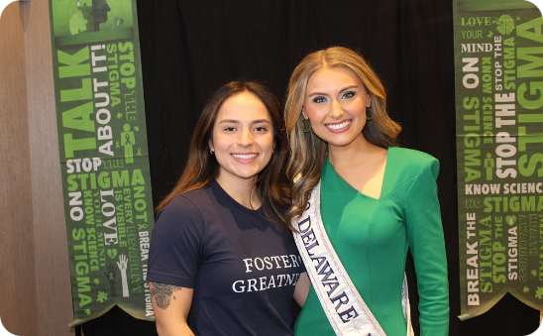
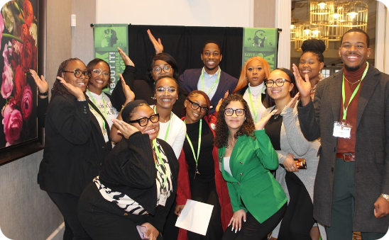
Mental Health Impact
Our Mental Health Summits create space for authentic dialogue and transformative action.
Youth-Led Discussions
Expert Insights
Action Planning
Young people facilitate conversations about mental health challenges and solutions.
Mental health professionals share knowledge and strategies in youth-friendly formats.
Participants develop concrete steps to improve mental wellness in their communities.
Our summits bring together youth, professionals, and community members to build lasting mental health support networks.

Slide 12
Mental Health Impact
1 in 5
50%
Youth Affected
Onset Age
Young people experience mental health challenges.
Mental health conditions begin before age 14.
Source: National Institute of Mental Health (NIMH)
Source: World Health Organization (WHO)
60%
90%
Untreated
Preventable
Youth don't receive needed mental health services.
Early intervention can reduce suicide risk.
Source: Centers for Disease Control (CDC)
Source: American Academy of Pediatrics (AAP)

Slide 13
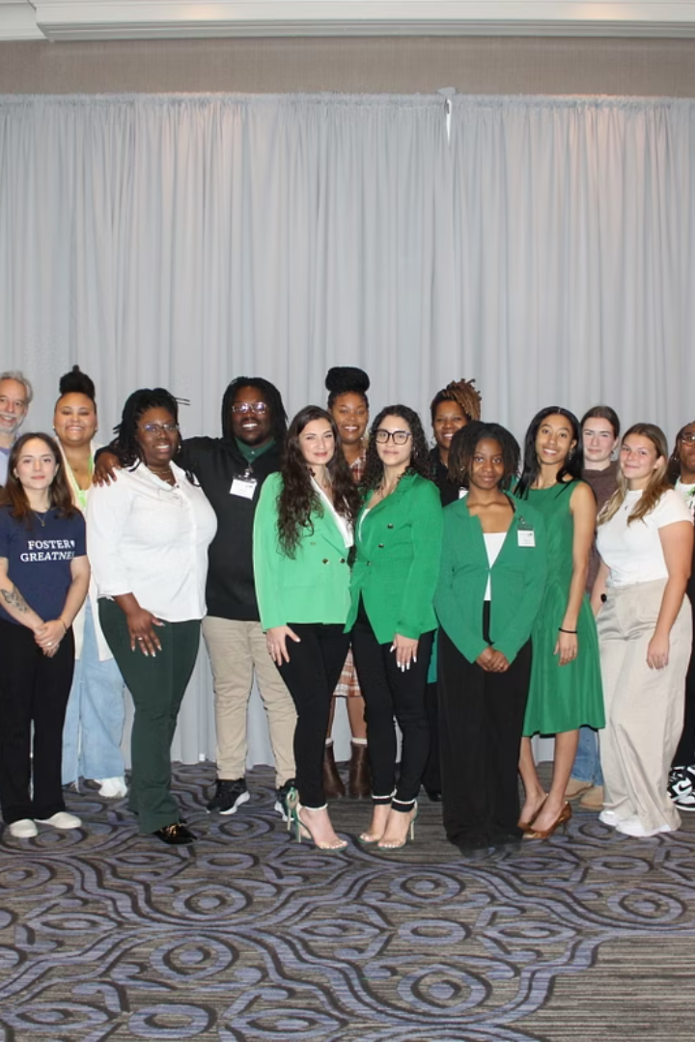
Breaking the Stigma
Open Conversations
Accurate Information
We create safe spaces for honest dialogue. Young people learn to express their feelings.
We combat myths with facts about mental health. Education replaces fear with understanding.
Personal stories humanize mental health struggles. Vulnerability becomes strength, not weakness.
Youth learn to recognize warning signs. They understand the difference between typical stress and mental illness.
Positive Language
We model person-first, respectful terminology. Words shape perceptions and attitudes.
Youth become advocates who correct misconceptions. They promote dignity in all mental health discussions.

Slide 14










Our Approach to Wellness
Mental Wellness
Physical Wellness
Coping skills build resilience against stressors.
Healthy habits support mental well-being.
Social Wellness
Healthy relationships create support networks.
Balance
Integrated wellness creates sustainable health.
Personal Growth
Self-discovery leads to identity development.

Slide 15
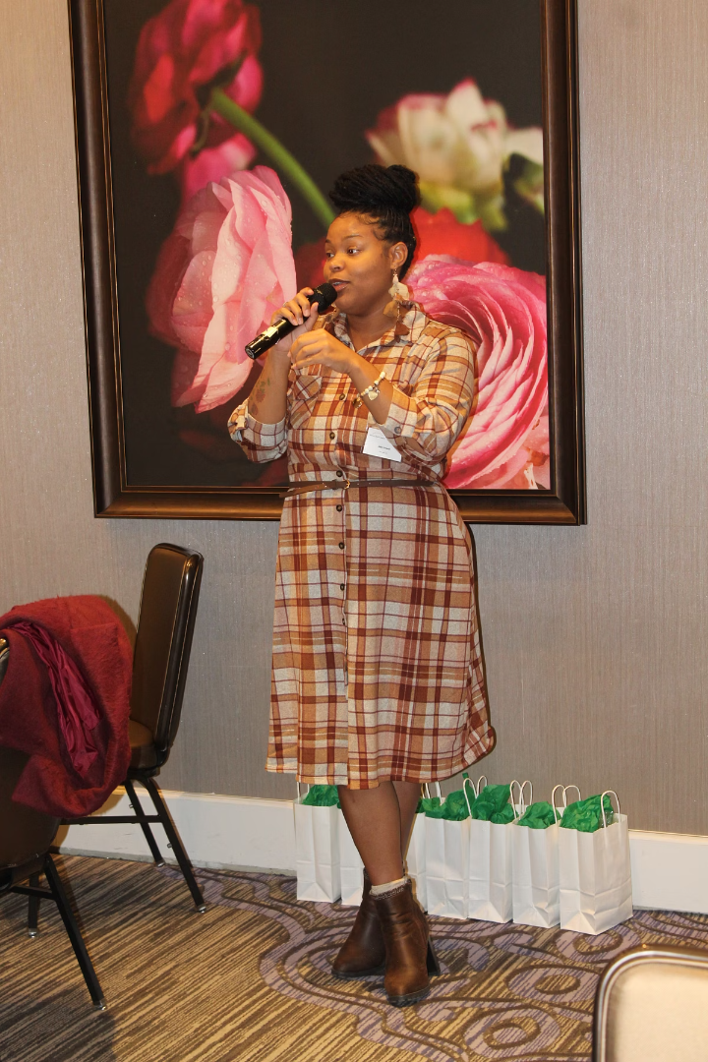



Why First State Youth MOVE?
Joining First State Youth MOVE
Searching for connection after struggling silently. Finding a community that truly understands.
2
Peer Support Experience
Learning to both receive and offer help. Discovering strength in vulnerability and shared stories.
Leadership Development
Building skills through training opportunities. Growing from participant to program leader.
Becoming an Advocate
Speaking at community events and policy meetings. Creating change that helps others.

Slide 16
Community Partnerships
We believe in strategic collaborations to amplify our impact across Delaware. We partner with government agencies, healthcare providers, schools, and community organizations.
We've worked with the State of Delaware (DSCYF & DPBH), Alternative Solutions, Behavioral Health Consortium, Alpha Kappa Alpha Sorority, and more.
Together, we create comprehensive support systems for youth. No single entity can address mental health alone.

Slide 17




Youth Leadership Development
Participation
Initial involvement in programs and events
Voice
Sharing personal experiences and opinions
Collaboration
Co-creating projects with peer support
Leadership
Guiding initiatives and mentoring others

Slide 18







Join Our Movement
Become a Member
Volunteer
Advocate
Join our growing community of youth leaders. Your voice and experience matter.
Support our events and initiatives. Help create positive experiences for peers.
Speak up for youth mental health. Share our message with decision-makers.
Partner With Us
Donate
Organizations can collaborate on initiatives. Together we achieve greater impact.
Support our mission with financial contributions. Every dollar helps expand our youth programs.

