Slide 1
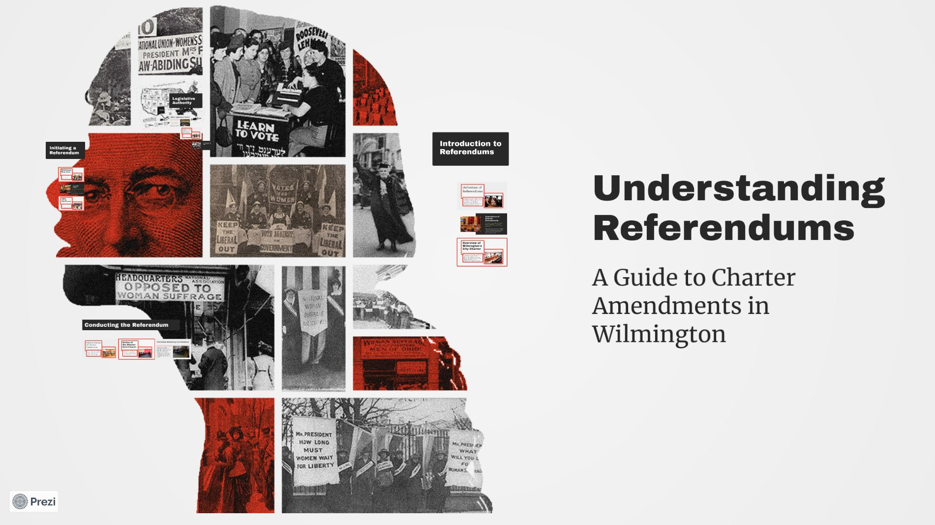

Slide 2
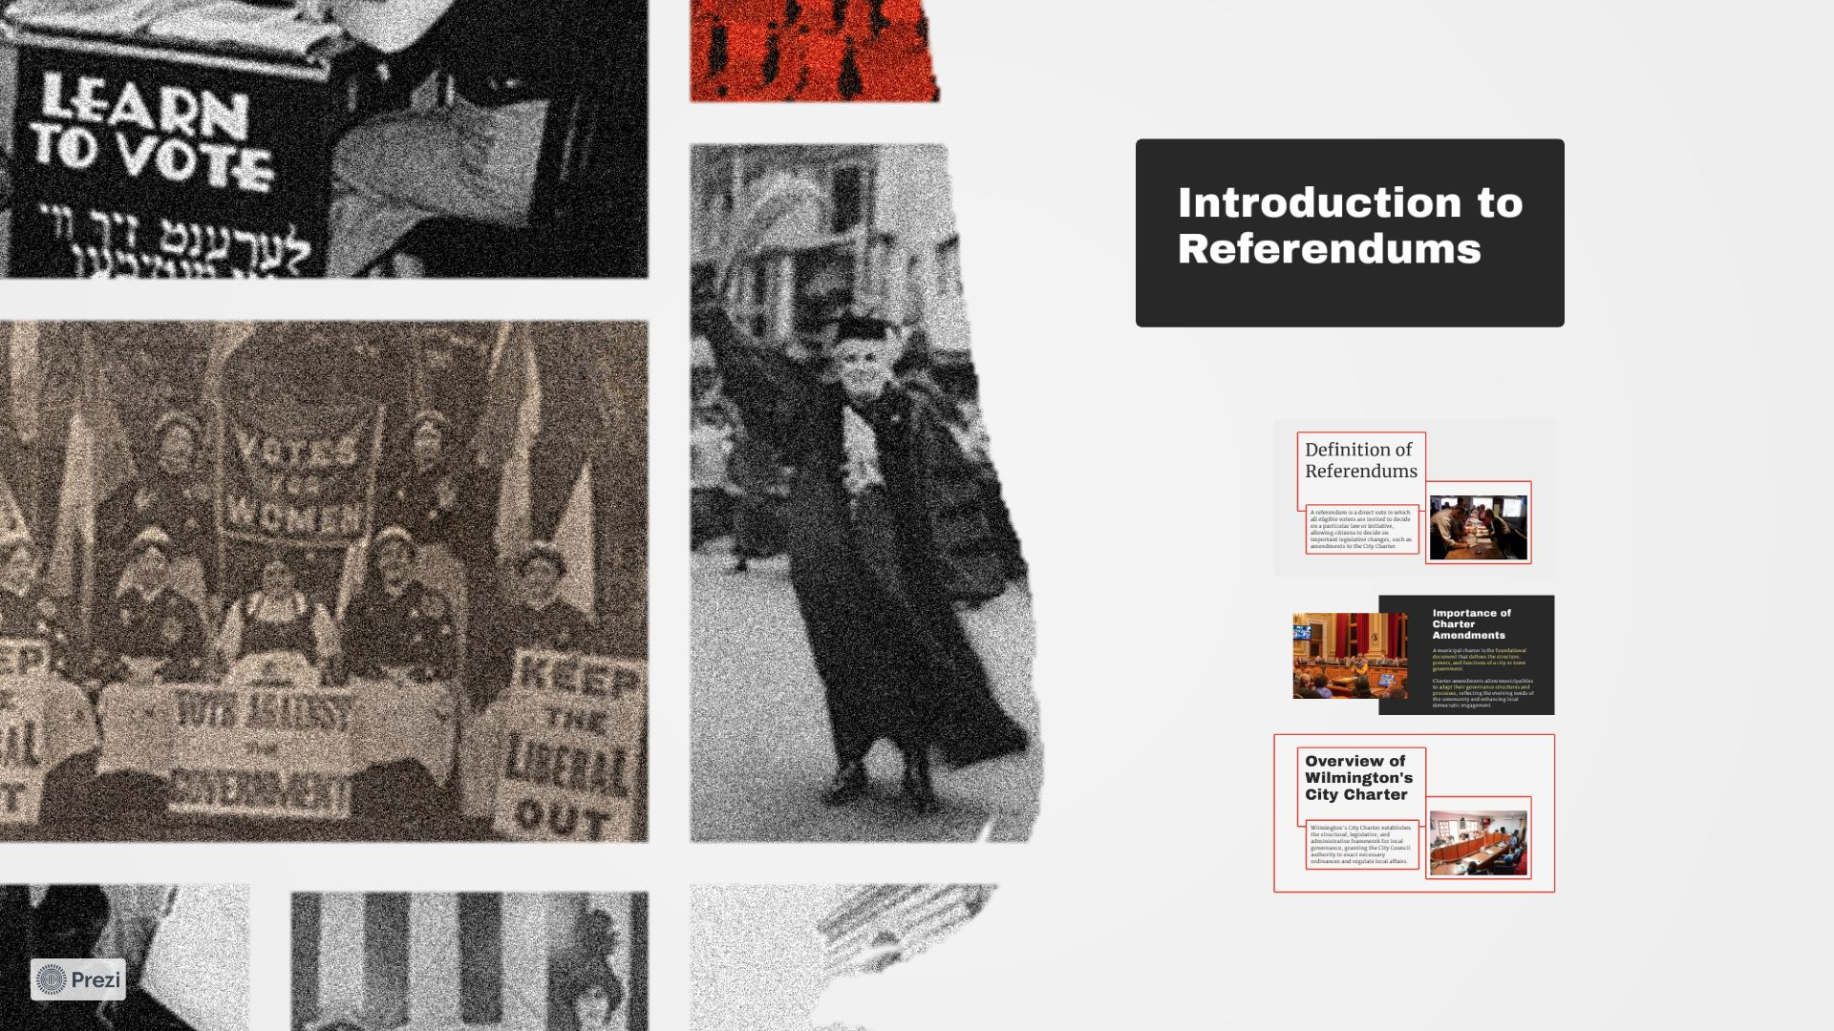

Slide 3
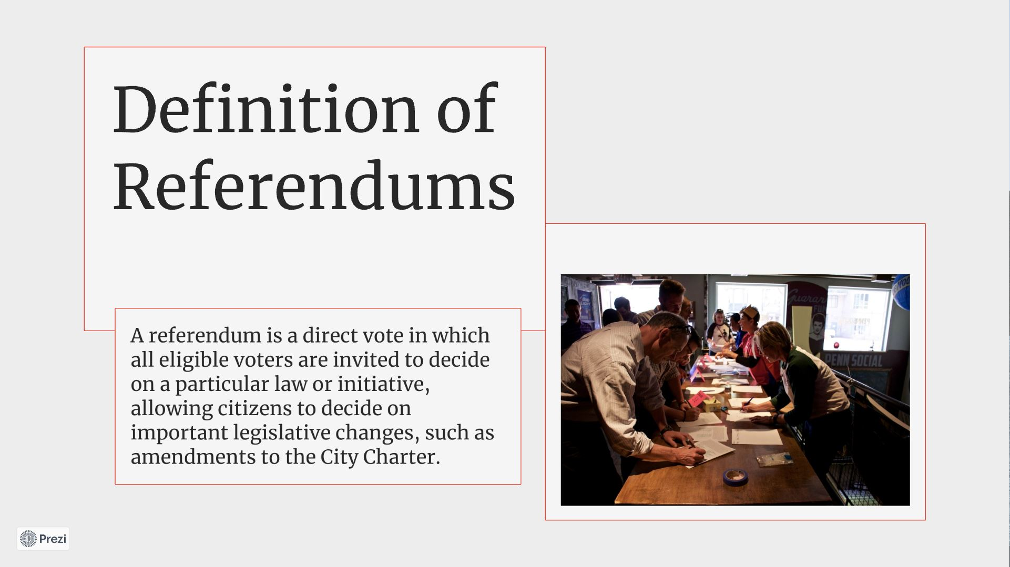

Slide 4
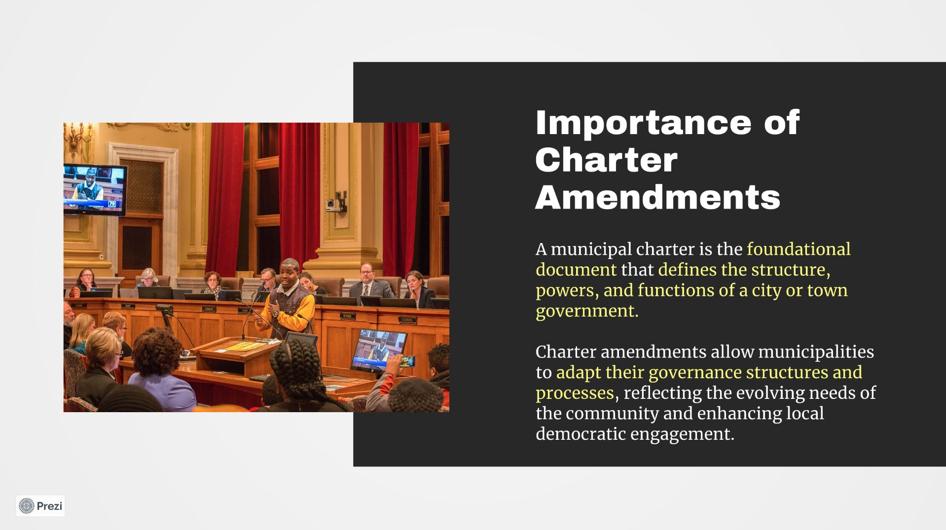

Slide 5
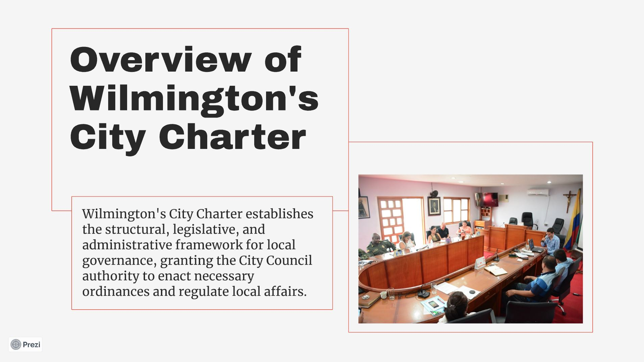

Slide 6
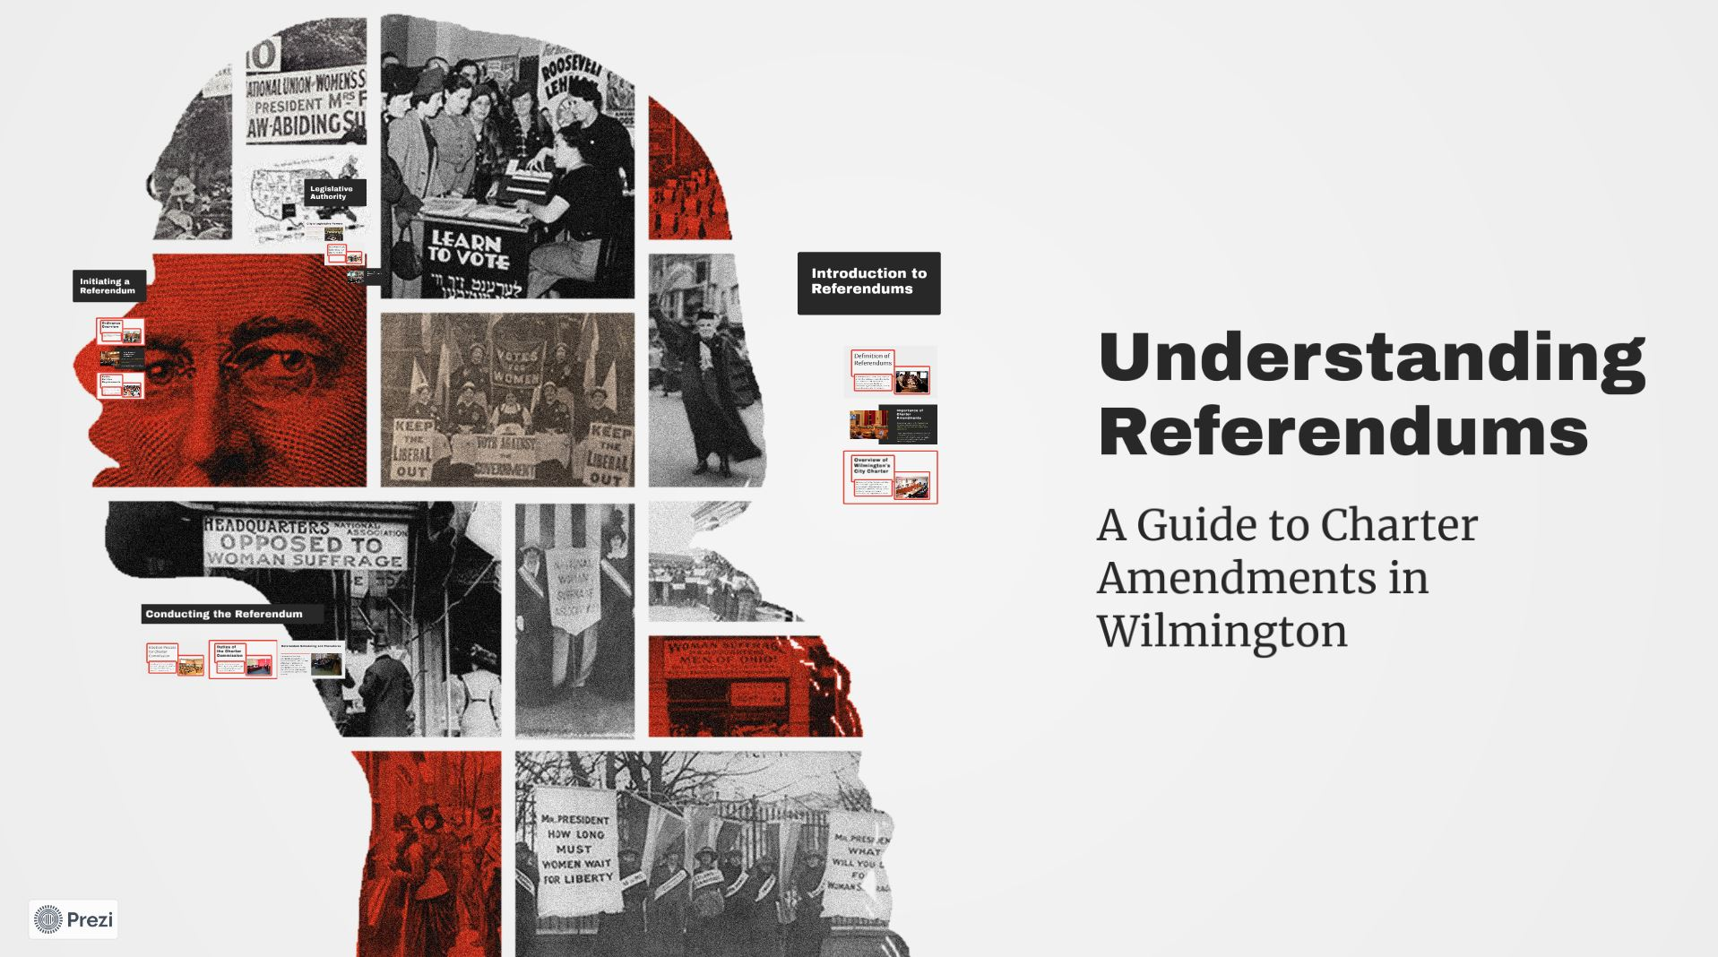

Slide 7
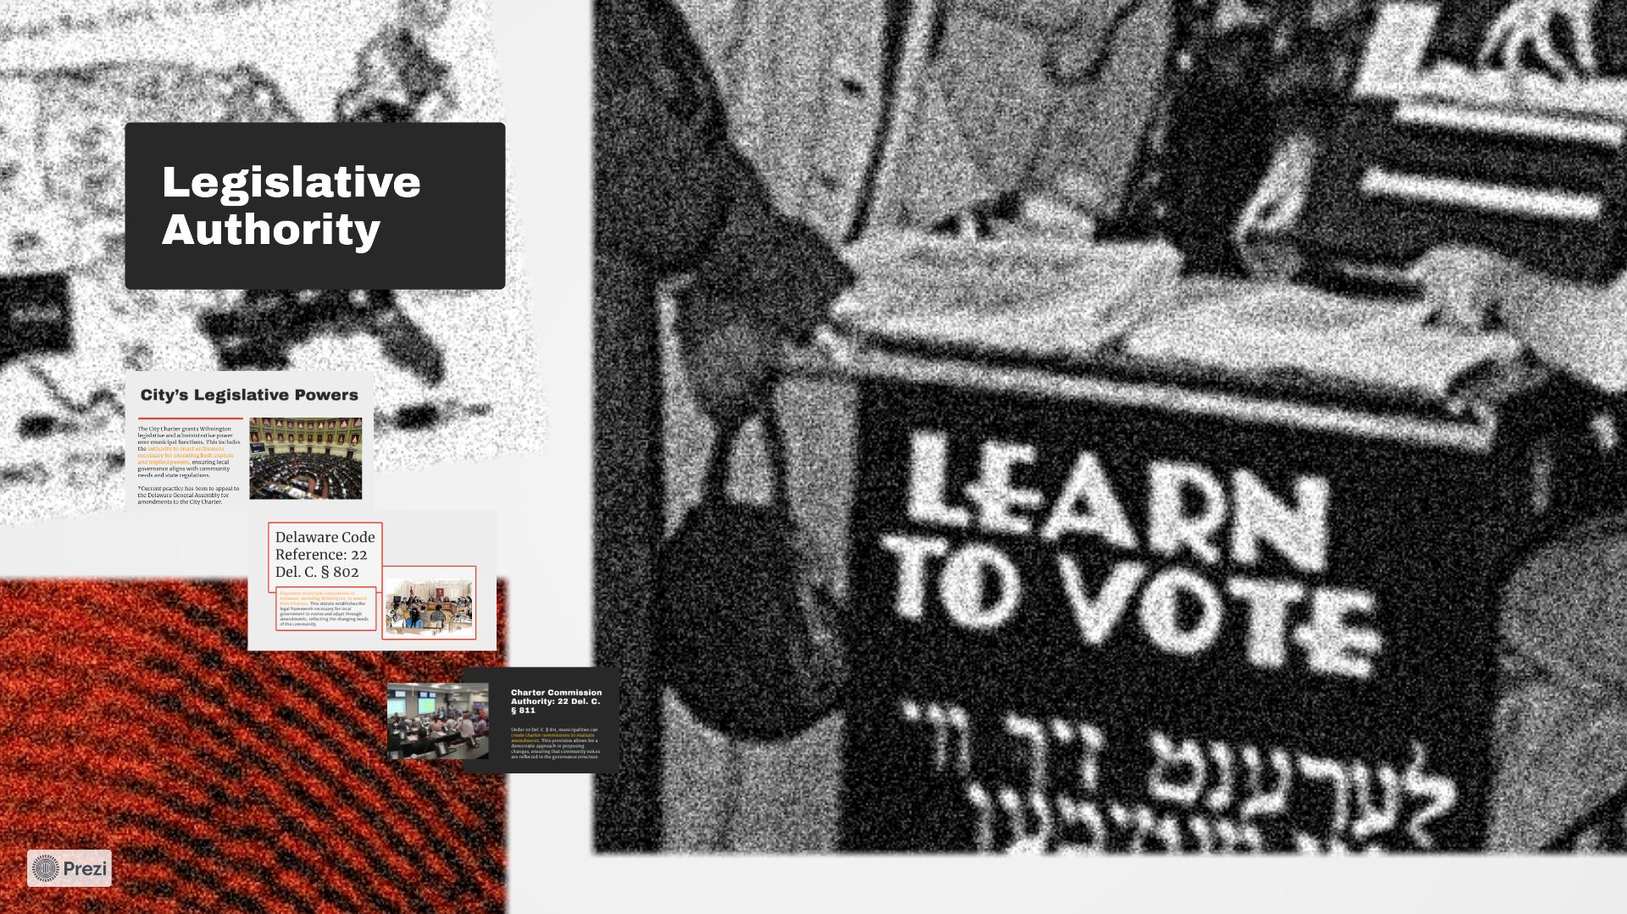

Slide 8
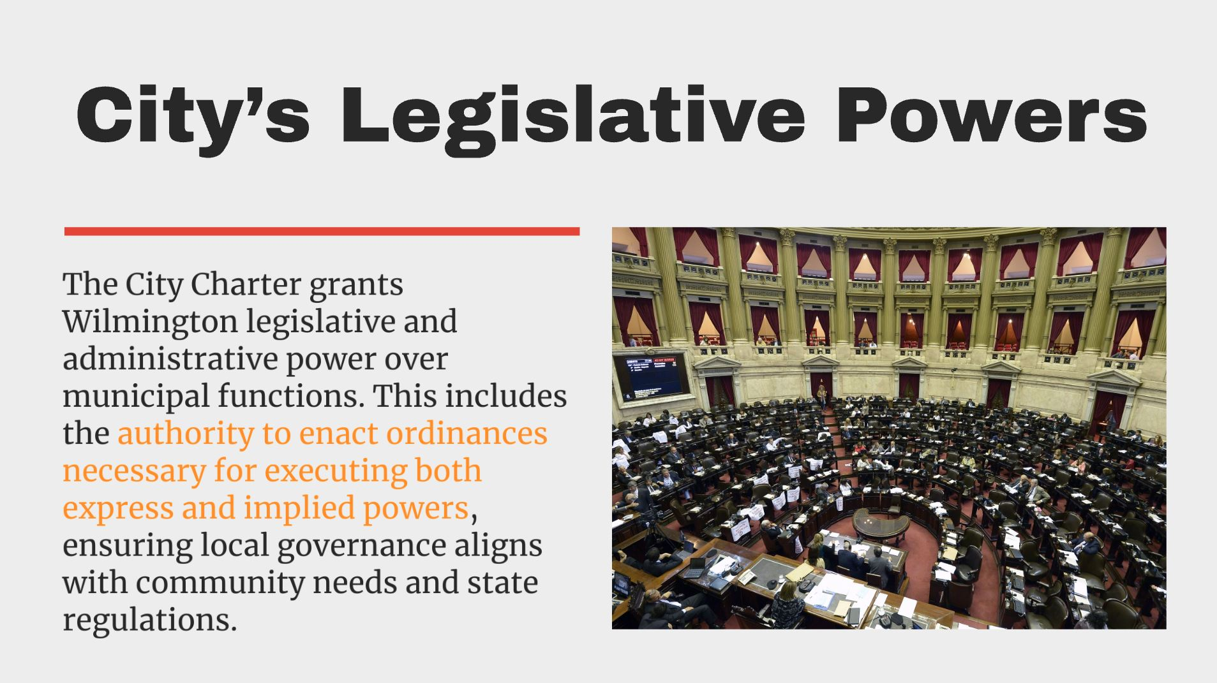

Slide 9
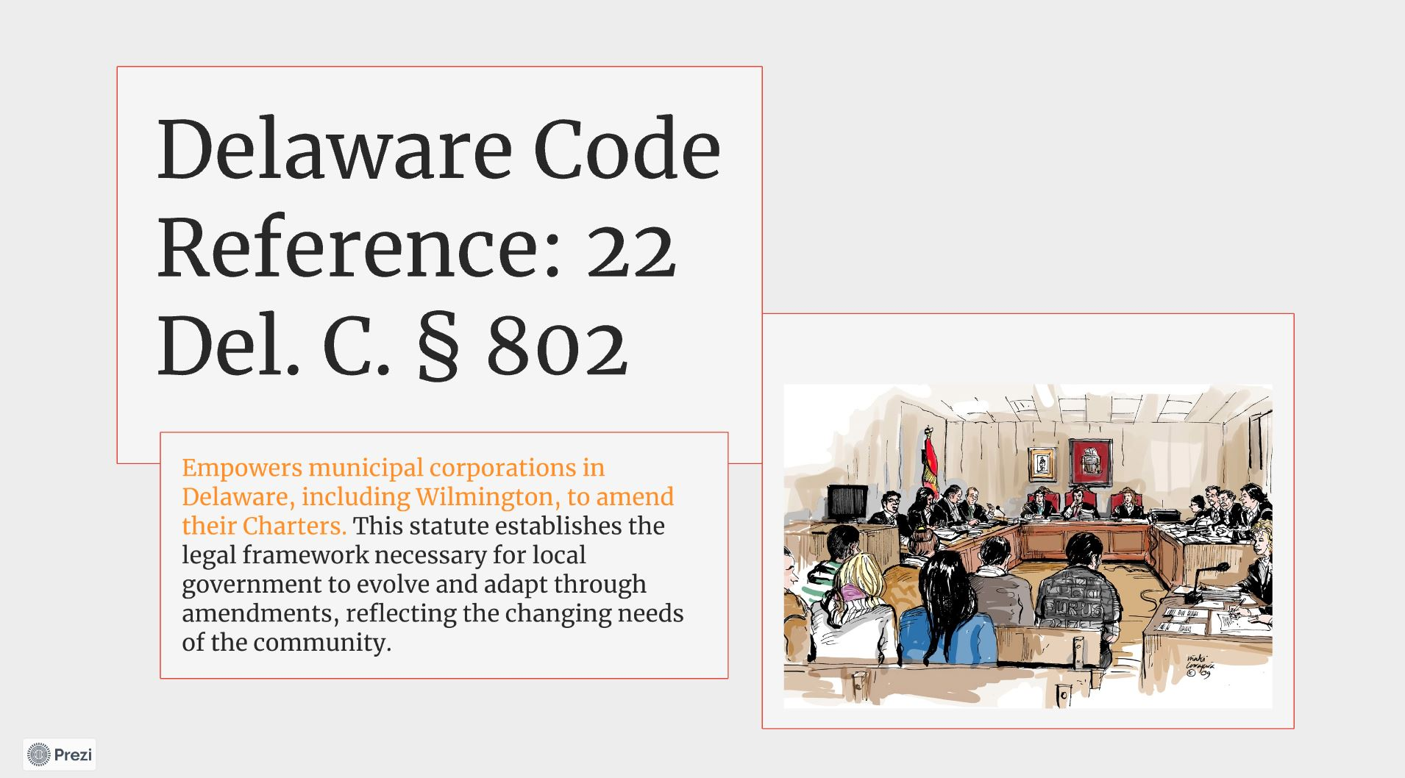

Slide 10
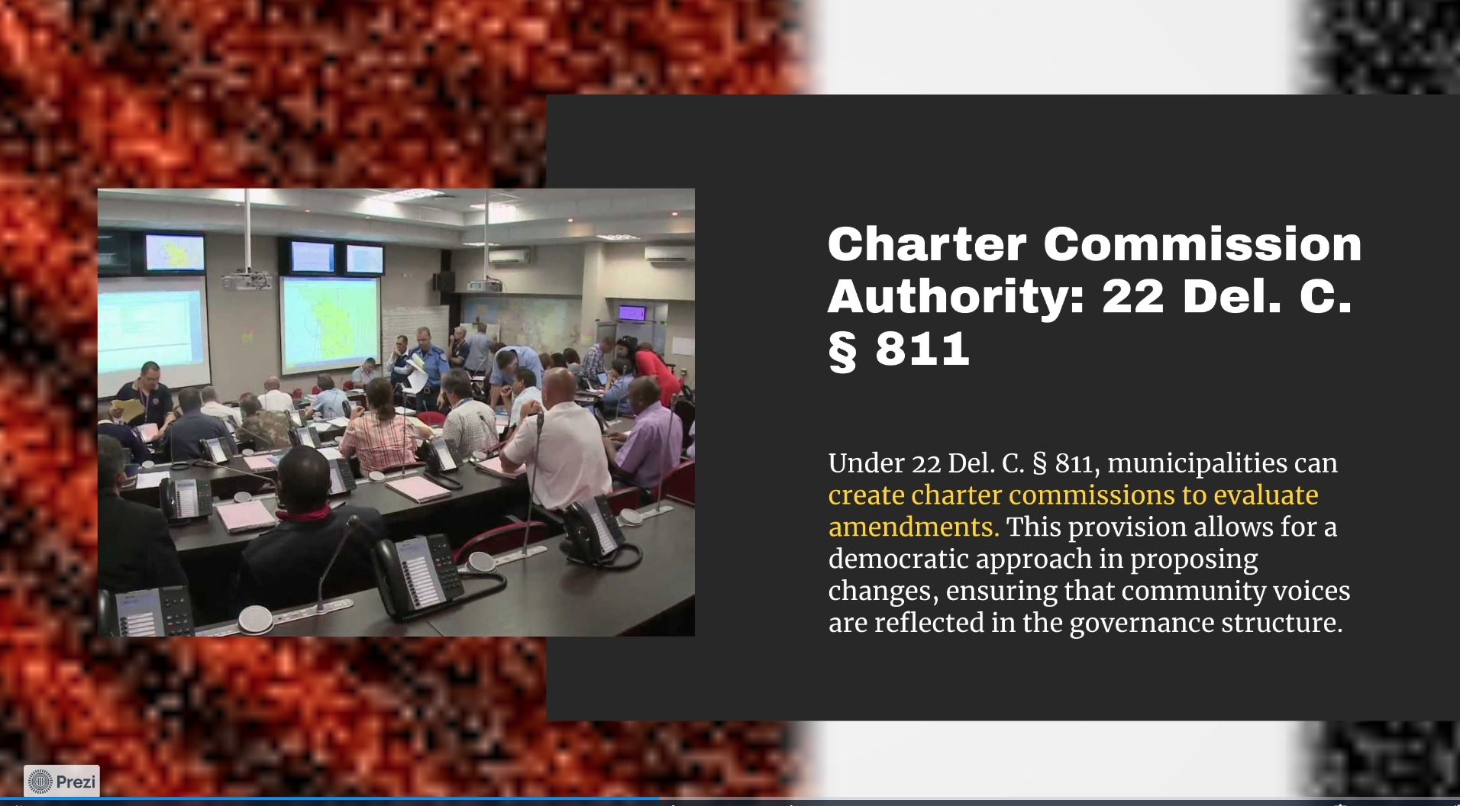

Slide 11
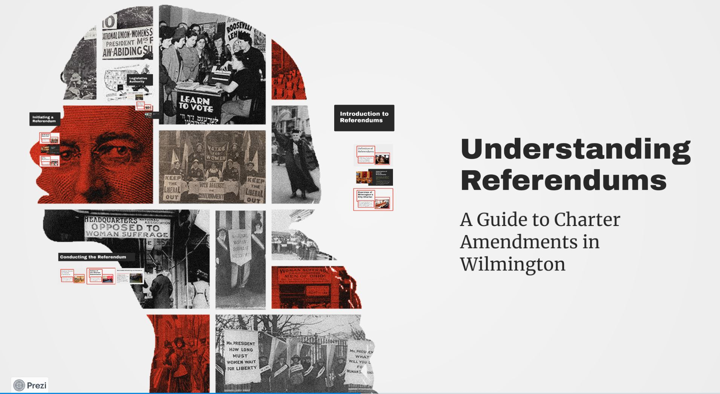

Slide 12
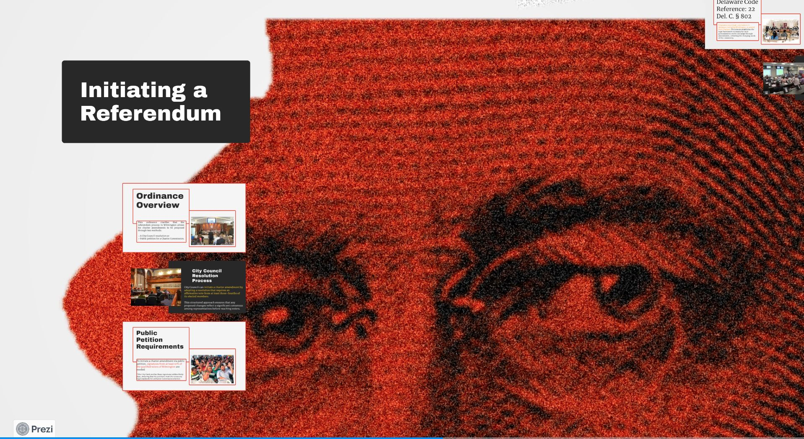

Slide 13
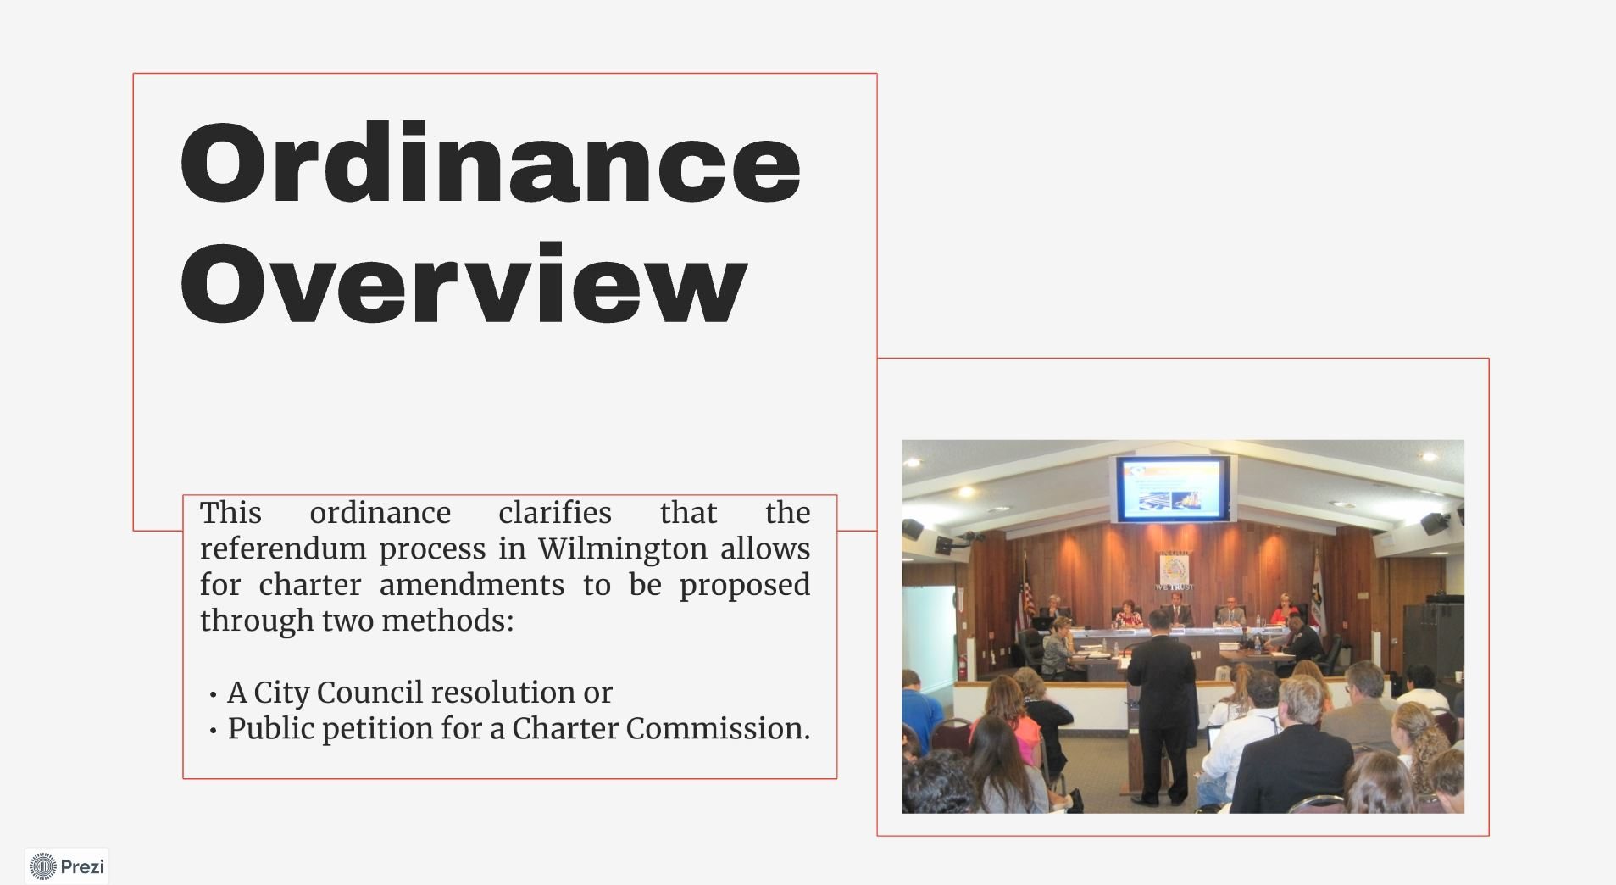

Slide 14
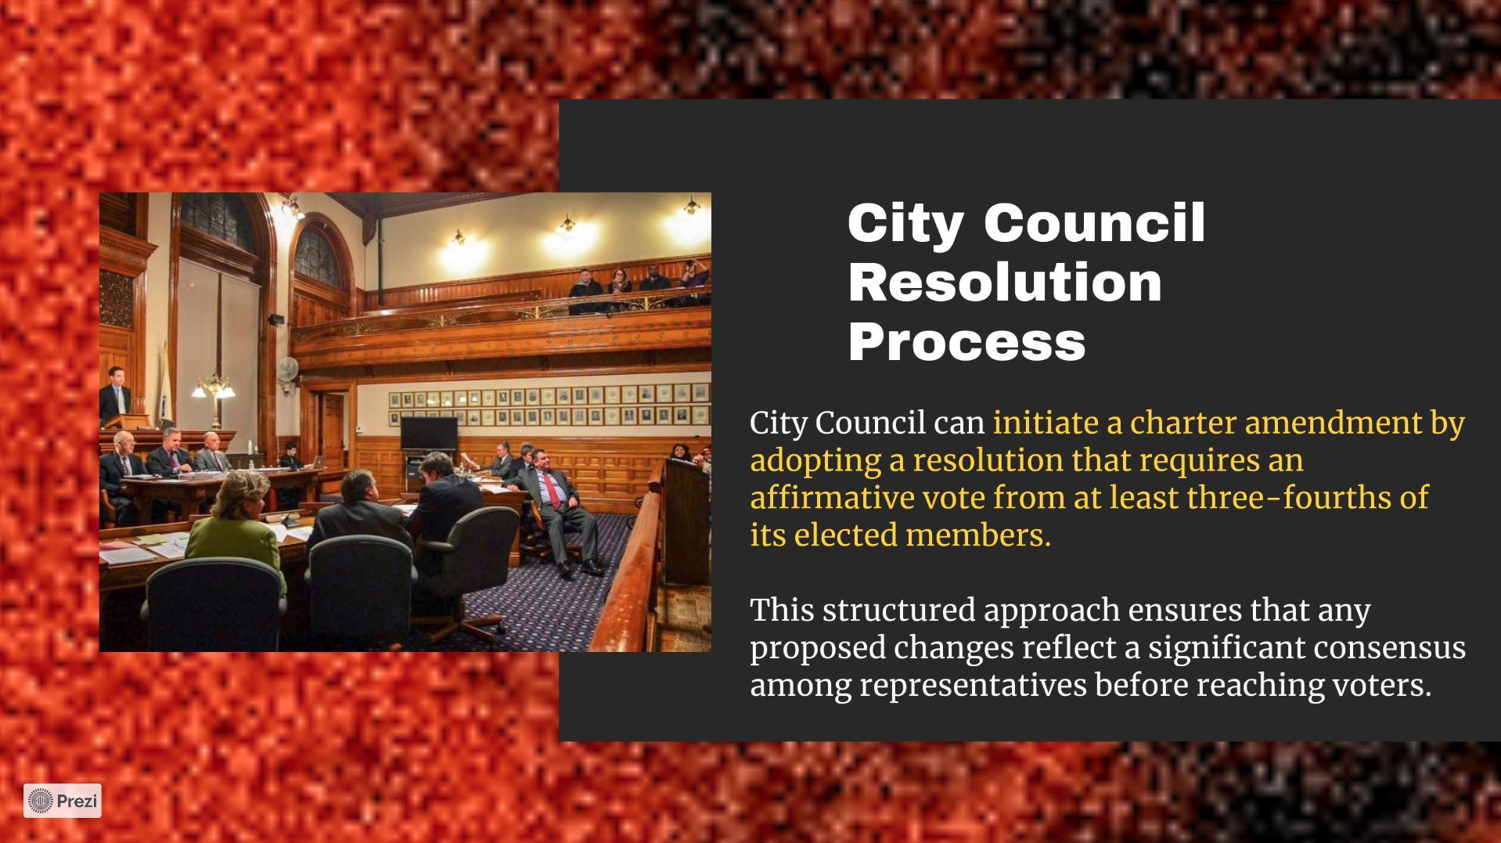

Slide 15
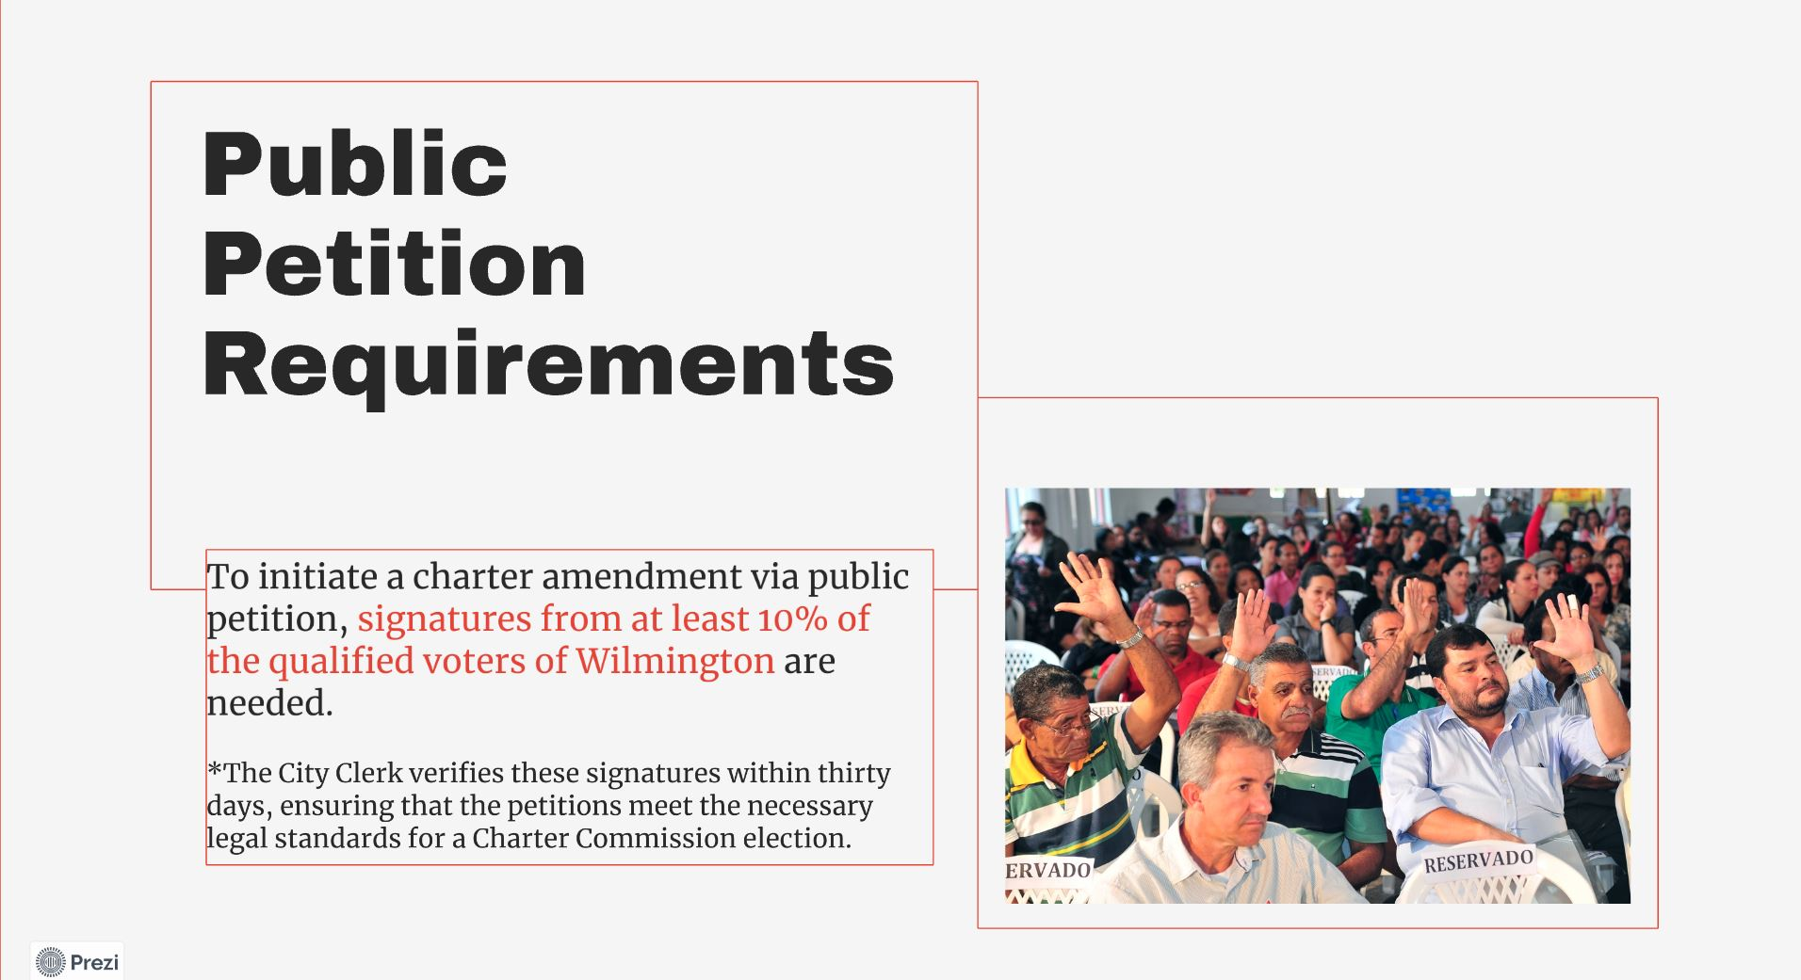

Slide 16
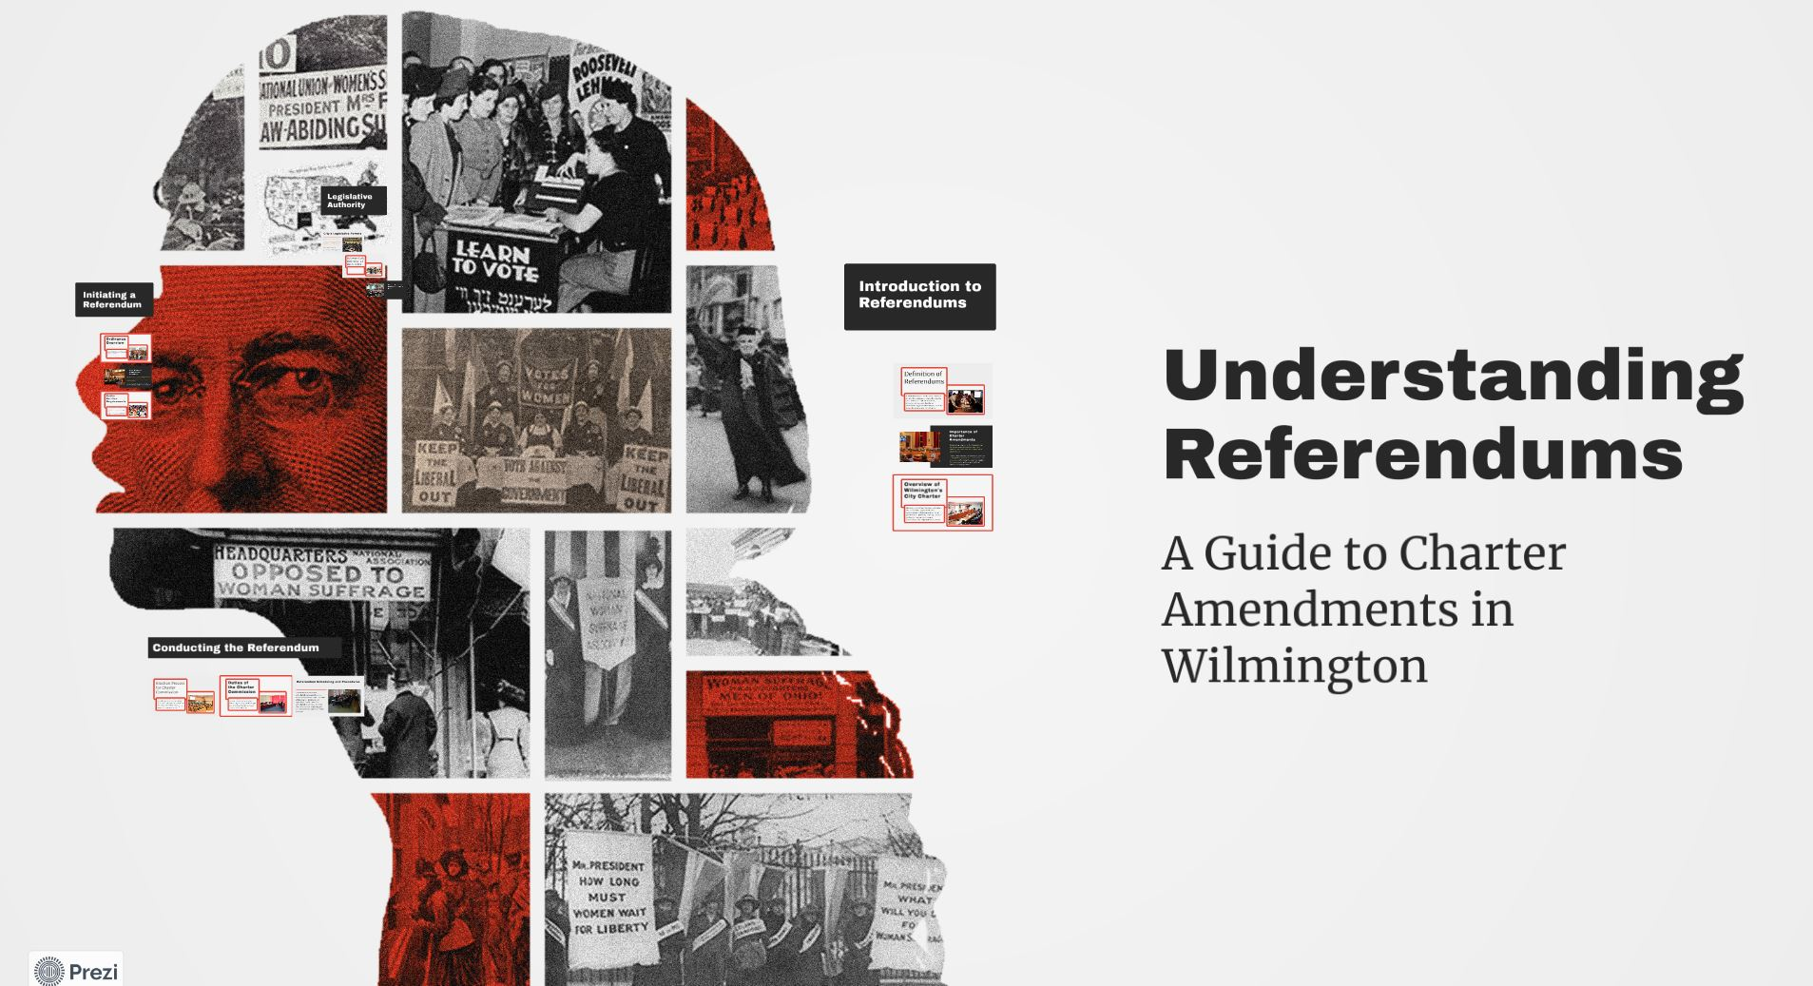

Slide 17


Slide 18
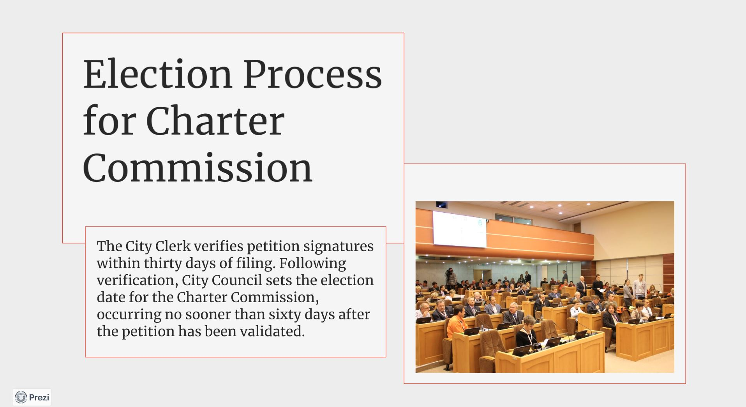

Slide 19
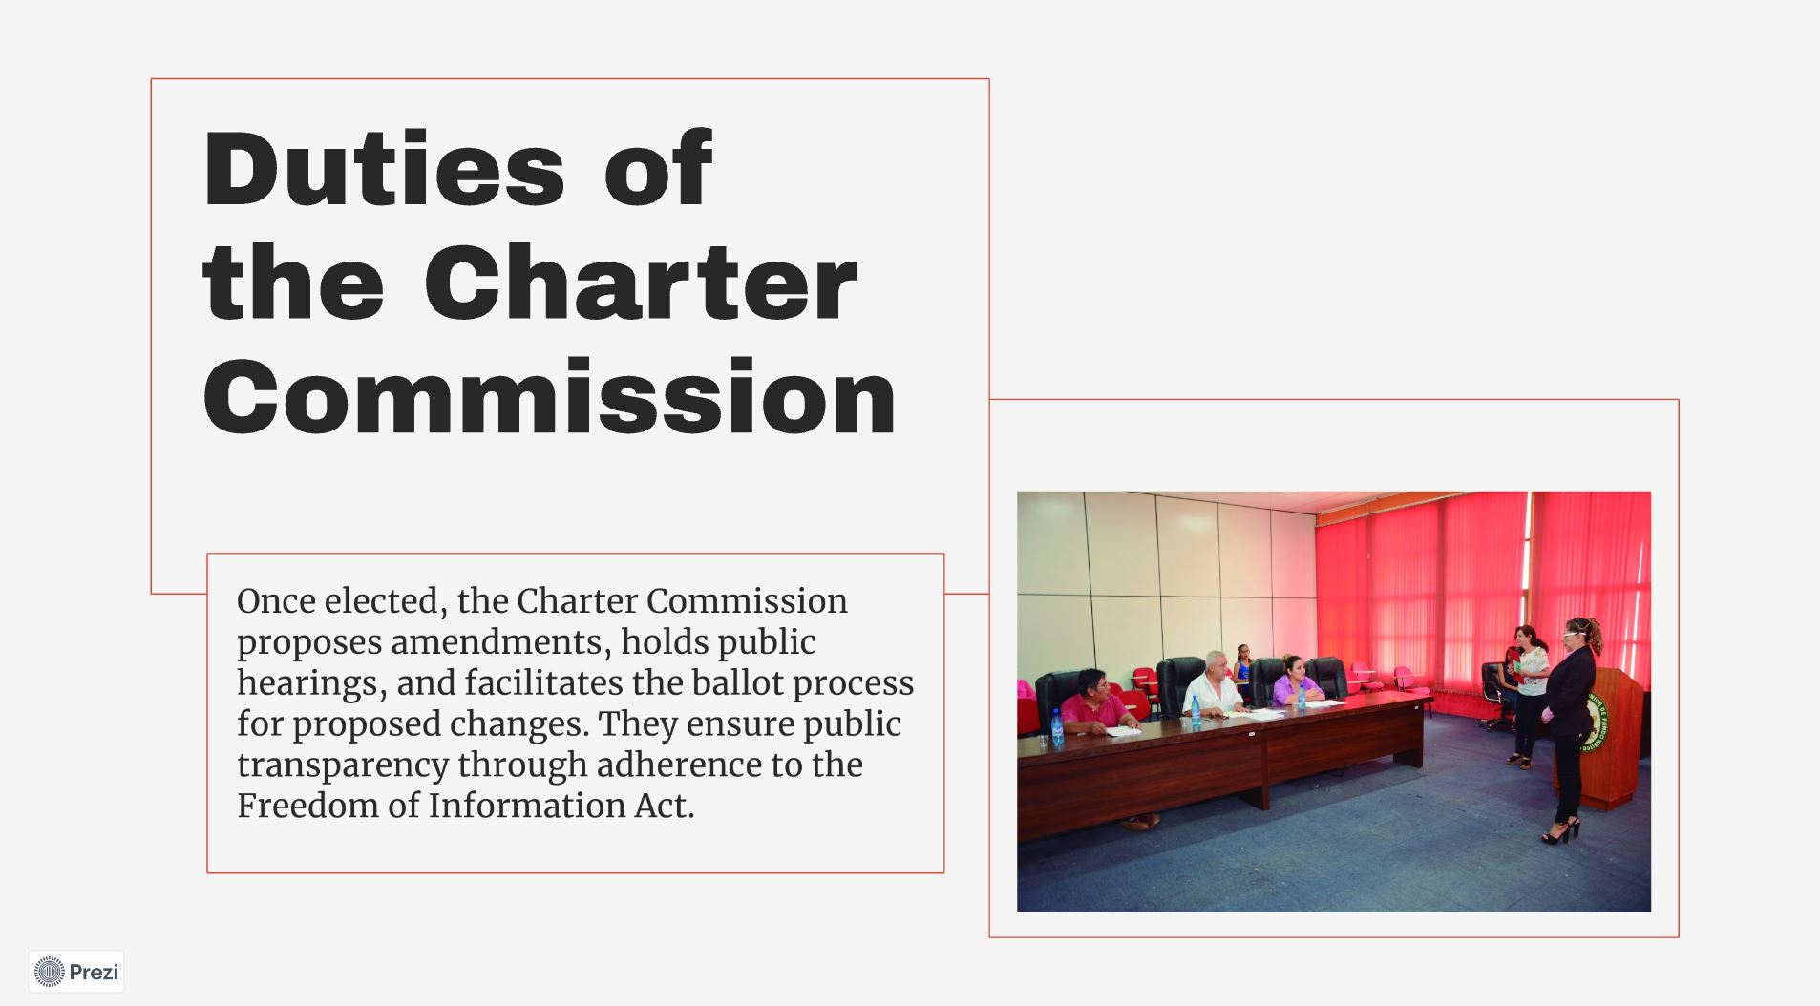

Slide 20
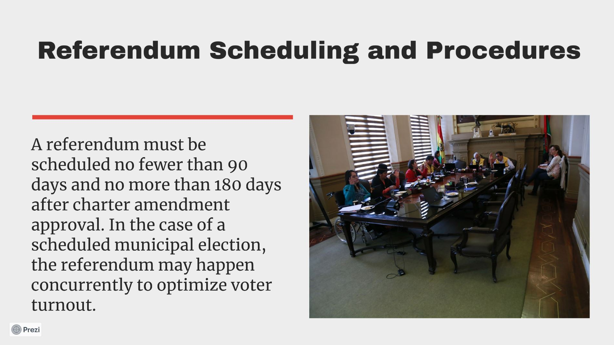

Slide 22
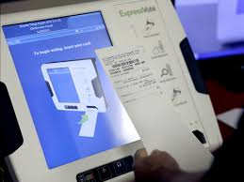
Cost Estimate
$75 per machine (includes volunteer training)
Estimated 2 machines (per district)
Assuming $1,000 room rental (per district)
$2,000- $3,000 marketing and constituent outreach

Slide 23
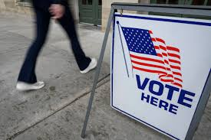
Referendum Examples
Newark, DE periodically holds referendums on various issues, including bond/certificate of indebtedness matters regarding specific projects
Milford, DE recently held a referendum to approve funding for updated water infrastructure
Notes:
City of Newark: https://newarkde.gov/1052/City-of-Newark-Referendum
Milford: https://www.delawarepublic.org/politics-government/2025-04-29/milford-residents-approve-water-infrastructure-referendum

