Slide 1
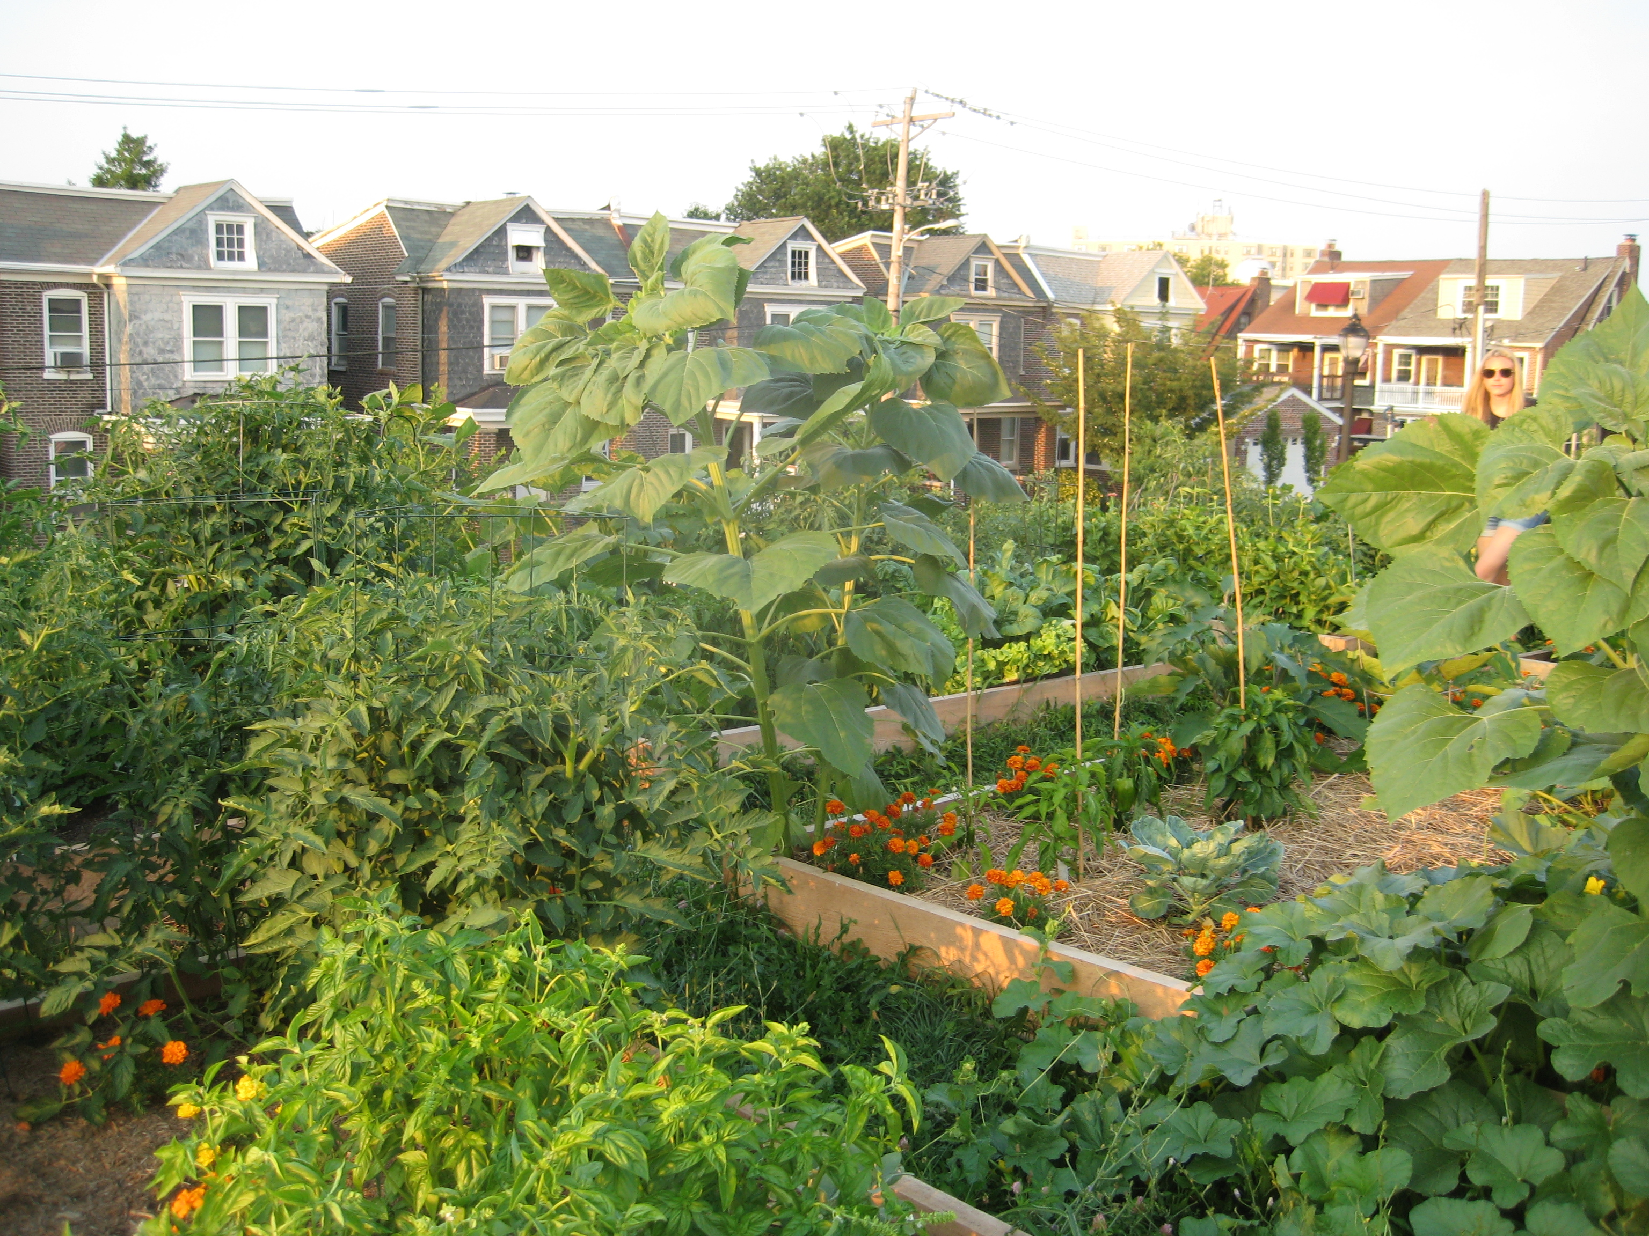

Health, Environment, Aging and Disability Committee
May, 21, 2025

Slide 2
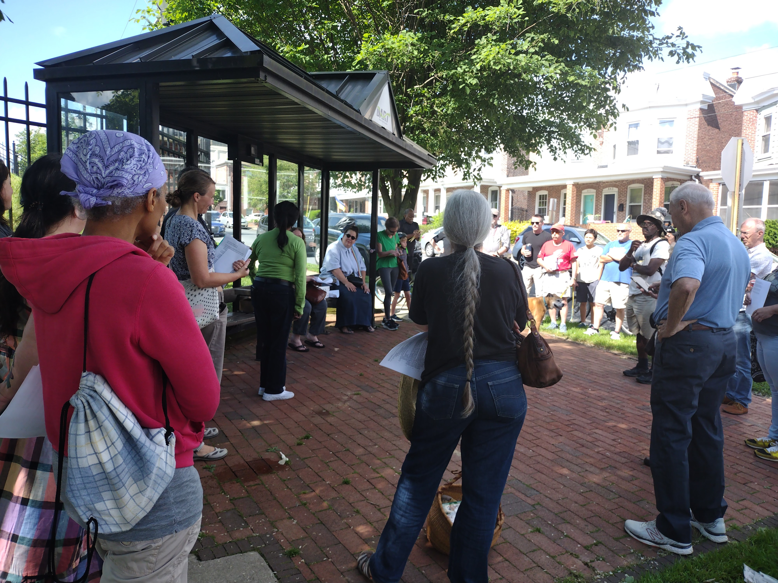
We are a community group of gardeners, residents and other stakeholders in the area that surrounds the Rodney Reservoir.
Our goal is to keep the site public, safe and green and create a future where all residents can enjoy its use.

Slide 3
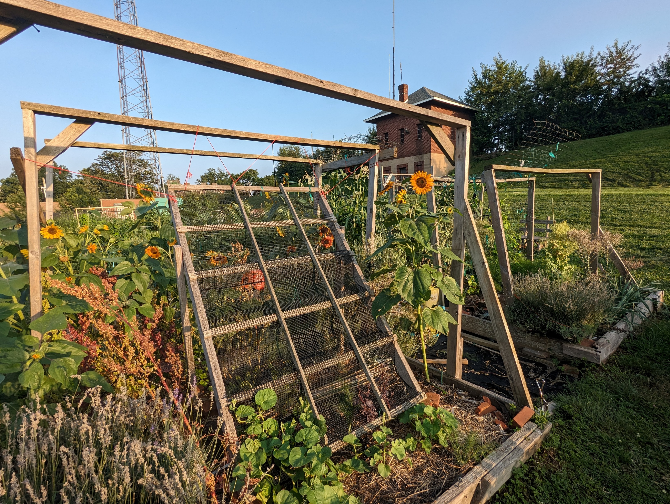
What is Community Gardening?
Community gardens are local, resident-driven green spaces:
Individual plots
People grow food to eat and give away
Build relationships
Expand access to food
Resident-led

Slide 4
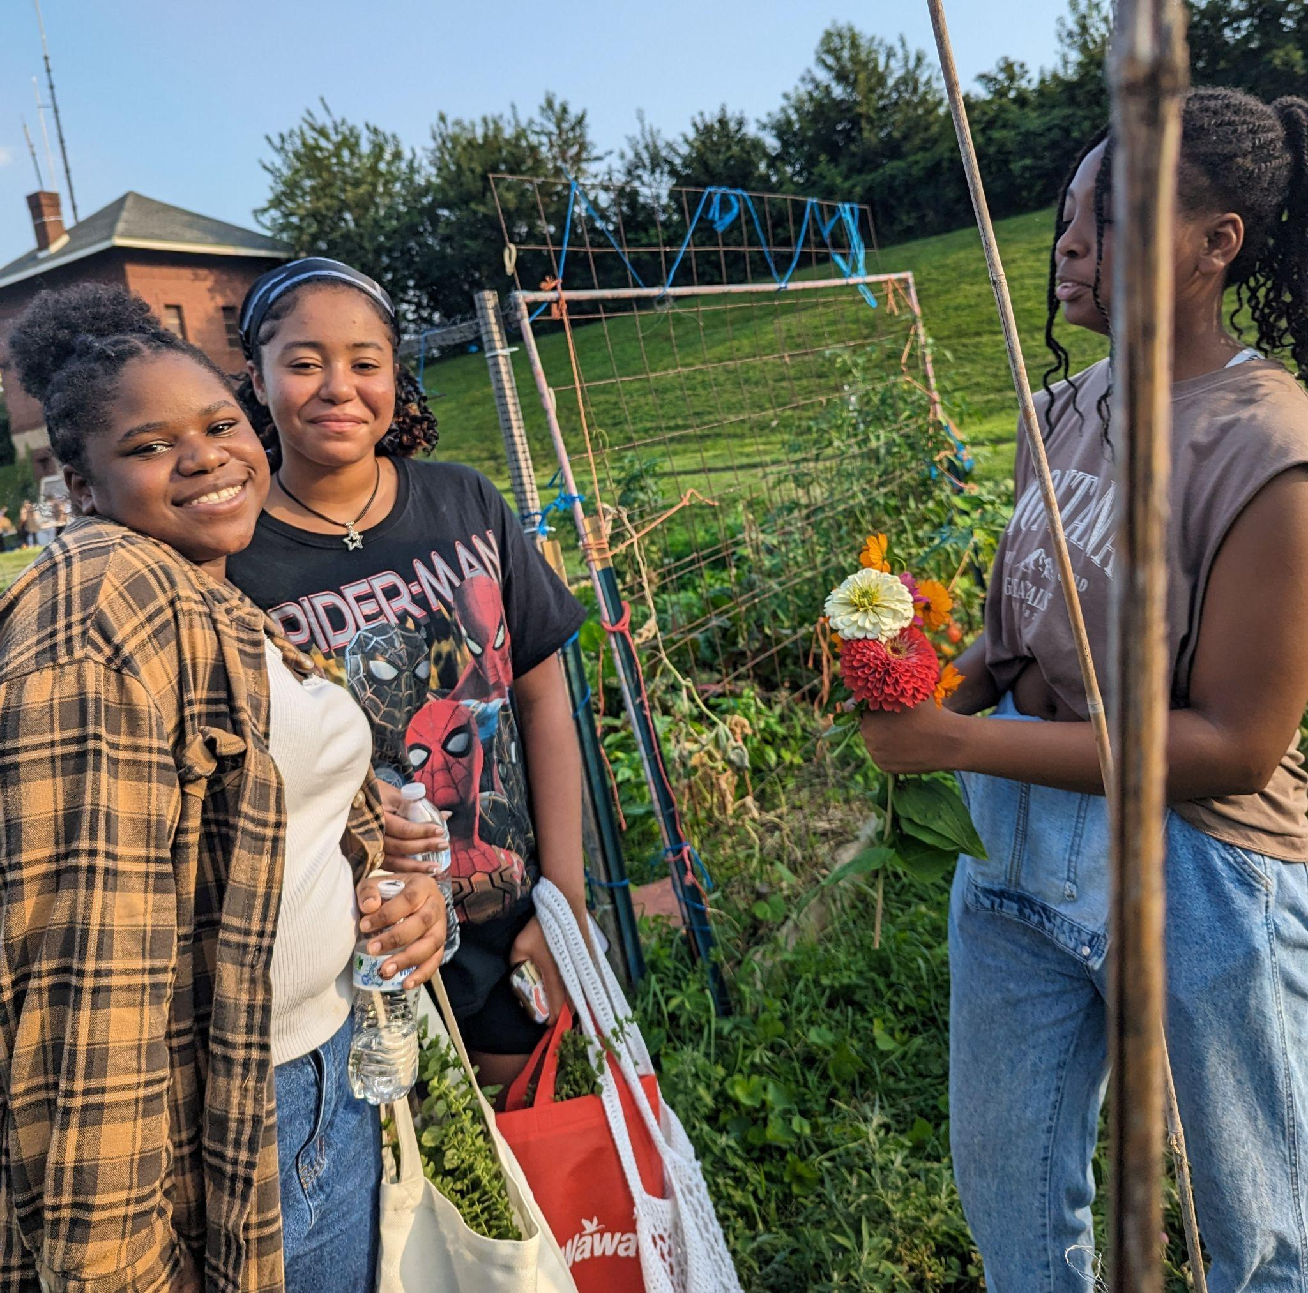
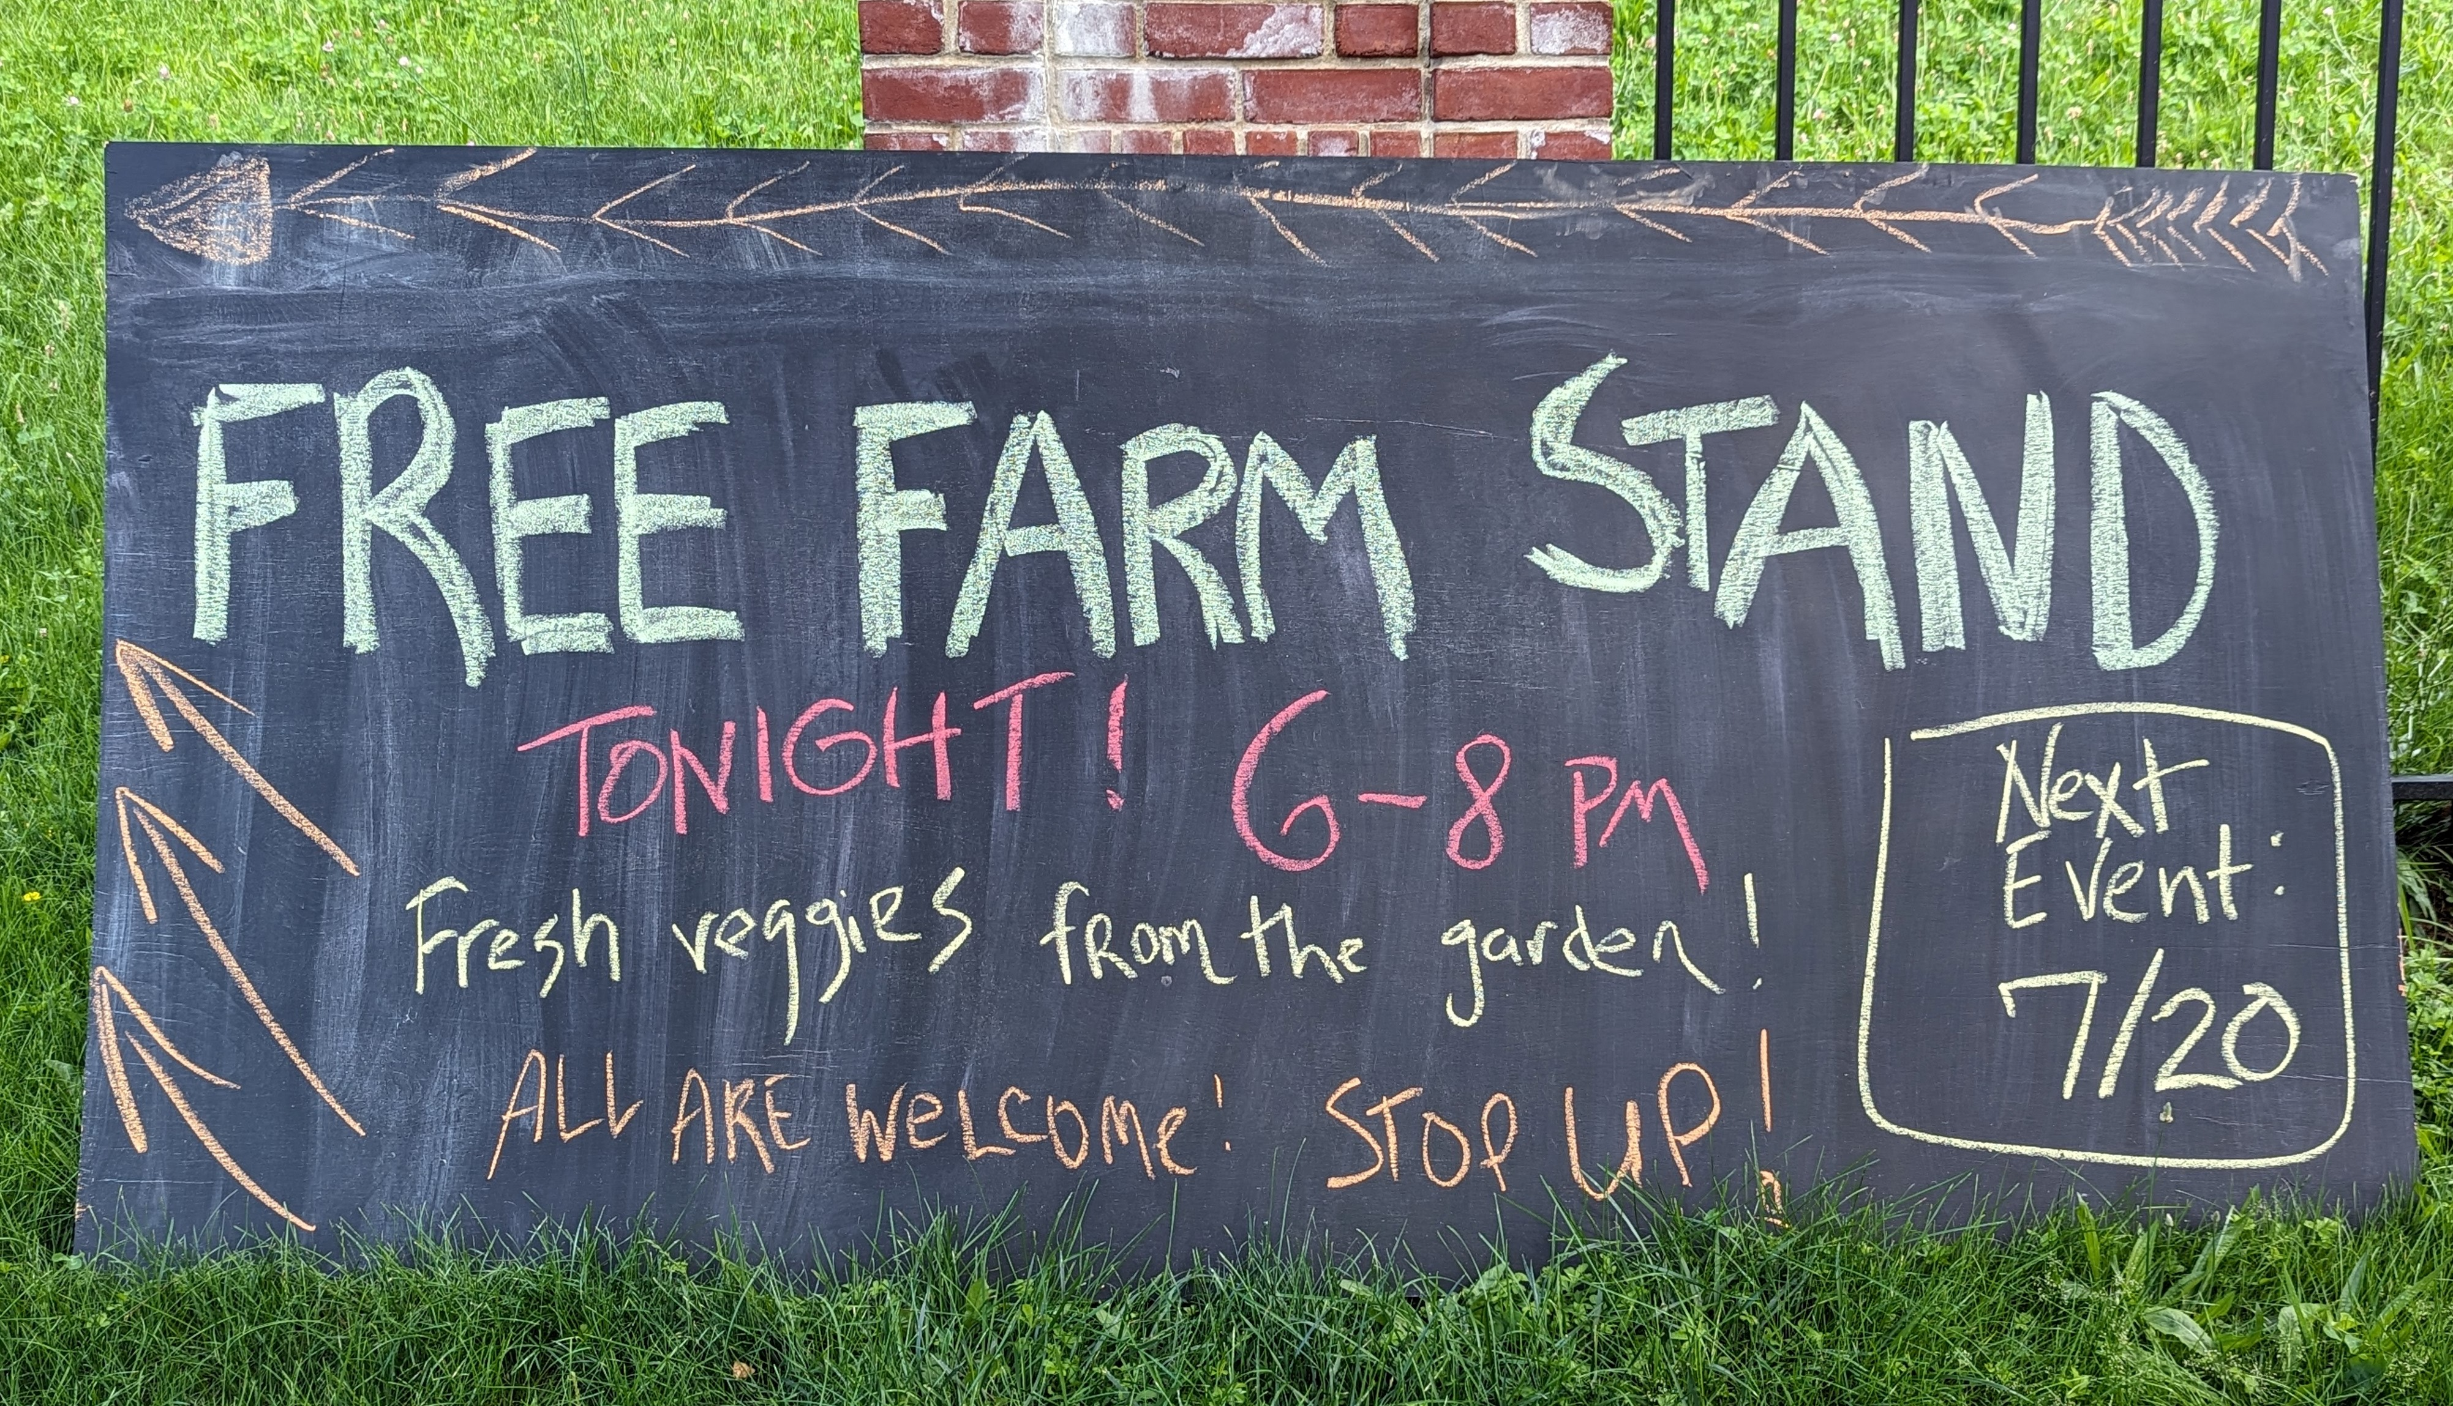
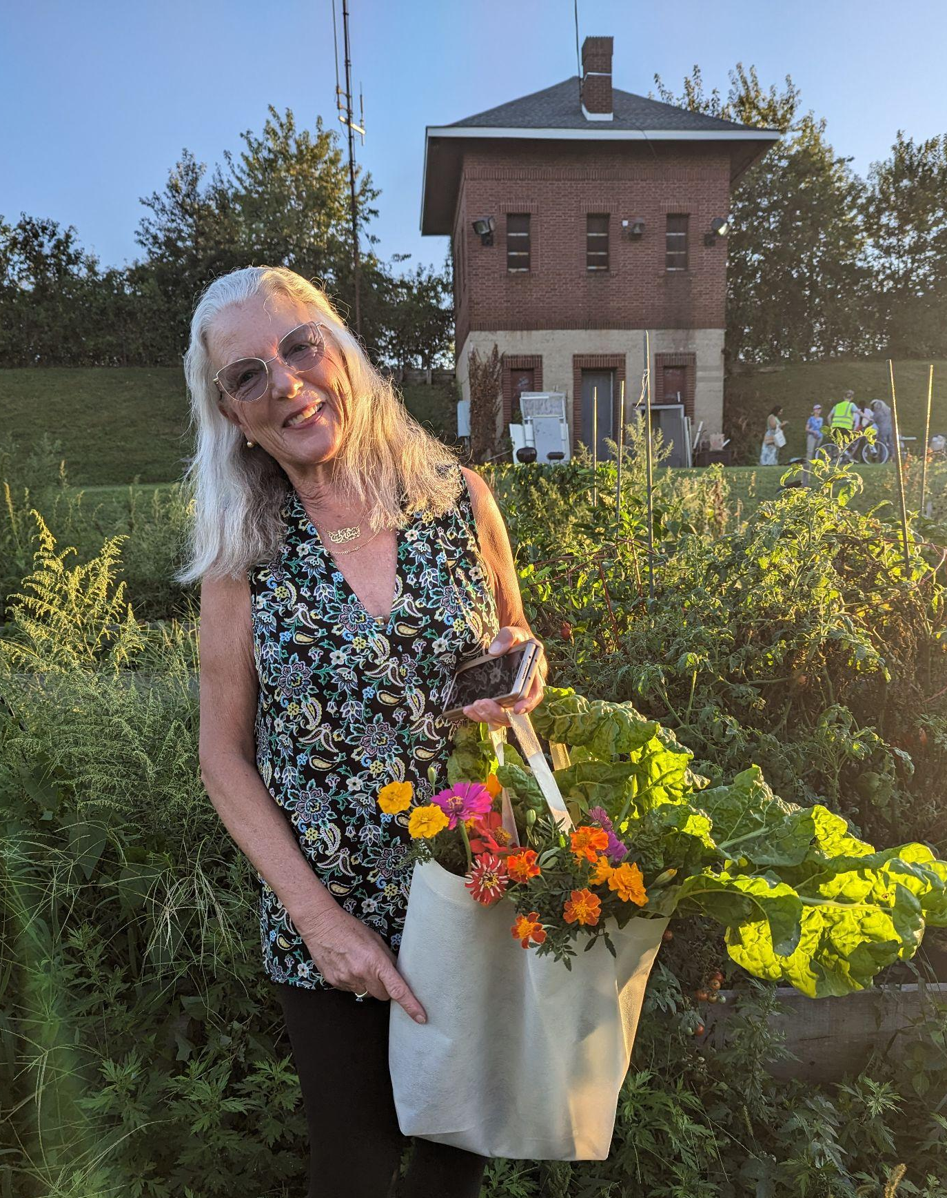
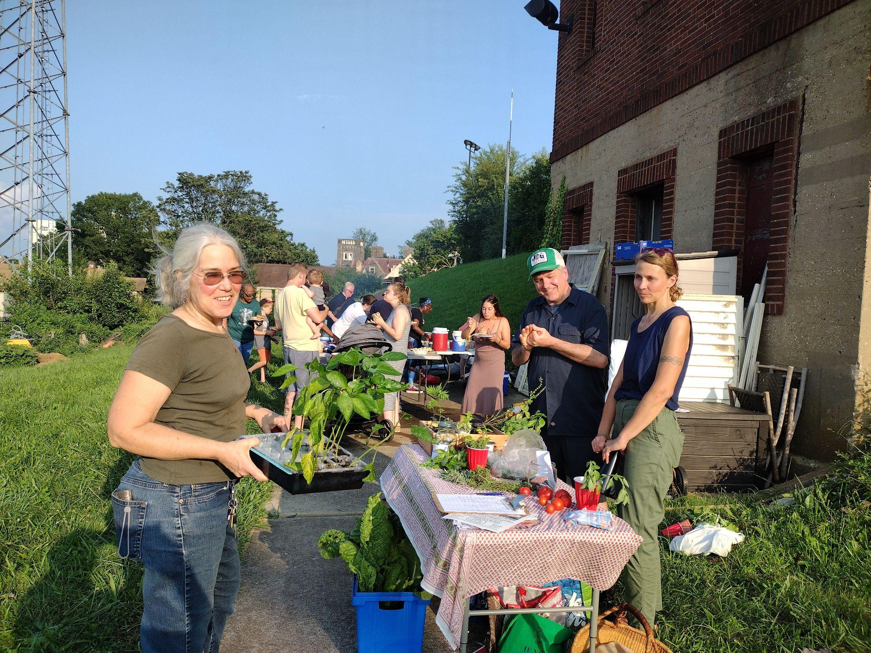
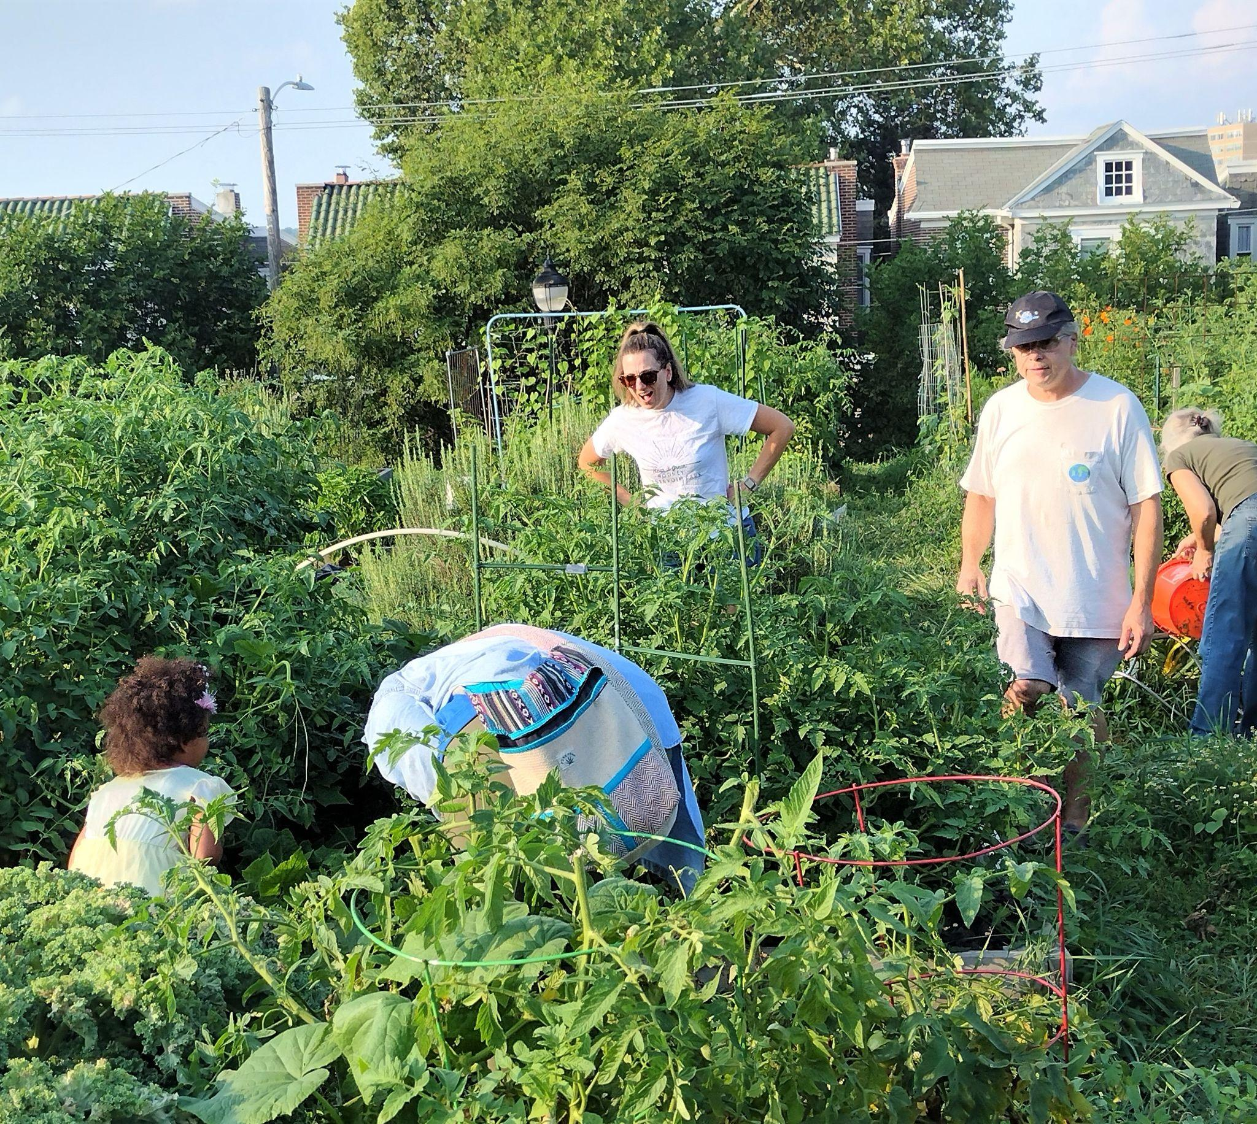
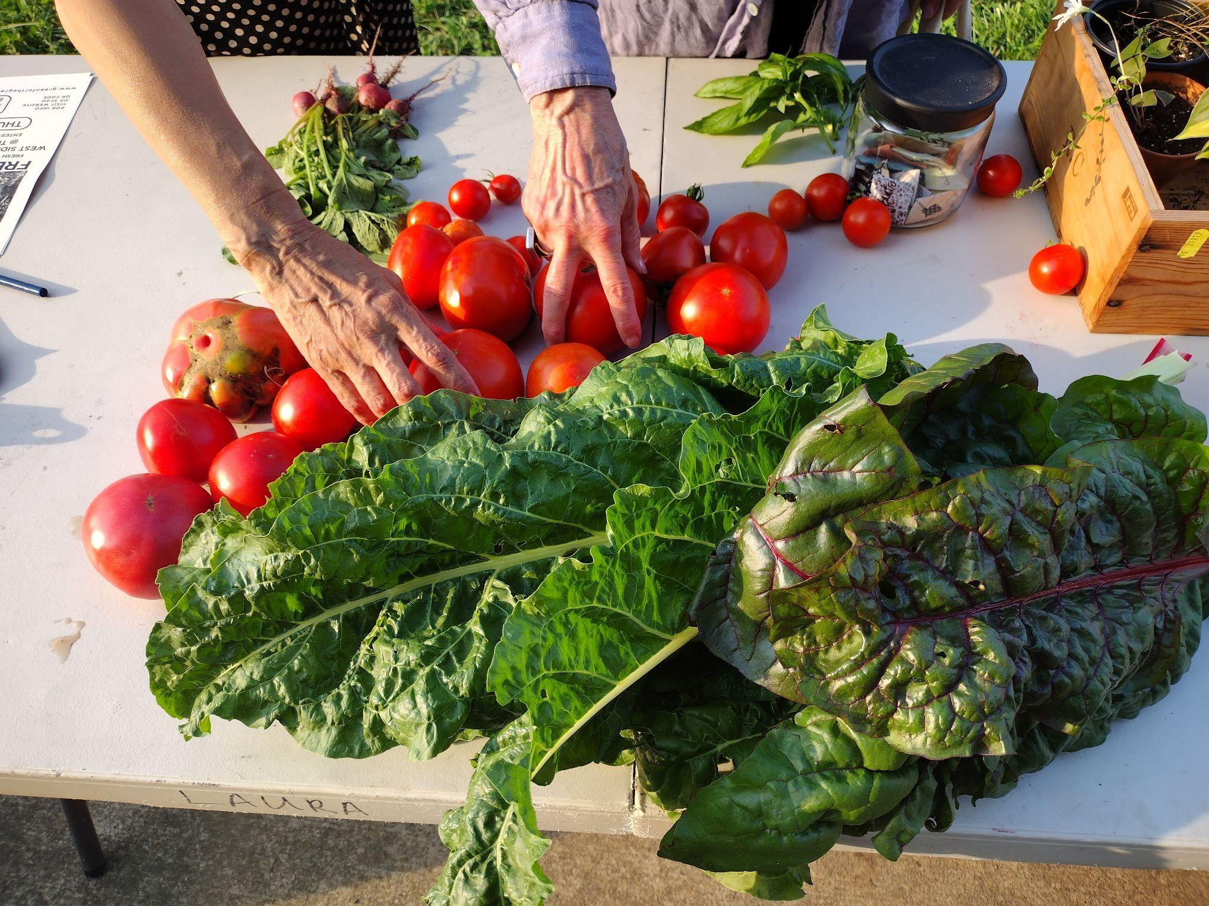

Slide 5
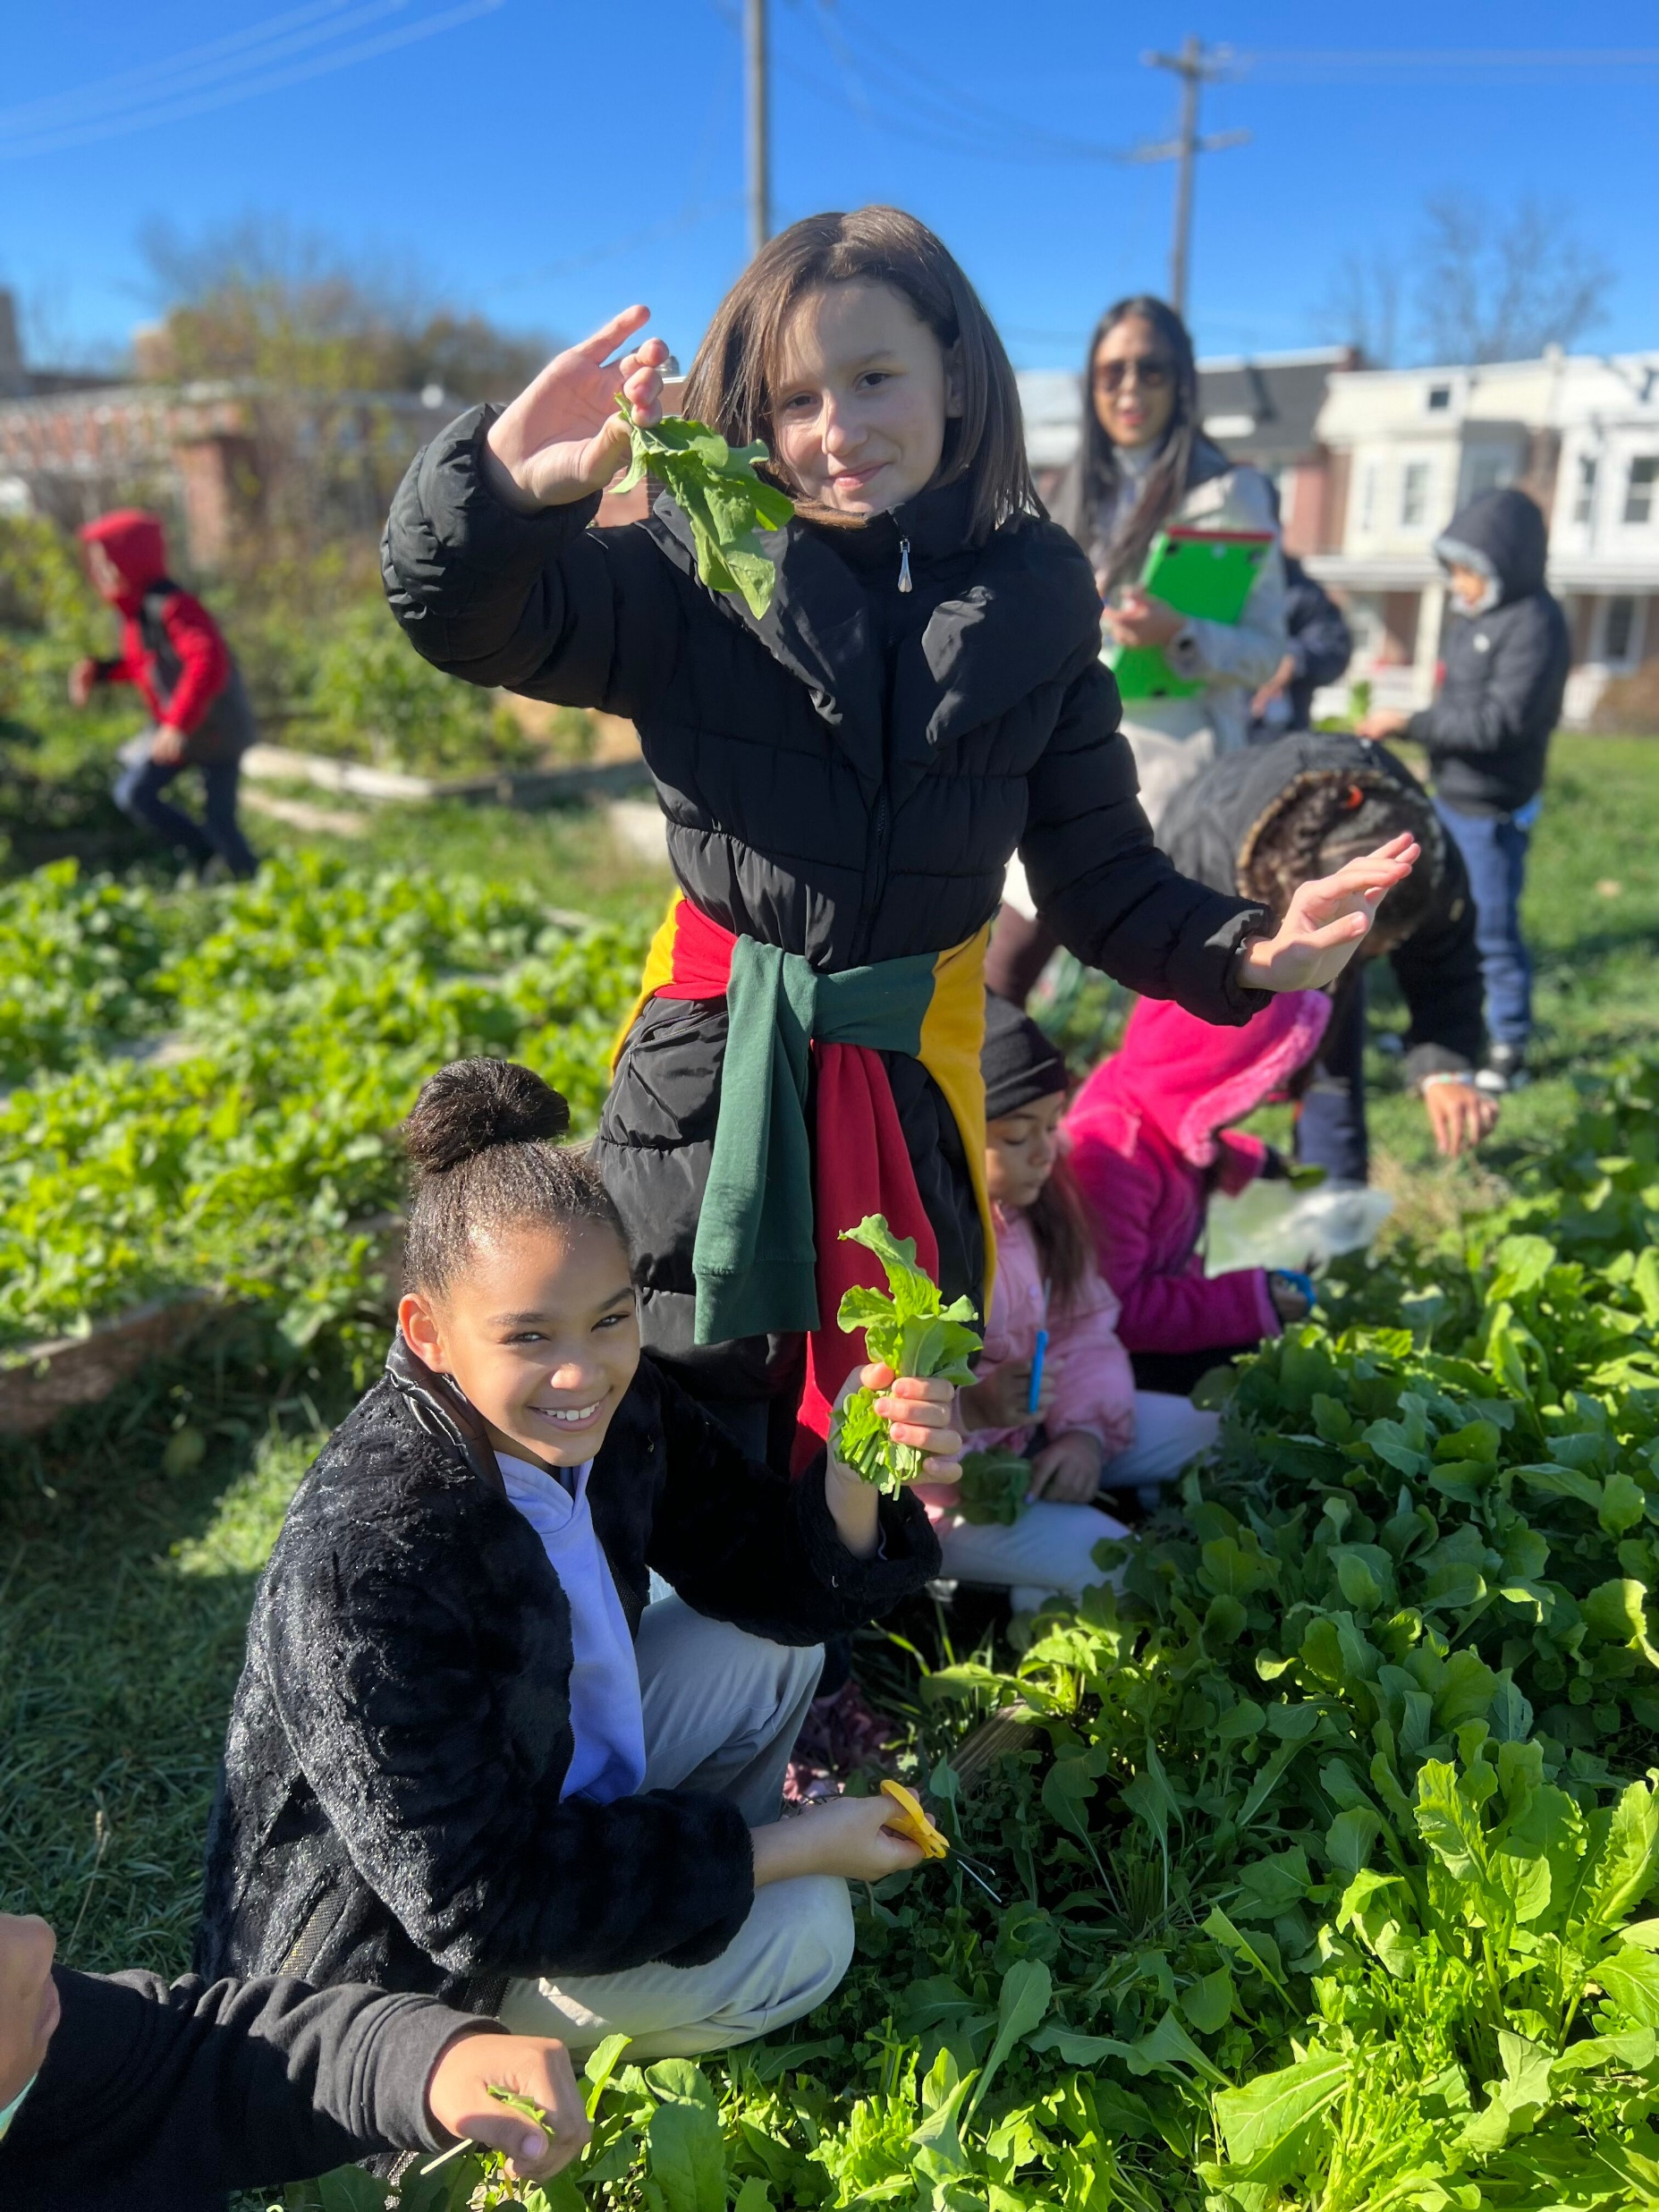
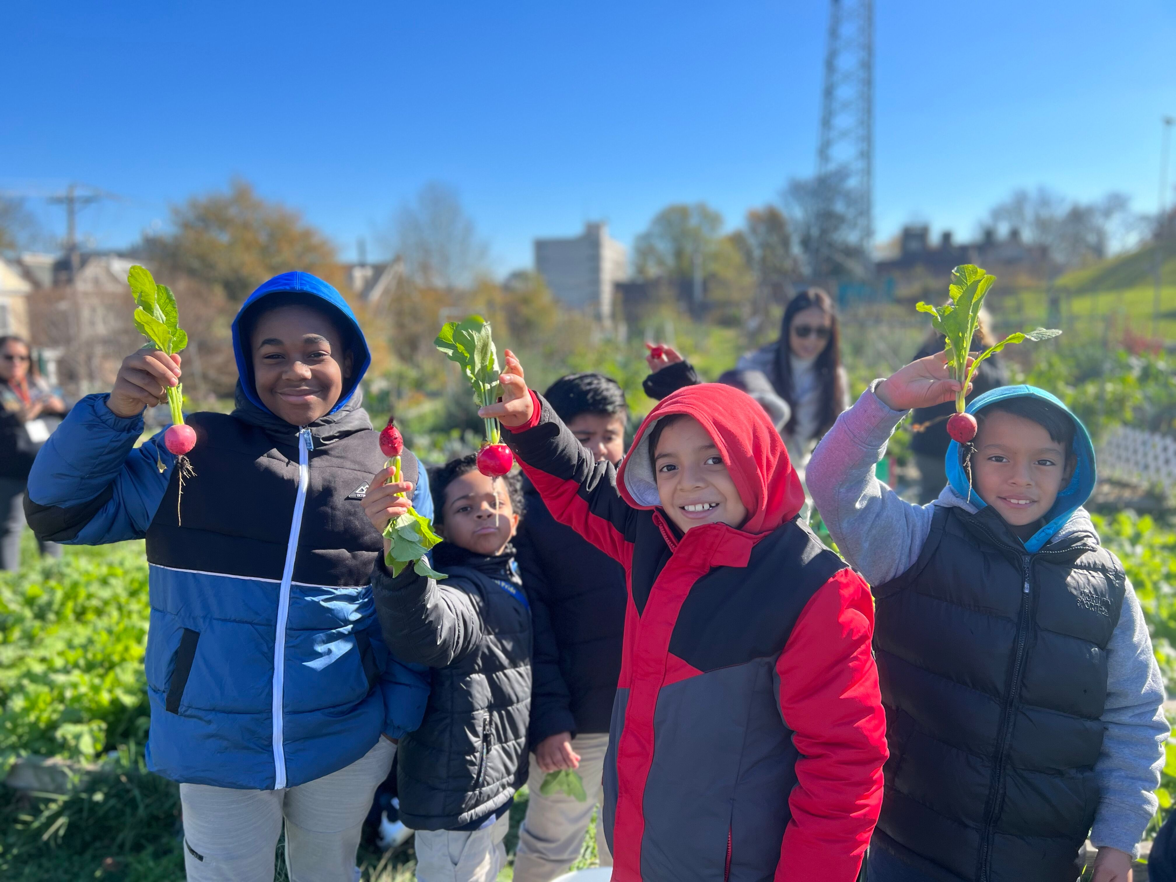
Outdoor Education
In the fall of 2022, Green for the Greater Good launched a partnership with Healthy Foods for Healthy Kids and Lewis Dual Language Elementary at the West Side Grows Community Garden.

Slide 6

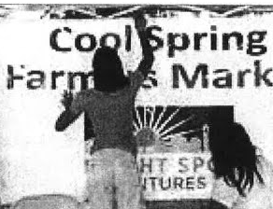
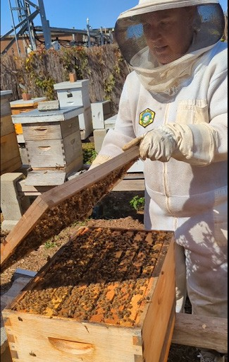
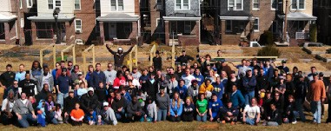
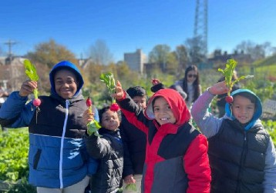
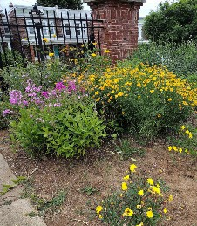
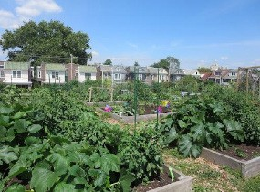
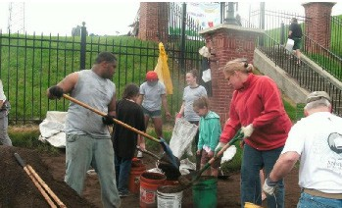
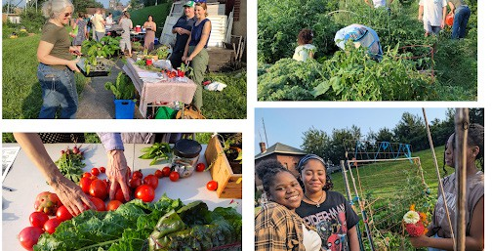
Rodney Reservoir Community Garden
Community Built - Urban Agriculture - Community Hub
The City of Wilmington’s largest community garden, with 60 plots and over 100 active gardeners. Initiated by residents seeking to transform underutilized land, the garden was managed by volunteers with oversight by Cornerstone West CDC. It helped incubate several projects, including the Cool Spring Farmers Market, Bright Spot Farm and the comprehensive community development initiative West Side Grows Together. More recently, Green for the Greater Good launched a partnership with Lewis Dual Language Elementary and Healthy Foods for Healthy Kids to host their school gardening program. There have been a number of vegetable sharing and outreach efforts over the years, including Free Farm Stand, launched in 2023 by Green for the Greater Good.
Community Development!
Bright Spot Ventures/ Cool Springs Market
Resident-driven Initiative to Build the Garden with Partners
School Gardening Program: Lewis Elementary & HFHK
Native Pollinator Beds
First Urban Apiary in Wilmington
60, 10’ x 10’ Garden Beds
Annual Dirt Day
Free Farm Stand

Slide 7
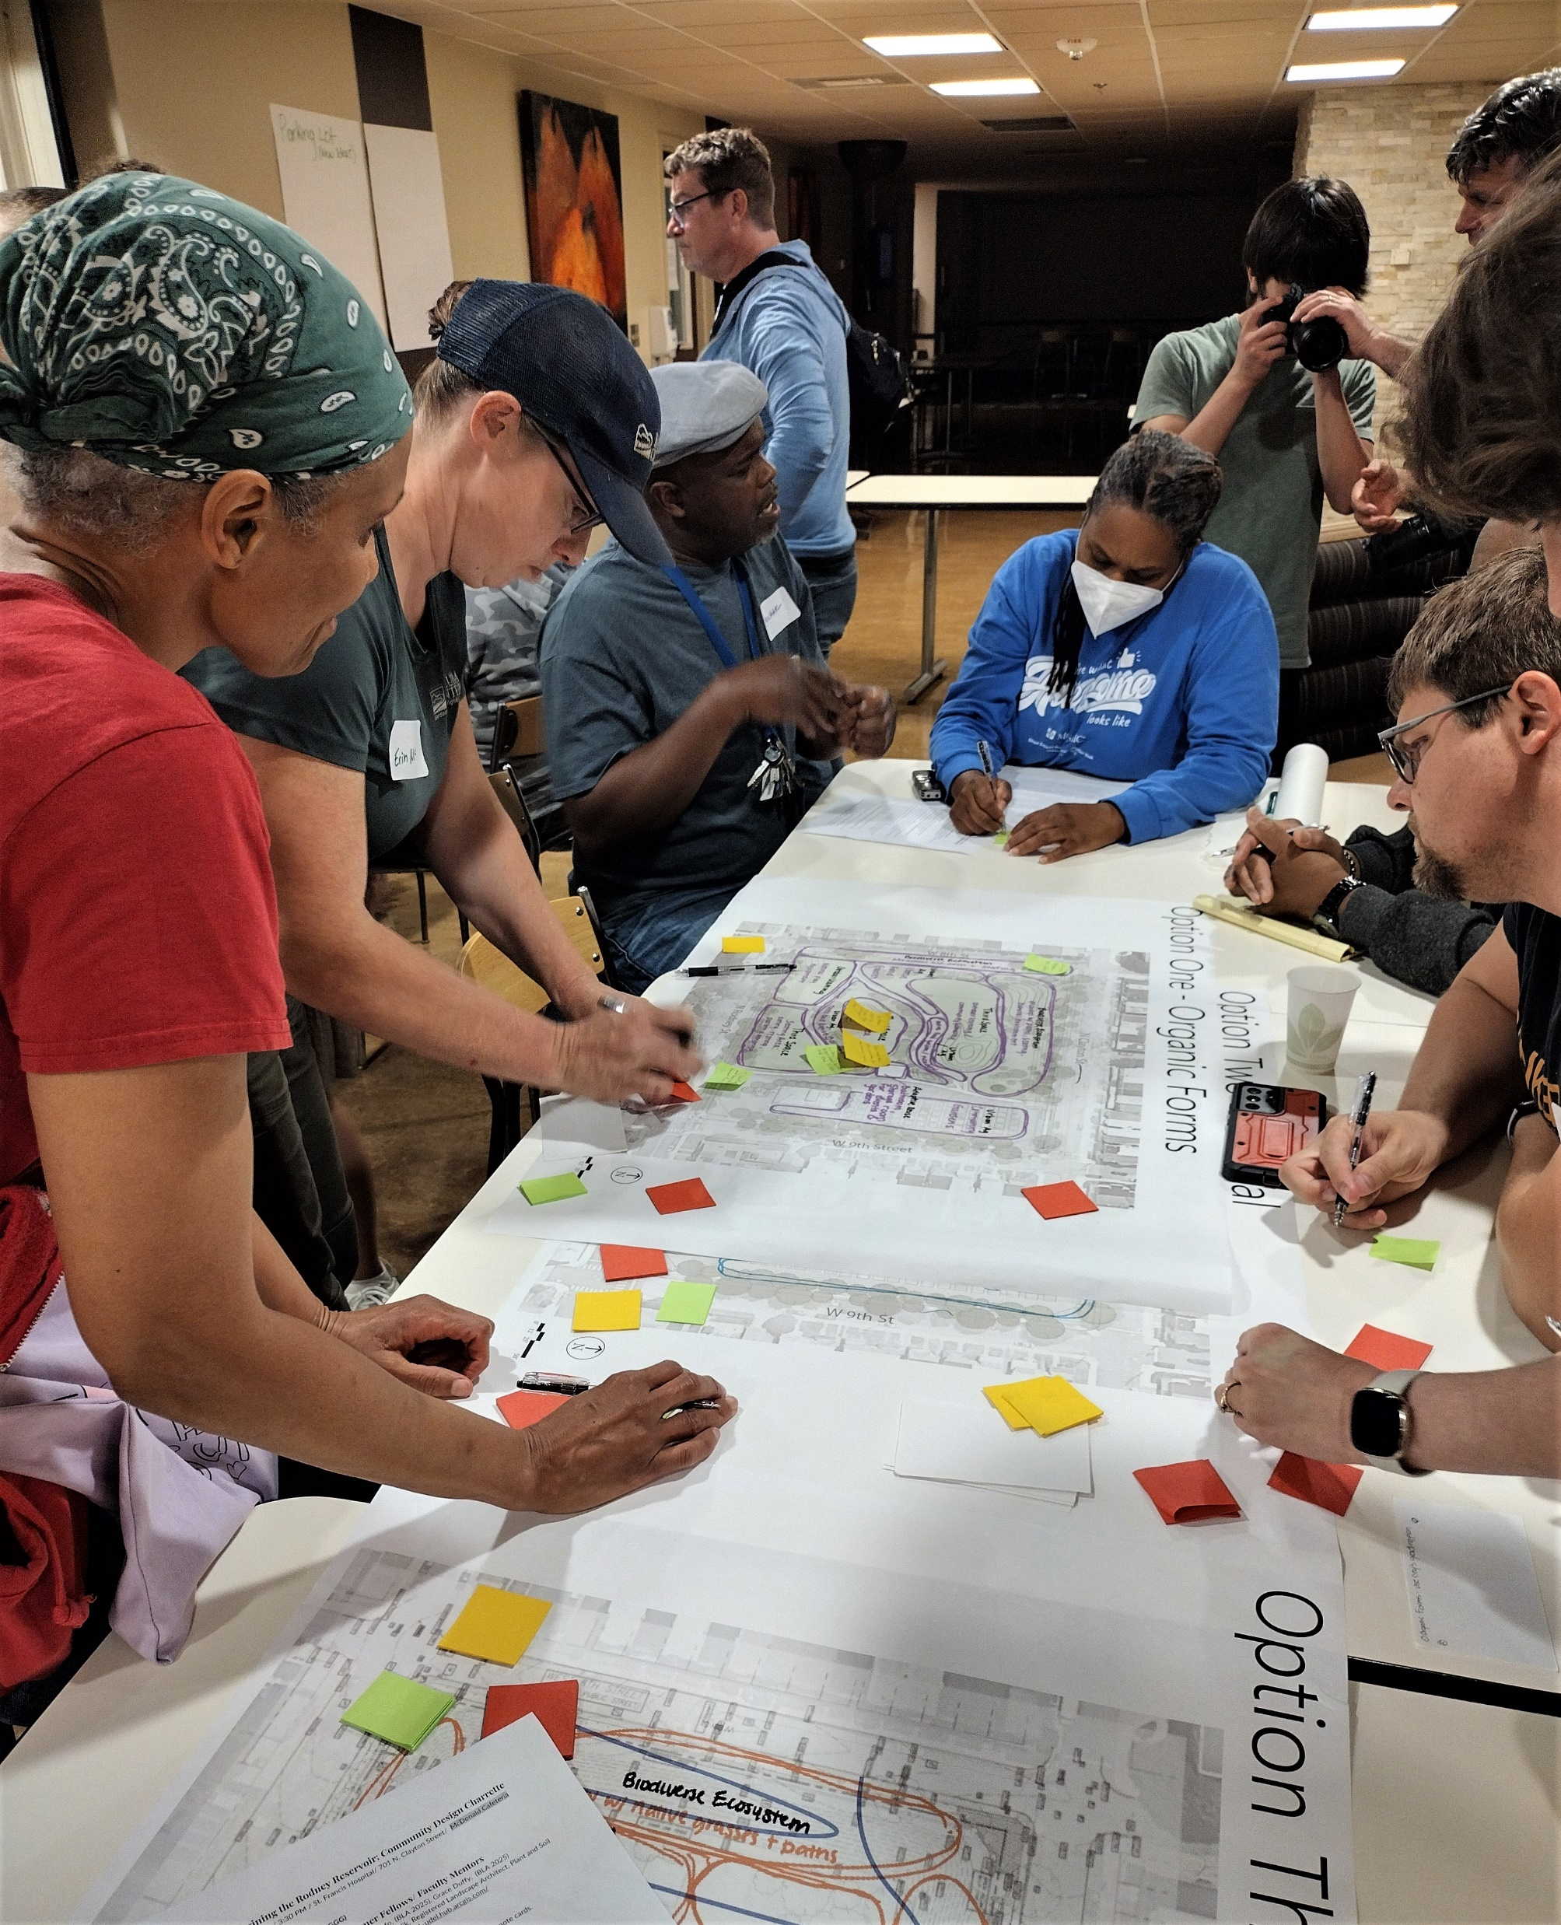
2023 Rodney Reservoir Community Design Events
Over 80 community members came together and created a high-level vision for a nature- and community-focused park at the Rodney Reservoir that:
centers the public good
supports resiliency
builds on the urban agriculture initiatives already activating the site
promotes environmental justice
meets goals of the City’s 2028 Comprehensive Plan and
aligns with Resilient Wilmington Report.

Slide 8
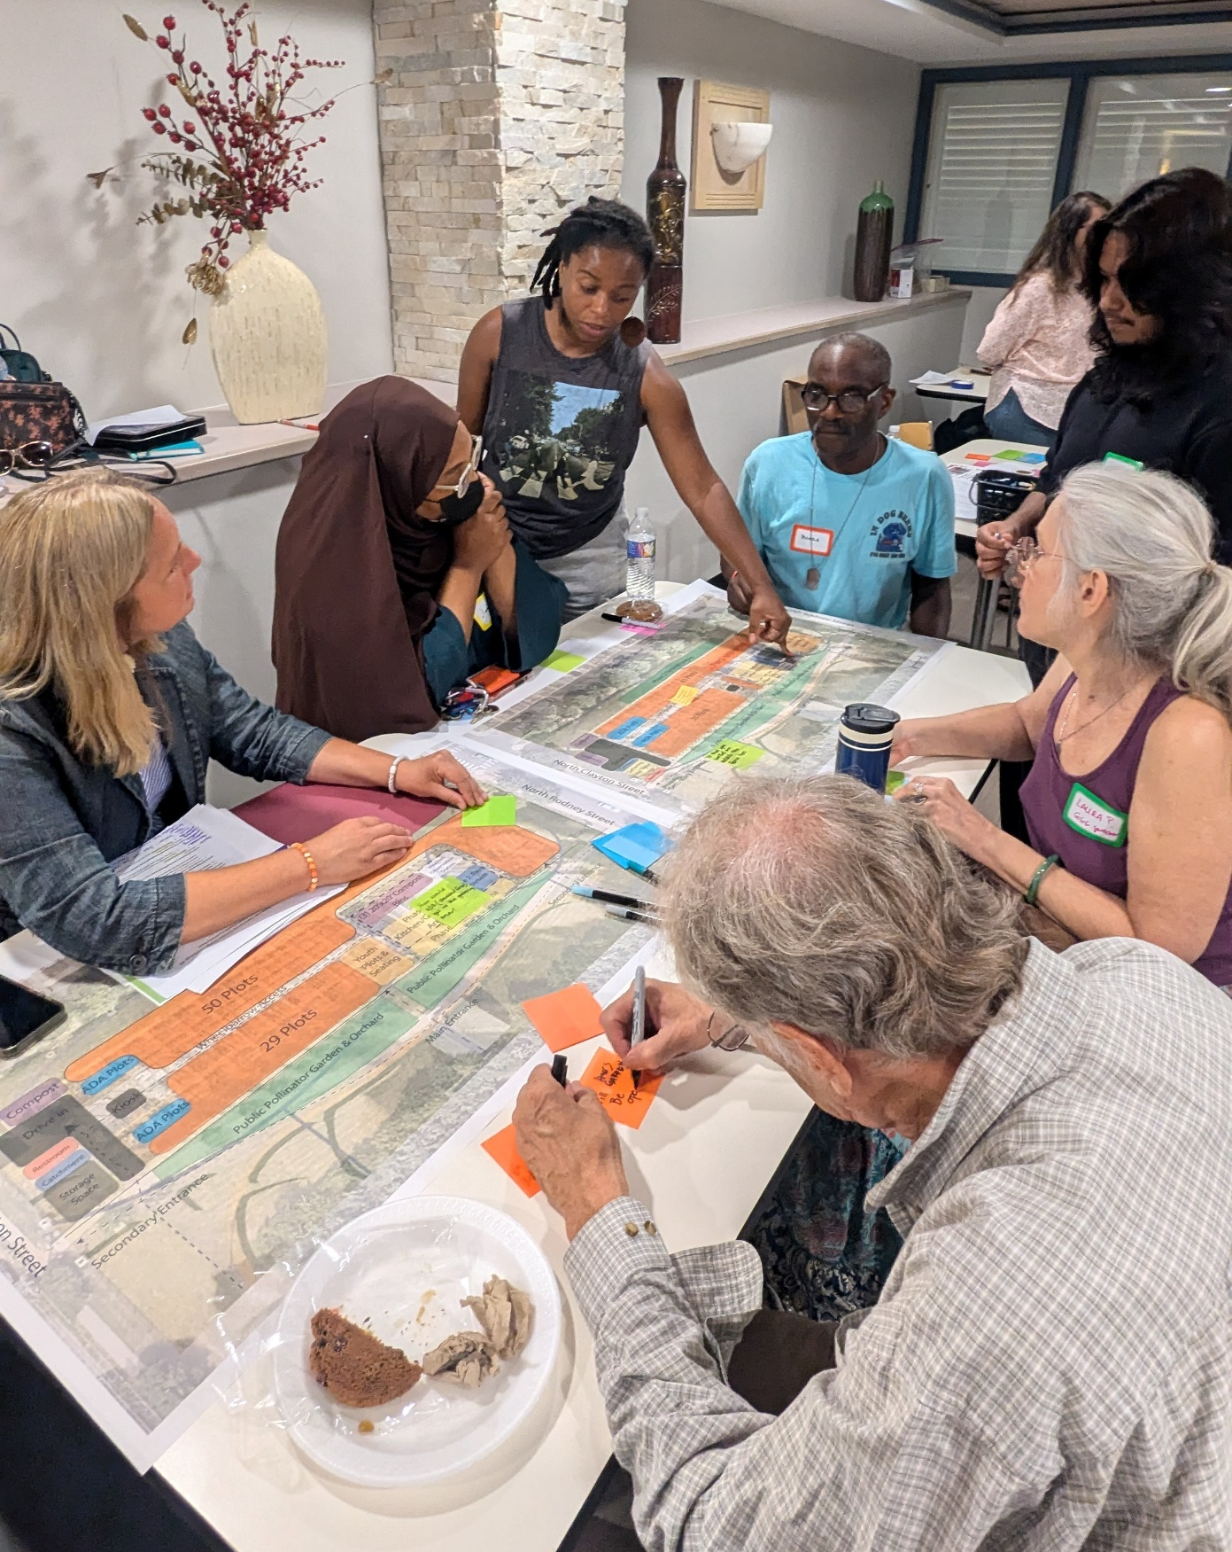
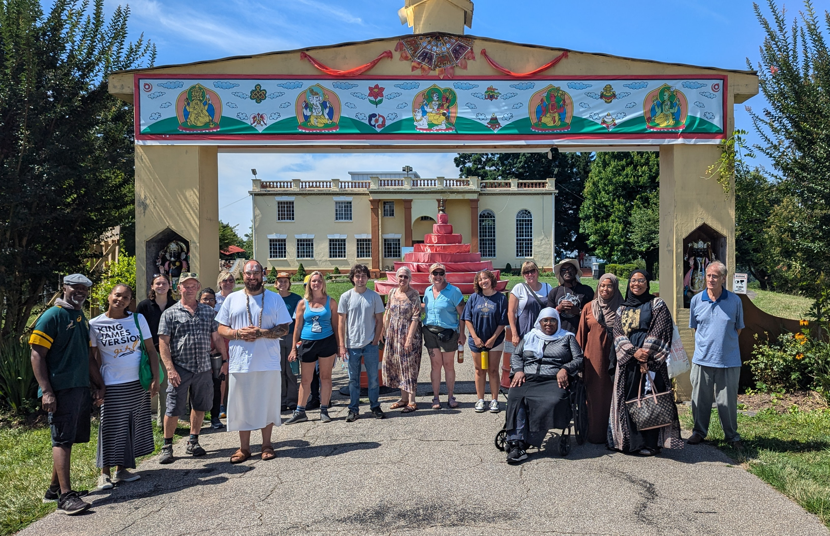
2024 Community Garden Design Events
  More than 125 participants, including neighbors, gardeners, and a wide range of organizational partners and leaders, took part in the activities:
  three in-person design workshops
  field trip to Baltimore
  virtual report out session

Slide 9
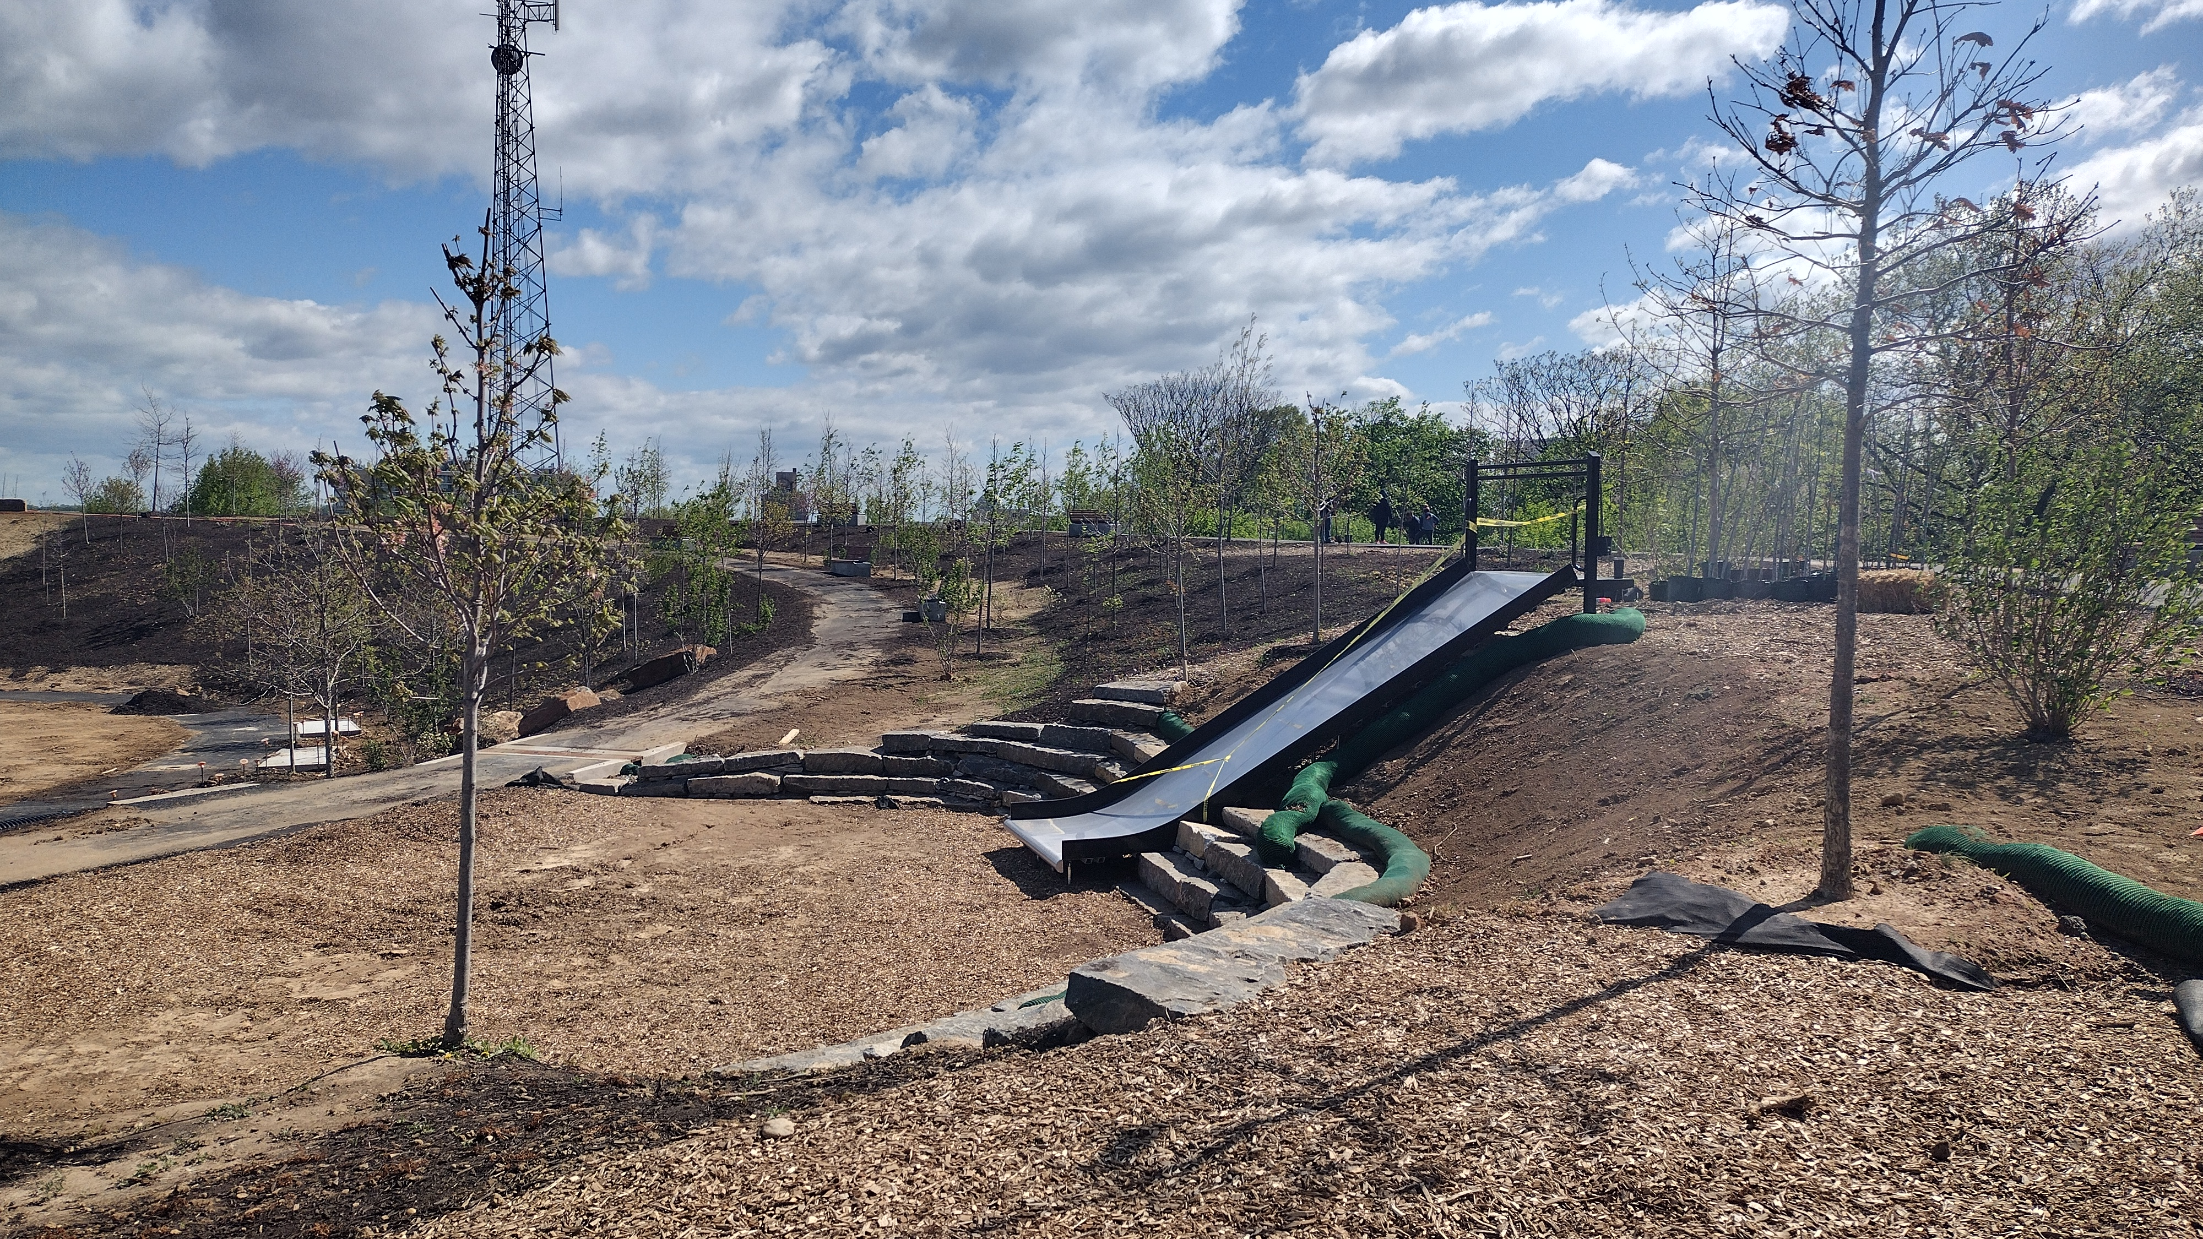
Community gardens can transform spaces and strengthen communities.

Slide 10
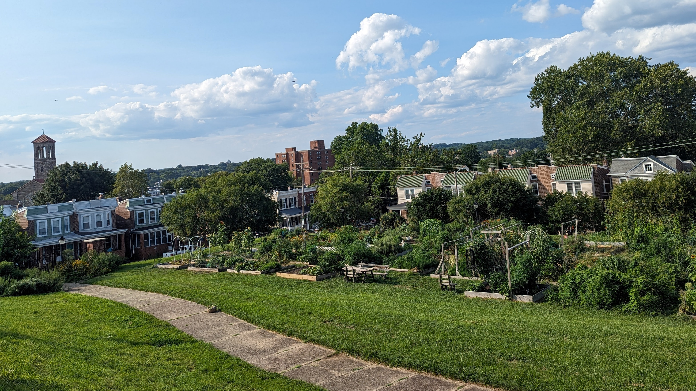
Community Gardens Benefit Residents
Resident-Led & Community-Run
  Managed by neighbors, not institutions—built on trust, care, and shared responsibility.
Builds Community
  Brings people together across experiences, cultures and generations; fosters civic engagement; encourages knowledge sharing and mutual aid; increases safety and sense of belonging.
Citywide Access
  Community gardens are extensions of neighborhoods. Every neighborhood deserves access to land for growing food and building connection.
Fresh Local Vegetables
  Residents grow their own food, participate in mutual aid and community resource building.
Being in Nature
  In dense urban areas, gardens provide vital green space to foster community wellbeing.

Slide 11
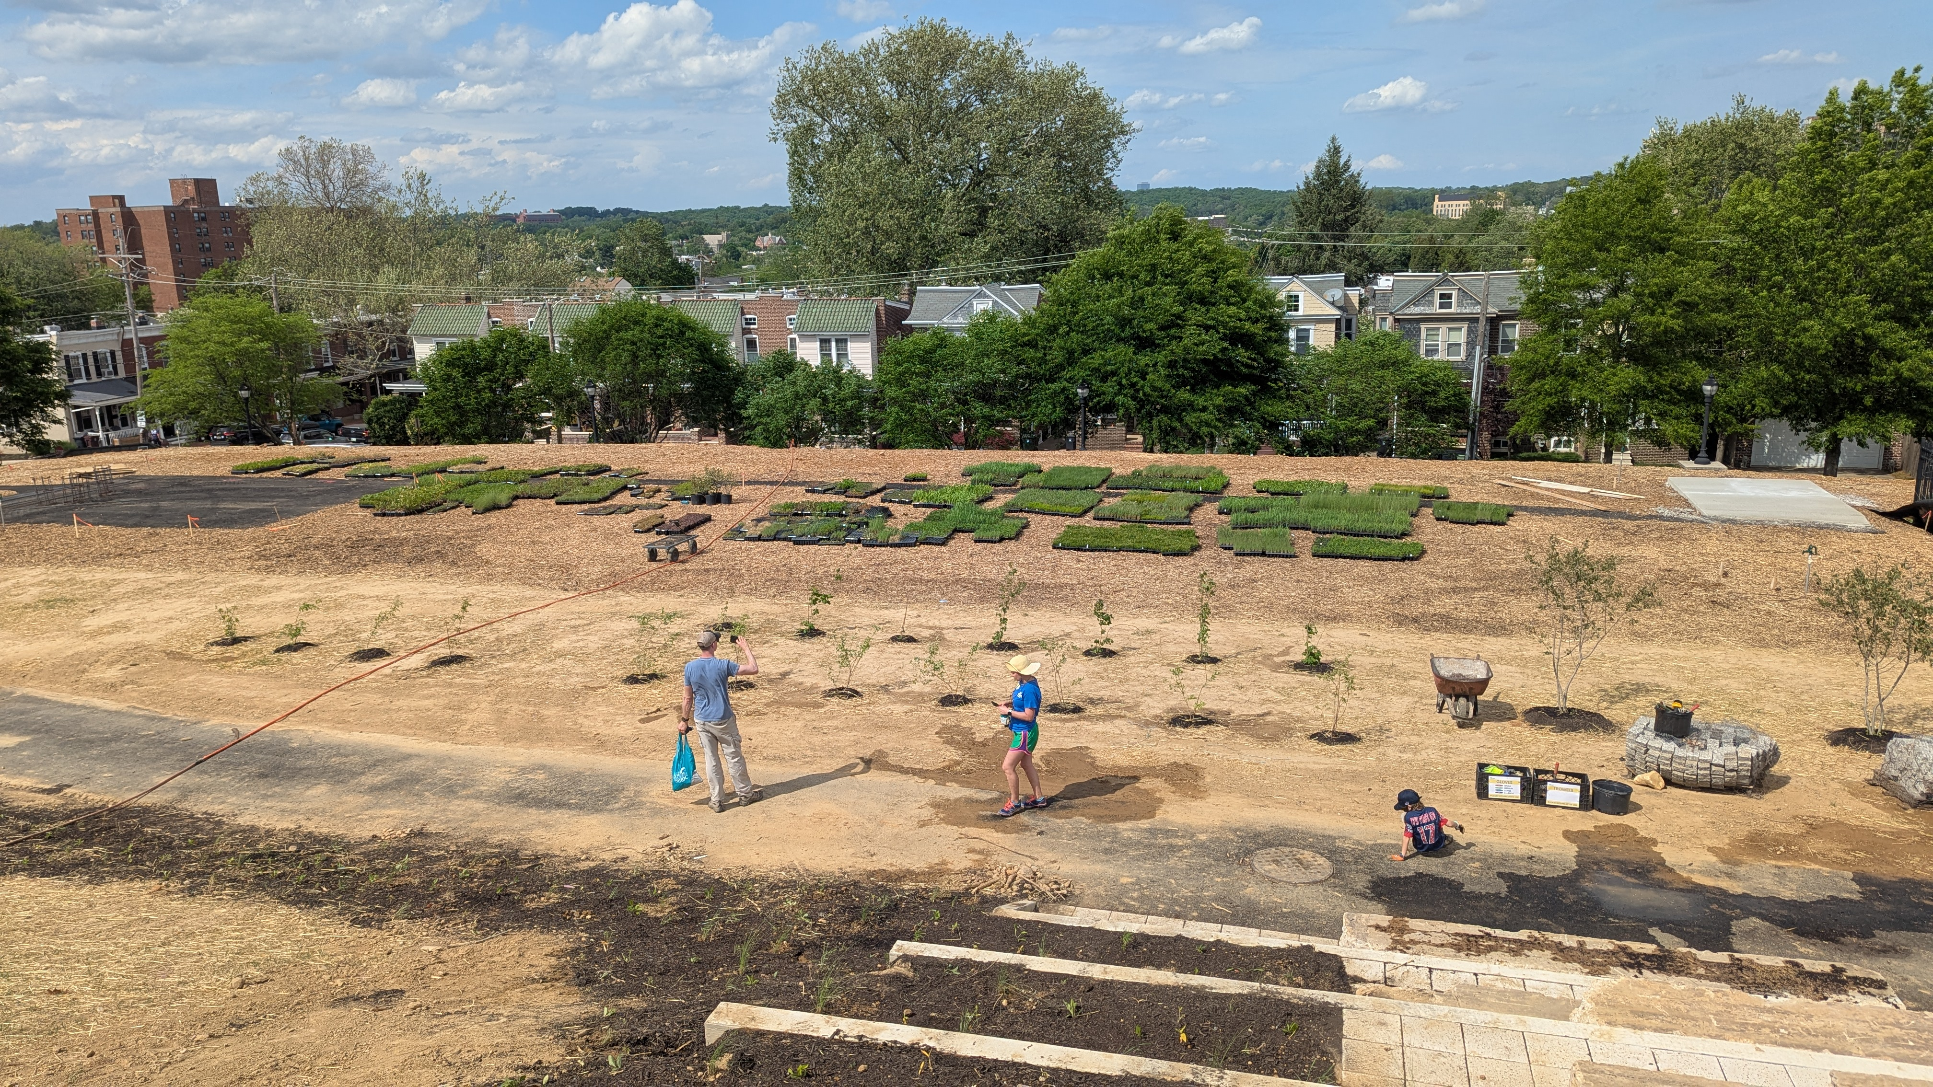
What’s Next?
The new park will open late this summer! We hope to continue to have a gardener- and resident-driven gardening program at the site.

Slide 12
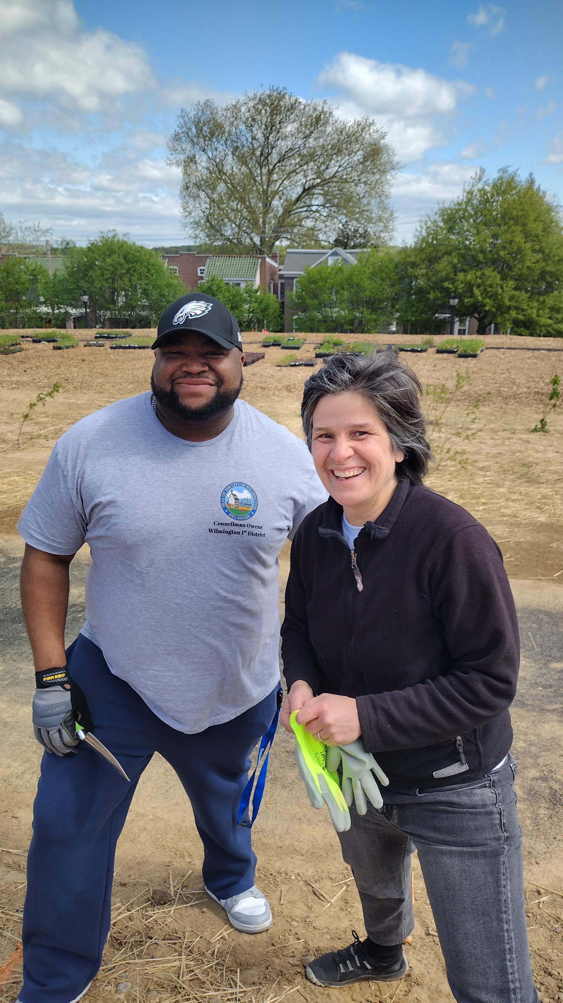
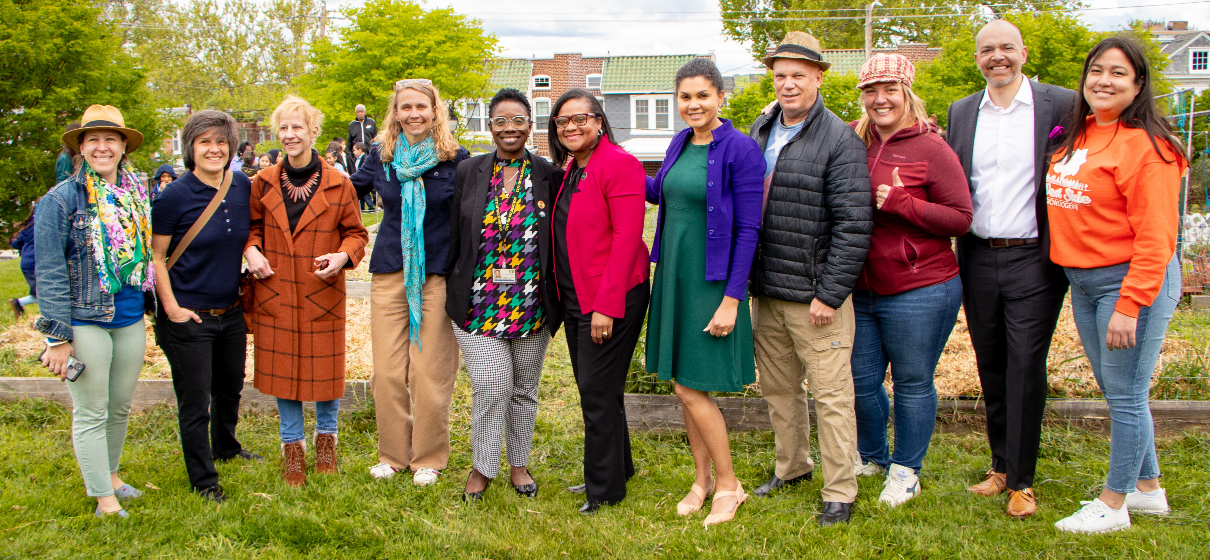
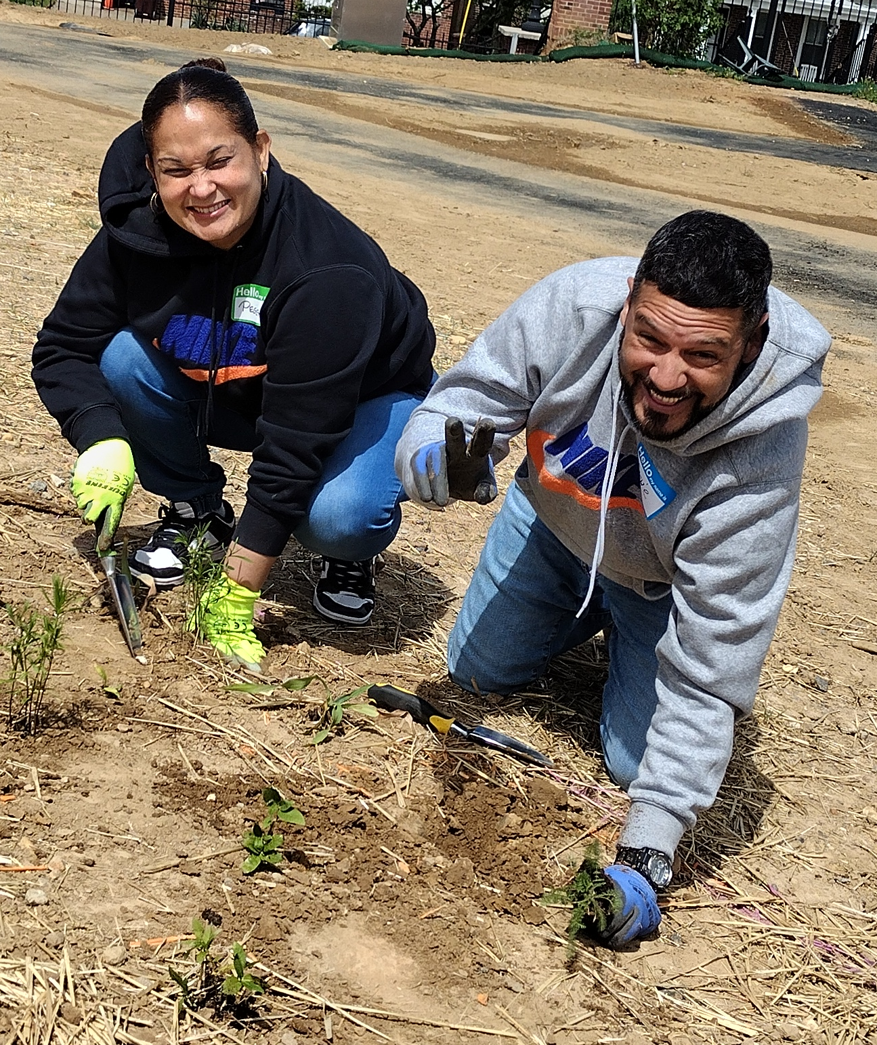
How you can help
Become a Community Gardening Champion!
Uplift the work of community gardeners
Understand and share your knowledge about how community gardens strengthen communities
Expand community gardening across the city and in your districts
Advocate for new community gardens in open neighborhood spaces where it makes sense
Support the Rodney Reservoir community garden by advocating for resident-led models to the City of Wilmington

Slide 13
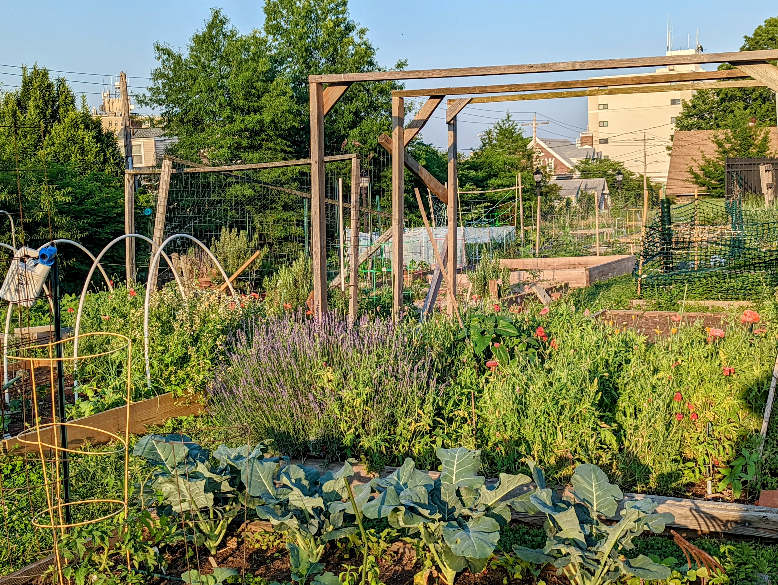
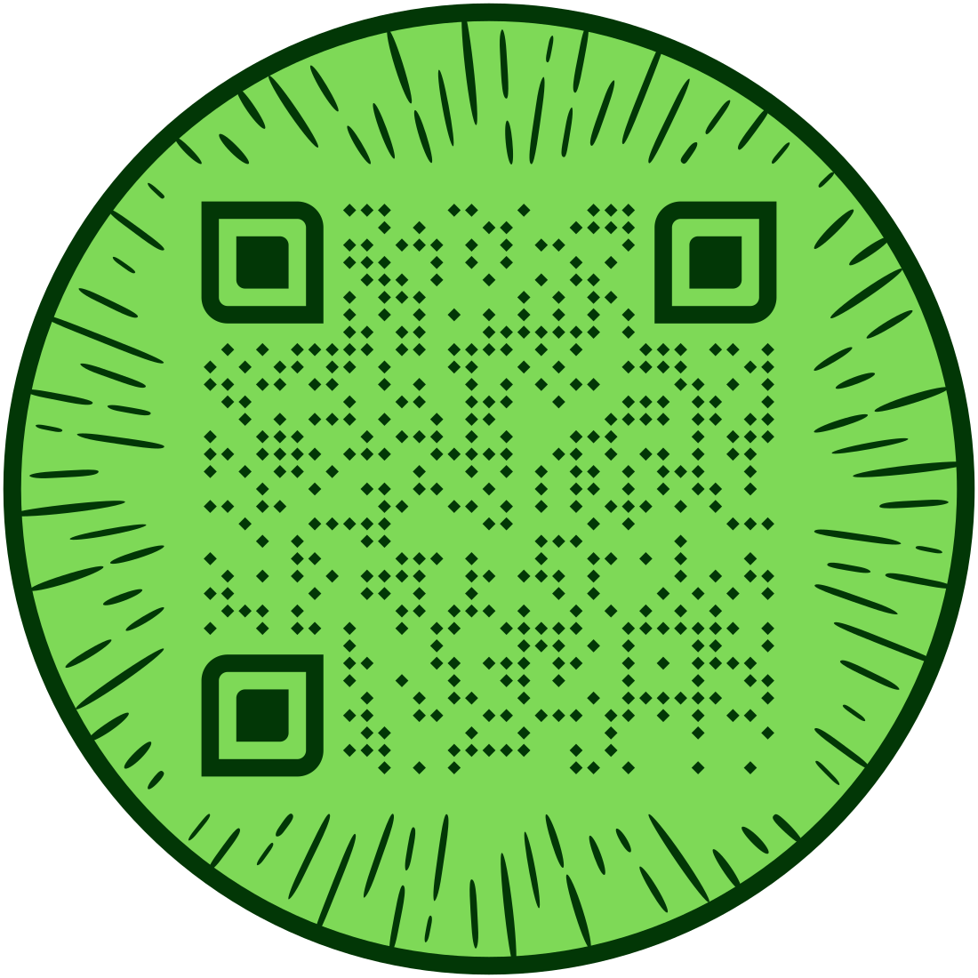
Contact Us:
On Facebook and Instagram @GreenfortheGreaterGood
greenforthegreatergood.org
greenforthegreatergoodde@gmail.com
Weekly Saturday meetings at 10 AM at the Church of The Holy City.
Sign up for garden updates with the QR code:

