Slide 1
DBE Program Update
Execution of Disparity Study Recommendations

Slide 2
Disparity Study Takeaways
Program Implementation and Monitoring
Improve Data Collection and Reporting
Outreach and Capacity Building
Capital Access and Financial Support

Slide 3
Program Implementation and Monitoring
Updates
OED provides DBE training to departments as part of the annual trainings conducted by Procurement.
Established the DBE Program Steering Committee which meets quarterly to determine and review program updates and progress.
OED has gained access to the Capital Projects report to provide a forward look at opportunities on the horizon in order to help DBEs prepare and build capacity in anticipation of bid opportunities.
Shifting from using unemployment data for Race and Gender Conscious programming to the Disparity Study Findings.
Actively seeking to increase industry knowledge of best practices by attending diverse procurement conferences, summits, and trainings on pertinent subject matters. (NMSDC, EMSDC, Greater Phila. Chamber of Commerce, Economy League of Greater Phila.)

Slide 4
Improve Data Collection and Monitoring
Updates
OED has received access to the 3rd Line reporting tool, which provides access to purchase order, invoice and vendor related data.
OED has implemented B2GNow DBE onboarding tool to manage the certifying process.
OED is working to roll out the B2GNow Contract Compliance module.

Slide 5
Outreach and Capacity Building
Updates
Actively supports and participates in local diverse procurement events.
Utilizes B2GNow data to recruit DBE’s from State and DelDot certified lists.
Actively identifies DBE businesses for prime bidders to increase subcontract opportunities.
Promote DBE participation at the prime contractor level by actively encouraging DBE’s to attend prebid meetings.
Encouraging successful Prime non-DBEs to explore partnerships and mentorship relationships with DBE’s.
Working to gain access to City Wide contract data in order to try to matchmake with DBEs using set-asides or other race conscious methods, where the Disparity Study findings justify these remedies.
Partners with True Access Capital, the Wilmington Alliance, the New Castle County Small Business Enterprise Office, KOG International, among others in local private and government entities to utilize their capacity building programs. Partnered with and hosted the Turner Construction School of Construction Management (Fall 2023). Beginning discussions for a repeat session in 2025.

Slide 6
Capital Access and Financial Support
Updates
Actively reviewing claims of slow payments and payment disputes reported by subcontractors
Created a relationship with local bonding and insurance experts to council and support DBE businesses to improve their bondability.
Open to utilizing the OED Strategic Fund Set-Aside to provide capital grants and loans in support of approved uses, such as, payment of permit fees, float capital for project participation, and general development projects that would increase a businesses ability to compete for City contracts.

Slide 7
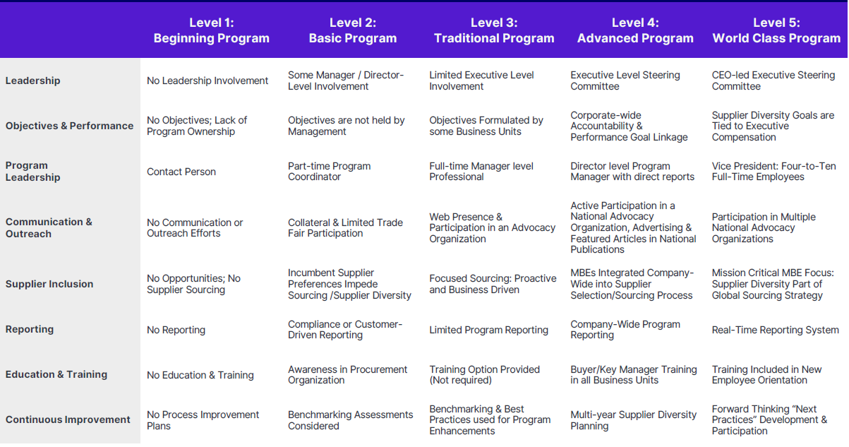
2023
2024
2025
TBD
TBD
Key:
Progress Made
In Progress

Slide 8
Challenges and Opportunities
Challenge
Opportunity
Anti “DEI” federal climate
High costs associated with technology solutions
Lack of sight over non-bid contracts
Buy-in from local leadership at all levels
Many local partners in support of inclusive procurement
-Access to 3rd Line reporting tool
-B2GNow Contract Compliance

Slide 9
Next Steps
Rollout Contract Compliance (By May 1)
Continue to evaluate impacts of the current “DEI” climate
Top vendor forum & DBE Day (March/April)

Slide 10
Questions ?

Slide 11
Appendix

Slide 12
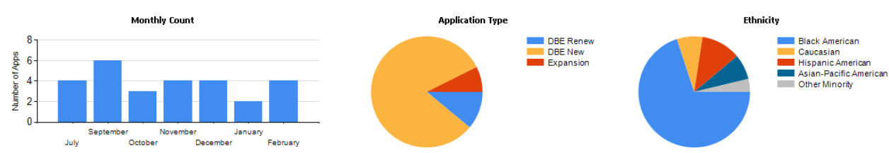
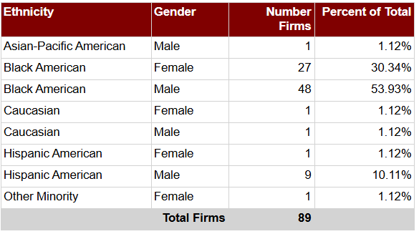
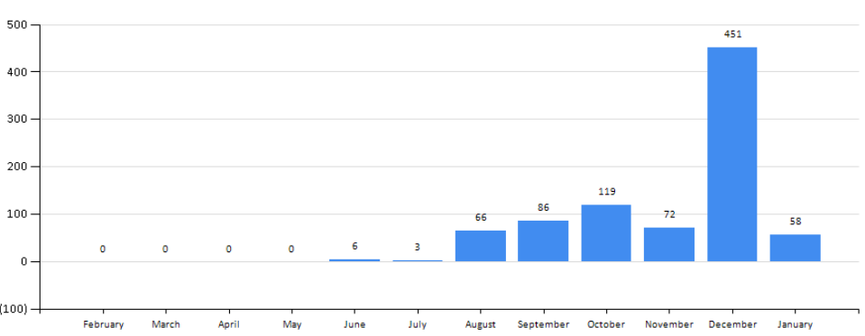
DBE Statistics
Applications Submitted
Certified Gender and Ethnicity Breakdown
Public Directory Searches

Slide 13
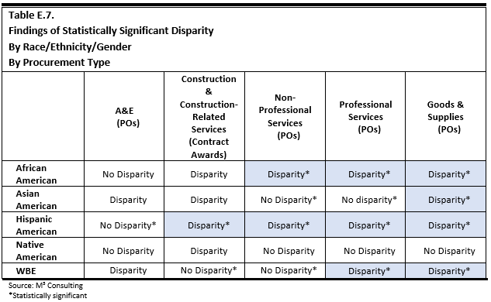
Disparity Study Findings

Slide 14
Recommendations and Progress Details
# | Recommendation | Action Step | Progress Update
1 | Change inclusion focus from programmatic (compliance with DBE regulations) to organizational (commitment to inclusive procurement environment). | Establish a cross functional director level Supplier Diversity Committee. | The City has created a working group that includes representatives from each department… Changes require buy in from all departments. When we roll out the program rewrite, we will seek a City-Wide directive for each department to actively seek opportunities to utilize DBEs for procurements.
2 | Address decentralized nature of the City’s procurement process and its effect on DBE participation. | Explore procurement workflow tools and DBE support services to ensure fair, open, transparent, and inclusive decision-making throughout the City. | B2GNow Certifying application was launched in July 2024. We have budgeted for and are in the process for adding the Contract Compliance module to allow for centralized oversight of contract performance on City contracts. Vendor Self Service will further streamline the Vendor Certification process ensuring more accurate DBE data in the database allowing departments to source DBE quotes.
3 | Identify community economic development and inclusive procurement objectives. | Identify community partners willing to participate in DBE Support Services. | Partnerships with Wilmington Alliance, True Access Capital, SBDC, SBA, New Castle County, among others have led to increased interest in the DBE program. We have fostered relationships with the Greater Philadelphia Chamber of Commerce, The National Minority Supplier Diversity Council, and the Eastern Minority Supplier Diversity Council. These orgs have increased our awareness of best practices to pursue as well as increased our pipeline of potential DBE businesses.
4 | Provide procurement and DBE training and development to all staff throughout the City. | Include DBE and diverse supplier content in their staff training. | Procurement training has been completed. OED continues to look for opportunities to participate in industry trainings, workshops, and info sessions. In 2024 we attended the NMSDC Conference in ATL, GA in addition to regional MED Week training and seminars.
5 | Fully implement existing DBE programmatic initiatives and address prior internal audit concerns. | Analyze the Agreed Upon Procedures (AUP) report findings and take appropriate actions. | OED has expanded its capabilities regarding Good Faith Effort reviews for all publicly bid projects by hiring a dedicated DBE admin. We have also pivoted our quarterly disparity working group to act as a DBE steering committee to explore and pursue policy and procedural changes to continually improve the program.
6 | Conduct a culture audit which will assist the City in understanding any underlying values, perceptions, traditions, and biases. | Identify vendors to conduct a culture audit in the future. | To Be Determined
7 | Address data capture issues to allow the City to effectively monitor and track all procurement decisions. | Explore procurement workflow tools and DBE support services to enhance monitoring and tracking of procurement decisions. | OED has implemented a DBE Certifying tool. The procurement team is rolling out Tyler's Vendor Self-Service, which will improve vendor data capture quality. OED/Finance has budged for and is proceeding with a compliance module to enable data collection enabling contract oversight.
8 | Implement procurement focused budgeting, forecasting and scheduling. | The Supplier Diversity Committee will actively search for opportunities and produce a "contracts to watch" list. | OED has been exploring the available data to understand department’s budgets in order to explore where Dbe focused opportunities may exist. We’ve recently gotten access to a new enterprise reporting tool 3rd Watch, which should enable us to pull aggregate level data to help us understand the City’s overall purchasing. We intend to use this info to identify opportunities and matchmake/recruit MBEs/DBEs for those opportunities

Slide 15
Recommendations and Progress Details
# | Recommendation | Action Step | Progress Update
9 | Monitor contracts for the issue of concentration. | Implement a Contract Compliance application | OED has recently had an in-depth demo of the contract compliance module presented by our DBE certifying tool vendor. OED will begin the contract process to implement the new module.
10 | Determine how the City can engage in youth entrepreneurship programs. | Work with community partners and existing youth programs to identify and support entrepreneurship opportunities. | Preliminary discussions have been had with Parks and Rec. department to include youth entrepreneurship as part of their existing youth programming.
11 | Refocus certification and pre-qualification efforts to identify qualified firms. | Explore updates to the City’s DBE criteria | Our new certification tool enables OED to have a more robust certification process. We are also working to leverage existing area DBE programs as well as to align our new PE Program (PEP) with existing state program requirements.
12 | Increasing pipeline of DBEs using outreach techniques. | The City has been actively meeting with service providers and leveraging data from M³ Consulting for outreach efforts. | OED has actively been promoting the DBE program by exhibiting and presenting at local and regional DEI events. The new certifying tool enables us to access DelDot and State of DE data regarding certified firms. New Castle County has also made Wilmington’s certification it’s de facto certification, increasing interest in the program and increasing opportunities for certified businesses.
13 | Expand competition by conducting a deeper dive into the City’s procurement and bidding practices. | Utilize the Capital Projects review forum to identify and advocate for DBE opportunities. Explore under bid threshold data to identify opportunities for DBE small businesses. | OED is reviewing the available data to determine where opportunities lie to target for DBE involvement.
14 | Promote DBE participation at the prime contractor level. | Work with local partners to increase MBE capacity through training and support services. | OED is working with community partners to build capacity in support of bid ready DBEs. Conduct Post Bid reviews by soliciting feedback from internal stakeholders and reviewing bids with DBE bidders to provide valuable feedback to help improve their bidding on future contracts.
15 | Develop DBE program which addresses requirements of large construction and development projects. | Review the Capital Projects list and create opportunities by unbundling according to the seven stages of development. | Turner Construction conducted it’s Turner School of Construction Management to the City in the Fall of 2023 to help build capacity within the DBE community of construction businesses. OED will continue to support programs that increase the capacity of DBE businesses.
16 | Implement small business set-asides and sheltered market projects. | Identify small business purchase opportunities, encourage DBE registration, and advocate for small vendors to departments | OED is exploring the available data to identify opportunities for set aside projects, carve outs, and sheltered market projects. The DBE program rewrite includes set aside projects for under bid threshold opportunities.
17 | Address concerns about slow payments. | The Finance Department will streamline the invoicing process through the Vendor Self Service module. | Vendor self service will improve payment times. The team is exploring improved payment terms for Prime Vendors who meet or exceed DBE participation goals in order to incentivize those Contractors to use DBEs, and consequently improving DBE payment times on sub contracts. Additionally, we have secured access to a reporting tool that may allow us to have insight into payments to DBE prime contractors.

Slide 16
Recommendations and Progress Details
# | Recommendation | Action Step | Progress Update
18 | Develop bonding and insurance programs related to a project-based procurement process. | Identify partners to provide bonding support services for MBEs. | OED has met with several bonding and insurance providers and support businesses to communicate the need for services in the City. We have established an ecosystem of bonding partners who are able to provide support and guidance on bonding. One of these new relationships has recently produced a successful DBE prime bid winner for the business' largest contract to date.
19 | Maximize use of joint ventures, mentor-protégé programs, and distributorships. | Leverage community partnerships and the local ecosystem to identify opportunities for joint ventures, mentorship, and distributorships. | OED and partner organizations will work to identify opportunities for JVs, mentor-protégé relationships, etc. OED will encourage these arrangements by advocating for and supporting DBEs with the full scope of services provided to local businesses.
20 | Develop effective matchmaking and outreach programs. | Leverage community partnerships and secure a procurement management tool for enhanced outreach and matchmaking efforts. | The City’s new certification application allows access to DelDot and State of DE certified data allowing us to target businesses in our MSA when opportunities exist.
21 | Increase outreach by focusing efforts on expanding the total vendor and bidder pools. | Leverage available data sources and conduct targeted outreach and promotion of the DBE program. | Our DBE certifying tool has improved the outreach capabilities of the City. We utilize the data captured by the disparity study, OSD DBEs, DelDot DBEs, and other regional certifying bodies to promote and recruit for the City's DBE program.
22 | Develop detailed and effective monitoring and tracking reports for overall projects and project-by-project. | Reporting, monitoring, and tracking will be a key requirement for any procurement management tools the City pursues. | New reporting capabilities will be available once we have tools to capture data around contract participation.
23 | Develop and assign post-award compliance responsibilities. | Enact contract compliance monitoring | A contract compliance application will enable post award monitoring and compliance oversight.
24 | Partner with technical assistance providers to increase the City’s ability to utilize its opportunities for capacity building. | Identify the ecosystem of partners who can assist with capacity building efforts. | Ecosystem partners have been identified who have committed to building capacity within the DBE community. (True Access Capital, The Wilmington Alliance, WEDCO, KOG International, EMSDC, NMSDC, SBDC)
25 | Develop working capital loans, paymaster programs, and prompt pay requirements particularly with minority-owned banks and partners. | Establish of a DBE fund at Wilmington Economic Development Corporation (WEDCO) or other CDFI | The City has explored City Backed financing opportunities to help DBEs overcome capital access challenges. For now, the City's strategic fund and minority business set aside are sources for potential capital support on project specific needs.
26 | Identify Race/Gender Conscious Goal Possibilities. | Determine where race and gender conscious goals are feasible and establish them accordingly. | The team continues to evaluate program changes and will implement race and gender conscious policies where feasible and justifiable using the Disparity Study findings.

