Slide 1

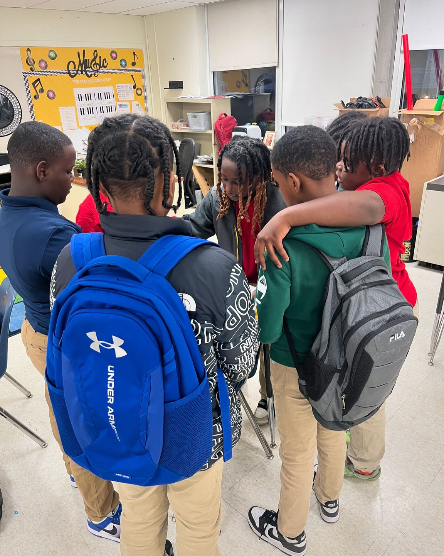
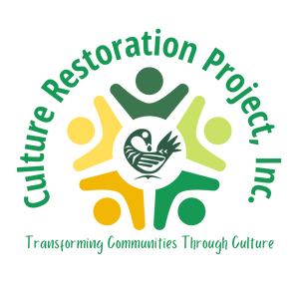






CULTURE
RESTORATION
PROJECT, INC.
Culture is the fruit of a people’s history!
-Amilcar Cabral
Political Organizer

Slide 2

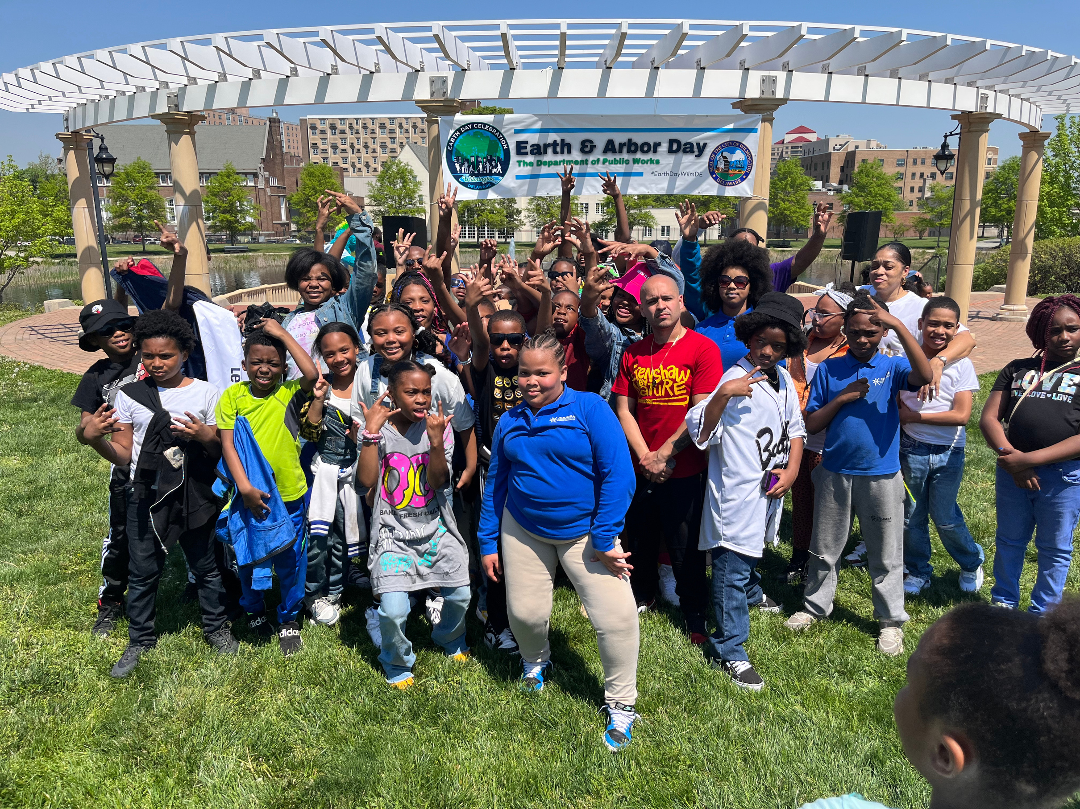


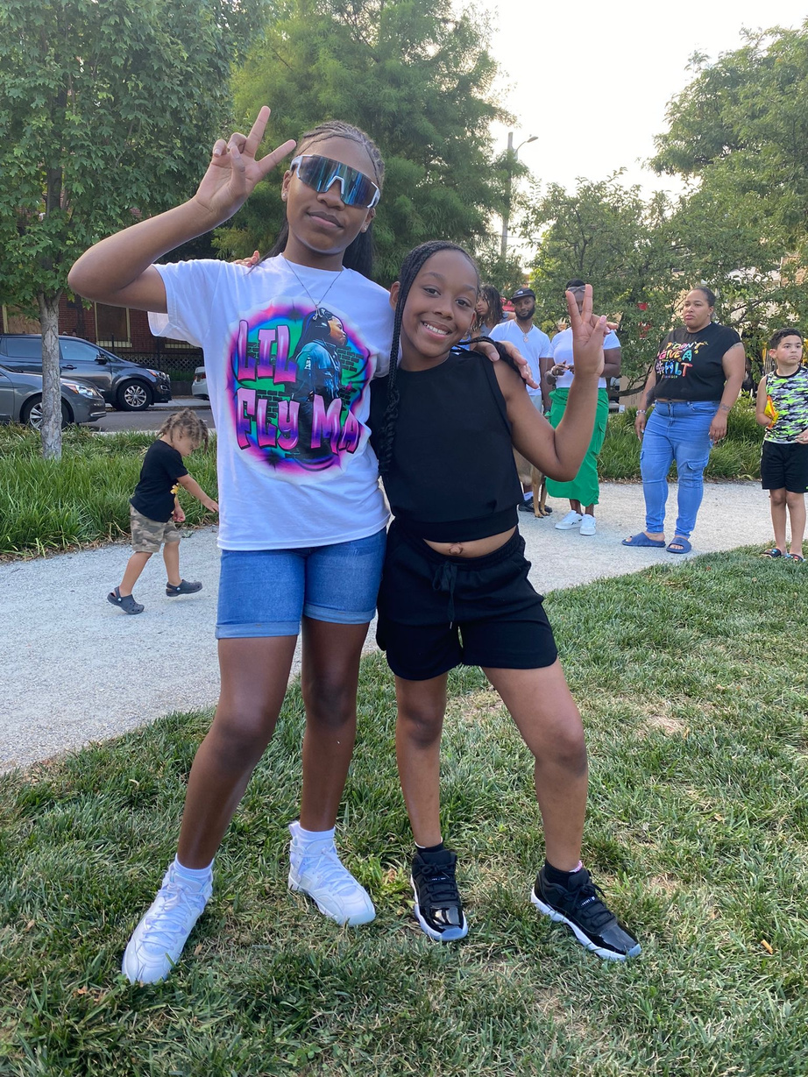

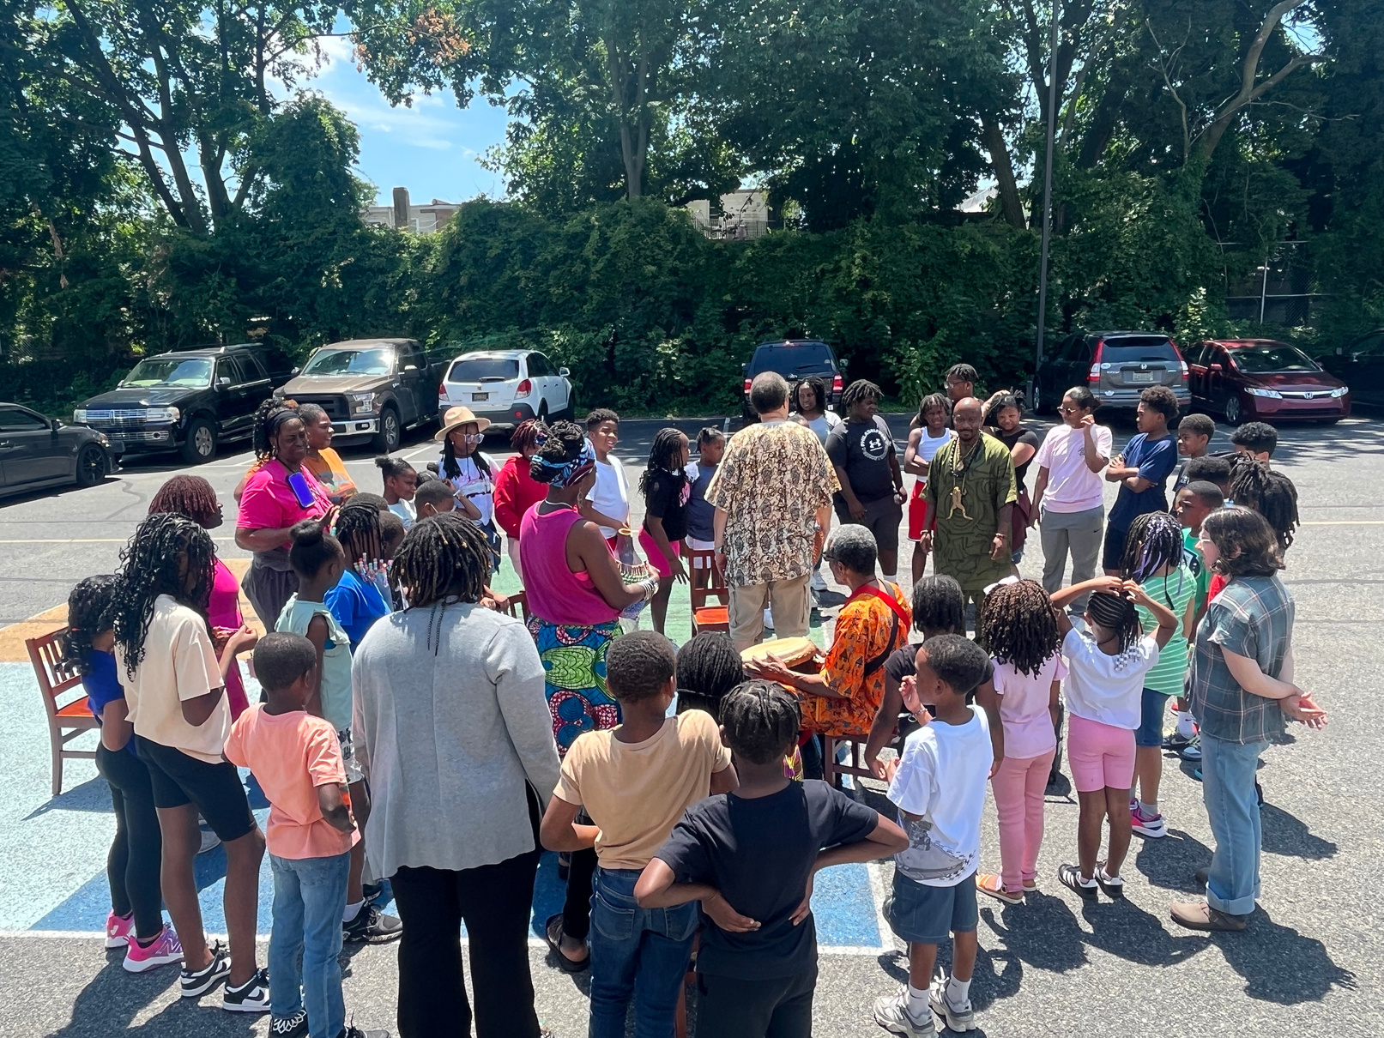
WHAT GUIDES US
Our Mission
To provide culturally competent educational and arts-based programs and services that build culturally aware, self-reliant youth leaders and communities.
Our Vision
A reimagined community transformed by culturally adapted and engaged youth and adults who accept responsibility for the maintenance of their communities.

Slide 3

OUR RESULTS
600+
Students served in 2024!
We exceeded our goal for the 3rd year in a row!
* Goal: 300 students per year

Slide 4
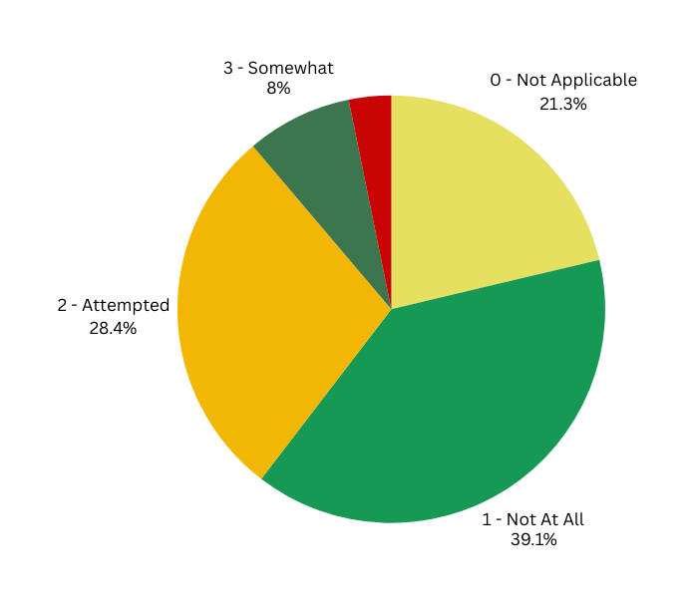
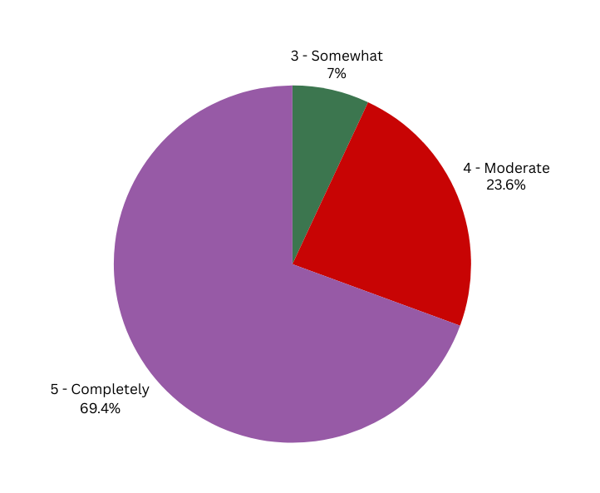

OUR RESULTS
We evaluated a sample of 95 students who participated in our curriculum-based programs, each spanning 12 weeks or more. Our goal was for at least 50% of our students to demonstrate a appropriate "Knowledge of Self." To measure this, we evaluate students’ workbook assignments, classroom behavior, and feedback from teachers and guardians, considering a score of 3 or higher as a success. The results are as follows:
Pre-Assessment Averages
(in the beginning of the program)
Post- Assessment Averages
(at the end of program)
4 - Moderate
3.2%
In the beginning of the program, we provided students with a series of questions to assess their "Knowledge of Self" (KOS). Answers to questions were assessed based on a scale of 0 -5. Higher assessment values equal a higher KOS.
At the end of the program, we provided students with the same series of questions presented in the beginning to re-assess their ' "Knowledge of Self" (KOS). Higher assessment values equal a higher KOS.
Knowledge of Self - basic understanding of self from a cultural, historical, familial, communal, and social perspective, development of a more positive self-affirming self-identity

Slide 5
OUR RESULTS
97.7%
of students exhibited an adequate level of “Knowledge of Self”
(average assessment values of 3, 4, & 5) - Compared to 11.2% at the beginning of our 2024 program year.
We exceded our goal!
Goal: 75%
How did we achieve these results? - In 2023, 82.9% of students achieved an appropriate level of "Knowledge of Self," a remarkable improvement from 36.5% at the start of that year. For 2024, we adjusted our approach to address students' challenges with critical self-reflection. By providing daily reminders and encouragement to emphasize their purpose, we cultivated deeper
self-awareness, which is evident in the 2024 final assessment outcomes.

Slide 6


PROGRAMS & EVENTS
Beyond Those Bars (BTB)
Beyond Those Bars Youth Artist Development
Sankofa Drum Core
Knowledge of Self (KOS)
Sankofa Rites of Passage Initiative
BTB Beatmaking & Production
Ponya Circles
Kulture Keepers
Malcolm X Day
Kwanzaa

Slide 7
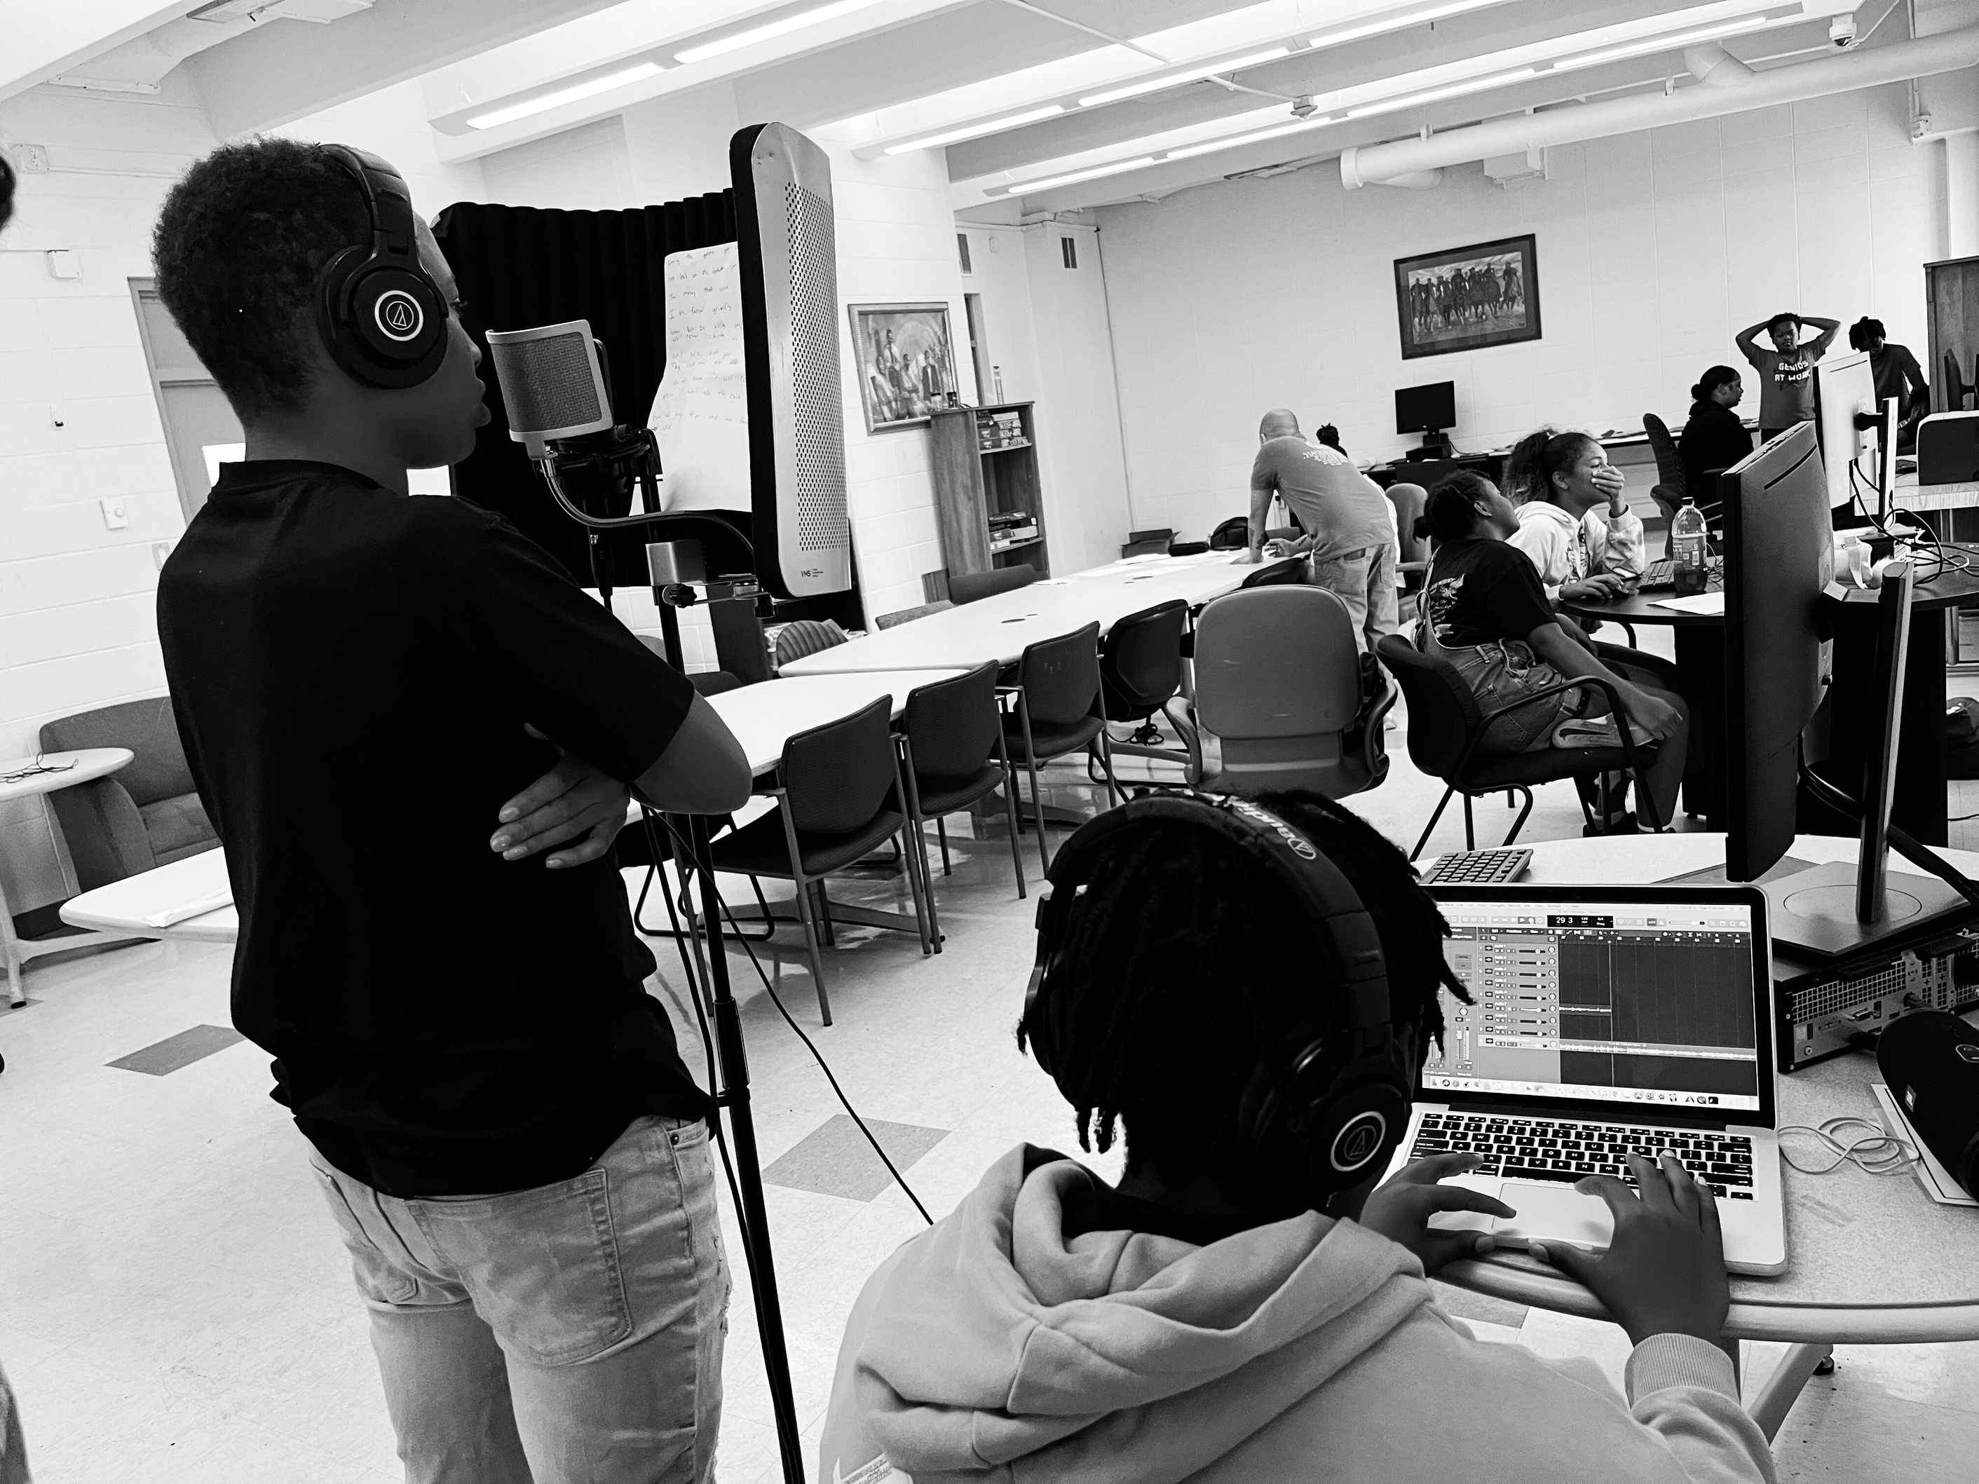
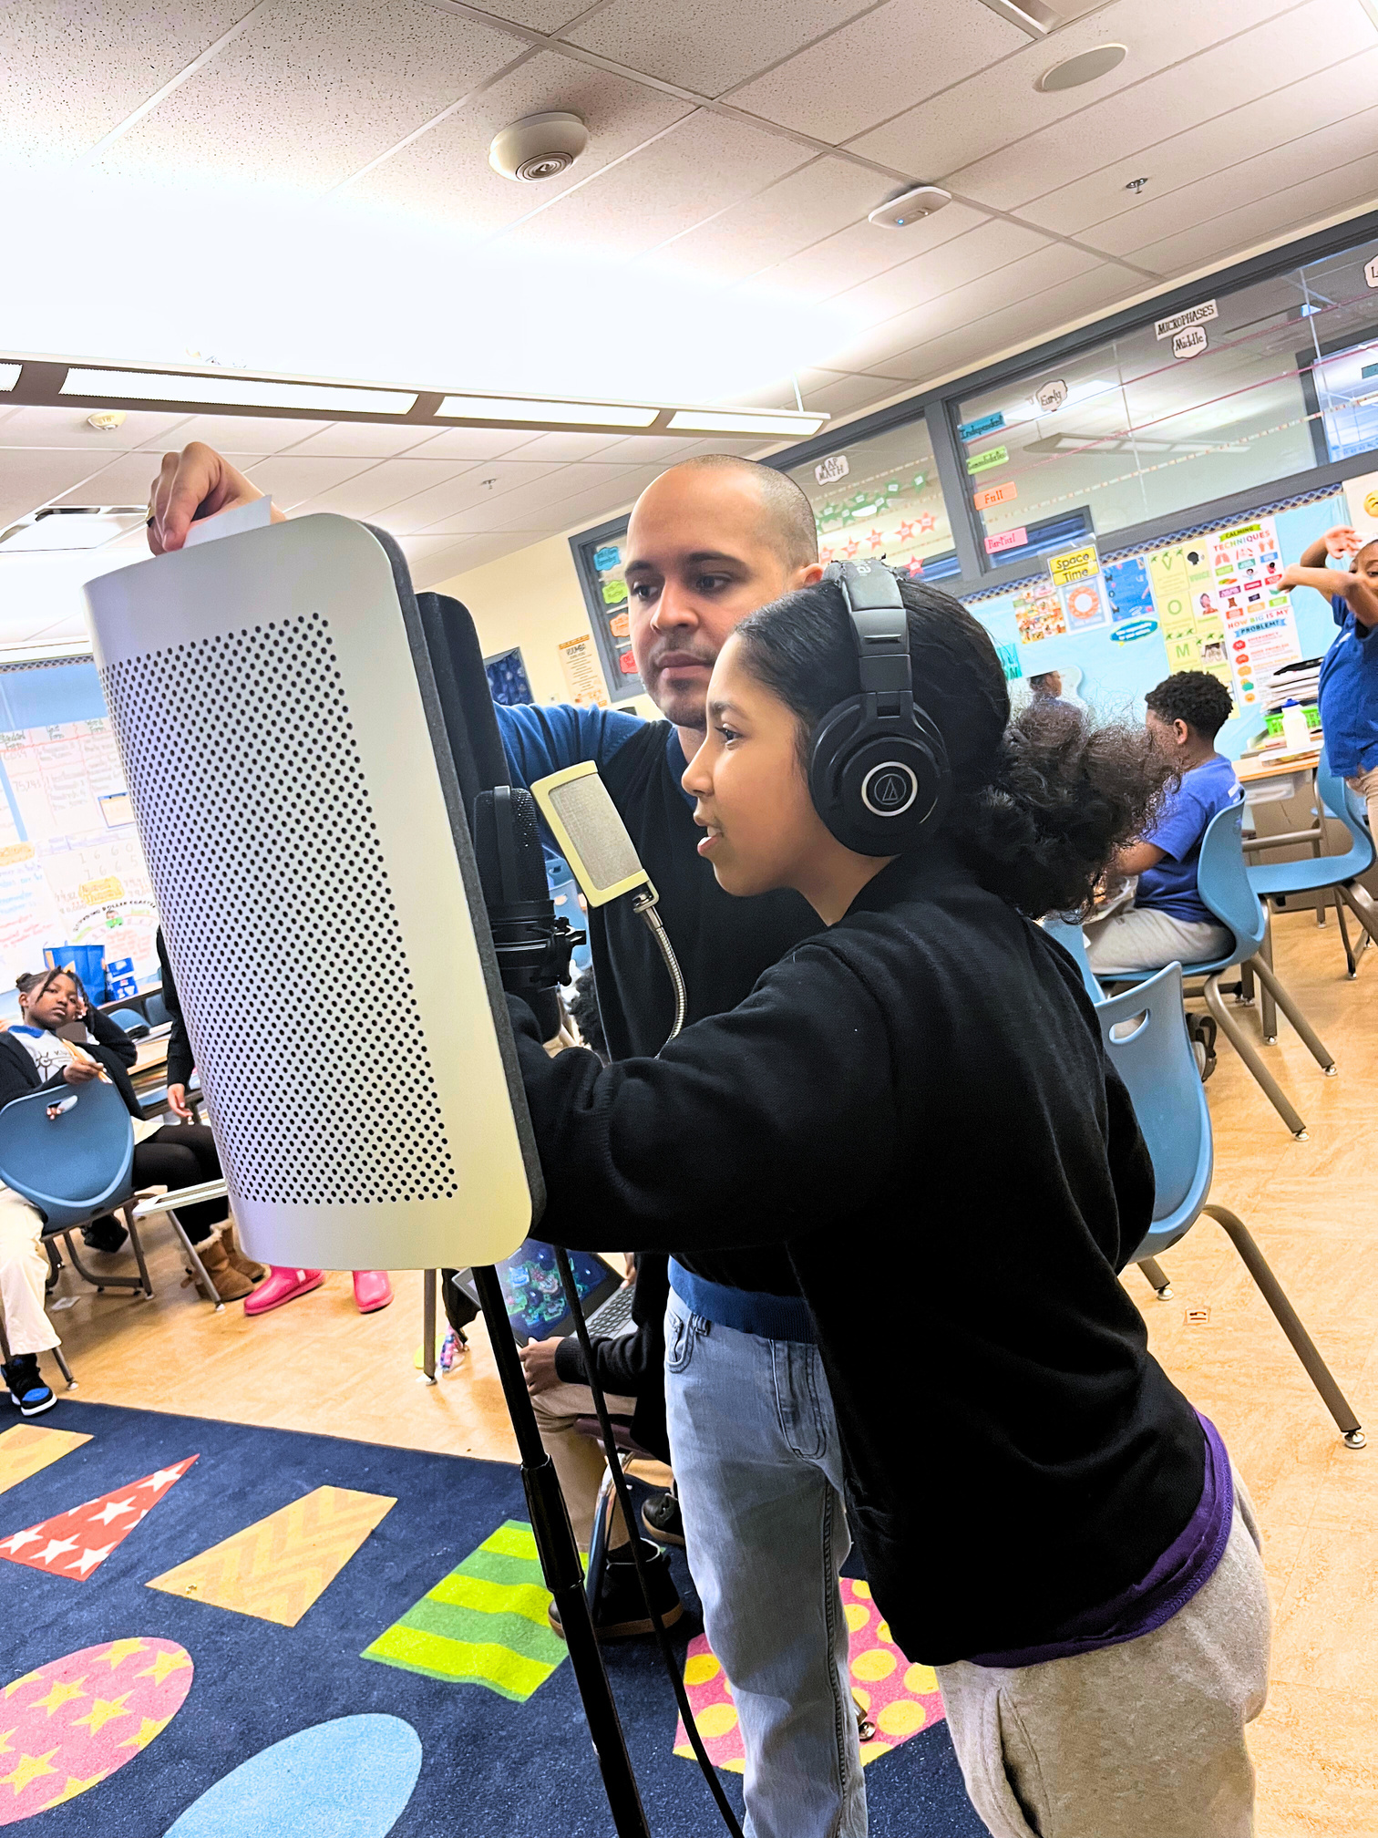
PROGRAMS & EVENTS
Beyond Those Bars (BTB)
is a Project-Based Learning (PBL) enrichment program. BTB utilizes interactive hip-hop workshops to engage youth grades 3-12 in positive, culturally relevant activities.
Our workshops focus on positive self-identification, cultural pride, civic engagement, critical thinking, and educational success.

Slide 8

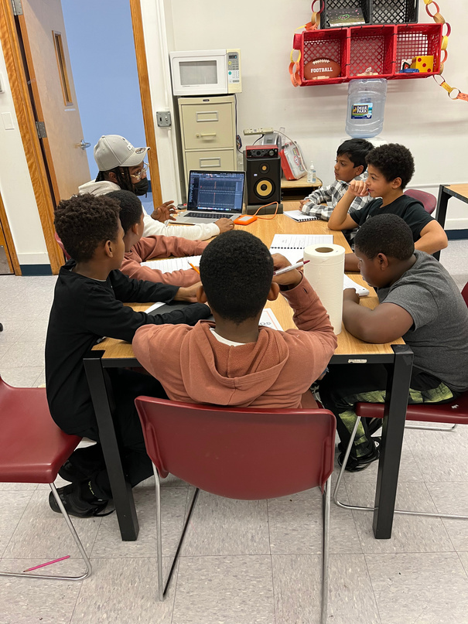
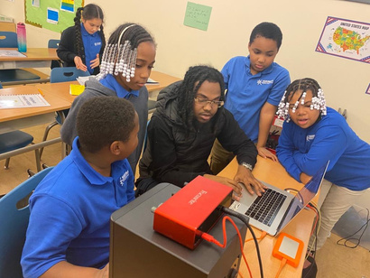
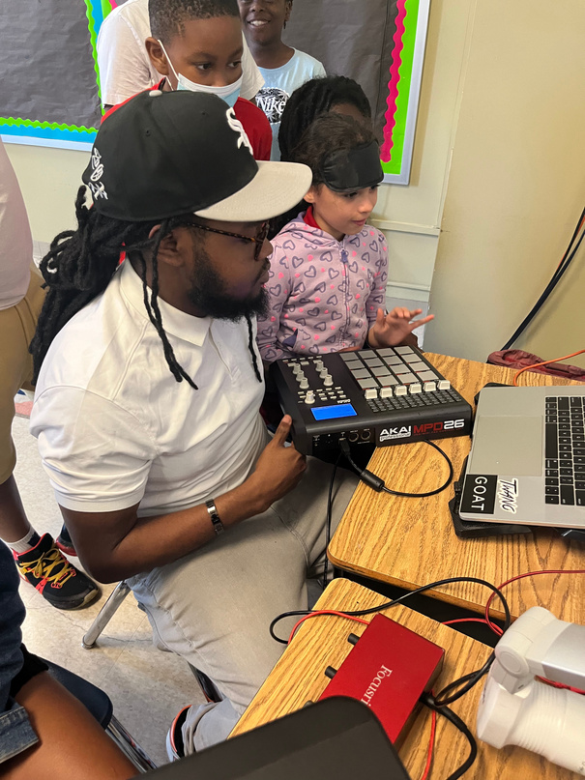

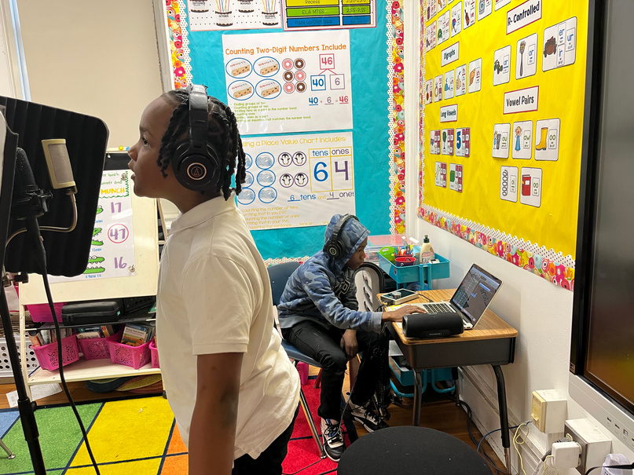
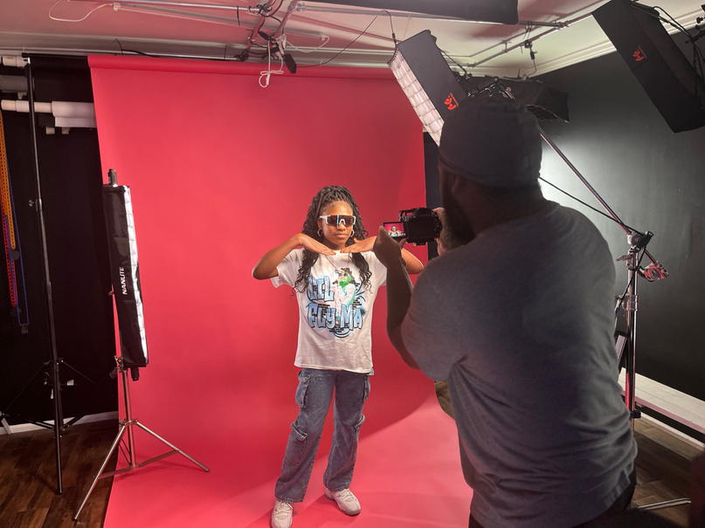
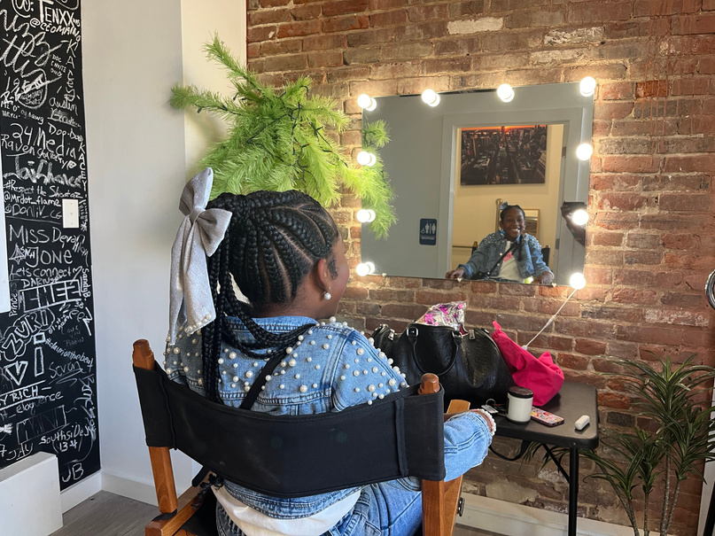
PROGRAMS & EVENTS
Beyond Those Bars (BTB)
BTB Youth Artist Development
BTB Beatmaking & Production
is a hands-on course designed for young artists to explore the art of music production. Participants will learn the fundamentals of creating beats, including rhythm, melody, sampling, and sound design, while using industry-standard software and equipment. Guided by professional producers, students develop their own unique sound and finish with original tracks that showcase their creativity. This course fosters self-expression, technical skills, and collaboration in a supportive, culturally-rich environment.
is a transformative initiative for underserved youth, equipping them with the skills and confidence to excel in the music and tech industries. Participants collaborate with industry professionals to develop expertise in songwriting, performance, recording, and music business strategies. The program culminates in a professionally produced 6-song project and music video, preparing young artists to showcase their talents on streaming platforms while gaining real-world experience in cutting-edge creative fields.

Slide 9

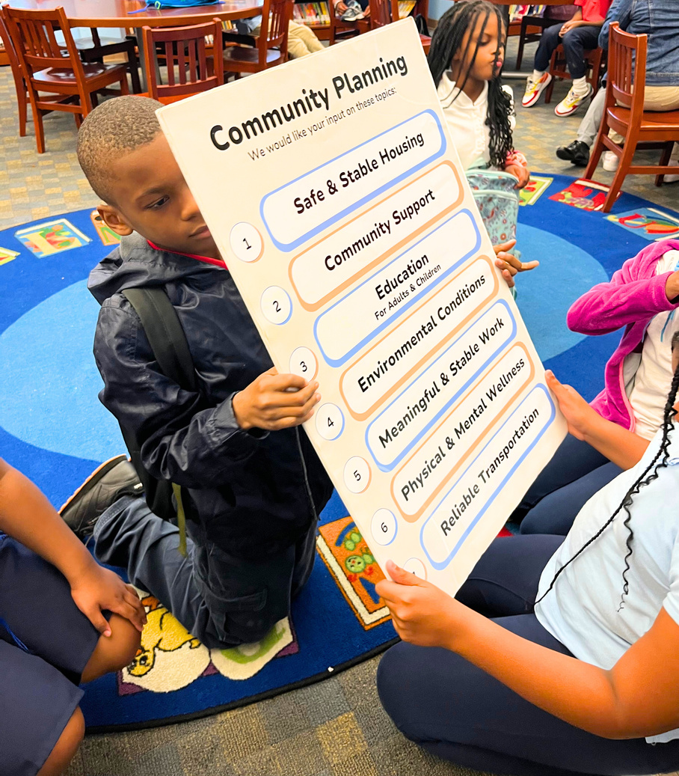
PROGRAMS & EVENTS
Knowledge of Self
Sankofa Rites of Passage Initiative
is a character and life-skills-building program that uses basic African-centered principles and artistic, cultural awareness to teach skills necessary for positive social engagement in family, community, and professional settings. KOS works on the premise that self-awareness, self-appreciation, and cultural pride can improve all levels of social engagement for young people.
an African-centered development process that teaches practical life skills, cultural pride, civic responsibility, and positive self-identification. It is a 9-12-month process that supports a connection between self, family, and community. It is a formalized, structured way to socialize participants and symbolizes a shift from one stage of life to another. SROPI addresses social/emotional inadequacies caused by historical trauma.

Slide 10
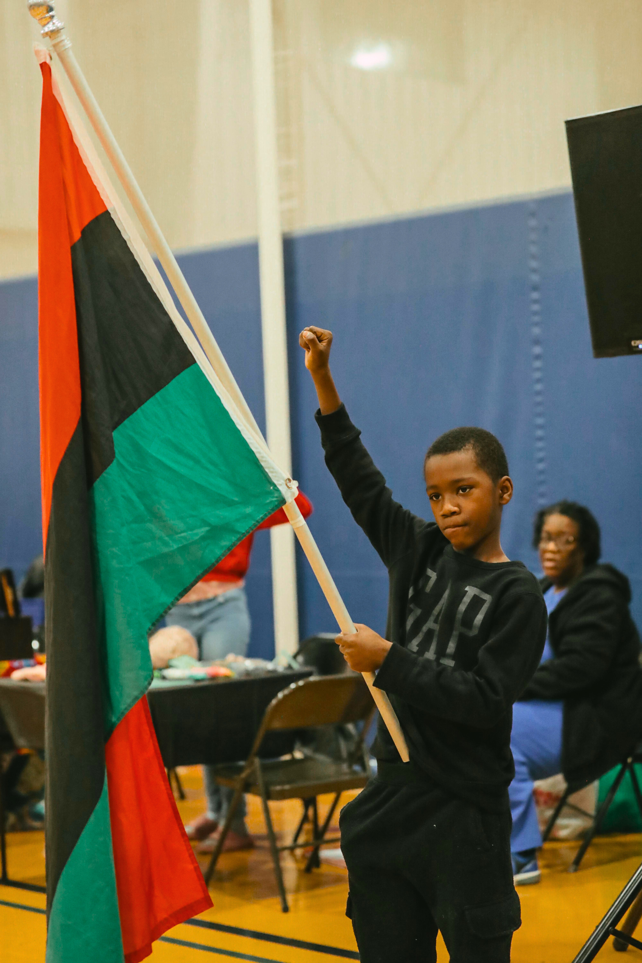
PROGRAMS & EVENTS
Kulture Keepers
is a Virtues-based youth enrichment program that utilizes arts and culture to promote leadership and character-building skills. Through interactive experiences, students build critical thinking and social skills from culturally relevant and responsive perspectives.

Slide 11
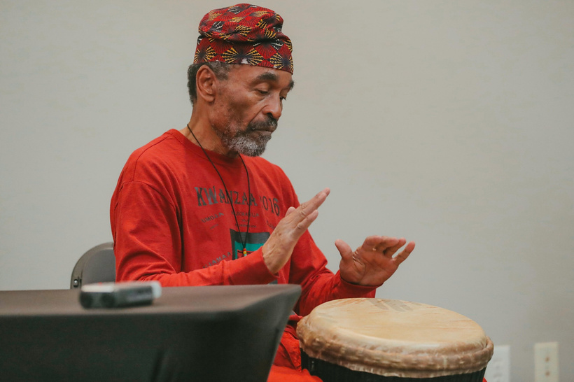

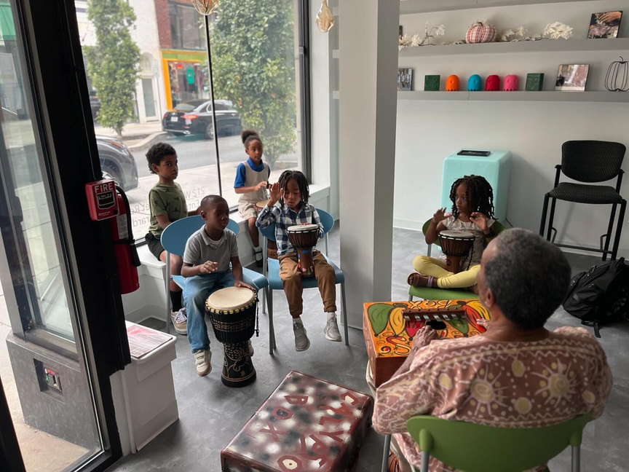
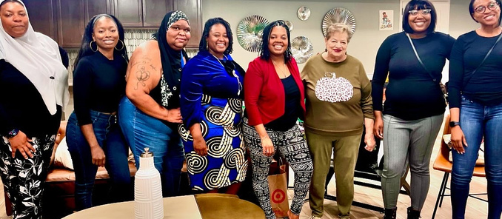
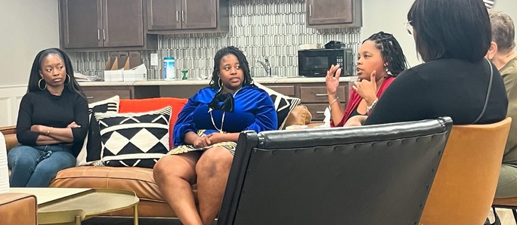
PROGRAMS & EVENTS
Ponya Circles
A culture-centered, safe, and supportive space where community members can fellowship, dialogue, organize, and find connection with each other in the communities where they live, work, and play. Ponya Circles promotes healing and wholeness for all.
Sankofa Drum Core
The Sankofa Drum Core imparts foundational African drumming skills to children while integrating healthy social-emotional techniques rooted in African traditions. Through an African-centered perspective, it engages participants in cultural immersion, fostering a holistic learning experience beyond drumming. Led by Master Drummer Baba Kamau Ngom of the Griots Wa Umoja.

Slide 12
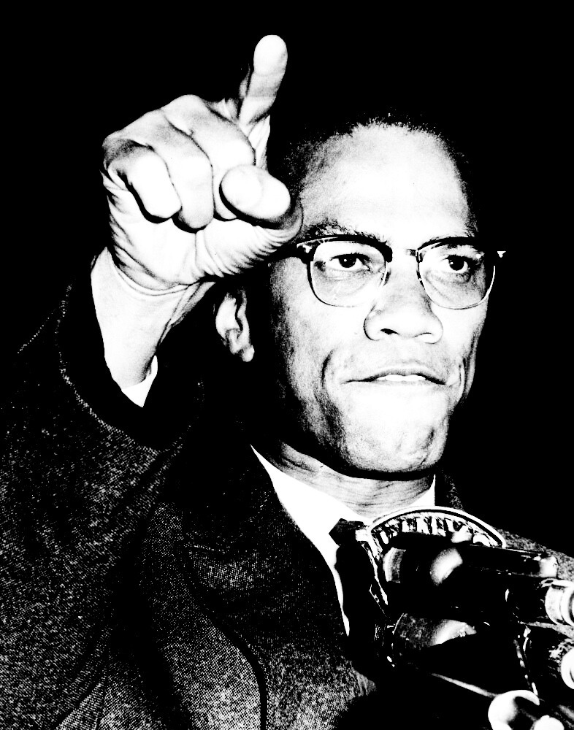
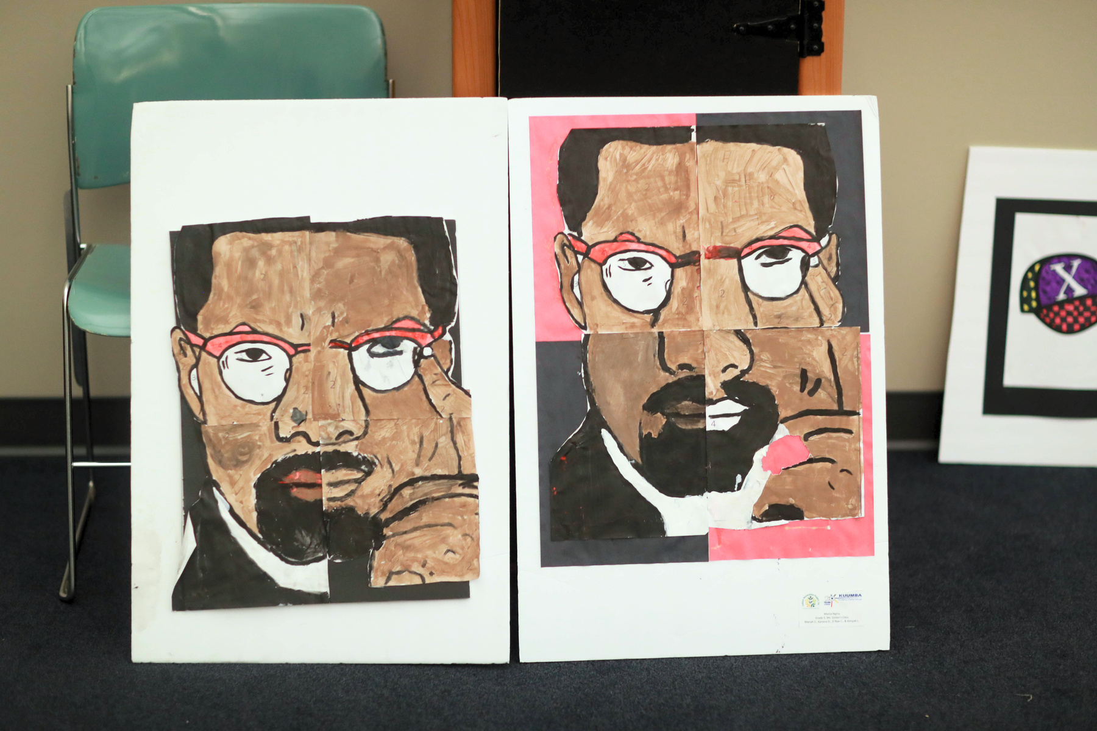
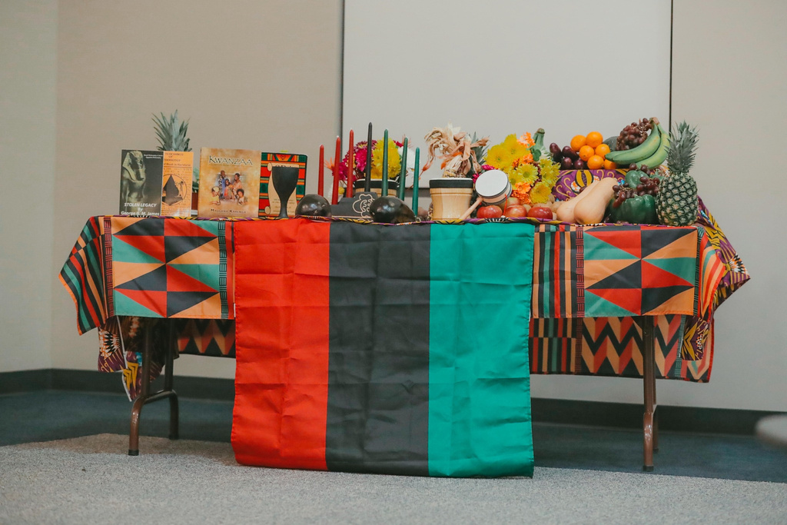

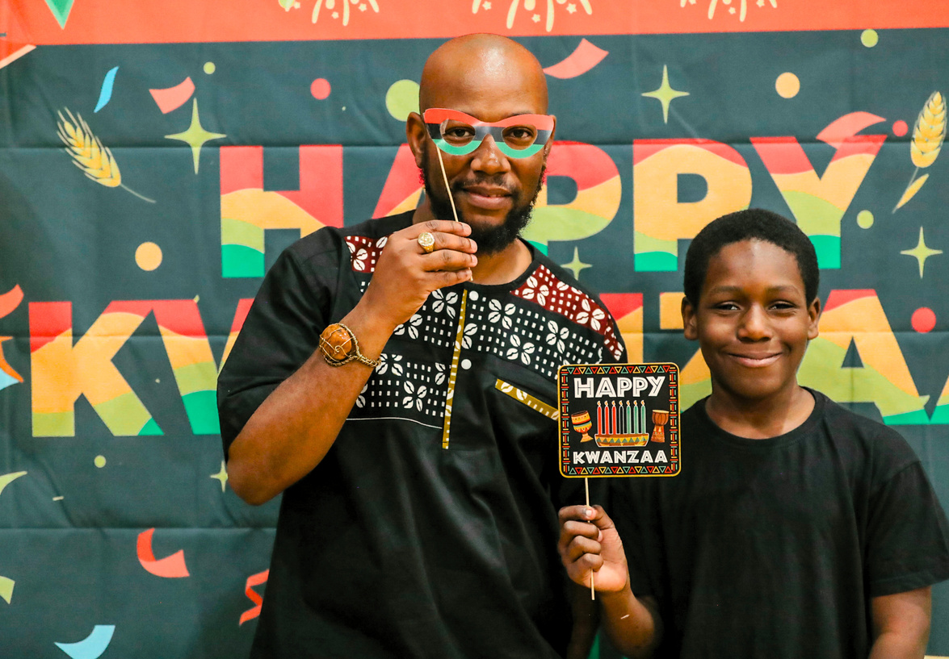
PROGRAMS & EVENTS
Kwanzaa
CRP, Inc. celebrates Kwanzaa with community events that promote family, community, and cultural education. Our events include traditional candle lighting ceremonies, music, dance, arts & crafts, and discussions about the principles of Kwanzaa. We emphasize the importance of unity, creativity, and collective responsibility within our communities. Hundreds of community members attend each year, making our celebrations the largest in our city.
Malcolm X Day
Malcolm X Day is a commemorative holiday that honors the life and legacy of Malcolm X. Our students celebrate this day with art exhibits, performances, and community. All activities promote Black empowerment and equitable opportunities for all.

