Slide 1

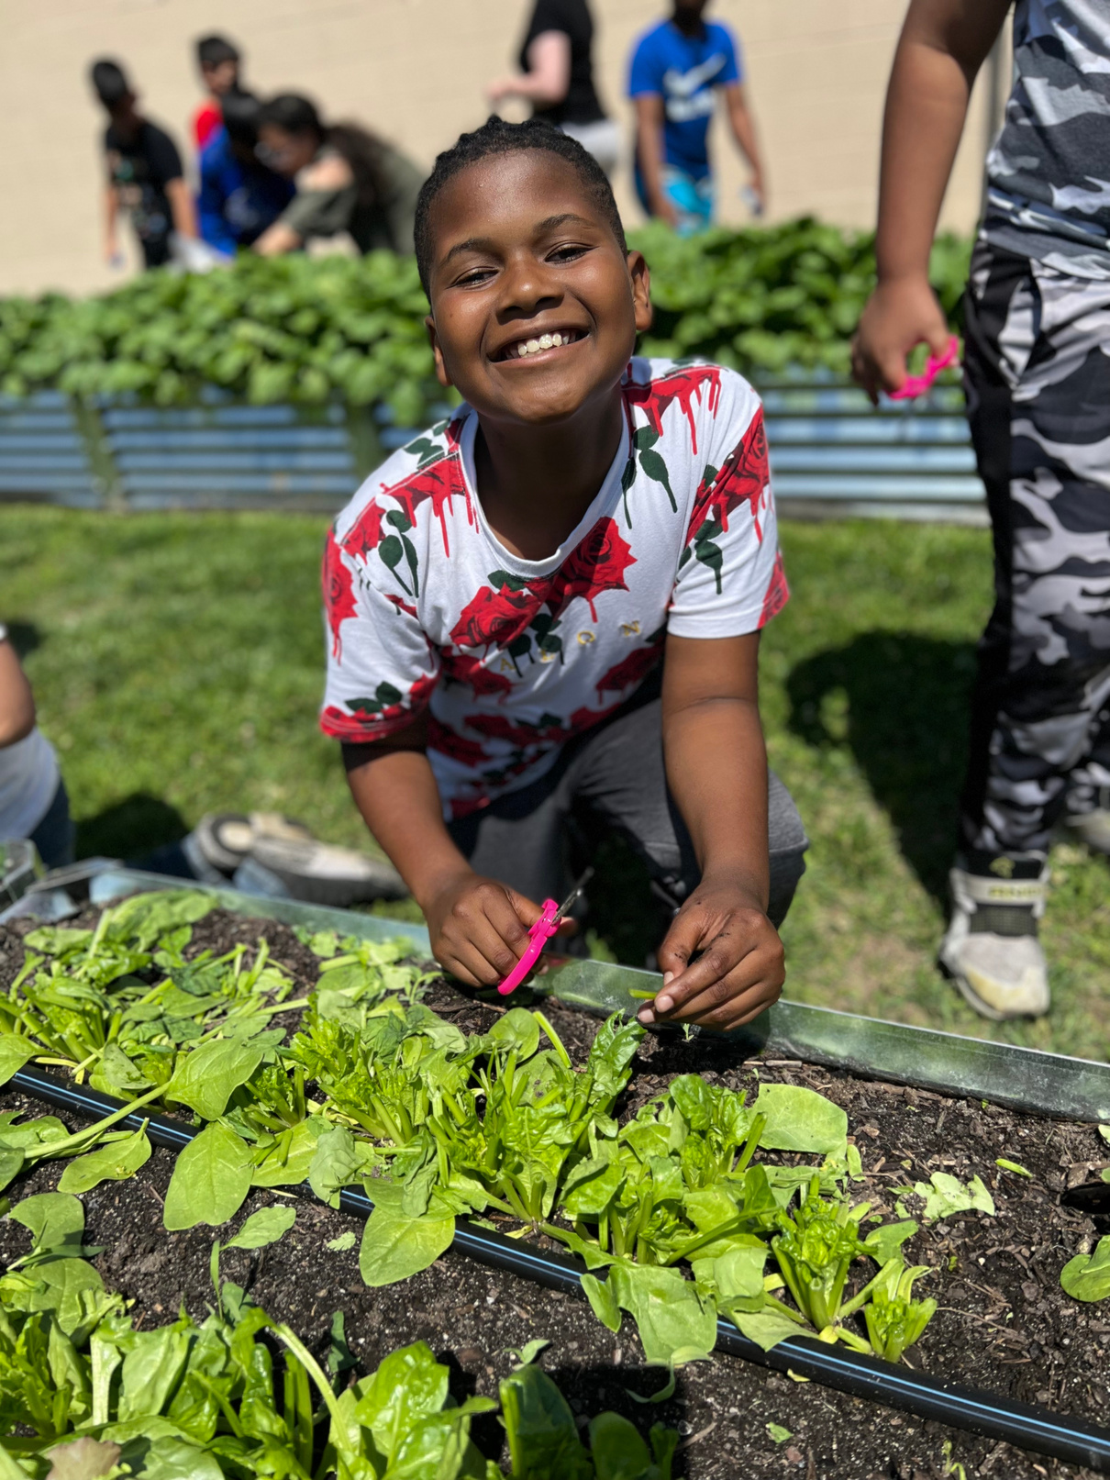


DO NOT SHARE THIS FILE WITHOUT THE EXPRESS CONSENT OF HEALTHY FOODS FOR HEALTHY KIDS
HEALTHY FOODS for HEALTHY kids
'Education Cultivation'
LET'S "VEGGIE-CATE THE FIRST STATE", TOGETHER!
HFHK, April 2024

Slide 2
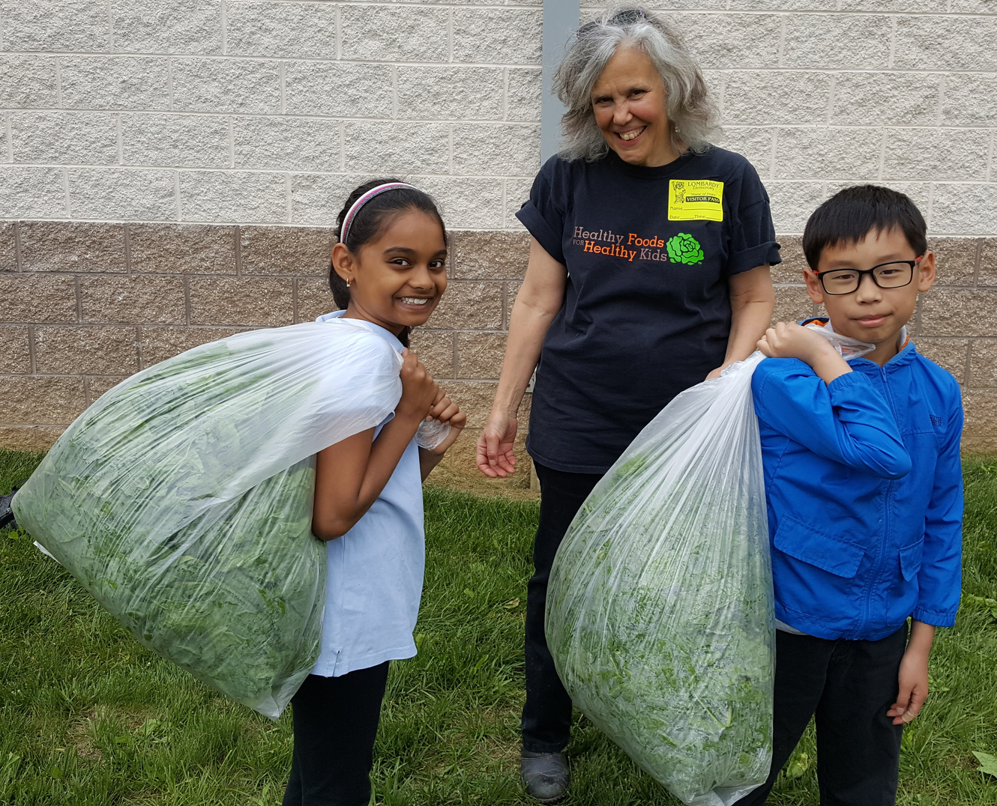
"THE FIRST STATE SCHOOL GARDEN EXPERTS"
History
Founded in 2008 by Dr. Thianda Manzara, a plant scientist.
Mission
To inspire healthier lives by providing youth with joyful school gardening experiences and opportunities to eat the garden-fresh vegetables they've grown.
Vision
A vegetable garden in every school, leading to generations of healthy families throughout Delaware.
Notes:
The program has its roots with Dr. Thianda Manzara, our founder, who 15 years ago discovered a cost effective way to deliver a school garden program that gives teachers a self-contained curriculum and roadmap at no cost.
Our audacious goal is to have a vegetable garden in every school, creating new generations who will eat healthier by growing their own vegetables and greens.
No other group in Delaware has our years of experience with school gardens. That's why we proudly call ourselves the first state school garden experts.

Slide 3
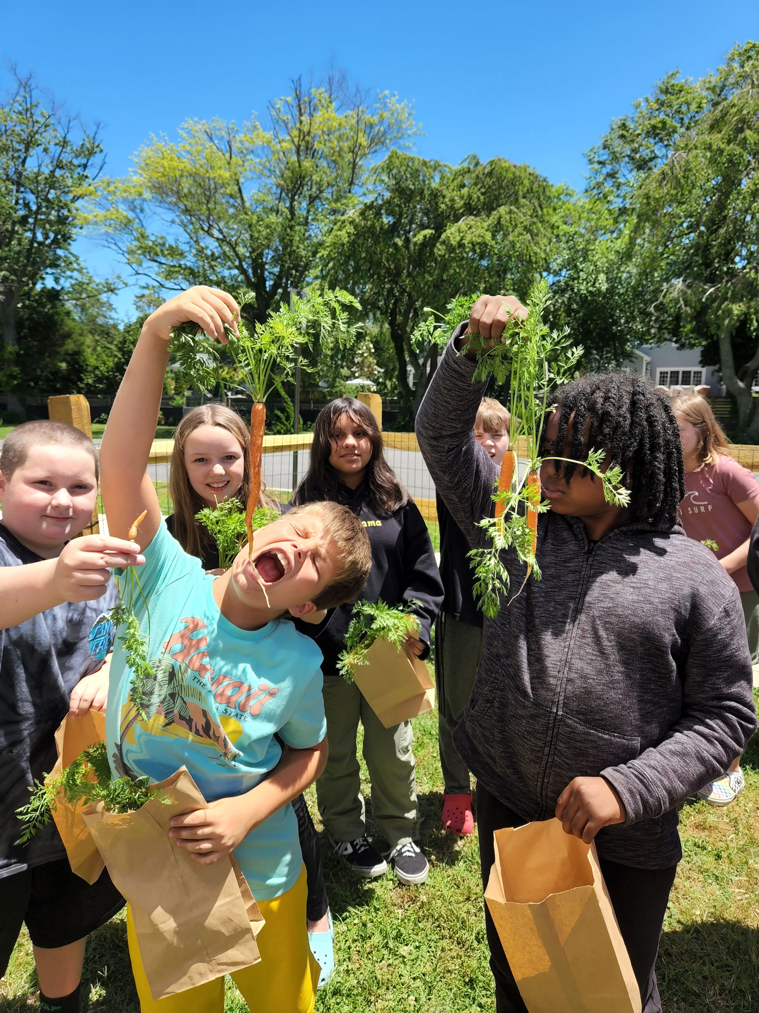


...I usually don't eat
things that come from dirt.
- 8th grade student,
Springer Middle School
EDUCATION CULTIVATION.
ALL STUDENTS, ALL GRADES, ALL SMILES.
Throughout every child's years at school, our program cultivates an appreciation for veggies that comes from hands-on gardening activities each growing season.
Notes:
We call our program 'education cultivation' because we are cultivating healthy eating habits for Delaware school children over a period of multiple years.
A unique aspect to our program is how every child in the school has a specific role to play so gardening and tasting veggies is reinforced year after year.

Slide 4
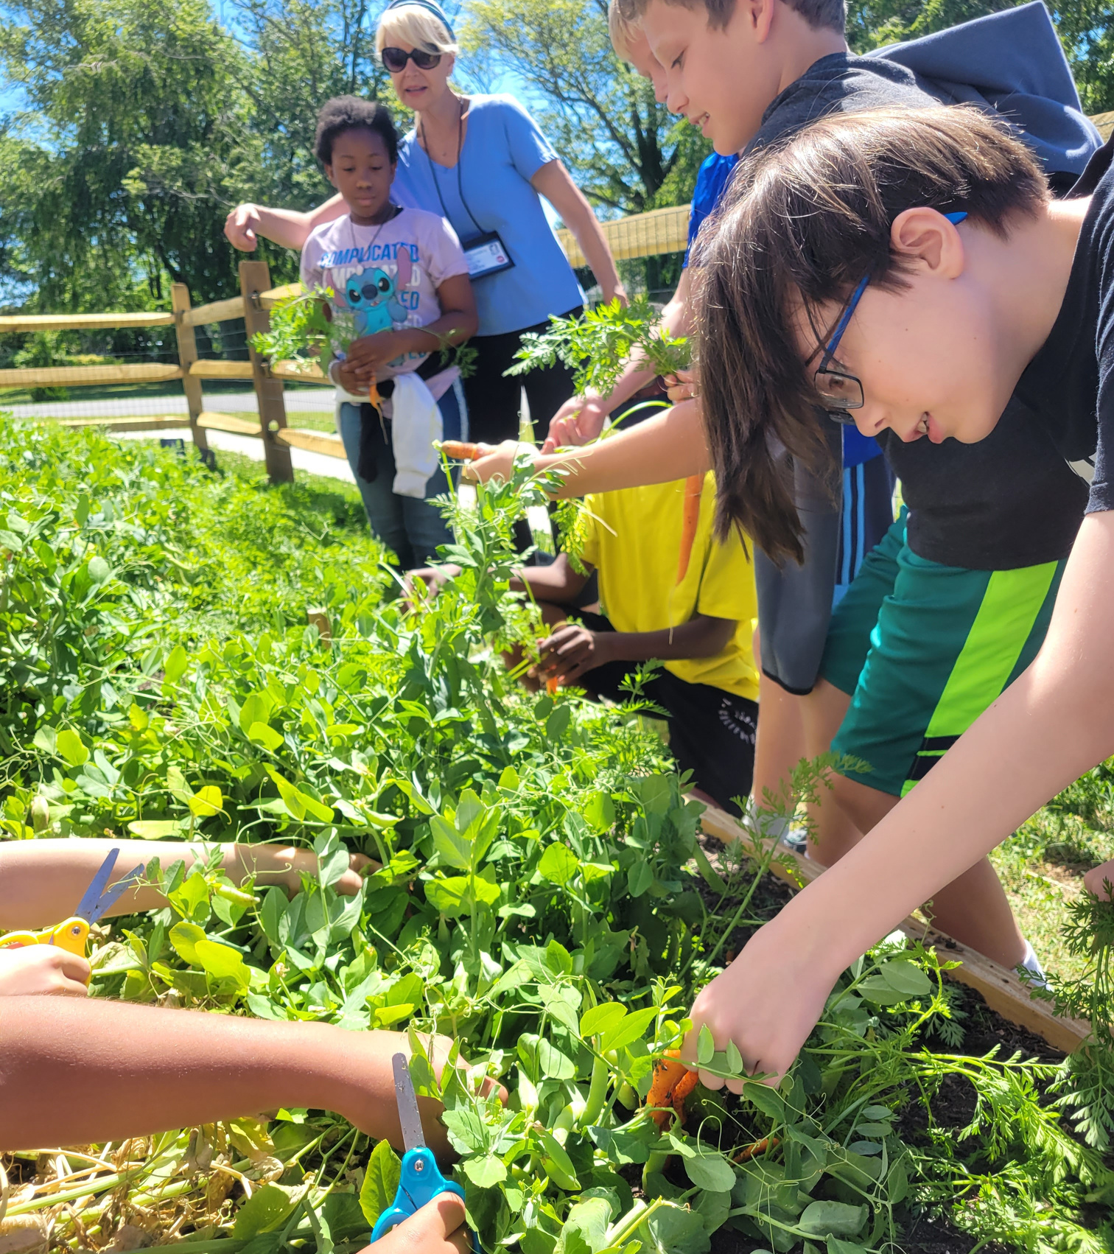

OUR PROGRAM
(in a pea shell!)
WHAT WE GROW
  Cool-weather, fast-growing crops such as spinach, carrots, arugula, bok choy, radishes, kale, turnips, & peas!
WHEN WE GROW
  Planting - March and September
  Harvesting - May and November
WHY WE GROW
  Teaches science in a fun and active way.
  Kids learn early on that vegetables can be delicious and lead to a healthier life.
Notes:
Our thesis is this: Healthy habits start early.
Everyone should know how to grow food. Not only is it essential for life, but it is also the lifeblood of the State of Delaware.
Here you see how we adapt our program to the growing seasons.
Kids love it...and so do teachers.

Slide 5
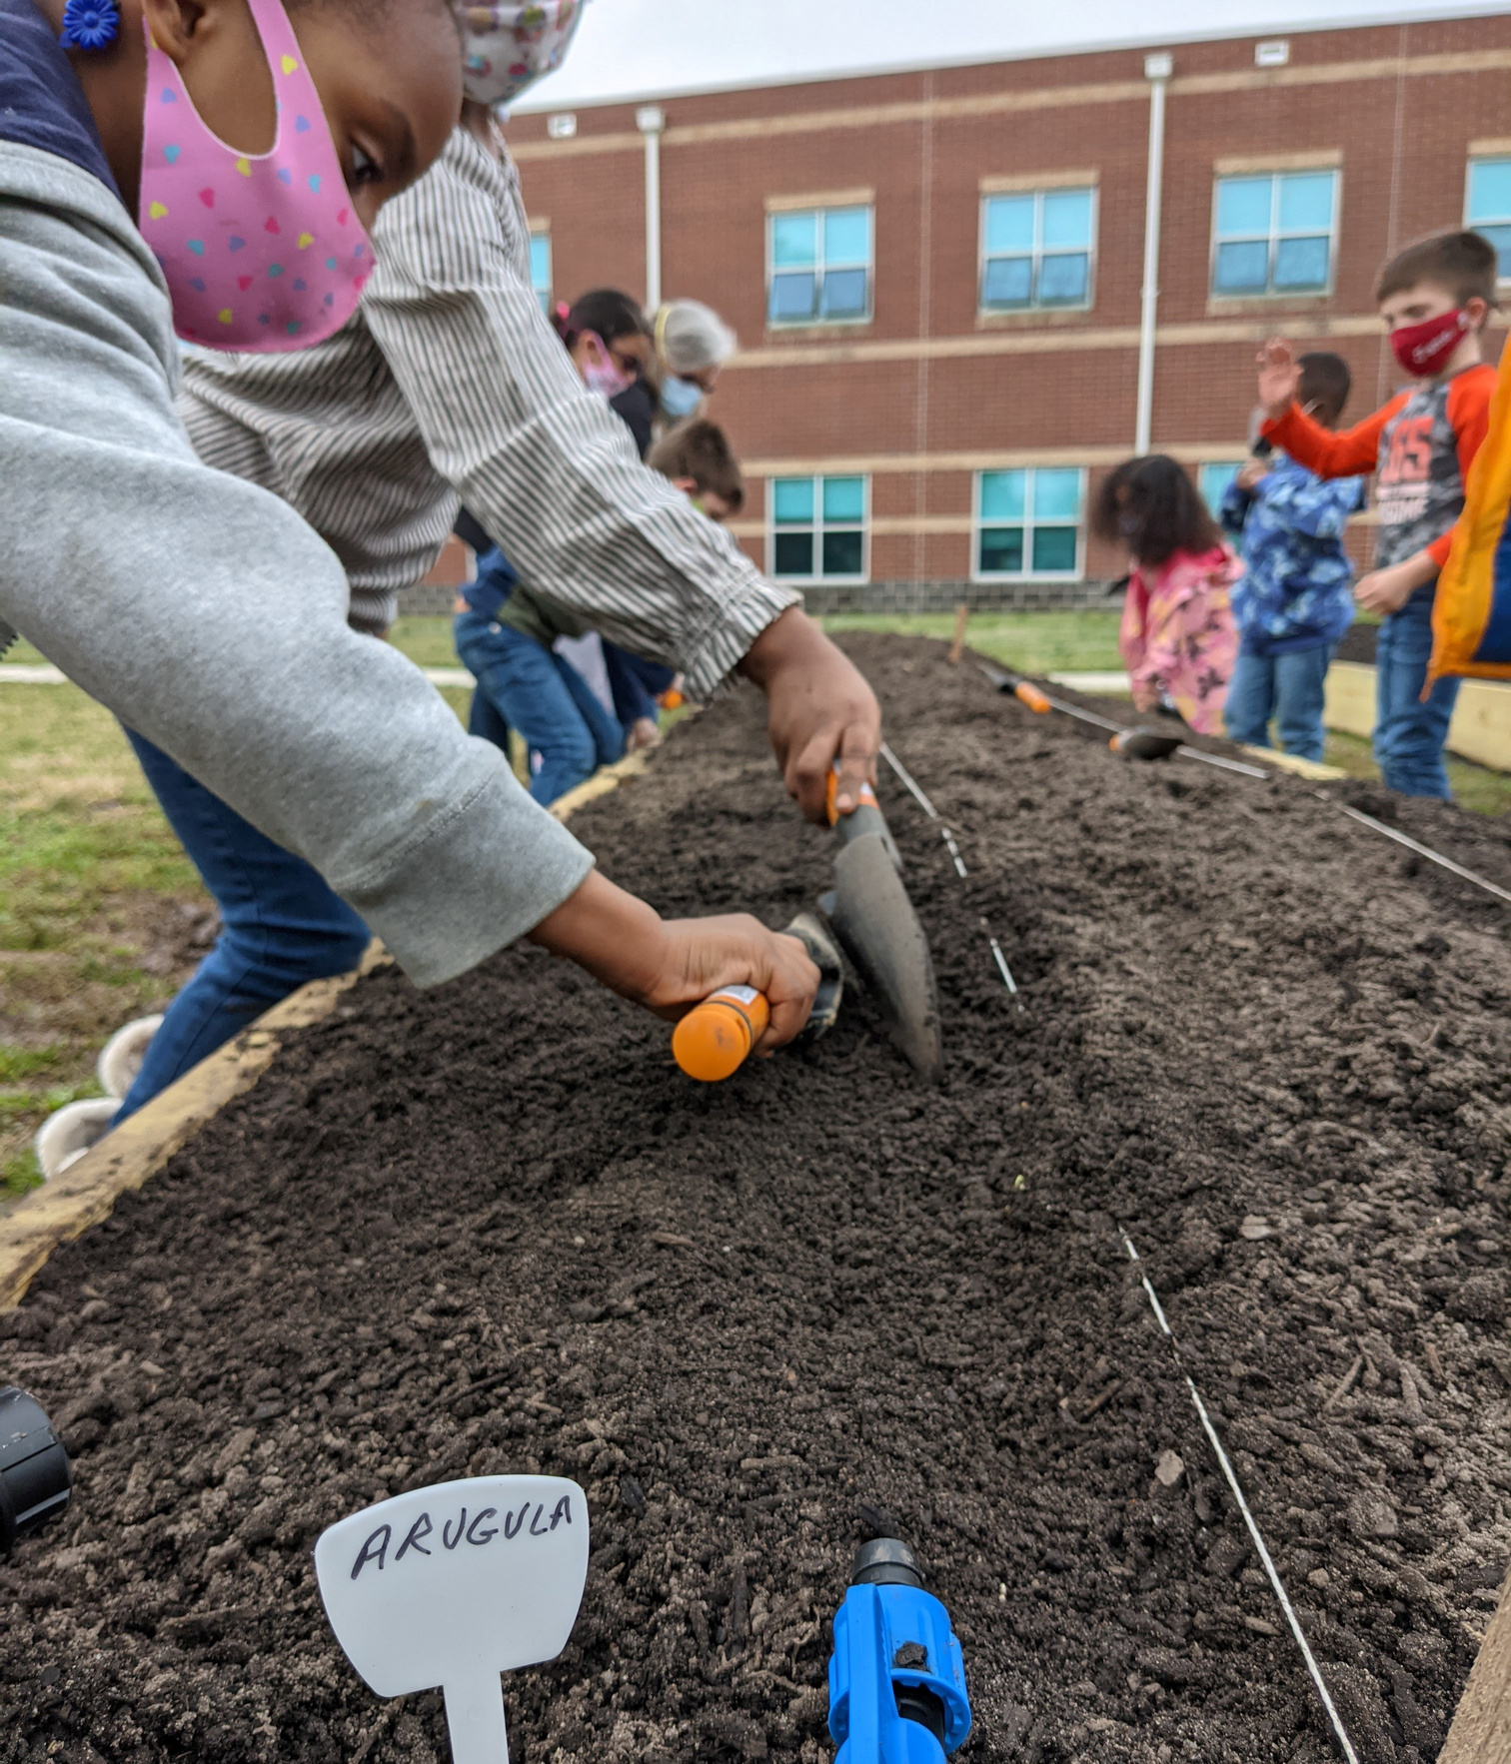




THE SEEDS OF OUR UNIQUE PROGRAM
  Carefully crafted lessons support the state’s content standards for science (NGSS-supported lessons)
  A simple, reproducible framework for gardening that's attractive to administrators and teachers
  Every child in the school participates in each growing season, spring and fall regardless of age or ability
  Children experience “seed to cafeteria table” experiences up to 4 times during the school year
"This is so valuable for student learning ..."
- Christy Kerr, Principal, Phillip C. Showell Elementary
in-classroom
lesson
outdoor garden
lesson
Education Cultivation
lesson
Notes:
When HFHK first partners with a new school, we are very involved! HFHK staff organizes site visits to meet with the 'Garden Team'. This usually consists of the Principal, Chief Custodian, Nutrition Services, and the school's designated Garden Coordinator.
The Garden Coordinator is usually a teacher who volunteers to run the program in their school. They act as the liaison between the school and HFHK.
We help set up the initial garden, then deliver
1. carefully crafted lessons by grade level to support Delaware's standards for science
2. A simple, easy-to-use framework for teachers

Slide 6
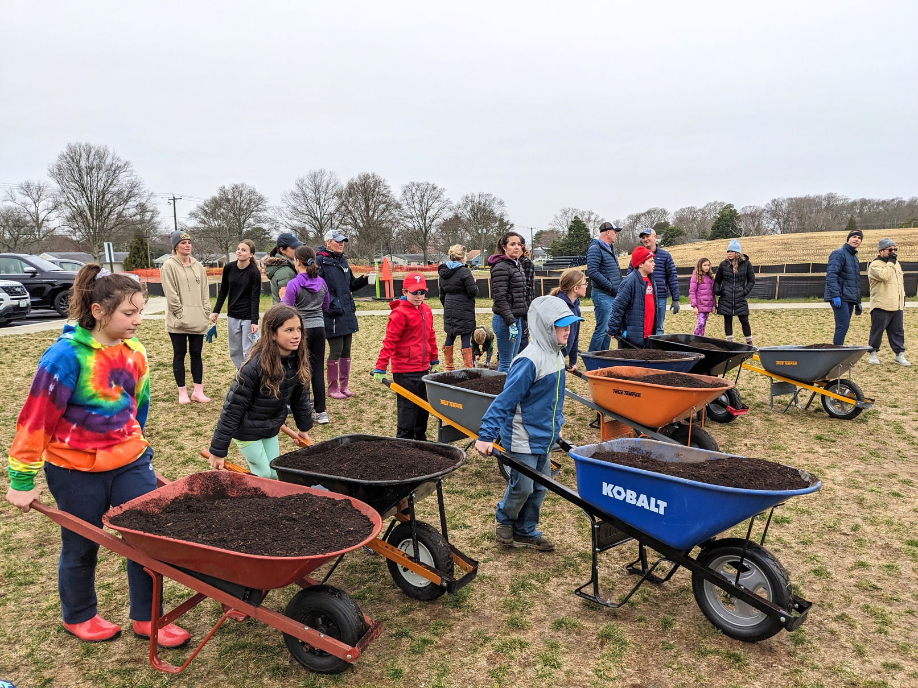


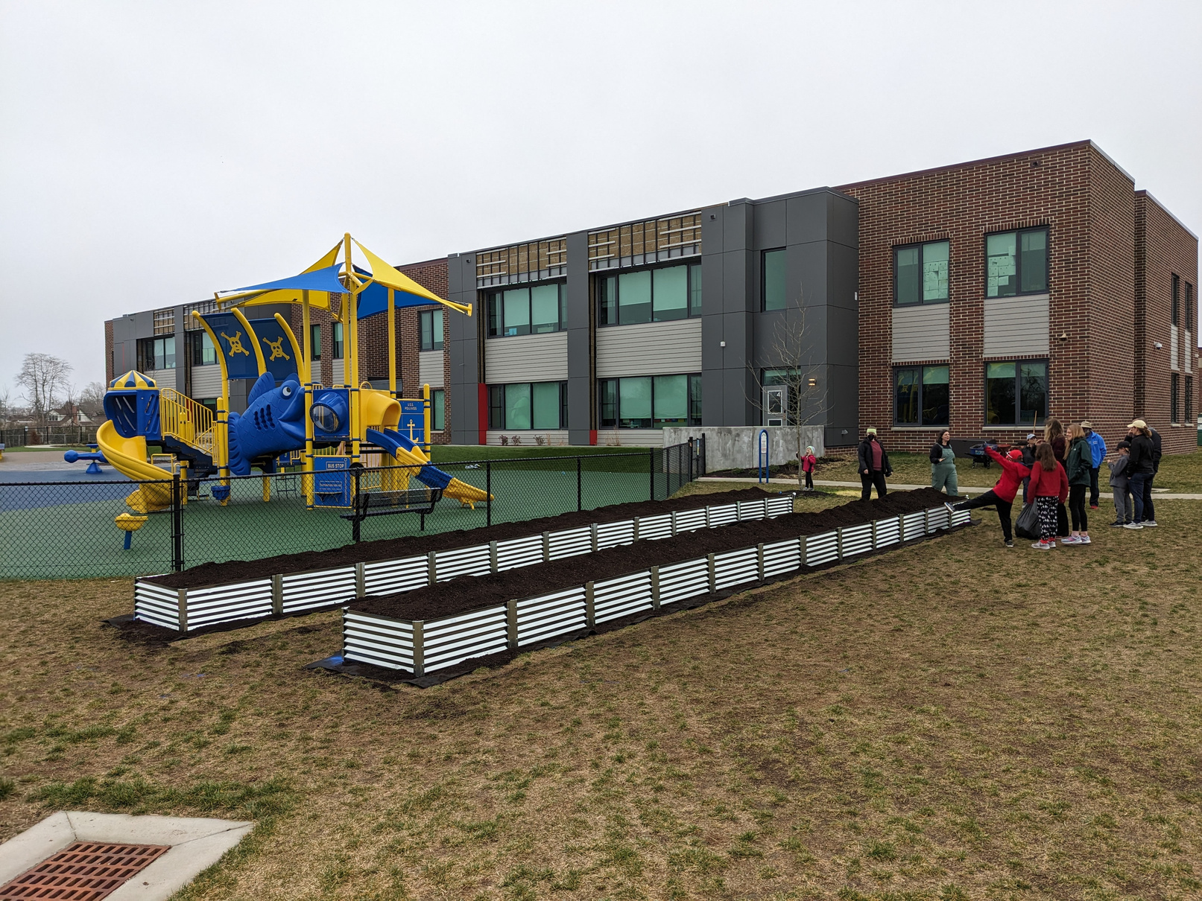

It’s a partnership
HOW WE LAUNCH OUR ‘EDUCATION CULTIVATION’ PROGRAM IN A NEW SCHOOL
  HFHK and the school work together to find funding (grants, corporate sponsors, and private donors)
  HFHK conducts site visits, maps out garden area, and begins preparations
  HFHK orders all materials and schedules deliveries
  Together with the school, HFHK organizes volunteers for the garden build (takes place in 1 day!)
We do more than just build gardens!!
Lewes Elementary, before & after
Notes:
Once funding is secured and the garden location determined, HFHK begins preparations!
HFHK orders all supplies and schedules the deliveries.
HFHK and the school work together to organize volunteers for the garden build. This takes place over one day and is a family-friendly event!

Slide 7

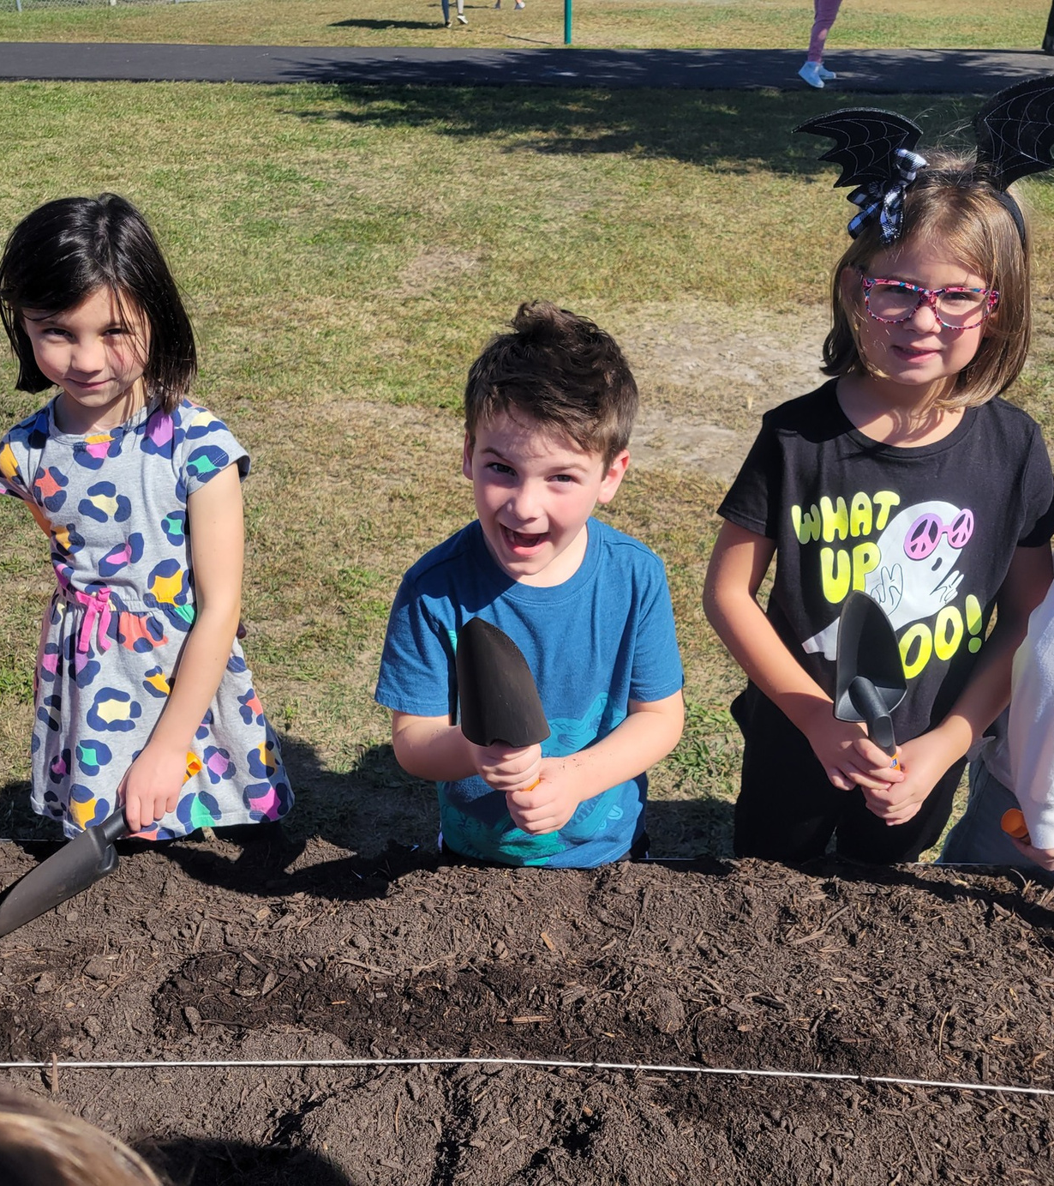

LET’S DIG IN!
FIRST GROWING SEASON
  HFHK staff models the garden lesson for each teacher in the school
SECOND GROWING SEASON
  HFHK staff meets with each grade-level team
THIRD GROWING SEASON+
  HFHK & Garden Coordinator choose crops each season
  HFHK creates planting kits for every K & 1st gr. teacher each season
    Individualized garden maps & curated seeds (253 this fall!)
  HFHK coordinates with each school’s GC for any garden needs (i.e.: compost deliveries)
Notes:
Our thesis is this: Healthy habits start early.
Everyone should know how to grow food. Not only is it essential for life, but it is also the lifeblood of the State of Delaware.
We play a critical role in the first two years. After that, the school's garden coordinator is able to handle most of the details.
This is how we are able to expand at a healthy pace in placing gardens in more schools.

Slide 8
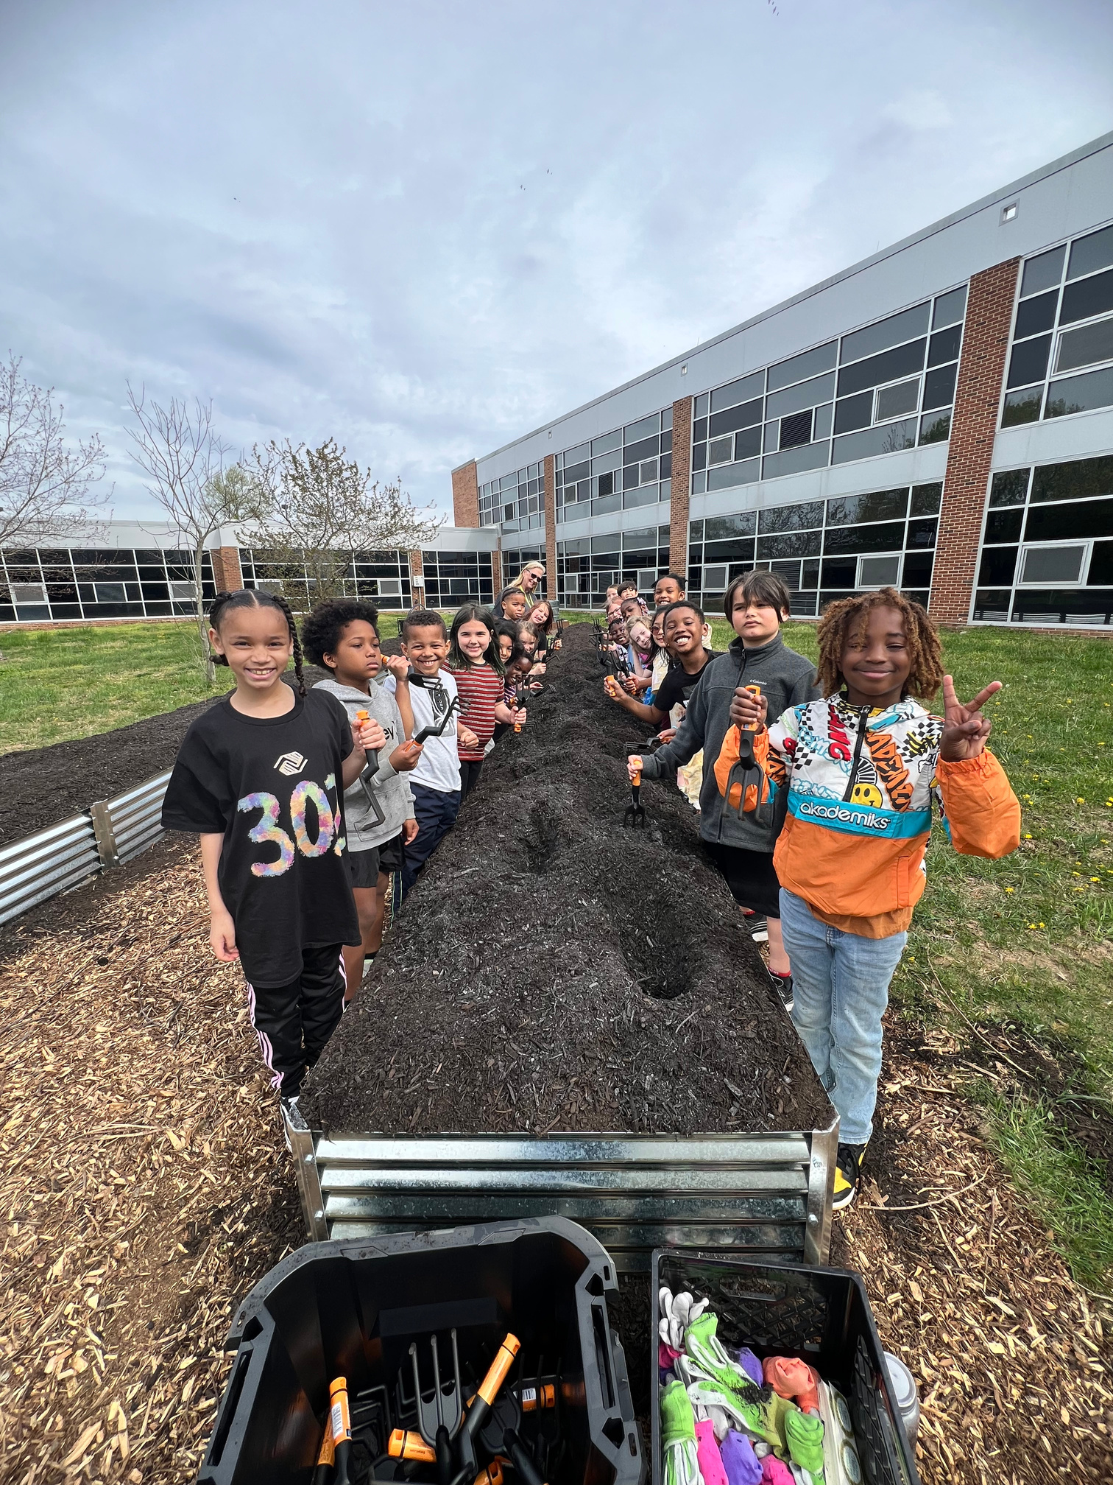


Second Grade
PREPARE THE SOIL
Students use cultivators to prepare the soil while learning the difference between soil and dirt. They also learn about soil composition and properties.
Notes:
Second graders actually kick off each gardening season.

Slide 9
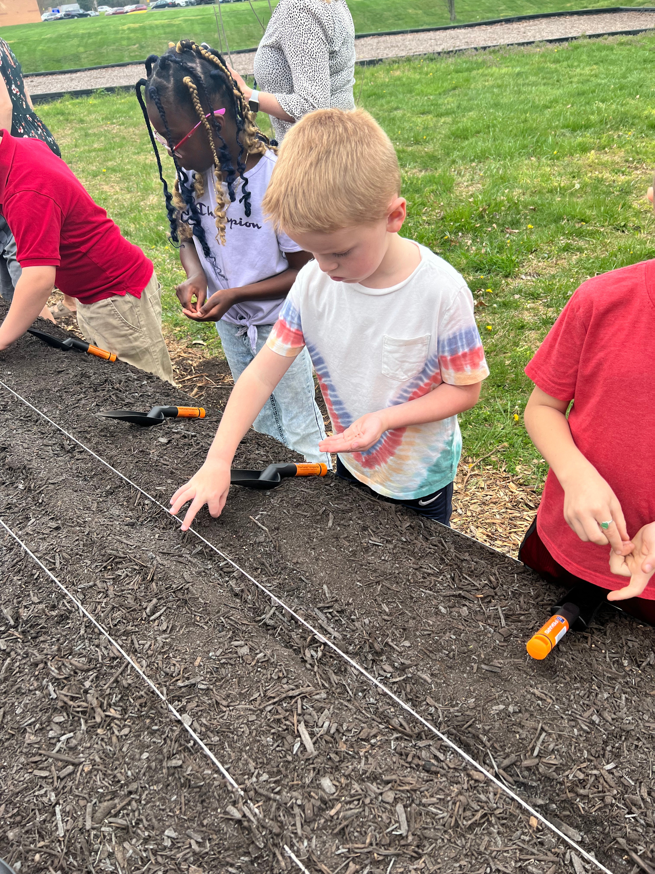

Kindergarten
& First Grade
PLANT THE SEEDS
Students learn about seed structure and how to properly plant seeds. Using trowels, they prepare furrows and plant at depths according to the seed packet instructions.
Notes:
The younger kids then take over. See how careful and respectful they are with their tiny seeds.
HFHK staff works together with each school's

Slide 10
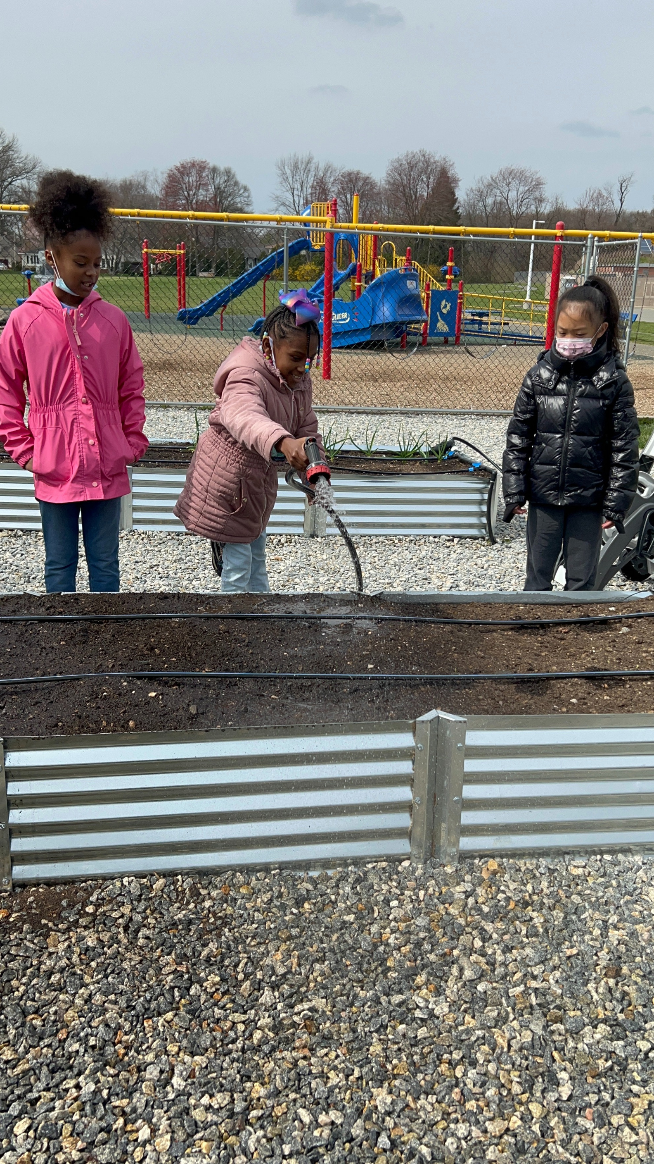


Third Grade
WATERS THE GARDEN
Students learn how to water a garden, how a drip irrigation system works, and about plant lifecycles. They watch for the first sprouts and handwater until they are visible.
Notes:
Things that grow require nourishment and care. That's some of what these kids learn.
Not too much and not too little until those seeds sprout.

Slide 11
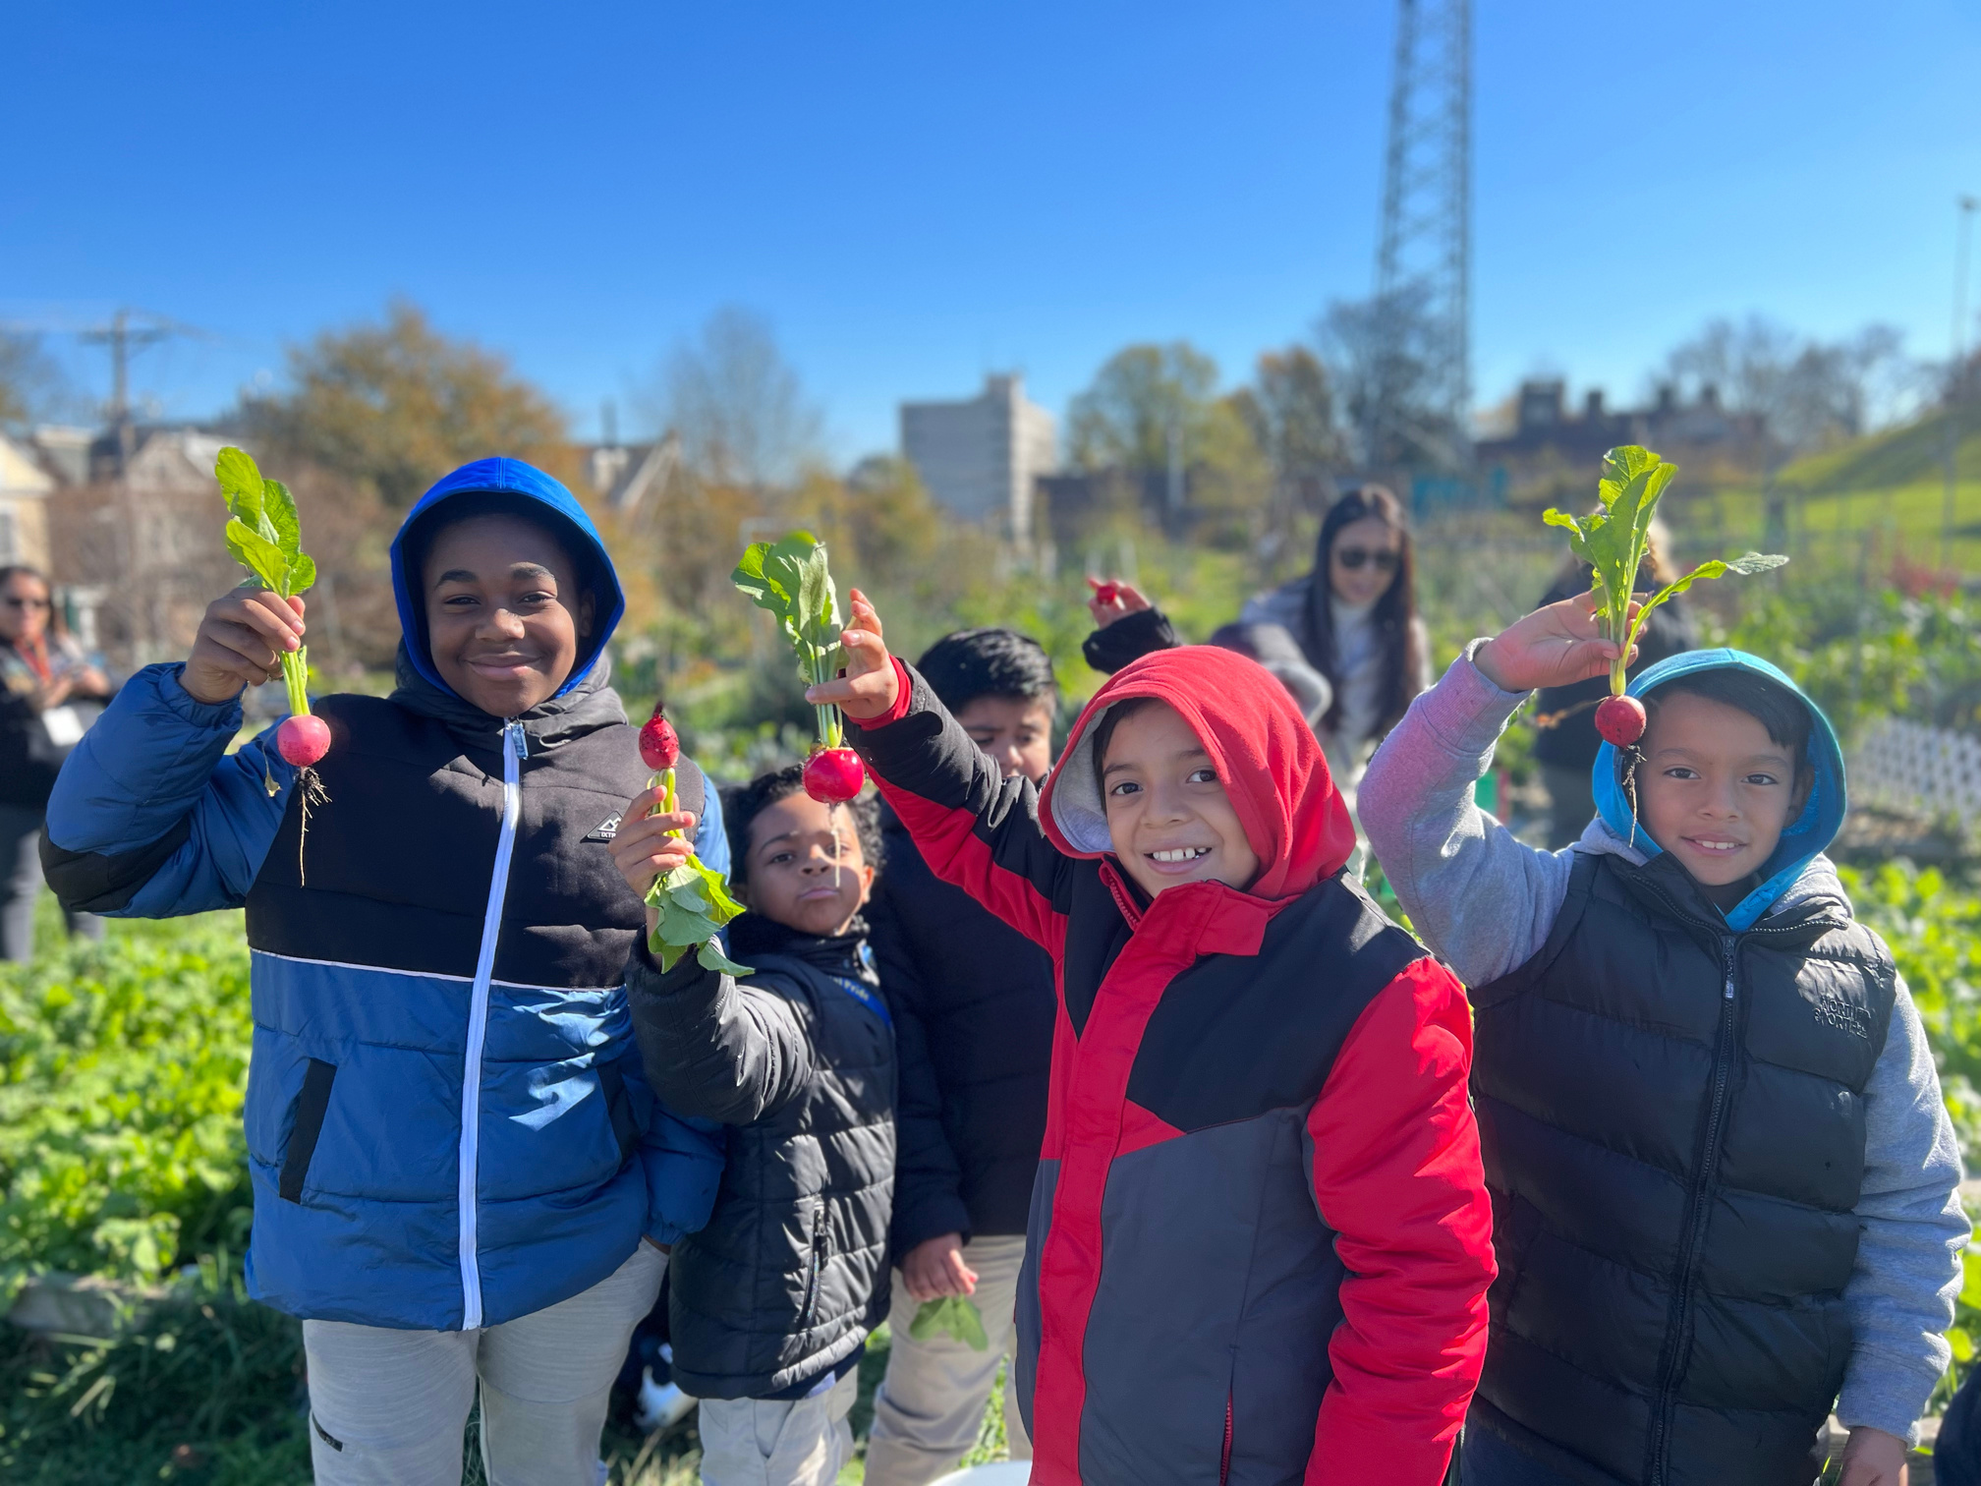

Fourth Grade
THE FIRST HARVEST
Students learn how to properly harvest a variety of vegetables, while observing hands-on the plants’ structure and function. They do this from two harvest lessons, one specific to Fall and the other specific to Spring.
Notes:
Harvesting, no matter the weather, is a time of joyful energy from the students. And the bigger the radish, the bigger the smiles!
Did you know that there are differences even between cool weather crops?
Example?

Slide 12
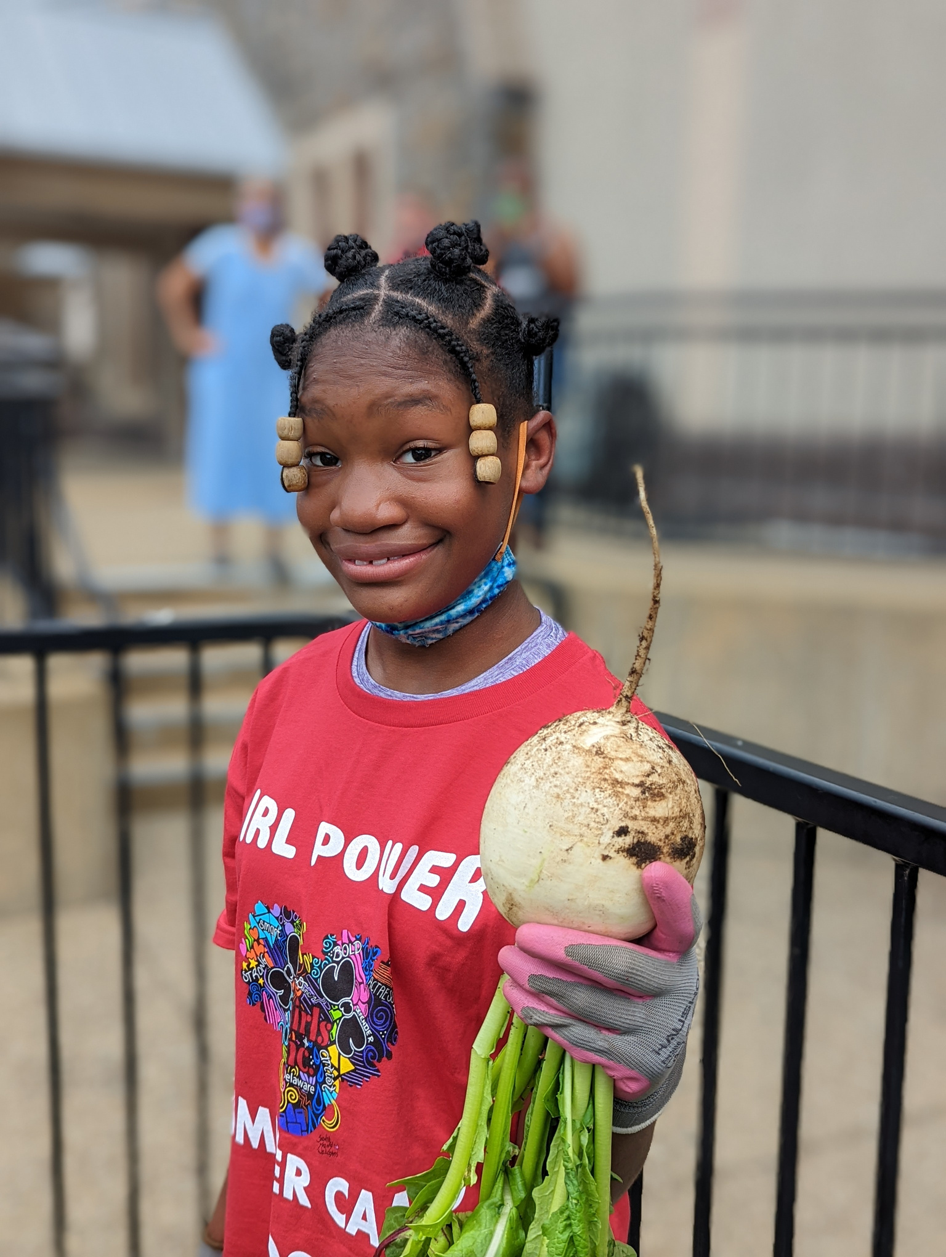


Fifth Grade
2ND HARVEST AND COMPOST
These students learn about the school garden as an ecosystem while harvesting and composting.
They also expand their knowledge of Matter and Energy.
Notes:
Students in 5th grade learn to use their garden as a model ecosystem, focusing on the transfer of matter and energy as well as following the food chain.

Slide 13

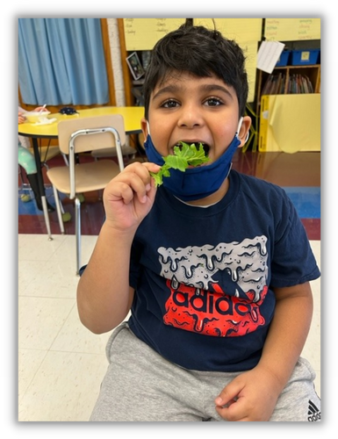
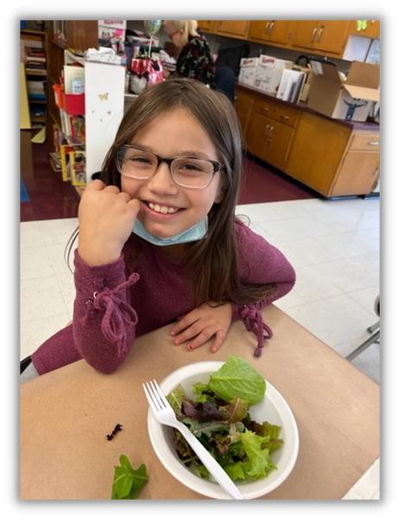
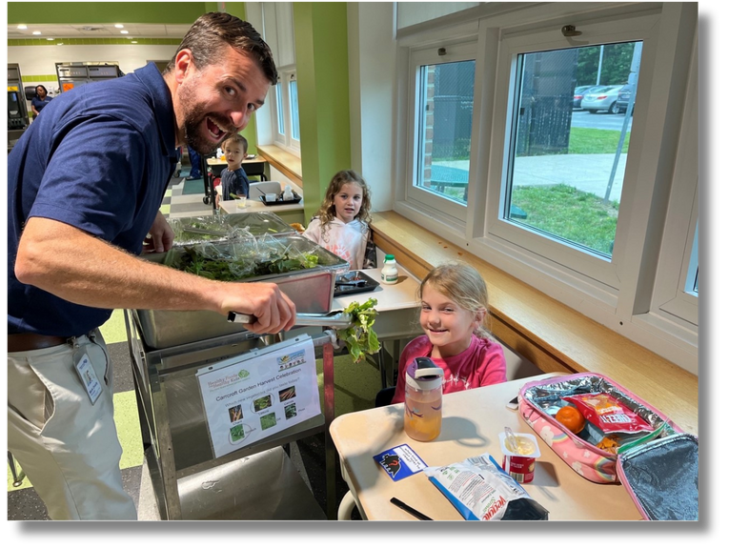
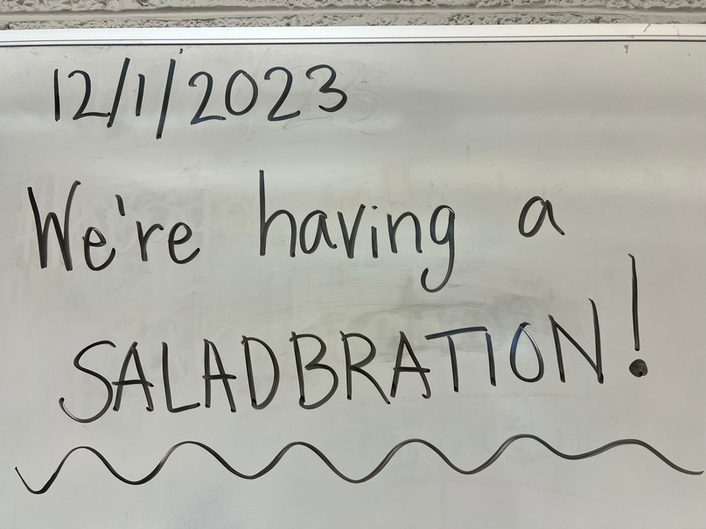
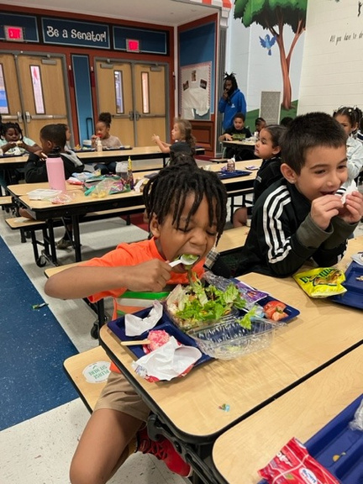
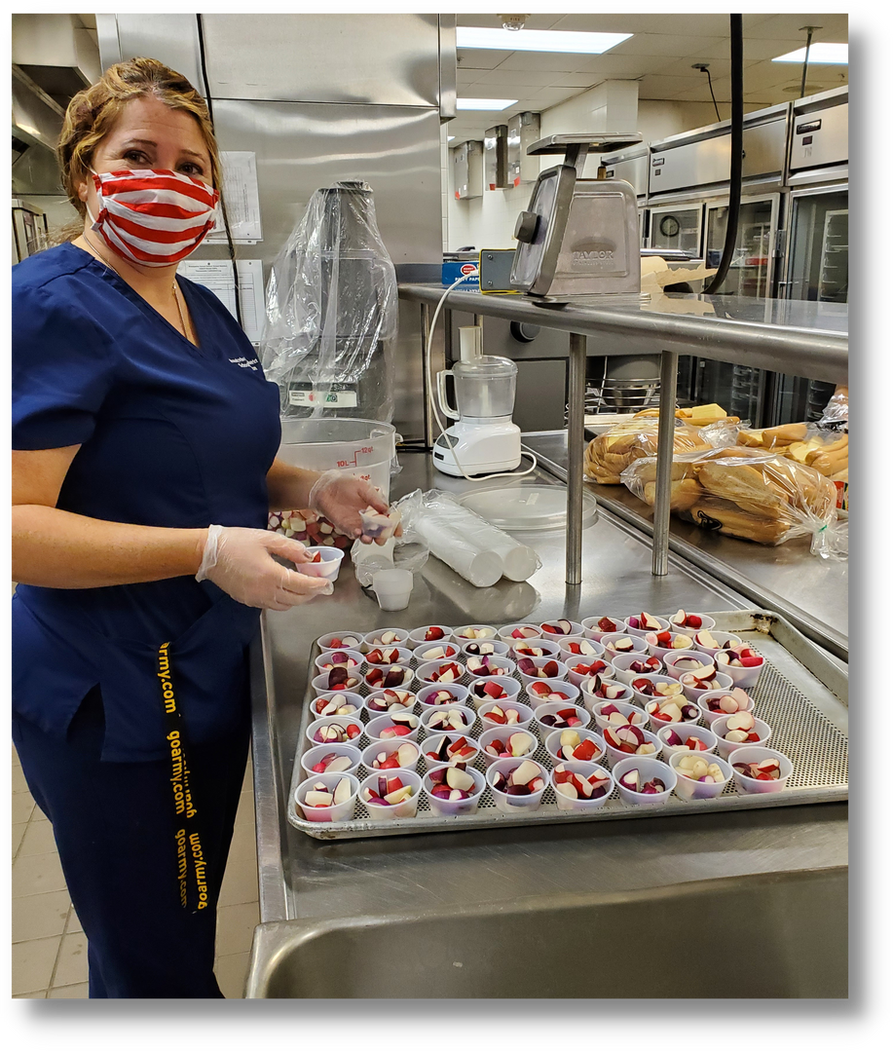

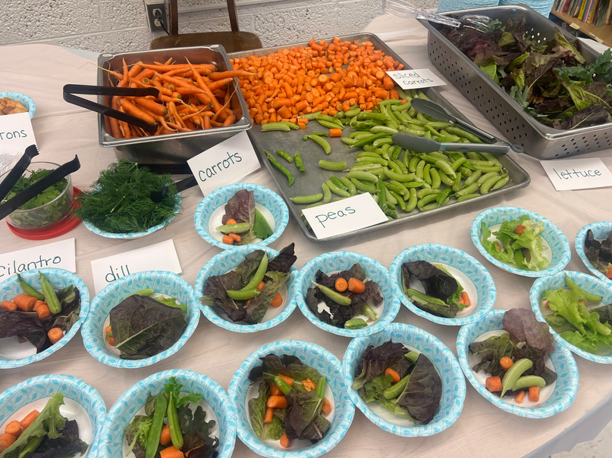

harvest Celebration!
Nutrition Services prepares the vegetables for the entire school to enjoy together at lunch,
up to 4 times per year!
I never trusted a turnip, but now that I have it tastes good. The veggies are delicious!
-4th grader, Brader Elementary
Notes:
The adults who prepare the vegetables and greens for the kids have as much fun as the kids do eating their produce and discovering how good they taste! It's the culmination of a season of constant care and learning about science through gardening.

Slide 14
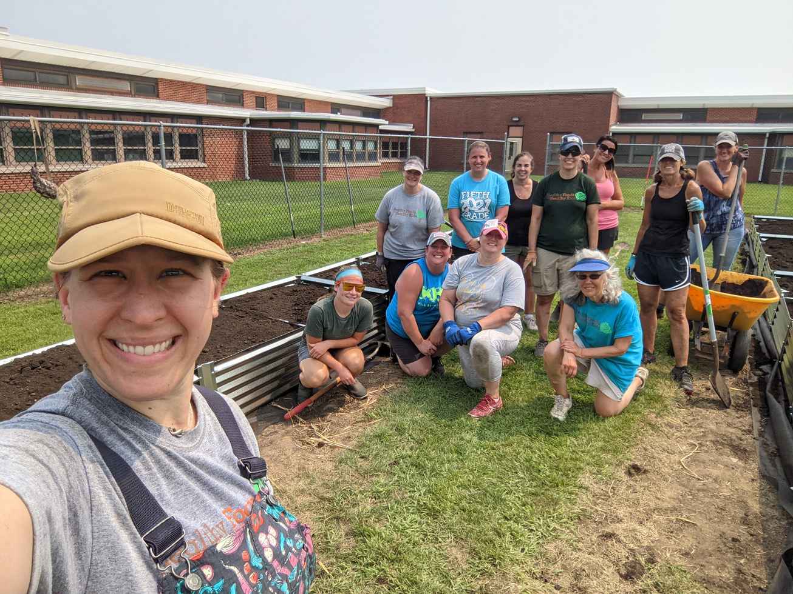


HOW YOU CAN HELP
Veggie-cate
the first state
VOLUNTEER
SPONSOR
DONATE
We can always use your help! From building the gardens to harvesting, HFHK provides all schools with technical support, but cannot do it without generous volunteers.
Do you see a school near you? Do you have children or grandchildren in one of our partner schools? Adopt a school garden and help the teachers as they work with the students to plant, harvest and everyone's favorite job, weeding!
Our program is not possible without the support of our funders, grantors and friends, like you! Follow us on social media and sign up for our newsletter to learn more about our program and events.

Slide 15
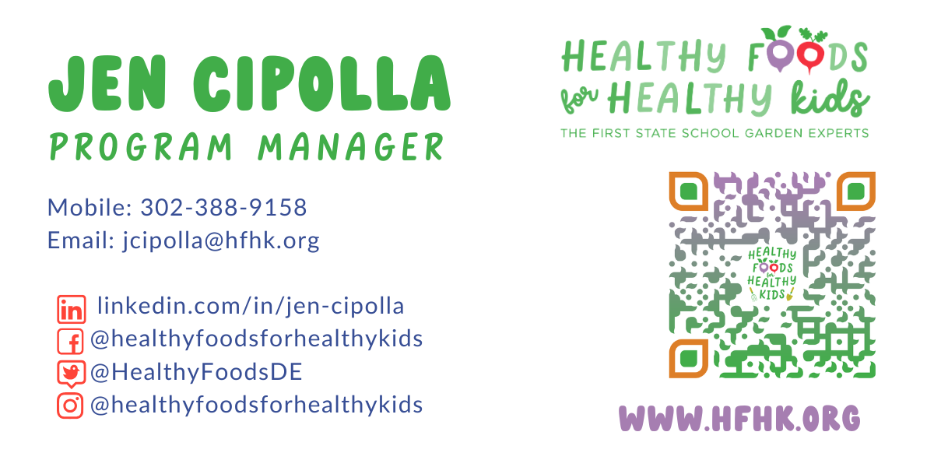
Thank you!
(Scan the QR & scroll to the bottom to join our mailing list and follow us on social media!)
hfhk.org
DO NOT SHARE THIS FILE WITHOUT THE EXPRESS CONSENT OF HEALTHY FOODS FOR HEALTHY KIDS

