Slide 1
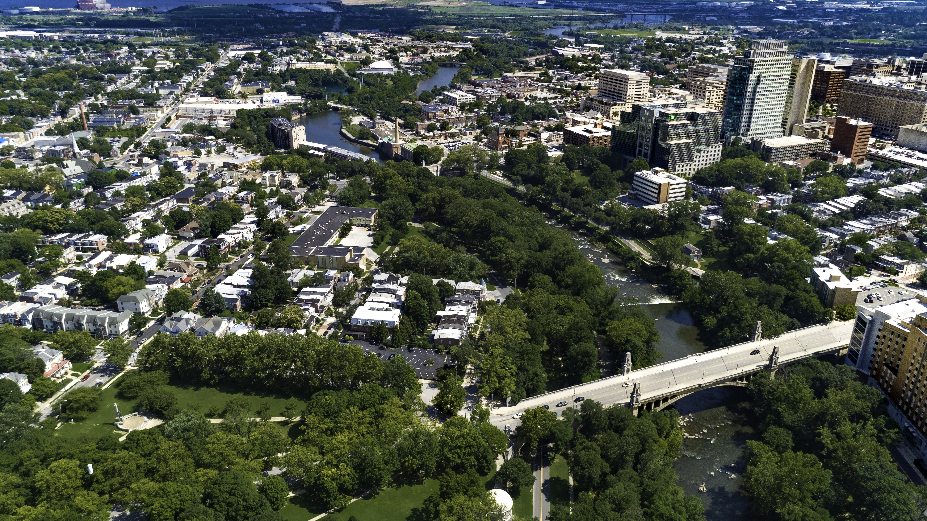
February 24, 2025 Finance Committee Meeting Federal Funding Freeze

Slide 2
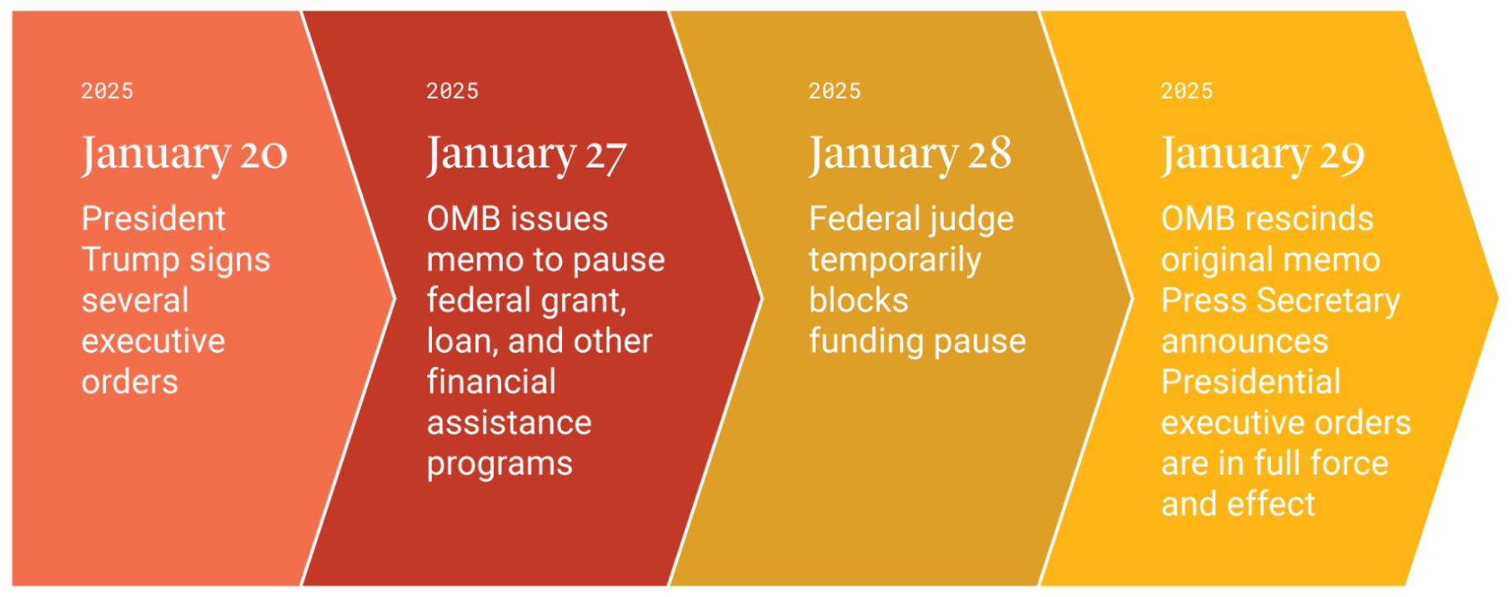
Federal Funding Freeze Overview
While OMB has rescinded the original memo, federal Departments have started to move towards individual funding memo – for ex. Department of Justice memo on sanctuary city compliance with current immigration laws and regulations.

Slide 3
Continuing Threats
Noncompliance with temporary restraining order
Certain funds, especially Department of Transportation and Inflation Reduction Act funds, have still not been released
This appears to have affected the City through the RAISE grant awarded for Riverfront East
Department of Governmental Efficiency (DOGE)
Staffing cuts could delay or halt agencies’ ability to process reimbursements
Recission of unspent funds
Obligated federal funds are not typically recouped
However, contracts can be terminated under 2 C.F.R. § 200.340 if the award “no longer effectuates the program goals or agency priorities”
Federal appropriation process
No certainty on future federal funding being allocated to the City of Wilmington

Slide 4
Potential Impact by Department
Real Estate & Housing
FY 2024 Federal Grant Spending: $5.6 million
FY 2025 Federal Grant Budget: $3.9 million ($886k is City FTE salaries)
Status: Funds are currently still being reimbursed
Who/what would be impacted by loss of funds: City nonprofits, affordable housing projects, General Fund bottom line

Slide 5
Potential Impact by Department
Parks & Recreation
FY 2024 Federal Grant Spending: $1.2 million for food program
FY 2025 Federal Grant Budget: $1.3 million ($886k is City FTE salaries)
Status: Funds are currently still being reimbursed
Who/what would be impacted by loss of funds: City youth who rely on this program for evening and summer meals

Slide 6
Potential Impact by Department
Public Works
FY 2024 Drinking Water and Clean Water SRF Spending: $10 million
Ongoing SRF Projects: ~$100 million
Status: Funds are currently still being reimbursed
Who/what would be impacted by loss of funds: Water/Sewer Fund rate payers

Slide 7
Potential Impact by Department
Economic Development
$17 million RAISE Grant for South Wilmington infrastructure
Status: Federal Highway Administration staff has stopped meeting regarding the project “due to current federal guidance.”
Who/what would be impacted by loss of funds: Riverfront East project

Slide 8
Potential Impact by Department
Emergency Management
FY 2024 Federal Grant Spending: $192k
FY 2025 Federal Grant Budget: $86k
Status: Funds are currently still being reimbursed
Who/what would be impacted by loss of funds: General Fund bottom line

Slide 9
Potential Impact by Department
Police Department
FY 2024 Federal Grant Spending: $452k
FY 2025 Federal Grant Budget: $400k
Status: Funds are currently still being reimbursed
Who/what would be impacted by loss of funds: General Fund bottom line; Partners in Care program

Slide 10
ARPA
All funds have already been received from the federal government, so the funding freeze does not apply
Funds are fully obligated; however, there could still be an attempt to recoup unspent funds
About $9 million remains unspent

