Slide 1

Common Interest Community Ombudsperson
Christopher J. Curtin, Ombudsman
Delaware Department of Justice
820 N. French Street
Wilmington, DE 19801
302-683-8801
Notes:
Welcome! My name… I wanted to introduce myself and my office –the office of the Common Interest Community Ombudsman, in the Department of Justice. I only have a few minutes so I will only hit a few of my duties, and processes in any detail. Anything else I say tonight is not intended to be, nor can it it be interpreted as legal advice. For legal advice you must consult a private lawyer, experienced in Community association law.

Slide 2

The Common Interest Community (CIC) Ombudsperson Act
Enacted 2014 as a NEW Office
One of 6 CIC Ombudsman Offices in the Nation
Only Ombudsman in an Attorney General’s Office
Only Ombudsman with subpoena power
Purpose
To assist those in CICs to understand their rights and responsibilities and the processes available to them according to the law, regulations, and documents governing their respective common interest community.
Notes:
FIRST: You will Notice: It is right in the Ombudsman’s statute: “The Ombudsperson is not your lawyer and cannot represent you, your board, the developer, or the community.”
The Ombudsman cannot provide legal interpretation, nor legal advice, nor advise on what is in the best interest of any owner, board, board member or developer.
As soon as a question involves both the law that applies and the facts of a specific community, legal representation- that I can’t provide- is required.
Though some of our Services might be of interest during Transition to owner control, the Ombudsman’s role is as mediator or arbitrator, or investigator.

Slide 3

The Common Interest Community (CIC) Ombudsperson Act
Overview of Act
Duties of Ombudsperson/Ombudsman
Education
Mediation, Arbitration, and Referrals
Investigation
Elections: Voting procedure and services
Advisory Council–Common Interest Community

Slide 4

What is a CIC?
Condominium
Cooperative
Residential Subdivision
Common Factors - Enforceable deed restrictions state:
Membership is mandatory and automatic.
Documents bind all purchasers to be governed by an association.
Mandatory lien-based assessments for each owner in order to operate and maintain the Community
Notes:
Common Interest communities are community associations. Voluntary civic associations are also community associations but they are different. Community associations are not required to be corporations, but most are. The DUCIOA only requires that a common interest community be created by recording a declaration in the recorder of deeds office. ¶ New Castle County law requires CICs to be “maintenance corporations.” Maintenance Corporations are also common interest communities. It is kind of Homeowners or Community association.
In Common interest communities you agree to be a member of the community association and to abide by the deed restrictions, by purchasing in a common interest community. Membership in the association is automatic, and unavoidable, Membership, assessments and obligations are not voluntary, like civic associations.
But studies show that most owners have a positive experience in their association, and a properly managed community increases the value of a home by about 5% compared to comparable homes that are not in a common interest community.

Slide 5
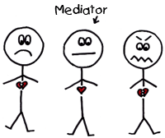
What is an “Ombudsman”?
-Usually a government official who:
Receives complaints.
Reports on complaints.
Deals with problems fairly.
Notes:
What kind of complaints? Violations of governing documents:
Closed board meetings;
Refusal to allow access to books and records, including financial documents;
Failure to hold elections. or to hold elections according to the bylaws…;
Occasionally Theft, or conflict of interest like self-dealing by board members, or pursuit of personal interest, e.g., keeping assessment too low.

Slide 6
CIC Ombudsman’s Office- Purpose
“To assist [those in common interest communities] to understand their rights and responsibilities and the processes available (to them) according to the law, regulations, and documents governing their respective common interest communities.”
No legal representation:
No legal advice.
No legal interpretation.
Can Provide general, nonbinding information without relying on specific facts.
Notes:
Since the purpose of my Office is to assist understanding and to resolve disputes, I cannot represent anyone,. I must remain neutral as a mediator or arbitrator or investigator. When law must be considered in light of facts of a community, that requires legal representation. One must seek a private lawyer for Legal advice or representation. I you do not have a lawyer, you might go to the Delaware State Bar Association’s Online Lawyer referral service at DSBA.org. The web page lists a dozen areas of law, including Real Estate>HOA . Clicking on the link will lead you to a lawyer who will to speak to you about your issue for ½ hour for a $35 contribution to the DSBA

Slide 7
1) Education
Website
Educational programs and workshops
Informational presentations on the Office
Written materials on community governance and effective meetings
Meetings to identify community concerns
Notes:
Very Quickly, this is a list of our Educational offerings. More about each is on our website.
Although I can meet with individual communities, to introduce the Office, our Education committee presents several workshops each year.
In 2023 we presented a workshop on Transition, by Zoom
Each Fall we offer a Joint workshop with Community Associations Institute: a full day “Board Leadership Development Workshop.” Add your email address to our list on our website to receive notice.

Slide 8
1) Education—Website
Website address:
https://attorneygeneral.delaware.gov/fraud/cpu/ombudsperson/
Or
Search for Attorney General’s Web page:
http://attorneygeneral.delaware.gov
At top and center of page is a link: “Initiatives.” Farther down the page is a blue bar labeled, “Initiatives.” Click on either.
Click on “Common Interest Community (HOA) Ombudsperson.”
Notes:
Any one been to the Ombudsman's website? Lots of free information available there.
While on the website, Please add your contact information to our email list to receive notices of upcoming events, and occasionally changes of law.
Click on this, and here is what you'll find [Click on saved site if there is internet connection]
You can search for Delaware Attorney General, and Ombudsman and usually will see my name and office, or at the home page see a menu across the top with: ”Initiatives” Clicking there with give a dropdown list including “HOA” and “Ombudsperson” in the 3rd item.

Slide 9
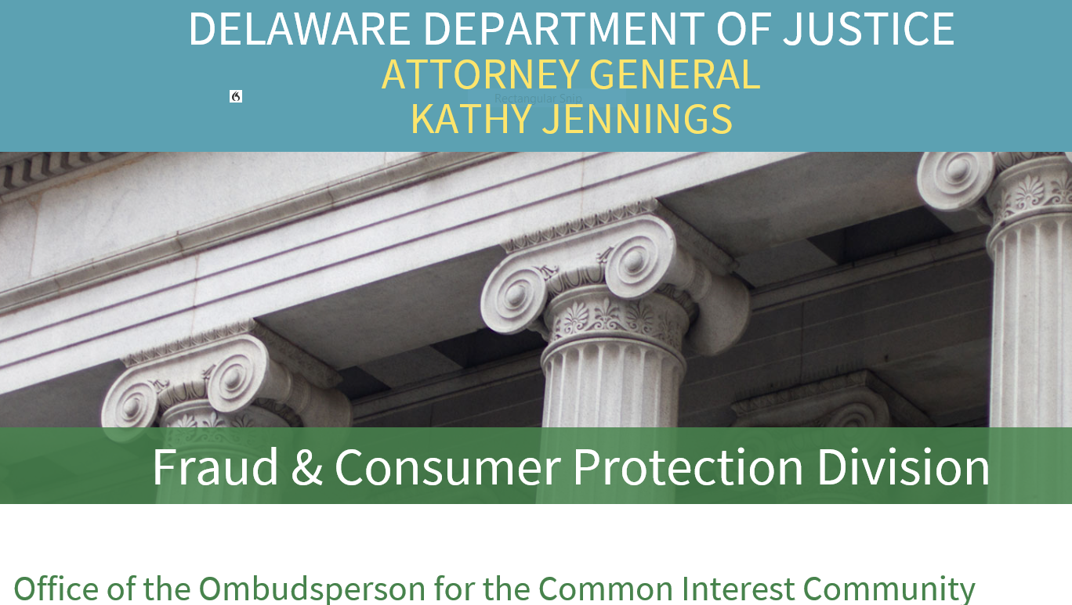
Ombudsman's website
Notes:
At the bottom of this frame you will see the name of the Ombudsperson’s Office. at the bottom of the page is a box with “Helpful Resources” including the statutory “Procedure for filing a Complaint”; a model Dispute resolution process; Election services; links to free information, including simplified Rules for conducting meetings, and the Roster of our Advisory Council.

Slide 10
Internal Dispute Complaint Form
Law now requires use of internal written form complaints.
Form is on website in “Forms” and in “Procedure for Filing a Complaint”
Download form and fill out on your computer.
Word document-word wrap and unlimited lines
Experience shows this resolves majority of complaints about governing documents, bylaws and Rules
Notes:
The second Major duty of the Ombudsman is Dispute Resolution, as limited by the statute. This can be used even before Transition. This form is the first step—bringing the complaint to the attention of the board for a first attempt to resolve the complaint. File it “internally” that is to say, within the community, and not with my Office. Usually, it is filed by a homeowner by delivery to the board, but it can be to an owner from the Board, even while under developer control. Usually, the complaints are about one party-often the board- not following governing documents, but sometimes it is about the owner being invited to mediation by the board for a violation. Our process works in all directions.
I recommend filling out the form, even if you do not file a complaint, as the process will sharpen your focus and help you support your position. It requires you to cite and quote the exact language of your Governing document that you feel is violated, and say what you want done about it.
This form is downloadable and Fillable on your computer. It is in the Forms Section and also linked to our “Procedure for Filing a Complaint.” I know you can’t see it from this, so I brought a copy for reference in your Materials. OR take a look at it online. This form is part of a process required before my Office can look into a complaint. It is intended to give the parties a first opportunity to resolve a dispute over governing documents without going to court. We urge parties to use “Meet and Confer” informally to resolve complaints. If that fails, this form can be attached to a complaint to our Office. We will coach agreement or offer mediation or arbitration or binding arbitration for which statute requires us to charge fees, or to refer parties who consent to our referral to Court of Common Pleas’ Community Mediation Program, which is free, but requires referral from a law enforcement agency, including our Office. If the parties will not consent, Court of Chancery has a program for expedited mandatory mediation or trial of homeowner association disputes, and can shift the lawyers’ fees, if any, to the party losing after trial. Details are on our website among the “Important Statutes.”

Slide 11
Internal Dispute Resolution (IDR)
Must be used before the Ombudsman can review the complaint.
Resolves the overwhelming majority of complaints.
Requires use of Ombudsman's statutory process if no Association process:
Written Complaint to Board “on a Form.”
“Notice and Opportunity” to be heard required- (witnesses called and neutral decision maker), or the recommended informal “Meet and Confer.”
Notes:
We recommend a process called “Meet and Confer” which is much less formal than a hearing before a board. Meet and confer is paragraph 6A of our Internal Dispute Resolution Procedure. It is far more likely to result resolution in a way that preserves friendly relations among neighbors.

Slide 12
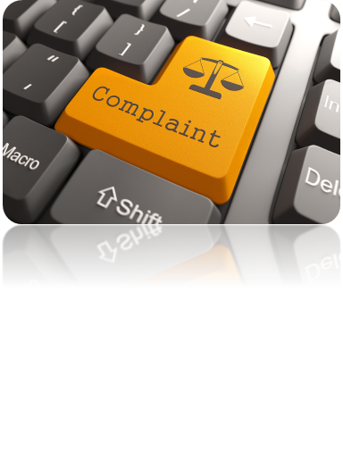
IDR Complaint
IDR Complaint is for violations of law, declarations, certificate of incorporation, bylaws, or rules governing a community.
IDR Complaint must be in writing (using form revised in 2018).
Must cite and quote the rule violated.
Must explain the facts of the violation.
Notes:
Violations of law can include DUCIOA, the Ombudsman’s Act, the Unit Property Act, and the General Corporation Law. It is not for federal statutes, criminal Acts, Consumer Fraud Act violations, or State Human and Civil Rights Commission complaints,. The last two have their own complaint forms, statutes, investigators and hearings
If Internal Dispute Resolution is not successful, or if the opposing party ignores it 20 days, the Internal Form can be attached to a form for our Office called the “Contact & Complaint” form. It requires more information we need to determine what law applies and to offer mediation or arbitration. It also requires an administrative fee to offset costs, of $35 required by statute.
Our Services for mediation arbitration and binding arbitration are consensual but require fees offsetting costs. We also made an arrangement with the Court of Common Pleas to accept our referrals, when the parties agree, to the CCP’s Community Mediation Program, which is Free.

Slide 13
Information for Voluntary Civic Associations
Statues and materials Voluntary Associations should know about:
City of Wilmington Website for government services, like Code compliance, laws about trees, parking, sidewalk responsibilities and government agencies
CCOBH website: Community Council of Brandywine Hundred: it has hundreds of community associations as members, and a “Civic Association Tool Box,” including an article about “How to Organize and Run a Successful Civic Association, and a sample of an association “Constitution and Bylaws,” that can be easily adapted to any community association. It has a wealth of information, and people willing to answer questions. It makes presentation on topics of interest.
New Castle County Website: For a copy of its "Civic Association Manual. It is available online in its “Community Association Portal” or “CAP” with other information.
The Delaware Uniform Unin-Corporated Nonprofit Association Act. Available online at Delaware Code Online, Tile 6 Delaware Code, Chapter 19. It allows unincorporated associations to act as an “entity” for some valuable actions, like enter contracts in the Association name, and to sue and be sued in the entity name instead of individual members’ names, among others
Notes:
I brough some copies of the Civic Association Manual; CCOBH’s “ How to Organize and Run A successful Civic association.” City of Wilmington “Civic Associations Tab, with a map of associations in the city;
and the CCOBH Sample Constitution and Bylaws, with some others. Homeowners should sign up for the County Reorder of Deeds Office Free “Alert Me” service.” If anyone tries to record a document affecting your home,, the Recorder of Deeds Office will notify you the same or next day, so if it is fraudulent, you can ate refute it immediately. It is the same as the TV offers for the same service for hundreds of dollars per year. All of Delawares Recorder's offices offer a similar service free of charge to those who register online.

Slide 14
Questions?
Notes:
That is all I have time for but, I am happy to talk to you about the Ombudsman's Office. and answer a few questions.

Slide 15


Thank you for attending.
Christopher J. Curtin
Deputy Attorney General
Common Interest Community Ombudsman
Office: (302) 683-8801
Toll Free: 800-220-5424

Slide 16
Website-Forms and Publications
Single largest source of complaints.
Personal Debt lawsuits in Justice of the Peace Court, Without using a lawyer.
Downloadable or useable online.
Online--links are live; click and go to forms and videos
Paper version contains copies of forms and other materials
Notes:
One major educational effort was the creation of this book, in paper and online on our website. The paper version has paper copies of forms. The online version takes you to the forms, mostly on the Justice of the Peace Court website. The online version is a little out of date since the Justice of the Peace Court has increased dollar jurisdiction, now up to $25,000, and a few new forms. We are updating the manual, but even online it is still useful.
Before the Pandemic we hosted free workshops in each County, where we go through the collection process and procedures and present a demonstration trial with a Justice of the Peace Court Judge presiding. We expect to resume those once the manual is updated.

Slide 17
Other Common Issues and Investigations:
My Letter following some Complaints may detail concerns of the Ombudsman’s Office.
Recently, Key issues included:
Board members admitted that the Board does not attempt to collect delinquent assessments from 30% or more homeowners. The value of those delinquencies exceeded $50,000 at that time.
No elections following the bylaws in years, only “appointing” the same “volunteers.” This may have invalidated all Board Actions
Bylaws never recorded as required by the DUCIOA since 2009, and those provided apparently not properly amended, possibly negating the amendments to the bylaws.
Notes:
Collecting assessments is a fiduciary duty of the Board. One board did not even record liens against the properties, and did not file lawsuits to collect them in JP Court without a lawyer, as detailed in our manual
One board did not follow bylaws or statutes requiring annual elections on proper notice, but “reappointed” themselves year after year.
The bylaws were still never recorded, and the amended versions provided to my Office do not show they were approved by a majority of owners, as required the General Corporation law, so they are likely invalid, and they are certainly problematic. I check with the Recorder's office to confirm there are no recorded bylaws. The DUCIOA Section 81-120 requires even exempt communities to record bylaws. We also offer election services.

Slide 18
Frequent Questions: AMENDING COVENANTS
Each document has its own rules for how to amend it. Those rules must be followed or the amendment will be void and unenforceable.
The hardest to amend is usually deed restrictions. They generally require 2/3, or 67%, or 75% or 80% or more APPROVAL by the community. It is not like other votes where a majority of a quorum is sufficient.
It is intentionally hard because every owner already agreed to the deed restrictions by purchasing land that is “subject to” them, in the recorded land documents.
If the declaration is silent on the “recipe” for amendment, 25 Del. C. sec. 318 allows “residential property which does not explicitly include a mechanism to amend the document, may hereafter be amended by a vote requiring the affirmative vote of 2/3 of the property owners.”

Slide 19
COVENANT ENFORCEMENT
Covenant enforcement is a fiduciary Duty of the Board-generally explicitly found in both the Declaration and the Certificate of incorporation
It is the board’s duty to enforce covenants as written, but also to exercise informed judgment.
Enforcement must be consistent. If it is based on personal preferences or aesthetic preferences courts are holding them to be “arbitrary and capricious” and therefore unenforceable, and may require the losing party to pay the winning party's lawyers fees. See 10 Del. C. Sec 348, which is stated in detail among the “Important Statutes” on our website, and Bragdon v. Bayshore Opinion in 2021 Annual Report.
Courts in Delaware are consistently requiring enforcement based on standards that are measurable rather than personal presences, or notions of taste.

Slide 20
AMOUNT OF FINES
The purpose of fines is to obtain compliance with association documents and Rules. Punishment is not an appropriate goal.
What is in your governing document? If the power to fine for violations of governing documents is not there, consult your association lawyer before setting or enforcing fines. The authority must be in your governing documents or be added by amendment or Rule.
How much to fine? Again, what do your governing documents authorize? The amount is a business judgment, but should be informed by discussion with experts, like the association manager and lawyer.
How much will your community stand to pay to defend or enforce fines in litigation? If they are so high as to be punitive or a vendetta, courts will not enforce them and they may be a breach of the fiduciary duty to act only in the best interests of the community, they may at that extreme level invite personal liability of the board.

