Slide 1
Community Development & Urban Planning Committee City Planning Commission: Approved Resolution 03-24 April 24, 2024

Slide 2
Community Development & Urban Planning Committee City Planning Commission: Approved Resolution 03-24

Slide 3
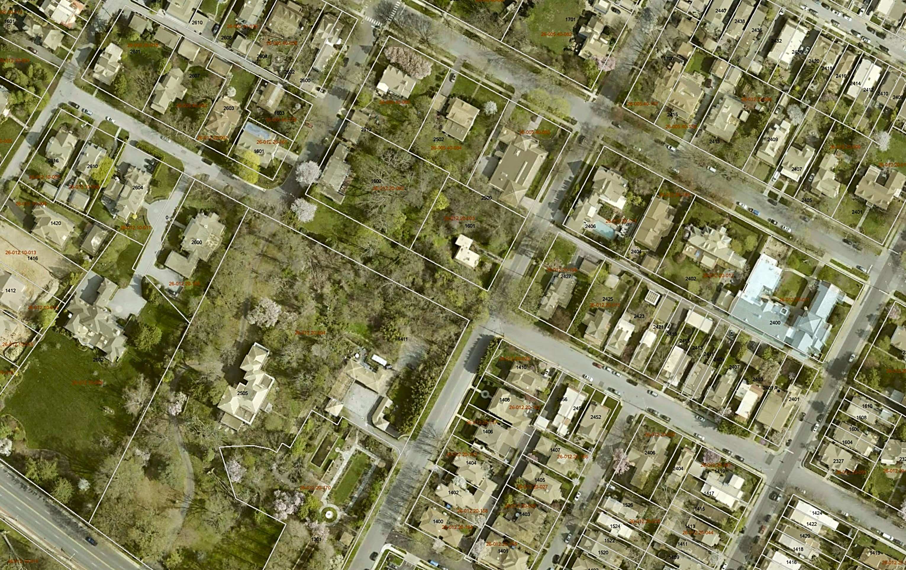
Community Development & Urban Planning Committee City Planning Commission: Approved Resolution 03-24
BRINCKLE AVE
W 16TH ST
GREENHILL AVE
W 17TH ST
W 16TH ST
RIVERVIEW AVE

Slide 4
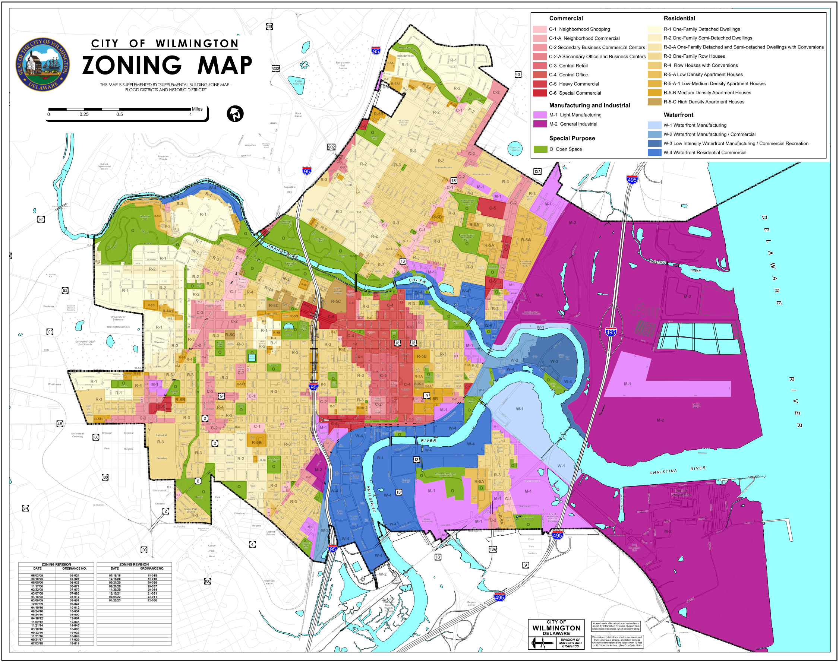
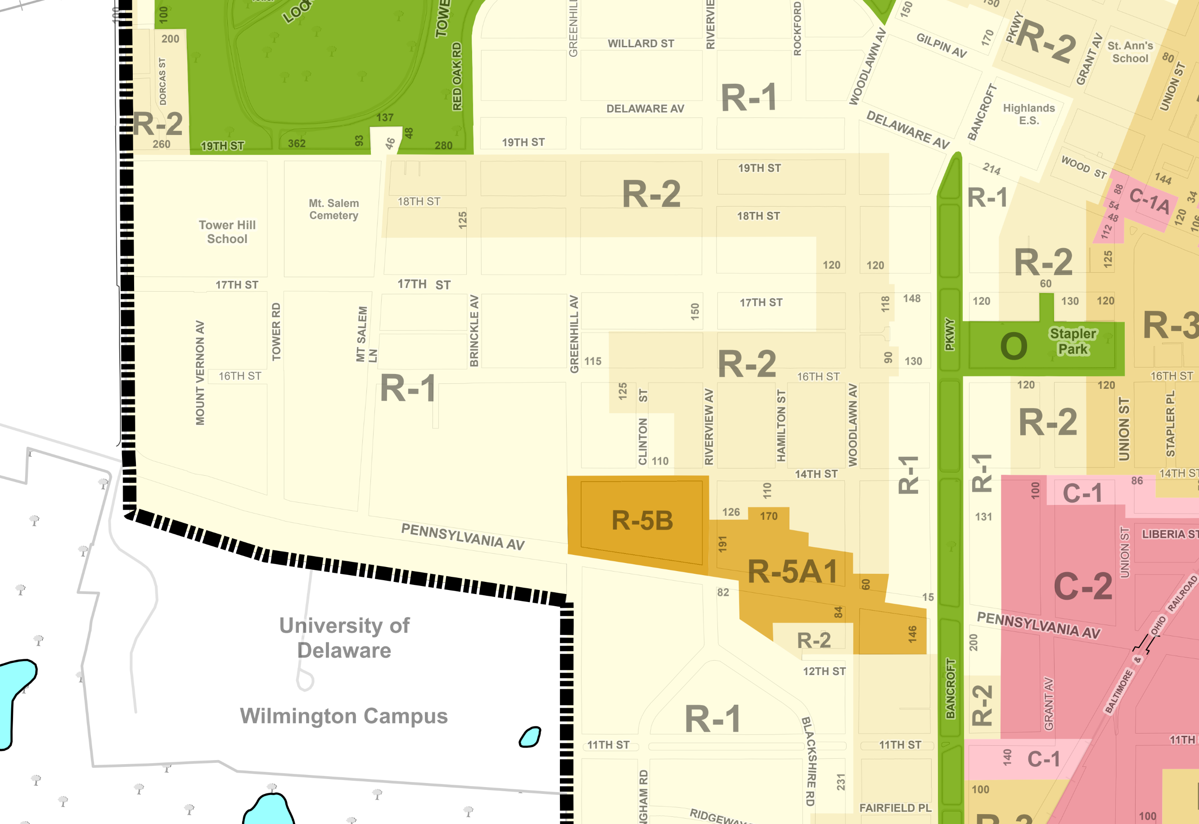
Community Development & Urban Planning Committee City Planning Commission: Approved Resolution 03-24

Slide 5
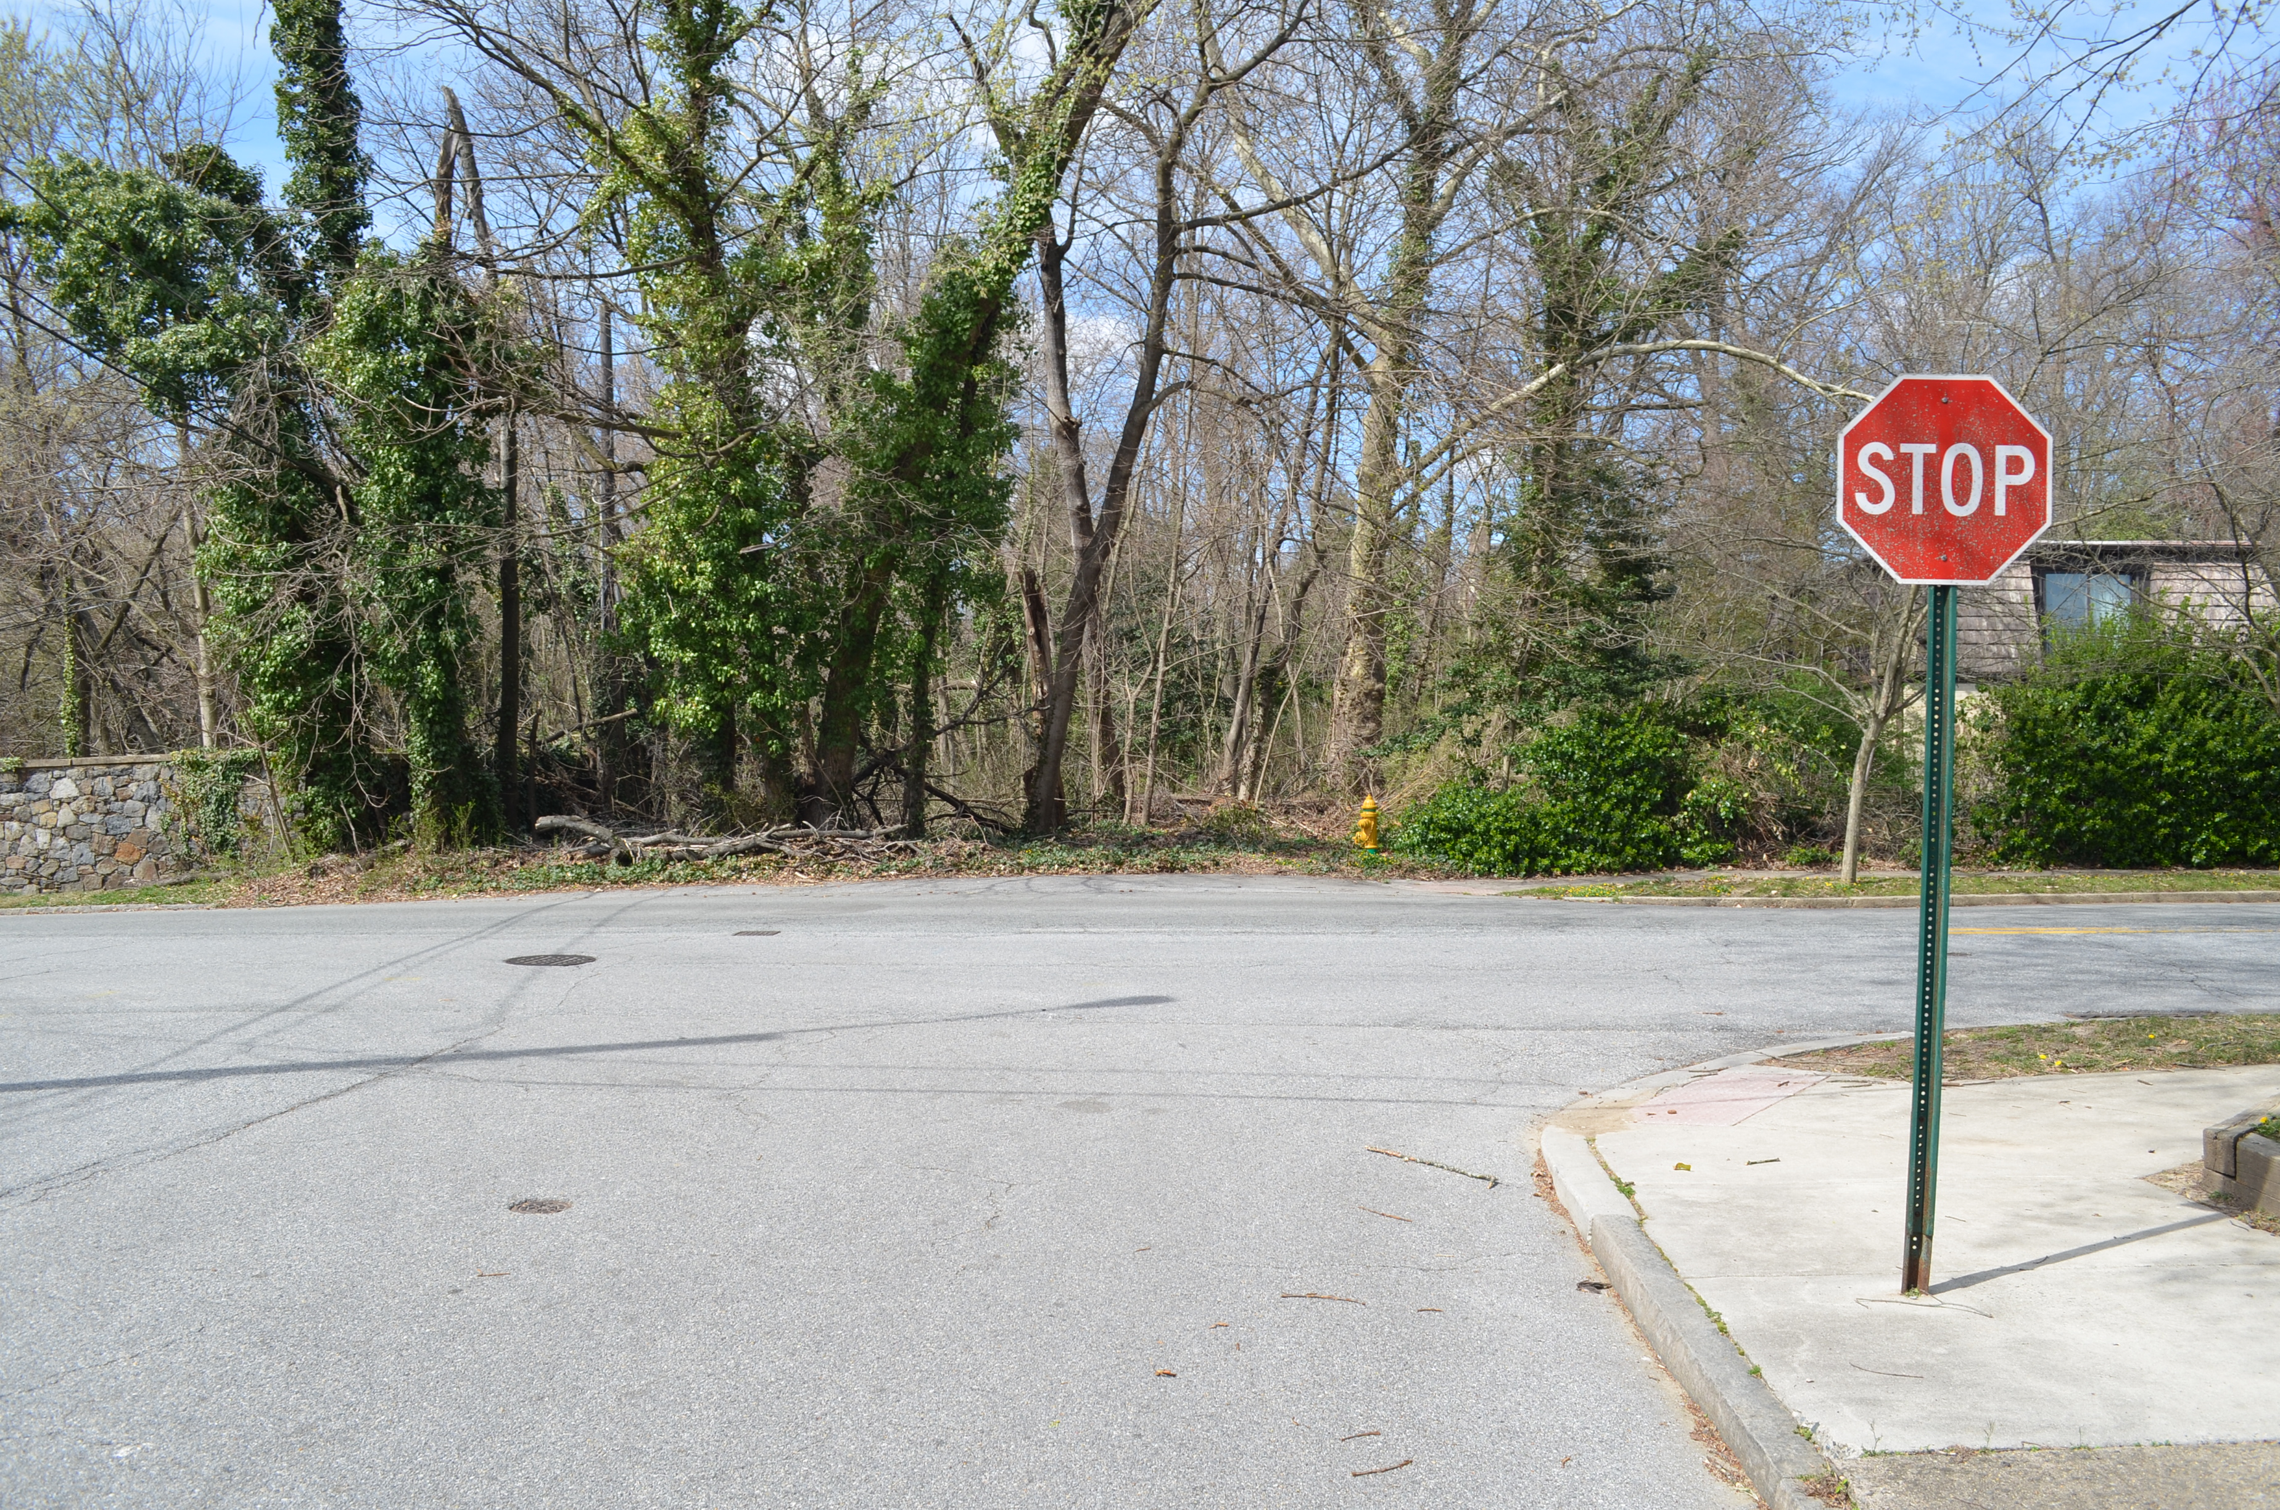
Community Development & Urban Planning Committee City Planning Commission: Approved Resolution 03-24

Slide 6
Community Development & Urban Planning Committee City Planning Commission: Approved Resolution 03-24
The proposed street removal is consistent with the City’s Comprehensive Development Plan.
The street bed of West 16th Street between Brinckle and Greenhill Avenues falls within the R-1 (One Family Detached Dwellings) zoning district.
The City’s records confirm that the portion of West 16th Street is a paper street owned by the City, is unimproved, and heavily wooded with varied topography.
The Public Works Commissioner supports the proposed street removal and confirmed there are no plans to develop the paper street, nor are there any major water, sewer, or stormwater utility infrastructure within the right of way.
The Fire Marshall’s Office has no objection or comments related to the proposed street removal.
That the proposed removal also met all requirements of Section 42-11 of the City Code.

Slide 7
Community Development & Urban Planning Committee City Planning Commission: Approved Resolution 03-24
The City Planning Commission recommends that City Council approve the request to remove a portion of West 16th Street, located between Brinckle and Greenhill Avenues, from the Official City Map.

Slide 8
Community Development & Urban Planning Committee City Planning Commission: Approved Resolution 03-24
Thank you.

