Slide 1

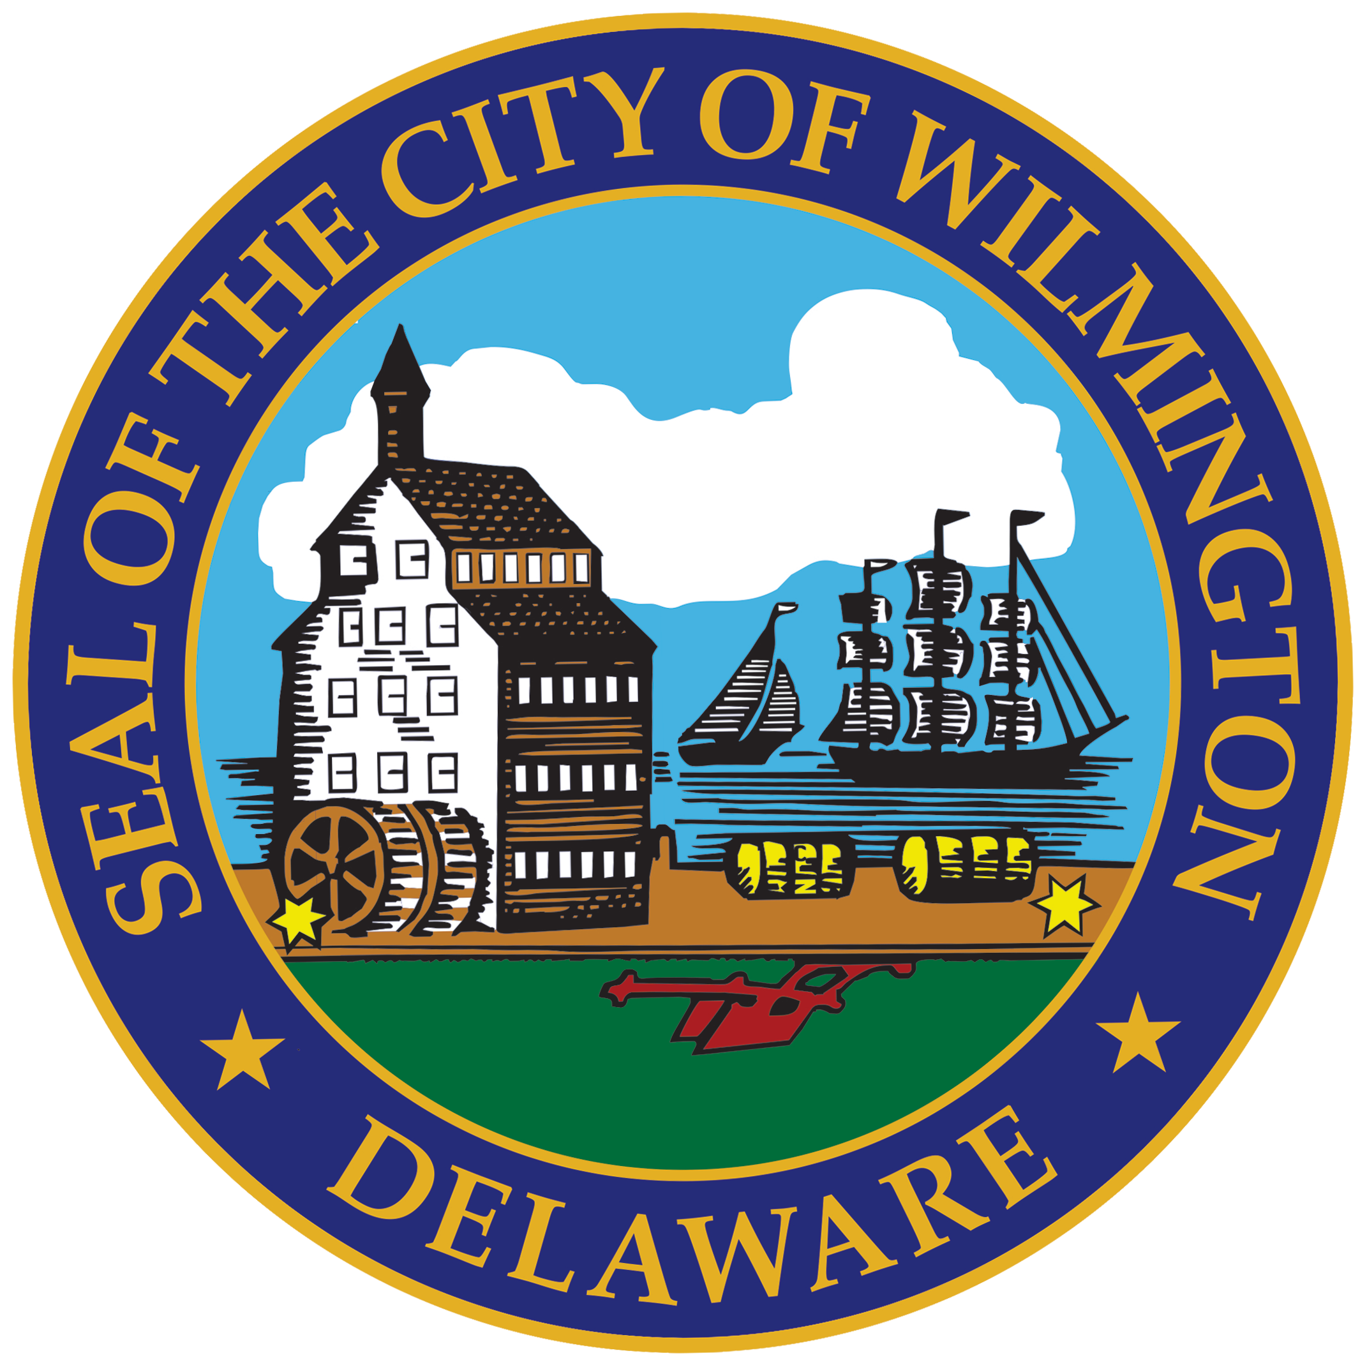
Wilmington Street Team
Community Public Safety Initiative (CPSI)
City of Wilmington

Slide 2
Wilmington Street Team
Responsibilities
Network Connect
  Provides wrap-around services to East Side and Prices Run
Center for Structural Equity (CFSE)
  Provides services to high-risk individuals between the ages of 13-26 – East Side
Youth Advocate Programs (YAP)
  Provides services to high-risk individuals between the ages of 13-26 – Prices Run
Wilmington Community Advisory Council (WCAC)
  Host all Public Safety Roundtables
Community Public Safety Initiative (CPSI)
City of Wilmington

Slide 3
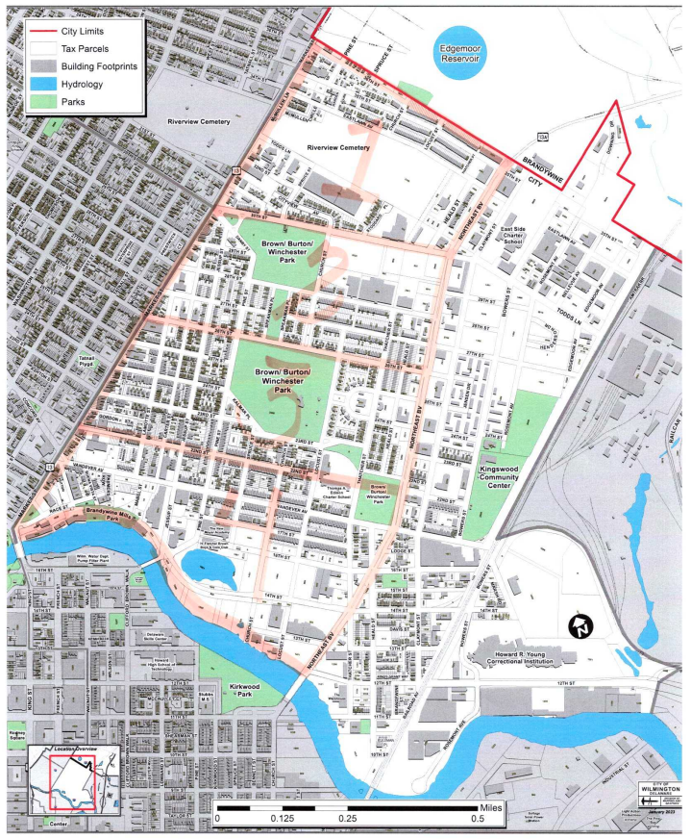
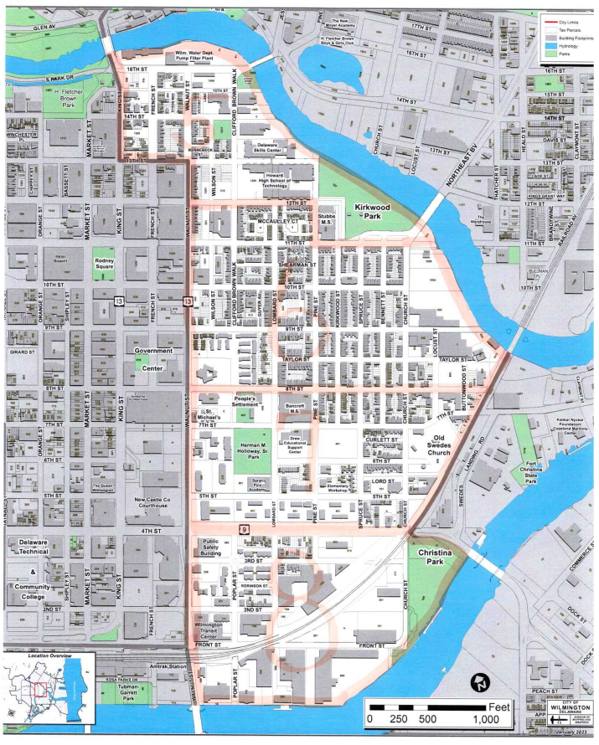
Wilmington Street Team
Zones in the City
Prices Run
  Zones 1-4
    Zone 1 - 30th - 36th & Market to Northeast Blvd
    Zone 2 - 26th - 30th & Market to Northeast Blvd
    Zone 3 - 22nd - 26th & Market to Northeast Blvd
    Zone 4 - Brandywine River - 22nd & Market to Northeast Blvd
East Side
  Zones 5-8
    Zone 5 - 12th - Brandywine River & King to Kirkwood Park/River
    Zone 6 - 8th - 12th & Walnut to Railroad/River
    Zone 7 - 4th - 8th & Walnut to Railroad
    Zone 8 - River – 4th & Walnut to Christina Park
Community Public Safety Initiative (CPSI)
City of Wilmington

Slide 4
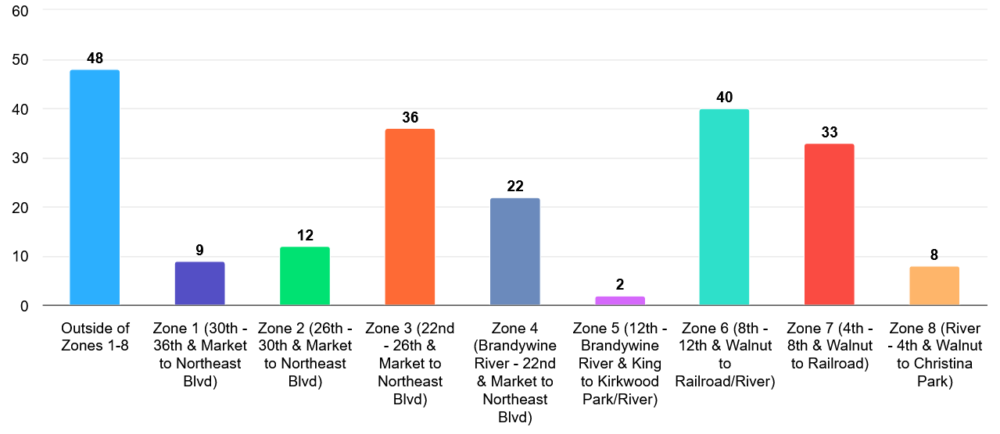
Wilmington Street Team
Community Encounters
Community Public Safety Initiative (CPSI)
City of Wilmington

Slide 5
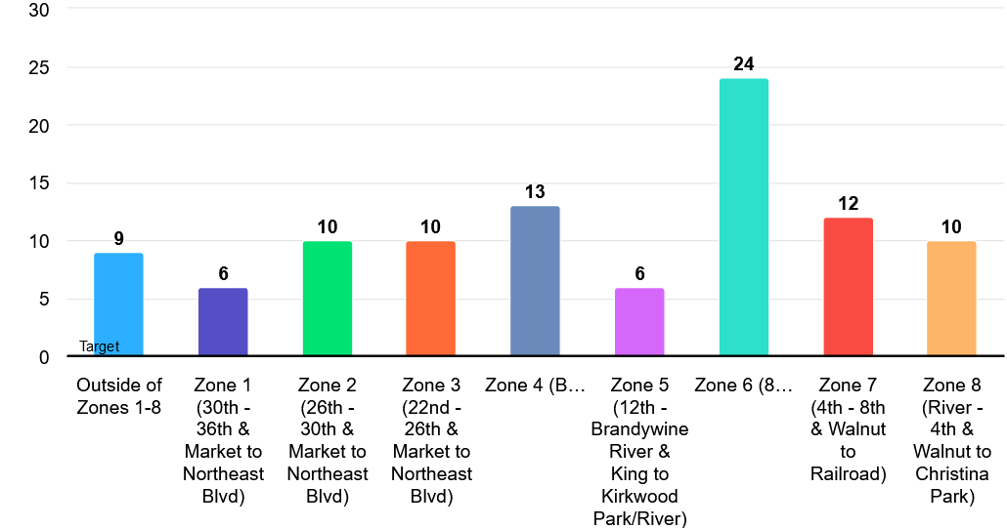
Wilmington Street Team
Dispatch Calls by Zones
Community Public Safety Initiative (CPSI)
City of Wilmington

Slide 6
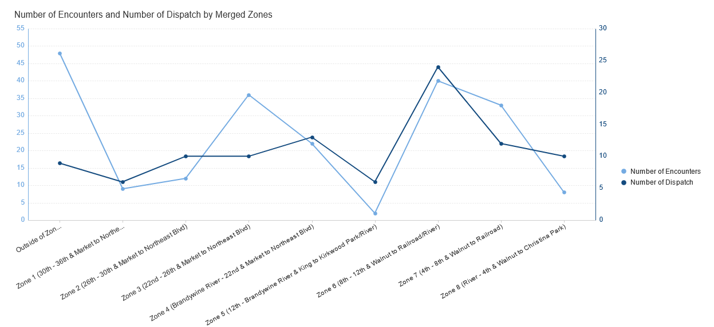
Wilmington Street Team
Impact
Community Public Safety Initiative (CPSI)
City of Wilmington
 | Community Encounters | Dispatch Calls
Outside of Zones 1-8 | 48 | 9
Zone 1 (30th - 36th & Market to Northeast Blvd) | 9 | 6
Zone 2 (26th - 30th & Market to Northeast Blvd) | 12 | 10
Zone 3 (22nd - 26th & Market to Northeast Blvd) | 36 | 10
Zone 4 (Brandywine River - 22nd & Market to Northeast Blvd) | 22 | 13
Zone 5 (12th - Brandywine River & King to Kirkwood Park/River) | 2 | 6
Zone 6 (8th - 12th & Walnut to Railroad/River) | 40 | 24
Zone 7 (4th - 8th & Walnut to Railroad) | 33 | 12
Zone 8 (River - 4th & Walnut to Christina Park) | 8 | 10

Slide 7
End of Year CompStats Data from WPD
YEAR TO DATE for 2023
Districts that INCREASED in Crime
Districts that DECREASED in Crime
District 12 increased by 18%
District 14 increased by 10%
District 10 increased by 40%
District 16 increased by 13%
District 17 increased by 3%
District 18 increased by 19%
District 19 increased by 42%
District 13 decreased by 1%
  Northside – East of Market St.
  Zones 1-4
  151 community encounters for 2023
District 11 decreased by 18%
  East Side
  Zones 5-8
  150 community encounters for 2023

Slide 8
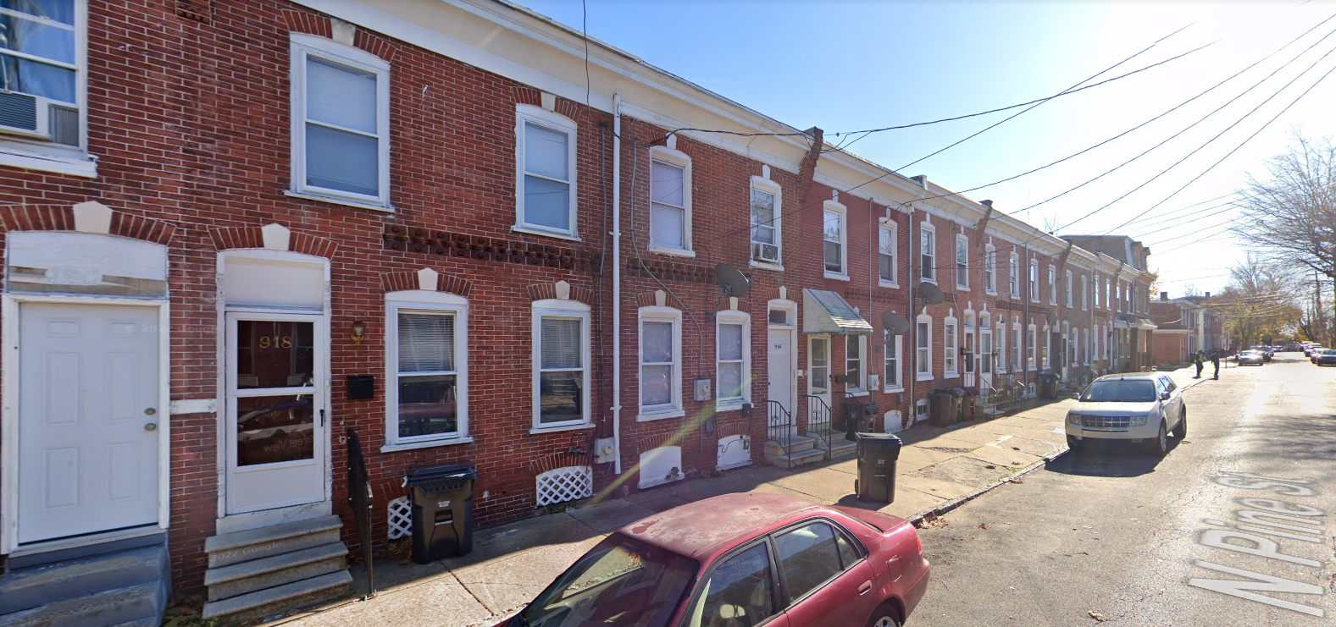
Wilmington Street Team
HUBS
914 N. Pine Street
We have a HUB on the North Side but still looking for another house.
Community Public Safety Initiative (CPSI)
City of Wilmington

Slide 9
Wilmington Street Team
Questions
Thank you
Contact information
Dr. Debra Mason
dmason@wilmingtonde.gov
302-893-5165
Community Public Safety Initiative (CPSI)
City of Wilmington

