Slide 1


Wilmington Street Team
Community Public Safety Initiative (CPSI)
City of Wilmington

Slide 2
Wilmington Street Team
Responsibilities
of the
WILMINGTON STREET TEAM
Community Public Safety Initiative (CPSI)
City of Wilmington
Provide services in East Side and Prices Run
Provide wrap-around services
Provide services to high-risk individuals between the ages of 13-26
Mediations, Community Encounters, Community Passage, Respond to Incidents in the Community, Connect Community Members to Resources in the City
Wilmington Community Advisory Council (WCAC)
Host all Public Safety Roundtables

Slide 3
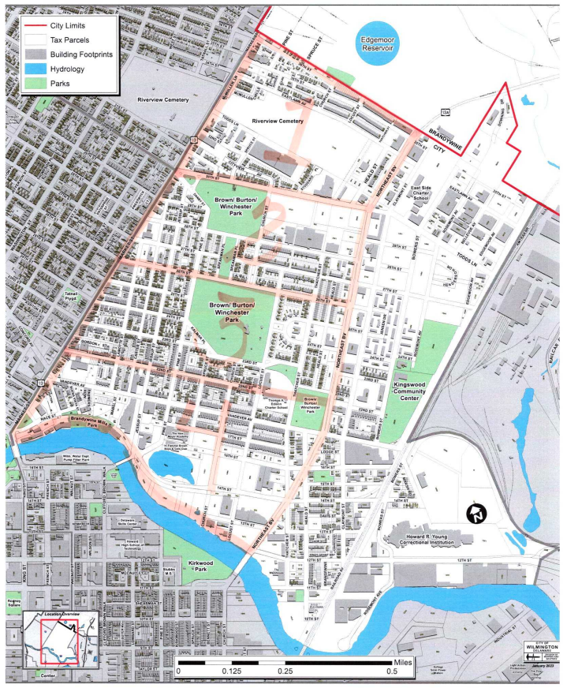
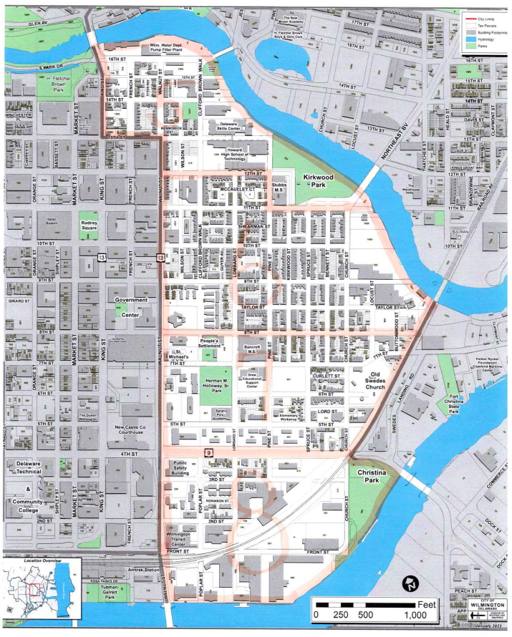
Wilmington Street Team
Zones in the City
Prices Run
Zones 1-4
Zone 1 - 30th - 36th & Market to Northeast Blvd
Zone 2 - 26th - 30th & Market to Northeast Blvd
Zone 3 - 22nd - 26th & Market to Northeast Blvd
Zone 4 - Brandywine River - 22nd & Market to Northeast Blvd
East Side
Zones 5-8
Zone 5 - 12th - Brandywine River & King to Kirkwood Park/River
Zone 6 - 8th - 12th & Walnut to Railroad/River
Zone 7 - 4th - 8th & Walnut to Railroad
Zone 8 - River – 4th & Walnut to Christina Park
Community Public Safety Initiative (CPSI)
City of Wilmington

Slide 4
Impact from 2023 End of Year CompStats Data from WPD
Districts that INCREASED in Crime
Districts that DECREASED in Crime
District 12 increased by 18%
District 14 increased by 10%
District 10 increased by 40%
District 16 increased by 13%
District 17 increased by 3%
District 18 increased by 19%
District 19 increased by 42%
District 13 decreased by 1%
Northside – East of Market St.
Zones 1-4
151 community encounters for 2023
District 11 decreased by 18%
East Side
Zones 5-8
150 community encounters for 2023

Slide 5
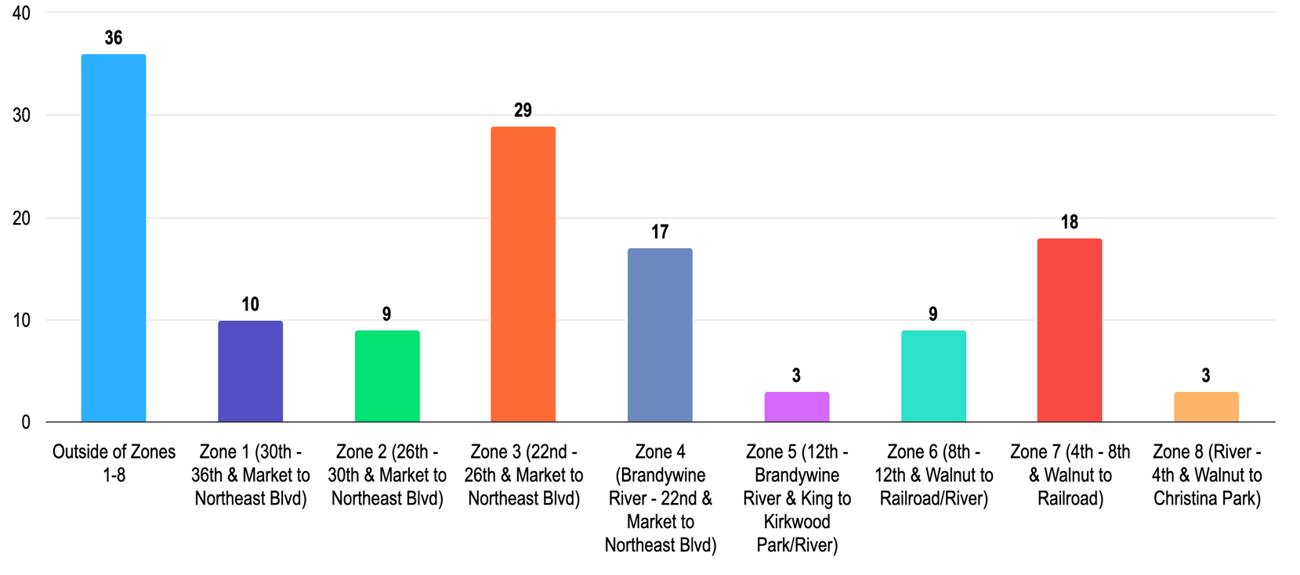
Wilmington Street Team
Community Encounters
Jan 2024 – March 2024
Community Public Safety Initiative (CPSI)
City of Wilmington

Slide 6
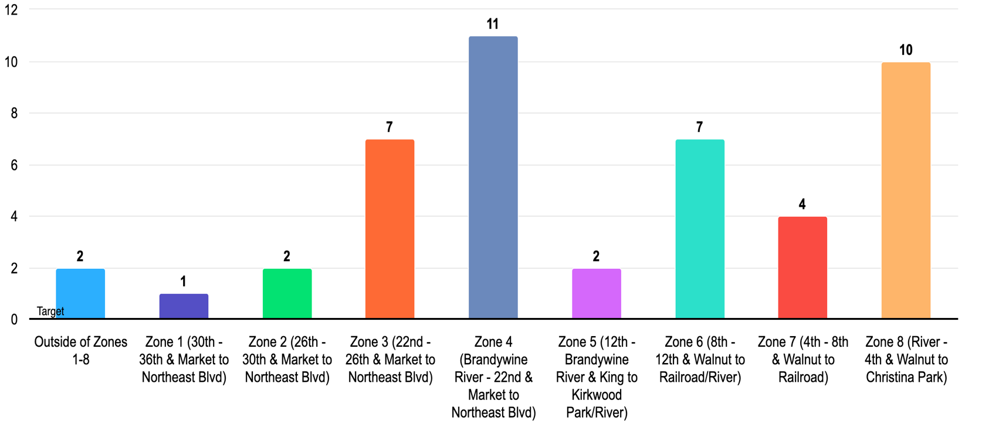
Wilmington Street Team
Dispatch Calls by Zones
Jan 2024 – March 2024
Community Public Safety Initiative (CPSI)
City of Wilmington

Slide 7
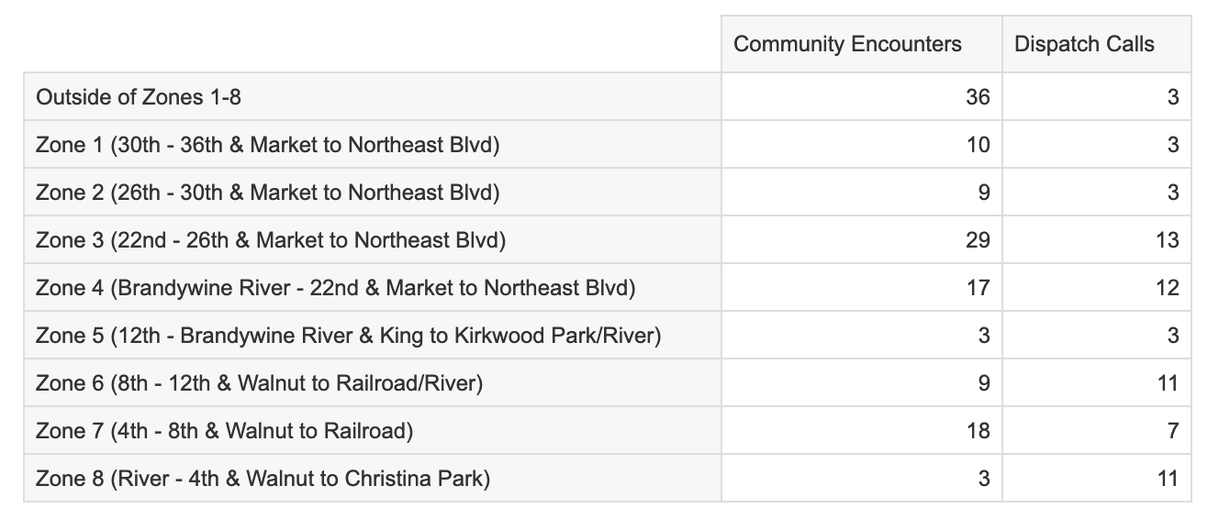
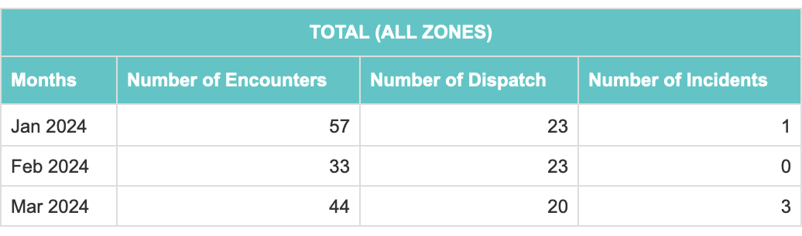
Impact
Jan 2024 – March 2024
Community Public Safety Initiative (CPSI)
City of Wilmington

Slide 8
Wilmington Street Team
HUBS and Community Events
914 N. Pine Street – East Side HUB
2214 N. Market Street - Will be open by July 1, 2024 – North Side HUB
East Side HUB
The East Side HUB served 173 people from January 1 to March 31, 2024. During this quarter, the Wilmington Street Team (WST) provided bus passes, clothing, diapers, employment assistance, food, and assistance with washing clothes.
Community Events
The Wilmington Street Team (WST) hosted 22 community events and provided services to 1091 community members. The events included a Chili Cook-off, which fed 28 community members; a diaper giveaway, which provided diapers to 120 people; an Easter Egg Hunt, an MLK Community Dinner; a Pop-up Produce Giveaway; a game night at Sojourner's Place, and numerous other events.
Community Public Safety Initiative (CPSI)
City of Wilmington

Slide 9


Wilmington Street Team Members
IMPACT ON THE COMMUNITY

Slide 10
Questions
Thank you
Contact information
Dr. Debra Mason
dmason@wilmingtonde.gov
302-893-5165
Cierra Hall-Hipkins – Network Connect
Darryl Chambers – Center for Structural Equity
Community Public Safety Initiative (CPSI)
City of Wilmington

