Slide 1

Community Development and Urban Planning Committee
November 14, 2024
Sub. No. 1 to Ord. 24-053 (Rev. #1) per
Recommendations of CPC Res. 8-24
(As Amended)
Substitute No. 1 to Ordinance 24-053
(Rev. # 1)
A Proposal to Regulate Recreational Marijuana Uses in the City in accordance with State Enabling Legislation

Slide 2
State Legislation
State of Delaware House Bill No. 1
  Enacted in April 2023 to legalize marijuana for personal use by adults 21 and over, and established “personal use quantity” of 1 ounce or less
  Restricted from being consumed in public or in moving vehicles
  Permits employers to enforce zero tolerance policies
  Marijuana cannot be sold, grown or manufactured unless done so as a state-licensed business
State of Delaware House Bill No. 2
  Enacted April 2023; effective August 2023
  Regulates and taxes marijuana for recreational use
  Created a framework for production, manufacture, and sales in a legal recreational marijuana industry
  Created the State Office of the Marijuana Commissioner.
  Authorized 125 statewide business licenses for the 4 types of uses

Slide 3
October 1st CPC Special Meeting: Regulating Marijuana Uses
Identified Zoning Districts where the four licensed marijuana uses could locate.
Established Buffer Zones within which the four types of licensed marijuana operations would NOT be permitted
  1. Original Proposal: “Marijuana buffer zone” of 100 feet shall be established between each of the four licensed marijuana uses and 1) residential zones, and 2) K - 12 public and private schools
  2. CPC Recommendation: “Marijuana buffer zone” increased from 100 feet to 300 feet

Slide 4
City Council Action
October 3, 2024, City Council Meeting
  Introduction, 1st & 2nd reading of Ordinance 24-053
  Sponsor Council Member Maria Cabrera referred the matter back to CPC for reconsideration
    Ordinance 24-053 also referred to Council’s CDUP Committee and scheduled for a public hearing
Planning Commission Special Meeting #2 held on October 22nd to review the request

Slide 5
October 22nd CPC Special Meeting Results
The Planning Commission approved a motion to amend their recommendation in Resolution 8-24 as follows:
1) Reduce the 300 feet buffer zone recommendation back to 100 feet
2) Increase state’s requirement of a 1200 feet distance between the same marijuana license types to a distance of 2600 feet when located within City boundaries
3) Classify marijuana retail shops as uses requiring zoning board of adjustment approval as special exceptions within the C-2 Secondary Business Centers and C-2A Secondary Office Centers zoning districts. In other words, these uses would not be permitted in C-2 and C-2A as a matter of right.

Slide 6
Current Recommendations (Zoning)
Type of Use License | Permit as Matter of Right | Permit as Special Exception
Cultivation | C-5 M-1, M-2 W-1, W-2, W-3 | - -
Product Manufacturing | C-5 M-1, M-2 W-1, W-2, W-3 | - -
Retail Operation | C-3, C-4, C-5 M-1, M-2, W-1 W-2, W-3 | C-2, C-2A W-4 with conditions
Product Testing Facility | C-5 M-1, M-2 W-1, W-2, W-3 | W-4 with conditions

Slide 7
100 Feet

Slide 8
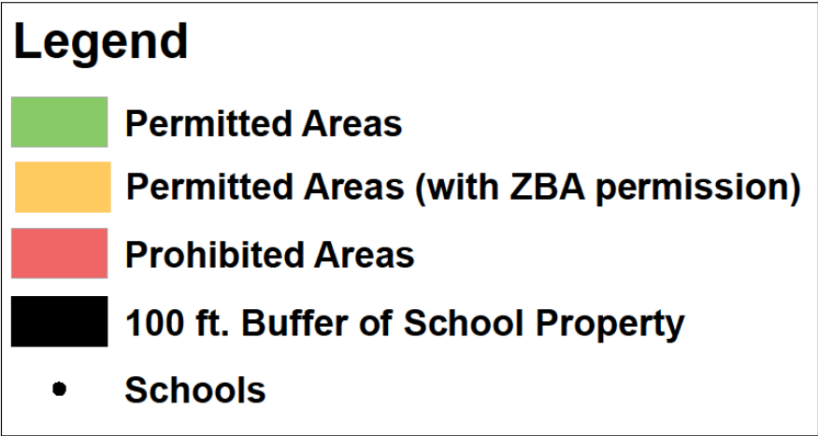
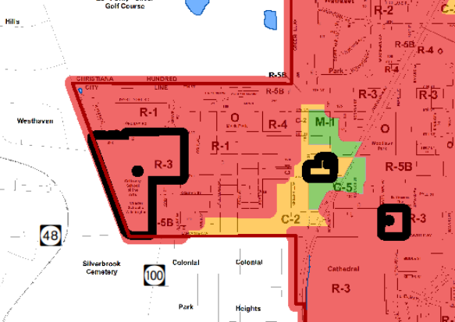

Slide 9
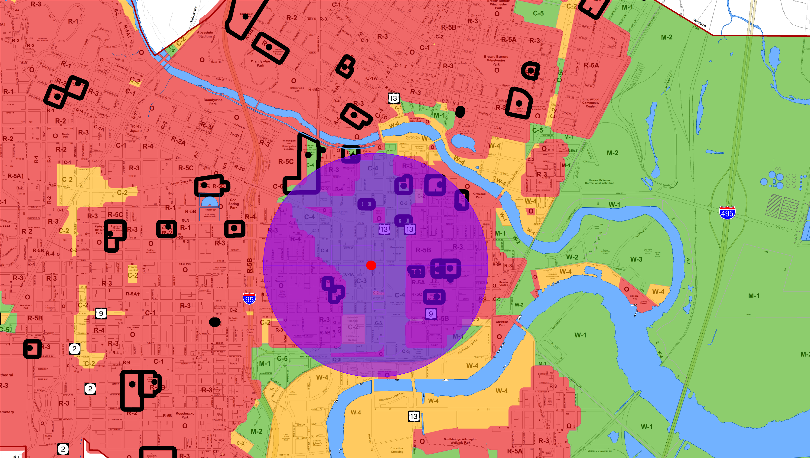
2600’ Spacing Requirement
2600 feet

Slide 10
Review of Regulations
Regardless of Actual Buffer Distance:
No licensed marijuana operations permitted in residential districts
Buffers will exist between each licensed marijuana type and 1) residential boundaries and 2) K - 12 public and private schools
Neighborhood commercial districts will not permit marijuana uses
Marijuana consumption will not be permitted in public spaces, including parks
At the state level, licensed operations of the same type (e.g., retail to retail) must be 1200 feet apart (2600 feet within City limits with CPC amendment)
Driving under the influence remains illegal
The State defines specific hours of operation for retail sales

Slide 11
Questions/Comments

Slide 12
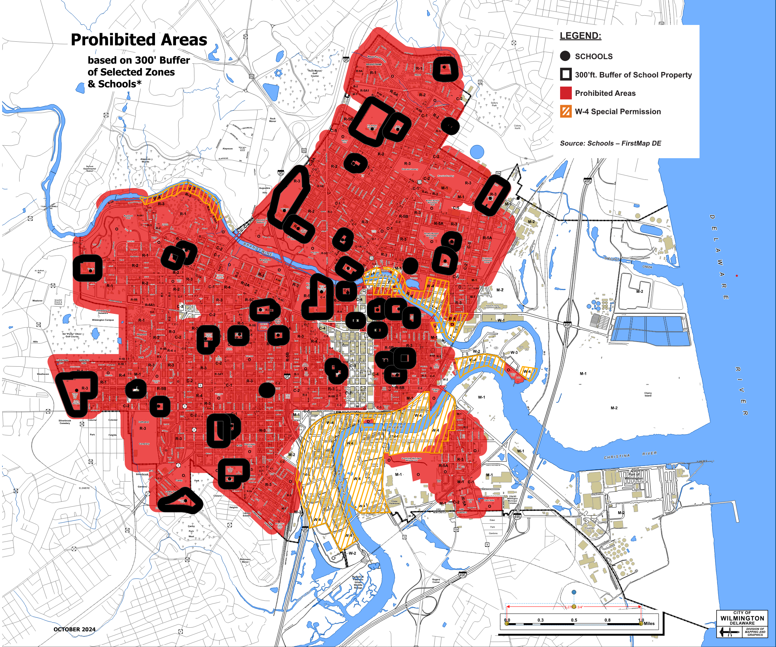
300 feet

Slide 13
“Do Nothing”
Type of Use License | Permitted Matter of Right | Permitted as Special Exception
Cultivation | C-5, M-1, M-2 W-1, W-2, W-3 | - -
Product Manufacturing | C-5, M-1, M-2 W-1, W-2, W-3 | - -
Retail Operation | C-1, C-1A, C-2, C-2A C-3, C-4 C-5, C-6 M-1, M-2, W-2, W-4 | R-3, R-5A1, R-5B R-5C W-1
Product Testing Facility | M-1, M-2 W-1, W-2, W-3 | C-2A

Slide 14
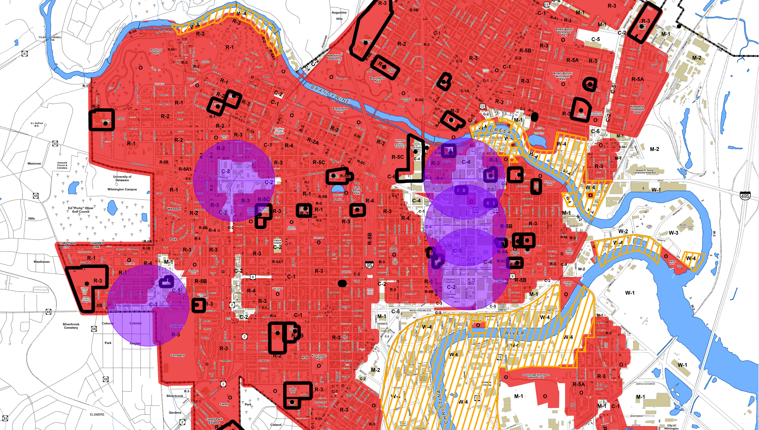
State 1200’ Distance Requirement Imposed on 100’ Buffer Map
(Hypothetical Scenarios)

Slide 15
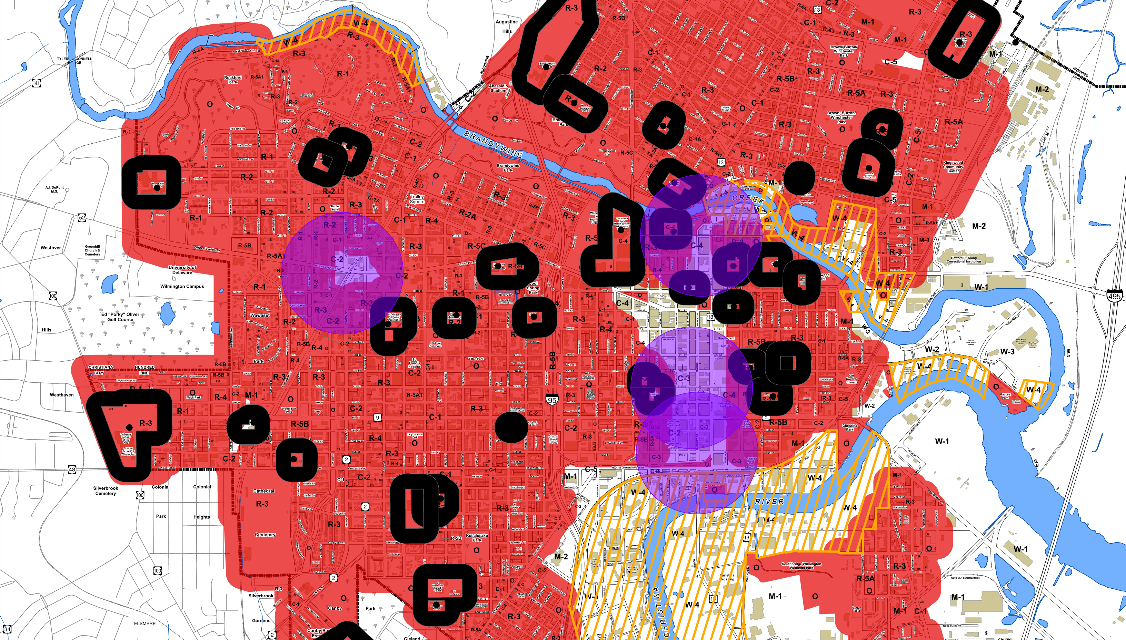
State 1200’ Distance Requirement Imposed on 300’ Buffer Map
(Hypothetical Scenarios)

Slide 16
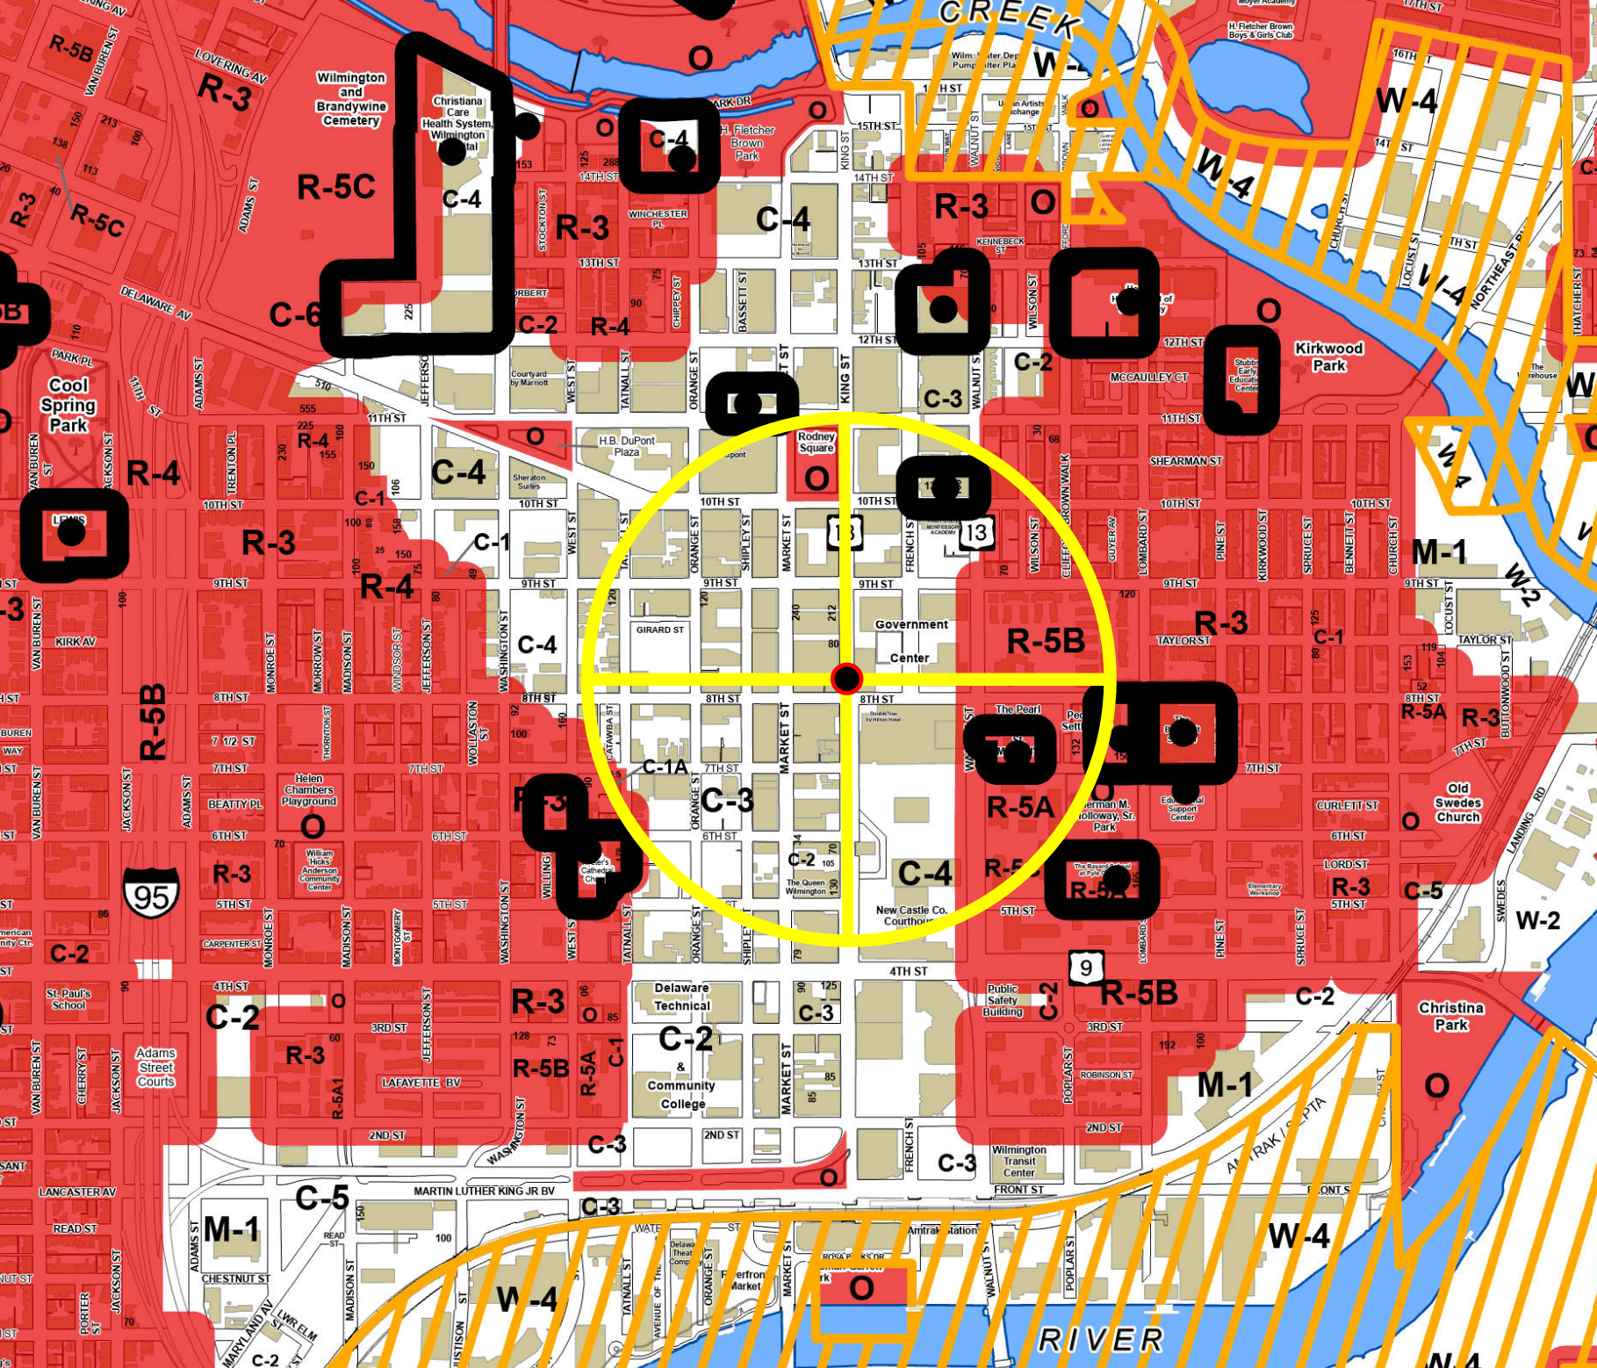
State 1200’ Distance Requirement
Imposed on 100’ Buffer Map
(Hypothetical Scenario - Location
at 8th & Market)

Slide 17
State of Delaware House Bill No. 2
  Authorized 125 statewide business licenses for 4 types of uses:
# / TYPE OF STATE LICENSES | DATE AVAILABLE
60 Cultivation | November 2024
30 Manufacturing | December 2024
30 Retail | March 2025
5 Testing | March 2025

Slide 18
Operations Similar to Alcohol Sales
Marijuana sales will operate similarly to alcohol sales.
At the state level:
  applicable 15% state sales tax
  defined hours of operation
  fines and penalties for the sale to underage individuals
Prohibited from being sold in establishments licensed to sell alcohol.
Sales regulations enforced by the Delaware Division of Alcohol and Tobacco Enforcement.
Operation of a vehicle under the influence of marijuana will have the same penalties as drunk driving.
5

