Slide 1
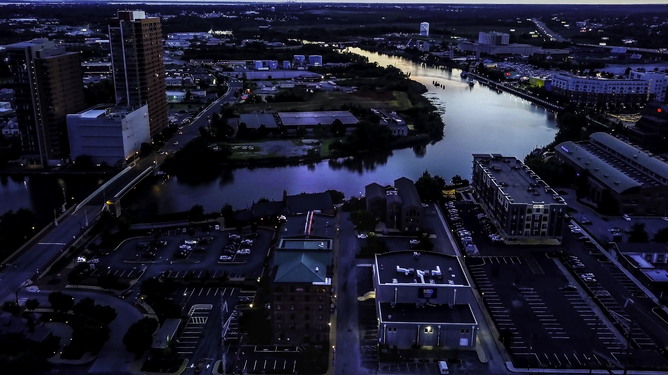
Ord 24-011 re: Electric Vehicles

Slide 2

Res. 23-051 established a working group:
Administration Appointees:
Robert Goff – City Solicitor
Kelly Williams – Commission of Public Works
Michael Boykin – Commissioner of L&I
Jeff Starkey – Director of Land Use & Planning
Stephanie Mergler – Deputy Chief of Staff
Breanne Preisen – DNREC
Scott Johnson
Council Appointees:
Cora Castle
Anaya Harrison
Jed Hatfield
Mike Lenon
Pauletta Tinklepaugh
Joe Zilcosky
Directive: Study Ord. 23-027 and formulate recommendations for appropriate changes.
Meetings: The Working Group held four public meetings starting in October 2023 and ending in December 2023. Their conclusions led to the following changes legislation:

Slide 3
Summary of Major Changes:
Section 42-246
Revises the definition of Charging Level and Electric Vehicle.
Creates definition of Frequent operator of an electric vehicle.
Section 42-247
Creates a “sunset date” for the use of curbside charging cords of July 1, 2030.
Section 42-248
Subsection (b)(2)1. clarifies that the owner of a property shall be deemed to be a permit holder along with any non-owner applicant.
Subsection (c)(2) allows applicants with off-street parking to apply for a variance if they are otherwise eligible for a permit.

