Slide 1
The City of Wilmington
October 2024

Slide 2
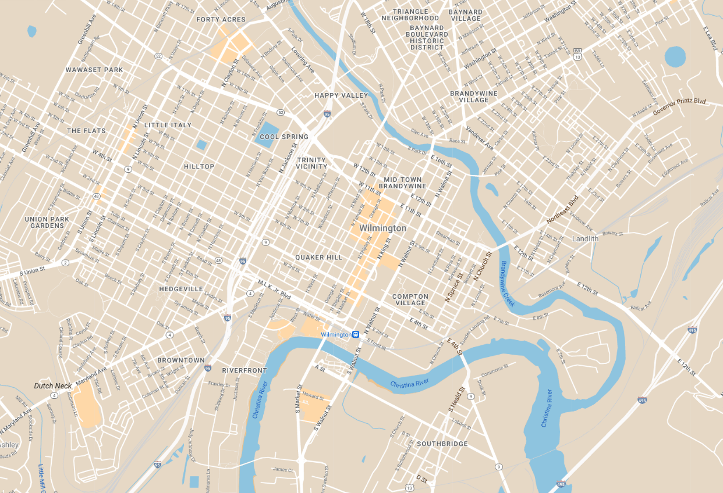



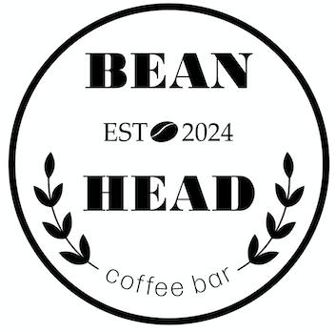
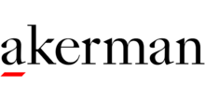

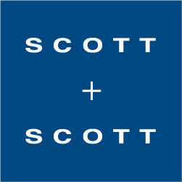
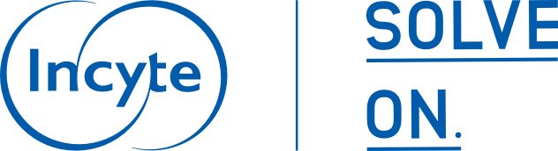












Slide 3
Residential Development
In Development as of October 2024: 17 Projects - 1110 Residential Units
Recently Completed in 2024: 7 Projects - 736 Residential Units
Trends:
Vacant office conversions
  Central Business District office vacancy rate decreased from 28.1% in 2023-Q4 to 18.5% in 2024-Q2
  Flexible office space
    The Mill Nemours Building expansion
    Regis (901 N. Market St.)
  Residential conversions in development:
    913 N. Market St.​
    300 Delaware Ave.
Parking lot redevelopment
  Orange and W 11th St. Residential development
  Lattice Industries Tier 4 data center and data exchange center (16th Street and King Street)
Out-of-State investors
  Berger Development (Pennsylvania)
  Westrum Development Company (Pennsylvania)
  Washington Place Equities (Maryland)
Notes:
Highlights
The Press (BPG): $90 million residential project called the Press in October 2023. The 243-unit complex, which will be similar in scale to the recently completed Crosby Hill, will replace a Wilmington Parking Authority parking lot at the corner of 8th and Orange street.
Humble Park (BPG) announced in July 2023 a $16 million, 61-unit complex at the corner of 4th and Market Street will replace the previous City property known as Humble Park.
9SDC is estimated to complete construction on the 8th and Market property which was previously owned by Rite Aid by the end of this year. The mixed-use property will offer 18 residential units, 3 commercial spaces, and rooftop views that were previously unavailable at this property.
Berger Communities 130 Unit Building at 1021 Gilpin Avenue
Pennsylvania-based Westover Companies held a ribbon cutting last Friday for 901 N Market St. The 14-story building was a former masonry building and previously known as “The Equitable Building,” and “The Bank of Delaware,”. The office to residential conversion was initiated in 2017 and had a total development cost around $30 million. It is now a full-service apartment complex with 82 units and commercial space on the first floor.
Conversions
Riverfront
At Riverfront East, Washington Place Equities is set to complete construction of the 145 unit River House next month and start leasing in June. River House is located on A Street in South Wilmington and they also have plans to develop an additional 150 units on the neighboring site. Including the Luxor residential development by Westrum Development Company, it’s notable that the top 3 residential development projects announced in the riverfront are all from out-of-state investors.
Under residential development,
Investment in the multifamily housing market remains an area of focus for the City of Wilmington. The expansion in this market allows for new residents to relocate to Wilmington, contributing to wage tax growth and expanding the City’s professional workforce – a key consideration of business relocation. The Office of Economic Development has actively tracked 18 residential projects currently in development within City limits, accounting for 1084 new units in the Downtown, Riverfront, and West Side areas.
Doubletree (December 2023)
Courtyard Marriot (October 2023)

Slide 4
Economic Development Products and Services
Strategic Fund
Employment
Attraction
Retention
Property Investment
Architecture and Engineering Study
Façade Improvements
Operating Budget
Consulting Budget
Black restaurant week
Talent Attraction Studies
Advertising
State Incentives
Downtown Development District
City Component Units
Community Development Financial Institutions (CDFI)
Delaware Community Development Corporation
Grow America Fund
Wilmington UDAG Corporation
Christina Gateway Corporation
Expansion
InWilm
Business Xpansion Journal
Site Selector Magazine
Capital Budget
Site Acquisition
Site Improvements
Delaware Prosperity Partnership
Division of Small Business
Industry Demand Studies
Wilmington Economic Development Corporation
True Access Capital
Grow Wilmington Fund
Notes:
Black restaurant week

Slide 5
Economic Development Strategic Fund
 | FY'25 (So Far) | FY'24
Fund Expenditures | $215,000 | $467,521
Funds Allocated to SMBEO's | $50,000 | $381,287
Total Fund Balance as of October 1, 2025 | $1,441,583
SMBEO Set-aside Balance | $300,000
Notes:
Names of 4 commitments and years
Define the pipeline

Slide 6
Recent Set-aside Activity
Recent Commitments
13 commitments underway:
The Juice Joint 2.0 & Be Suite (Westside)
Basquiat Bodega (Westside)
Tuskegee Aero Engineering (N. Market)
Snow’s Cornerstore BBQ (Southbridge)
Carry My Own Weight (Southbridge)
Oath 84 (Downtown)
Lena’s (Downtown)
Bean Head Café (Trinity Vicinity)
Make and Mellow (Midtown)
4th St. Triplex (Quaker Hill)
2Much (LOMA)
Serenas (LOMA)
DE Black Chamber of Commerce (Eastside)
Total: $ 460,220
FY ‘25 Pipeline
Sax's (North East)
Green Box Kitchen (Downtown)
Hummingbird (Downtown)
Italian Rest (LOMA)
Egyptian Bakery (Westside)
Pinji’s Café (Trolley Sq)
Keem’s (Southbridge)
The Stand (TBD)
Mitche’s Mo Betta Chicken (TBD)
OASE5 (TBD)
Current Set Aside Balance: $300,000
Expected Expenditures: $460,220
Total Remaining Balance: ($160,220)
- Wilford Enterprises (2501 N. Market St) – Infrastructure Agreement (Capital budget expense)
- $114,490 ARPA committed to minority projects
Notes:
Notes:

Slide 7
DBE Program Updates
Recent and upcoming activities:
Rolled out B2GNow as the City’s new DBE Application Portal and certification database
Exploring the Contract Compliance module within B2GNow
Coordinating a Day with Public Service DBE Event
Attending the National Minority Supplier Development Council on Oct 20-23
Participating in the Eastern Minority Development Council’s Minority Enterprise Development (MED) Week events Oct 8-11
Attending as a panelist on UD's Inaugural Delaware MED week on Thurs Oct 17
Hosting a Social Media training day (date TBD)
Participating as a presenter for True Access Capital’s upcoming Procurement Webinar (Date TBD)
Notes:
Notes:

Slide 8
DBE Program Updates
Status:
Pending final Legal Department guidance on the proposed changes
Pending Admin Board Review
Proposals that may require legislative updates:
Proposed update to the program name from DBE to the Procurement Equity Program (PEP)
Update code from using unemployment rate as the primary justification for race and gender conscious programs to instead use the recent disparity study findings (35-132)
Expand the participation criteria to align with other State of DE certifying bodies (DelDot, OSD)
Update goal setting language to include the availability of Ready, Willing and Able firms
Create improved payment terms for non-DBE’s who meet or exceed goals
Create incentives for Non-DBE’s to partner with or subcontract with DBE’s
Enable set aside projects for projects under the bid threshold
Create incentive tiers for bids over the bid threshold (requires an update to the State’s lowest bidder charter)
Remove or update references to defunct department and functions
Notes:
Notes:

Slide 9
