Slide 1
The Healthy Village at Saint Francis Hospital

Slide 2
Healthy Village Priorities
Behavioral Health
(including substance abuse services)
Education,
Job Training & Skills Development
Health
Equity
Affordable Housing /
Senior Services
Saint Francis Hospital

Slide 3
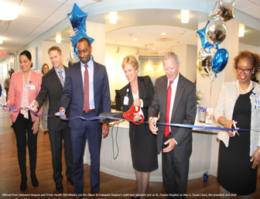
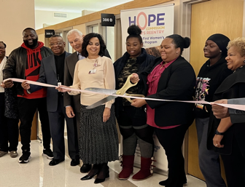
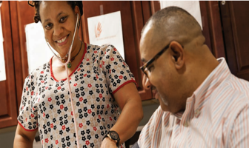
Delaware Hospice
Healthy Village has seen early success in collaborative care.
Women’s Reentry
Wellness Recovery Center
Merakey’s Wellness Recovery Team works to improve the physical and behavioral health of individuals with serious mental illness, substance use disorders, and physical health conditions.
Delaware Hospice at Saint Francis Hospital offers a comforting option when loved ones need a higher level of support outside the home. Opportunities for space increase for dementia unit.
Hope Commission Women’s Reentry serves women referred from the Delaware DOC and Baylor Women’s Correctional Facility, offering a West End Neighborhood House GED program, one-on-one and group sessions with reentry coordinator to help navigate other community support systems, and behavioral health help.

Slide 4
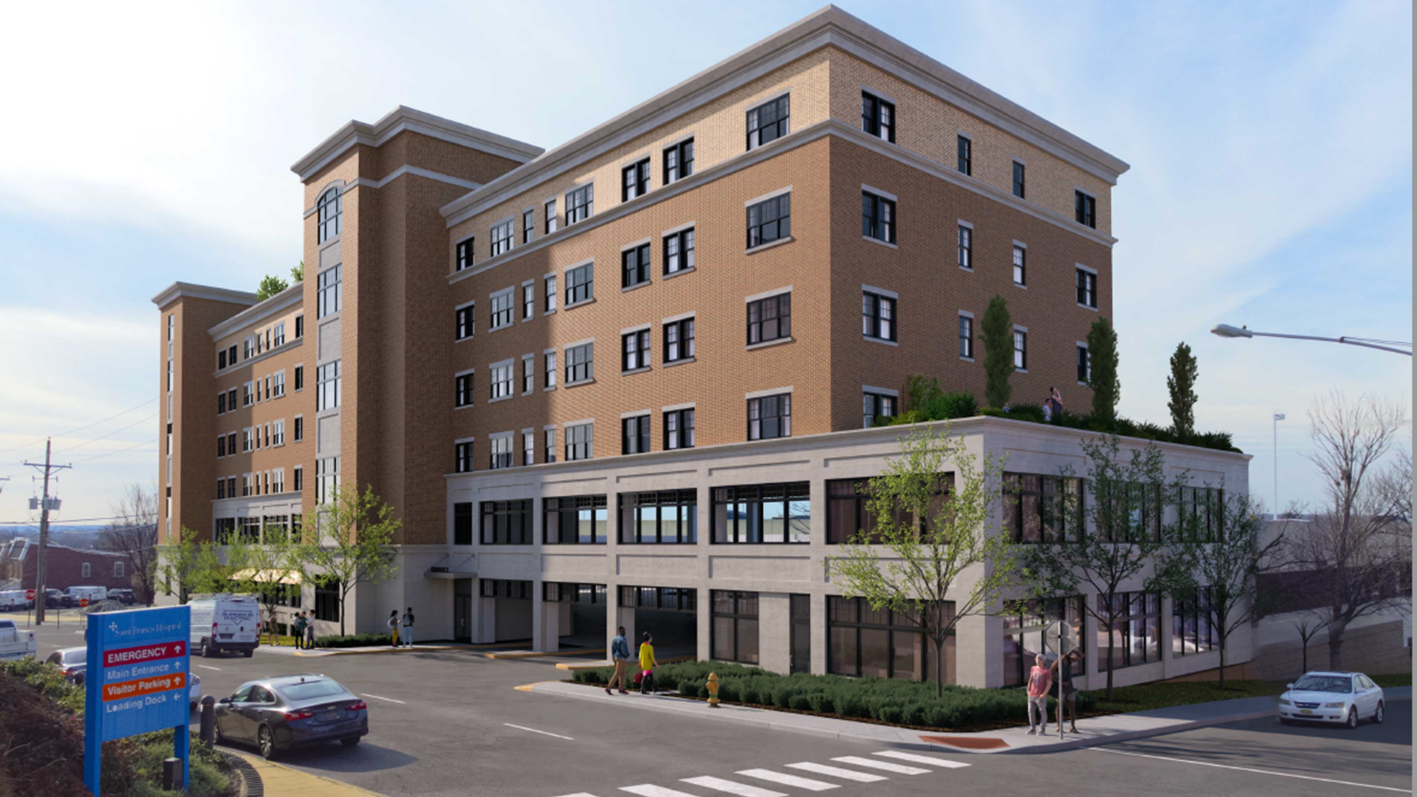
HOUSING
Transforming Community Initiative
  Funded by Trinity Health (Up to $1Million over four years)
Collaborating with Westside Grows Together to update the Revitalization Plan
Grant will fund initiatives within the Housing Pillar with a focus on:
  Expanding homeowner repair programs
  Support the development of affordable housing in the West Side
  New homeownership opportunities
  Advocating for programs to support responsible landlord practices
Vistas Projects-Senior Affordable Housing (57 units)
Developer Engaged
LOI-in legal review
Zoning Changes
Community Meetings

Slide 5
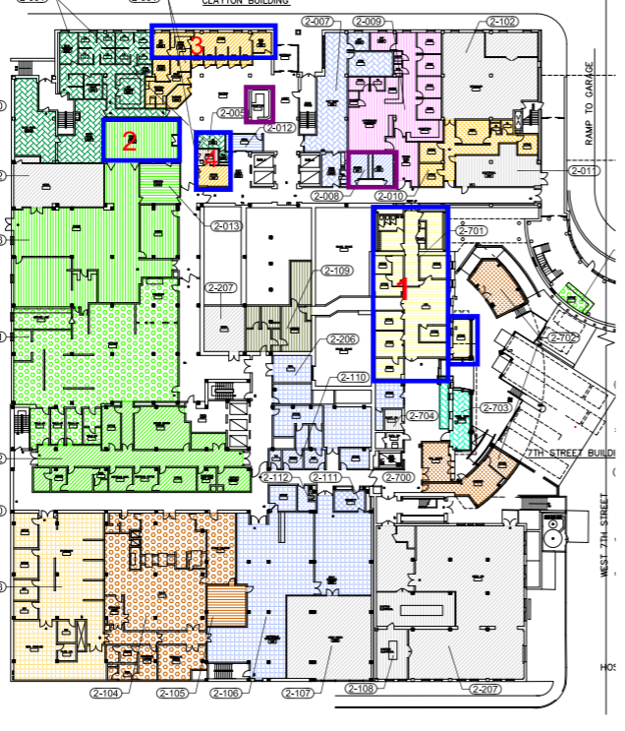

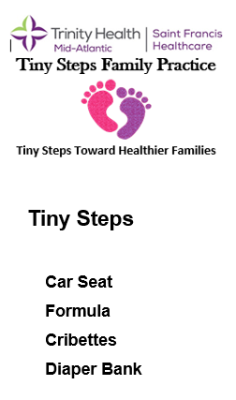

Community Health Center (Old Gift Shop)
Services to be provided
  CARES (Durable Medical Equipment lending)
  Surplus Food
  Emergency Food
  Personal Hygiene Items
Upcoming Construction-$1M Highmark Donation
Old HR- Making space partner ready for small community-based organizations
MacDonald Lounge- Changing the space to a Community Conference Room
2nd Floor Bathroom-renovations to include ADA requirements

Slide 6
Healthy Village Strategy for 2024
Partners
Philanthropy Funded Construction (1.4M dollars)
Conference room
Lobby Refresh
Bathrooms
Programs on Mainstreet (Health Equity Programs)
Food insecurity ( Backpacks, Homeless food boxes, Farm boxes, Surplus food)
DME ( Durable Medical Equipment)
Personal Care items
Expansion of Tiny Steps program (Cribs, car seats)
Community Health Workers (to be funded by Philanthropy)
Mainstreet tenant build out
Engage smaller community-based organizations
Educational partners
Focus on Delaware partners for Behavioral Health/SUD services
Follow up and reengage partners both small and large (i.e. Nemours, NovaCare, Delaware Hospice-dementia)
Financial Literacy
Access to Healthcare
SIOH self-sufficiency programs
Develop outcome and measures
Advocacy (State, local, federal)

Slide 7
We are building partnerships in the community to meet these needs.
Healthy Village Priority | Services | Current Partners (bold) & Engaged Prospective Partners
Acute & Emergency Care | Acute & Primary Care, Surgical Services, Wound Care, Pediatrics, Respite Care, Physical Therapy, Hospice | Saint Francis Hospital, Saint Francis Wound Care, Nemours, Catholic Charities, Novacare, Delaware Hospice, Life Health Center | Life Health Center, LA Red Health Center
Education, Job Training & Skills Development | Educational Training/Certifications | Red Clay Consolidated School District, Catholic Diocese, Delaware Tech & Community College, University of Delaware, Wilmington University | Red Clay, Catholic Diocese, Delaware Tech & Community College, Hilltop Neighborhood Center, University of Delaware, Childcare (TBD)
Health Equity | Services to Support Social Determinants of Health | Retail Pharmacy, Latin American Community Center, Ministry of Caring, YWCA, Food Bank of DE, Trinity Farm Boxes/Backpack Program, Women’s Reentry, Hope Center, REACH Riverside, Children & Families First, Governmental Office of Services & Support, Community Health Workers, Community Health Center to include Personal Care Items, Financial Literacy, SIOH Self-Sufficiency Programs, Expansion of Tiny Steps Program (Cribs, Car Seats) | Ministry of Caring, DE Ecumenical Council on Children & Families, Hope Center, REACH, Governmental Office of Services & Support
Behavioral Health | Behavioral Health, Mental Health, SUD | Limen House, Brandywine Counseling, Merakey Wellness Recovery, Amanecer Counseling & Resource Center, SL24 Unlock the Light Foundation, Recovery Innovations, Inc., Rockford Center, Community Health Workers | Recovery Innovations, Inc.
Affordable Housing | Housing | West End Neighborhood House, West Side Grows Together, Cinnaire, Housing Alliance Delaware, Woodlawn Trust | Cinnaire, Housing Alliance Delaware, Woodlawn Trust
Senior Services | Long Term Care, Durable Medical Equipment | THMA CARES, Senior ER, Caregiver Program, Saint Francis LIFE | Long term care TBD

Slide 8
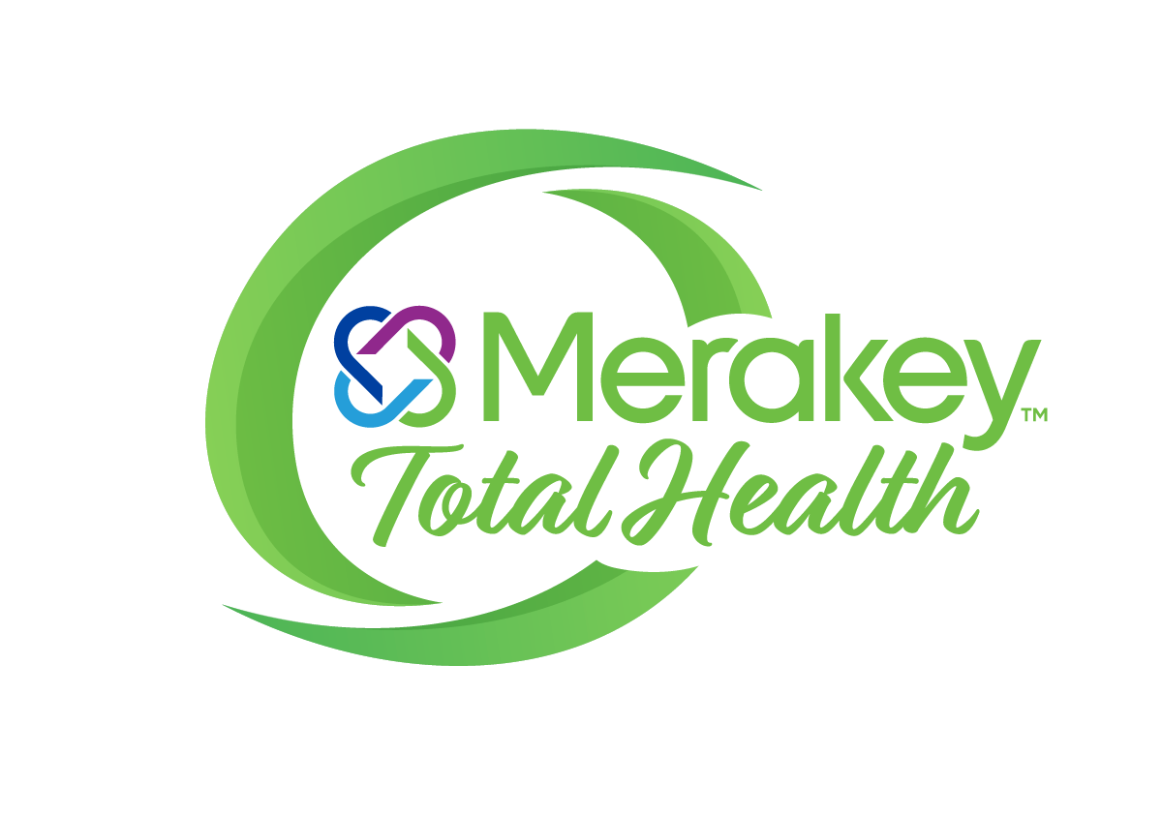
Merakey & Merakey Total Health Provide High-Quality Care to the Most Vulnerable Populations
Merakey is a non-profit provider of developmental, behavioral health, and education services. More than 8,000 employees provide support to nearly 40,000 individuals and families throughout 12 states – including Delaware.
Merakey Total Health, Inc. (MTH), an independent affiliate of Merakey, provides primary care services, with a focus on individuals who have difficulty accessing primary care and the low income and uninsured residents of our community.
MTH provides patient-centered, whole person care by integrating physical and behavioral health
MTH’s goal is to operate as a FQHC to enable us to provide integrated care and support services to all patients regardless of ability to pay
Physical
Behavioral
Social
Notes:
We will be expanding our services to add primary care – not only to the people Merakey serves, but also to the entire community.
We have been good neighbors to our community, and we will continue to be with our new program
Designed by federal government as a medically underserved area – the facility will serve surrounding areas, which are also designated as medically underserved
Just opened children’s behavioral health crisis center at 265 E. Lehigh
Source: City of Philadelphia, Regional Community Health Needs Assessment
North Philadelphia: 19132, 19121
Intergenerational substance use and trauma
Gun violence
Stress due to trauma as well as homelessness, lack of access to healthy affordable food and lack of opportunities for physical activity.
High rates of chronic diseases like diabetes, hypertension, cholesterol, and heart disease contribute significantly to poor health.
Low quality of the public schools and the potential closing of the local high school threaten education opportunity.
Northwest Philadelphia: 19119, 19118, 19128, 19129, 19127, 19144
https://www.phila.gov/documents/regional-community-health-needs-assessment/
Higher than average infant mortality
Desire for racial concordance between providers and the population.
Lack of local behavioral health care providers
Perceived stigma regarding race and mental health.
Need for more family-focused support services, for example, trainings to deescalate household conflict and support families with children that have behavioral and mental health needs.

Slide 9
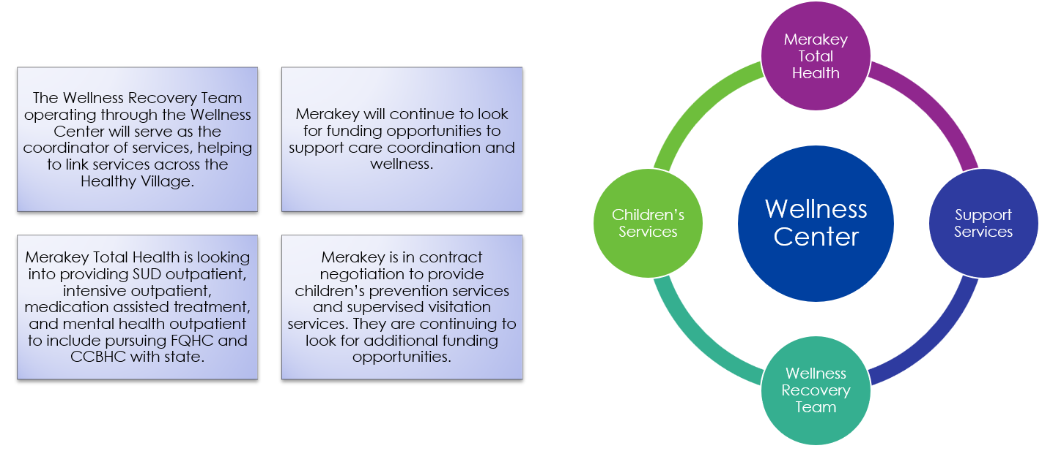
Merakey 2024 Strategy for Saint Francis Healthy Village

Slide 10
Federally Qualified Health Centers provide an opportunity to expand care and services to vulnerable populations
Federally Qualified Health Centers (FQHCs) and FQHC-Look Alikes care for significantly fewer patients in Wilmington than other major cities
Wilmington FQHCs care for 22% of the low-income population and 9% of the total population
Philadelphia FQHCs see 46% of the low-income population and 21% of the total population
Camden FQHCs see 60% of the low-income population and 37% of the total population
Baltimore FQHCs see 42% of the low-income population and 17% of the total population
FQHCs are an essential part of community health. They provide preventative, whole person care and remove health access barriers for the underserved individuals
FQHCs serve federally-designated medically underserved areas
One in five Medicaid members are served by an FQHC
One in 12 Americans are served by an FQHC
FQHCs are patient-centered medical homes.
Notes:
FQHCs are a Critical Part of Community Heath Care
FQHCs are a Smaller Part of the Health Care Landscape in Wilmington

