Slide 1
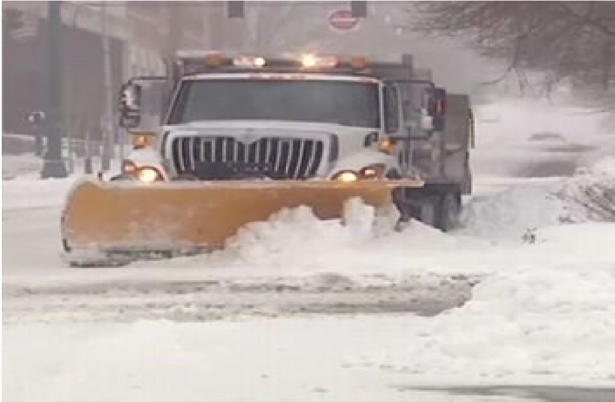

Department of Public Works Operations Division
Snow Removal Plan
Commissioner, Kelly Williams
Operations Director, Jason Leary
2024 Response Overview

Slide 2
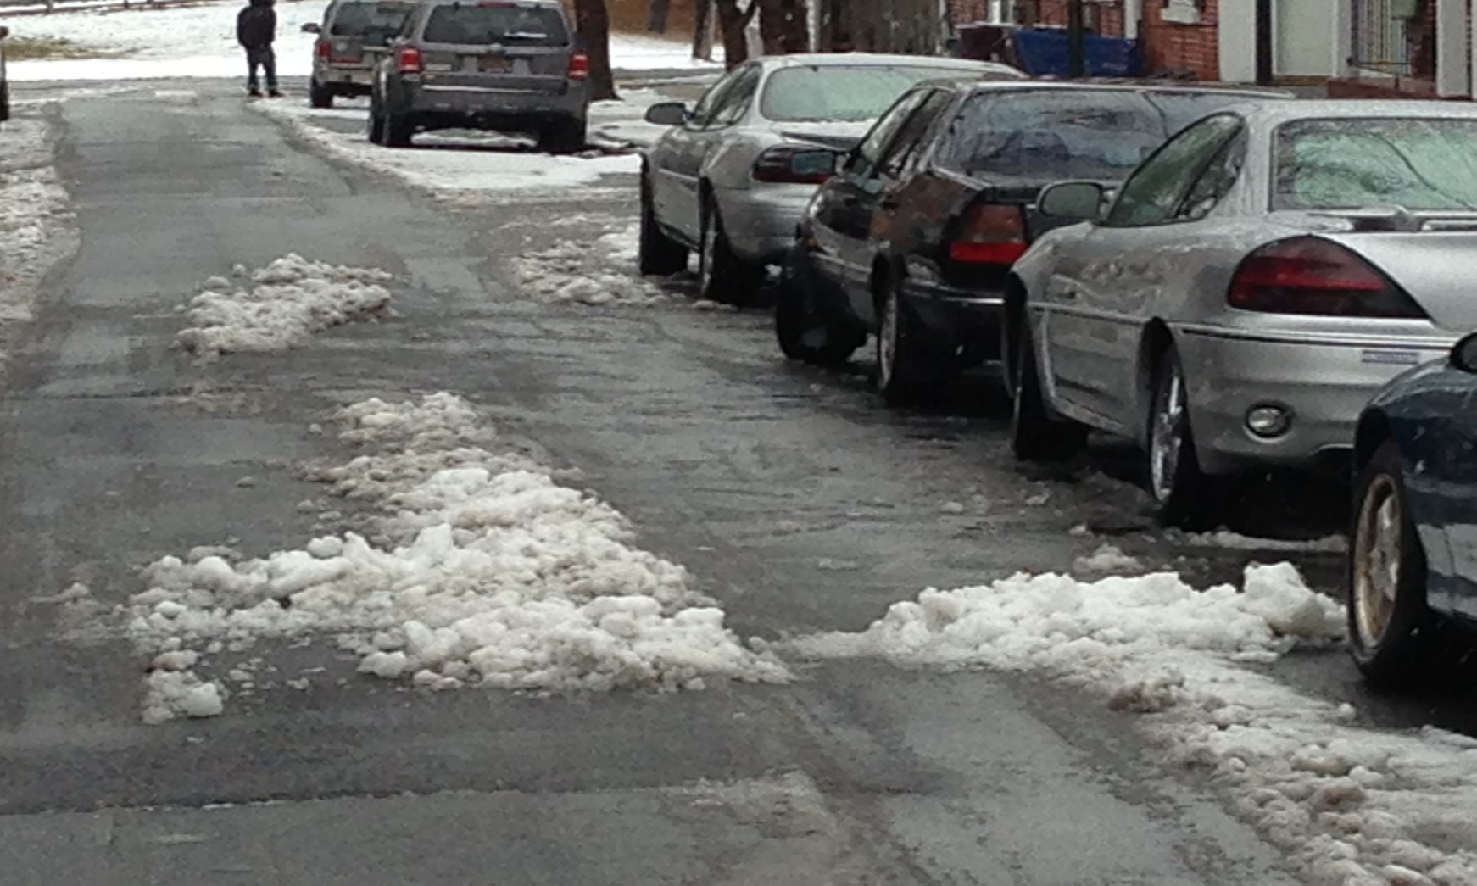
Snow Operations Personnel
All weather events are the responsibility of the Department of Public Works Operations Division
Assistance and support is provided by additional Operations Division personnel as needed during the event.
Street Cleaning
Building Maintenance
Sanitation Division
Street Maintenance Division
If the event is significant our staff will transition into twelve hour shift rotations.

Slide 3
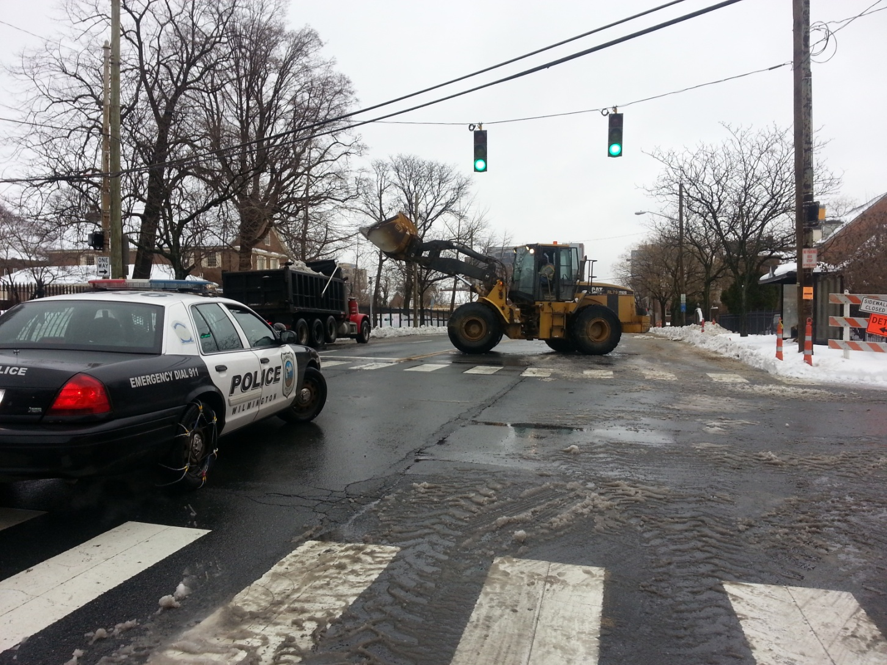
Command Structure
The Commissioner of Public Works and staff handle all plowing and salting during the event. Close coordination with The Office of Emergency Management, Police and Fire to ensure continuity of services.
All internal communications are forwarded by the Commissioner to the Director of Emergency Management and Mayor’s Office.

Slide 4
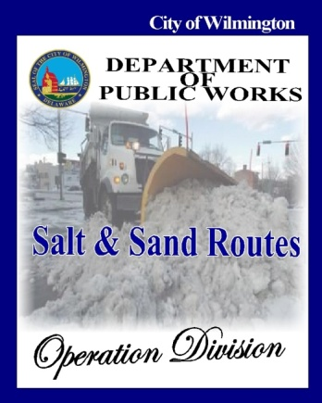
Classification of Snow Events
All weather events are classified in three categories.
Class I Event
Class II Event
Class III Event

Slide 5
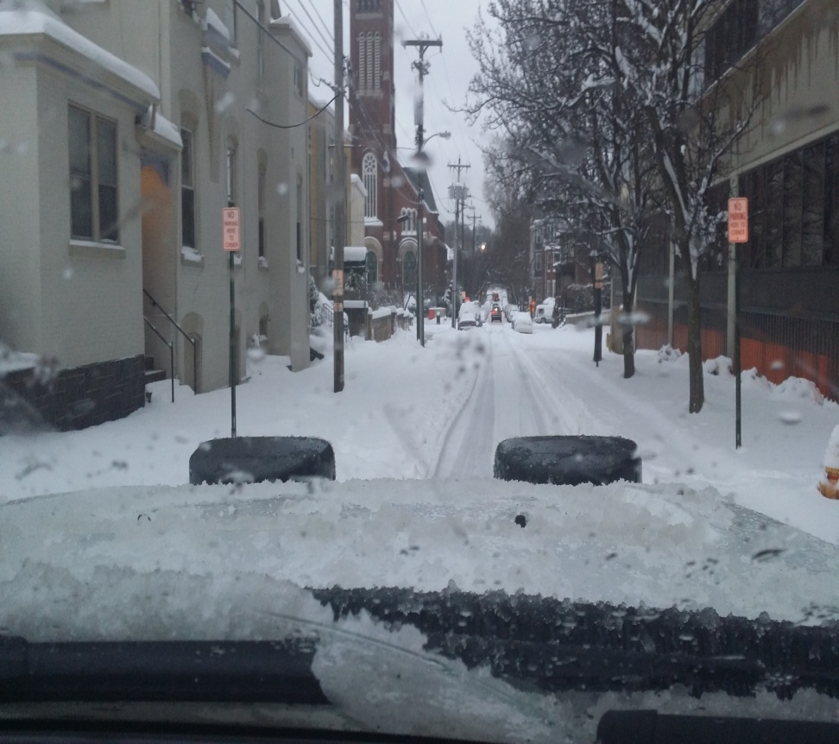
Class I - Event
Less than 4”inches of snow on the roadways and the event lasts less than 12 hours.
The event is normally handled by City employees.

Slide 6
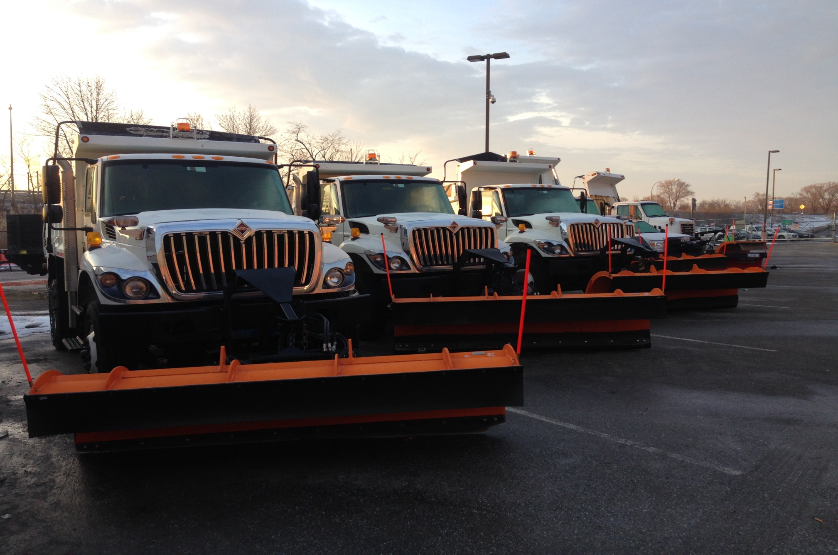
Class I - Response
Plow, salt and sand all primary & secondary roadways
Feeder Roads and Neighborhoods
The objective is to complete within 48 hours of the end of the event
Large Dumps Plows / Spreaders

Slide 7
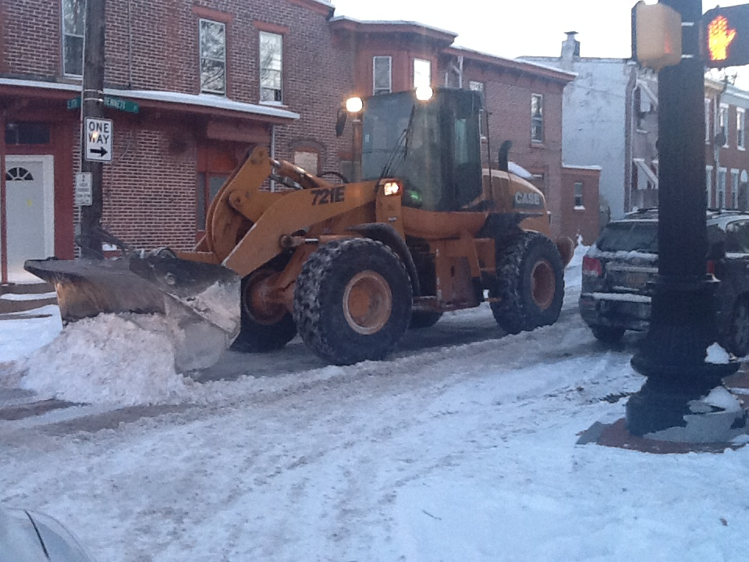
Class II - Event
A storm with accumulations ranging from 4 to 8 inches and the duration is more that 12 hours.
This type of storm will require employees and private contractors (with their equipment).

Slide 8
Class II - Response
Plowing, salt and sand all primary arterial roadways
Secondary roads
Feeder & neighborhood roads
A response team will service complaints and requests of emergency nature
The goal is to complete work within 96 hours of the conclusion of the event.

Slide 9
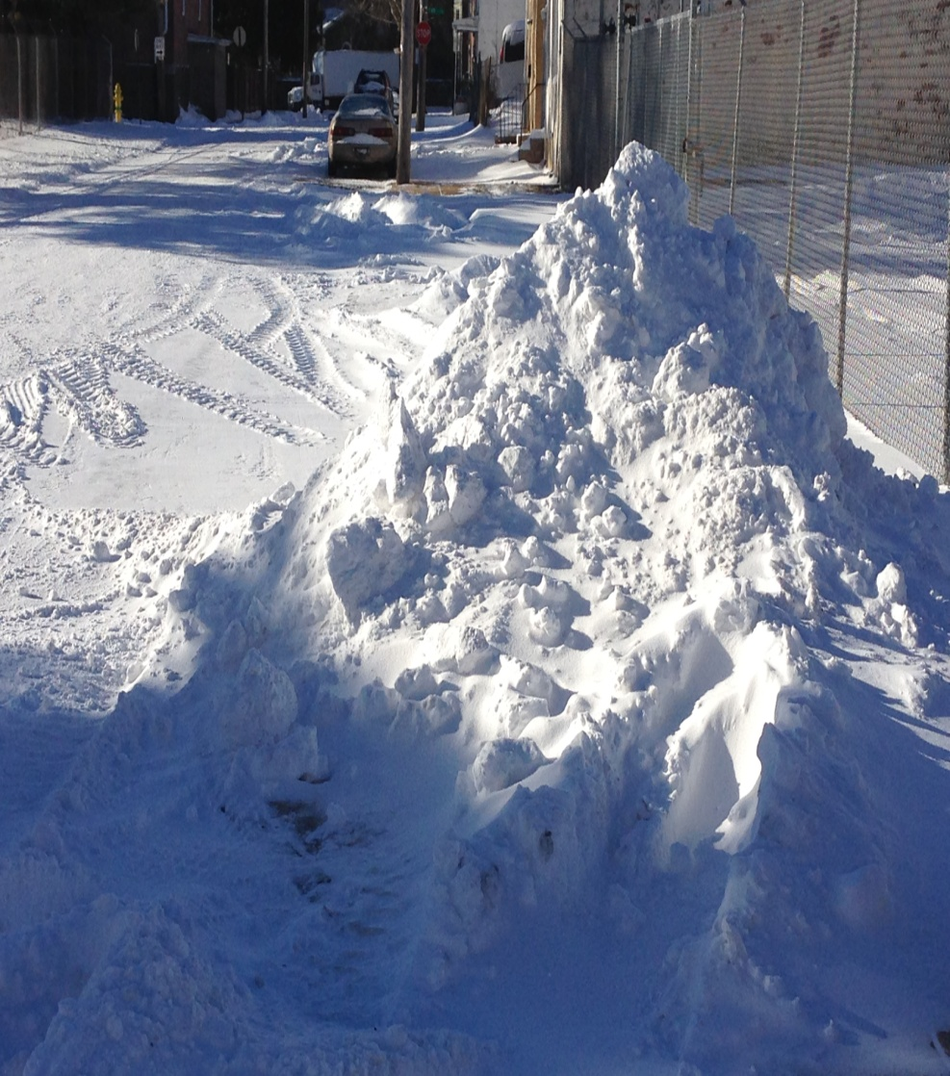
Class III – Event
Storm with snow accumulations greater than 9 inches and lasts for more than 24 hours.
This will require all Public Works Operations Personnel along with support from other departments and our outside contractor.
We service approximately 200 miles of City Streets.

Slide 10
Class III - Response
Plow, salt and sand all primary roadways
Secondary roads.
Feeder roads and neighborhoods.
Identify specific areas that will need snow extraction.
Create extraction teams with City Equipment and Other City Employees along with private Contractors Teams

Slide 11
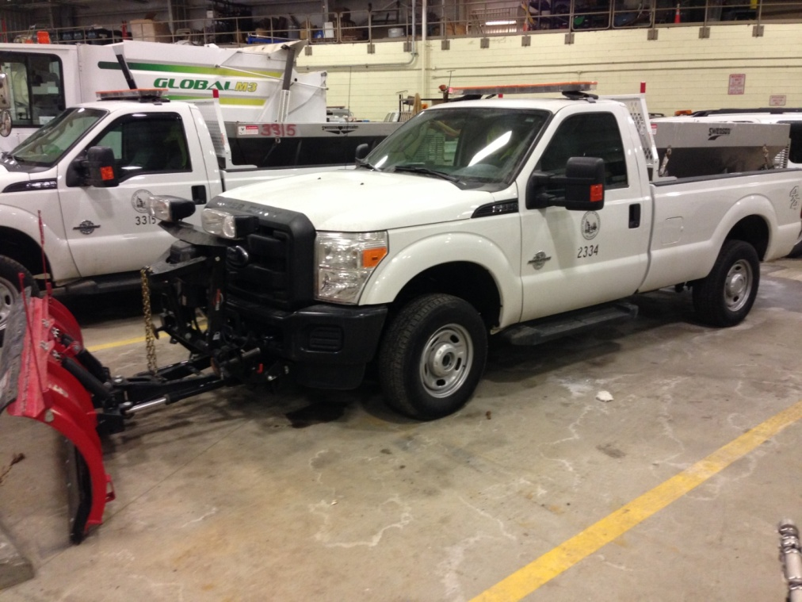
City Owned Equipment
20 Dump Trucks with Plows & Material Spreaders(increased 9 pieces)
13 Pickup Trucks with Plows/10 with V Box Material Spreaders
3 Stake Body Trucks for Snow Removal
2 City Owned Backhoes
2 Loaders
3 Small Bobcat Units
6 Mechanical Brine Units
6 Utility Trucks with Plows
PICKUP WITH PLOW / V BOX

Slide 12
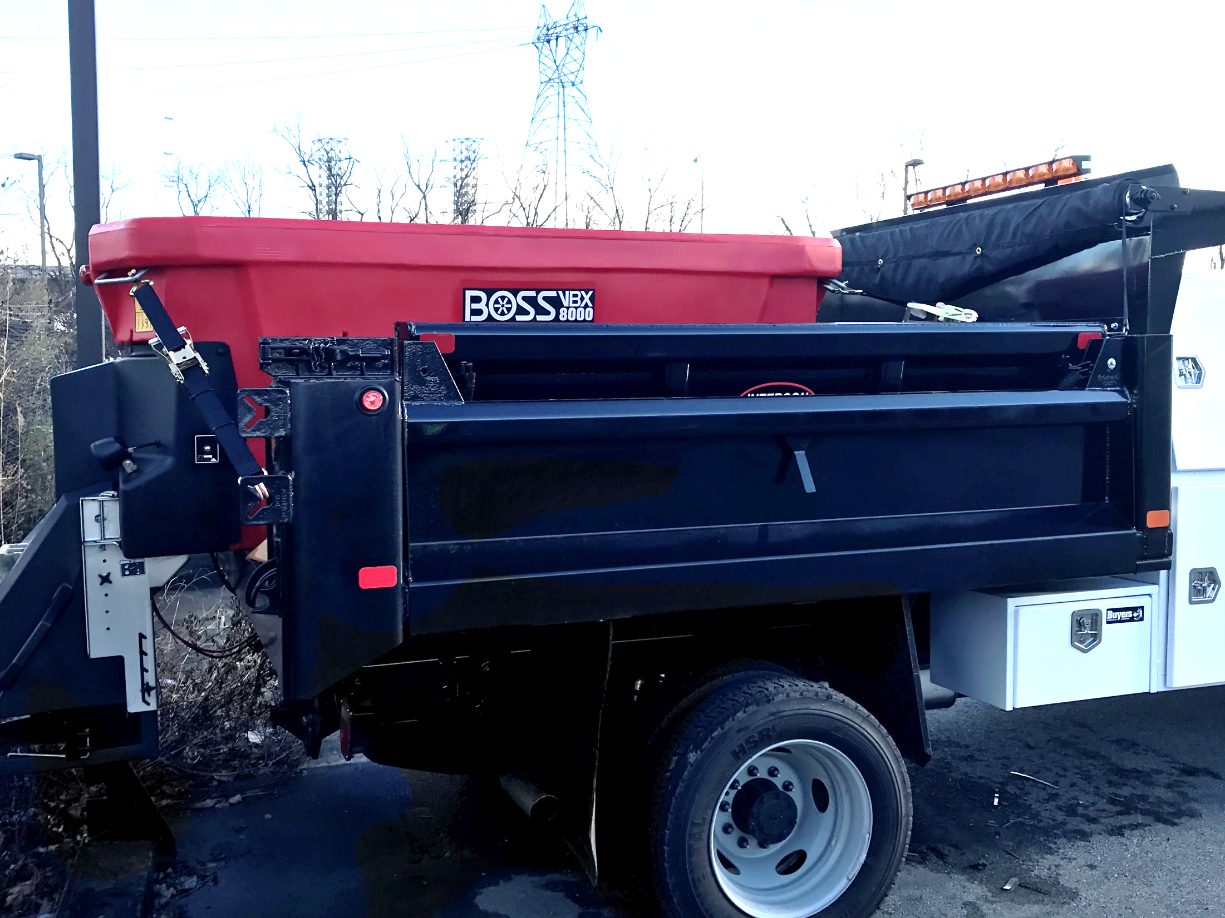
Upgraded Equipment

Slide 13
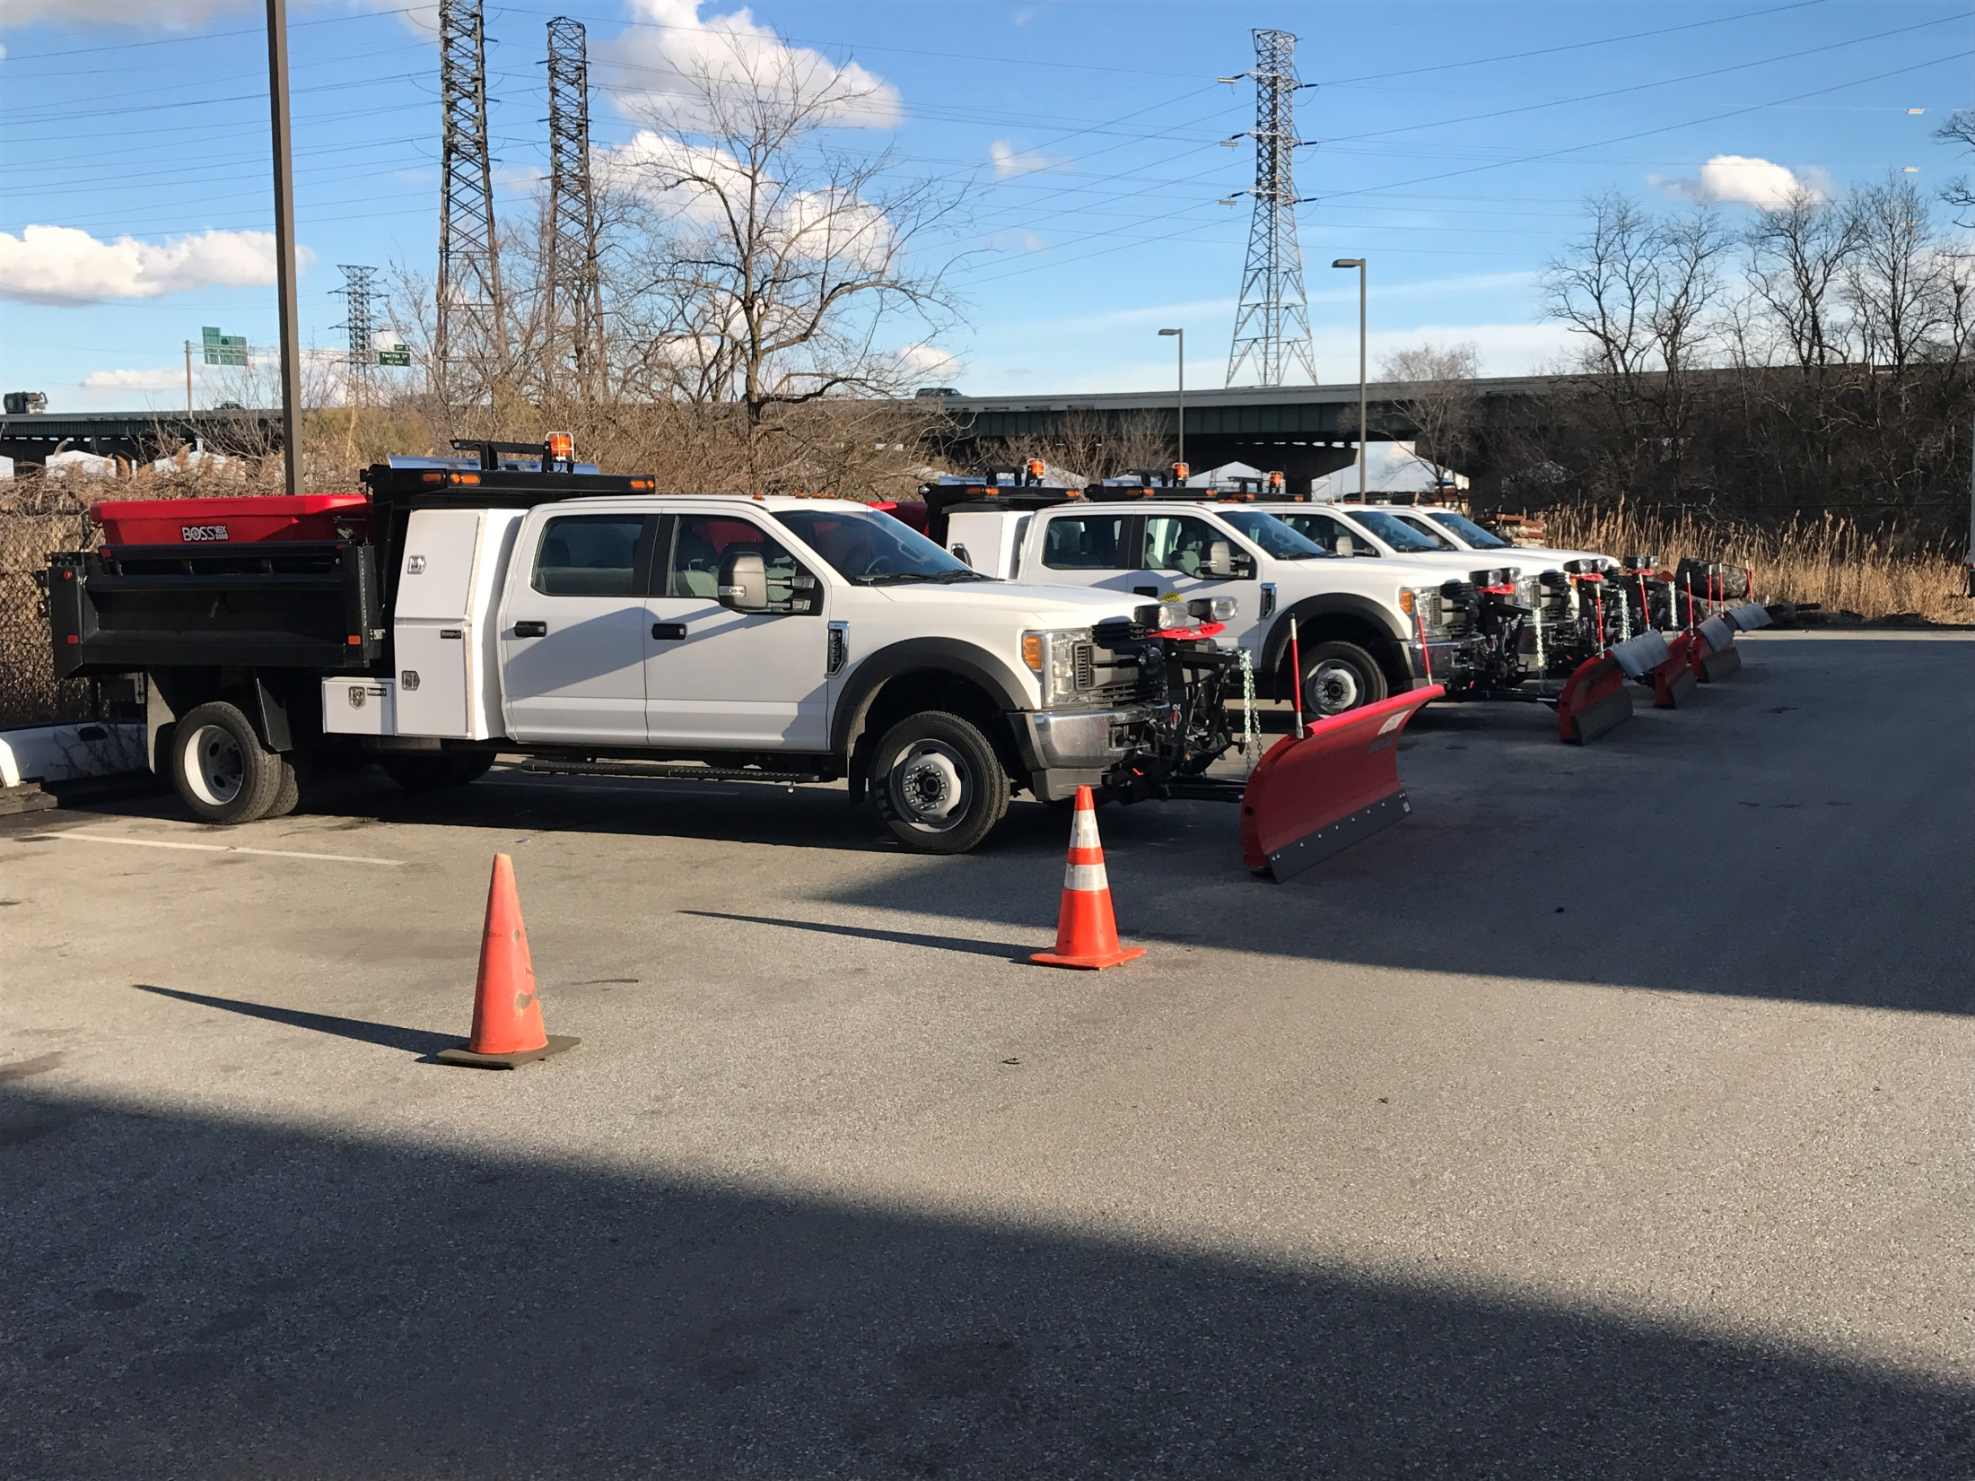
Upgraded Trucks

Slide 14
Weather Event Personnel
1 Director of Public Works Operations
1 Administrative Coordinator
9 Supervisors-Operations Supervisors
24 Equipment Operators
17 Sanitation Drivers
2 Building Maintenance Employees
3 Street/Sewer Maintenance Employees
4 Call Center Representatives
4 Fully Staffed Motor Vehicle Shop
65 TOTAL PERSONNEL if fully staffed
(If Operation requires additional personnel, other City Departments will be called in for assistance)

Slide 15
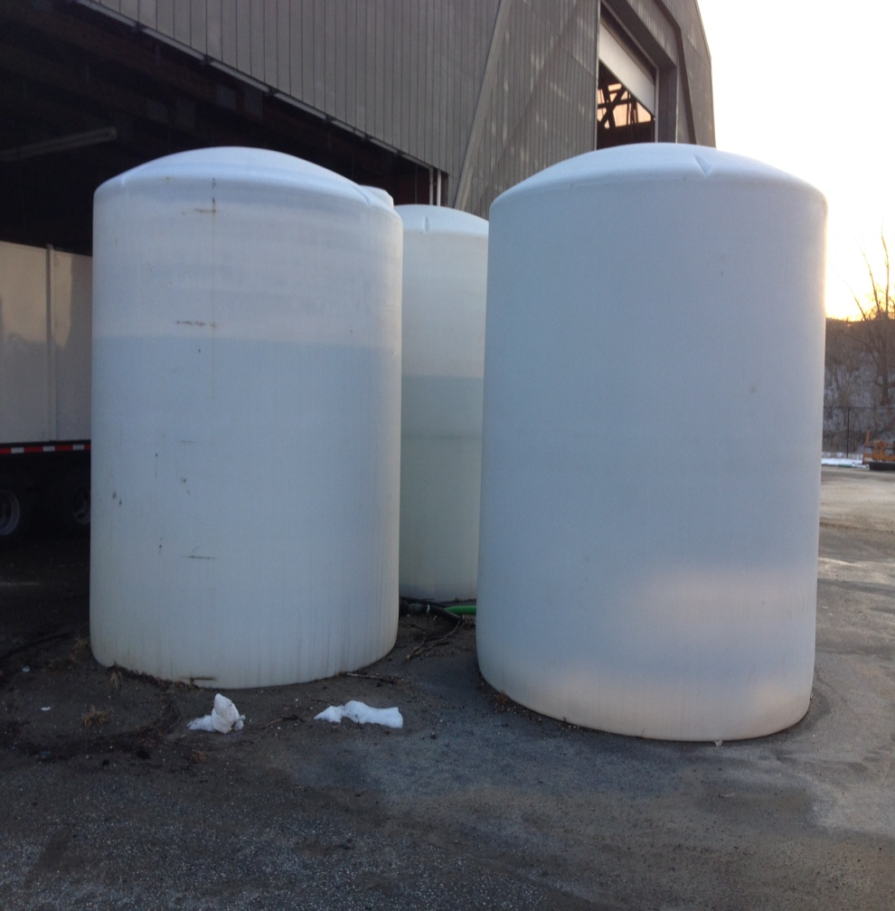
Pre-Operation Planning
Weather Intelligence Reports/ type of event pre-planning has several options
Option # 1 - A liquid Salt Brine Mixture and Beet Juice is used to prepare streets prior to the event.
Option # 2- is salt and sanding just prior to event on known problematic areas in conjunction with Brine Mixture application earlier.
Locations for Pre-Event Applications
Primary roads arteries leading into/out of the City
All routes leading to hospitals and emergency facilities, Police, Fire, Ambulance Services
Secondary feeder roads supporting entry and exit of City
All Dart Bus Routes
Geographic problematic areas: hills, narrow side streets.
Side streets and neighborhoods
PRE-PLANNING
BRINE TANK MIXING

Slide 16
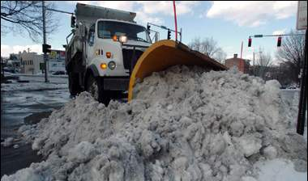
Primary Streets
Delaware Avenue
Pennsylvania Avenue
Adams Street
Jackson Street
North & South Walnut Streets
Bus and Hospital Arterials
8th and 9th Streets
Claymont Street
DuPont Street
2nd and 4th Streets
10th ,11th, & 12th Streets
Martin Luther King Boulevard
Lancaster Avenue
Union Street
Washington Street
Concord Avenue
North & South Market Streets
Miller Road

Slide 17
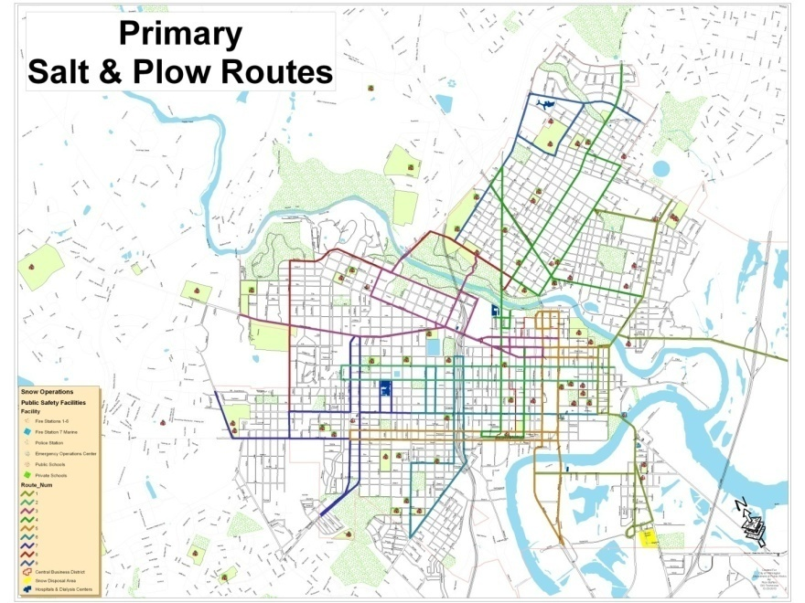

Slide 18
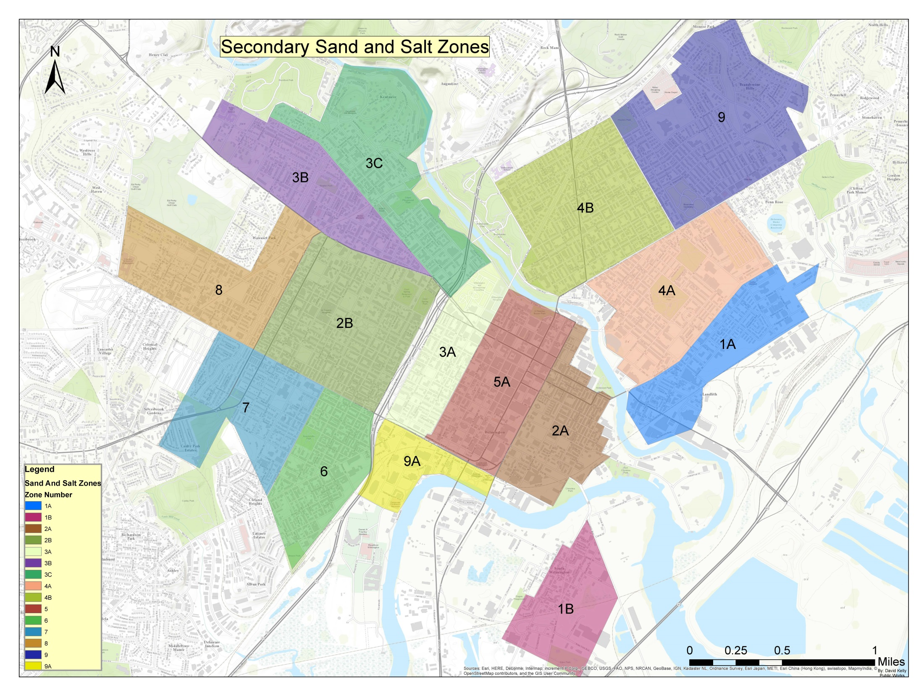
Additional Assignments to Primary Routes

Slide 19
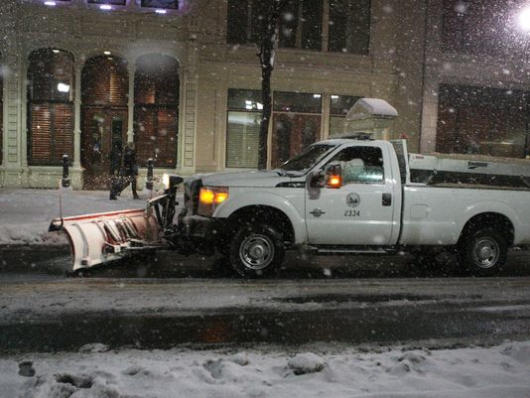
Operational Plan
Personnel are sent out to the primary roads first. There are 9 Primary Routes with 15 City plow trucks assigned to clear those routes.
As the event continues and primary routes are cleared then the supervisors will redirect our trucks to their alternate route.
After we have opened primary routes & Emergency Routes trucks move into the 17 neighborhood routes.
OPS PLANNING

Slide 20
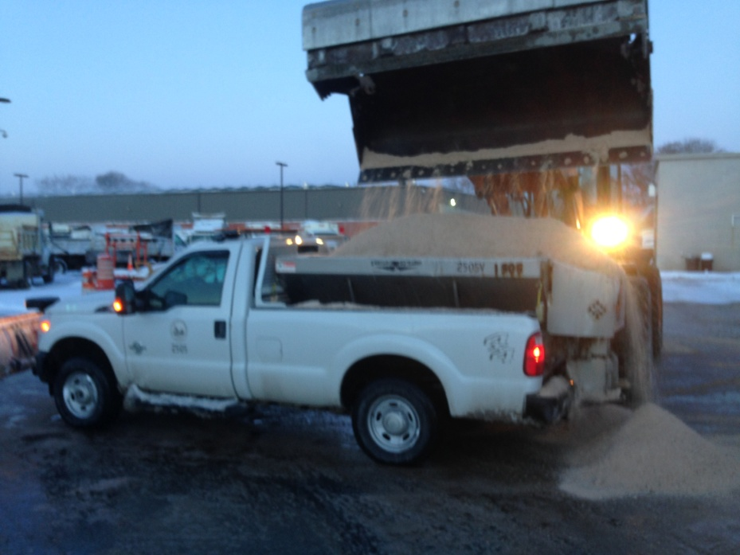
17 GRIDS FOR DEPLOYMENT
Canby Park
Union Park Gardens
Westmoreland
Browntown
Hedgeville
Lancaster-Pennsylvania (Jackson to Union Street)
Brandywine Hills
31st to Lea Blvd -Market to Miller
18th to 30th Street-Market to Broom
South Wilmington (Riverfront )
Front to 16th -Locust to Walnuts
Northeast Blvd to Market-12th to 35th Street
Delaware Ave to Lovering Avenue-Scott to Adams
Pennsylvania Avenue to 19th Street-Broom to Rising Sun Lane
French to Washington-Front to 16th Street
Washington to Adams-Front to Brandywine River
Northeast Riverside Eastlake Area

Slide 21
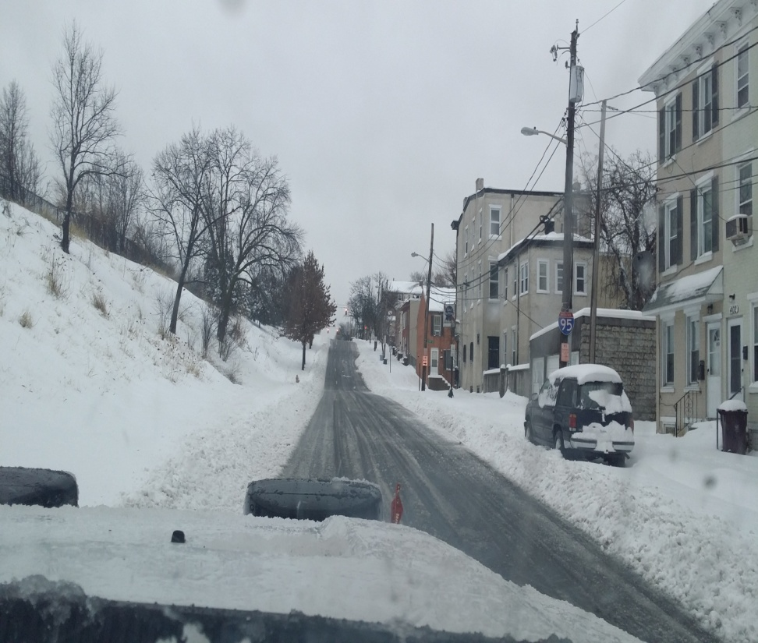
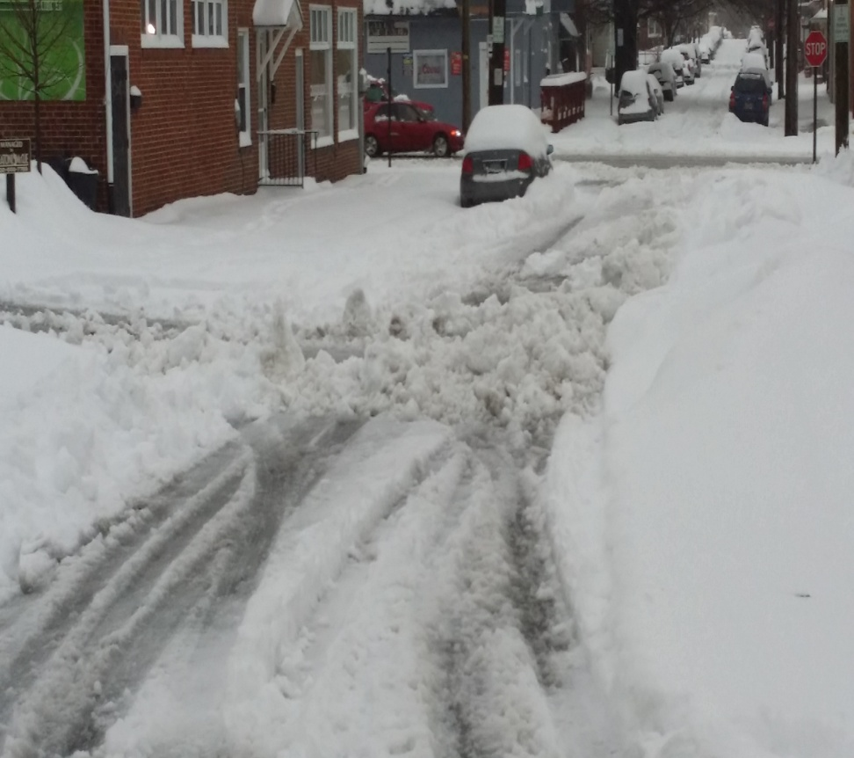
Secondary Roads

Slide 22
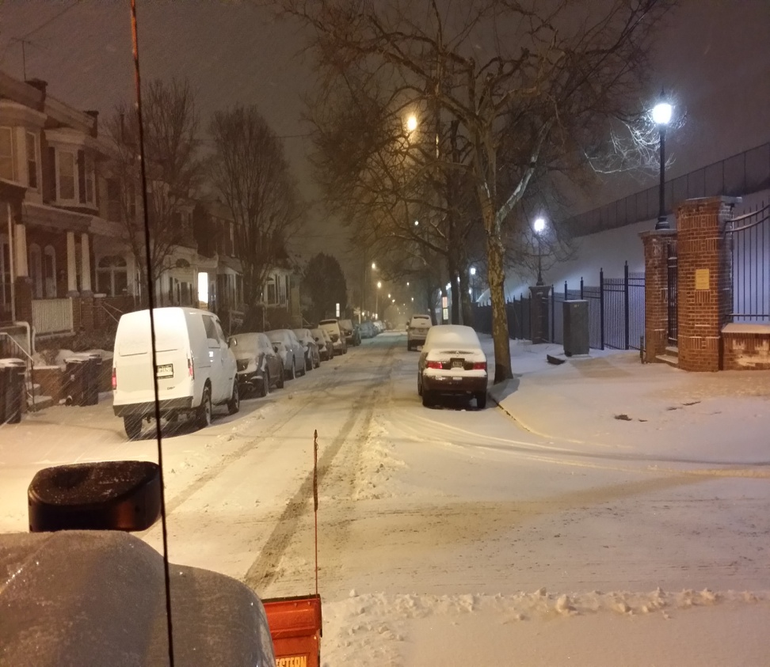
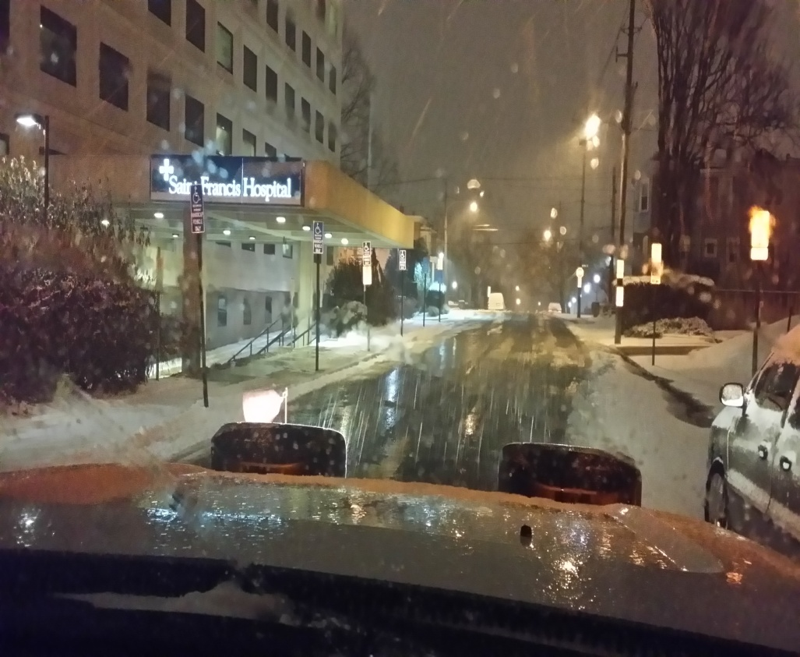
Emergency/Hospital Routes

Slide 23
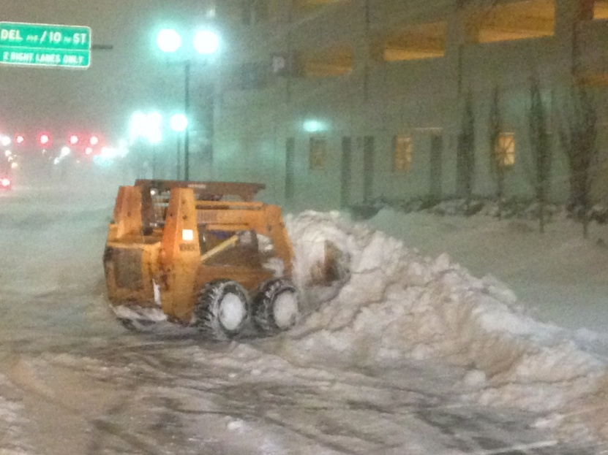
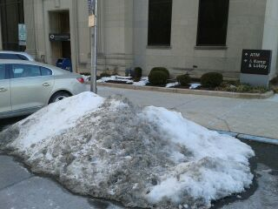
Encountered Issues/Problems
Public (residents) and private contractors returning snow back to roadways after it has been cleared.
Clearing snow emergency routes.
Snow that reverts to ice (hazard).

Slide 24
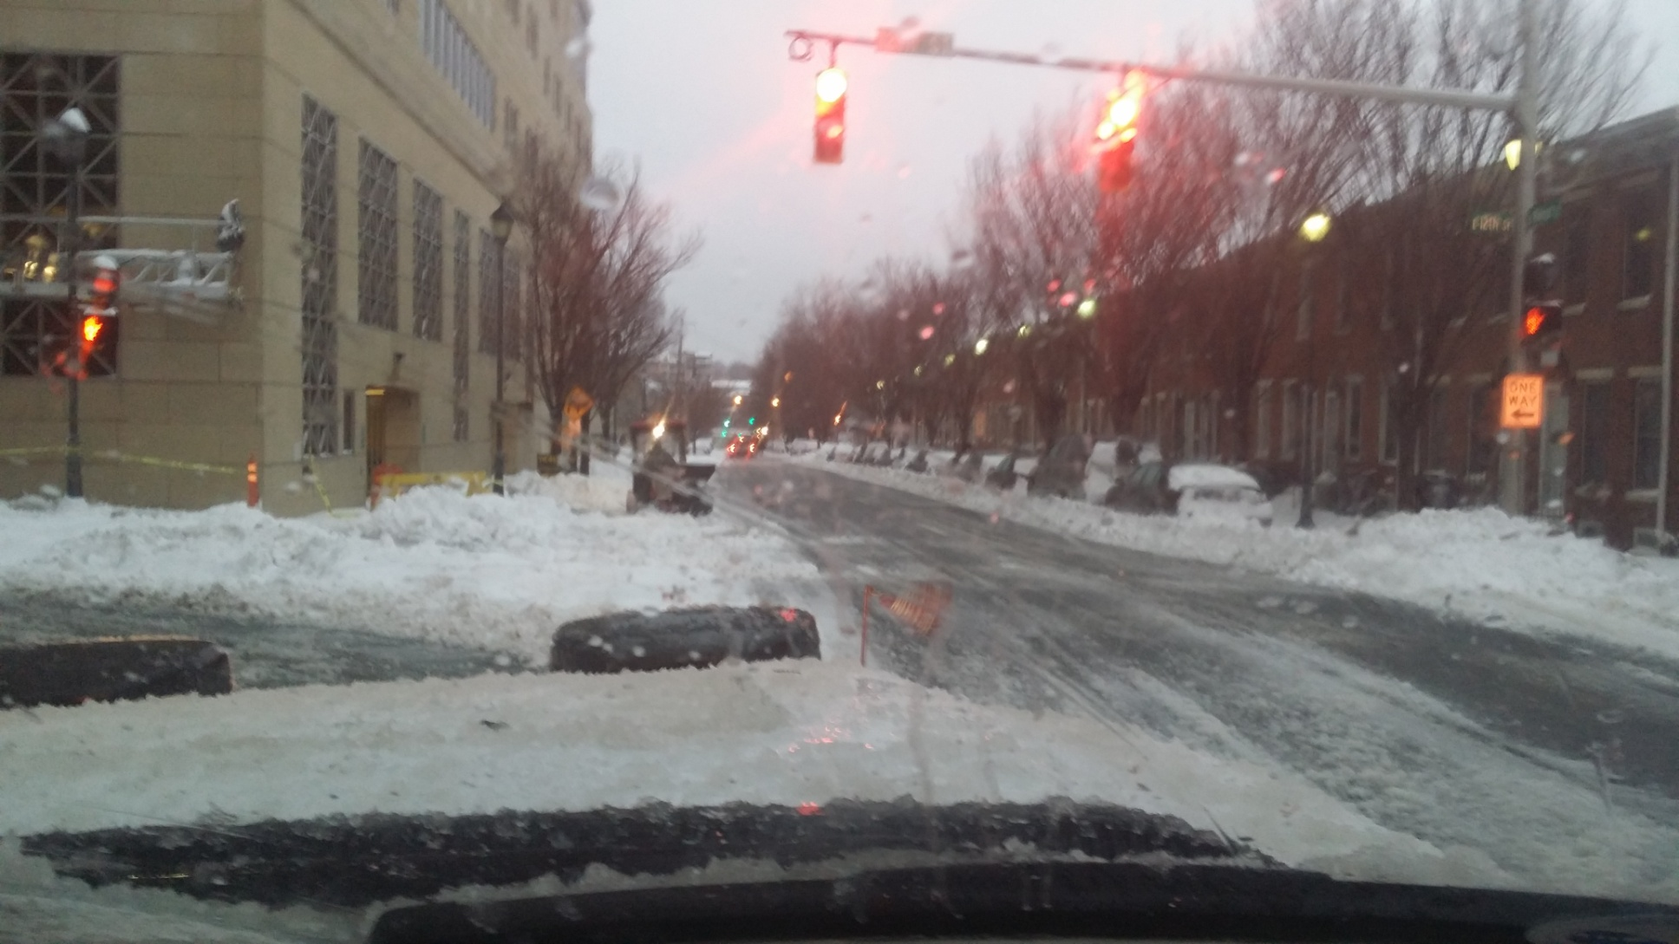

Slide 25
City Code Governing Snow
Sec. 42-_419. -Procedure for making pathways and snow clearance.
(a) In removing ice and snow from sidewalks, it shall be unlawful to deposit any part thereof in the gutters or on the roadway forming a part of such public street. Such snow and ice shall be deposited on the sidewalk at or near the curb
In removing ice and snow from private motor vehicle parking areas, including commercial parking lots for motor vehicles, or from any area which is not open and used by the public, the following procedures shall apply:
Snow and ice shall be deposited wholly to the interior of the perimeter of the private lot or behind the building line and shall in no case be deposited so as to obstruct an adjacent sidewalk, gutter, or roadway forming part of a public street
(2) The snow and ice removed from a lot or parking area shall not be piled beyond a height of five feet without specific permission to do so by the public works commissioner , nor shall such snow and ice be placed within 15 feet of any fire hydrant.
(Code 1968, § 45-117; Ord. No. 92-053(sub 1), § 1(j), 7-2-92)

Slide 26
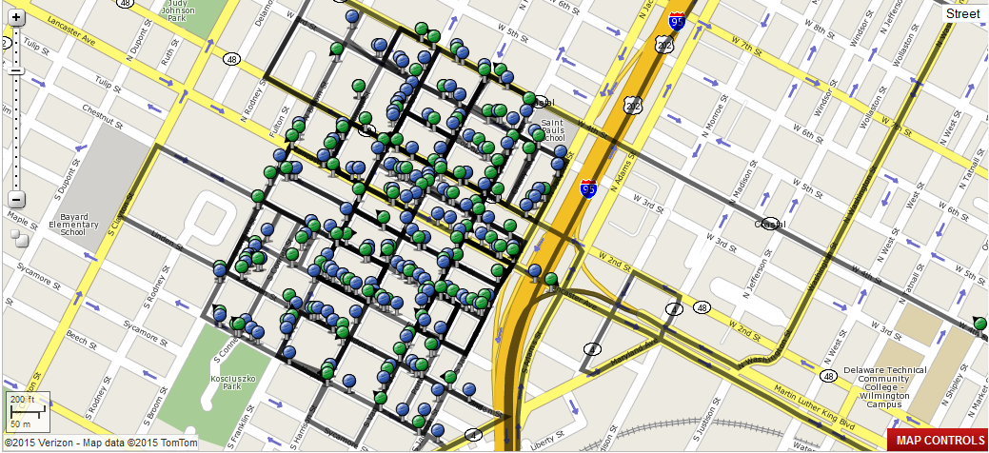
Verizon GPS System

Slide 27
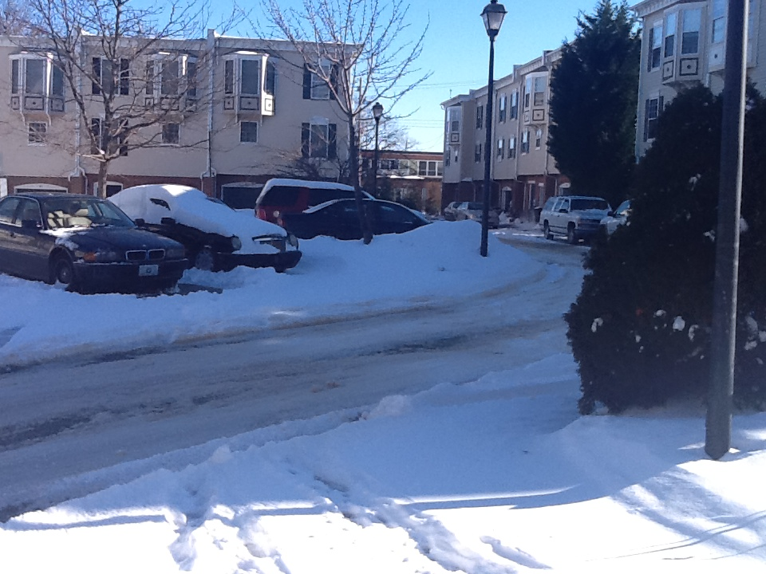
Contact Us
Citizens can tune into the City of Wilmington’s television station, (WITN – Ch. 22), or log onto the City’s website, www.wilmingtonde.gov, for updated information.
For all emergencies, citizens should call 911. For non-emergency inquires, call the Public Works Call Center (302)-576-3878 / 311.
All City Snow Emergency Routes are also located on the City’s website.
Email us your service request
winterstorm@wilmingtonde.gov

