Slide 1
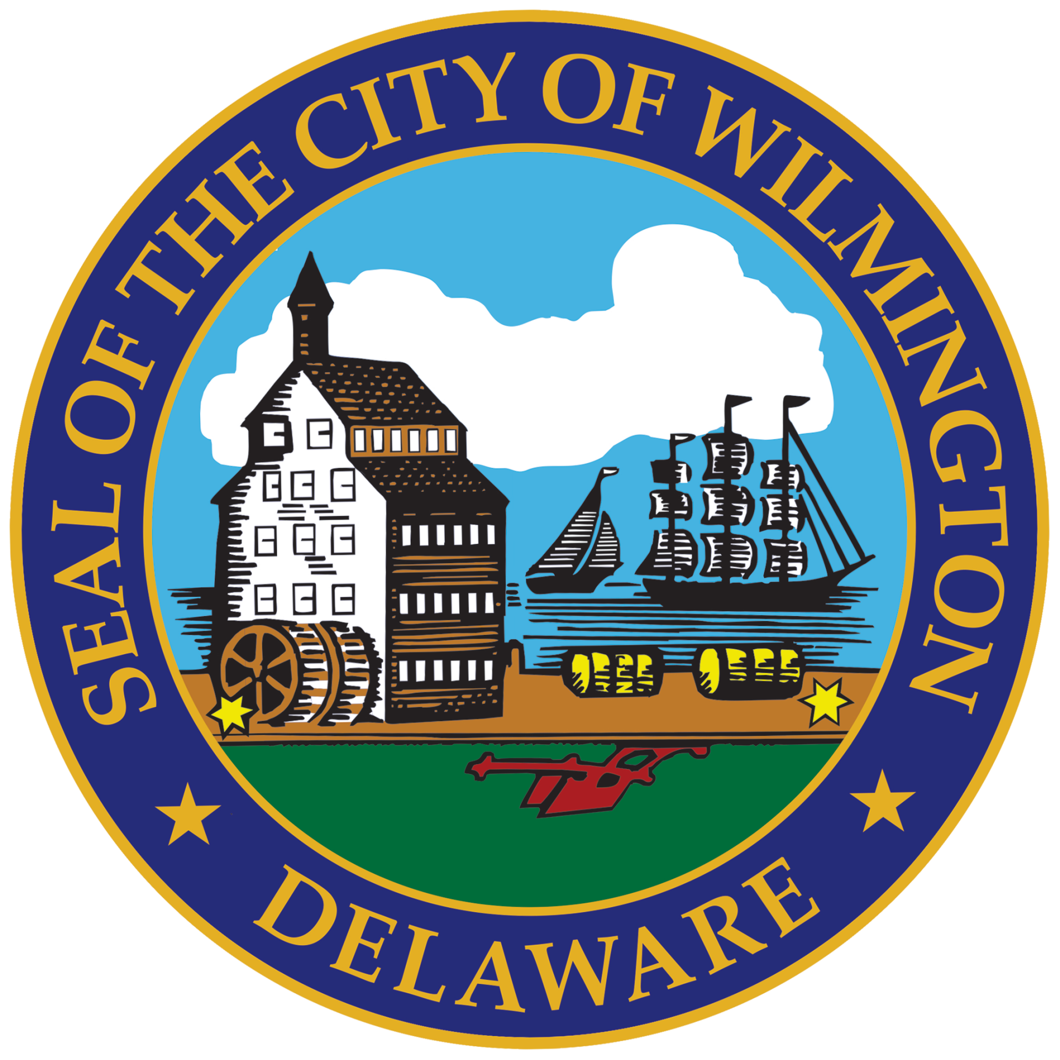

WILMINGTON
City Council
Health, Aging & Disabilities Committee
HarmGuard FX

Slide 2
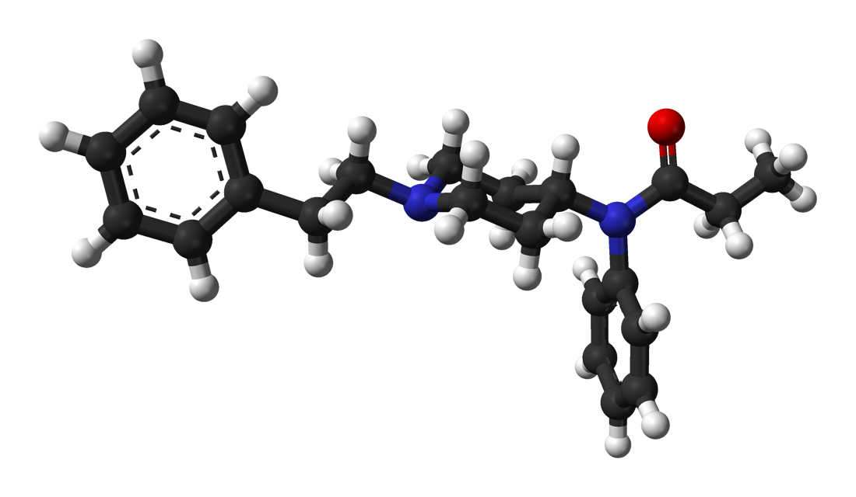
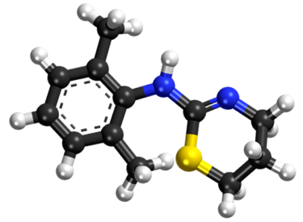
HarmGuard FX™
THE Powerful New Harm Reduction Tool
Fentanyl
Xylazine
Feature ➔ Benefit
Combination Test ➔ Ensures awareness of both lethal adulterants in a single test
Results in under 5 minutes ➔ Eliminates resistance to testing
Interpretation key printed directly on the test strip ➔ No interpretation errors | No need for external reference guides
Displays Safety Lines ➔ Removes the line-absent positive counter intuitive interpretation
iPortal ➔ Fully customizable QR code with full analytics

Slide 3
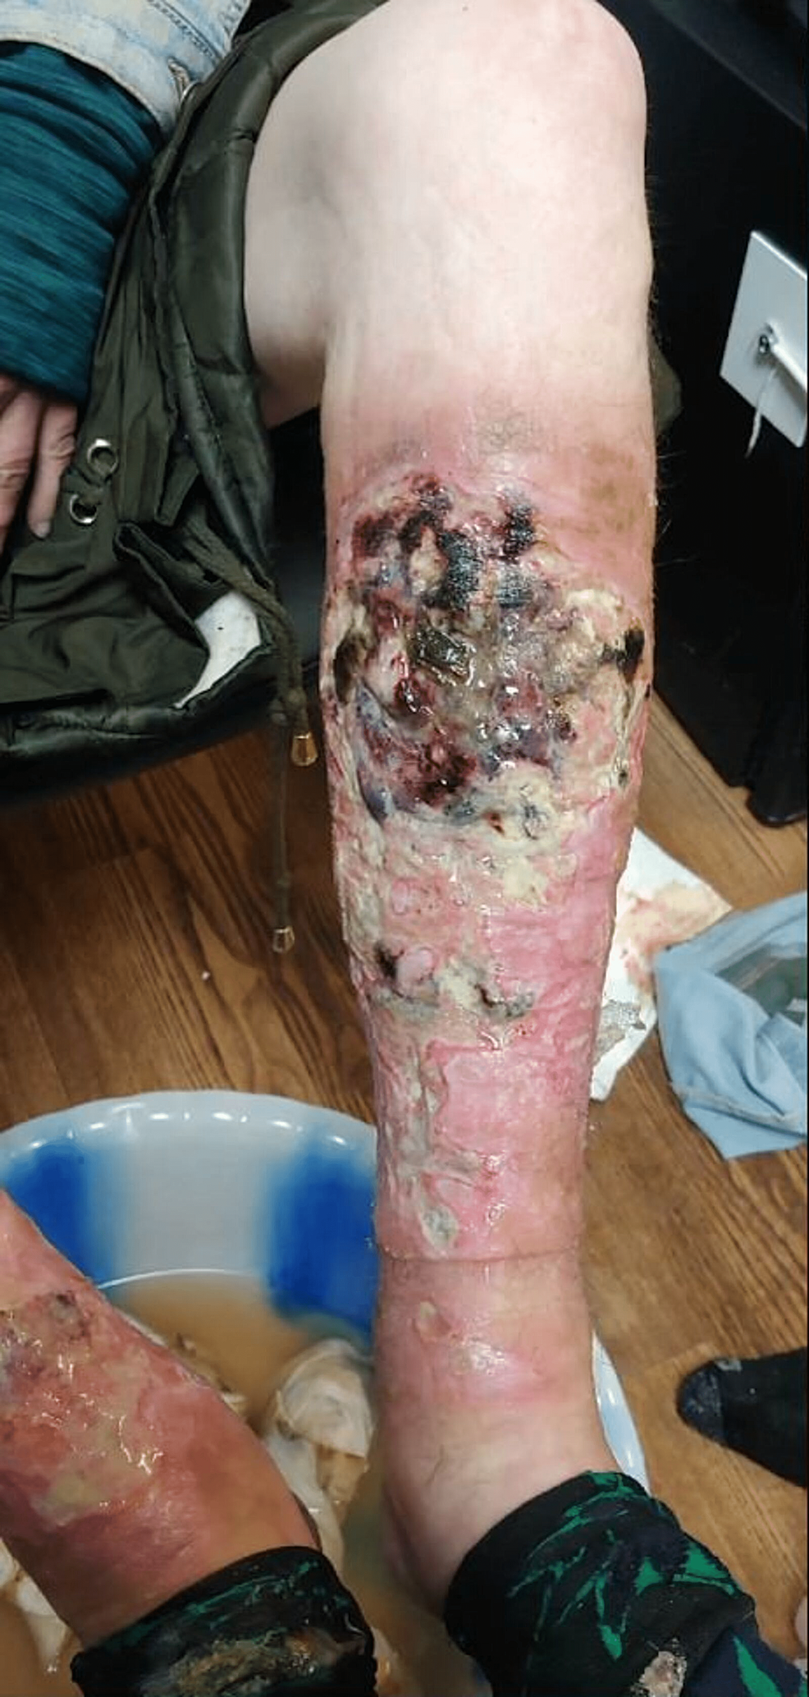

Xylazine – An Overview
Batch # | Xylazine Concentration | Fentanyl Concentration
1 | 60% | 3%
2 | 53% | 8%
3 | 51% | 8%
4 | 47% | 5%
5 | 44% | 9%
6 | 43% | 11%
7 | 41% | 13%
8 | 40% | 19%
Animal tranquilizer (Tranq + Zombie Drug)
Long term use causes serious body ulcers
User may lose consciousness for 4–6 hours
Separate dependency from opioids
No reversal agent (naloxone will not work)
Drug seizure data in Philly demonstrates that xylazine has far surpassed fentanyl

Slide 4
Benefits of a Combination Test
Outcome Benefits
Multiple studies have clearly demonstrated that combination tests:
Greatly simplify use – eliminates the barrier of using 2 separate tests
Ensure that the user is immediately aware of both potentially lethal adulterants
Significantly optimize outcomes
Financial, Logistics, and Training Benefits
Less expensive than 2 separate tests
Only 1 item to inventory and ship
Greatly simplified training on 1 test instead of 2 tests

Slide 5


Results in 3 Minutes
Combination Test
2-in-1 is far superior to 1 + 1
Results in 3:00 minutes

Slide 6
The Issue With a Line-Absent Positive Test
Drug tests results are counterintuitive and confusing
Typical Drug Test Strip (confusing)
No line = the presence of the potentially lethal adulterant
No drug-absent line is displayed = positive for fentanyl
HarmGuard FX (very intuitive)
A safety line = safe for that potentially lethal adulterant
Both SAFETY lines are displayed = safe for fentanyl and safe for xylazine

Slide 7
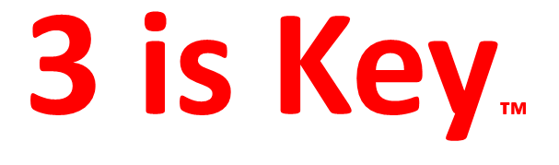
Interpretation Key of Safety Lines Is Printed Directly on the Test Strip
Easy to Read
Test is functional
Safe from xylazine
Safe from fentanyl
Patented printing process – will not corrupt test results
Eliminates interpretation errors
Eliminates the need for external reference guides

Slide 8
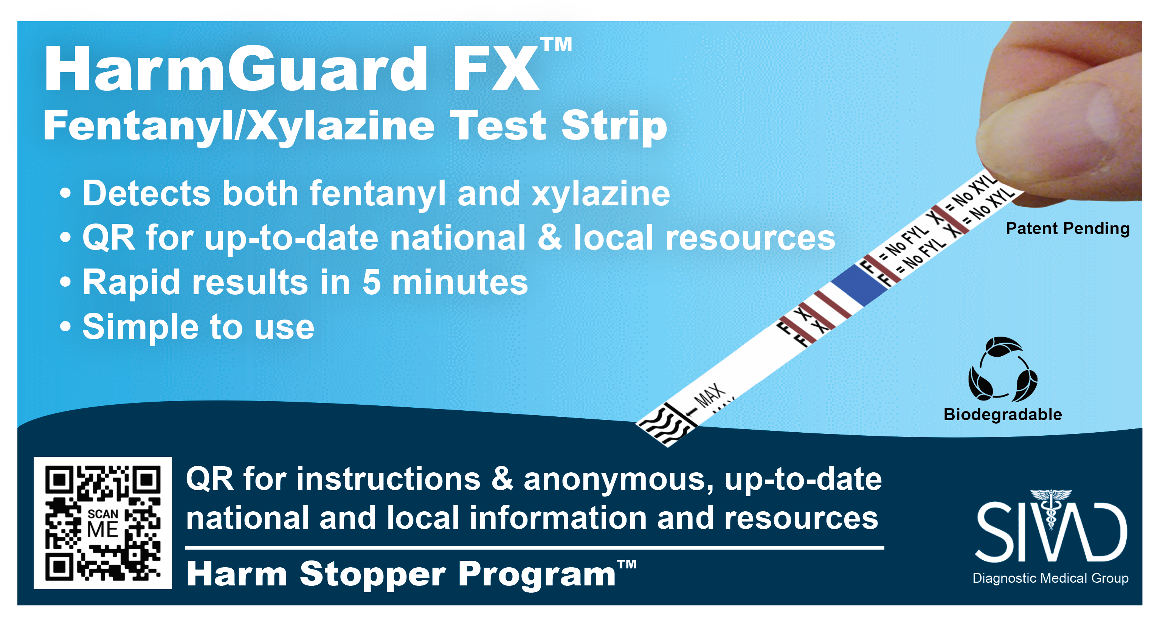







iPortal
AI Geolocation
Information Local Resources Training Analytics

Slide 9





iPortal Example
CVS
1005 Delaware Avenue
Wilmington, DE 19806
(302) 574-9836
1.2 miles
8:00 a.m. to 8:00 p.m.
Open now
New Castle County Fernhook Building Bridge Clinic
14 Central Avenue
New Castle, DE 19720
(302) 255-1650
6.1 miles
8:00 a.m to 11:30 p.m.
Open now
Notes:
<speak>
CVS
1 0 0 5 Delaware Avenue
Wilmington, DE 19806
(302) 574-9836.
1.2 miles.
8:00 a.m. to 8:00 p.m.
Open now.
New Castle County Fernhook Building Bridge Clinic
14 Central Avenue
New Castle, DE 19720
(302) 255-1650.
6.1 miles.
8:00 a.m to 11:30 p.m.
Open now.
</speak>

Slide 10
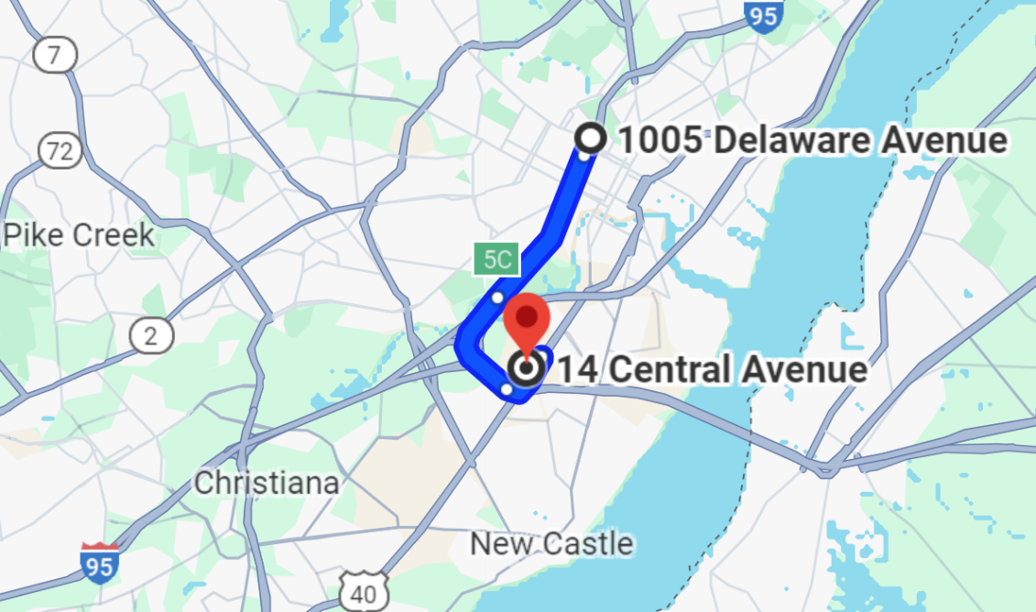
iPortal Example (Cont’d)

Slide 11

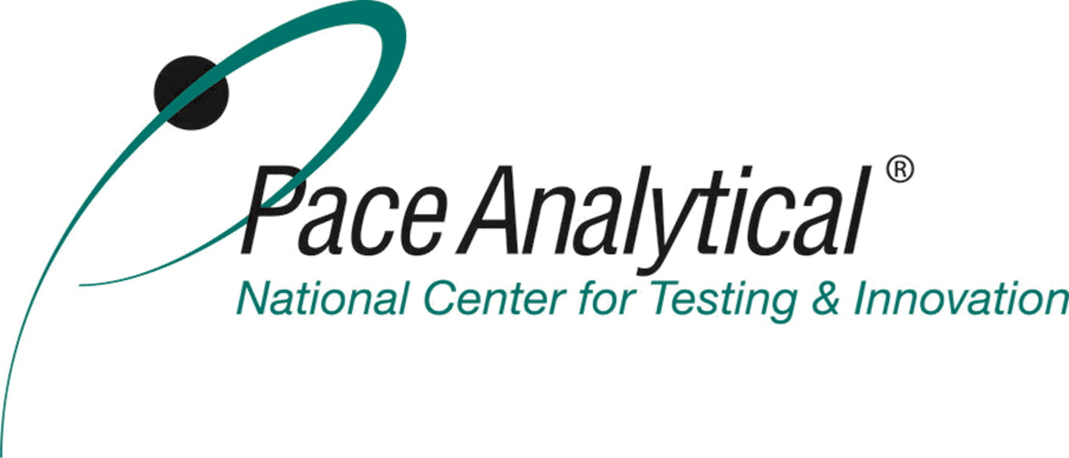

Validation
Notre Dame University Pace National Analytical Labs Assure Tech – Test’s Production Facility
FDA-registered
DEA-registered
ISO 13485:2016
ISO 13975:2003
ISO 13612:2002/AC:2002
ISO 14971:2019
ISO 15223-1:2016
ISO 13641:2002
ISO 18113-1:2011
ISO 18113-2:2011
ISO 62366:2008
ISO 23640:2015

Slide 12
Endorsement from Dr. Gibney
From: Sandy Gibney <gibneymd@me.com> Sent: Thursday, March 21, 2024, 8:43 PM
To: Joseph Scrocco <jscrocco@diagnosticsolutionsgroup.com>
Cc: Wolf, Alexia (Lt Governor) <alexia.wolf@delaware.gov>; Lynn Morrison <lmorrison@brandywinecounseling.org>; Holly Rybinski <hollyrybinski@gmail.com>; Bethany Hall-Long <blong@udel.edu>
Subject: Re: HarmGuard FX dual test strips testimonials
Joe,
I am certainly willing to share my experience and testimonial to the value and use of the Harm Guard FX dual test strips. I would also like to thank our Lieutenant Governor, Bethany Hall Long, for her strong support.
My Outreach team and I have personally trained folks on the proper use of HarmGuard FX and then distributed the strips throughout Delaware.
I am more than happy to weigh in on their tremendous value to both clinicians and clients. As you know, adulterants are very pervasive, so having a tool to verify composition of a substance in question is clinically quite valuable.
For example, if an overdose patient does not respond to escalating doses of naloxone, whether the delivery is by intravenous line, intramuscular injection, or nasal mucosal spray; verifying the presence of Xylazine can inform and direct our clinical care for that patient. There are many such scenarios that knowing the presence or absence of both these substances will guide my resuscitation efforts.
Feel free to contact me if I can assist you in speaking about their value.
Sandy Gibney, MD
Founder & CEO of Gibney Mobile Healthcare,
Chairperson for Lt Governor’s Behavioral Health Consortium: Access & Treatment Committee
Member: Addiction Action Committee, Overdose System of Care.
Dual Board Certified: Internal Medicine & Emergency Medicine

Slide 13
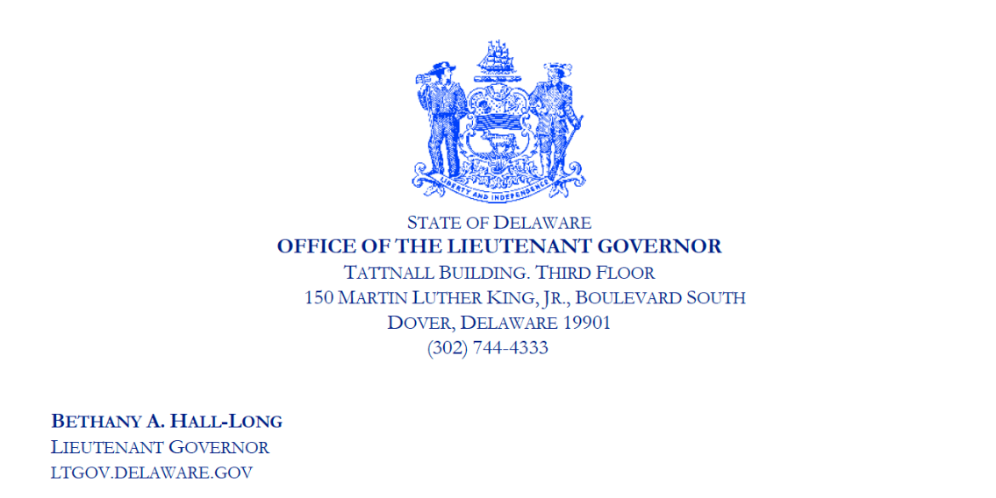
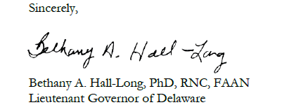
Endorsement from the Lieutenant Governor
August 3, 2023
I am writing to share a resource that I have found very useful in our state’s fight against the opioid epidemic, a fight I have been engaged in as a clinical nurse, as Chair of Delaware’s Behavioral Health Consortium, and as the state’s 26th Lieutenant Governor. Recently, my office partnered with Diagnostic Solutions Group, to pilot HarmGuard FX, a dual test strip that detects the presence of fentanyl and xylazine, both deadly substances commonly found in street drugs, in one simple strip.
HarmGuard FX, is validated by a U.S.-based, FDA-registered testing lab and is the first harm reduction test strip to detect both fentanyl and xylazine in substances including powders, pills, or residue from baggies or cookers. The primary purpose of the test is to reduce harm from these substances before they are used; thus, greatly reducing the need for naloxone and EMT interventions.
As a nurse, I personally distributed these test strips to at-risk Delawareans during our pilot program rollout, demonstrating their use and their importance along with Dr. Sandra Gibney, who specializes in treating patients with opioid use disorder. (OUD) The ease of testing for both substances in one simple test can make a meaningful difference for people in the throes of substance use disorder, helping them protect themselves from the worst possible consequences.

Slide 14
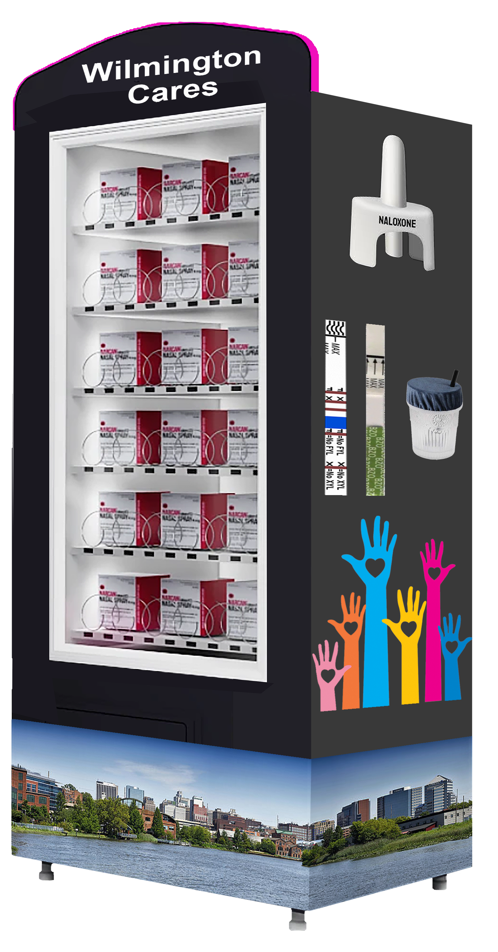
Harm Reduction Vending Program Overview
Provides 24/7 access to life-saving products
Floor and wall-mounted units available
Annual and short-term event-focused programs
Comprehensive servicing and inventory management
Suitable for public spaces, schools, colleges, and prison re-entry programs
Partnered with OpiSafe Vending

Slide 15
Harm Reduction at Events and Festivals
Tailored programs for concerts, festivals, and large gatherings
Provides immediate access to essential harm reduction tools
Enhances public safety by reducing overdose risks
Mobile vending units for short-term events
Comprehensive inventory management and servicing during events

Slide 16
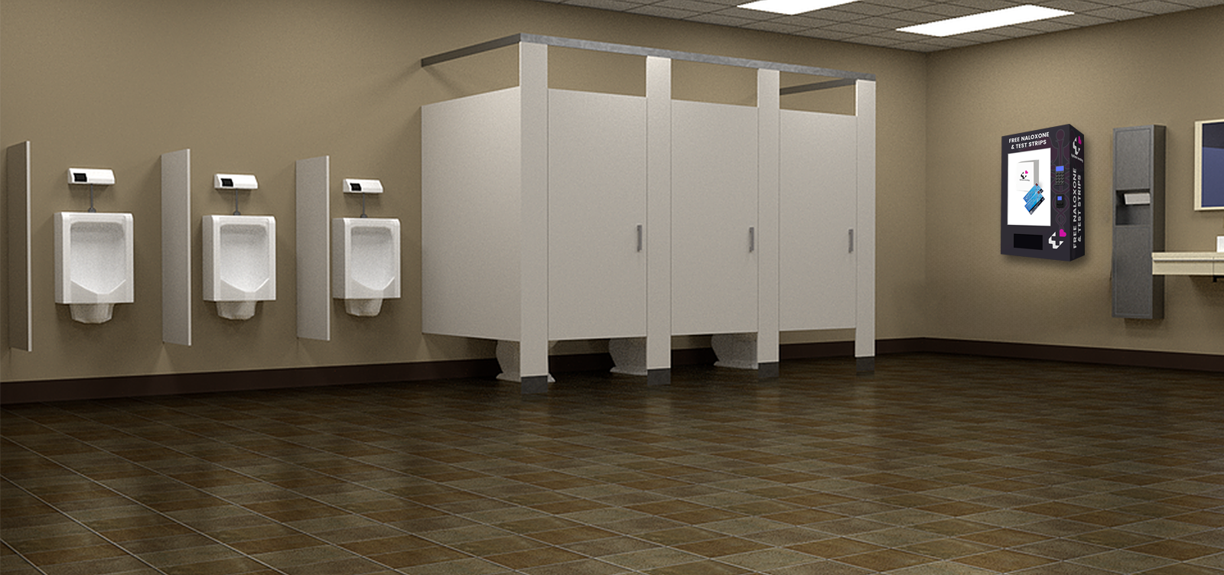
Strategic Placement in Urban Areas
Vending machines in high-traffic urban locations – such as our wall-mount unit with LCD display panel
Enhances community safety with 24/7 access to resources
Supports citywide harm reduction initiatives
Collaborations with local health departments and organizations
Regular maintenance and data-driven inventory management

Slide 17
Thank you!

