Slide 1
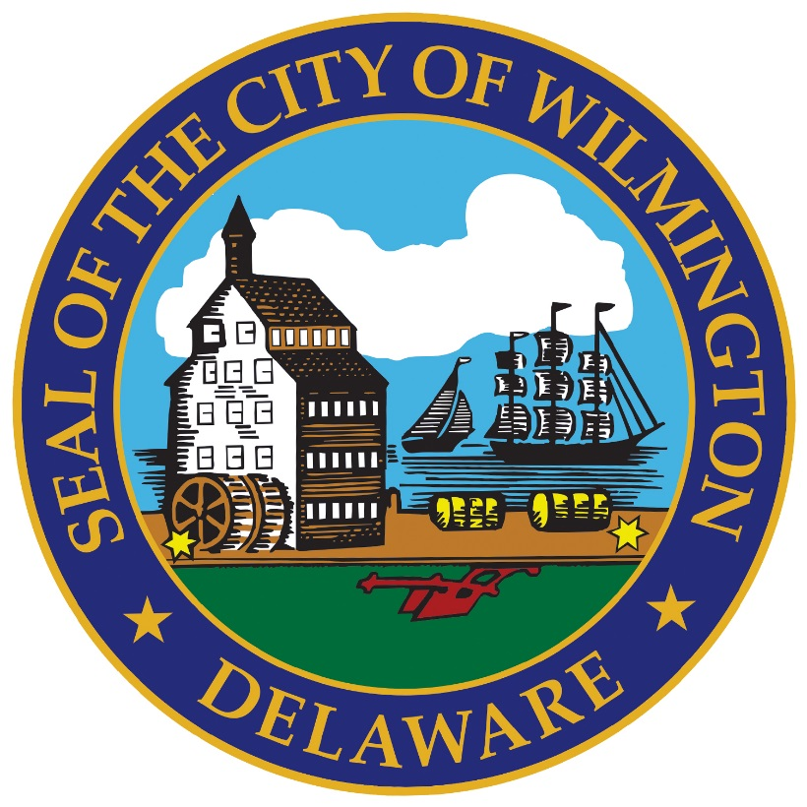
Public Works & Transportation Committee Resolution Approving Application for Five-Year Renewal of DDD June 17, 2024

Slide 2
Downtown Development District
Public Works & Transportation Committee Resolution Approving Application for Five-Year Renewal of DDD
Key Milestones
2015
2019
2023
2024
2025
January 11, 2015
June 2019
September 2023
July 01, 2024
January 01, 2025
State of Delaware designates Wilmington District
District boundary increase and extension
Final boundary Extension
State of Delaware OSPC 5-year Renewal deadline
First 5-year Renewal

Slide 3
Public Works & Transportation Committee Resolution Approving Application for Five-Year Renewal of DDD
District | DDD Rebate | Private Investment | Large Projects | Small Projects
Delaware City | $280,724 | $1,725,909 | 0 | 10
Dover | $1,619,563 | $13,297,542 | 4 | 55
Georgtown | $537,842 | $4,163,162 | 1 | 6
Harrington | $837,860 | $8,094,104 | 1 | 32
Laurel | $729,627 | $4,201,135 | 1 | 18
Middletown | $255,756 | $2,220,843 | 1 | 6
Milford | $2,351,796 | $17,315,231 | 6 | 60
New Castle City | $399,113 | $2,922,546 | 1 | 11
Seaford | $2,614,210 | $29,326,743 | 4 | 29
Smyrna | $867,696 | $6,764,479 | 1 | 29
Wilmington | $24,449,038 | $436,606,682 | 44 | 42
Total | $34,943,225 | $526,638,375 | 64 | 298

Slide 4
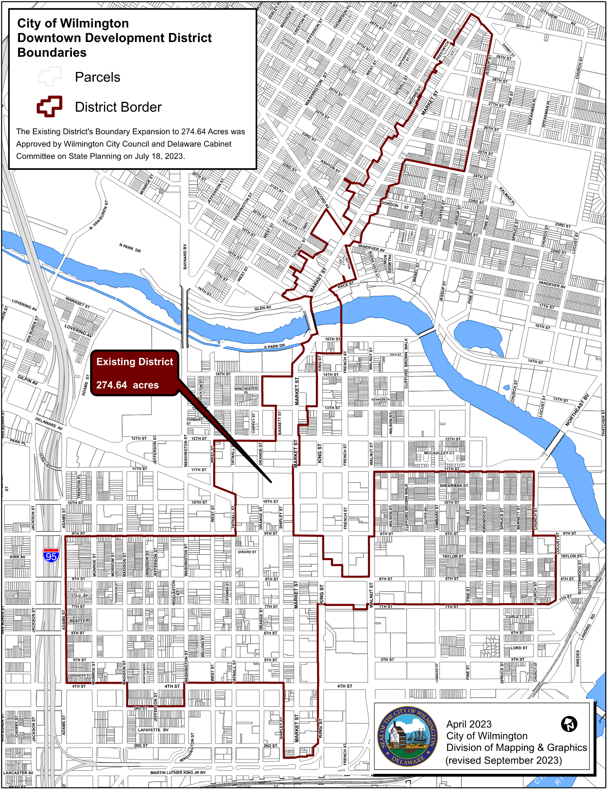
Public Works & Transportation Committee Resolution Approving Application for Five-Year Renewal of DDD

Slide 5
Public Works & Transportation Committee Resolution Approving Application for Five-Year Renewal of DDD
Thank you.

