Slide 1
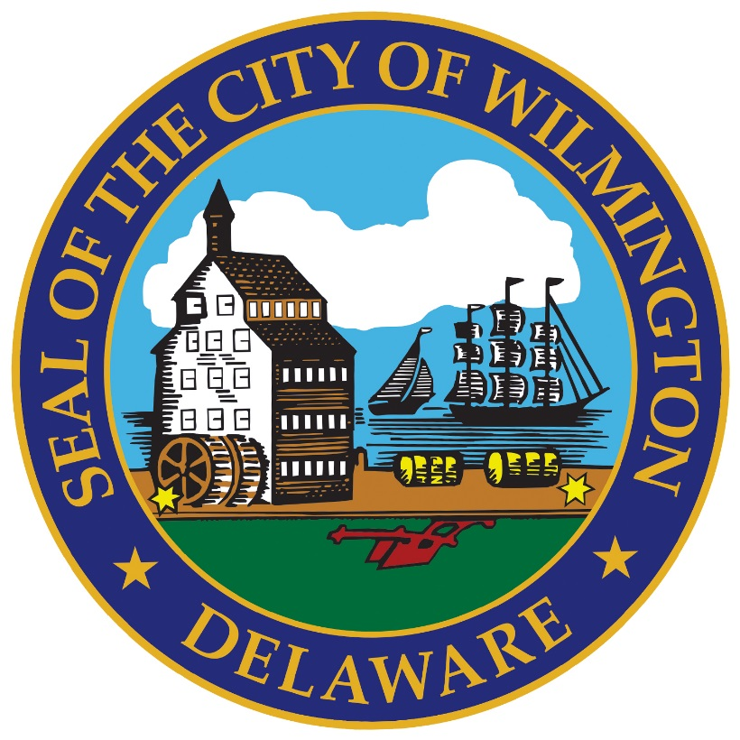
Amendments to the Wilmington Flats Large Scale Redevelopment Plan CD&UP Committee March 14, 2024

Slide 2
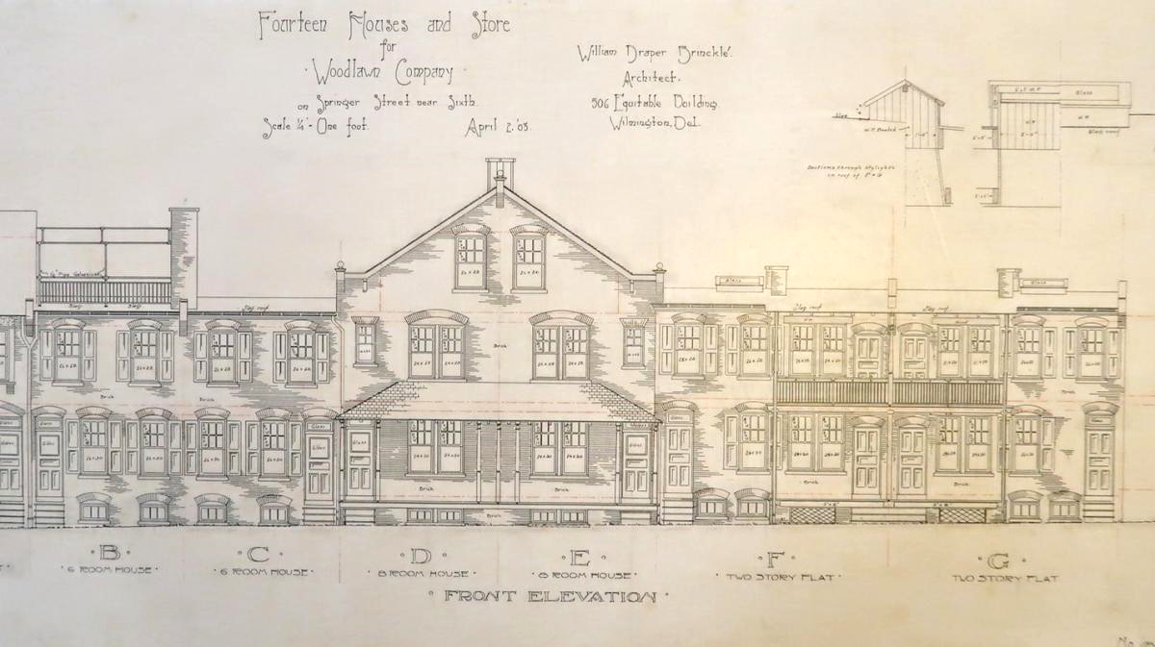
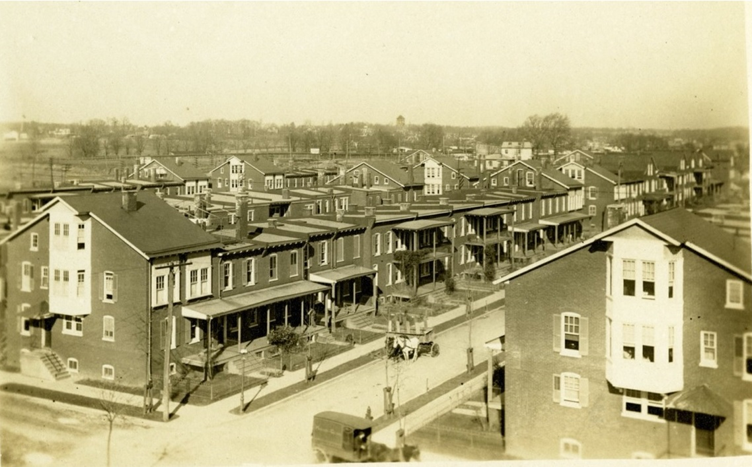
Context Map
South Walnut Street
South Market Street
Garasches Lane
Photo Circa 1910 ~ 1920
Maryland Ave
Plans from 1903

Slide 3
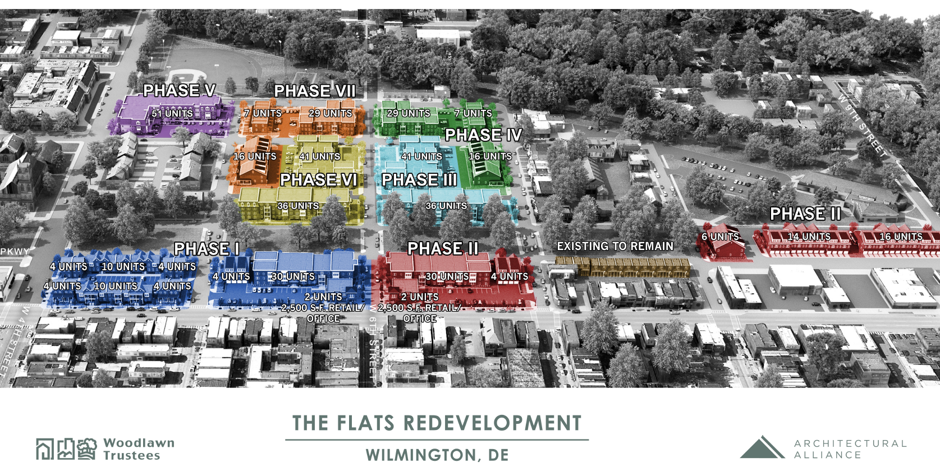
Context Map
South Walnut Street
South Market Street
Garasches Lane
Maryland Ave

Slide 4
Proposed Amendments
Large Scale Redevelopment Application:
September 2023 submission by Woodlawn Trustees, Inc. to amend the Large Scale Redevelopment Project application originally approved in 2013
Includes changes to site and building designs:
Minor changes to blocks E/F, G, and H
Block M has been redesigned

Slide 5
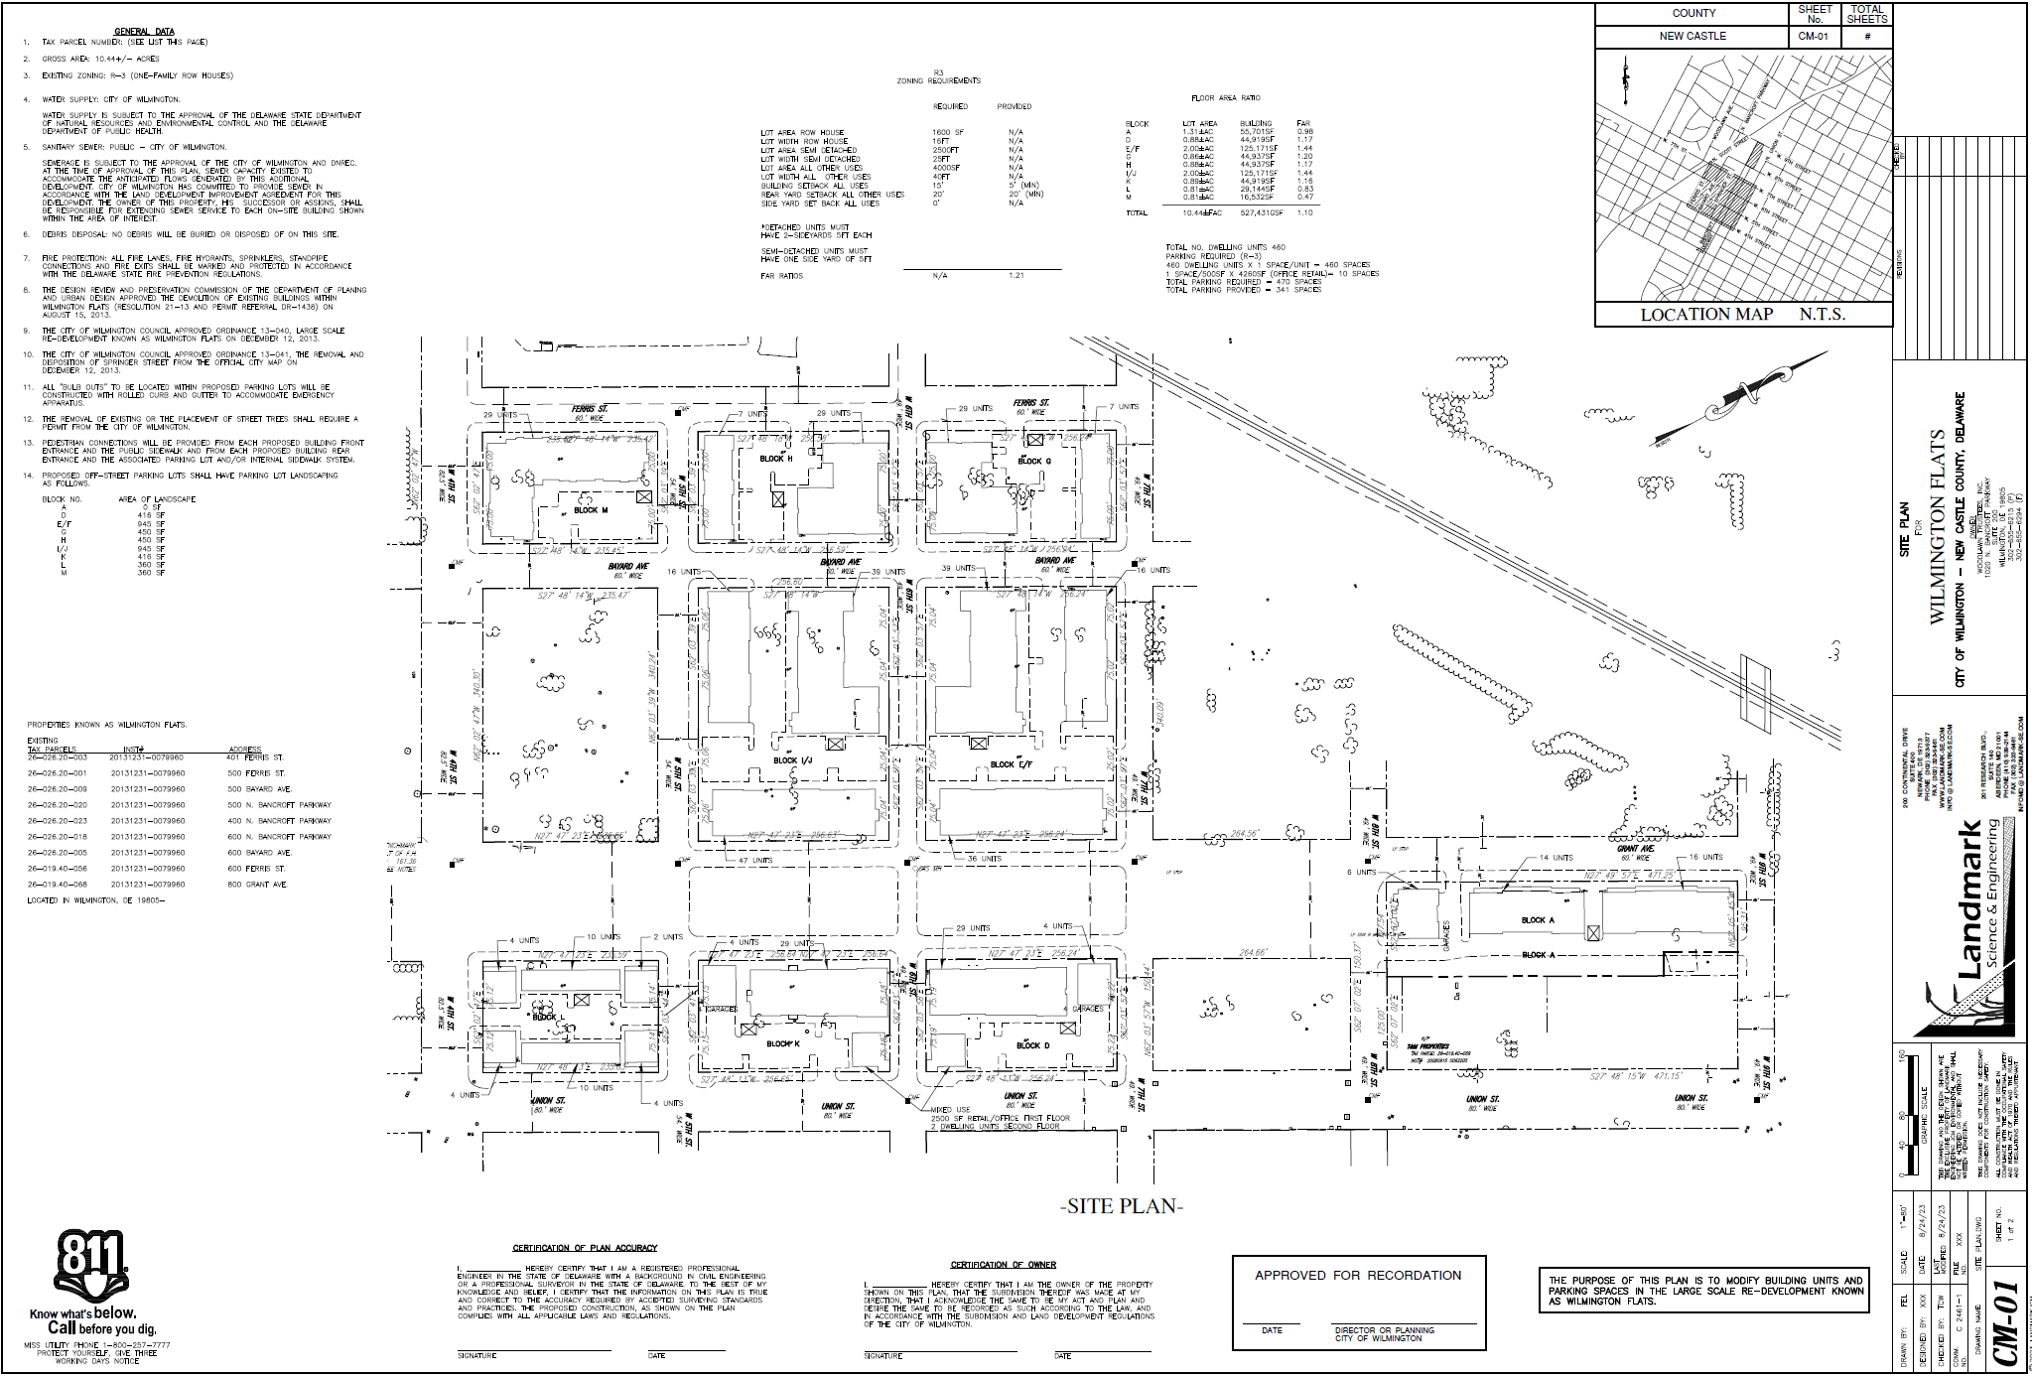
Context Map
South Walnut Street
South Market Street
Garasches Lane
Maryland Ave

Slide 6
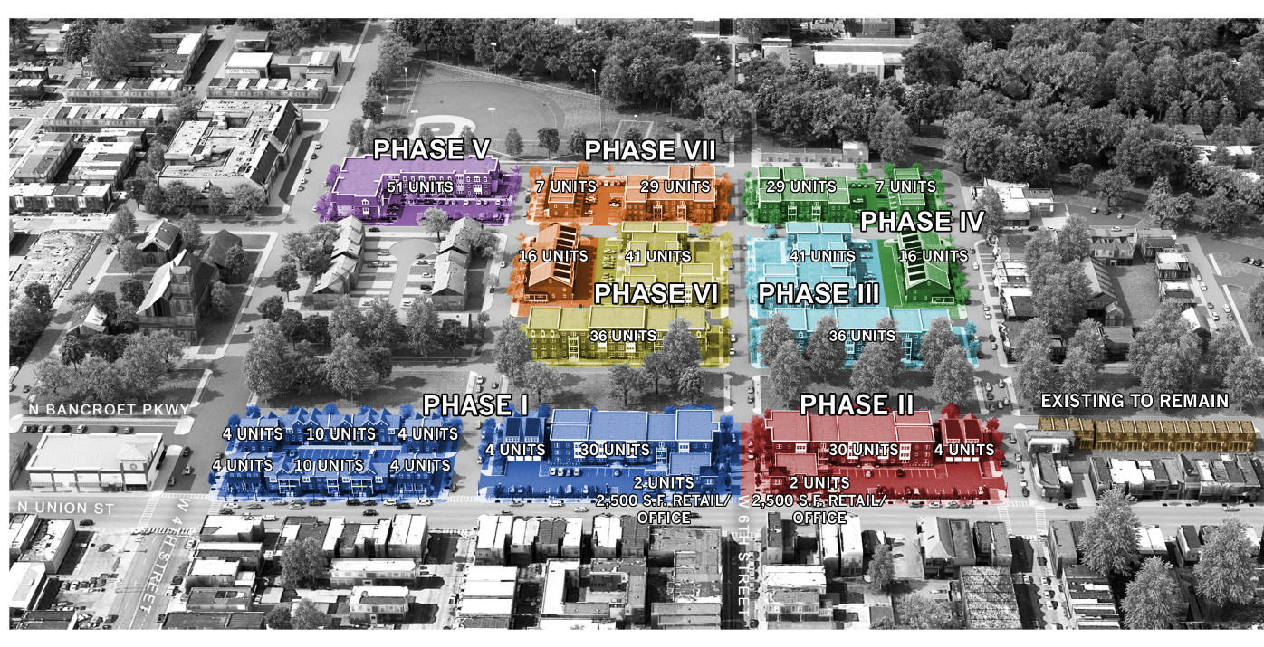
Context Map
South Walnut Street
South Market Street
Garasches Lane
Maryland Ave

Slide 7
Block/Building Changes
Proposed changes to Blocks E/F, G, H, and M:
Project Block | Original |  | Proposed | Increase/Decrease
Block E/F | Building #3 | 47 Units | 36 Units | - 11 Units
Block G | Building #2 | 27 Units | 29 Units | + 2 Units
Block H | Building #2 | 27 Units | 29 Units | + 2 Units
Block M | 6 Buildings | 36 Total Units | 1 Building, 53 Units | + 17 Units
TOTAL |  | 137 Units | 147 Units | +10 Units

Slide 8
Plan and Zoning Review
Parking
Zoning Board of Adjustment – October 23, 2023
Approved to provide 341 parking spaces
Massing and Scale
Floor to Area Ratio
Building Coverage Ratio
Building Height

Slide 9
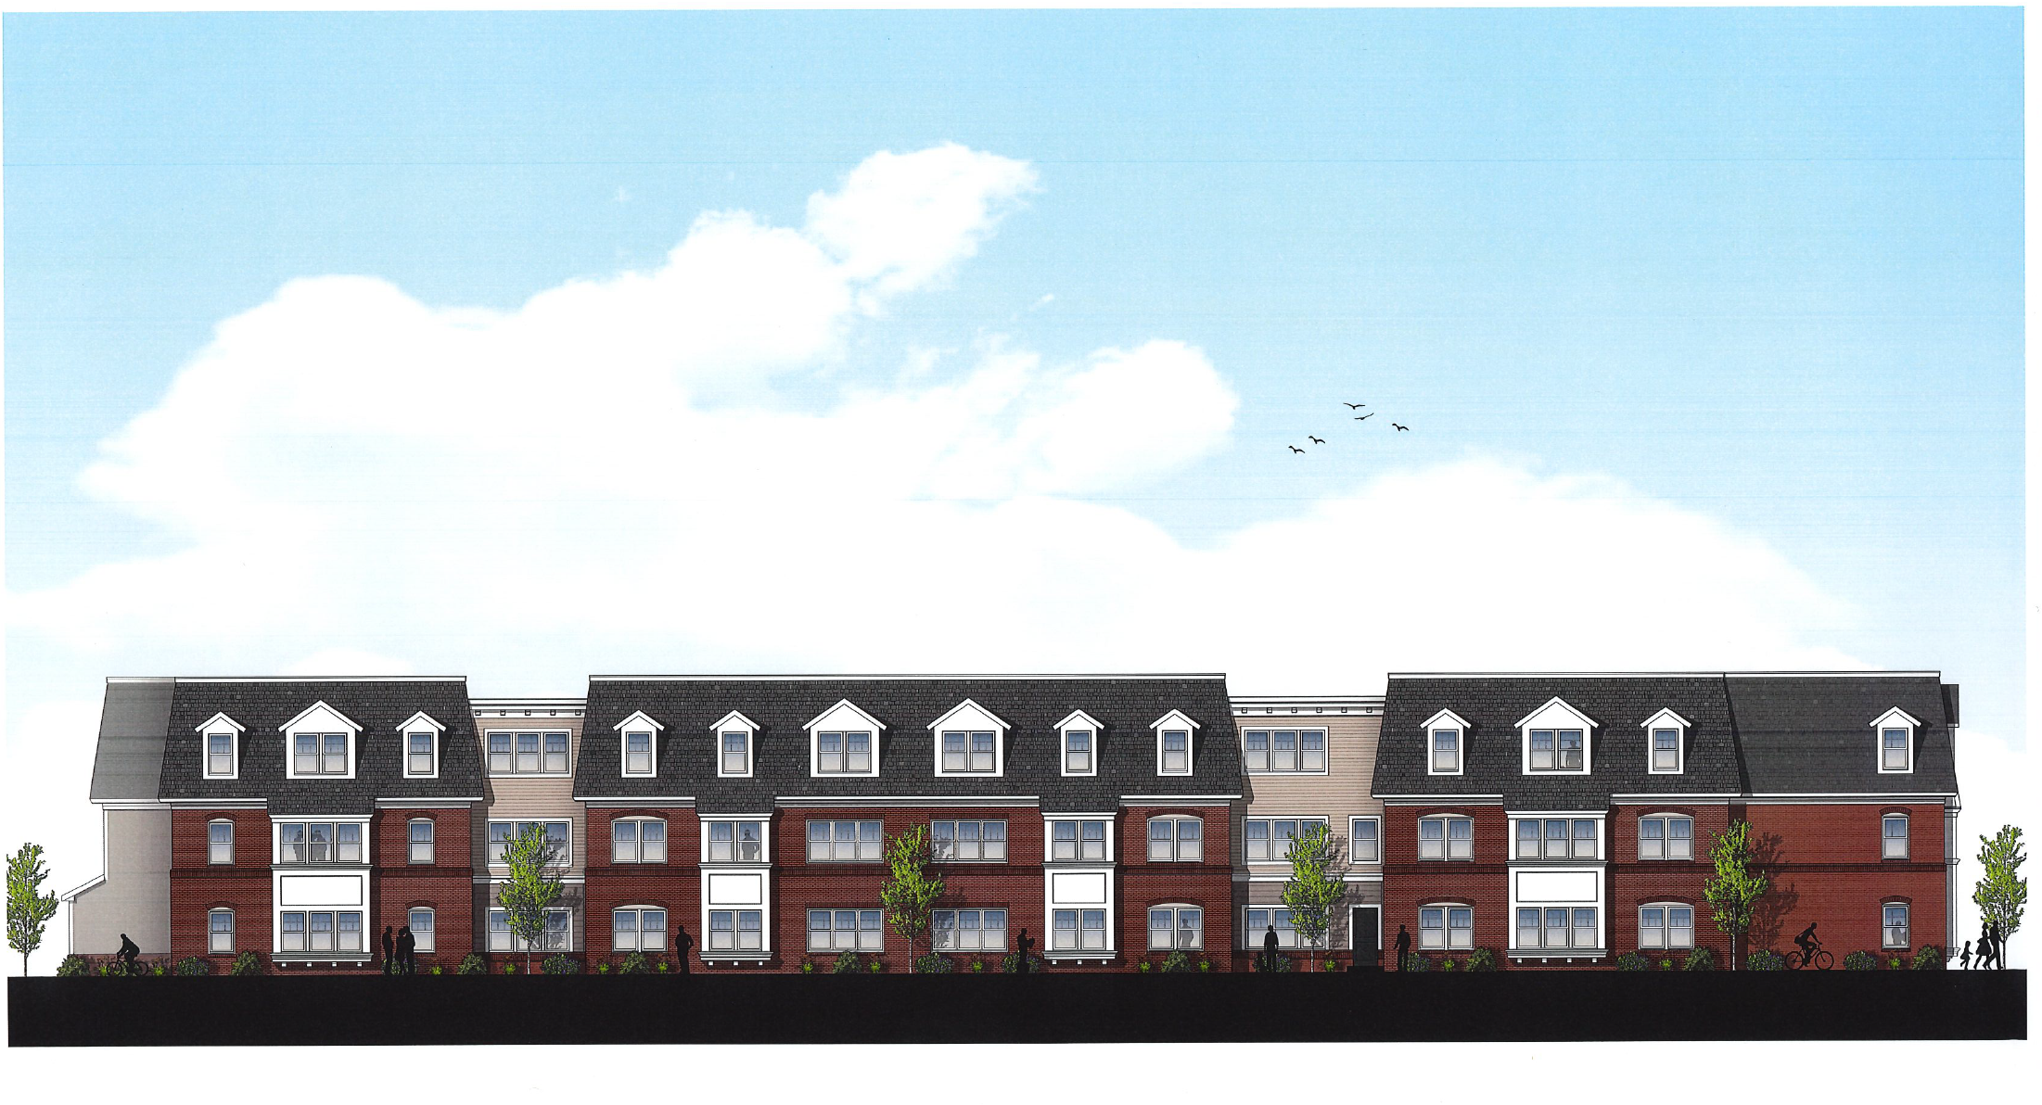
South Walnut Street
South Market Street
Block M - Phase V
(View from Ferris Street)
Garasches Lane
Maryland Ave

Slide 10
Findings and Recommendations
City Planning Commission Resolution 10-23:
The proposed amendments were found to be consistent with the original intent of the 2013 redevelopment plans
CPC recommends approval of the amended plan

Slide 11

Thank You

