Slide 1


Office of the Marijuana Commissioner
.
May 22, 2024
Commissioner Rob Coupe
Deputy Commissioner Paul Hyland
Health, Aging & Disabilities Committee

Slide 2


Agenda
Overview of HB2 Delaware Marijuana Control Act
Timeline for Implementation and License Types
Overview Office of the Marijuana Commissioner (OMC)
Health & Safety
Current Marijuana Industry – Office of Medical Marijuana
Considerations – Towns, Cities and Rescheduling
Legislative Requests – Technical Fixes and New Legislation
Budget Projections

Slide 3
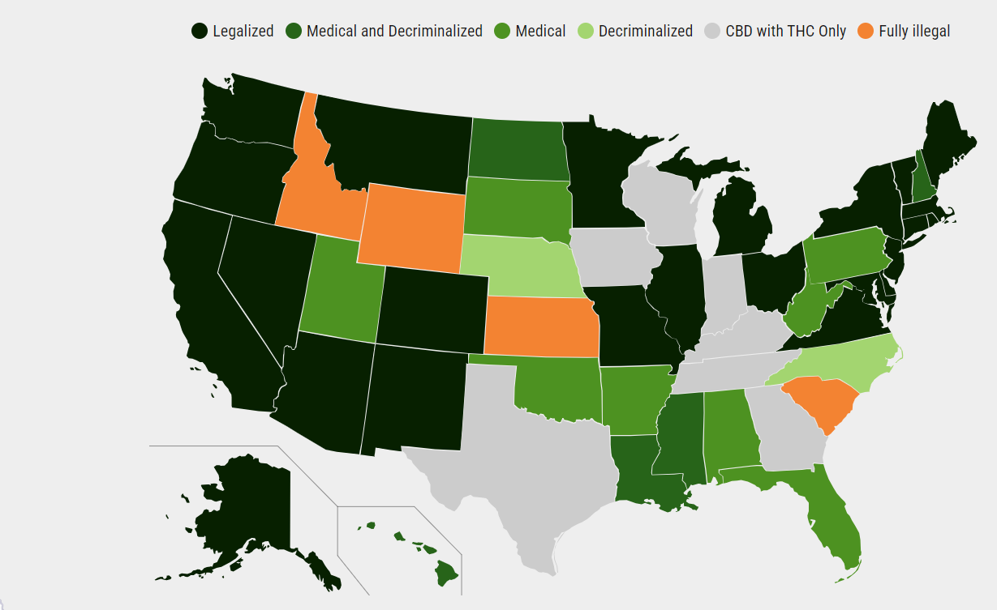
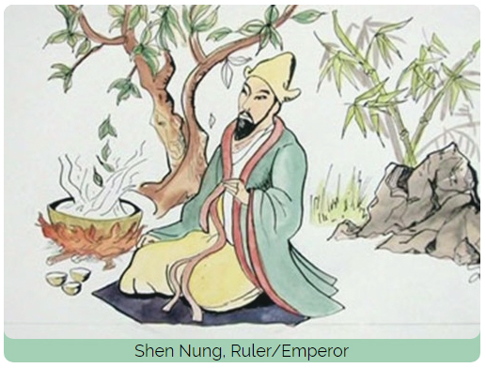
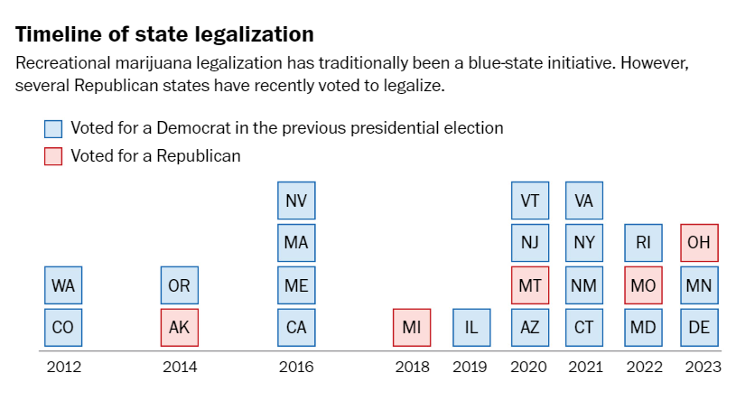
Background of Marijuana
Today
2800 BC: Emperor Shen Nung in China used cannabis for medicinal purposes
24 States
Marihuana Tax Act of 1937
Federal Bureau of Narcotics
Commissioner Harry Anslinger
Delaware Medical Marijuana Enabling Legislation SB-17 in 2011
Disa.com Marijuana Legality by State updated 5/13/2024
In 2012 Colorado and Washington became the first states to legalize recreational marijuana through ballot initiatives
December 18, 2015, Delaware HB39 Decriminalized Simple Possession to a Civil fine
Washington Post 11.8.2023
Notes:
It has been used by cultures all over the world for millennia for its medicinal, religious and recreational properties (for 4, 823 years)
Marihuana Tax Act of 1937 under which the importation, cultivation, possession and/or distribution of marijuana were regulated. www.cbp.gov
Among the act's provisions was one requiring importers to register and pay an annual tax of $24. A Marihuana Tax Act stamp, affixed to each original order form and marked by the revenue collector, insured that proper payments were made.
Recreational 24 States + DC (25)
US states where recreation and medical marijuana is legal in 2024 – NBC4 Washington (nbcwashington.com)
Tracking where weed is legal by state - The Washington Post

Slide 4
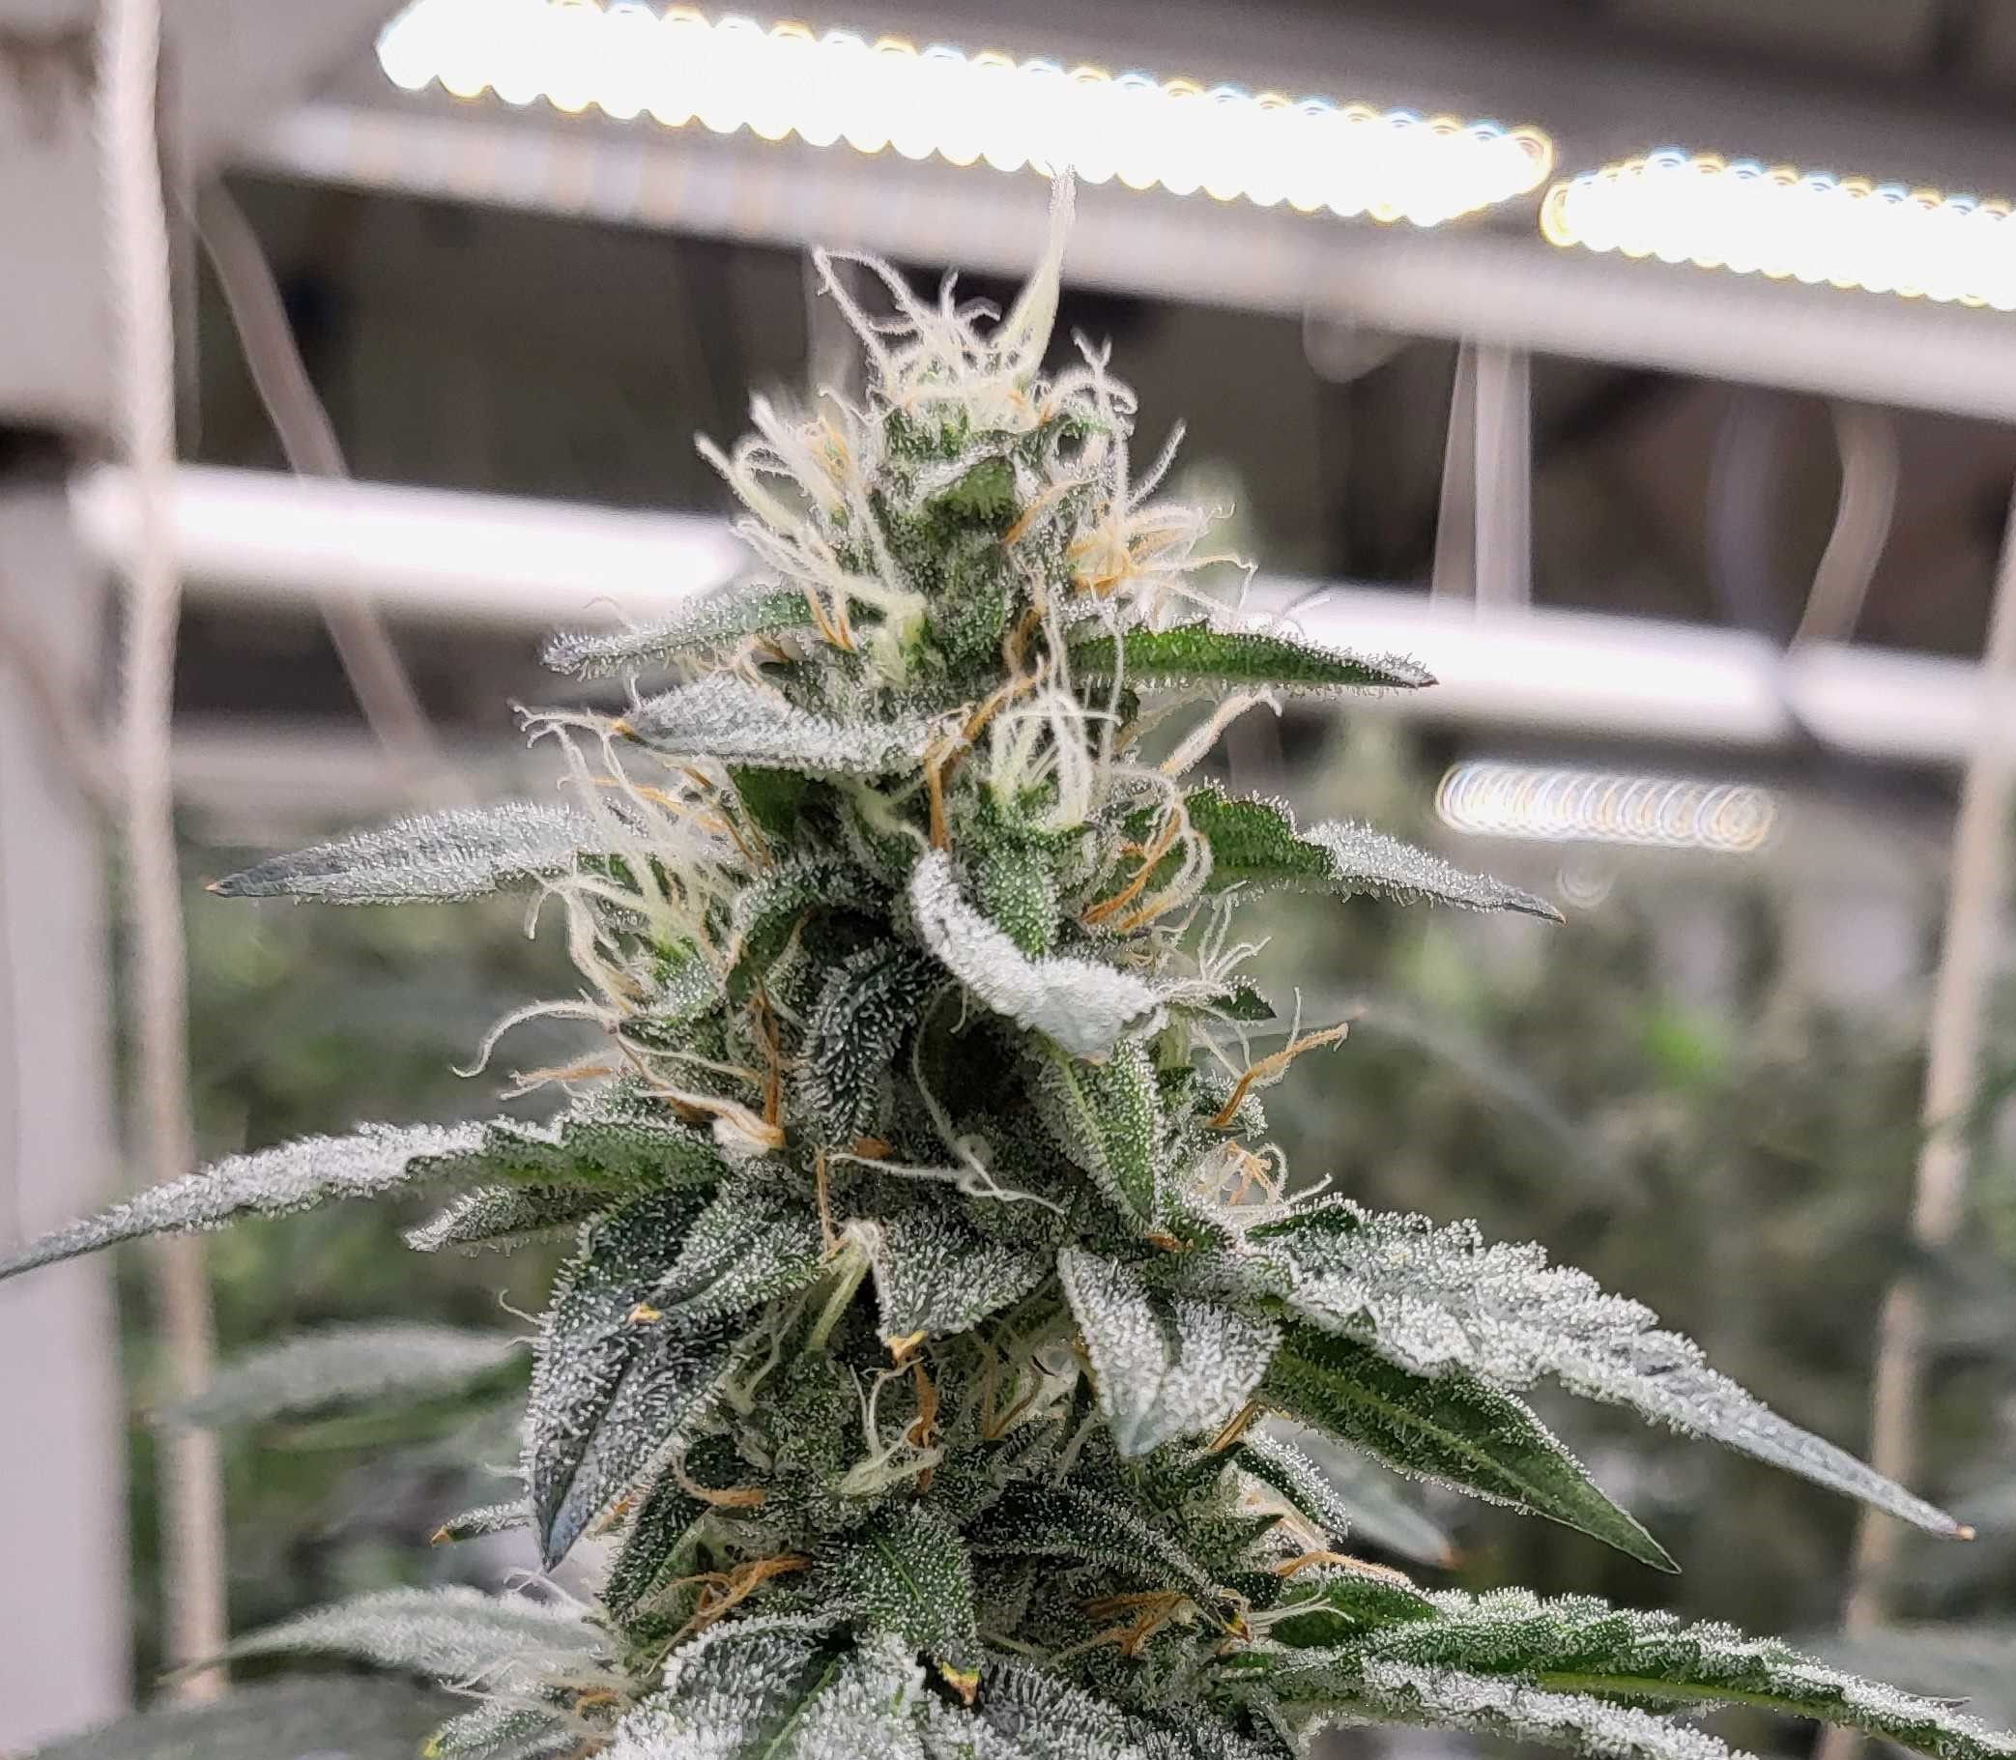
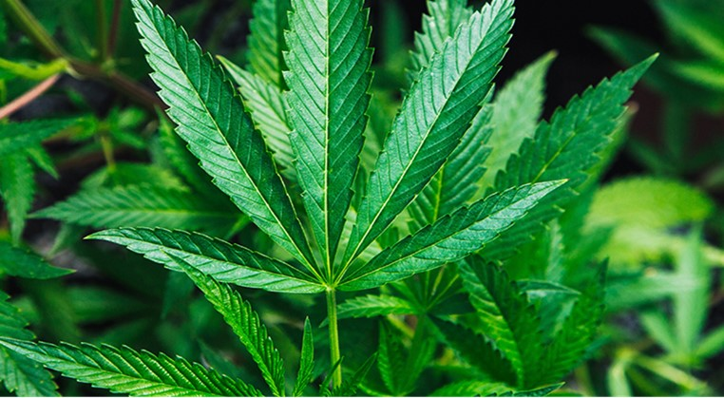
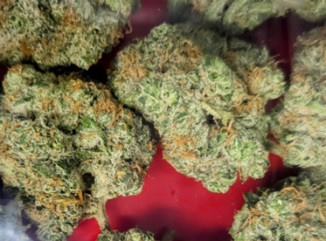
Which one to smoke?
Notes:
HB 1 Became law on April 23, 2023, without the Governor’s Signature. HB2 Became law on April 27, 2023, without the Governor’s signature
Effective Date – the Act takes effect the later of the following Publication in the Register of Regulations of a notice by the Controller General – posted 8/01/2023.
Goal of legislation – eliminate illegal market – address criminal justice concerns, disparate impact, creates jobs, creates revenue for state, neighbors legalized NY, NJ, MD
Bartenders are now Budtenders

Slide 5
Enabling Legislation 152nd GENERAL ASSEMBLY
2023
House Bill 1 (HB-1)
House Bill 2 (HB-2)
Now legal for adults, 21 or over, to possess, use, purchase and transport Marijuana
"personal use quantity" up to one ounce leaf marijuana, 12 grams of concentrated cannabis, or cannabis products containing 750 mgs of Delta 9 THC
Not legal to consume in public or in a moving vehicle
Cannot sell, grow, or manufacture unless state licensed business
Title 16 Chapter 47
Created OMC
Effective Date 08/01/2023
Title 4 Chapter 13
Notes:
HB 1 Became law on April 23, 2023, without the Governor’s Signature. HB2 Became law on April 27, 2023, without the Governor’s signature
Effective Date – the Act takes effect the later of the following Publication in the Register of Regulations of a notice by the Controller General – posted 8/01/2023.
Goal of legislation – eliminate illegal market – address criminal justice concerns, disparate impact, creates jobs, creates revenue for state, neighbors legalized NY, NJ, MD
Bartenders are now Budtenders

Slide 6

Overview of HB2 Delaware Marijuana Control Act
Main Concepts
State Agency Positions (34)
Effective Date 08/01/2023 Published in Register of Regulations
Created OMC
Authorized 125 business licenses
Directed OMC to establish Rules& Regulations (R&Rs)
Empowered DATE to enforce R&Rs
Established 15% sale tax
Created implementation timeline
Title 4 Chapter 13
OMC 5 positions
DATE 14 positions
Div. of Revenue 7 positions
Dept of Agriculture 2 positions
Div. Public Health 6 positions - HSP
(Health Systems Protection)
(All positions listed in HB195 FY24 Budget)
Funds
Committee & Commission
The Delaware Marijuana Control Act Oversight Committee – 15 members
Appeals Commission – 3 members
Marijuana Regulation Fund
The Office of the State Treasurer shall administer the fund §1381(a)
Justice Reinvestment Fund
7% of monthly total tax revenue collected will be
allocated to the Justice Reinvestment Fund
The Criminal Justice Council (CJC) will administer grants, contracts, services or initiatives §1387(b)

Slide 7
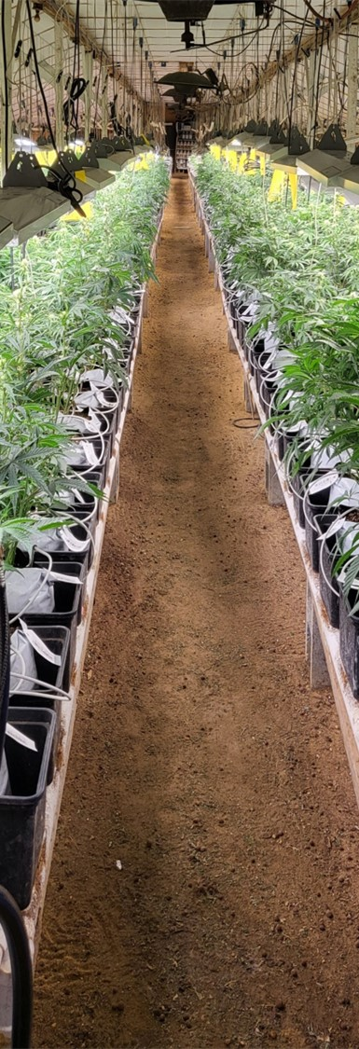
Timeline for Implementation
July 11, 2024
Adopt regulations for licensing adult use recreational marijuana businesses
September 1, 2024
Shall begin accepting license applications
December 1, 2024
Shall begin to issue 30 Manufacturing Facility Licenses
March 1, 2025
Shall begin to issue 30 Retail Store Licenses
November 1, 2024
Shall begin to issue 60 Cultivation Facility Licenses
March 1, 2025
Shall begin to issue 5 Testing Facility Licenses
Title 4 § 1343. Licensing Process

Slide 8
License Types
Cultivation - 60
Open Cultivation License: 20
Social Equity Cultivation (≥2500 ft²): 10
Microbusiness Cultivation: 20
Social Equity Cultivation (≤2500 ft²⁾: 10
Manufacturing - 30
Open Manufacturing: 10
Social Equity Manufacturing: 10
Microbusiness Manufacturing: 10
Retail - 30
Open Retail License: 15
Social Equity Retail License: 15
Testing Lab - 5
Open Testing Lab: 3
Social Equity Testing Lab: 2
Total All Licenses – 125
Total Social Equity Licenses - 47
Notes:
Sect 1332 Retail marijuana store licenses
Sect 1333 Marijuana testing facility licenses
Sect 1334 Marijuana Cultivation facility licenses
Sect 1335 Marijuana product manufacturing licenses

Slide 9
Application & License Costs:
Application fee is $5,000
Discount: Social Equity application fee is $1,000; Microbusiness application fee $3,000
(§1337 & §1341)
OMC license fee is $10,000 for two-year license (adjusted costs for Cultivation license based on plant grow canopy size cost $2,500, $7,500, or $10,000)
Social Equity and Microbusiness licenses are discounted to 40% of regular license and cost $4,000 for two-year license.
Sunday Sales require a $500 biennial license fee §1309 (b)(3).
(Note: T4 §1309(b) May not sell or deliver on Thanksgiving, Easter or Christmas)
Notes:
Adult Use it is $10,000 for each license type
Sect 1334 Cultivation is based on canopy size from $2,500 to $10, 000

Slide 10
Social Equity License Program:
This program is designed to create a more inclusive and equitable marijuana industry by providing opportunities for those disproportionately impacted by past marijuana laws.
Who Benefits?
Individuals with past marijuana-related convictions.
Residents of neighborhoods heavily affected by past marijuana enforcement.
How Does It Work?
Reserved Licenses: A portion of available licenses are specifically designated for social equity applicants.
Reduced Fees: Applying for a marijuana business license can be expensive. This program reduces those fees for qualified applicants.
Community Investment: Tax revenue from marijuana sales will fund programs that support communities harmed by past marijuana laws.

Slide 11
Social Equity License Program:
§ 1336 Social equity applicant.
Applicant must have at least 51% ownership and control… and meet one of the following criteria.
Criteria 1: have resided for at least 5 of the preceding 15 years in a disproportionately impacted area as defined in §1302 Definitions.
Criteria 2: Was convicted of or adjudicated delinquent of a marijuana-related offense under Delaware law prior to April 23,2023, except any of the following:
Delivery to a minor.
Any marijuana offense with a Tier 3 quantity of marijuana as defined in § 4751C of Title 16.
(5000 grams of Marijuana = 11.02 pounds)
Criteria 3: Had or has a parent, legal guardian, child, spouse, or dependent who was convicted of or adjudicated delinquent for any marijuana-related offense under Delaware law prior to April 23, 2023, that would qualify under Criteria 2 above.
Updated 3.22.24 with HB334
§ 1338 Technical assistance.
The Commissioner shall develop a technical assistance program to aid social equity applicants…

Slide 12
Social Equity License Program Workshops:
New Castle County (6/5/2024) Stanton Campus Delaware Technical Community College (400 Stanton Christiana Rd, Newark, DE 19713)
Sussex County (6/12/2024) Owens Campus Delaware Technical Community College (21179 College Dr, Georgetown, DE 19947)
City of Wilmington (6/18/2024) Wilmington Campus Delaware Technical Community College (333 N Shipley St, Wilmington, DE 19801)
Kent County (6/26/2024) Dover Library, Loockerman St., Dover, DE 19901 (Tentative New Location and Date DNREC location no longer available)
Updated 5.20.2024
§ 1338 Technical assistance.
The Commissioner shall develop a technical assistance program to aid social equity applicants…

Slide 13
Office of the Marijuana Commissioner (OMC) - Overview
Building infrastructure of the OMC: Offices, Equipment, Branding and Hiring Staff
Rules & Regulations – Formal posting of regulations began on 05/01/2024 to the Register of Regulations and ends on 06/03/24. Then the feedback is reviewed.
Stakeholder Engagement & Outreach – State agencies, local government, non-government agencies, etc.
DTCC Marijuana Industry Training Program – Fall 2024
Social Equity License Program and Technical Assistance – SE Workshops will be held in June
OMC Large Scale IT Projects:
Seed to Sale Tracking Software
Develop statewide RFP for an integrated marijuana track and trace solution
Tracks each plant throughout life-cycle, manufacturing process, including point of sale – customer
License Application Process Software
Receive, score and track applications online for the 125 available licenses, information and document repository (RMS)
Current State Contract with Salesforce utilized by OABCC
Data Analytics Program
Uses predictive estimate technology looking for data anomalies and violations
Investigative tool giving regulators a starting point to look for diversion or inversion, also tracks revenue

Slide 14
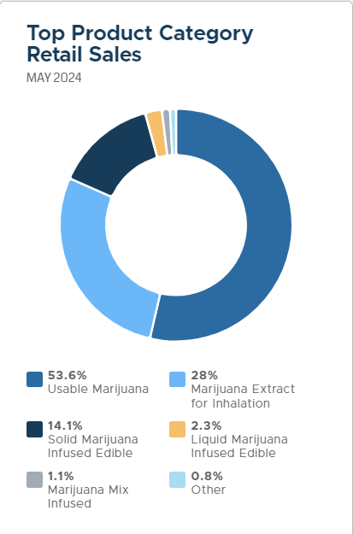
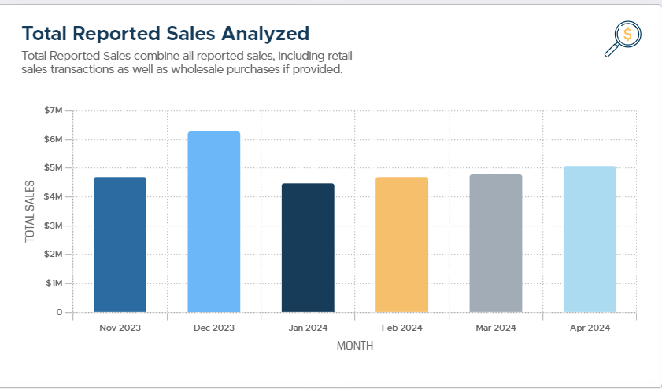
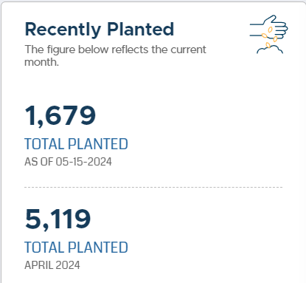
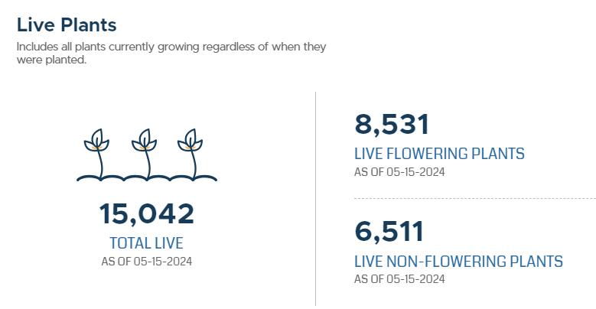
NCS Transparency Project
OMM Website
MMP Live Industry Snapshot
Notes:
Link to Office of Medical Marijuana (OMM) Transparency Project. NCS Transparency Report (ncsanalytics.com) The Transparency Project will continue with the OMC. You can also connect to the page through the OMM website using the blue button near the bottom of the page “MMP Live Industry Snap Shot”. https://dhss.delaware.gov/dhss/dph/hsp/medmarhome.html

Slide 15
Health & Safety
OMC is partnering with Stakeholders to develop communications strategies and initiatives that will address safety concerns
Delaware Pharmacists Society
The Office of the Child Advocate
Child Protection Accountability Commission (Training Committee)
The Addiction Action Committee
The Office of Highway Safety
Grass Roots Organizations addressing Substance Use Disorder Related Concerns

Slide 16
Harm Reduction – “Safer” Marijuana?
Reduction of the illegal market
Safety Standards for cultivation, manufacturing and sales
Risks of Mold, Residuals and Pesticides are addressed through standards and testing
Canadian study revealed a significant contrast in safety between cannabis grown for the legal market versus illegal market in Canada. study published in the Journal of Cannabis Research found that 92% of unregulated or illicit market cannabis tested positive for various pesticides. In contrast, only 6% of regulated products tested positive for pesticide contamination. (Charron,2023)
Delaware Testing Project will test illegal marijuana products seized by the DSP
Charron, K. (2023, Sept 28). Pesticide Residue Prevalent in Illegal Cannabis. Labroots. https://www.labroots.com/trending/cannabis-sciences/25951/pesticide-residue-prevalent-illegal-cannabis-2

Slide 17
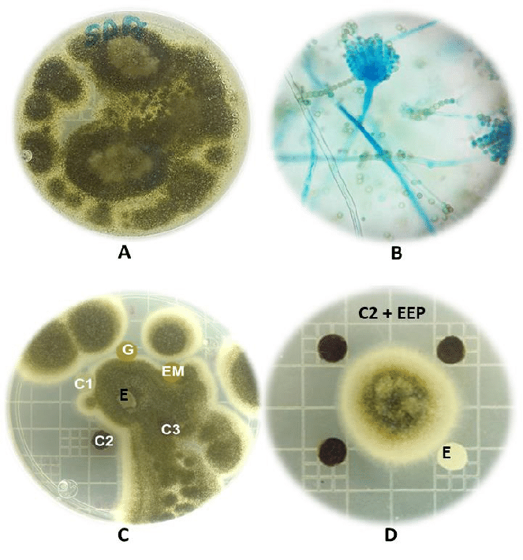
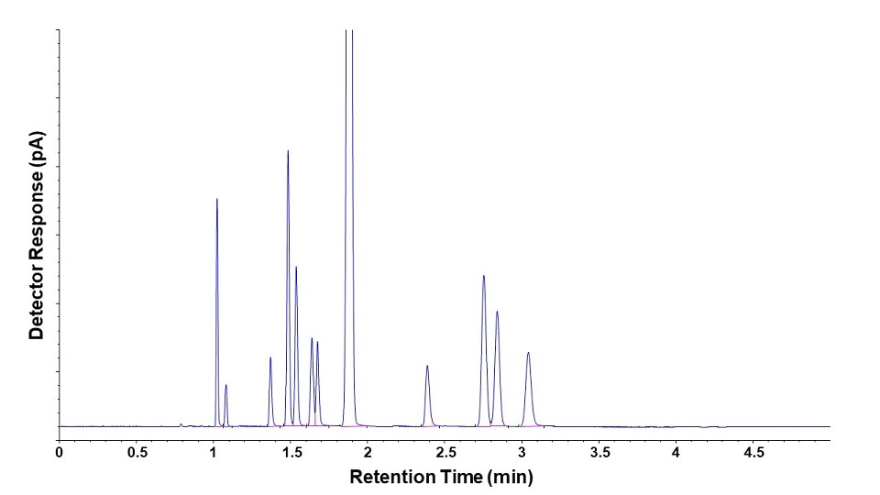
Sample Testing
Samples are collected by DPH marijuana regulators
Testing includes:
Mold, yeast, bacteria
Cannabinoid Profile (THC, CBD, CBG)
Terpene Profile
Heavy Metals
Pesticides
Mycotoxin
Solvents
Notes:
Delaware Mold Standard is 400 CFU/gram

Slide 18

Office of Medical Marijuana (OMM)
Current Marijuana Industry in Delaware
Enabling Legislation SB-17 in 2011
First Compassion Center opened in 2015
Patients in the Medical Marijuana Program – 15, 860 in May 2024, a decline of 1,744 patients since May 2023 (17, 604)
Patients by County
New Castle County (49%)
Kent County (19%)
Sussex County (32%)
Authorizing Physicians - 770
Delaware will use the same products for Medical Marijuana and Adult Use Recreational Marijuana
Medical Marijuana Program qualified patients can legally possess more Marijuana than someone under the Adult Use Recreational Marijuana program.
Medical Patient can possess up to 6 ounces (T16 Sec 4903A)
Notes:
The products are identical with the same production and testing standards.
Medical patients are granted access to increased amounts of marijuana products and can participate in promotional sales and home delivery (purchase 3 ounces every two weeks, possess up to 6 ounces (T16 Sec 4903A), no taxes

Slide 19
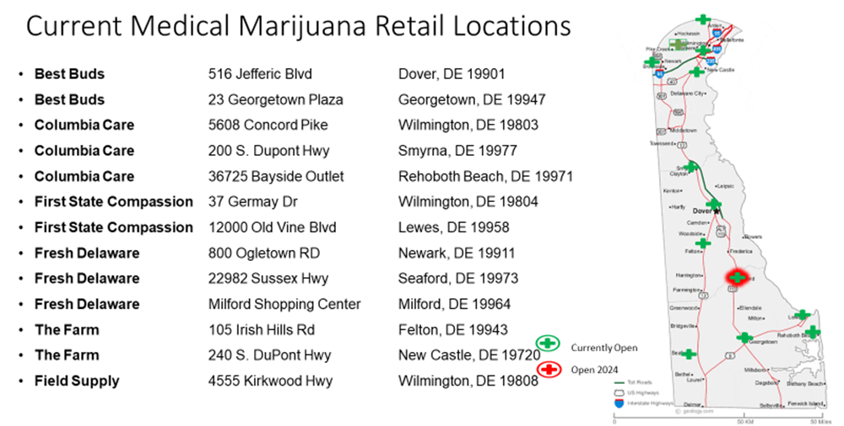
Office of Medical Marijuana (OMM)
13
6- Licensed Operators in OMM combine for 13 retail locations
5 have cultivation - 4 have manufacturing
Notes:
There are six licensed companies, five have active cultivation facilities, four have active manufacturing facilities, and combined there are 13 active retail locations, most recent opened in Milford, Delaware in May 2024.

Slide 20
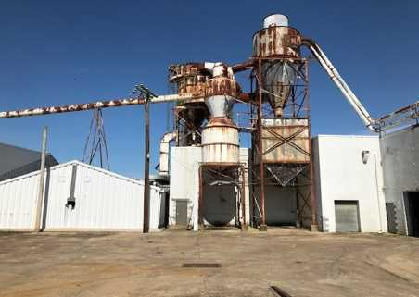
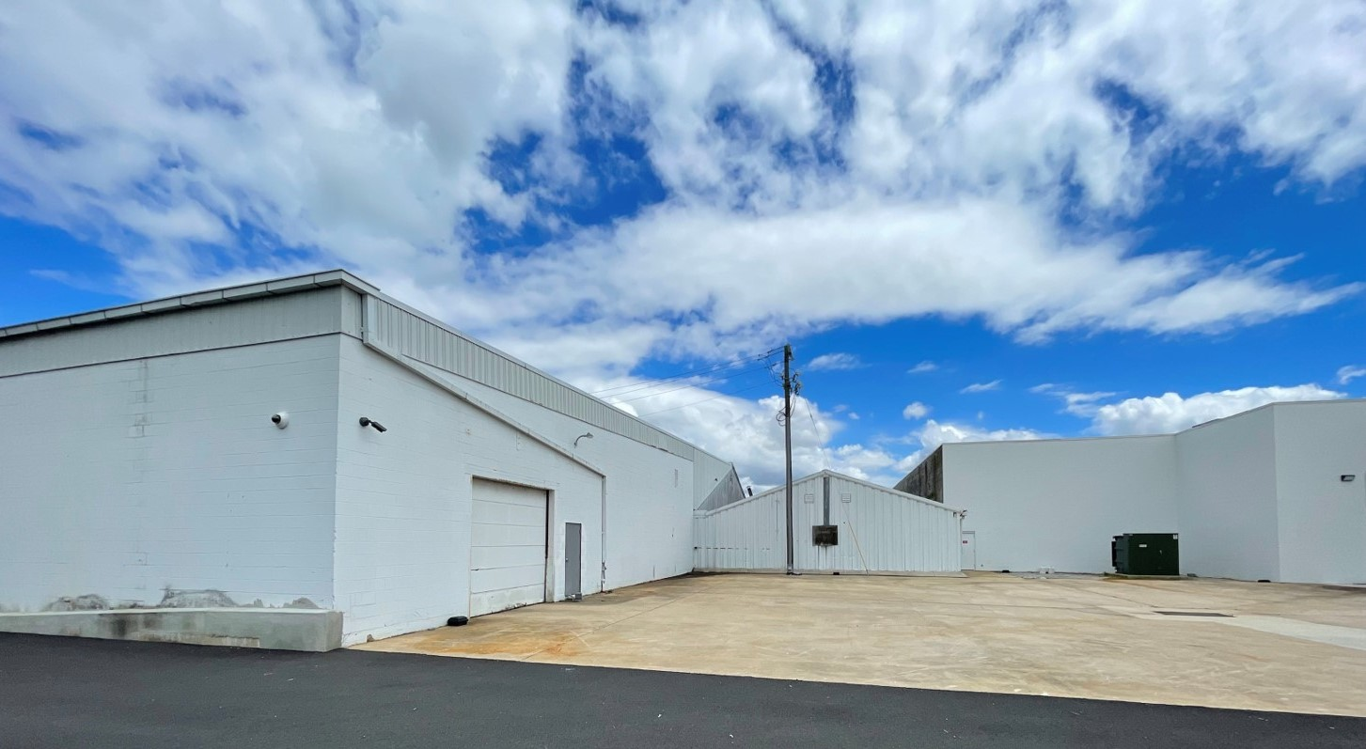
What is the Economic Impact
Office of Medical Marijuana program generated ≈$49 Million in Sales CY2022 and ≈ $53.8 Million in Sales in CY2023
Creation of Jobs ≈ 248 jobs statewide in May 2024 down from 323 in May 2023
positions are located - 41% in NCC, 24% in KC, 35% in SC
Improving blighted areas
Serving citizens with disabilities – medical needs
Reduction of the illegal market

Slide 21
Economic Impact
Reviewing current Delaware medical marijuana program participant’s purchase habits can be an indicator of what to expect
In 2023, the ≈ 17,000 medical marijuana patients spent an average of $3,303 per year on marijuana products.
Compared to the modest, projected adult use recreational purchase population of 85,000 customers the estimated annual sales would be $281M
With potential tax revenues of $42M/year. (generated by 15% sales tax)
Or using current average monthly sales of medical marijuana at $4.0 M/month multiplied by 4 for the increase in Adult Use Customers would be $16 M/month
With potential tax revenues of $2.4 M/month (generated by 15% sales tax)
Estimates Only
Notes:
Cost of marijuana flower is about $11 gram
Purchase amounts is usually 1/8 ounce which is 3.54 grams

Slide 22
Marijuana Industry Business Challenges
26 U.S. Code § 280E – Tax Code denies deductions and credits for business expenses when business is in connection with the illegal sale of drugs
Cash Business
Banking Limitations – SAFER Banking Act
Investors
No pesticides permitted – must use organic growing standards
Restrictions on advertising including a prohibition on mass market campaigns that have a high likelihood of reaching minors [§1331(15)]
Water Filtration & Plant Nutrient Systems for indoor grows
Creating a new demand on electricity – buildout from electrical provider
Notes:
Not in print or broadcast media – can do promotional event sponsorships. T4 Sect 1331 Regulations (15) ---(15) Restrictions on the advertising, marketing, and signage of marijuana and marijuana products, including a prohibition on mass market campaigns that have a high likelihood of reaching minors.

Slide 23
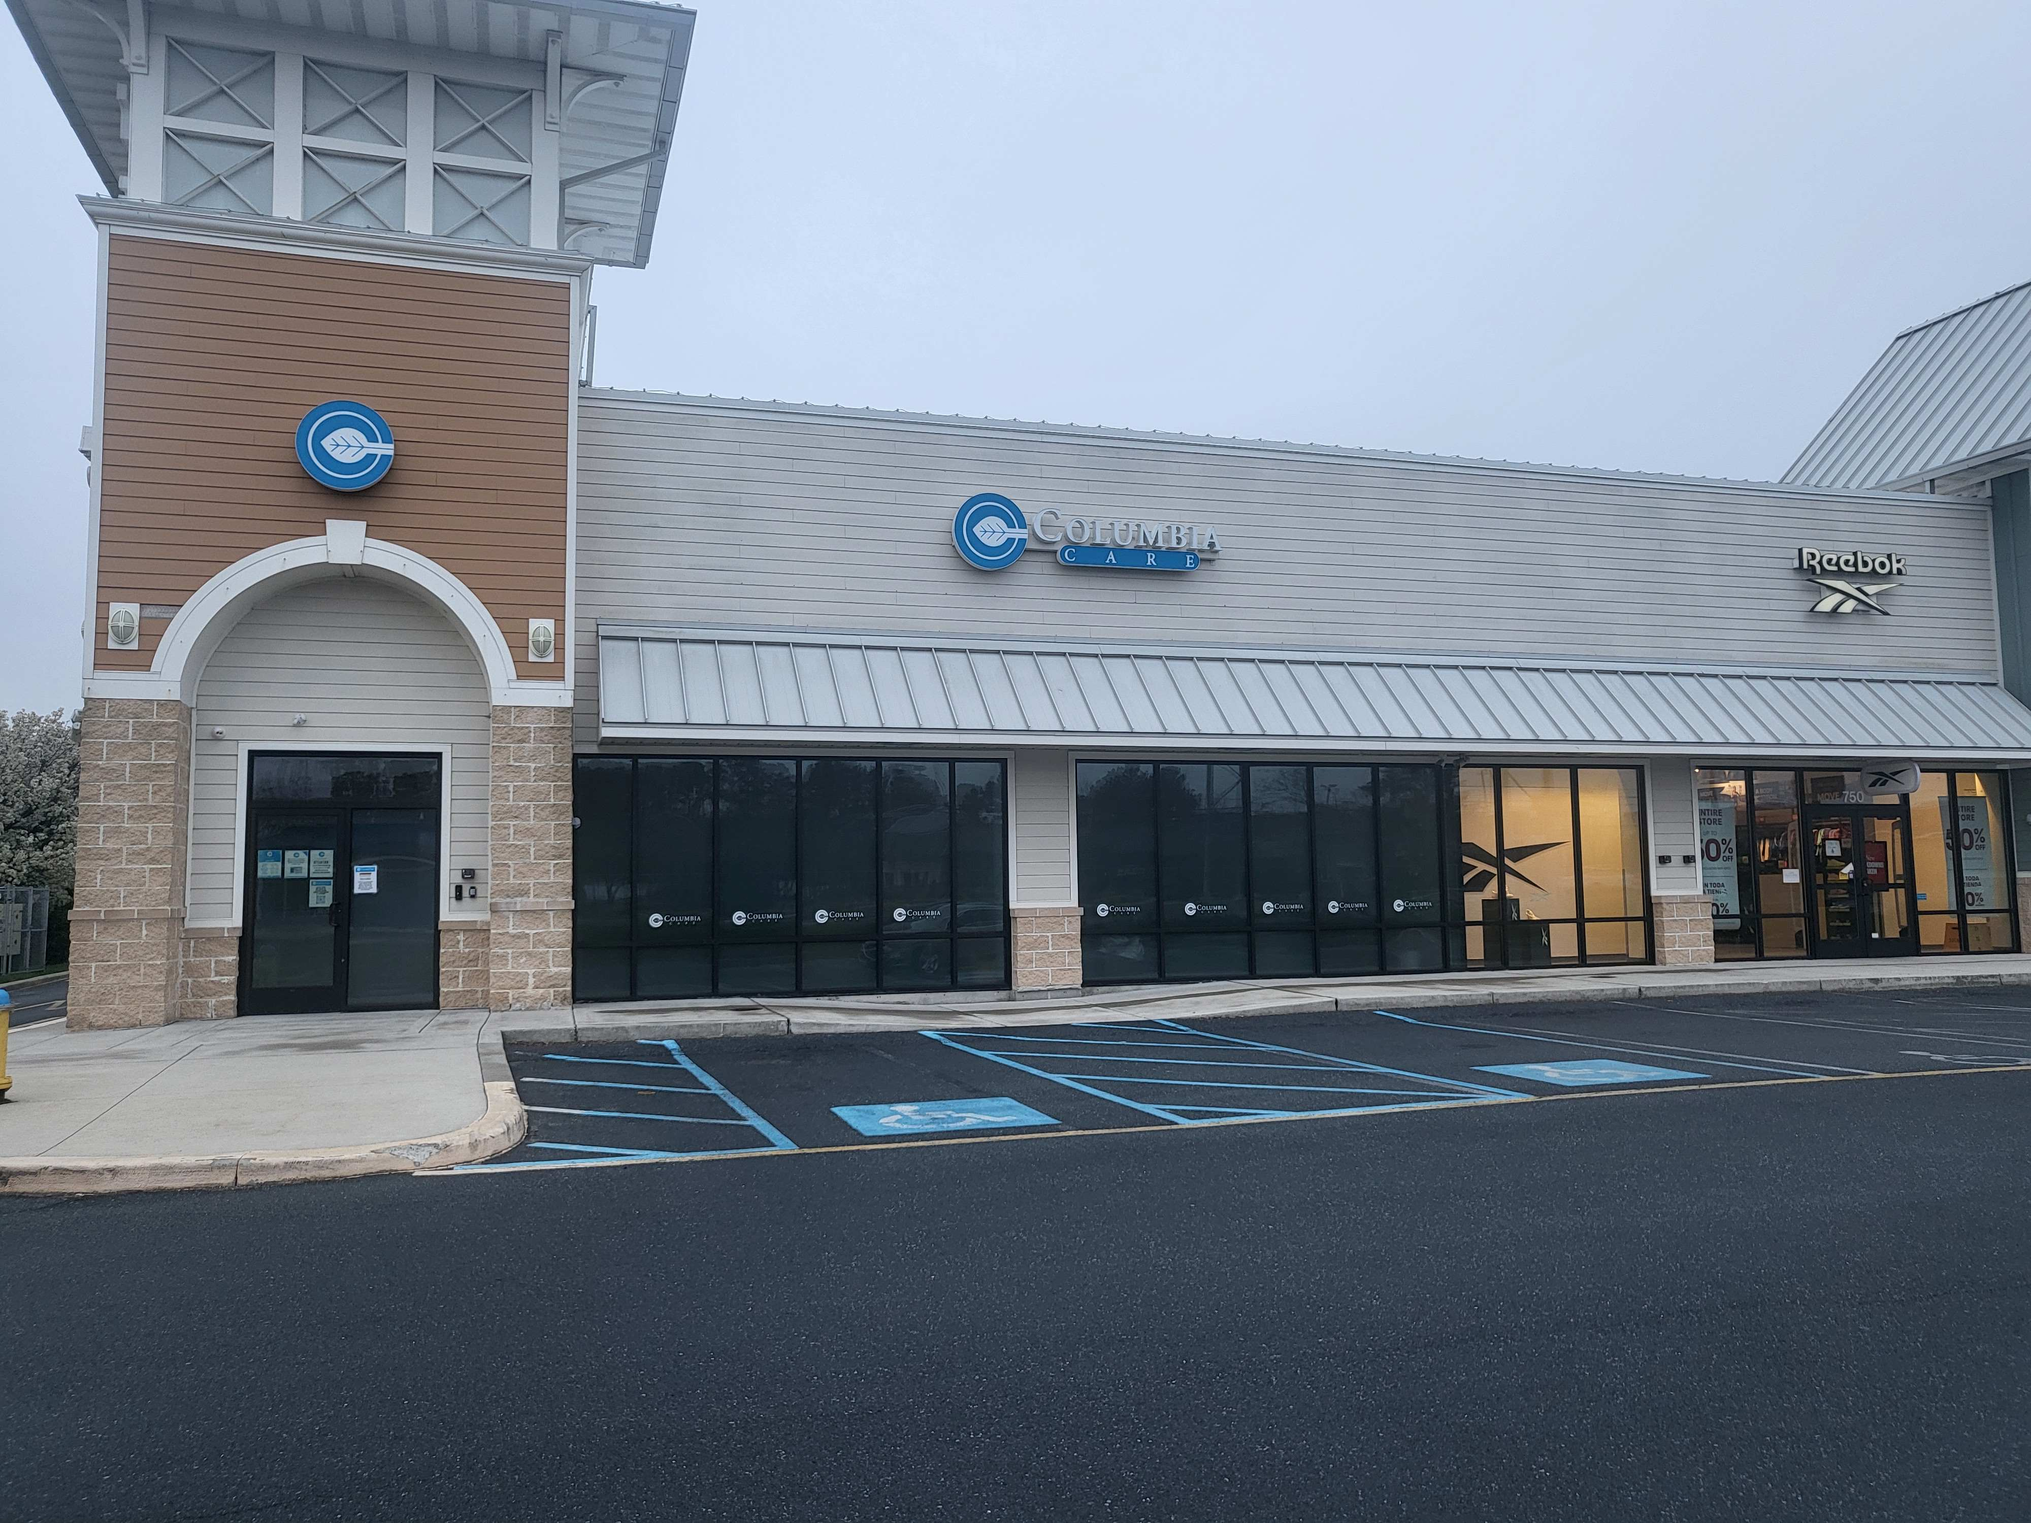
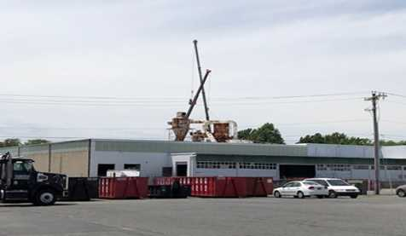
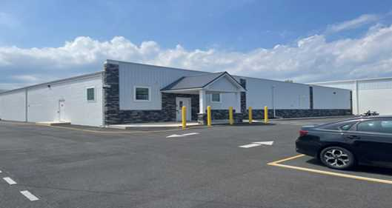
Not in My Town
§ 1351 Local control - A municipality may prohibit the operation of …
Marijuana Use is Legal – it can be used in your jurisdiction
Does the illegal market currently supply marijuana users?
Improving Blighted Areas? Industrial areas?
Medical Card Holders – how many are in your town or jurisdiction?
Will persons with disabilities benefit from having a dispensary nearby?
Would your town benefit from the employment opportunities?
Opportunities for the construction trades and other businesses?
Notes:
-(a) A municipality may prohibit the operation of marijuana cultivation facilities, marijuana product manufacturing facilities, marijuana testing facilities, or retail marijuana stores through the enactment of an ordinance or through an initiated or referred measure.
(b) A municipality or county may enact ordinances or regulations that are not in conflict with this chapter or in conflict with regulations enacted by the Commissioner, governing the time, place, manner, and number of marijuana establishment operations. A municipality or county may establish civil penalties for violation of an ordinance or regulations governing the time, place, and manner that a marijuana establishment may operate in such municipality or county.

Slide 24
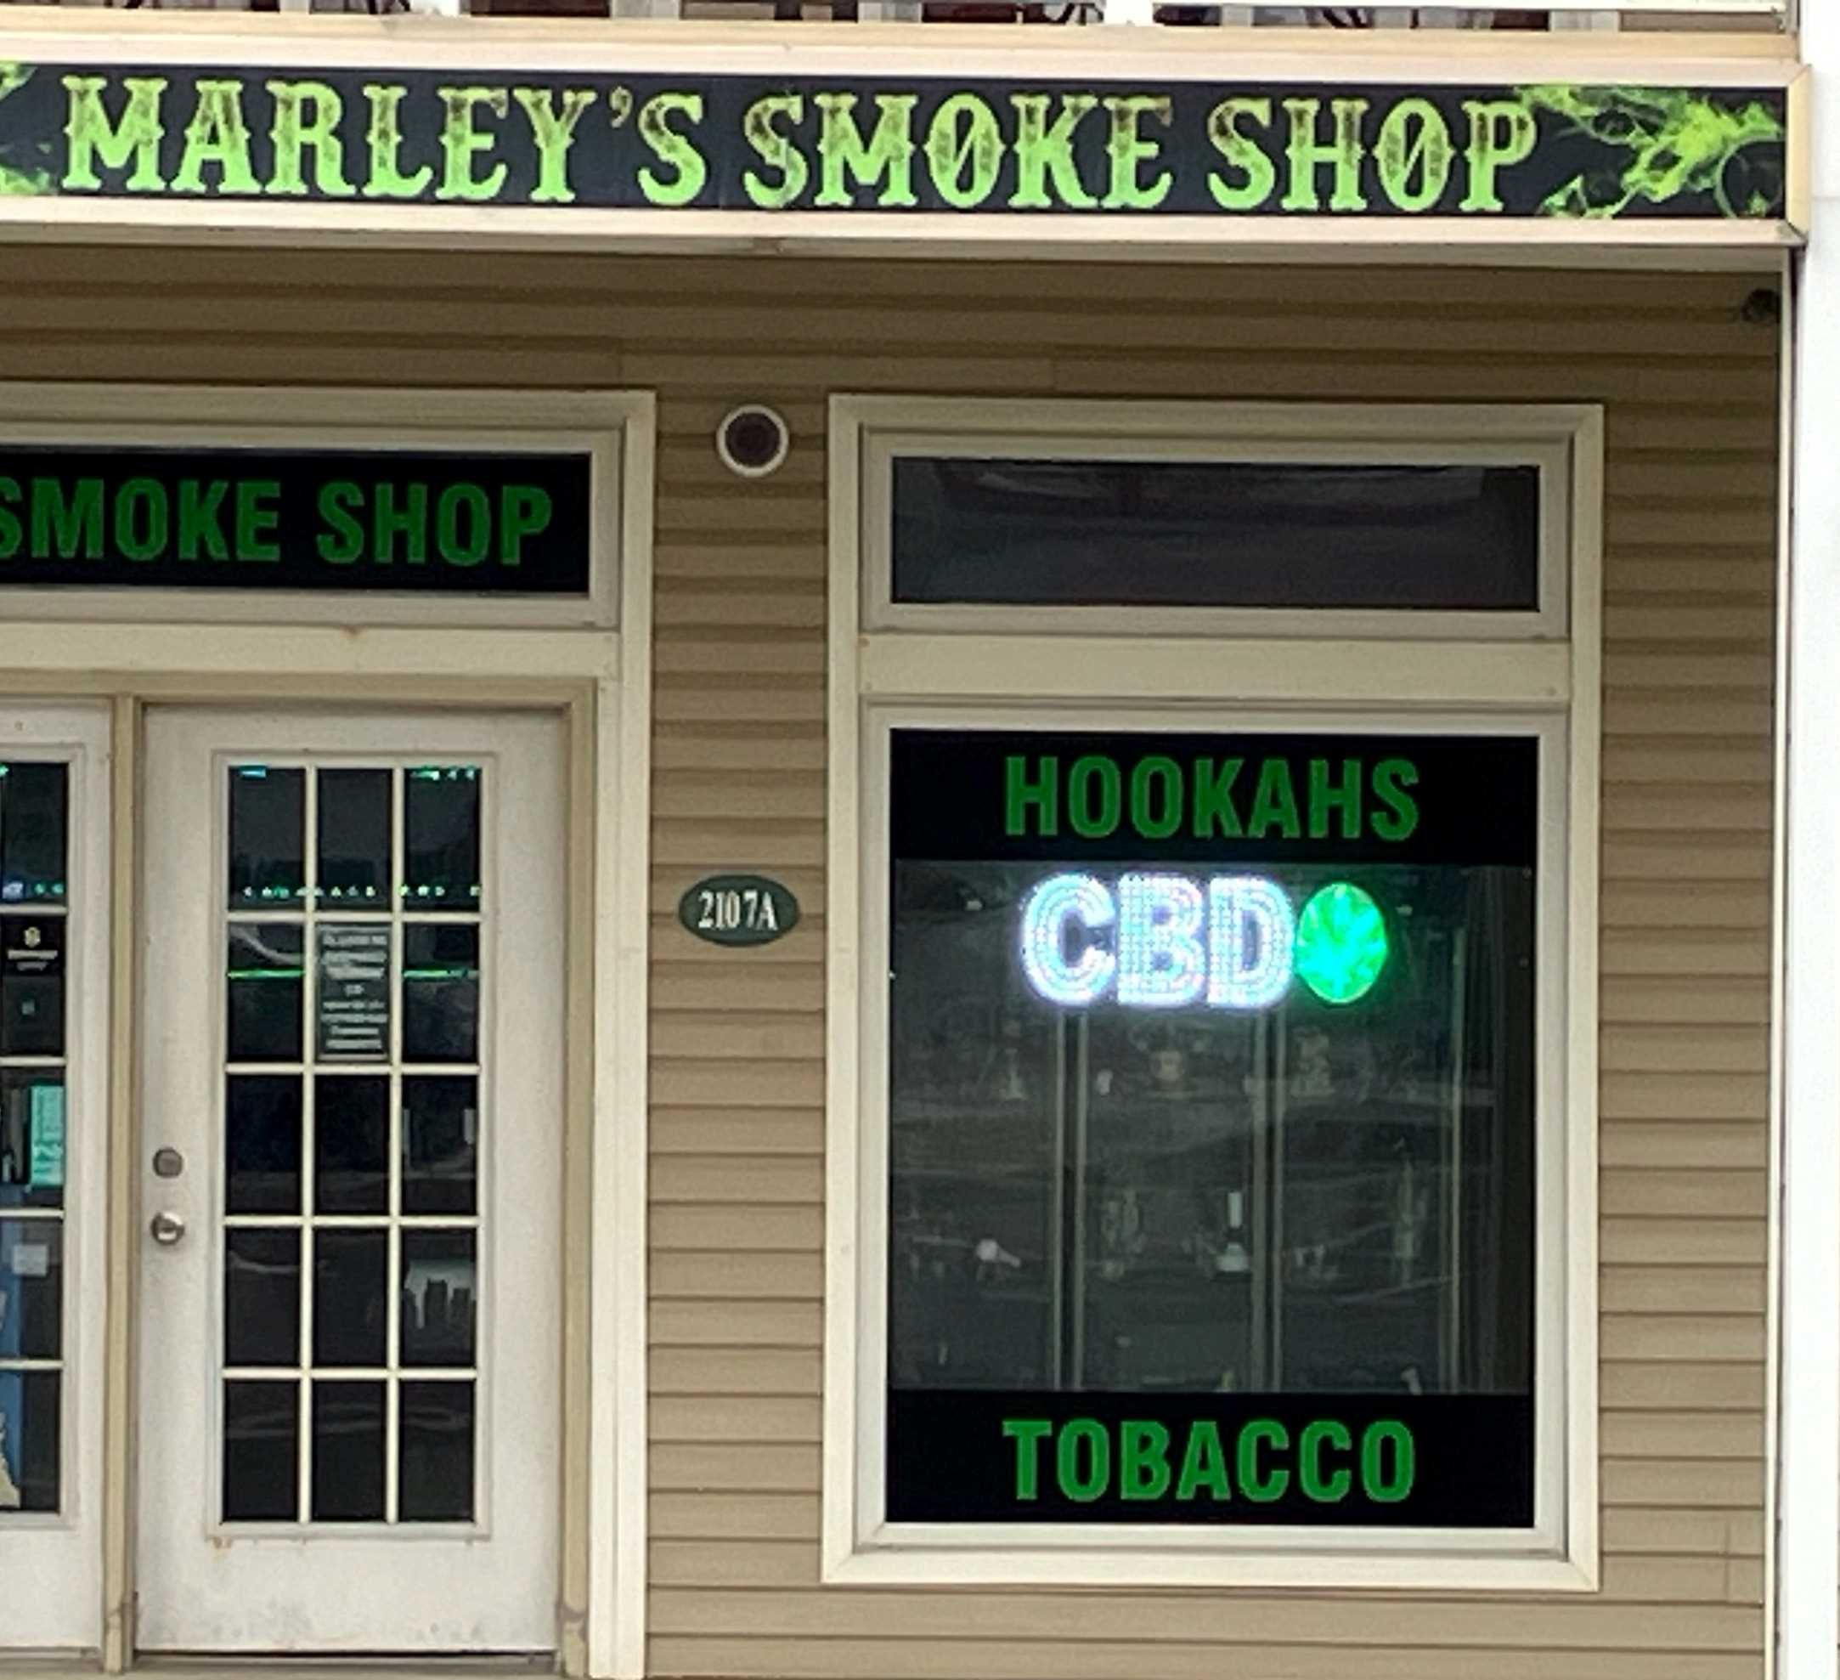
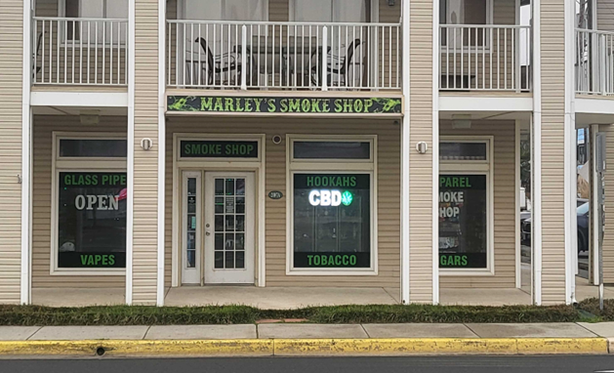

What’s in My Town?
Keep an eye on this developing “gray market”
Hemp based THC infused products
2018 Farm Bill unintentionally created this market
Unregulated after cultivation
Intoxicating hemp products
0.3% THC limit
delta 8 THC synthesized from CBD
CBD + acid + heat = delta-8 THC
Congress working on a new 5-year authorization…
Notes:
Source Turning Point of Tampa Delta 8 v. Delta 9 THC 8/10/2023

Slide 25
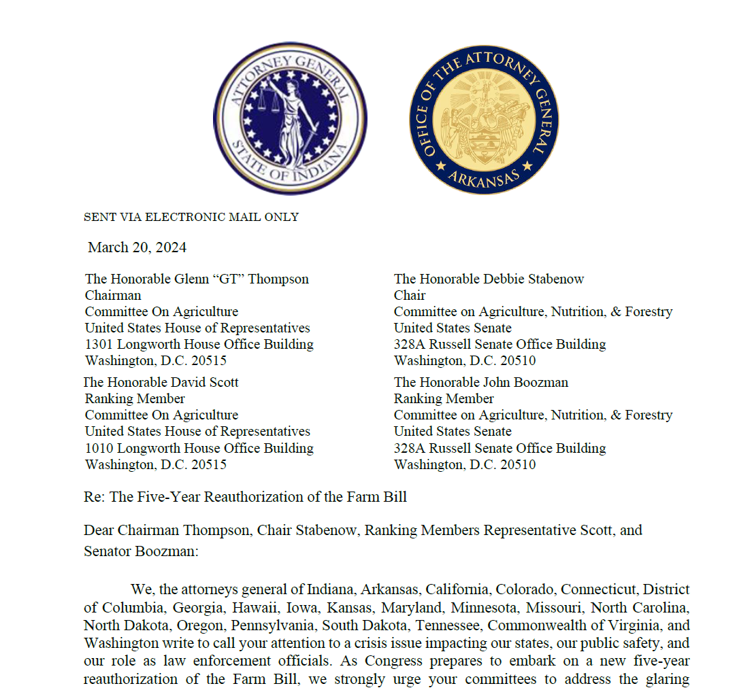
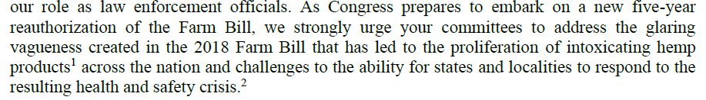
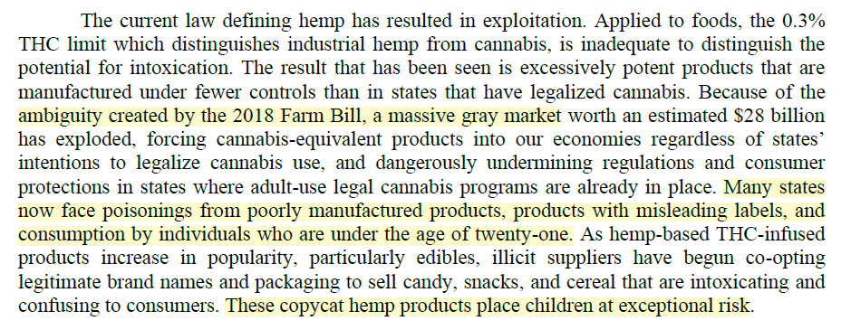
The Gray Market

Slide 26
Rescheduling of Marijuana
The benefits to the marijuana industry if marijuana is rescheduled from Schedule I to Schedule III.
Marijuana businesses are subject to the federal tax code Section 280E, which prohibits them from taking most tax deductions. If Schedule III would not be limited by 280E.
Increased access to research. Marijuana is currently classified as a Schedule I drug; this has made it very difficult for researchers to study the plant and its potential medical benefits.
Unknown if it would help with banking challenges
Rescheduling marijuana to Schedule III would not legalize it federally for recreational use.
Congressional Research Service Sept. 13,2023
Notes:
Department of Health and Human Services Recommendation to Reschedule Marijuana: Implications for Federal Policy (congress.gov) Congressional Research Service Sept. 13,2023

Slide 27
Legislative Requests – Technical Fixes and New Legislation
HB 334 - Legislative Technical Fixes
License process
Application → Lottery → Selected Applicant → Conditional license → Active license
Social Equity and Micro Business Residency Requirements Challenged
Dormant Commerce Clause
New Legislation
HB 408 Conversion License for existing OMM License Holders
(Pending) Merging the Office of Medical Marijuana (OMM) into the OMC
Watching:
HB285 makes modifications to current OMM program – passed on 3/28/24 now to the OGOV
HB355 provides reassurance to banking industry working with state regulated marijuana industry

Slide 28
Budget Projections
Application Fees Revenue starting in FY25 2nd Quarter
125 licenses estimating 2 applicants per license potential $ 754,000
License Fees Revenue starting in FY25 2nd and 3rd Quarters
125 licenses potential total if all licenses issued $ 758,000
Conversion Fees Revenue starting in FY25 1st and 2nd Quarters (If Legislation passed)
25 converted licenses if all existing OMM licenses are converted could generate $1.15 Million to $5 Million depending on assessment formula used by the State (OMC)
Projection – Sales and Tax Revenue starting in FY25 3rd Quarter and first full year will be FY26
Current Medical Marijuana Program – 17,000 patients spend average of $3, 303 per year on marijuana products
Projected adult use recreational market – 85,000 customers annual sales would be approximately $281 Million in sales
Potential Tax Revenue of $42 Million (generated by 15% sales tax)
FY25 1st Qtr. – July, Aug, Sep
FY25 2nd Qtr. – Oct, Nov, Dec
FY25 3rd Qtr. – Jan, Feb, Mar
FY25 4th Qtr. – Apr, May, Jun

Slide 29


Questions
Commissioner Rob Coupe
Deputy Commissioner Paul Hyland
Keila Montalvo, Community Relations Officer
Taylor Shannon, Administrative Specialist II
DAG Adria Martinelli, Legal Counsel
Website OMC.Delaware.gov
Also on Facebook, Instagram and X

Slide 30
Local Government Reference Slides Follow.
If needed.

Slide 31
My Town & The OMC
§ 1354 Grounds for refusal of license; transfer or extension of premises.
(a) The Commissioner may not grant a license under this chapter in any county or subdivision thereof, if granting a license is contrary to the law of any municipality or county adopted under § 1351 of this title.
(b) The Commissioner may refuse to license an applicant if the Commissioner has substantial evidence that would reasonably support a belief that any of the following apply:
(1) There are sufficient licensed premises in the municipality or county, or the granting of a license in the municipality or county stated in the application is not otherwise demanded by public interest or convenience.
(d) The Commissioner may refuse to grant a license to sell marijuana, marijuana products, or marijuana accessories to any new establishment to be located in the vicinity of a church, school, college or substance abuse treatment facility as defined under § 2203 of Title 16...
(e) The Commissioner shall refuse to grant a license for the sale of marijuana, marijuana products, or marijuana accessories when there is an existing licensed establishment of the same type within 1200 feet by accessible public road or street in any incorporated city or town, or within 1 mile by accessible public road or street in any unincorporated or rural area. …

Slide 32
My Town & The OMC
§ 1354 Grounds for refusal of license (cont’d)
(g) The Commissioner may not grant a new license of any type and may not grant an extension of premises of an existing license of any type unless the application for said new license or for said extension is accompanied by a certificate of compliance from the appropriate political subdivision showing all of the following:
(1) That the premises where the license is to be used are properly zoned for the applicant’s intended use.
(2) That all necessary permits have been approved.
(3) That the applicant has complied with all other applicable licensing requirements of the appropriate political subdivision.
(h) Subsection (g) of this section does not apply to any application for a temporary extension of premises as authorized by Commissioner rule if such application has not been objected to by the appropriate political subdivision and the political subdivision was provided with notice of the application by the applicant within 7 days of the date the application is filed with the Commissioner.

