Slide 1
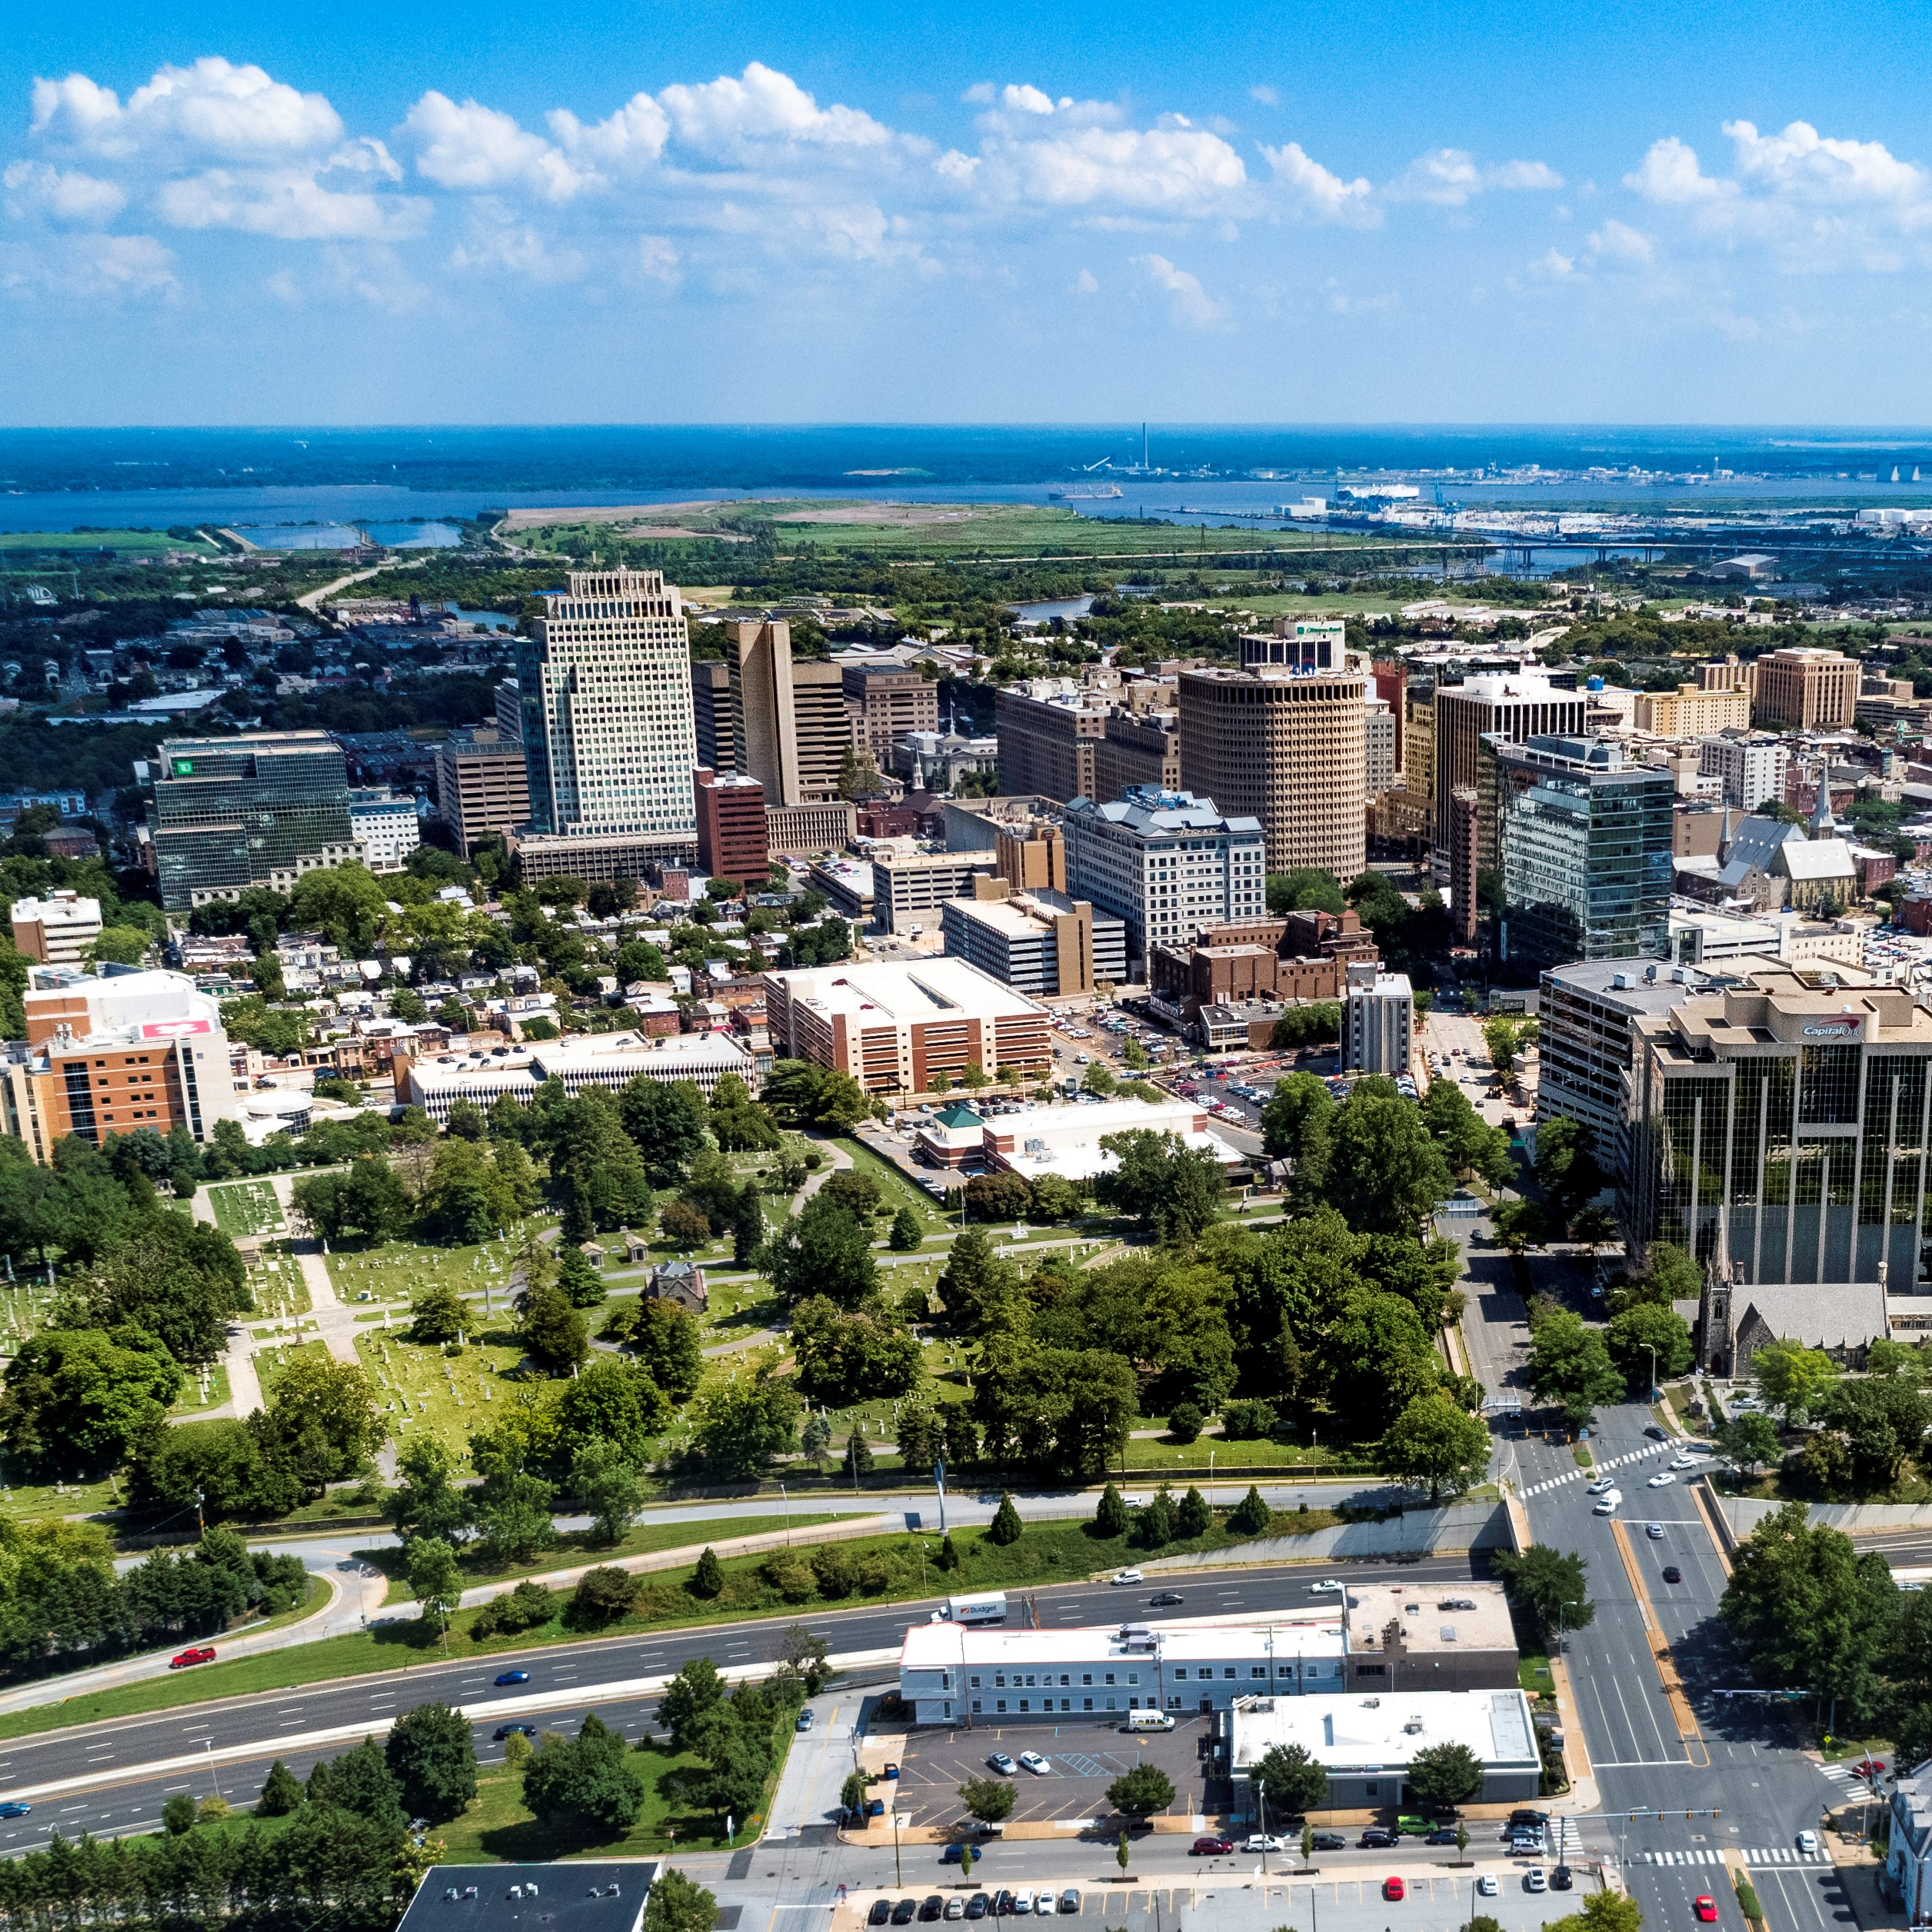
City of Wilmington ARPA Spending by Category
May 2023

Slide 2
Summary by Category
Summary Allocated by Category
Category | Budget | Total Allocated for Projects | Unallocated
Administrative Costs | $2,311,453 | $2,311,453 | $0
Building Safer Communities | $9,103,076 | $9,103,076 | $0
Community Investment | $4,842,667 | $4,842,667 | $0
Essential Pay for Essential Work | $2,664,318 | $2,664,318 | $0
Neighborhood Revitalization | $22,000,000 | $22,000,000 | $0
Revenue Replacement | $12,000,000 | $12,000,000 | $0
Workforce Development | $2,424,240 | $2,424,240 | $0
Total: | $55,345,779 | $55,345,779 | $0

Slide 3
Major Category Budget Changes
Major Category Budget Changes:
Building Safer Communities
The Community Public Safety Budget has been updated through CY 2026, including the following amounts:
  $450k each for Network Connect, CSE and YAP per year – total of $5.6 million (funds will be passed through United Way)
  $105k total for small organizations (funds will be passed through United Way)
  $150k per year for Program Coordinator – total of $600k
  $100k per year for WCAC Public Safety Roundtables – total of $400k
These changes result in an $1.1 million increase to the Building Safer Communities category
Administrative Costs
Budget for UHY Advisors has been increased to $300k per year to allow for an additional compliance specialist
This results in a $580k increase to the Admin Expenses category
Workforce Development
Category budget has been decreased from $4 million to $2.4 million to cover increases in Building Safer Communities and Admin Costs

Slide 4
New Projects
New Projects
Category | Project | Amount Allocated for Project | Amount Spent in Project | Project Balance
Building Safer Communities | Community Public Safety Initiative: WCAC Roundtables | $400,000 | $0 | $400,000
Building Safer Communities | Advantech – Automatic License Plate Recognition Cameras (contract in process) | $100,000 | $0 | $100,000
Neighborhood Revitalization | Central Baptist CDC (contract in process) | $2,820,000 | $0 | $2,820,000
Neighborhood Revitalization | CityFest – Urban Artist Exchange Amphitheater Construction | $50,000 | $0 | $50,000
Workforce Development | CityFest – Urban Artist Exchange Artist Teen Apprenticeship Program | $75,000 | $0 | $75,000
 | Total: | $3,345,000 | $0 | $3,345,000

Slide 5
Administrative Costs $2,311,453
ARPA Spending Category | Total Budget | Total Allocated for Projects | Total Unallocated
Administrative Costs | $2,311,453 | $2,311,453 | $0
Project Detail | Amount Allocated for Project | Amount Spent in Project | Project Balance
Administrative Expenses | $61,112 | $61,112 | $0
Disparity Study (Miller3) | $290,200 | $274,625 | $15,575
Disadvantaged Business Enterprise Analysis (Pope Consulting) | $60,000 | $50,600 | $9,400
Compliance (UHY Advisors Mid-Atlantic MD, Inc.) | $1,080,000 | $186,666 | $893,334
COVID-related Expenditures | $32,000 | $28,479 | $3,521
Construction Project Management (EDiS) | $264,167 | $264,167 | $0
Construction Project Management (Allied Construction) | $524,000 | $60,038 | $463,962

Slide 6
Building Safer Communities $9.1 million
ARPA Spending Category | Total Budget | Total Allocated for Projects | Total Unallocated
Building Safer Communities | $9,103,076 | $9,103,076 | $0
Project Detail | Amount Allocated for Project | Amount Spent in Project | Project Balance
WCAC/CSE/United Way - Community Violence Prevention Initiative | $500,000 | $83,000 | $417,000
DE DOJ - Violence Reduction Program | $90,000 | $19,698 | $70,302
Eastside Neighborhood Camera Initiative & Maintenance (Contract in Process) | $1,300,000 | $0 | $1,300,000
Community Public Safety Initiative: The Community Based Public Safety Collective | $400,000 | $100,000 | $300,000
Community Public Safety Initiative: United Way of Delaware - Fiscal Agent | $5,674,591 | $618,000 | $5,056,591
Community Public Safety Initiative: Debra Mason - Coordinator | $600,000 | $150,000 | $450,000
Community Public Safety Initiative: Apricot 360 Software | $38,484 | $38,484 | $0
Community Public Safety Initiative: WCAC Roundtables* | $400,000 | $0 | $400,000
Advantech – Automatic License Plate Recognition Cameras* (contract in process) | $100,000 | $0 | $100,000
*New project

Slide 7
Community Investment $4.8 million
ARPA Spending Category | Total Budget | Total Allocated for Projects | Total Unallocated
Community Investment | $4,842,667 | $4,842,667 | $0
Project Detail | Amount Allocated for Project | Amount Spent in Project | Project Balance
United Way of DE - Learning Pods | $150,000 | $150,000 | $0
Milk & Honey LLC | $25,000 | $25,000 | $0
Parking Garage Assistance | $500,000 | $500,000 | $0
DE Zoological Society | $150,000 | $150,000 | $0
Faithful Friends | $95,000 | $95,000 | $0
The Grand | $100,000 | $0 | $100,000
Reed's Refuge | $300,000 | $255,113 | $44,887
Latin American Community Center | $500,000 | $500,000 | $0
Culture Restoration Project | $150,000 | $18,723 | $131,277
Utility Payment Assistance Program | $300,000 | $300,000 | $0
The Juice Joint | $20,000 | $20,000 | $0
The Nomad | $41,000 | $41,000 | $0
Our Youth, Inc. | $30,000 | $30,000 | $0
St. Michael's School and Nursery | $100,000 | $100,000 | $0
NERDit Now | $200,000 | $200,000 | $0
Christina Cultural Arts Center | $500,000 | $1,950 | $498,050
The Challenge Program | $100,000 | $100,000 | $0
Central YMCA | $150,000 | $0 | $150,000
Delaware Children's Museum | $150,000 | $0 | $150,000
HBCU Week | $150,000 | $150,000 | $0
Jefferson Street Center | $150,000 | $50,000 | $100,000
Books and Bagels, LLC | $12,000 | $12,000 | $0
Dun Rite Cleaners | $12,000 | $12,000 | $0
Oath 84 | $40,000 | $40,000 | $0
It's Time - Tapp Networks | $230,667 | $144,167 | $86,500
It's Time - Venue Communications | $36,000 | $18,000 | $18,000
St. Francis Hospital | $100,000 | $100,000 | $0
I am My Sister's Keeper | $296,000 | $155,974 | $140,026
WCAC - Affordable Connectivity Program | $90,000 | $30,000 | $60,000
Apexx Bar & Restaurant | $40,000 | $0 | $40,000
St. Patrick's Center | $25,000 | $0 | $25,000
Go Make a Difference Corporation (Go MAD) | $100,000 | $0 | $100,000

Slide 8
Neighborhood Revitalization $22 million
ARPA Spending Category | Total Budget | Total Allocated for Projects | Total Unallocated
Neighborhood Revitalization | $22,000,000 | $22,000,000 | $0
Project Detail | Amount Allocated for Project | Amount Spent in Project | Project Balance
Habitat for Humanity - A Brush with Kindness | $2,000,000 | $1,044,080 | $955,920
Land Bank - Eastside | $3,922,200 | $3,407,433 | $514,767
Land Bank - Hilltop | $1,000,000 | $872,294 | $127,706
REACH Riverside | $1,000,000 | $1,000,000 | $0
Eastside Housing Partners, LLC | $100,000 | $100,000 | $0
DE Affordable Housing Group (WHA) | $318,955 | $179,520 | $139,435
Cornerstone West | $1,450,000 | $427,766 | $1,022,234
Todmorden Foundation | $1,000,000 | $0 | $1,000,000
Woodlawn Trustees | $2,000,000 | $400,000 | $1,600,000
Habitat for Humanity - Bennett Street Housing Construction | $2,000,000 | $10,607 | $1,989,393
WEDCO Revolving Loan Program | $2,000,000 | $2,000,000 | $0
Richard Dyton - Neighborhood Liaison | $42,000 | $21,000 | $21,000
Southbridge CDC | $250,000 | $5,833 | $244,167
RL Construction - Alleyway Cleanup Contract | $105,000 | $105,000 | $0
DE Affordable Housing Group - McMullen Square | $595,000 | $0 | $595,000
DE Affordable Housing Group - Bennett Street | $210,000 | $0 | $210,000
Pipeline – Strategic Acquisition | $1,136,845 | $0 | $1,136,845
Central Baptist CDC* | $2,820,000 | $0 | $2,820,000
CityFest – Urban Artists Exchange Amphitheater Construction* | $50,000 | $0 | $50,000
*New project

Slide 9
Workforce Development$2.4 million
ARPA Spending Category | Total Budget | Total Allocated for Projects | Total Unallocated
Workforce Development | $2,424,240 | $2,424,240 | $0
Project Detail | Amount Allocated for Project | Amount Spent in Project | Project Balance
NCC Vo-Tech School District | $1,821,443 | $267,234 | $1,554,209
Delaware Art Museum | $150,000 | $0 | $150,000
DETV | $250,000 | $62,500 | $187,500
Hilltop Lutheran Neighborhood Center | $70,000 | $0 | $70,000
HOPE Commission – Women’s Reentry Program | $75,000 | $0 | $75,000
CityFest – Urban Artists Exchange Teen Apprenticeship Program* | $75,000 | $0 | $75,000
*New project

Slide 10
Other Categories
Revenue Replacement: $12 million
Essential Pay for Essential Workers: $2,664,318

