Slide 1
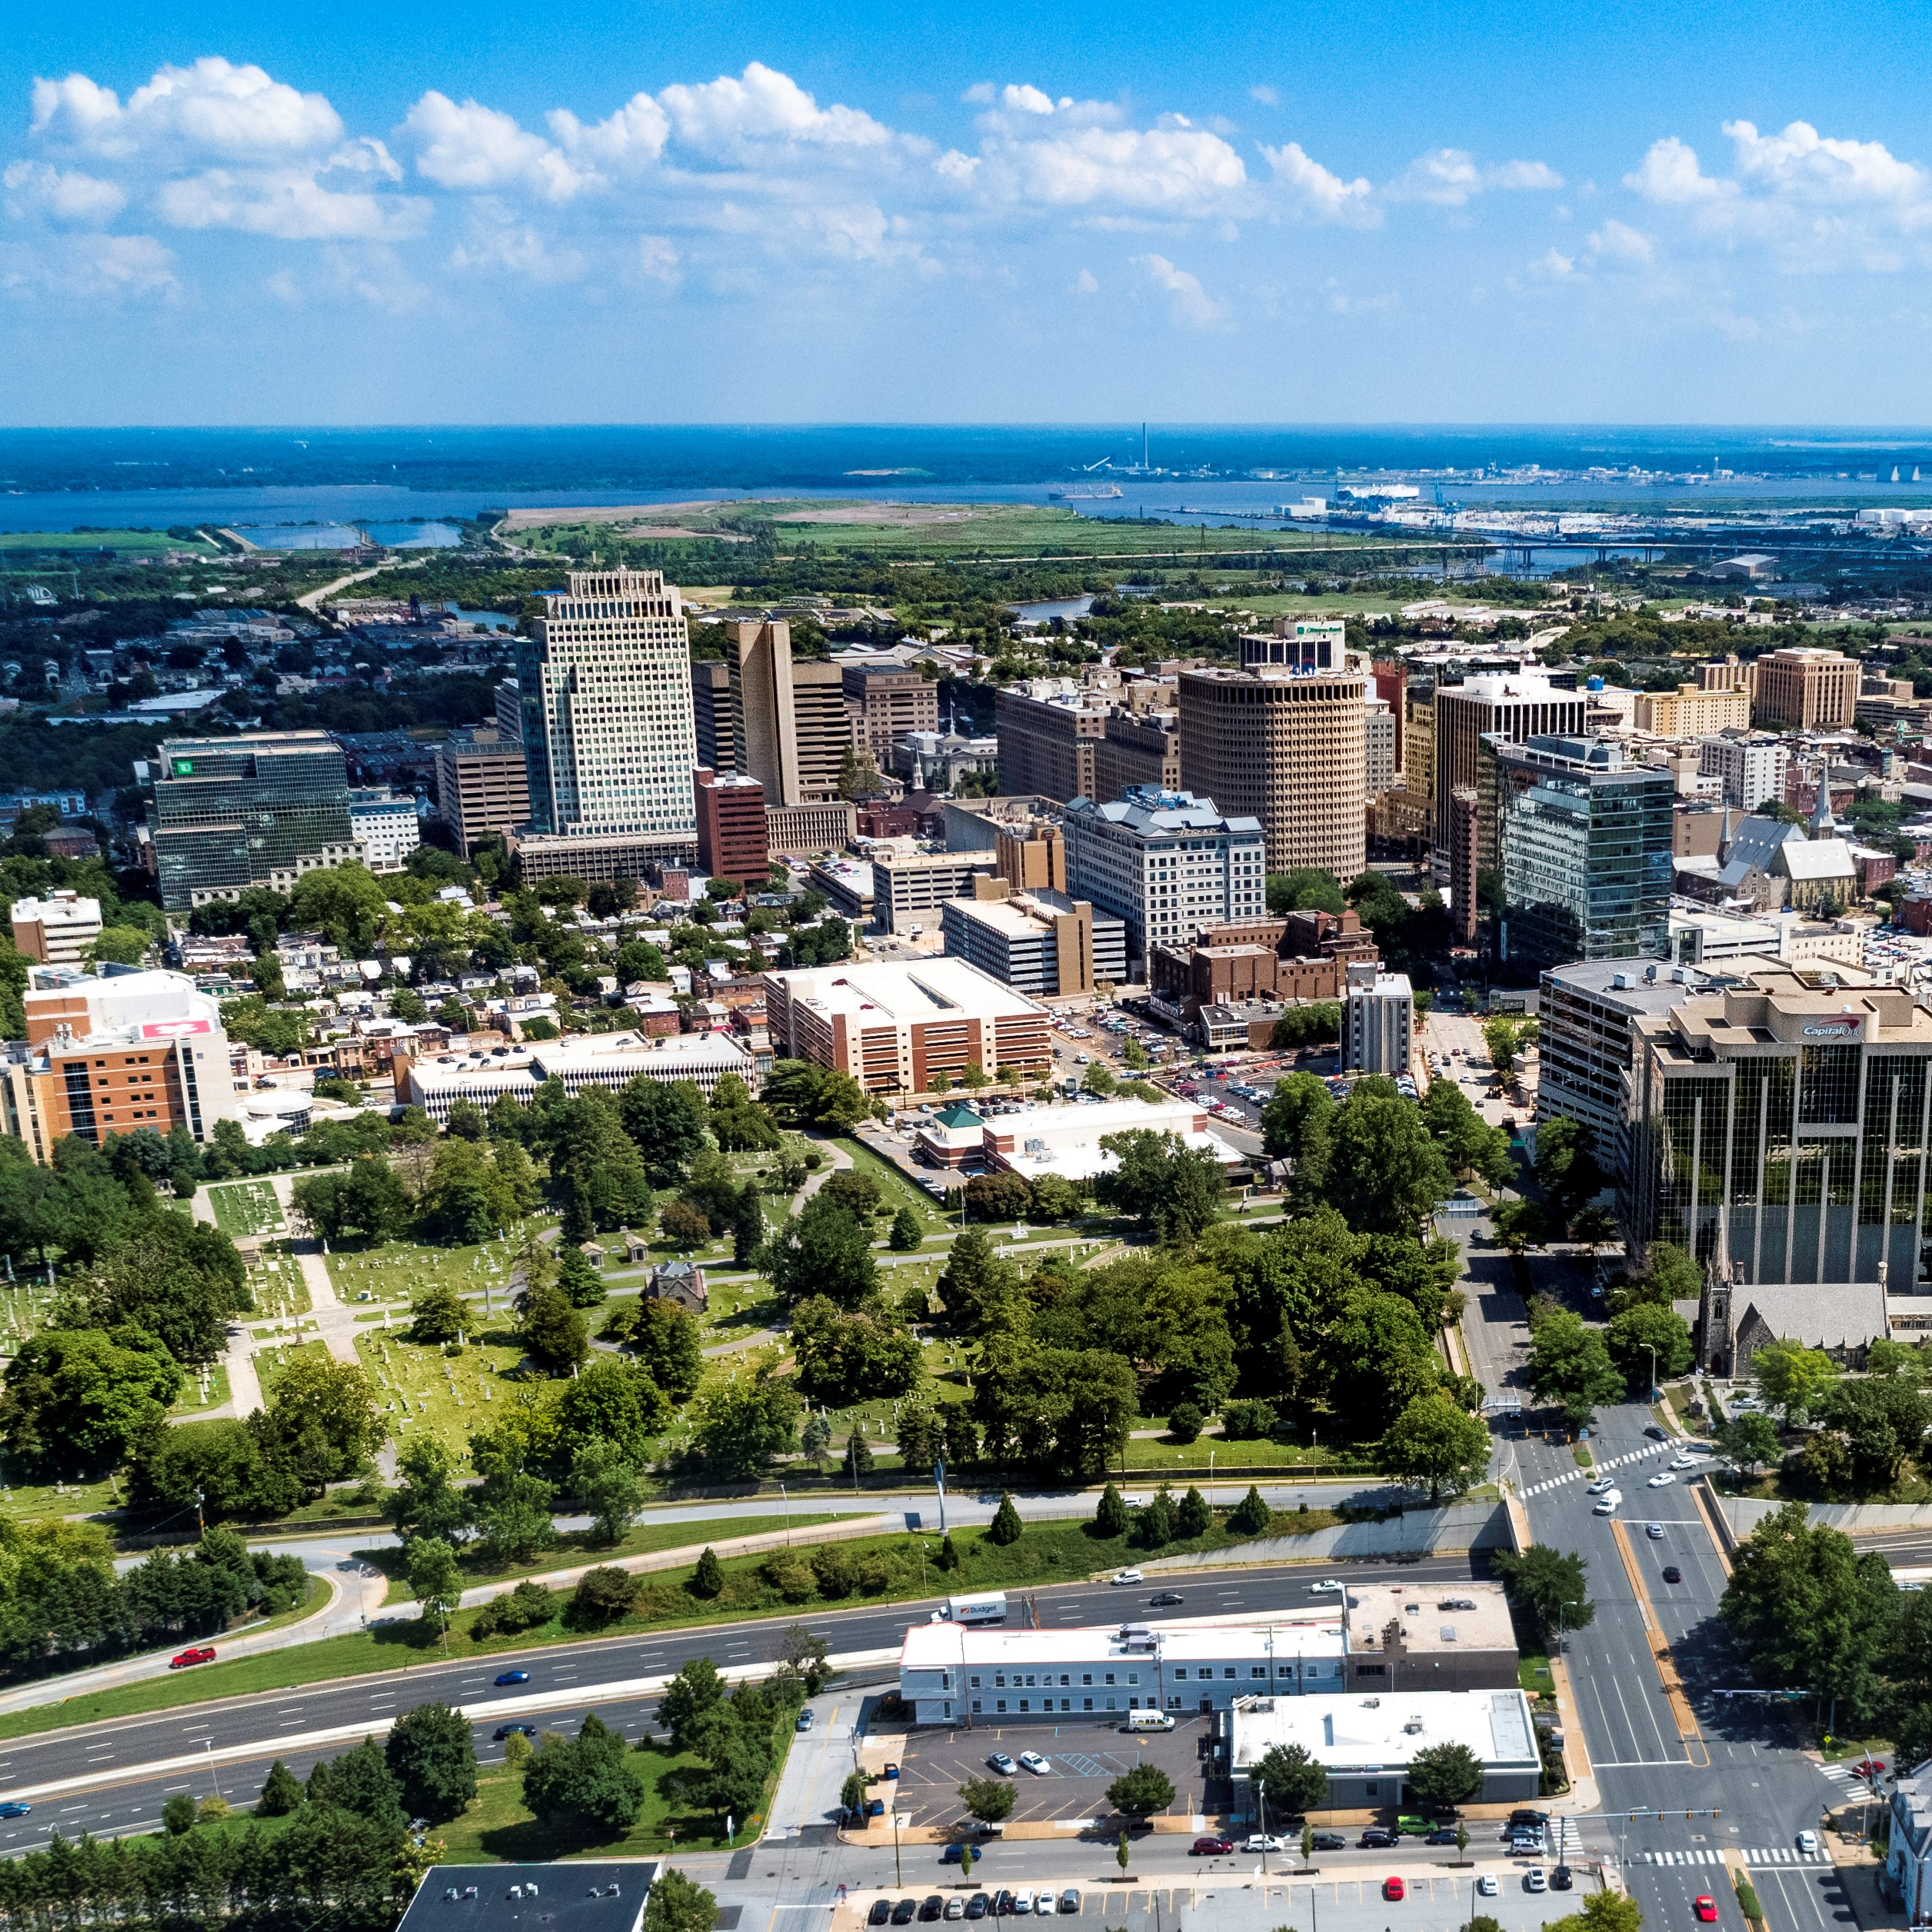
City of Wilmington ARPA Spending by Category
September 2023

Slide 2
Summary by Category
Summary Allocated by Category
Category | Budget | Total Allocated for Projects | Unallocated
Administrative Costs | $2,311,486 | $2,311,486 | $0
Building Safer Communities | $8,263,962 | $8,263,962 | $0
Community Investment | $4,842,667 | $4,842,667 | $0
Essential Pay for Essential Work | $2,664,318 | $2,664,318 | $0
Neighborhood Revitalization | $22,588,062 | $22,588,062 | $0
Revenue Replacement | $12,000,000 | $12,000,000 | $0
Workforce Development | $2,490,314 | $2,490,314 | $0
Total: | $55,345,779 | $55,345,779 | $0

Slide 3
Changes Since May 2023
Changes Since May 2023:
We determined that we were overbudgeting for the outyears of the Community Public Safety Initiative by about $1.35 million
Those funds were reallocated to the following areas:
  Neighborhood Camera Initiative: $286k
  Outyear budget for Apricot case management software: $115k
  Land Bank: $900k
  NCC Vo-Tech “Wilmington’s Future Builders Program”: $60k

Slide 4
Administrative Costs $2,311,486
ARPA Spending Category | Total Budget | Total Allocated for Projects | Total Unallocated
Administrative Costs | $2,311,486 | $2,311,486 | $0
Project Detail | Amount Allocated for Project | Amount Spent in Project | Project Balance
Administrative Expenses | $61,112 | $61,112 | $0
Disparity Study (Miller3) | $290,200 | $274,625 | $15,575
Disadvantaged Business Enterprise Analysis (Pope Consulting) | $60,000 | $57,000 | $3,000
Compliance (UHY Advisors Mid-Atlantic MD, Inc.) | $1,080,000 | $286,666 | $793,334
COVID-related Expenditures | $32,000 | $32,000 | $3,521
Construction Project Management (EDiS) | $264,167 | $264,167 | $0
Construction Project Management (Allied Construction) | $524,000 | $103,702 | $420,298

Slide 5
Building Safer Communities $8.3 million
ARPA Spending Category | Total Budget | Total Allocated for Projects | Total Unallocated
Building Safer Communities | $8,263,962 | $8,263,962 | $0
Project Detail | Amount Allocated for Project | Amount Spent in Project | Project Balance
WCAC/CSE/United Way - Community Violence Prevention Initiative | $500,000 | $436,571 | $63,429
DE DOJ - Violence Reduction Program | $90,000 | $19,698 | $70,302
Eastside Neighborhood Camera Initiative & Maintenance (Contract in Process) | $1,586,424 | $0 | $1,586,424
Community Public Safety Initiative: The Community Based Public Safety Collective | $400,000 | $233,333 | $166,667
Community Public Safety Initiative: United Way of Delaware - Fiscal Agent | $4,289,298 | $930,540 | $3,358,758
Community Public Safety Initiative: Debra Mason - Coordinator | $600,000 | $150,000 | $450,000
Community Public Safety Initiative: Apricot 360 Software | $153,240 | $38,484 | $114,756
Community Public Safety Initiative: WCAC Roundtables | $400,000 | $100,000 | $300,000
Advantech – Automatic License Plate Recognition Cameras (contract in process) | $100,000 | $0 | $100,000

Slide 6
Community Investment $4.8 million
ARPA Spending Category | Total Budget | Total Allocated for Projects | Total Unallocated
Community Investment | $4,842,667 | $4,842,667 | $0
Project Detail | Amount Allocated for Project | Amount Spent in Project | Project Balance
United Way of DE - Learning Pods | $150,000 | $150,000 | $0
Milk & Honey LLC | $25,000 | $25,000 | $0
Parking Garage Assistance | $500,000 | $500,000 | $0
DE Zoological Society | $150,000 | $150,000 | $0
Faithful Friends | $95,000 | $95,000 | $0
The Grand | $100,000 | $0 | $100,000
Reed's Refuge | $300,000 | $255,113 | $44,887
Latin American Community Center | $500,000 | $500,000 | $0
Culture Restoration Project | $150,000 | $31,331 | $118,669
Utility Payment Assistance Program | $300,000 | $300,000 | $0
The Juice Joint | $20,000 | $20,000 | $0
The Nomad | $41,000 | $41,000 | $0
Our Youth, Inc. | $30,000 | $30,000 | $0
St. Michael's School and Nursery | $100,000 | $100,000 | $0
NERDit Now | $200,000 | $200,000 | $0
Christina Cultural Arts Center | $500,000 | $83,175 | $416,825
The Challenge Program | $100,000 | $100,000 | $0
Central YMCA | $150,000 | $146,270 | $3,730
Delaware Children's Museum | $150,000 | $20,154 | $129,846
HBCU Week | $150,000 | $150,000 | $0
Jefferson Street Center | $150,000 | $50,000 | $100,000
Books and Bagels, LLC | $12,000 | $12,000 | $0
Dun Rite Cleaners | $12,000 | $12,000 | $0
Oath 84 | $40,000 | $40,000 | $0
It's Time - Tapp Networks | $230,667 | $230,667 | $0
It's Time - Venue Communications | $36,000 | $36,000 | $0
St. Francis Hospital | $100,000 | $100,000 | $0
I am My Sister's Keeper | $296,000 | $256,832 | $39,168
WCAC - Affordable Connectivity Program | $90,000 | $72,000 | $18,000
Apexx Bar & Restaurant | $40,000 | $40,000 | $0
St. Patrick's Center | $25,000 | $6,784 | $18,216
Go Make a Difference Corporation (Go MAD) | $100,000 | $50,000 | $50,000

Slide 7
Neighborhood Revitalization $22.3 million
ARPA Spending Category | Total Budget | Total Allocated for Projects | Total Unallocated
Neighborhood Revitalization | $22,337,358 | $22,337,358 | $0
Project Detail | Amount Allocated for Project | Amount Spent in Project | Project Balance
Habitat for Humanity - A Brush with Kindness | $2,000,000 | $1,817,519 | $182,481
Land Bank - Eastside | $5,216,200 | $4,784,396 | $431,804
Land Bank - Hilltop | $1,000,000 | $1,000,000 | $0
REACH Riverside | $1,000,000 | $1,000,000 | $0
Eastside Housing Partners, LLC | $100,000 | $100,000 | $0
DE Affordable Housing Group (WHA) | $318,955 | $179,520 | $139,435
Cornerstone West | $1,450,000 | $560,598 | $889,402
Todmorden Foundation | $2,000,000 | $0 | $1,000,000
Woodlawn Trustees | $1,000,000 | $600,000 | $400,000
Habitat for Humanity - Bennett Street Housing Construction | $2,000,000 | $10,607 | $1,989,393
WEDCO Revolving Loan Program | $2,000,000 | $2,000,000 | $0
Richard Dyton - Neighborhood Liaison | $189,000 | $42,000 | $147,000
Southbridge CDC | $250,000 | $7,708 | $242,292
RL Construction - Alleyway Cleanup Contract | $105,000 | $105,000 | $0
DE Affordable Housing Group - McMullen Square | $595,000 | $0 | $595,000
DE Affordable Housing Group - Bennett Street | $210,000 | $0 | $210,000
Pipeline – Strategic Acquisition | $1,136,845 | $0 | $1,136,845
Acquisition and Renovation of Central Baptist CDC Properties | $2,500,000 | $0 | $2,500,000
CityFest – Urban Artists Exchange Amphitheater Construction | $50,000 | $0 | $50,000

Slide 8
Workforce Development$2.5 million
ARPA Spending Category | Total Budget | Total Allocated for Projects | Total Unallocated
Workforce Development | $2,490,314 | $2,490,314 | $0
Project Detail | Amount Allocated for Project | Amount Spent in Project | Project Balance
NCC Vo-Tech School District | $1,887,517 | $374,450 | $1,513,067
Delaware Art Museum | $150,000 | $68,718 | $81,283
DETV | $250,000 | $62,500 | $187,500
Hilltop Lutheran Neighborhood Center | $70,000 | $54,991 | $15,009
HOPE Commission – Women’s Reentry Program | $75,000 | $16,448 | $58,552
CityFest – Urban Artists Exchange Teen Apprenticeship Program | $75,000 | $0 | $75,000

Slide 9
Other Categories
Revenue Replacement: $12 million
Essential Pay for Essential Workers: $2,664,318

