Slide 1
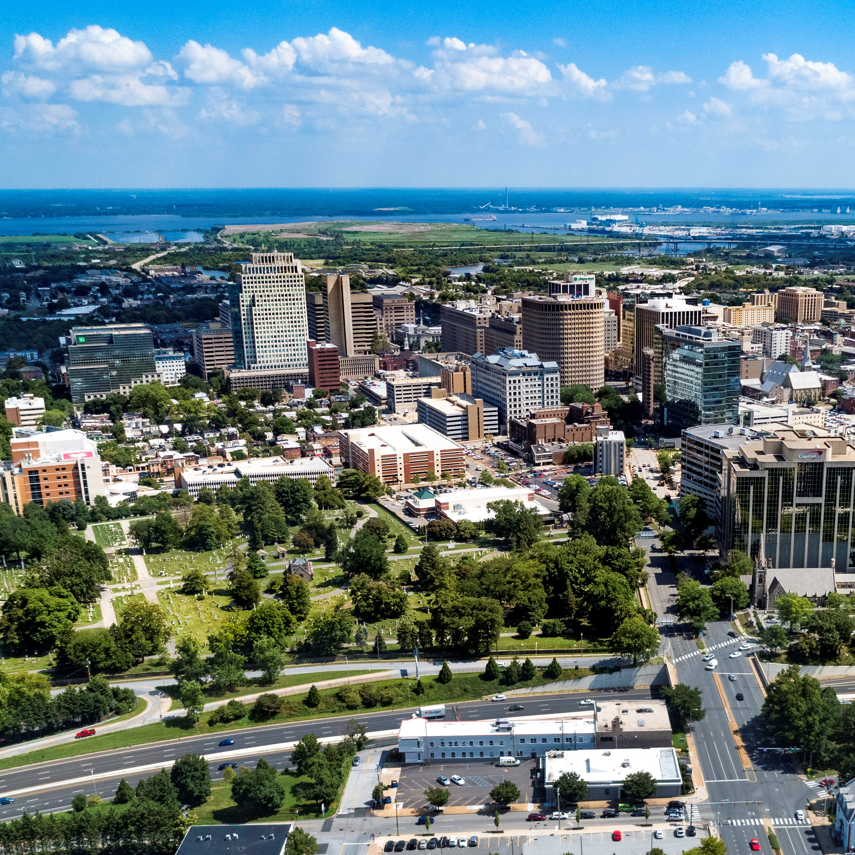
City of Wilmington ARPA Spending by Category
March 6, 2023

Slide 2
Summary by Category
Summary Allocated by Category
Category | Budget | Total Allocated for Projects | Unallocated
Administrative Costs | $1,831,462 | $1,831,462 | $0
Building Safer Communities | $8,000,000 | $3,096,485 | $4,903,515
Community Investment | $4,850,000 | $4,730,667 | $119,333
Essential Pay for Essential Work | $2,664,318 | $2,664,318 | $0
Neighborhood Revitalization | $22,000,000 | $22,000,000 | $0
Revenue Replacement | $12,000,000 | $12,000,000 | $0
Workforce Development | $4,000,000 | $2,349,240 | $1,650,760
Total: | $55,345,780 | $48,672,171 | $6,673,609

Slide 3
New Projects
New Projects
Category | Project | Amount Allocated for Project | Amount Spent in Project | Project Balance
Workforce Development | HOPE Commission – Women’s Reentry Program | $75,000 | $0 | $75,000
 | Total: | $75,000 | $0 | $75,000

Slide 4
Administrative Costs $1,831,462
ARPA Spending Category | Total Budget | Total Allocated for Projects | Total Unallocated
Administrative Costs | $1,831,462 | $1,831,462 | $0
Project Detail | Amount Allocated for Project | Amount Spent in Project | Project Balance
Administrative Expenses | $181,095 | $60,844 | $120,251
Disparity Study (Miller3) | $290,200 | $267,125 | $23,075
Disadvantaged Business Enterprise Analysis (Pope Consulting) | $60,000 | $36,200 | $23,800
Compliance (UHY Advisors Mid-Atlantic MD, Inc.) | $480,000 | $157,996 | $322,004
COVID-related Expenditures | $32,000 | $24,843 | $7,157
Construction Project Management (EDiS) | $264,167 | $264,167 | $0
Construction Project Management (Allied Construction) | $524,000 | $38,206 | $485,794

Slide 5
Building Safer Communities $8 million
ARPA Spending Category | Total Budget | Total Allocated for Projects | Total Unallocated
Building Safer Communities | $8,000,000 | $3,096,485 | $4,903,515
Project Detail | Amount Allocated for Project | Amount Spent in Project | Project Balance
WCAC - Community Violence Prevention Initiative | $500,000 | $83,000 | $417,000
DE DOJ - Violence Reduction Program | $90,000 | $0 | $90,000
Eastside Neighborhood Camera Initiative (Contract in Process) | $1,200,000 | $0 | $1,200,000
Community Public Safety Initiative: The Community Based Public Safety Collective | $400,000 | $66,667 | $333,333
Community Public Safety Initiative: United Way of Delaware - Fiscal Agent | $618,000 | $618,000 | $0
Community Public Safety Initiative: Debra Mason - Coordinator | $150,000 | $150,000 | $0
Community Public Safety Initiative: Apricot 360 Software | $38,485 | $38,484 | $0

Slide 6
Community Investment $4.85 million
ARPA Spending Category | Total Budget | Total Allocated for Projects | Total Unallocated
Community Investment | $4,850,000 | $4,730,667 | $119,333
Project Detail | Amount Allocated for Project | Amount Spent in Project | Project Balance
United Way of DE - Learning Pods | $150,000 | $150,000 | $0
Milk & Honey LLC | $25,000 | $25,000 | $0
Parking Garage Assistance | $500,000 | $500,000 | $0
DE Zoological Society | $150,000 | $150,000 | $0
Faithful Friends | $95,000 | $95,000 | $0
The Grand | $100,000 | $0 | $100,000
Reed's Refuge | $300,000 | $221,489 | $78,511
Latin American Community Center | $500,000 | $500,000 | $0
Culture Restoration Project | $150,000 | $9,356 | $140,644
Utility Payment Assistance Program | $300,000 | $300,000 | $0
The Juice Joint | $20,000 | $20,000 | $0
The Nomad | $41,000 | $41,000 | $0
Our Youth, Inc. | $30,000 | $30,000 | $0
St. Michael's School and Nursery | $100,000 | $100,000 | $0
NERDit Now | $200,000 | $200,000 | $0
Christina Cultural Arts Center | $500,000 | $1,950 | $498,050
The Challenge Program | $100,000 | $100,000 | $0
Central YMCA | $150,000 | $0 | $150,000
Delaware Children's Museum | $150,000 | $0 | $150,000
HBCU Week | $150,000 | $150,000 | $0
Jefferson Street Center | $150,000 | $50,000 | $100,000
I am My Sister's Keeper | $185,000 | $102,987 | $82,013
Books and Bagels, LLC | $12,000 | $12,000 | $0
Dun Rite Cleaners | $12,000 | $12,000 | $0
Oath 84 | $40,000 | $40,000 | $0
It's Time Campaign | $265,667 | $147,062 | $118,605
St. Francis Hospital (Contract in Process) | $100,000 | $100,000 | $0
WCAC – Broadband Access Program | $90,000 | $30,000 | $60,000
Apexx Lounge | $40,000 | $0 | $40,000
St. Patrick’s Center | $25,000 | $0 | $25,000
Go Make a Difference Corporation | $100,000 | $0 | $100,000

Slide 7
Neighborhood Revitalization $22 million
ARPA Spending Category | Total Budget | Total Allocated for Projects | Total Unallocated
Neighborhood Revitalization | $22,000,000 | $22,000,000 | $0
Project Detail | Amount Allocated for Project | Amount Spent in Project | Project Balance
Habitat for Humanity - A Brush with Kindness | $2,000,000 | $764,879 | $1,235,121
Land Bank - Eastside | $3,922,200 | $3,201,884 | $720,316
Land Bank - Hilltop | $1,000,000 | $855,371 | $144,629
REACH Riverside | $1,000,000 | $1,000,000 | $0
Eastside Housing Partners, LLC | $100,000 | $100,000 | $0
DE Affordable Housing Group (WHA) | $318,955 | $179,520 | $139,435
Cornerstone West | $1,450,000 | $327,766 | $1,122,234
Todmorden Foundation | $1,000,000 | $0 | $1,000,000
Woodlawn Trustees | $2,000,000 | $300,000 | $1,700,000
Habitat for Humanity - Bennett Street Housing Construction | $2,000,000 | $10,607 | $1,989,393
WEDCO Revolving Loan Program | $2,000,000 | $2,000,000 | $0
Richard Dyton - Neighborhood Liaison | $42,000 | $21,000 | $21,000
Southbridge CDC | $250,000 | $0 | $250,000
RL Construction - Alleyway Cleanup Contract | $105,000 | $105,000 | $0
Cost Overruns and Change Orders | $2,000,000 | $0 | $2,000,000
DE Affordable Housing Group - McMullen Square | $595,000 | $0 | $595,000
DE Affordable Housing Group - Bennett Street | $210,000 | $0 | $210,000
Eastside Neighborhood Revitalization (Earmark) | $1,886,845 | $0 | $1,886,845
Central Baptist CDC | $120,000 | $0 | $120,000

Slide 8
Workforce Development$4 million
ARPA Spending Category | Total Budget | Total Allocated for Projects | Total Unallocated
Workforce Development | $4,000,000 | $2,349,240 | $1,650,760
Project Detail | Amount Allocated for Project | Amount Spent in Project | Project Balance
NCC Vo-Tech School District | $1,804,240 | $242,911 | $1,561,329
Delaware Art Museum | $150,000 | $0 | $150,000
DETV | $250,000 | $62,500 | $187,500
Hilltop Lutheran Neighborhood Center | $70,000 | $0 | $70,000
HOPE Commission – Women’s Reentry Program* | $75,000 | $0 | $75,000
*New project

Slide 9
Other Categories
Revenue Replacement: $12 million
Essential Pay for Essential Workers: $2,664,318

