Slide 1


Miller ³ Consulting, Inc www.miller3group.com 404-827-9019
Atlanta, GA
City of Wilmington
2022 Comprehensive Disparity Study Presentation February 6, 2023

Slide 2

Acknowledgements
For participating in the Disparity Study process for the best interest of those whom they serve, Miller³ Consulting, , Inc acknowledges the leadership and commitment of:
City of Wilmington
The Mayor’s Office
Office of Economic Development
Procurement Department
Along with:
Accounts Payable
IT Department
User Departments
2/6/2023

Slide 3


Outline of Presentation
Miller³ Consulting Background and Experience
Legal Framework for Race and Gender Conscious Programs and Disparity Studies
Miller³ Consulting Approach and Methodology
Statistical Analysis & Disparity Study Qualitative Findings
Conclusions and Recommendations
2/6/2023

Slide 4

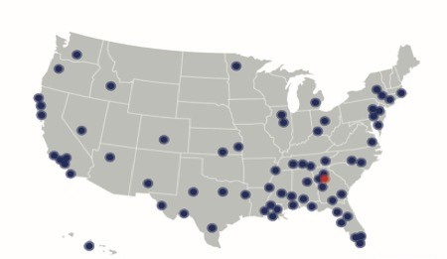
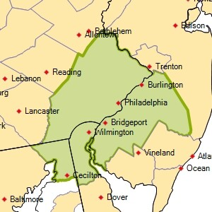



M³ Consulting Experience at a Glance
Creators of the Disparity Study industry & RWA Analysis
30+ years of Inclusive Procurement & Economic Development Consulting
Conducted over 140 disparity studies at the local, state and federal level
Disparity Studies completed for City of Philadelphia and 9 Other Public Entities in Philadelphia
Subconsultant Support: Q&A Research
Successful litigation & turnkey approach to S/M/W/VBE service delivery
2/6/2023

Slide 5

Legal Framework for Race and Gender Conscious Programs & Disparity Studies
Richmond v Croson and Its Progeny
2/6/2023

Slide 6
Richmond v. Croson
U.S. Supreme Court, 1989
Compelling governmental interest provides a factual predicate for an MWBE program
Active participant in discrimination Passive participant in discrimination
Narrow Tailoring -- program must be focused on remedy to identified discrimination
2/6/2023

Slide 7
Richmond v. Croson
U.S. Supreme Court, 1989
In conjunction with or following race neutral efforts, race and gender-conscious initiatives should include:
Sunset provision Graduation provision Flexible goals
Tied to availability
Limit impact on third parties
Limited to groups that have suffered discrimination or have shown statistically significant disparity
2/6/2023

Slide 8

Approach and Methodology
10-Part Methodology
2/6/2023

Slide 9
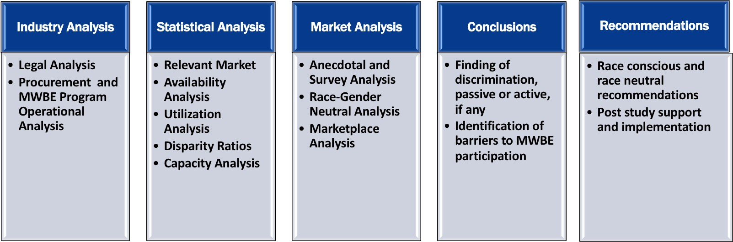
10 Part Methodology for Wilmington
Disparity Study
10 Part Methodology Leads To
2/6/2023

Slide 10


Statistical Findings
for Architecture and Engineering, Construction and Construction-Related Services, Non-Professional Services, Professional Services, and Goods and Supplies
Relevant Market findings Availability findings Utilization findings Disparity findings Capacity findings
Note: Observations Reflect The Study Period Of FY 2016 Through FY 2020.
2/6/2023

Slide 11
Relevant Market Determination FY2016-FY2020
Procurement Type | Relevant Market
Architecture & Engineering | Nationwide
Construction and Construction-Related Services | MSA
Non-Professional Services | MSA
Professional Services | Nationwide
Goods & Supplies | Nationwide
Philadelphia-Camden-Wilmington MSA
2/6/2023

Slide 12
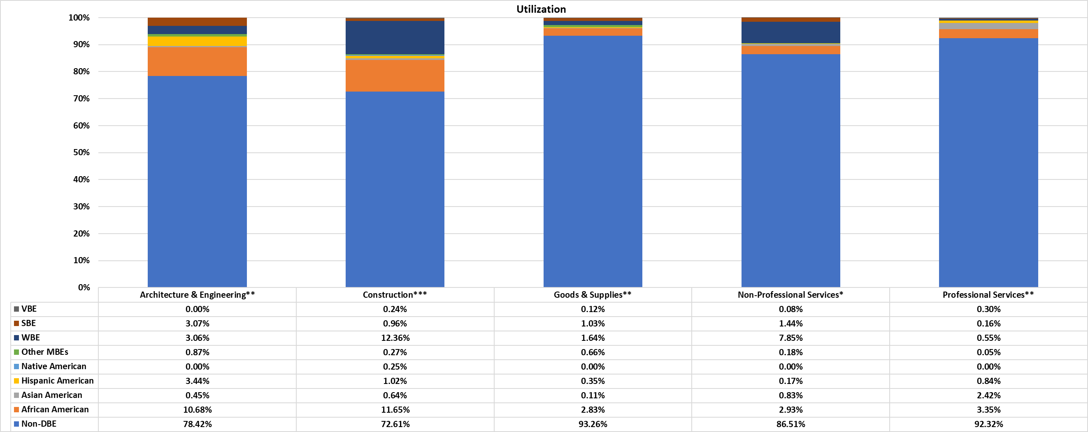
Utilization By Procurement Type
*PO Data, Relevant Market - MSA
**PO Data, Relevant Market - Nationwide
***Contracts Data, Relevant Market - MSA
2/6/2023

Slide 13
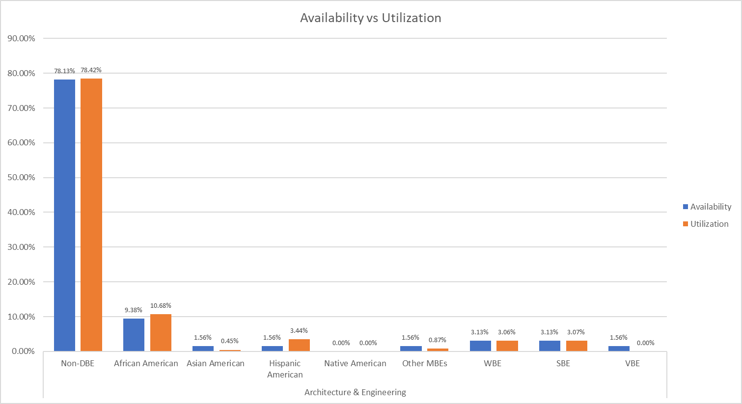
Level 2 RWASM Availability and Utilization for Architecture & Engineering
Total Utilization = $15,406,365
2/6/2023

Slide 14
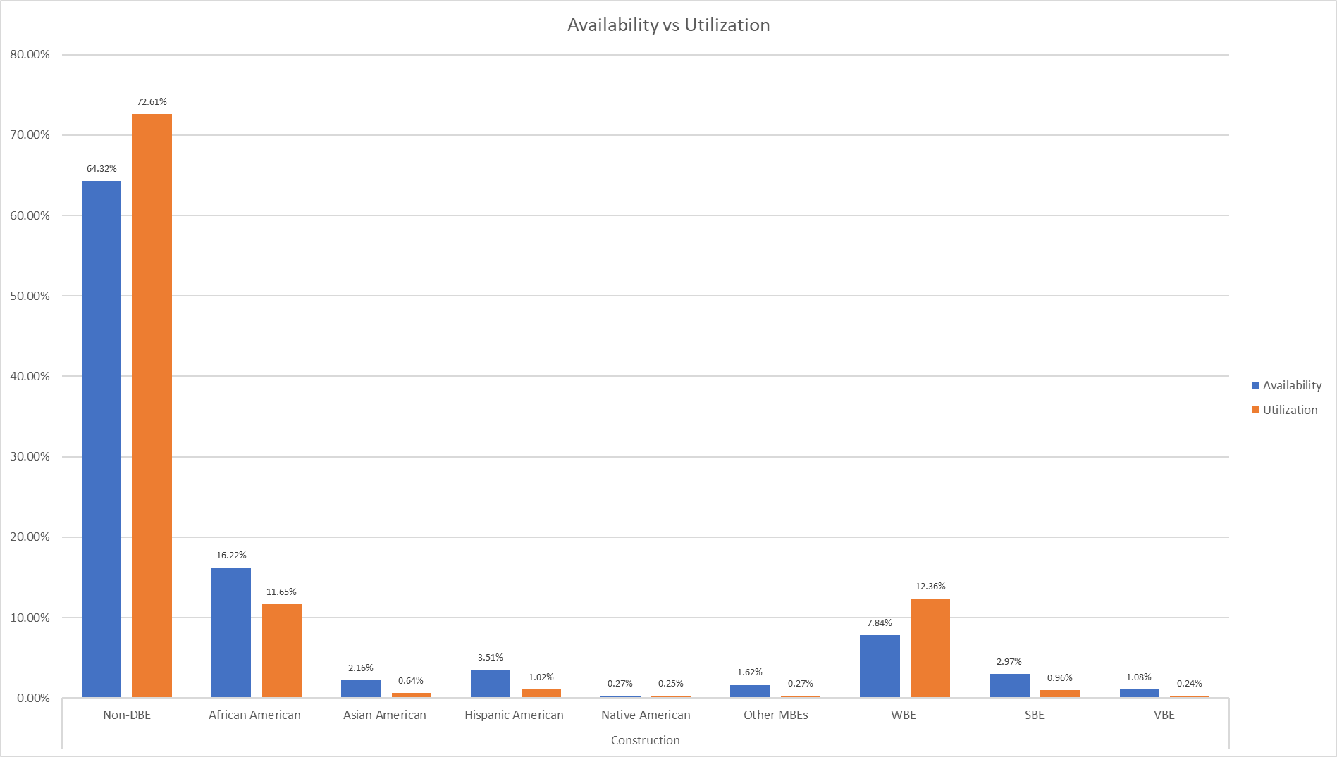
Level 2 RWASM Availability and Utilization for Construction and Construction-Related Services
Total Utilization = $64,924,034
2/6/2023

Slide 15
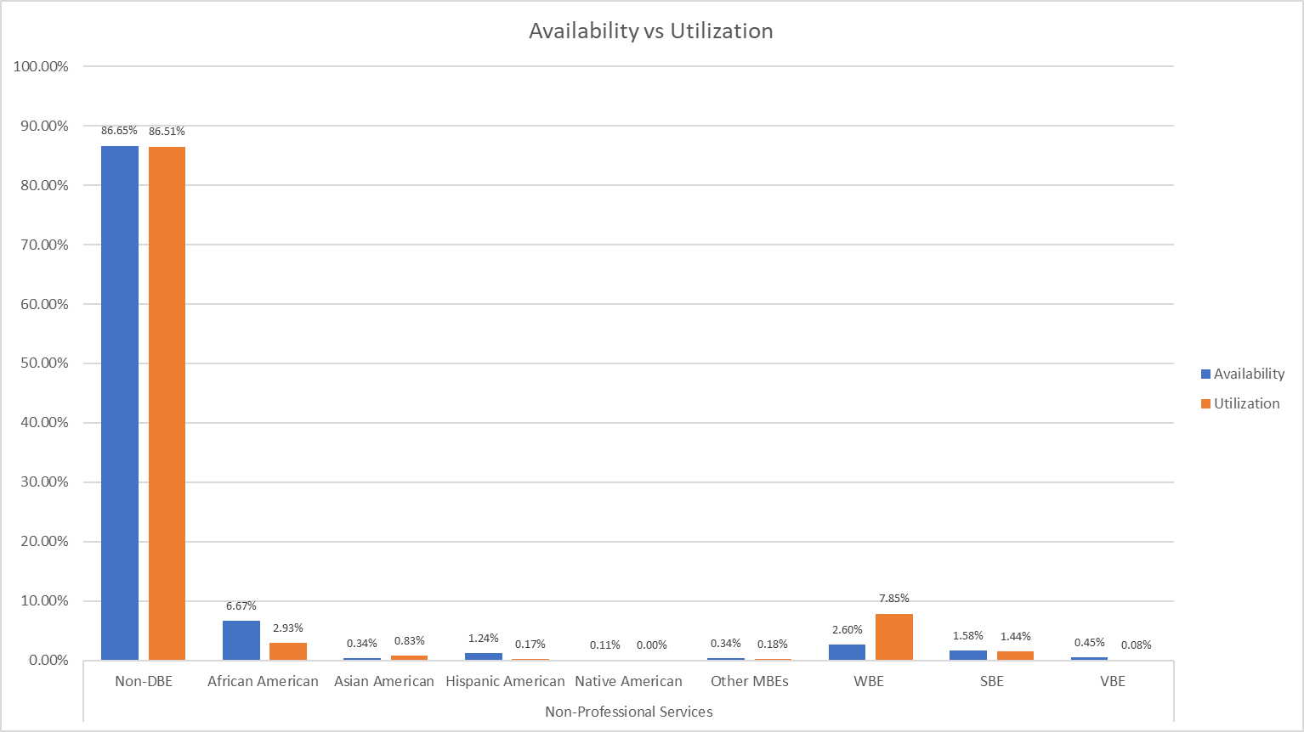
Level 2 RWASM Availability and Utilization for Non- Professional Services
2/6/2023
Total Utilization = $212,298.114

Slide 16
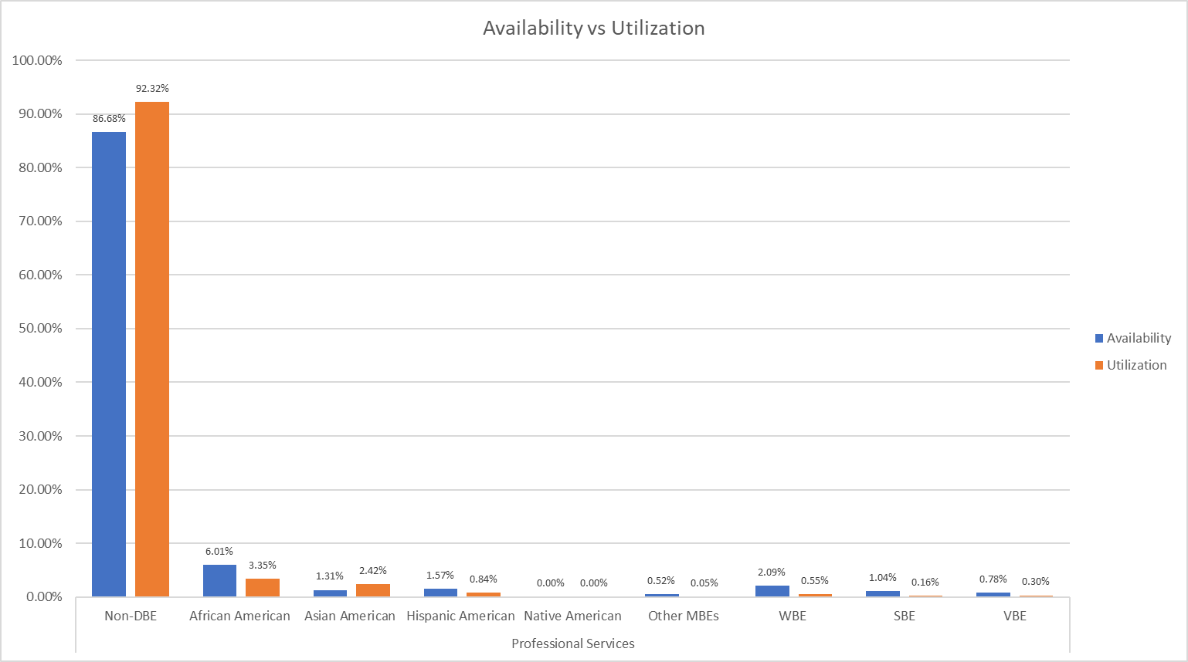
Level 2 RWASM Availability and Utilization for Professional Services
Total Utilization = $64,866,425
2/6/2023

Slide 17
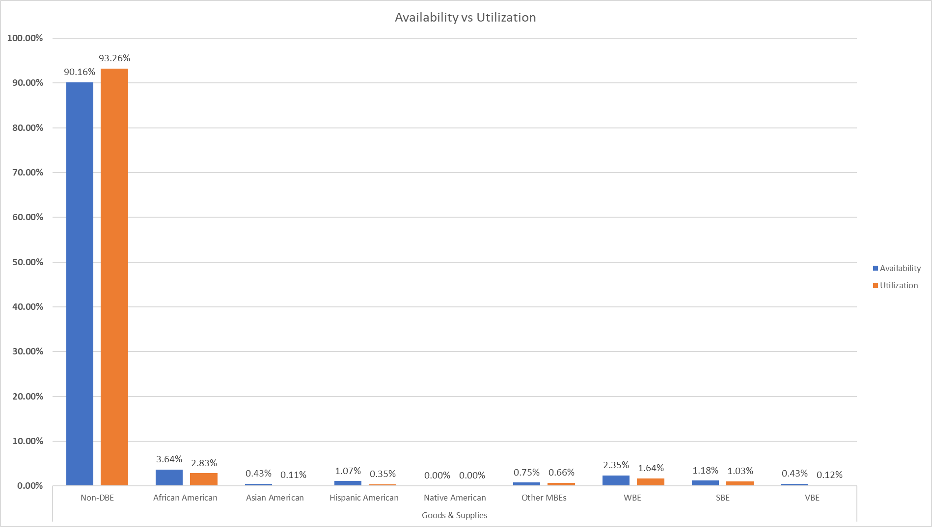
Level 2 RWASM Availability and Utilization for Goods & Supplies
Total Utilization = $80,212,234
2/6/2023

Slide 18
Disparity Findings
Note: Observations Reflect The Study Period Of FY 2016 Through FY 2020
2/6/2023

Slide 19
M³ Consulting Disparity Ratio© Calculation
The ratio of the percentage of MWBEs in the market (availability) compared to the proportion of dollars spent with those businesses (utilization).
U
D =
A
2/6/2023

Slide 20
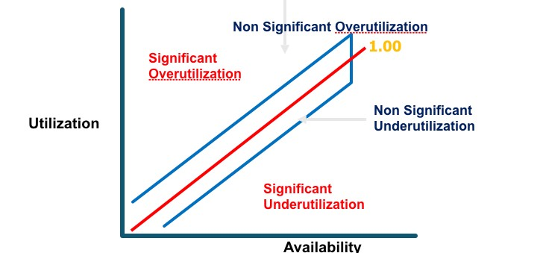
M³ Disparity Ratio Concept© Disparity=Utilization/Availability
2/6/2023

Slide 21
City of Wilmington Disparity Findings
Based on Utilization and Level 2 RWASM Availability
(by Relevant Market and Percent, FY 2016 - FY 2020)
Ethnicity | Architecture & Engineering (Purchase Orders) |  | Construction & Construction-Related Services (Contract Awards) |  | Non-Professional Services (Purchase Orders) |  | Professional Services (Purchase Orders) |  | Goods & Supplies (Purchase Orders)
 | Ratio | Sign. | Ratio | Sign. | Ratio | Sign. | Ratio | Sign. | Ratio | Sign.
Non-DBE | 1.00 | NS | 1.13 | S | 1.00 | NS | 1.06 | S | 1.03 | S
African American | 1.14 | NS | 0.72 | NS | 0.44 | S | 0.56 | S | 0.78 | S
Asian American | 0.29 | NS | 0.30 | NS | 2.44 | S | 1.86 | S | 0.26 | S
Hispanic American | 2.20 | S | 0.29 | S | 0.14 | S | 0.54 | S | 0.32 | S
Native American | 0.00 | S | 0.93 | NS | 0.00 | S | 0.00 | S | 0.00 | S
Other MBE | 0.56 | NS | 0.16 | NS | 0.52 | S | 0.10 | S | 0.89 | NS
Total MBE | 1.10 | NS | 0.58 | S | 0.47 | S | 0.71 | S | 0.67 | S
WBE | 0.98 | NS | 1.58 | S | 3.02 | S | 0.26 | S | 0.70 | S
Unknown DBE | 0.00 | S | 0.00 | S | 0.00 | S | 0.00 | S | 0.00 | S
Total DBE | 1.08 | NS | 0.83 | NS | 1.06 | NS | 0.63 | S | 0.68 | S
SBE | 0.98 | NS | 0.32 | NS | 0.91 | NS | 0.16 | S | 0.88 | NS
VBE | 0.00 | S | 0.22 | NS | 0.17 | S | 0.39 | S | 0.28 | S
2/6/2023

Slide 22
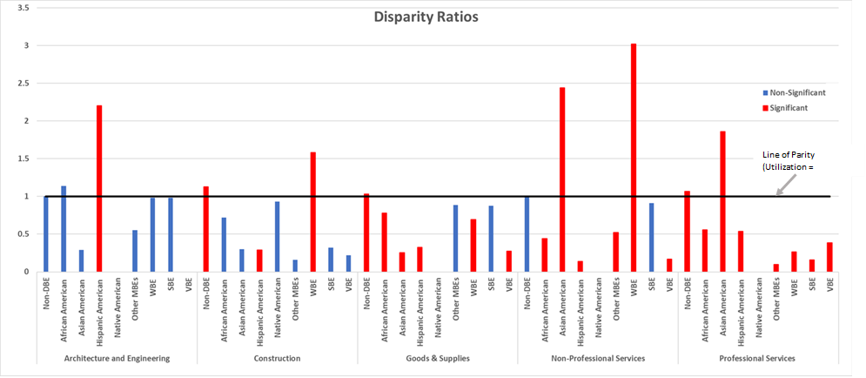
City of Wilmington Disparity Findings
Based on Utilization and Level 2 RWASM Availability
(by Relevant Market and Percent, FY 2016 -- FY 2022)
Statistically significant disparity shown by red bars and below the line of parity reflects disparity for which race/gender-conscious remedies may utilized; Non statistically significant disparity below the line of parity are shown by blue bars and can be attributed to chance.
2/6/2023

Slide 23
Disparity Ratios – Basis for Race/Gender-Conscious Goals
By Race/Ethnicity/Gender By Procurement Type
 | A&E (POs) | Construction & Construction-Related Services (Contract Awards) | Non-Professional Services (POs) | Professional Services (POs) | Goods & Supplies (POs)
African American | No Disparity | Disparity | Disparity* | Disparity* | Disparity*
Asian American | Disparity | Disparity | No Disparity* | No disparity* | Disparity*
Hispanic American | No Disparity* | Disparity* | Disparity* | Disparity* | Disparity*
Native American | No Disparity | Disparity | No Disparity | No Disparity | No Disparity
WBE | Disparity | No Disparity* | No Disparity* | Disparity* | Disparity*
Blue denotes reflects disparity for which race/gender-conscious remedies may utilized; * reflects statistical significance.
2/6/2023

Slide 24
Disparity Study Qualitative Findings
Procurement Anecdotal Marketplace Race Neutral
2/6/2023

Slide 25
Observations Impacting MWBE Participation in City of Wilmington Procurement System During
FY 2016 - FY 2022
Procurement Findings
Limited Knowledge and Staff Training Related to Inclusive Procurement and DBE Program
Limited and Inconsistent Implementation of DBE Policies/Strategies
Repeated Use of Same Vendors at Informal Level
Overuse of Bid Waiver
Lack of Enterprise-wide Ownership of DBE Program Policies and Procedures
Limited Vendor Registration
Inconsistent and Limited DBE Reporting
Limited Forecasting and Notification of Opportunities
Limited Diversity Firm Outreach and Matchmaking
Decentralized Process is leading to Limited Transparency and Accountability
2/6/2023

Slide 26
Anecdotal Comments Reflecting Interviewees’ Perceptions & Experiences
Anecdotal Participants
5 Focus Group—20 participants
Anecdotal Themes
DBE certifications not useful in securing contracts with the City.
Limited OED and M/WBE staff support and enforcement of inclusion of DBEs in the City’s contracting.
Inability to obtain work with the City of Wilmington, even though securing work with private and public sector agencies
Lack of notice or bidding of
Repeated use of the same vendors
Minority and Women Fronts
Prime contractors not utilizing DBEs in the private sector or in the absence of goals; primes list DBEs without intention to utilize
Small-dollar contracts
Professional Services
Long payment terms
Lack of access to procurement staff or appropriate user department staff
A&E
2/6/2023

Slide 27
Race Neutral Analysis
Race Neutral
Review 41 Race Neutral Provider Programs
9 Executive Director Interviews
Findings
Race Neutral Themes
Importance and availability of capital (funding);
Insufficient access to information, communication, and/or technology;
Need for improved City commitment to and processes supporting M/W/DBEs;
Need for training and education on bid process, running a business, and/or goal-based program requirements;
Need for improved engagement with the Hispanic community and other “non-English as a first language” communities; and
Lack of parity, inclusiveness, diversity, and/or discrimination.
2/6/2023

Slide 28
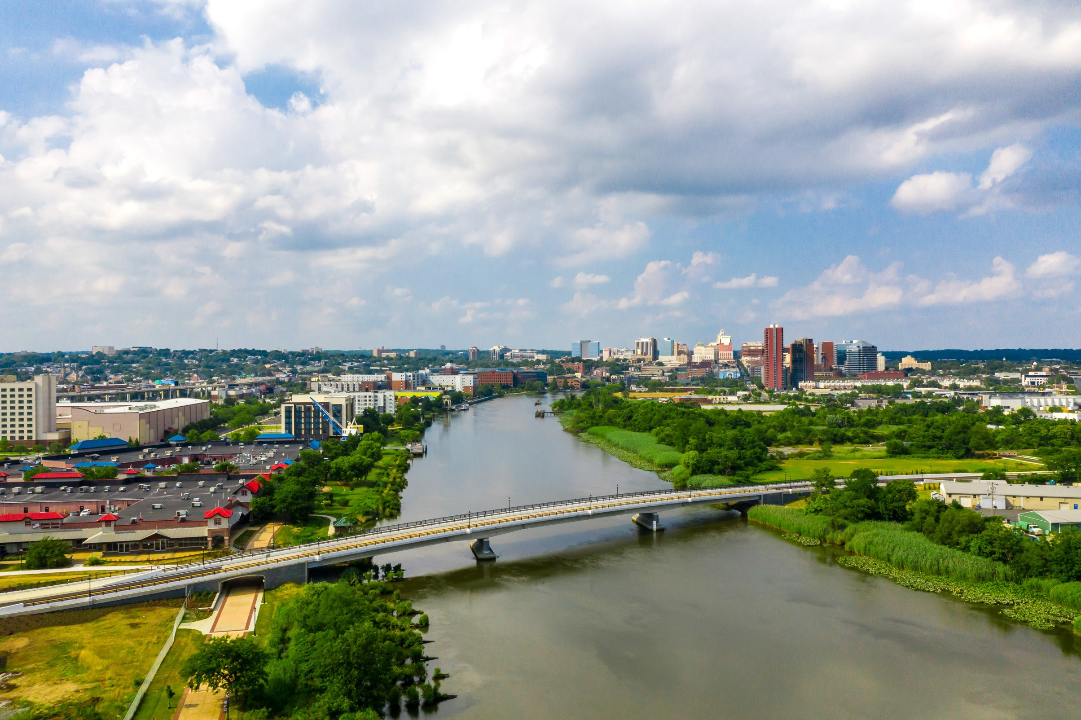
Recommendations
Note: Observations Reflect The Study Period Of July 1, 2017, Through June 30, 2021.
2/6/2023

Slide 29
Recommendations: Enhancements to Procurement and DBE Procedures and Practices
Change focus to inclusive procurement, as opposed to simple goal attainment.
Address decentralized nature of the City of Wilmington procurement process and impact on DBE participation
Identify community economic development and inclusive procurement objectives
Provide procurement and DBE training and development to all staff throughout the City that impact the “buy-decision”
2/6/2023

Slide 30
Recommendations: Enhancements to Procurement and DBE Procedures and Practices, cont.
Fully implement existing DBE Programmatic Initiatives and address prior internal audit concerns
Conduct a culture audit to understand values, perceptions, traditions and biases that may impact the “buy decision”
Address data capture issues to allow the City to effectively monitor and track all procurement decisions
Implement procurement focused budgeting, forecasting and scheduling to allow maximize identification of opportunities
Monitor contracts for issue of concentration
2/6/2023

Slide 31
Recommendations: Long-Term Availability and Capacity Building Initiatives—Increasing Pipeline of MBEs
Youth Entrepreneurship Initiatives
Emphasis on exposure to entrepreneurs instead of large corporations.
Determine how the City can engage in Youth entrepreneurship programs utilizing access to its vendors.
Increasing pipeline of DBEs
Using outreach techniques drawing upon Master List of M/W/DBEs
Developing relationship and access to Management, Financial and Technical Assistance providers who are identifying and supporting DBEs throughout the MSA.
Expanding competition by conducting a deeper dive into the City’s procurement and bidding practices that eliminate competition on specific bids.
2/6/2023

Slide 32
Recommendations: Expand DBE Initiatives
Promote DBE participation at the prime contractor level
Develop DBE program which addresses requirements of large construction and development projects by looking at opportunities at the 7 stages of development: Planning, Financing, Designing, Construction, Equipping, Maintaining, Operating
Implement small business set-asides and sheltered market projects
Address concerns about slow payments
Develop bonding and insurance program related to project-based procurement process
Maximize use of joint ventures, mentor-protégé programs, and distributorships
Develop effective matchmaking and outreach programs
2/6/2023

Slide 33
Recommendations: Expand DBE Initiatives
Develop detailed and effective monitoring and tracking reports -- overall and project-by-project
Develop and assign post-award compliance responsibilities
Partner with technical assistance providers to increase City’s ability to utilize its opportunities for capacity building
Develop working capital loans and paymaster programs + prompt pay requirements particular with minority-owned banks and partners, which should provide the City with assurances that financial management issues will not negatively impact contractor performance, while at the same time providing DBEs with critical financial support and advocacy
A paymaster is authorized by the firm to handle the firm’s receipts and payment of expenses, including payroll and subcontractor payments.
2/6/2023

Slide 34
City of Wilmington
2022 Comprehensive Disparity Study Presentation February 6, 2023
2/6/2023

