Slide 1
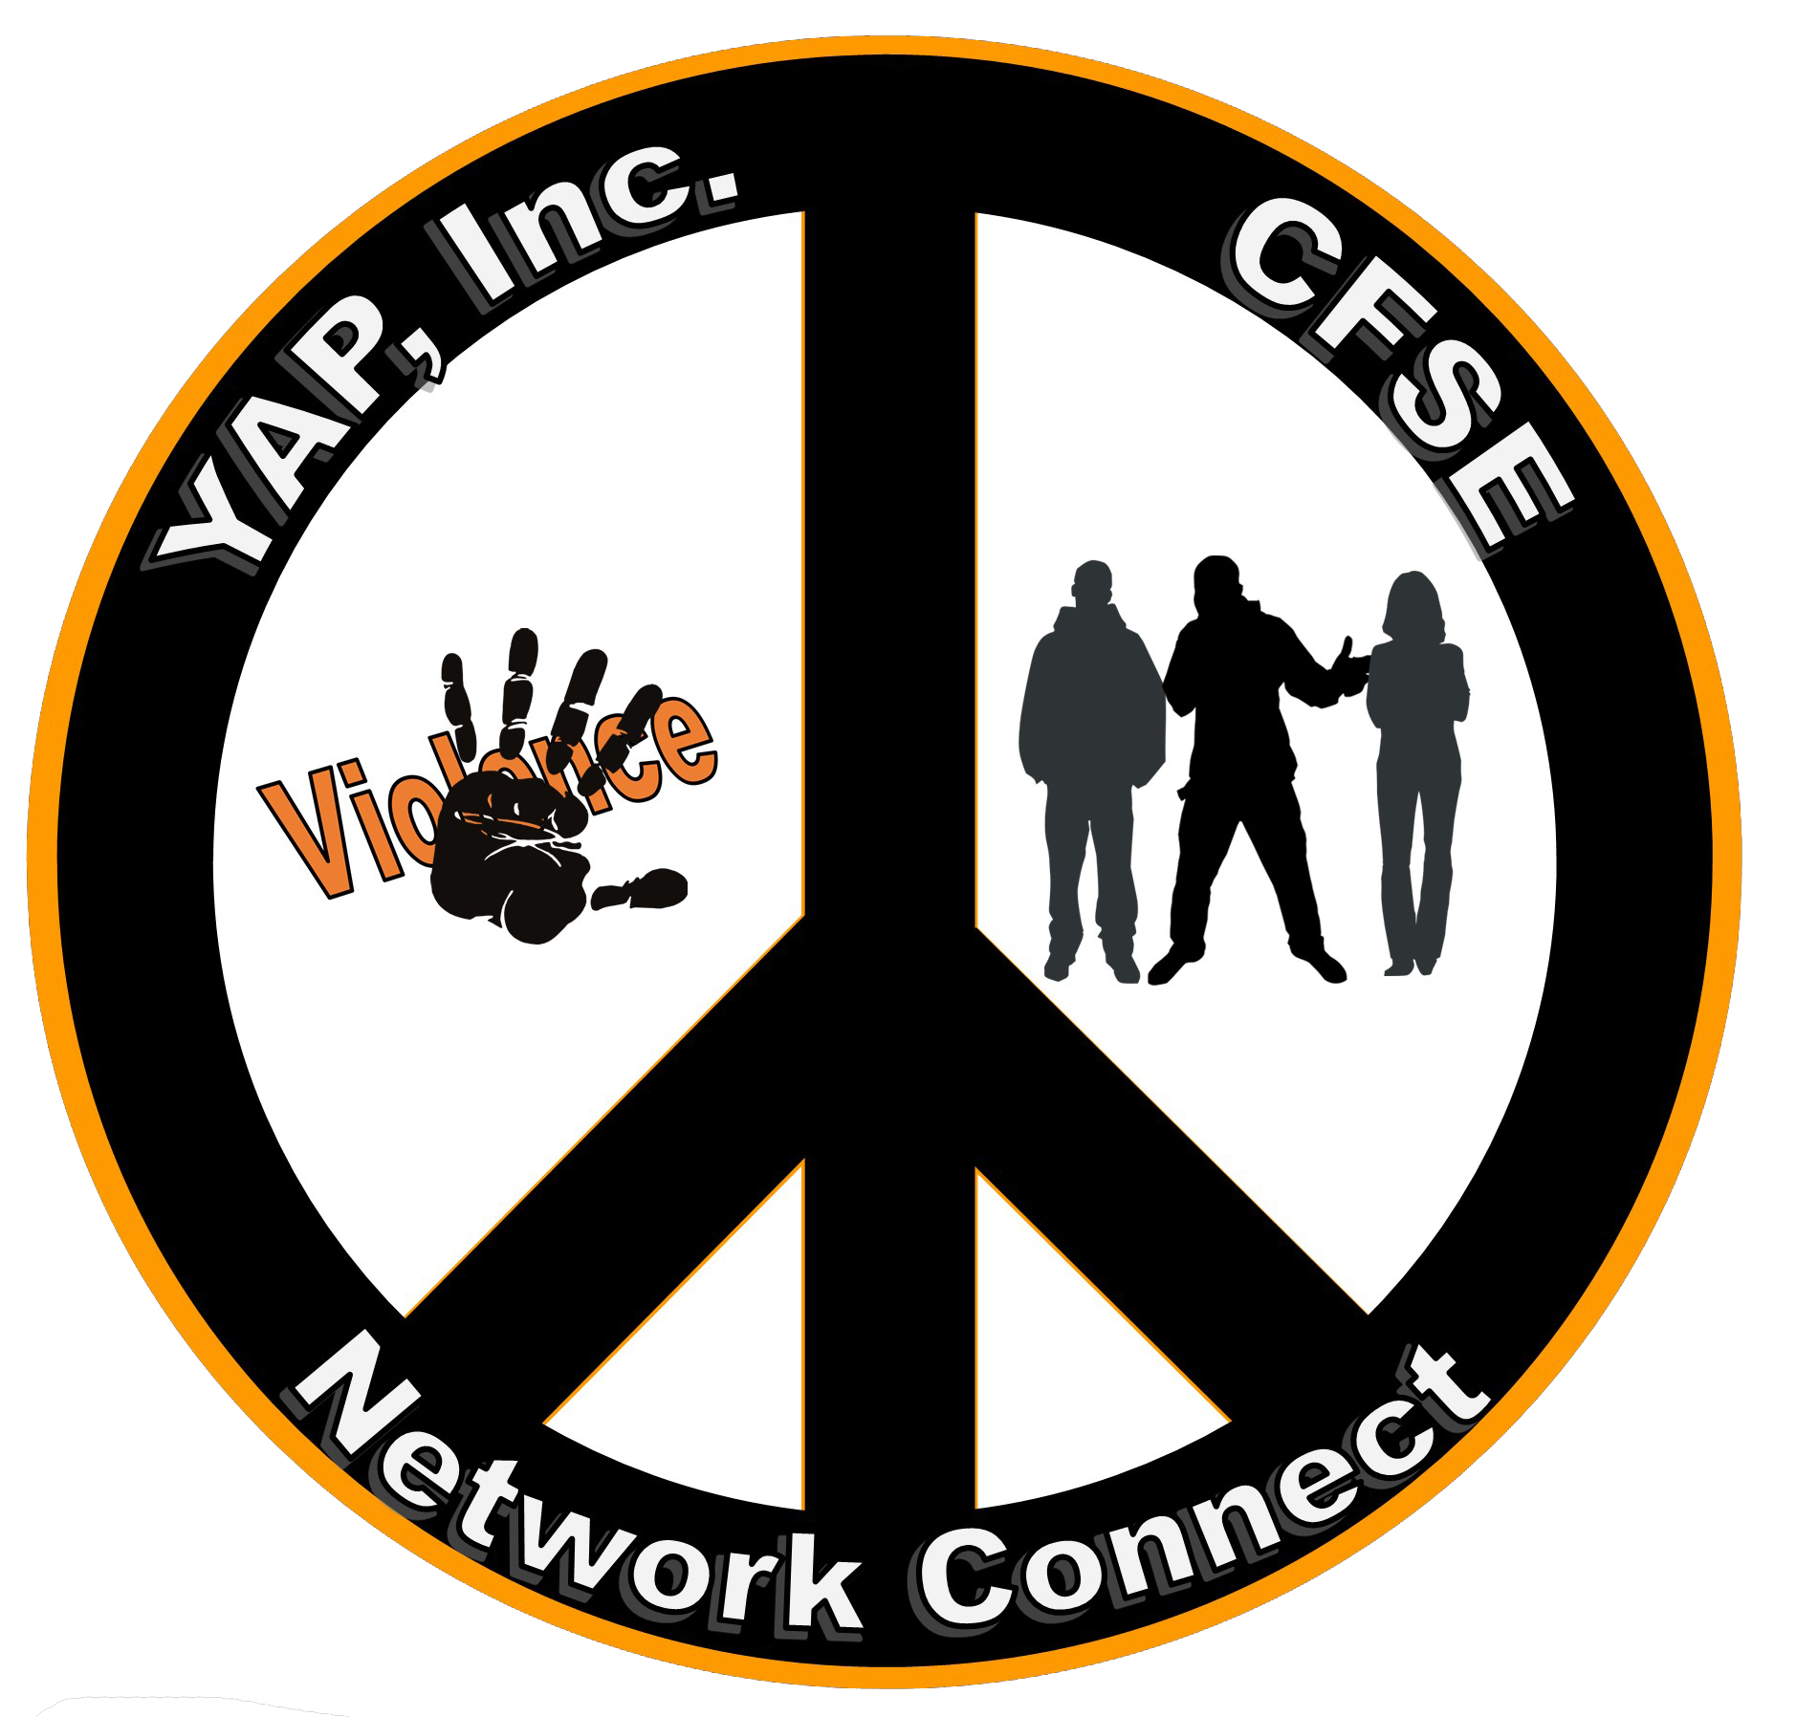
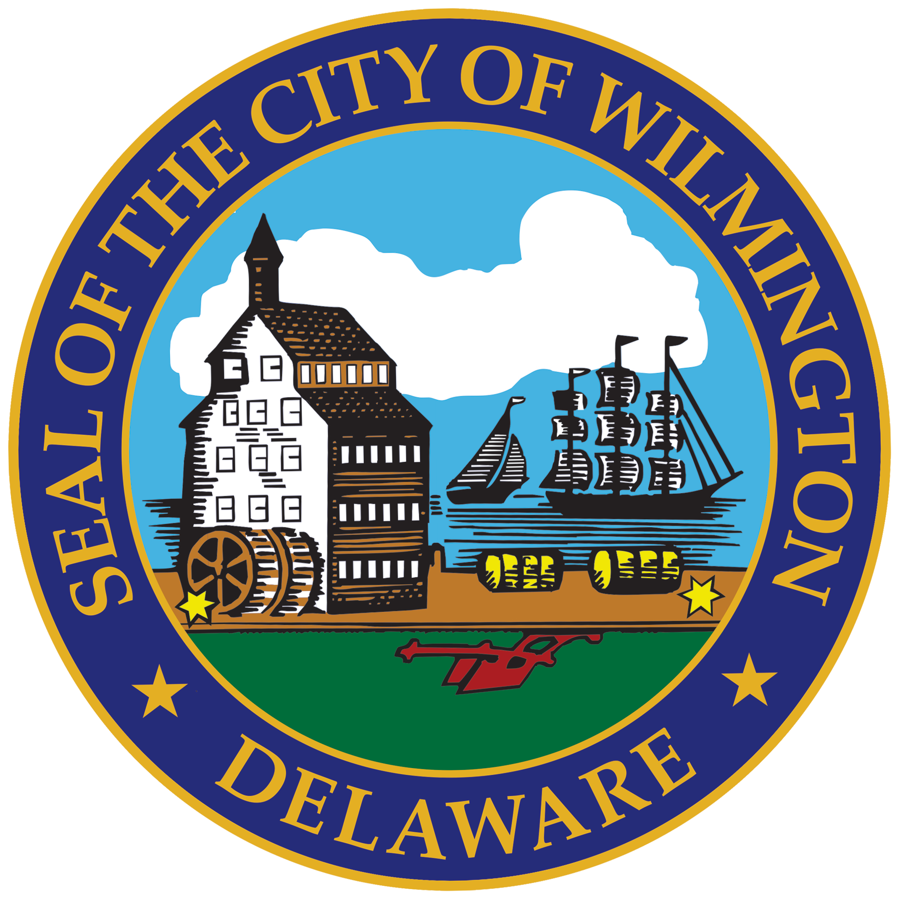
Wilmington Street Team
Community Public Safety Initiative (CPSI)
City of Wilmington

Slide 2
Wilmington Street Team
Community Public Safety Initiative
CPSI
Community Public Safety Initiative (CPSI)
City of Wilmington
In 2022, the Community Public Safety Collective (The Collective) completed a Landscape Analysis of the City of Wilmington. The analysis aimed to help the city identify a strategy to address violence from a community-based perspective.
The Landscape Analysis prompted Mayor Mike Purzycki and the Wilmington City Council to create the Community Public Safety Initiative (CPSI).
The goal is to utilize the community violence intervention (CVI) model to increase safety in the city. CVI is an evidence-informed strategy used to disrupt violence and retaliation cycles and establish community relationships.

Slide 3
Wilmington Street Team
Wilmington Street Team
The Collective identified four (4) organizations that could assist with this initiative; Network Connect, the Center for Structural Equity (CFSE), Youth Advocate Programs (YAP), Inc., and the Wilmington Community Advisory Council (WCAC).
The Wilmington Street Team (WST) consists of Network Connect, Youth Advocate Programs, Inc (YAP), and the Center for Structural Equity (CFSE).
Community Public Safety Initiative (CPSI)
City of Wilmington

Slide 4
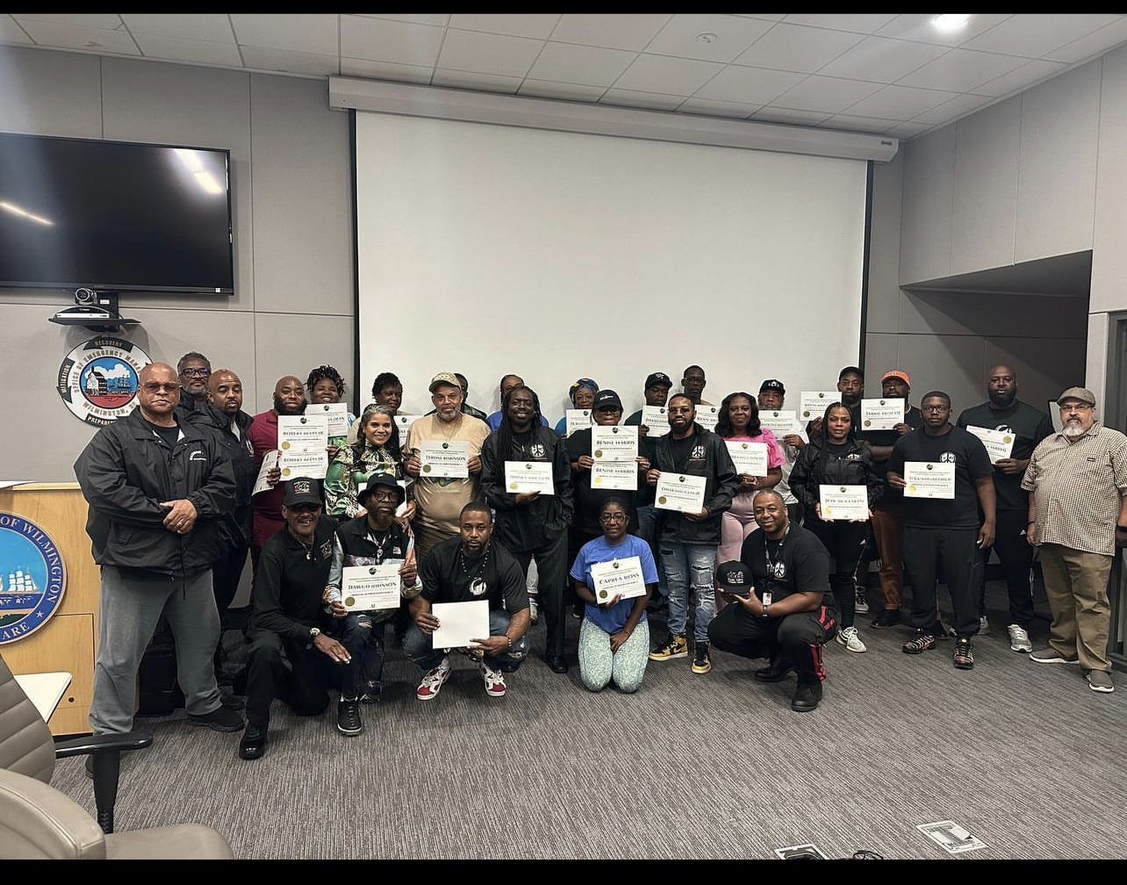
Wilmington Street Team
Training
Community Public Safety Initiative (CPSI)
City of Wilmington
Network Connect, YAP, and CFSE completed two (2) trainings presented by the Professional Community Intervention Training Institute (PCITI) under the tutelage of Dr. Aqui Basheer.
Individuals who completed the training received the title of Public Safety Professionals.

Slide 5
Wilmington Street Team
Responsibilities
Network Connect
  Provides wrap-around services to East Side and Prices Run
Center for Structural Equity (CFSE)
  Provides services to high-risk individuals between the ages of 13-26 – East Side
Youth Advocate Programs (YAP)
  Provides services to high-risk individuals between the ages of 13-26 – Prices Run
Wilmington Community Advisory Council (WCAC)
  Host all Public Safety Roundtables
Community Public Safety Initiative (CPSI)
City of Wilmington

Slide 6
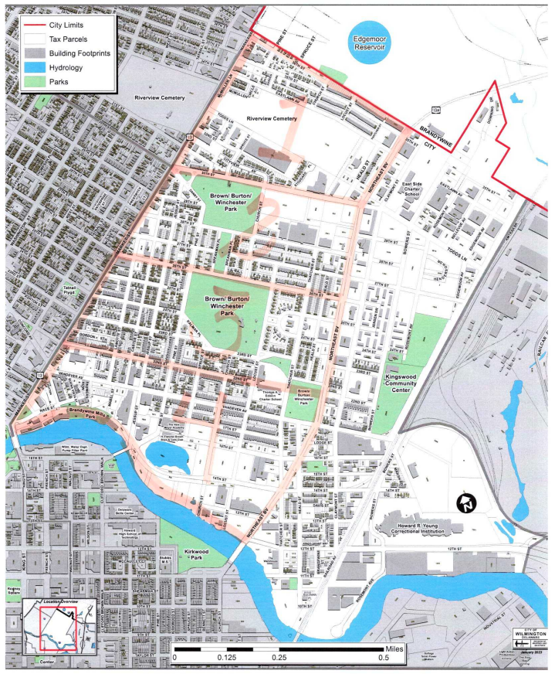
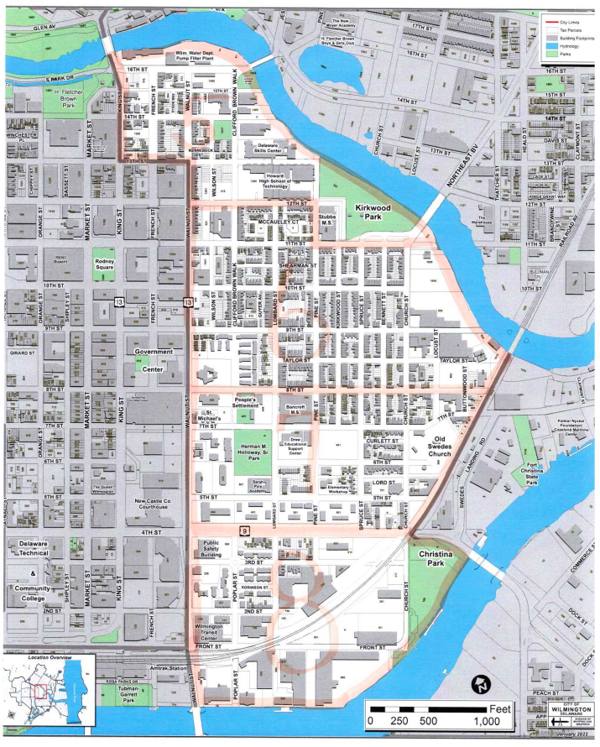
Wilmington Street Team
Zones in the City
Prices Run
  Zones 1-4
    Zone 1 - 30th - 36th & Market to Northeast Blvd
    Zone 2 - 26th - 30th & Market to Northeast Blvd
    Zone 3 - 22nd - 26th & Market to Northeast Blvd
    Zone 4 - Brandywine River - 22nd & Market to Northeast Blvd
East Side
  Zones 5-8
    Zone 5 - 12th - Brandywine River & King to Kirkwood Park/River
    Zone 6 - 8th - 12th & Walnut to Railroad/River
    Zone 7 - 4th - 8th & Walnut to Railroad
    Zone 8 - River – 4th & Walnut to Christina Park
Community Public Safety Initiative (CPSI)
City of Wilmington

Slide 7
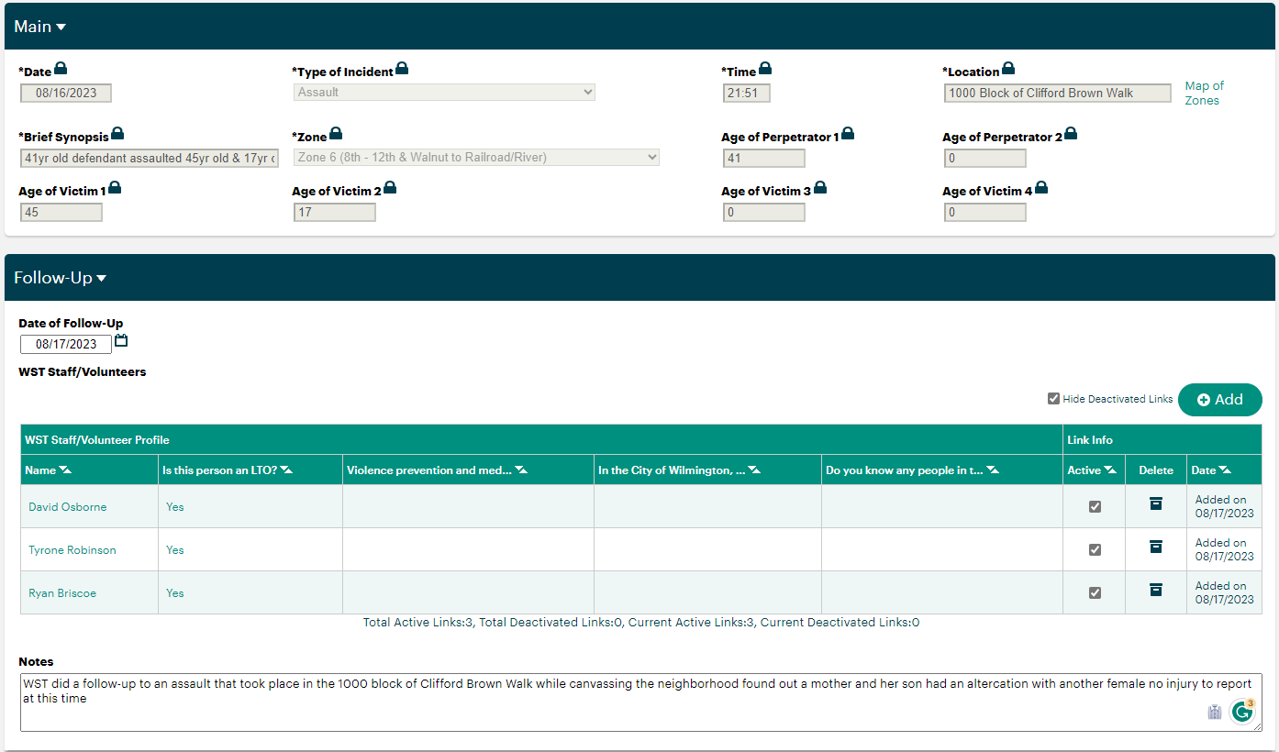


Wilmington Street Team
Wilmington Police Department & WST
Each morning, WPD submits all dispatch calls from the East Side and Prices Run
Recorded in APRICOT
Public Safety Professionals follow up in the community
Community Public Safety Initiative (CPSI)
City of Wilmington

Slide 8
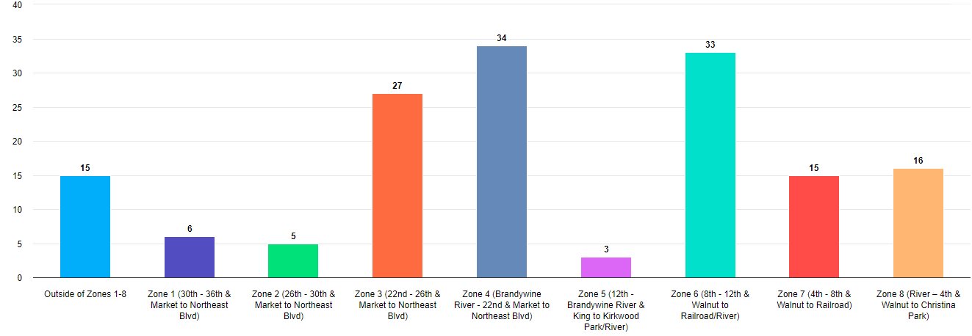
Wilmington Street Team
Community Encounters
Community Public Safety Initiative (CPSI)
City of Wilmington

Slide 9
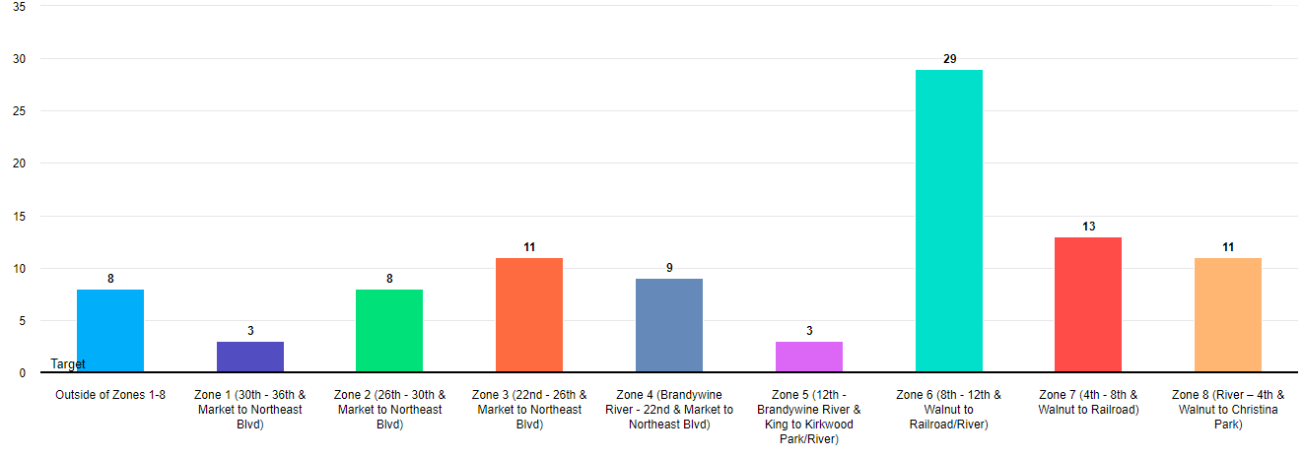
Wilmington Street Team
Dispatch Calls by Zones
Community Public Safety Initiative (CPSI)
City of Wilmington

Slide 10
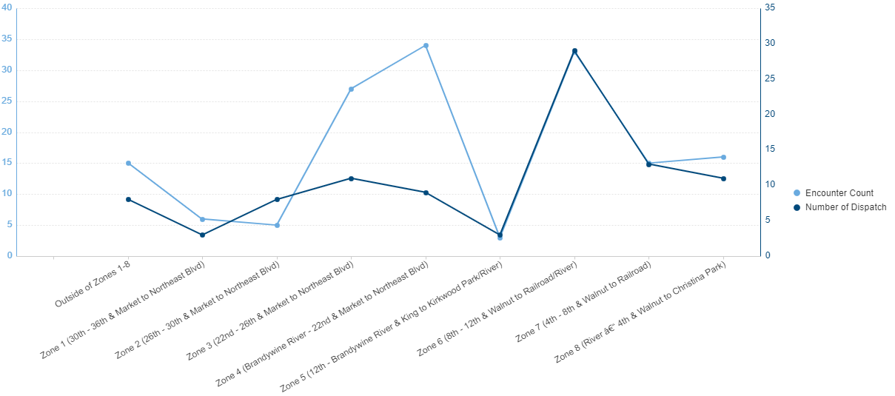
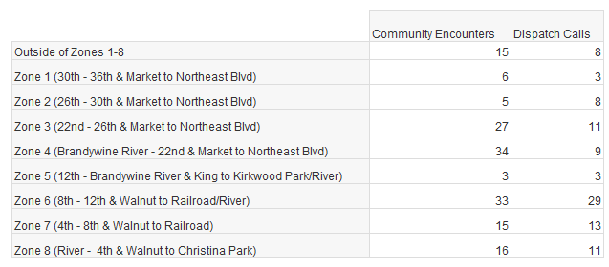
Wilmington Street Team
Impact
Community Public Safety Initiative (CPSI)
City of Wilmington

Slide 11
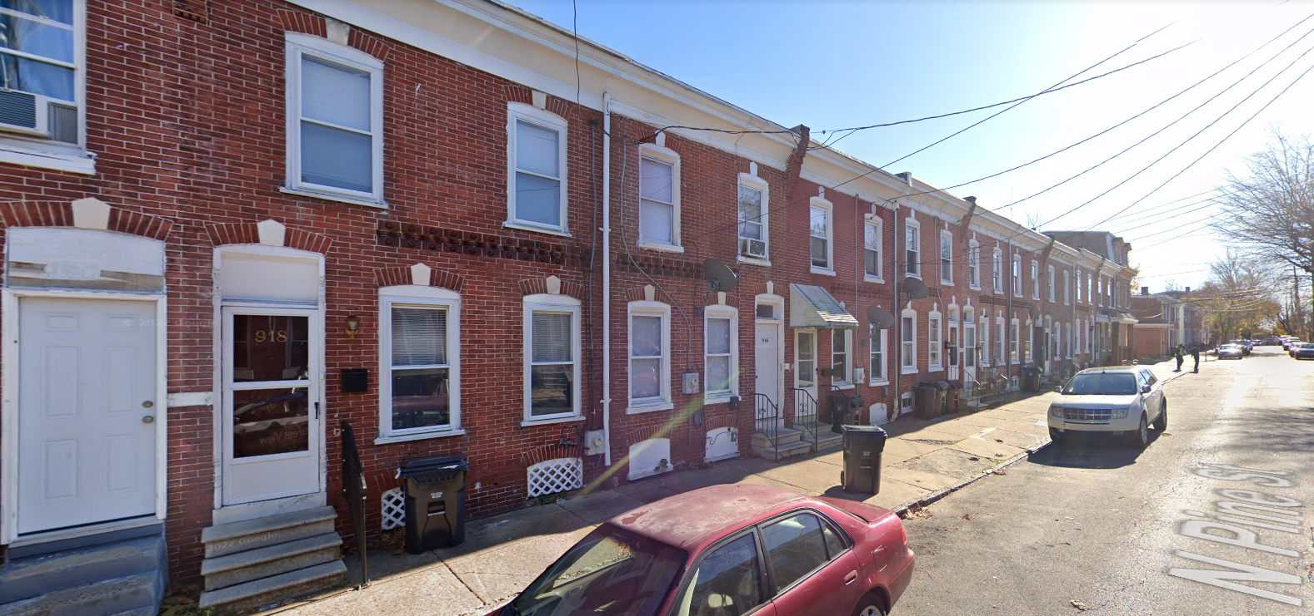
Wilmington Street Team
HUBS
914 N. Pine Street
Still looking for a HUB in Prices Run
Community Public Safety Initiative (CPSI)
City of Wilmington

Slide 12
Wilmington Street Team
Questions
Thank you
Contact information
Dr. Debra Mason
dmason@wilmingtonde.gov
302-893-5165
Community Public Safety Initiative (CPSI)
City of Wilmington

