Slide 1

Ordinance 23-042
Community Development and Urban Planning Committee
November 9, 2023

Slide 2
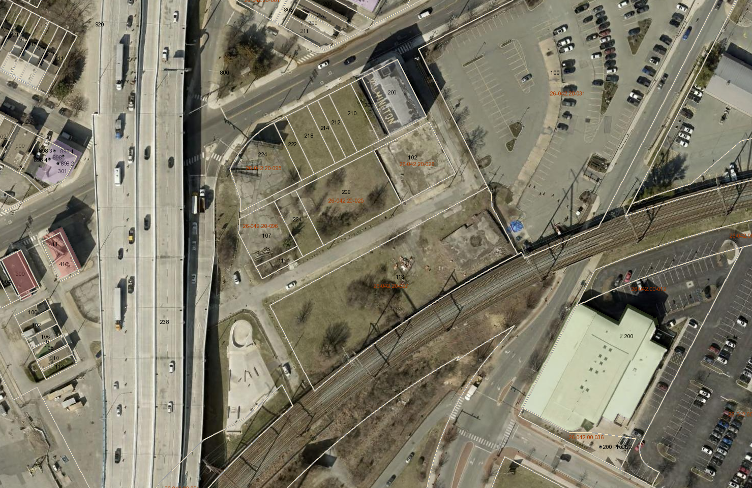
Context Map
Maryland Avenue
South Walnut Street
South Market Street
Lower Elm
Garasches Lane
Liberty Street
Maryland Ave
Lower Linden

Slide 3
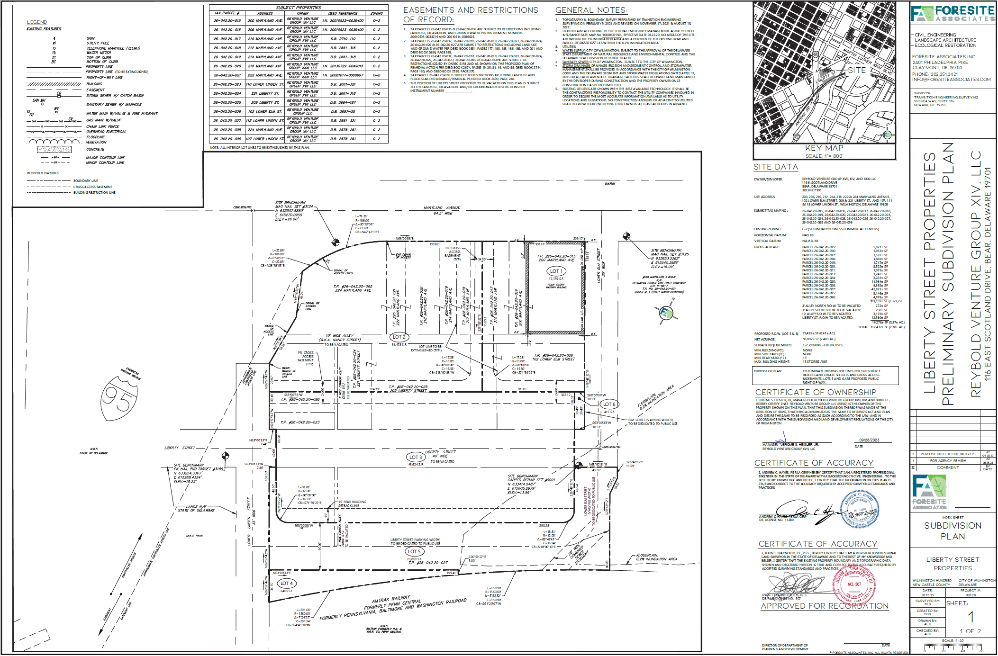
Major Subdivision Plan

Slide 4
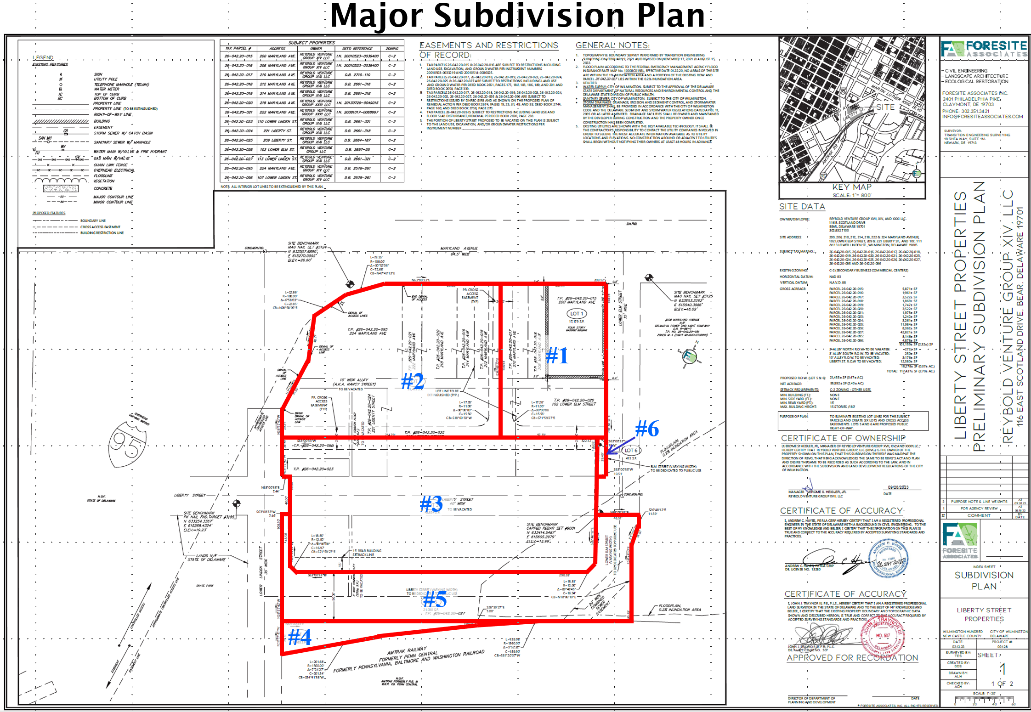

Slide 5
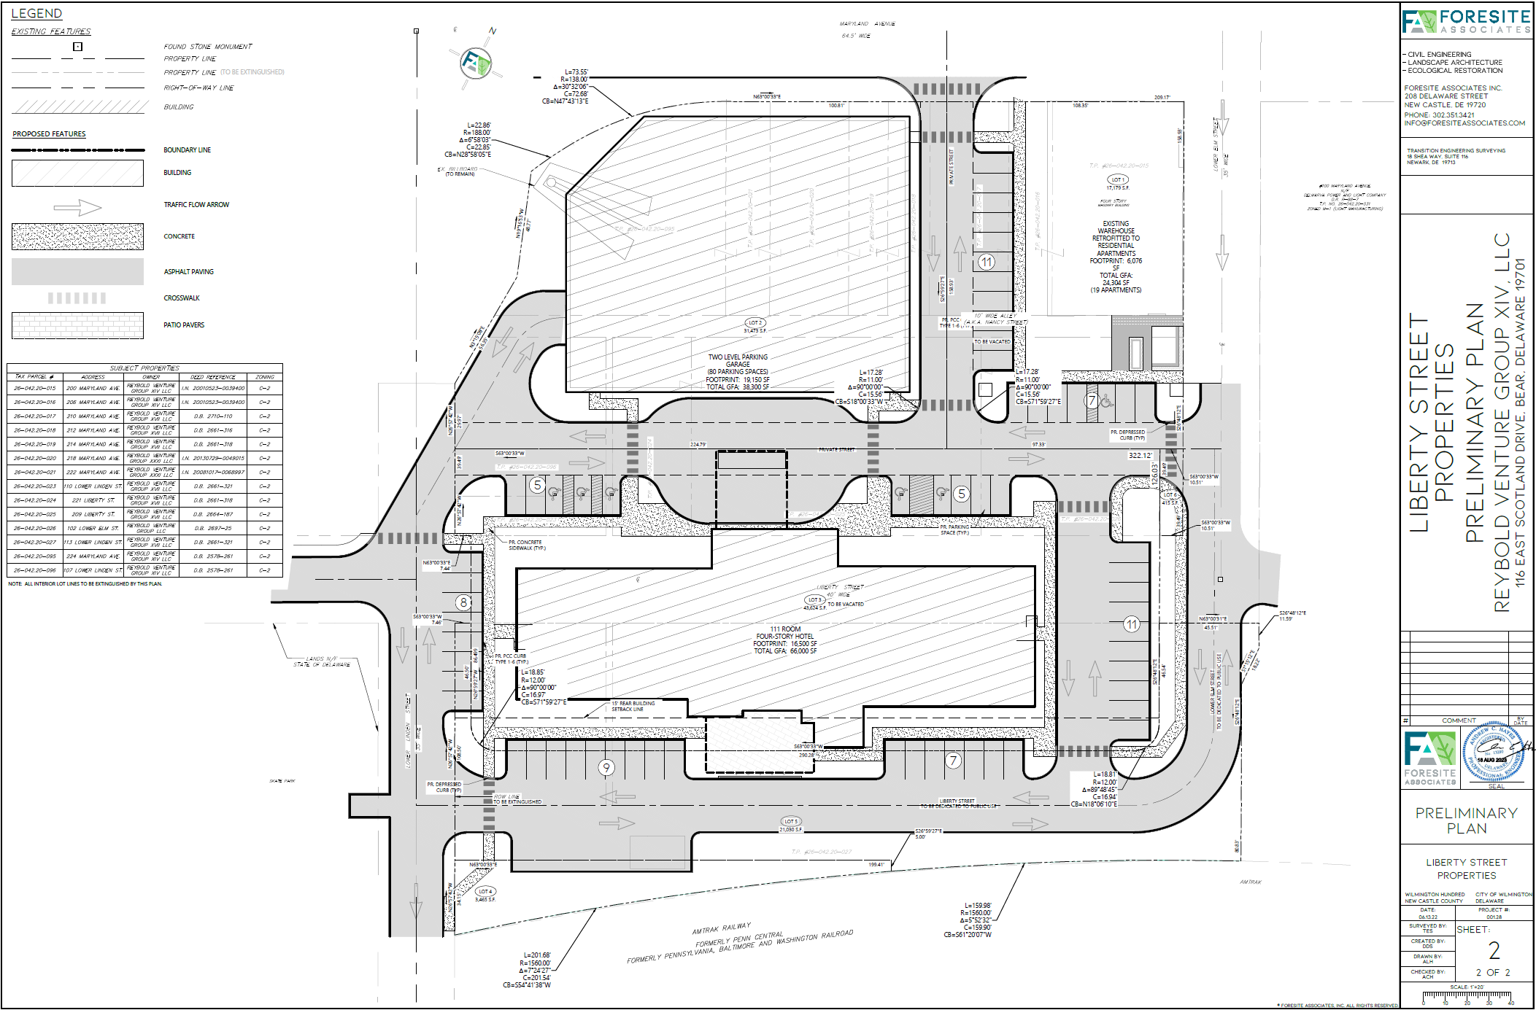
Street and Site Plan
Apartment
Building
Parking
Garage
Hotel

Slide 6
Street Actions
Lower Elm St.
Nancy Street
Liberty Street Removed
Relocated Liberty Street
Lower Linden St.

Slide 7

Thank You

