Slide 1

Ordinance 23-038
Community Development and Urban Planning Committee
November 9, 2023

Slide 2
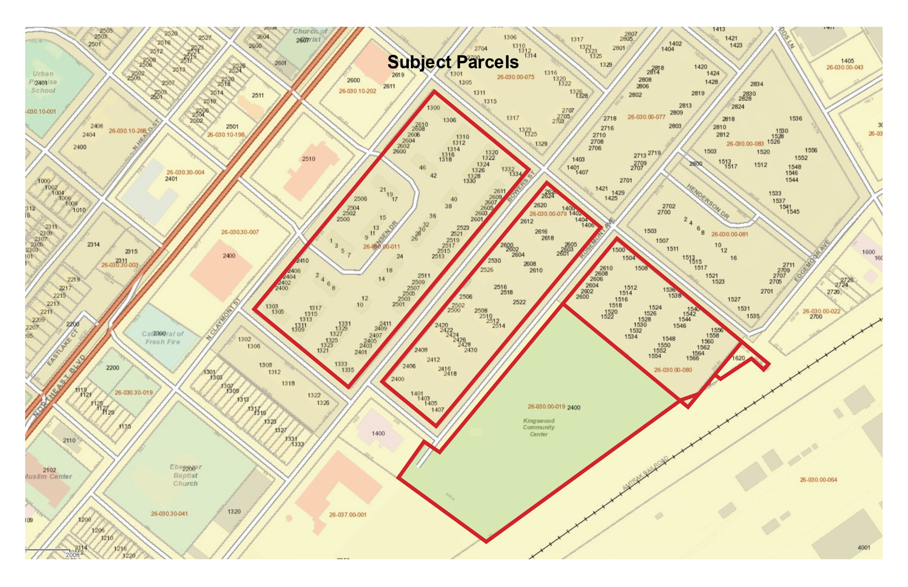

Slide 3
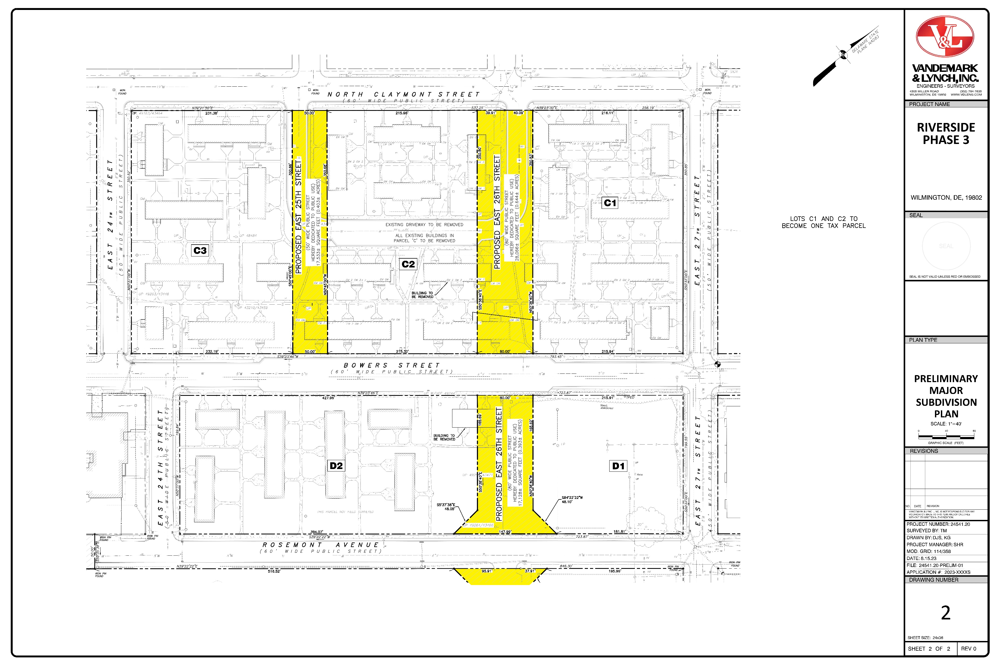

Slide 4
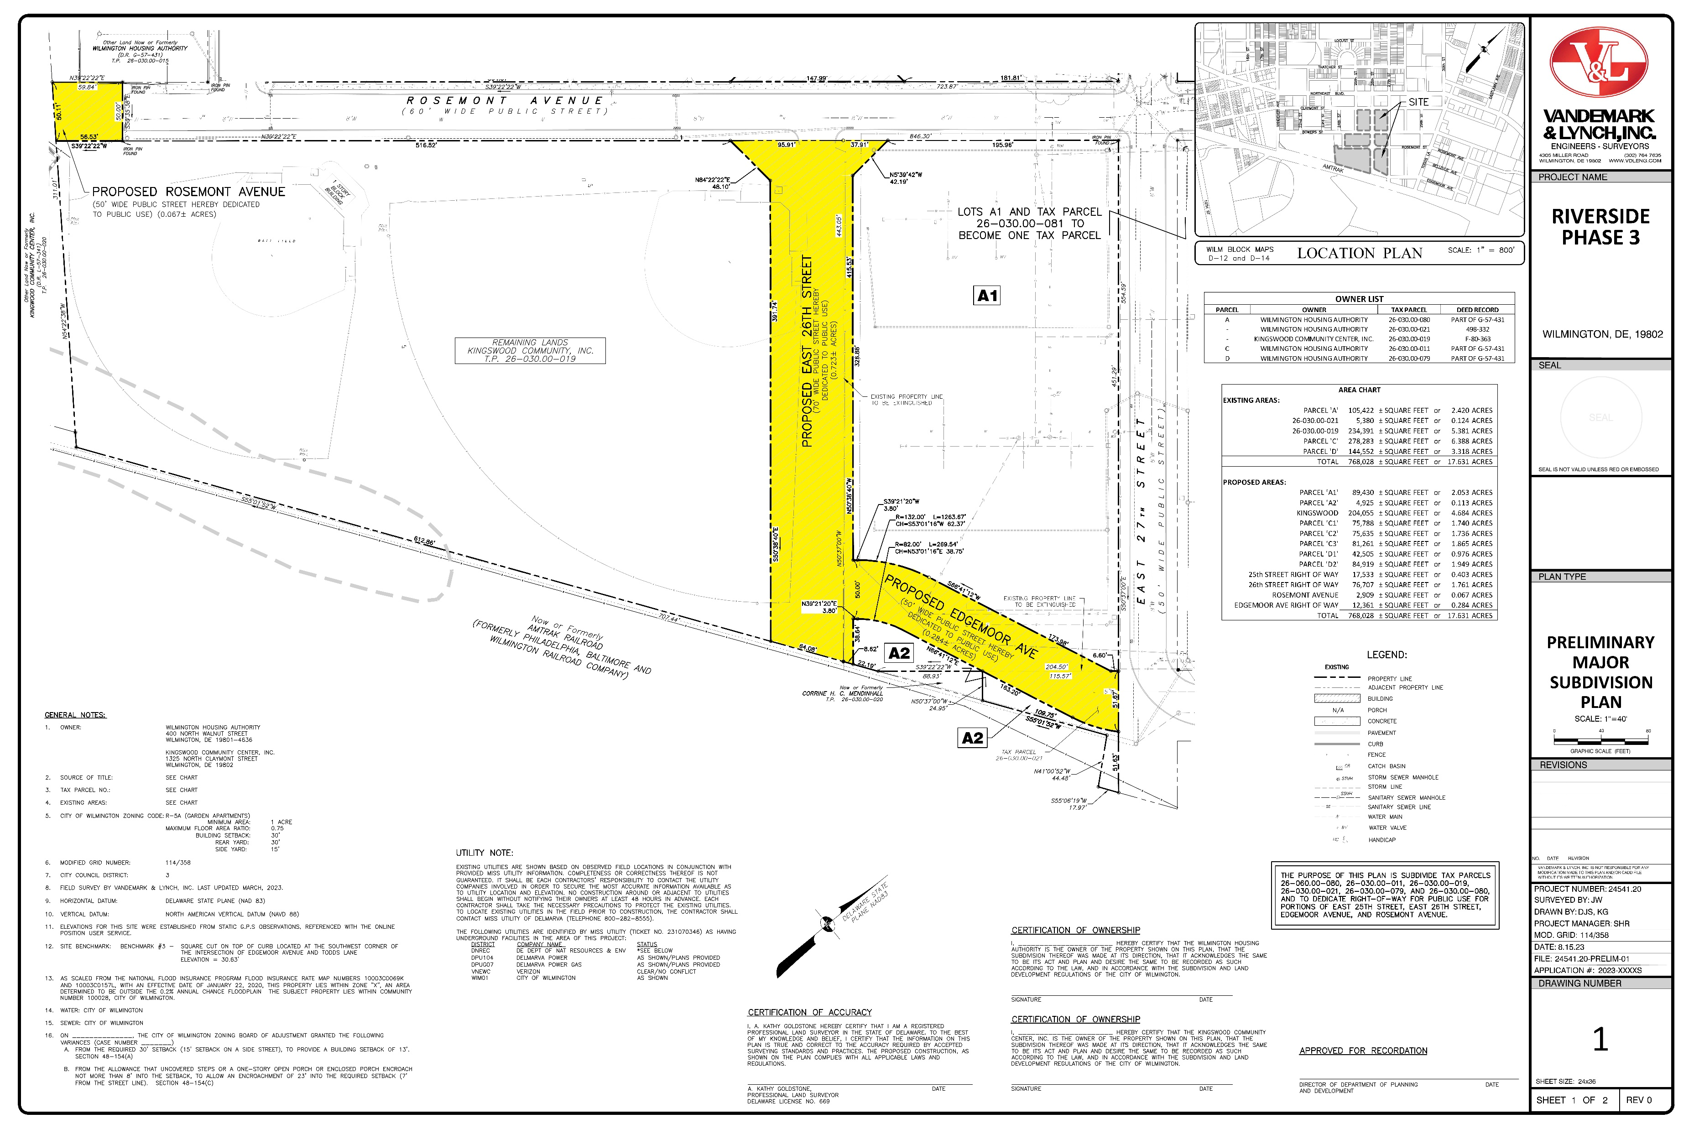

Slide 5
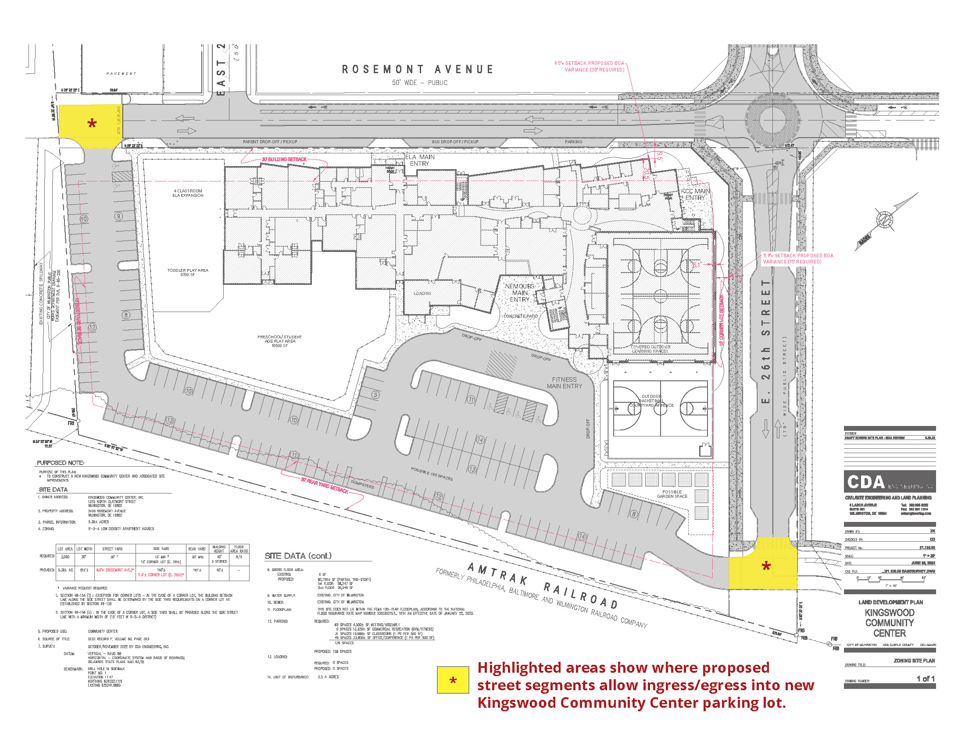

Slide 6

Thank You

