Slide 1
Community Development
& Urban Planning Committee
January 12, 2022
Ordinance 22-050:
A proposal to rezone the area generally bounded by Maryland Avenue, Amtrak Railroad Corridor, I-95 and Lower Elm Street from M-1 Light Manufacturing to C-2 Secondary Business Centers zoning

Slide 2
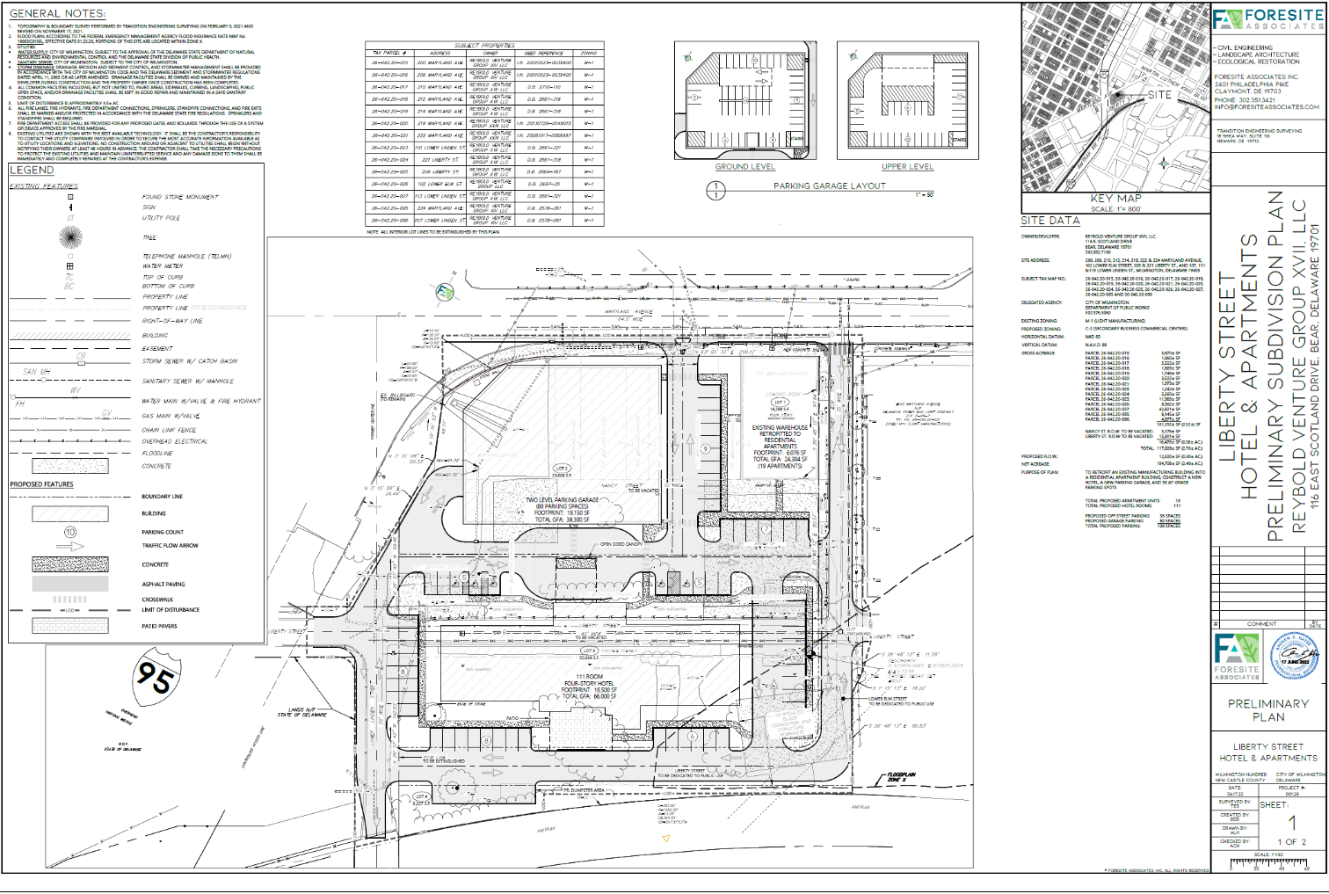
REYBOLD GROUP REDEVELOPMENT PROPOSAL
Maryland Avenue
2 story
garage
apartments
(existing vacant
warehouse)
hotel
2

Slide 3
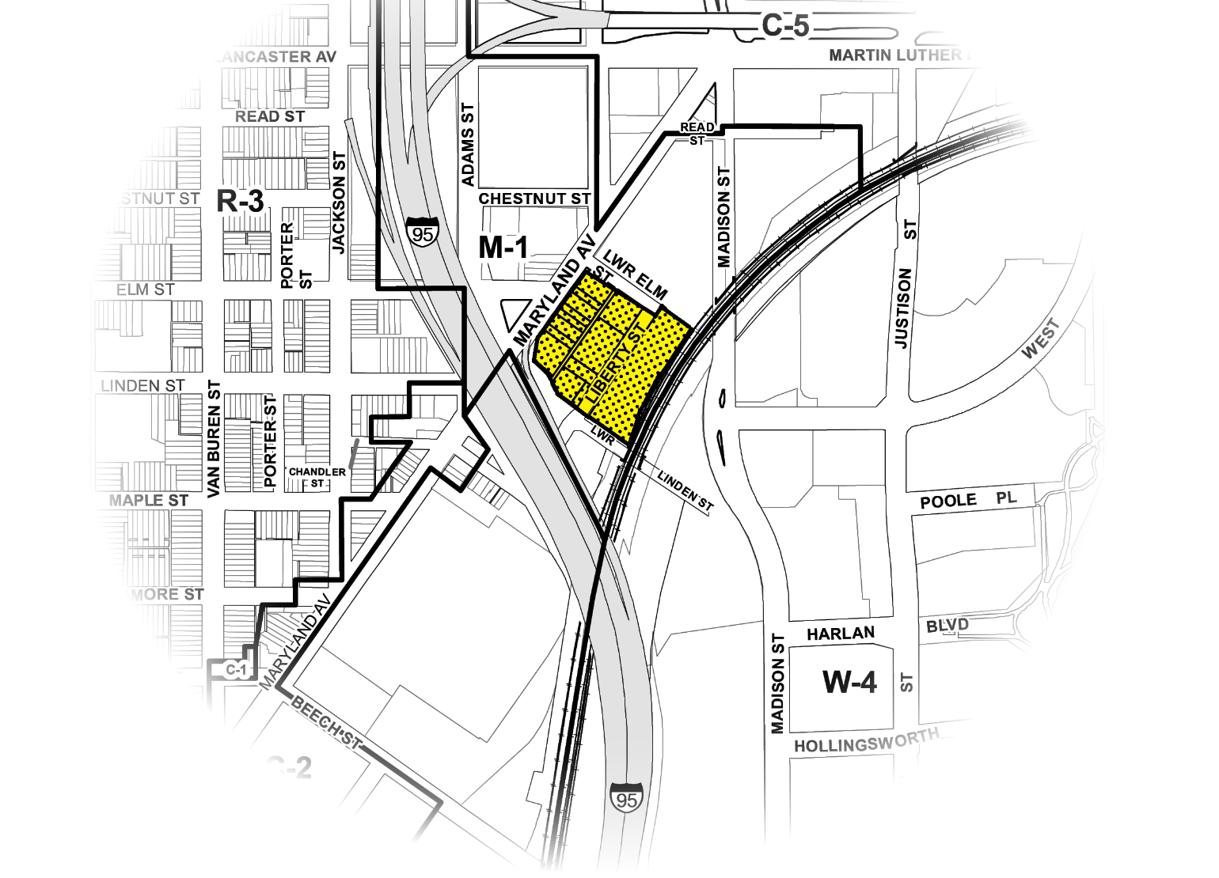
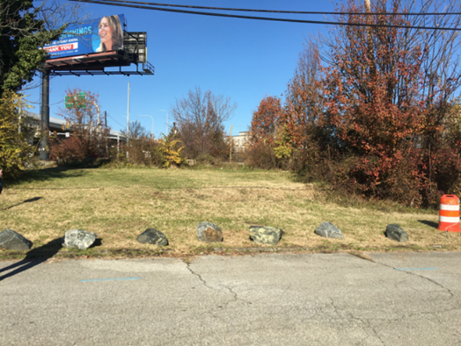
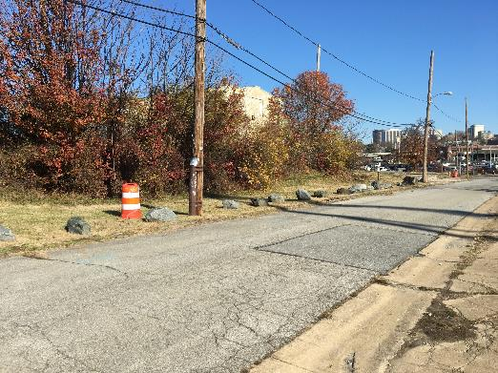
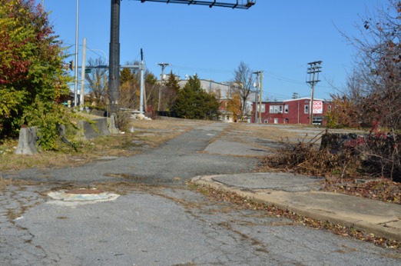
Rezoning Site
North of Liberty Street
#3
Liberty Street
#1
Liberty Street
#2
3

Slide 4
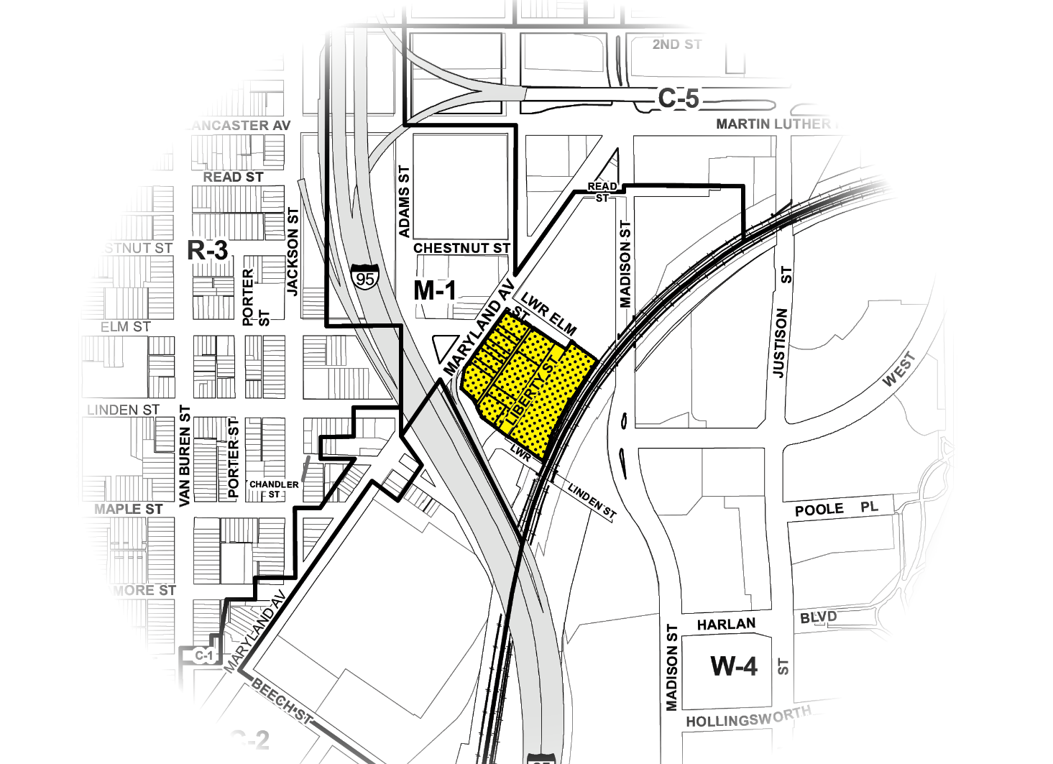
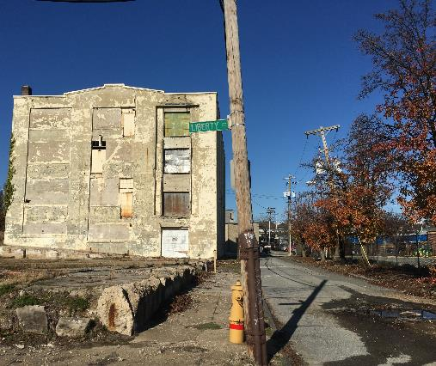
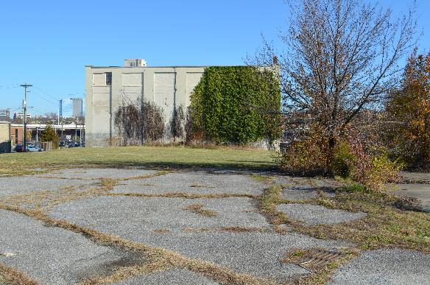
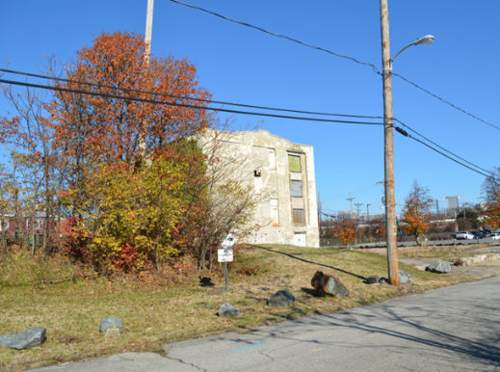
Rezoning Site
North of Liberty Street
#2
#1
#3
Liberty Street
4

Slide 5
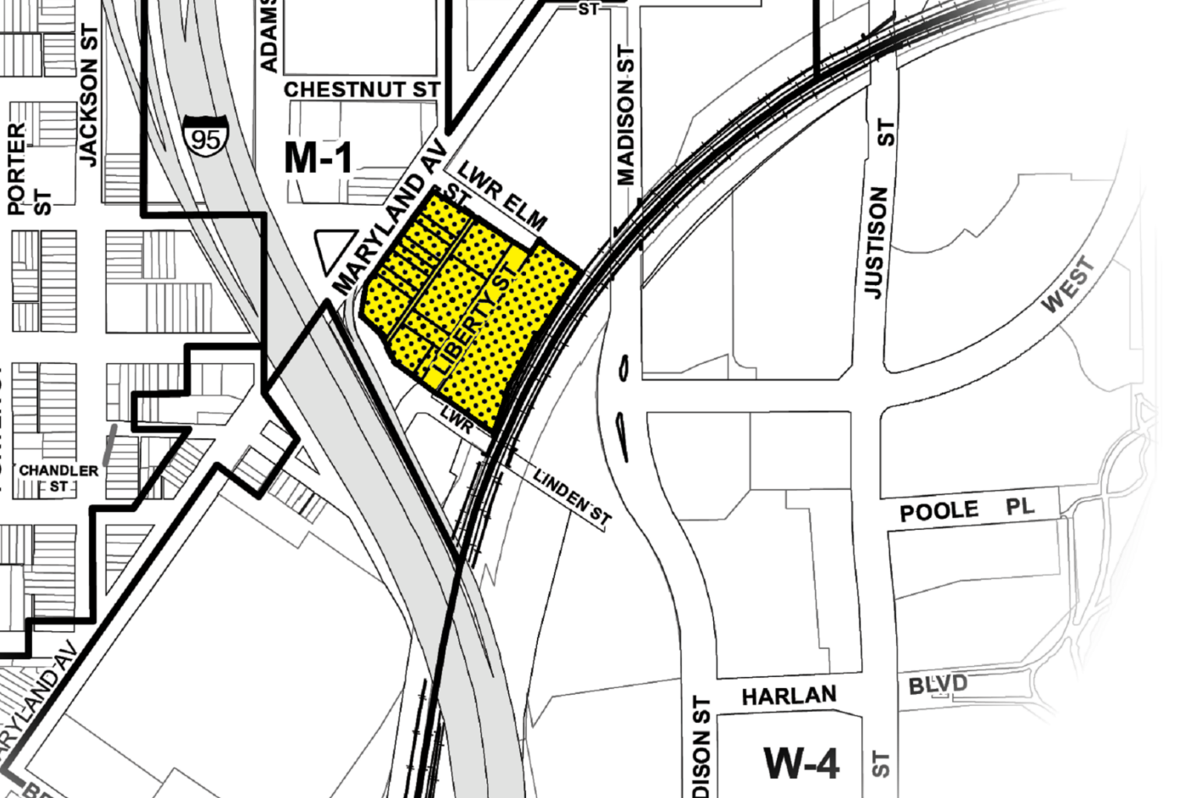
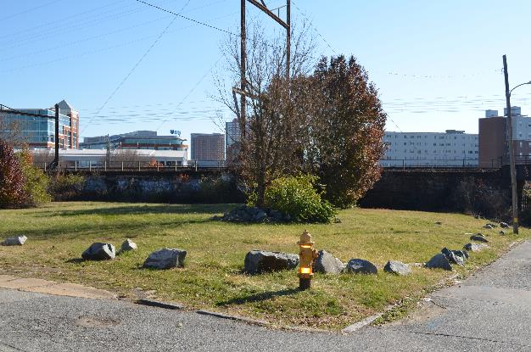
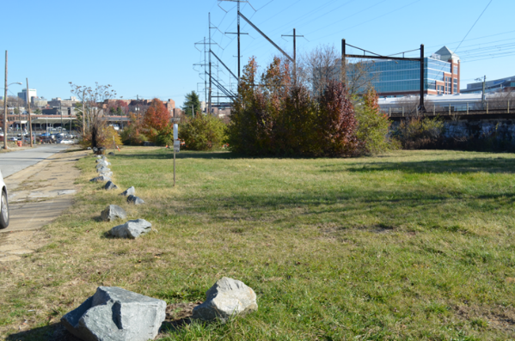
Rezoning Site
South of
Liberty Street
#1
Lower Linden
Liberty St.
#2
5

Slide 6
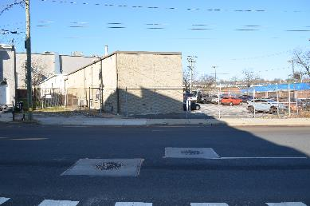
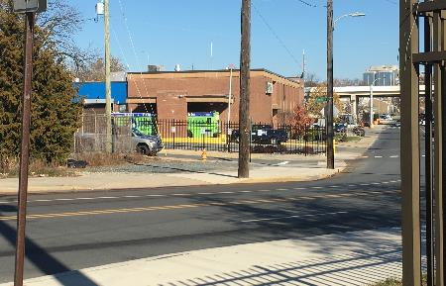
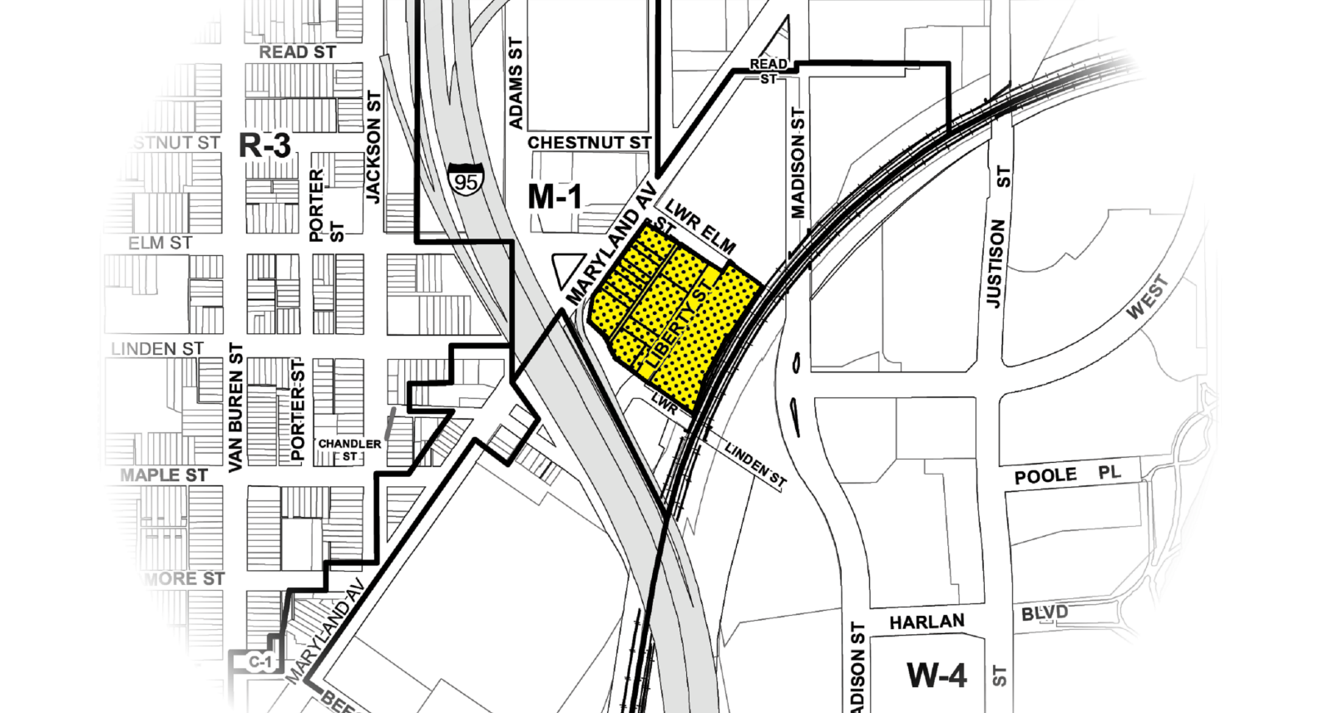
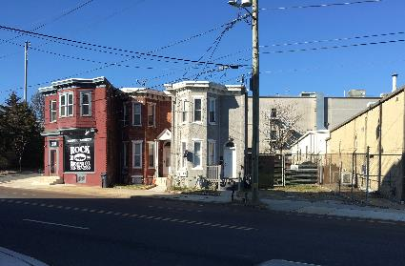
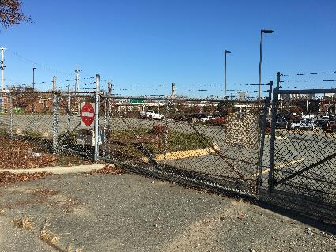
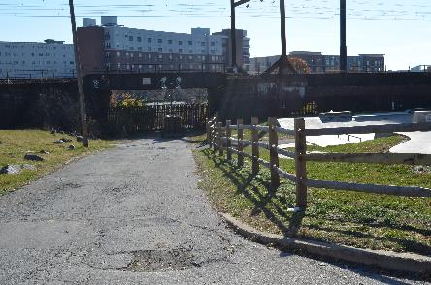
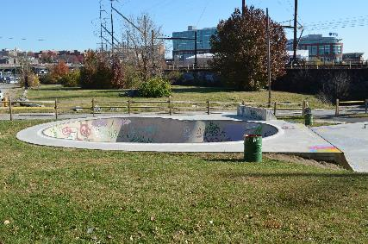
Land Uses Surrounding Rezoning Site
#2
DE Div. of
Forensic
Science
#3
DART
Operations
#1 Residential, commercial uses
#4 Delmarva Power
#6 View South
towards Amtrak Corridor
6
#5 Skateboard Park

Slide 7
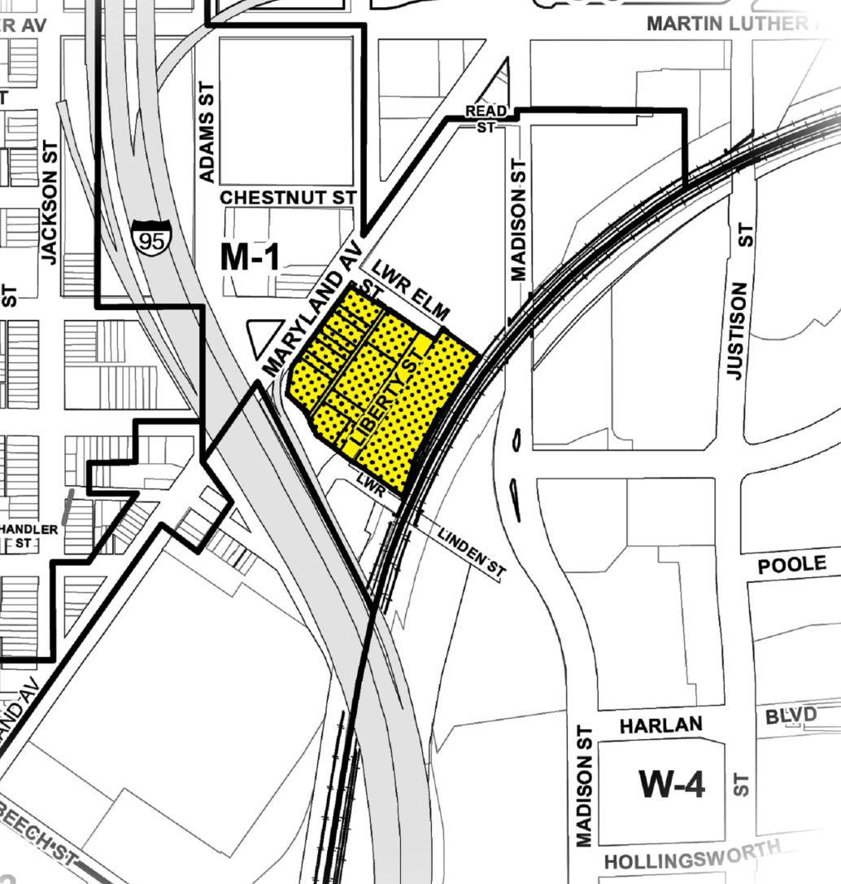
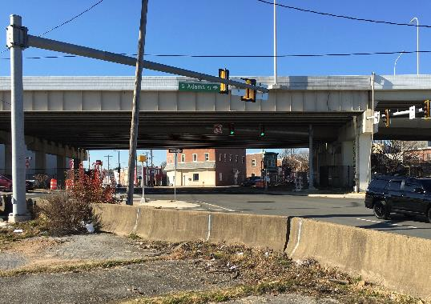
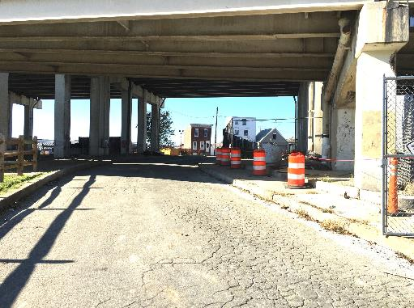
I-95
I-95 underpass looking west from Liberty Street
I-95 underpass
looking west from
Maryland Avenue
Liberty Street
#3
7

Slide 8
ZONING COMPARISON
Proposed C-2 Zone - Permitted Uses:
Hotels / Motels
Telephone central office
Funeral home
Non-nuisance businesses
Public garage, used car lot, gas station
Indoor theater, assembly hall, commercial recreation
Family day care & group day care homes, day care centers, emergency shelters
Residential (apartments, row homes, detached & semi-detached single family)
Commercial retail uses
Existing M-1 Zone - Permitted Uses:
Publishing
Laboratory for Research, testing or experiments
Light manufacturing, processing fabricating or Repair Establishment
Warehousing / Wholesale Sales / Storage
Offices (accessory to permitted uses), retail store, shops, restaurant
Group day care homes and day care centers
Indoor Commercial Horticultural Operation
Height: 4 stories
Bldg Setback: varies
FAR: 2.0
Height: 15 stories
Bldg Setback: no requirement
FAR: 5.0
8

Slide 9
REZONING IMPACTS
No Negative Land Use Impacts Result from Rezoning
  Site consists of vacant warehouse proposed for apartments, a permitted C-2 use
  Balance of site consists of vacant land
All Future Development must conform to C-2 Regulations
9

Slide 10
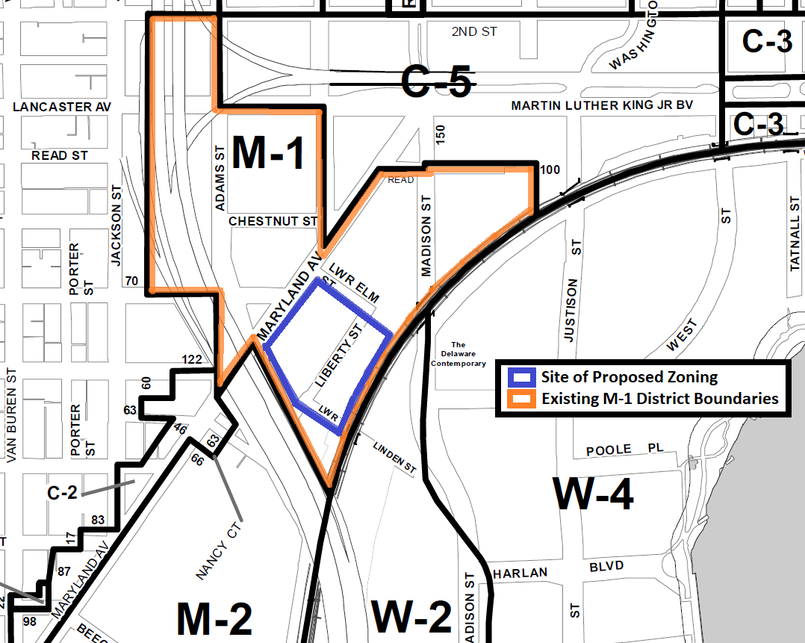
Current M-1
Zoning District Boundaries
10

Slide 11
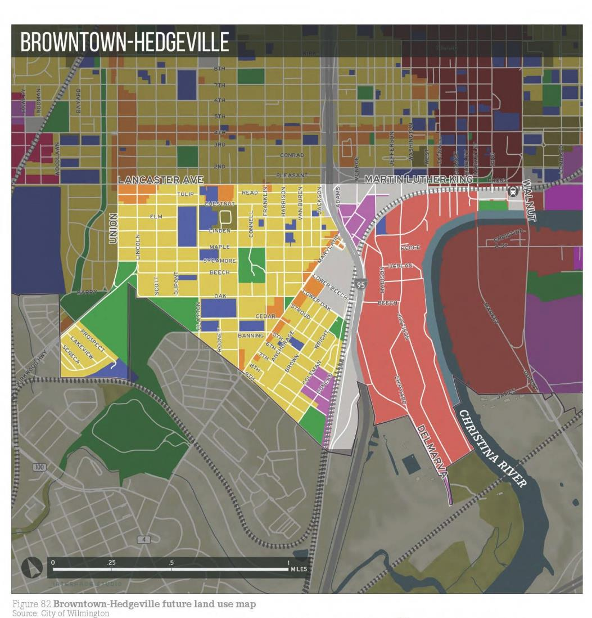
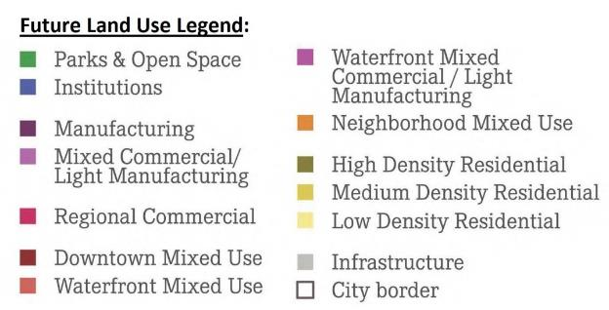
Wilmington 2028
Proposed rezoning is within the Browntown-Hedgeville Neighborhood
Plan recommends “Mixed Commercial/ Light Manufacturing” land use
Uses are consistent with proposed C-2 Secondary Business Centers Zoning
Rezoning
Site
11

Slide 12
CPC Recommendation / City Council Legislation
        Public Notice November 30 - Public Notice
  December 5 - Meeting Agenda (with Public Notice)
  - Legal Notice
        CPC Meeting December 13 - Public Hearing (CPC Resolution 9-22)
        Legislation December 8 - Introduction of Rezoning Ordinance 22-050
        - Resolution Scheduling Council Public Hearing
        January 12 - CD&UP Committee Review
        January 19 - City Council Public Hearing / Final Action
12

Slide 13
SUMMARY
Rezoning:
Maryland Avenue is an important City gateway. M-1 zoning is not appropriate along this commercial corridor
There are no manufacturing facilities in the M-1 district nor is light manufacturing appropriate adjacent to the Christina waterfront
Proposed C-2 zoning supports productive reuse of vacant site
Recommendation:
CPC and Planning recommend that City Council APPROVE Ordinance 22-050, a proposal to rezone 14 parcels within the area generally bounded by Maryland Avenue, Amtrak Railroad Corridor, I-95 and Lower Elm Street from M-1 Light Manufacturing to C-2 Secondary Business Centers zoning
13

Slide 14
Thank You

