Slide 1




New Castle County Reassessment 2025
Tyler Technologies

Slide 2
Court’s Decision in Reassessment Litigation?
The court determined that property values had changed significantly enough since the previous reassessment in 1983 and no longer represented the “true value of money” and that the current assessments were not uniform (i.e. not equitable).
The new assessed values will be effective for the 2025 tax year.

Slide 3
Reassessment Litigation
May 2020
To resolve pending litigation, New Castle County agreed to conduct a countywide reassessment.

Slide 4
Why Reassess?
A countywide reassessment values all properties at their current market value, restoring equity to all classes of property.

Slide 5

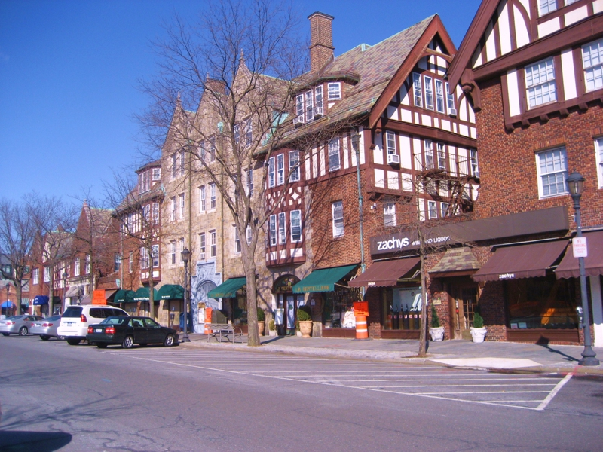

Reassessment Fears
Pay more taxes
Government will spend more
Discover unknown improvements on my property

Slide 6
Reassessment Fears – More Taxes?
Will a new assessment mean that I pay more in taxes?
A property's assessment should reflect its market value. As market values increase or decrease, assessed values may not reflect these changes. This means that some taxpayers could be paying more than their fair share of taxes, while others may be paying less than their fair share.
A reassessment does not necessarily mean that your assessment will increase. If your assessment does increase, it does not necessarily mean your taxes will increase.

Slide 7
Reassessment Fears – Government Spending
Will New Castle County collect more taxes as a result of the reassessment?
The county is capped by State law on how much additional revenue can be generated from reassessment. Following the reassessment, property tax rates will be adjusted to ensure the County does not collect more than allowed by statute. Per State law, the County is capped at a 15 percent increase in tax revenue following a reassessment.
New Castle County has committed to raising NO additional revenue with this reassessment!

Slide 8
Reassessment Fears – Government Spending
Will the local School Districts collect more taxes as a result of the reassessment?
School Districts are capped by State law on how much additional revenue can be generated from reassessment. Per State law, the School Districts are capped at 10 percent in additional revenue.
If you are concerned that the School District portion of your real estate taxes will increase, please contact your School District to address your concern.

Slide 9
Reassessment Fears – Government Spending
Will the City of Wilmington collect more taxes as a result of the reassessment?
A municipality may increase its property tax rate following reassessment. There is no statutory limit on the amount of additional tax revenue a municipality may raise. In New Castle County, municipalities use the County’s assessments.
If you live in the City of Wilmington, you should contact your City officials regarding any concerns you have specific to post-reassessment municipal taxes.

Slide 10
Reassessment Fears – Government Spending
A reassessment does not increase or decrease tax revenues. It only apportions the total tax burden more fairly by setting new assessed values.
While the overall impact on a community is capped by State law, individual property owners may see their taxes decrease or increase.

Slide 11
Countywide Reassessment – Tax Rate Change

Slide 12
Countywide Reassessment – Tax Rate Change

Slide 13
Countywide Reassessment – Tax Rate Change

Slide 14
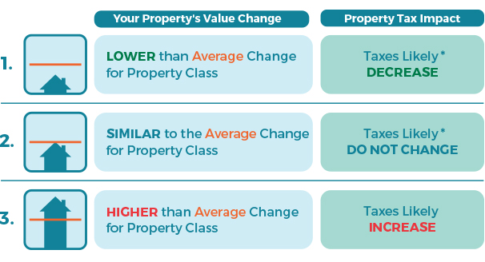
Countywide Reassessment – Revenue Neutral

Slide 15
Reassessment Fears – Discover Improvements
Discover Unknown Improvements
Updating assessment records to include newly discovered improvements ensures equity and that everyone pays their fair share of property taxes. The County is not using the reassessment to uncover code violations.
Countywide reassessments are intended to restore tax fairness.

Slide 16

Phases of Reassessment
Data Collection
Fall 2021
To
Late
2023
Data Analysis
Early 2023
To
Late
2024
Valuation Review & Informal Meetings
Late 2024
to
Early 2025
Aerial Imaging
Spring
of
2021

Slide 17

Aerial Imagery
SPRING OF 2021
New Castle County contracted with EagleView to collect aerial imagery. The flyover occurred in early 2021. This is not a Tyler Technologies project. However, the photos are being utilized for the reassessment project.

Slide 18
Data Collection
Trained data collectors will visit every property in New Castle County.
Data collectors can be identified by their bright yellow Tyler vest, and they will have a New Castle County issued photo ID badge.
Exterior measurements will be taken of all improvements.
All observations, notations, and sketch changes will be documented and returned for entry into the County’s CAMA (Computer Assisted Mass Appraisal) software.

Slide 19
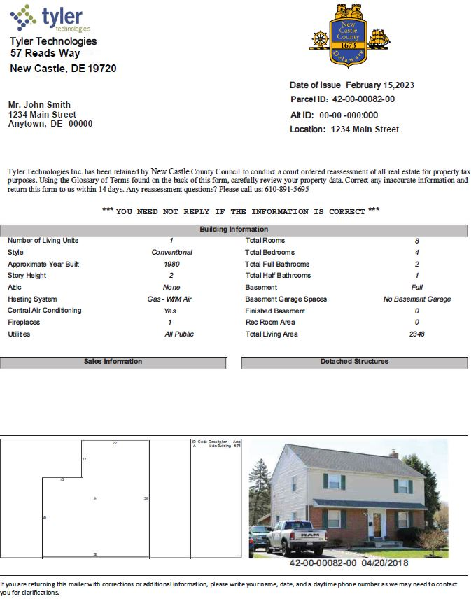
Data Mailers
Mailed to each property owner
Summer of 2024
Opportunity for owner to review and confirm and/or correct the items which will impact property values
In order to ensure accuracy and a high-quality level of the assessment data, the data mailer should be signed and returned to us if any of the information needs to be corrected.
Notes:
Owner Info: Name, Address, Tax Parcel ID,
Dwelling Characteristics: Style, Number of Stories, Attic, Basement type & Finish, Room Counts, Heating/Cooling, Square Footage
Sales History
Outbuildings
Sketch
Photo
Verify/Correct, Sign & Return

Slide 20
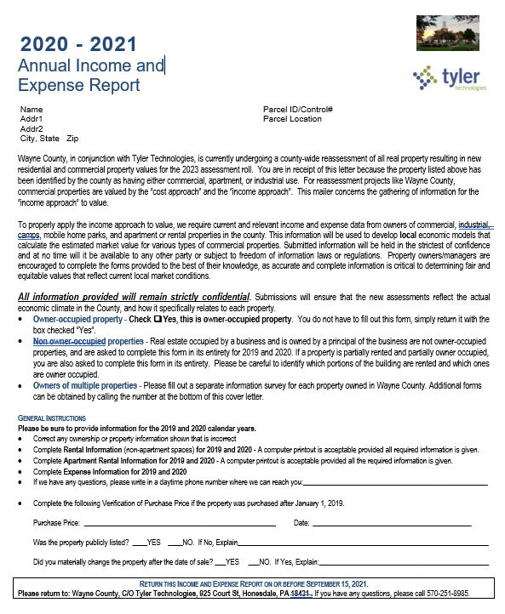
Income and Expense Surveys
This information is not being gathered for residential properties
Commercial properties are valued by the “cost approach” and the “income approach”
Surveys will gather current and relevant income and expense data from owners of commercial, industrial and apartment properties
Mailed in Summer 2024
Gathers data for multiple years
***All information provided will remain strictly confidential

Slide 21
Operating Statement – Retail, Industrial, Warehouse,
Other
Retail, Industrial, & Other Income Producing Properties
Total Gross Building Area
Net Leasable Area
Occupancy Status
Specific Use

Slide 22
Operating Statement - Apartments
Apartments
Resorts
Hotels/Motels
Number of Units
Unit Configuration
Amenities

Slide 23
Income and Expense Surveys
Property owners/managers are encouraged to complete the provided forms to the best of their knowledge. Accurate and complete information is critical to determining fair and equitable values that reflect current local market conditions and will eliminate the need to conduct market surveys of similar properties from published commercial real estate market sources.

Slide 24

Data Review & Analysis
DATA ANALYSIS

Slide 25
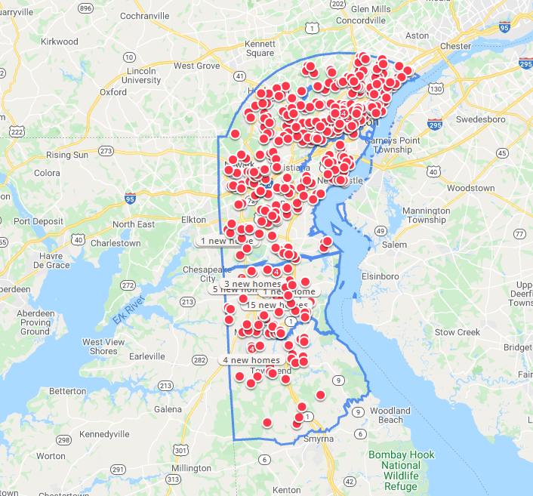

Sales Market
A sales study will be conducted for properties that sold within New Castle County over a 30-month period ending on June 30, 2024.
Data Analysis

Slide 26
Valuation
Tyler’s valuation specialists will use the collected data to calibrate computerized models specific to the New Castle County market.
Identify market areas within the jurisdiction.
Develop models relating price to property characteristics.
Use the models to select comparable sales prices to subject properties being valued.
Select appropriate comparable sales for each subject.

Slide 27
Valuation
Three accepted approaches/methods to arrive at value:
Market or sales approach - estimates value by comparing sales of similar properties to the property being appraised.
Cost approach - estimates value based upon the replacement cost of the improvements, less depreciation, plus the value of the land.
Income approach - estimates value by capitalizing the net operating income of a property.
      Typically, not used to estimate residential market values
Notes:
Market approach is normally the recommended for residential. Commercial income approach. If ever had an appraisal for financing purposes

Slide 28
Notice to Taxpayers
Late in 2024, property owners will receive a notice of the new tentative appraised value. Property owners are encouraged to evaluate whether the assessment appears to be at market value. If one believes the appraised value to be at market value, no further action is required.

Slide 29

Informal Hearings
Informal Meetings with Tyler Appraisal Staff
If you believe the tentative appraised value does not reflect the current market value, instructions will be provided with the notice on how to arrange an informal review of the value with Tyler.
These reviews give the property owner a simple and efficient means for resolving any discrepancies.

Slide 30

Informal Property Review
Informal Review Goals
One on one meetings with property owners
Review property data
Collect new information
Correct existing data as needed

Slide 31
Quality-Driven Process = Quality Results
Quality Data Collection
Detailed Analysis and Modeling
Accurate Valuation Review and Hearings
Fairness Equity Transparency

Slide 32
Tyler Technologies Contact Information
Michael McFarlane
Tyler Project Supervisor
(302) 395-3620
NewCastleCounty@tylertech.com

Slide 33
County Assessment Contact Information
Denzil Hardman
Accounting & Fiscal Manager
Assessment
(302) 395-5083

Slide 34
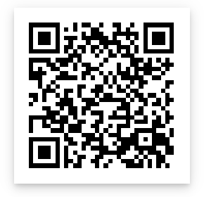
Reassessment Project Website
For Further Information:
https://empower.tylertech.com/New-Castle-County-Delaware.html

Slide 35
Thank you for joining us today.
We would be happy to answer any questions at this time.
Or visit us at
tylertech.com

