Slide 1




Health, Aging & Disabilities Committee Meeting
Wilmington City Council
Wednesday, October 23, 2023
Presented by: Tanya N. Bayne, Community Health Advocate

Slide 2

THE ABC
WHO IS THE ASSOCIATION OF BLACK CARDIOLOGISTS
The Association of Black Cardiologists (ABC) is a nonprofit organization dedicated to the prevention and treatment of cardiovascular disease, including stroke, in Black communities across the US.
With nearly 50 years of expertise since its founding in 1974 by Dr. Richard Allen Williams, the ABC has emerged as a leading authority in addressing cardiovascular health disparities.
The ABC works to eliminate disparities related to cardiovascular disease by advocating for research, education, and community outreach.
The ABC also aims to address the underrepresentation of minorities in clinical trials and improve access to quality cardiovascular care for underserved populations.
ABC's vision, credibility, and comprehensive approach position the organization as a transformative force in the fight against heart health disparities. With its rich history, diverse network, and expertise, ABC is poised to make a lasting impact.
By championing a diverse workforce, supporting research to uncover and adequately address the root causes of health disparity, and creating programs to empower communities, ABC is leading the change needed to ensure equitable health outcomes for all. Together, we can build a future where cardiovascular health disparities are a thing of the past and every individual has the opportunity to thrive with a healthy heart.
Notes:
Just Who Is the ABC? The Association of Black Cardiologists (ABC) is a nonprofit organization dedicated to the prevention and treatment of cardiovascular disease, including stroke, in Black communities across the US. With nearly 50 years of expertise since its founding in 1974 by Dr. Richard Allen Williams, the ABC has emerged as a leading authority in addressing cardiovascular health disparities.

Slide 3

50TH ANNIVERSARY CAMPAIGN
STRATEGIC PILLARS
Diversify The
Workforce
Clinical
Trials &
Research
text
The ABC seeks to advance cardiovascular health disparity by focusing on four strategic pillars that can address root causes and promote sustainable solutions that will ignite the change our communities need.
Community Health
Programs
Advocacy
& Capacity
Building
Notes:
These are our four pillars ---workforce diversity, diversity in research, advocacy and capacity building, and importantly community engagement-- An important emphasis here this evening….

Slide 4



Our why:
CARDIOVASCULAR DISEASE & STROKE
THE #1 KILLER OF AMERICANS
34 Seconds
1 American dies every 34 seconds from cardiovascular disease
650,000+
Deaths
per year
38%
of all deaths are attributable to cardiovascular disease and stroke
DISPROPORTIONATE IMPACT ON
THE BLACK COMMUNITY
30%
Blacks experience higher mortality rates than Whites for cases of heart failure
20%
of Blacks are more likely to develop heart disease at a younger age than Whites.
2X
Blacks are twice as likely
to die from Stroke.
Notes:
This slide amplifies ABC’s raison d’etre. It’s our Why….. These startling statistics show that heart disease and stroke combined are the #1 killer of Americans. The enormous impact on the Black community is reflected here.

Slide 5
Hypertension Prevalence in Delaware, by Race, 2011-2021
Source: Delaware Health & Social Services, Division of Public Health, Behavioral Risk Factor Survey (BRFS), 2011-2021
Notes:
The prevalence of hypertension is consistently higher over multiple time periods among non-Hispanic Blacks compared to non-Hispanic Whites. While the difference between non-Hispanic Blacks and non-Hispanic Whites have narrowed over the past eight years, this narrowing is because the prevalence of hypertension has increased among non-Hispanic Whites.

Slide 6
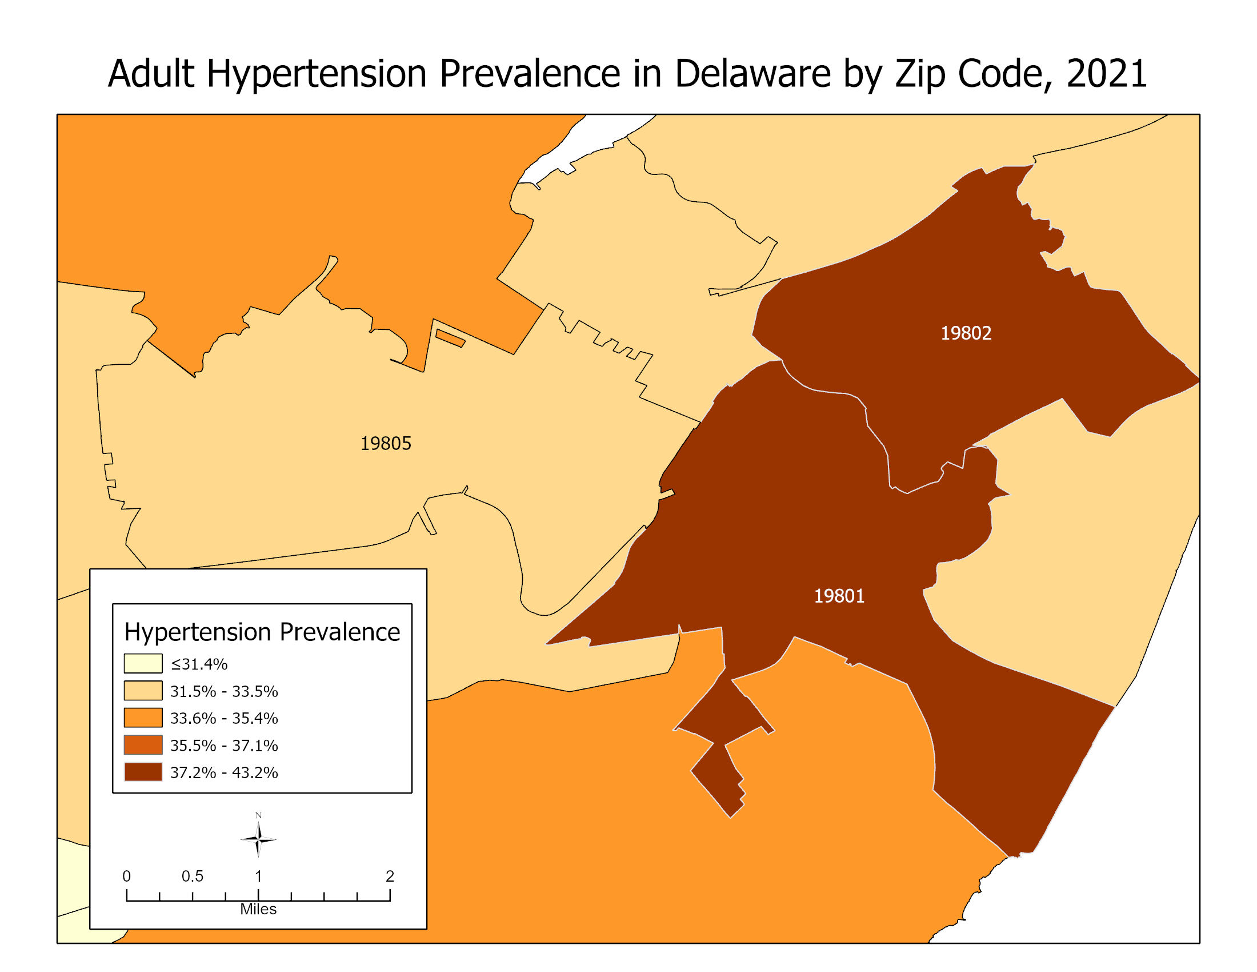
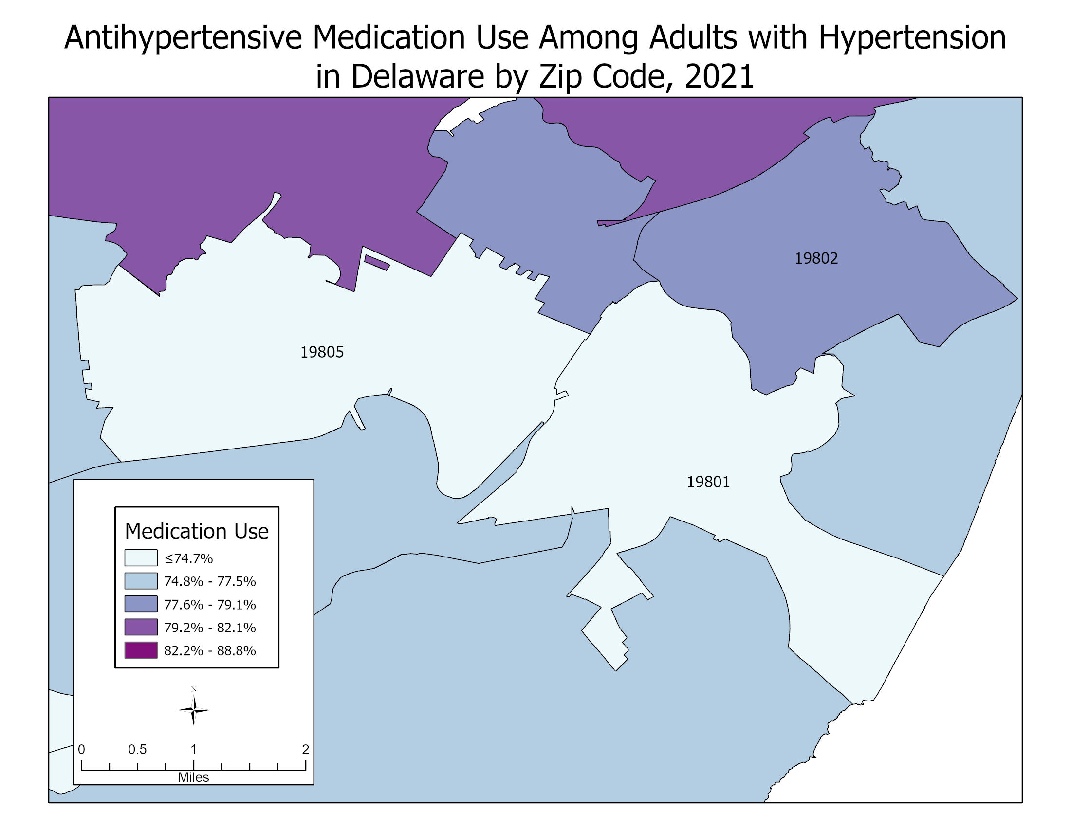
Adult Hypertension and Antihypertensive Medication Usage by Zip Code, 2021
Data Source: PLACES: Local Data for Better Health, ZCTA Data 2023 release. Centers for Disease Control and Prevention. Accessed September 20, 2023. https://www.cdc.gov/places
Notes:
This map on the left shows that zip codes 19801 and 19802 are in top 20% of zip code statewide for hypertension prevalence. The map on the right shows 19801 and 19805 are in the lowest lowest 20% for antihypertensive medication use among adults with hypertension. Zip code 19802 appears to have a higher antihypertensive medication usage. These two maps show some of the highest areas of need for hypertension control within New Castle County.

Slide 7
Essential Hypertension and Hypertensive Renal Disease Mortality, 2004-2020
Source: Delaware Health Statistics Center. Delaware Vital Statistics Executive Summary Report, 2020. Delaware Department of Health and Social Services, Division of Public Health, 2022.
Notes:
During this time period, non-Hispanic Blacks continue to have high mortality rates compared to non-Hispanic Whites.
For example, non-Hispanic Black males have an age-adjusted mortality rate of 11.7 deaths per 100,000 people compared to only 5.1 deaths per 100,000 people among non-Hispanic White males. That means Black males still have a 112% higher age-adjusted mortality rate compared to White males. Likewise, non-Hispanic Black females have an age-adjusted mortality rate of 8.1 deaths per 100,000 compared to only 4.7 deaths per 100,000. Black females have a 72% higher age-adjusted mortality rate compared to white females.

Slide 8
Cerebrovascular Disease Mortality
Age-Adjusted Mortality Rates, 2004-2020
Source: Delaware Health Statistics Center. Delaware Vital Statistics Executive Summary Report, 2020. Delaware Department of Health and Social Services, Division of Public Health, 2022.
Notes:
Hypertension is a major risk factor of cerebrovascular disease. As in essential hypertension and hypertensive renal disease age-adjusted mortality rates, there are differences in cerebrovascular disease mortality rates by race and sex.

Slide 9
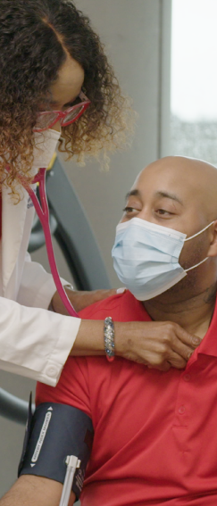

COMMUNITY EMPOWERMENT
Engaging the community as true partners in change
THE ISSUE:
We believe that the fight against heart disease is a collective effort that requires community-wide participation. We are dedicated to enhancing community programs and raising heart health awareness, particularly in communities with a high percentage of Black residents who face a greater risk of heart disease and stroke compared to their White counterparts.
THE VISION:
Through our health promotion programs, strategic partnerships, and a network of passionate community health advocates, we strive to develop innovative approaches that improve heart health and save lives. Our goal is to deepen our engagement with communities and foster a comprehensive understanding of the signs and dangers of heart disease among those most affected.
THE SOLUTION:
We recognize the need to expand our reach and resources to touch the lives of even more communities across the nation. Below are the initiatives we plan to undertake
ABC’s Signatures Initiatives | Description of initiative
 | Spirit of the Heart Community Programs
 | Credible Educational Resources
Notes:
Speaking of Community Engagement, the ABC believes that the fight against heart disease is a collective effort that requires community-wide participation. We are dedicated to enhancing community programs and raising heart health awareness, particularly in communities with a high percentage of Black residents who face a greater risk of heart disease and stroke compared to their White counterparts

Slide 10




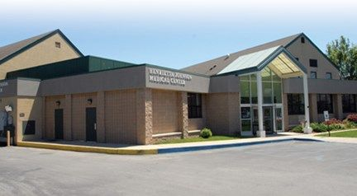
Community Level
Federally Qualified Health Centers
Provide technical assistance and workflow modifications for providers
Team-based care approach
Clinical-community linkages
Notes:
Most of our community level strategies focus on health care systems.
Under Cooperative Agreement 2304, the national cardiovascular health program, Delaware has approximately 100 MOUs with provider practice to deliver workflow assessments, technical assistance, academic detailing all of which are provided by practice transformation specialists.
We also provide academic detailing for Medicaid Management Care Organizations, Delaware First Health and Highmark Health Options (HHO).
Our program has worked to implement a MULTIDIRECTIONAL REFERRAL system – through Unite Us, we can receive referrals for the HHA-BPSM, and we can provide social service referrals for those with social needs. This includes referrals for housing, transportation, food, electric and heat, mental health, substance abuse.
Under the WISEWOMAN cooperative agreement, hypertension prevention and control activities take place within the Federally Qualified Health Centers (FQHCs). Delaware has three FQHCs: Westside Health, LaRed, and Henrietta Johnson.

Slide 11

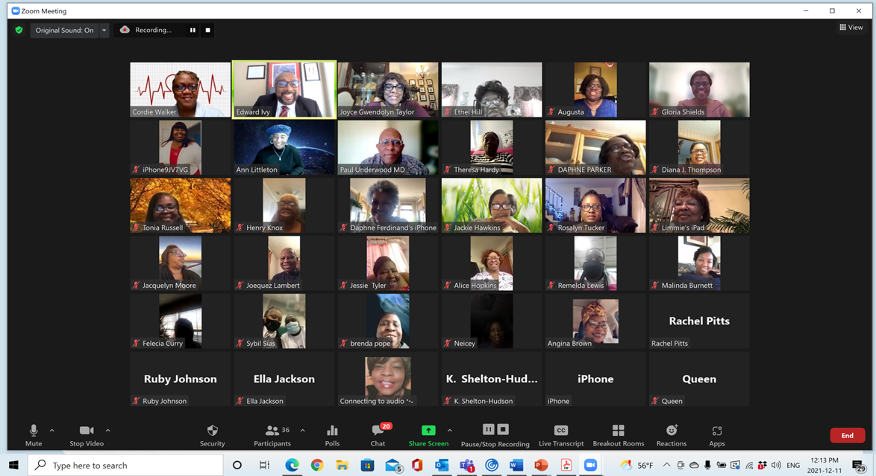


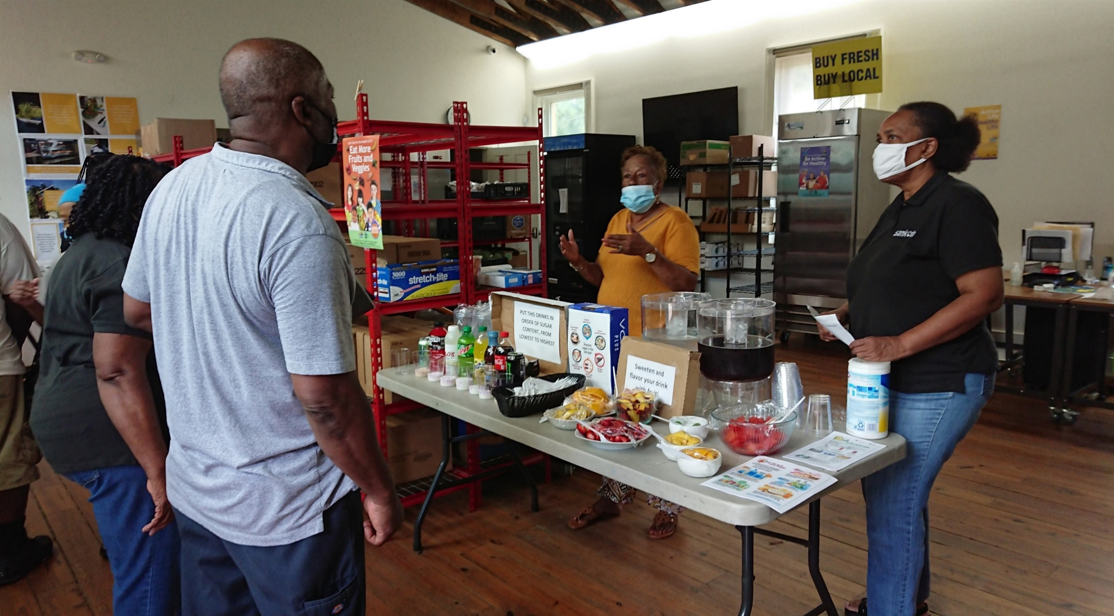
Community Health Advocate Training (CHAT)
 | Building Capacity through training and leadership development
Mobilizing Communities toward an integrated and comprehensive approach to reducing the burden of CVD |  | Engaging Communities through partnership development and Community Participatory Planning
 | Systems Approach Linking community education with clinical management
ABC Community
Health Advocates
Notes:
ABC’s signature Community Health Advocate Training

Slide 12
Community Health Advocate Training (CHAT) Program
The goal of the ABC Community Health Advocate Training (CHAT) Program is to train and empower individuals to serve their communities as Community Health Advocates (CHAs) to engage the healthcare and political systems to reduce disparities in cardiovascular health experienced disproportionately by African Americans.
CHAs can be anyone in the community that would like to drive change in health for their families and neighbors. While the program is designed to provide education and strategies to individuals with little or no past experience in healthcare, the program can also be used by seasoned nurses and physicians to learn more effective ways to communicate the risk factors for heart disease.
The CHAT program is designed to educate CHAs on policy issues and to teach more proactive approaches towards influencing change that affects health and well-being.

Slide 13
Community Health Advocate Training (CHAT) Program
The “With Every Heartbeat is Life” Community Health Worker Manual
The “With Every Heartbeat is Life” Community Health Worker Manual is a resource developed by the National Heart, Lung and Blood Institute specifically for the African American community. The manual provides a 12-session curriculum with 10 sessions dedicated to common risk factors for cardiovascular disease. The manual is culturally sensitive and language appropriate to help CHAs deliver effective education to the communities they serve.
The training sessions are typically held on a Friday evening, Saturday and Sunday afternoon.
In addition to the “With Every Heartbeat is Life” Community Health Worker manual, the NHLBI also provides a set of picture cards to use while teaching the manual, and an African American Heart Healthy Cookbook, as well as other promotional materials to help CHA’s use the program in their communities

Slide 14
Community Health Advocate Training (CHAT) Program
How Do I Become a CHA?
The ABC is always looking for ways to partner with communities to improve health outcomes in heart disease. If you are interested in learning more about the ABC Community Health Advocate Training (CHAT) Program, contact:
Tanya N. Bayne
ABC CHAT Coordinator
302-321-5242

Slide 15
Partnership Building, Recruitment and Advocacy
Recruitment of CHAT workers from within the Wilmington districts . Identify 5 constituent’s to participate as CHAT workers
Obtain $ 15,000 in financial support aimed at improving the ability of CHAT graduates to implement programs in the community.
Collaborate with committee to develop partnerships to build a healthier community.

Slide 16
QUESTIONS

Slide 17
Notes:
ABC’s signature 7 Steps to A Healthy Heart serve as our testament to cardiovascular risk reduction. The more comprehensive guide associated with each step is available in a page-turning format and a full multimedia experience, 7 Steps give you the tools you need to understand your condition and take steps to control it more effectively.

Slide 18

Thank you!
Tanya N. Bayne
ABC CHAT Coordinator
302-321-5242
www.abcardio.org
Notes:
Thank you

