Slide 1
James H. Groves Adult High School
Red Clay Center
50 Hillside Road
Wilmington, DE 19807
redclayschools.com/groves
Kellie Tetrick, Principal:
Kellie.tetrick@redclay.k12.de.us
Ronald Robinson, Site Coordinator:
Ron.robinson@redclay.k12.de.us

Slide 2
What is James H. Groves Adult High School?
James H. Groves Adult High School was established in Delaware in the 1960’s to allow for adult citizens who did not complete their high school to return to high school to earn a high school diploma.
There are 7 locations throughout the state of Delaware: Red Clay Center, Christina, Appoquinimink, Diploma at a Distance, New Castle County Votech, Polytechnic and Sussex Technical locations.
We are the Red Clay Center location and are proudly part of the Red Clay Consolidated School District.
You may remember us being located at Wilmington High School or at the Central School in Stanton. Now, at A.I. duPont High School, we are the closest Groves program to the City of Wilmington.

Slide 3
Did You Know?
62,000 or approximately 6% of Delawareans do not have a high school diploma or GED.
Those with a high school diploma or GED earn approximately $10,000 more than those who do not.
The age of our students at the RCC range from 16 to 81. Everybody is welcome!
Groves graduates may qualify for the SEED program.

Slide 4
Who is the Red Clay Center Typical Student?
2022-23 School Year: 448 Students Served
27% Male
73% Female
Ages:
16-19: 40%
20-25: 19%
26-30: 8%
31-40: 17%
41 and up: 16%
Highest Grades Completed (for those who did not complete high school):
Grades 1-5: 3%
Grades 6-8: 7%
Grades 9 and 12 (not graduated): 90%

Slide 5
General Program Details
The Red Clay Center (RCC) has 3 departments:
High School Diploma
Adult Basic Education (ABE)/GED
English as a Second Language (ESL)
Students must live or work in the State of Delaware
Students must be 16 years of age or older
16 and 17 year old students must show proof they have withdrawn from public schools before they may attend Groves.
Groves services are FREE!
Class Times: Classes are offered four days and four nights a week, students usually attend 2 days/nights a week.
Each department has an attendance policy.

Slide 6
General Program Details cont.
The Red Clay Center (RCC) operates generally with the Red Clay Consolidated School District calendar. Classes run from September through June of each year with some limited summer activities.
Groves has 23 employees. Except for 1 principal, 2 specialists and 1 teacher, all of the employees are part time.
All teachers and the principal hold Delaware teaching and/or administrative certifications.
Groves is state funded and goes through the RFP process or applies for continuing grants annually.
All classes and opportunities are dependent on funding from year to year.

Slide 7
High School Diploma Program
James H. Groves Adult High School admissions criteria and coursework is established in Delaware state code.
Students who complete the high school diploma program earn a State of Delaware Diploma from James. H. Groves Adult High School.
The Groves high school diploma program is accredited by the Middle States Commission on Higher Education and recently completed the renewal process in April of 2023.
To Qualify: 1 credit in English AND 1 credit in Math toward graduating high school OR with a CASAS placement assessment.
High School students may transfer the high school credits they have earned in high school and they will be applied to the Delaware high school graduation requirements to create a graduation plan.
Each student has an individual schedule and educational plan based on the courses they need to graduate.

Slide 8
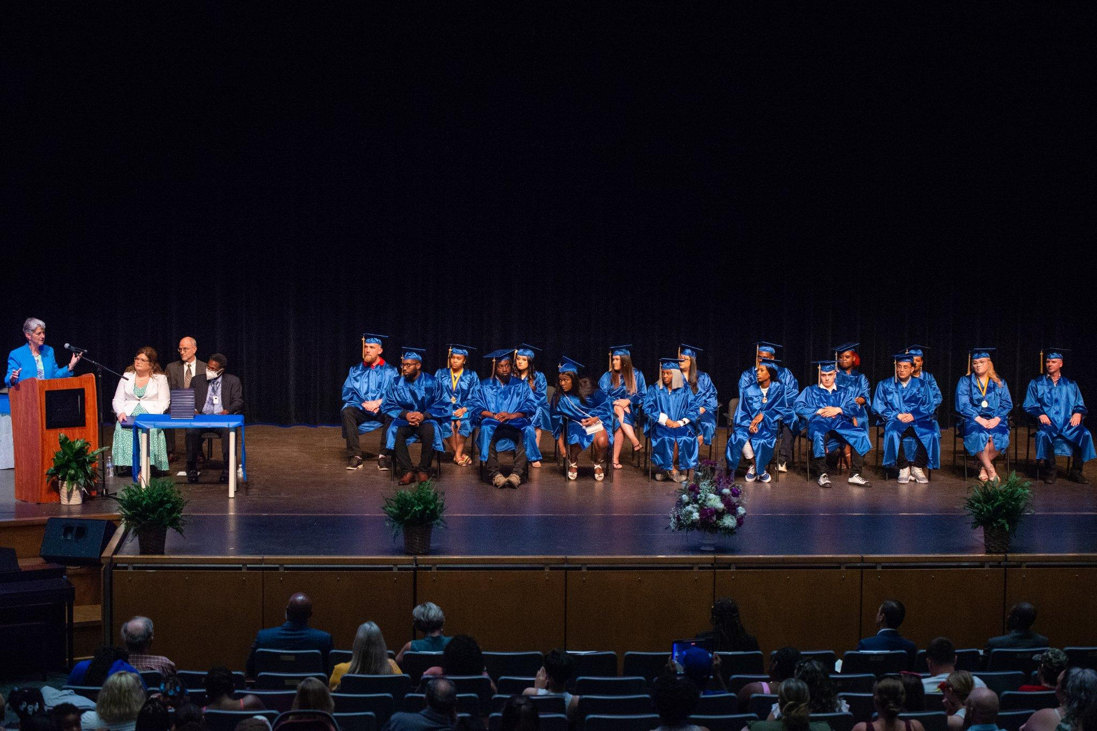
Graduation!
All graduates are a part of the annual Groves commencement ceremony held each June.
Graduation is usually held at the Cab Calloway Theater
There are generally 25-30 graduates, we are hoping for 40 this year!

Slide 9
GED Secondary Credential cont.
In the state of DE, the GED is considered a Secondary Credential, it is not a high school diploma or equivalent. However, GED completers can usually attend most any college or training program as well as serve in the armed forces.
Four subtests to the GED:
Reasoning Through Language Arts
Mathematics
Science
Social Studies
When the teacher sees the student is ready, they allow the student to take the GED Ready predictor test for one of the sub-tests and if they student earns a passing score of at least 145, they are assisted to register for the GED sub-test at a local testing center.
All completers are able to participate in an annual recognition program typically held in May.

Slide 10
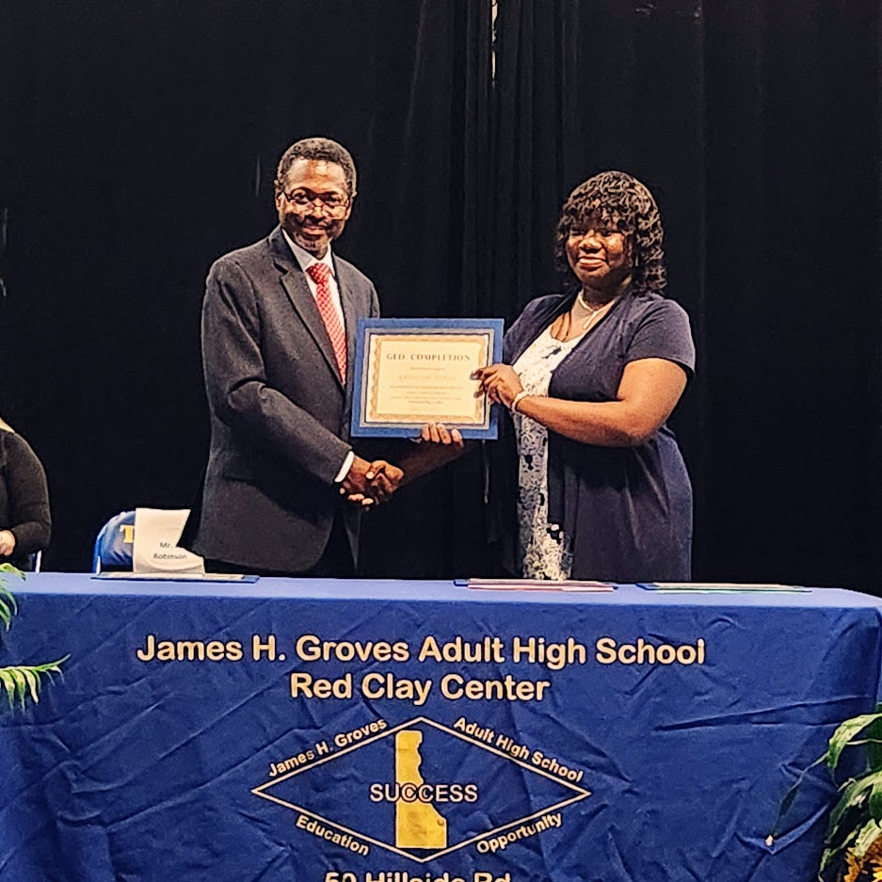
GED Recognition Ceremony 2023

Slide 11
Do I want a GED or High School Diploma?
This is the $100,000 question!
How many credits did the student complete before they left their traditional high school?
If they have a lot of credits, the HSD is often the logical route.
If they don’t have a lot of credits, the GED may be the logical route.
Is the student a good test taker?
If yes, the GED is a GREAT route and if NO, it will be difficult to earn a GED.
Both are great options, it’s all about what is the best fit for each individual student.
For more information about the GED, go to GED.com

Slide 12
How Long Does it Take Me to Graduate or Earn My GED?
Another $100,000 question!
HSD: The completion time depends on how many credits the student is transferring and how much time they can dedicate to classe.
GED: The completion time depends on the student’s entry academic level and how quickly they progress through the program.

Slide 13
English as a Second Language Classes
English as a Second Language (ESL):
Groves also offers English language courses for non-native non-English speakers.
Students take a placement test and are placed into classes based on their verbal English level.
In addition to speaking skills, students learn reading and writing in English.
The program is immersive and students from different language backgrounds attend the same classes.

Slide 14
OAASIS Team Member
Organization of Adult Alumni Students in Service - OAASIS:
Each Groves site is able to have an OAASIS Team Member work with the program.
The Team Member works for OAASIS, which is a non-profit organization s a part of Delaware’s adult education services.
The Team Member works approximately 12 hours a week at the school.
The Team Member is available to work with students to motivate them and assist them in their education. They also work with the staff on school projects such as fundraising, registration, orientation, etc.

Slide 15
Additional Opportunities
Certificate of Attainment (COA) - Students in ABE, GED and ESL classes may earn a COA upon completion of their academic level in their classes.
Employability Skills - Programming is available to assist students to learn more about the workplace and soft skills. Topics include teamwork, problem solving and professionalism.
Career Plan - Upon entry to the program students utilize DOL’s Career Scope to complete a Career Plan
Digital Learning - Students may complete modules in basic computer skills, MOS suite, Google, etc. and earn North Star certificates in each individual module. The North Star certificates are nationally recognized and may possibly assist students with job promotions and pay increase.
OAASIS Team Member - 1 student alumni is hired part-time to assist and mentor students.
Financial Literacy - Students work with representatives from Stand By Me to learn more about financial literacy and may meet individually for financial planning.

Slide 16
Additional Opportunities Cont
Monthly Recognition - Students are recognized for student of the month and perfect attendance in each class. High school students who complete a class each month are part of a drawing to win prizes.
Services - The RCC assists students to register for services or we can make referrals to partners when appropriate. We also partner with DOL to use the VOCAL program.
Post-Secondary Transition - Upon completion of a HSD or GED, Groves students may receive assistance to apply for college or other post-secondary training. Most graduates or GED completers will attend college, apply for other post-secondary training or get a promotion at their current position.
Job Placement - If a student needs a job or would like new employment, the staff will assist them with their job search, application process and interview skills. If needed, interview attire is available free of cost through the Clothing Bank of Delaware absolutely.

Slide 17
Transportation Barrier
We are the closest program to the City of Wilmington but we are are still struggling with transportation for all students.
We are on Bus Route 52, however services to 19807 are not as frequent as other areas. We have been working with DART to increase availability of transportation to our site.

Slide 18
Student Testimony
Shana Jarrett
2019 GED Recipient
2019 Recipient of a Groves scholarship to Wilmington University
Wilmington University Class of 2023 with a BA in Psychology

Slide 19
Student Testimony
Brian Peterson
2019 GED Recipient

Slide 20
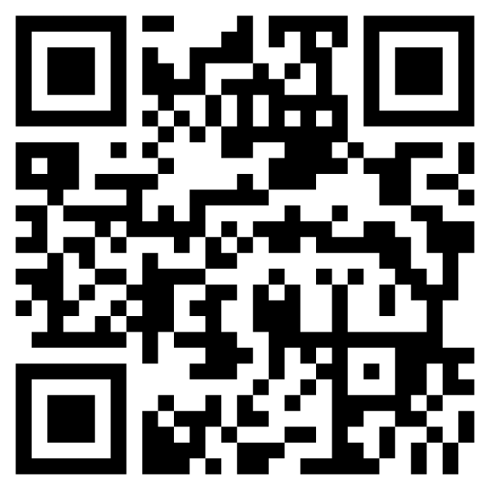
How do you become a student?
June 1, 2023 - Registration for the Fall of 2023 opens.
Prospective students may go to redclayschools.com/groves and complete the registration form.
They will be able to choose if they want to register for high school diploma, GED or ESL classes.
On the registration form, they can indicate what time of day they would like to register.
We have fliers provided with that information on them.
After registering, in August, prospective students will hear from their department on their next steps.
If a student needs assistance to register, they may set up an appointment to come to the school.
Classes for the fall of 2023 start on September 5th!

Slide 21
Questions?

Slide 22
Thank you so much for your time.
Contact Information:
Kellie Tetrick, Principal:
kellie.tetrick@redclay.k12.de.us
Ronald Robinson, Site Coordinator: ron.robinson@redclay.k12.de.us
Heather Farrell, Adult Education Specialist: heather.farrell@redclay.k12.de.us
50 Hillside Drive
Wilmington, DE 19807
redclayschools.com/groves

