Slide 1
Dual Generation Center
Meeting the needs of children and parents TOGETHER.

Slide 2
Our Mission
The Dual Generation Center addresses the immediate and long-term needs of the whole family by providing wraparound services in one central setting. The goal is to create an environment that nurtures lifelong learners and provides families with access to opportunities that may not be readily available. The overarching goal of the Dual Generation Center is to increase the number of families that are self-sufficient by taking away barriers that lead to impoverished living.

Slide 3
Vision & Core Values
To be transformational change agents for families, living in Poverty, by providing respect, accountability, and innovation to case management.
Family focused approach to supports and services.
Accountability to our clients, community and our employees.
Transformational not just transactional.
Develop and nurture relationships ensuring integrity is always at the forefront.
Empowering families to disrupt generational barriers.

Slide 4
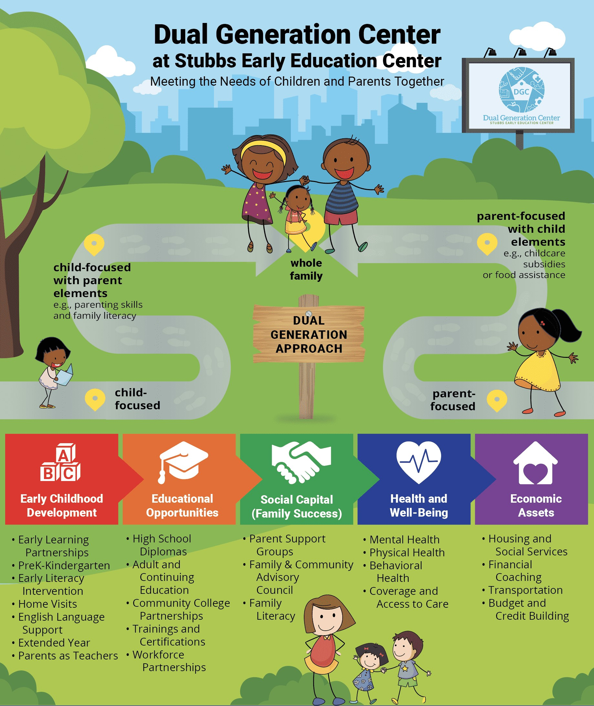

Here at Dual Gen., we support our families every step of the way.
Family and community support
Behavioral Health Services
Housing
Transportation Services
Expungement/Pardon Services
Social services navigation
Employment Services
Clothes Closet
Financial Counseling
Child Support Services
Adult education (GED & College)
Emergency Services
Food Pantry
Intensive Case management services

Slide 5
Poverty Disrupters
Employment & training to increase income. Create opportunities for families to have multiple streams of income
Address lack in our community with education access and opportunities
Increase educational OUTCOMES for students by increasing parent and community involvement

Slide 6
Dual Gen Initiatives
Homeless to Homeownership- Through a partnership with Interfaith Housing, families work towards the goal of homeownership.
Dining Room Table Program- This program aims to put FAMILY time around the table, back in the lives of displaced families.
The B.U.I.L.D. Fellowship- This Fellowship puts an emphasis on parent engagement though advocacy. It provides a deeper understanding of infrastructure, legislation and delegation through parent-based education.
Landlord Risk Mitigation Program- The fund is used to provide some guarantees to landlords that rent to rental adverse clients.
Dual Generation Shared Housing Program- This program works with landlords and clients to find suitable roommates. The families work towards their housing goals of becoming stable.

Slide 7
Courses offered
First Aid and CPR
Emergency Preparedness
Managing stress & Self – Care for parents/caregivers
Relationship building
Goal setting
Engagement vs Involvement
IDEA laws and advocacy
Chores, cleaning, and housekeeping for every age
Understanding proficiency data and what it means for your child’s education
Tenant 101
Networking
Time management/Organization
Healthy eating/Nutrition, Basics cooking skills
Conflict Resolution
Internet safety and Social media etiquette
Effective Decision making
Resume writing and cover letter do’s and don’ts
Job search strategies
Interviewing skills/etiquette
Budgeting 101
Making Effective Spending Decisions/Saving and investing
How to pay down debt
What is a Credit Profile/Credit history and credit scores
Selecting the right type of account
Setting financial goals
Retirement planning
Estate Planning

