Slide 1
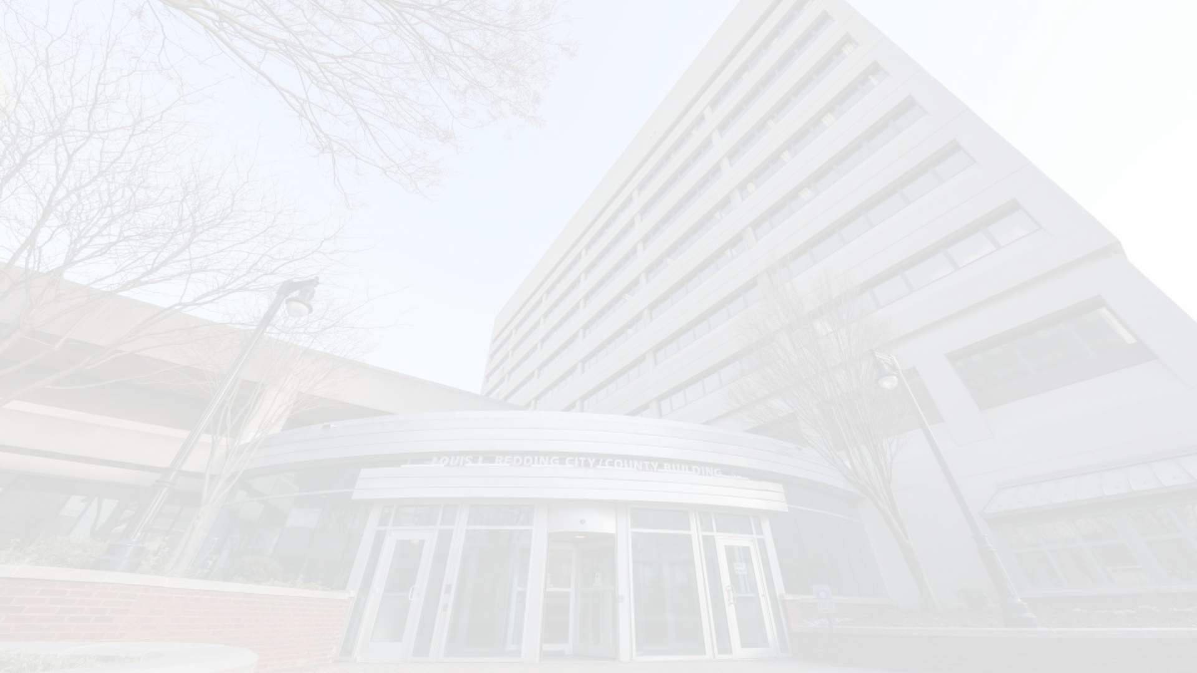
Equitable Procurement Updates - Finance and OED Committee Update 12/04/2023
Miller³ Consulting has provided recommendations to the City to improve the procurement process. In response to these recommendations, the City has been working on implementing meaningful changes that will improve access to City Procurement opportunities for minority owned businesses.

Slide 2
B2GNow - DBE Onboarding & Management Solution
OED finalized and executed the agreement with B2GNow on Oct 23. Implementation calls have begun. We expect to have access by Jan 1.

Slide 3
Increase DBE Industry Presence and Knowledge
OED recently became members of the Greater Philadelphia Chamber of Commerce. OED attended their Diverse Procurement Collaborative Reception in Philadelphia on June 8th. OED participated in a webinar entitled The Evolving State of Diversity, Equity, and Inclusion on October 25th.

Slide 4
DBE Program Rewrite
A Committee consisting of Department Heads, The Pope Consulting Group and relevant stakeholders have drafted a new Procurement Equity Program (PEP) to replace the current DBE Program.
The program write up is currently being reviewed by the Legal Department. Legal has faced delays in providing their feedback due to resource constraints.
Once completed, the committee will review the legal analysis and address any recommendations.
We will present the new program to the Administration Board once the Legal Analysis is complete and potential changes are addressed.

Slide 5
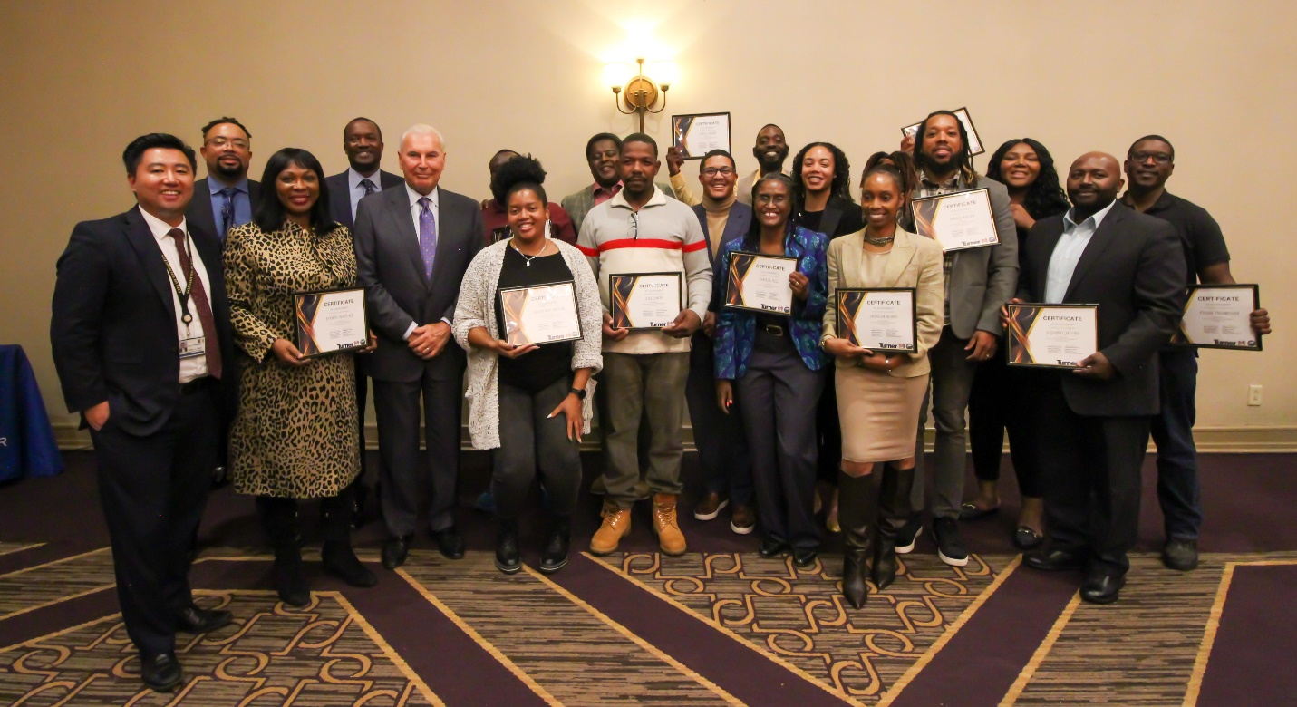
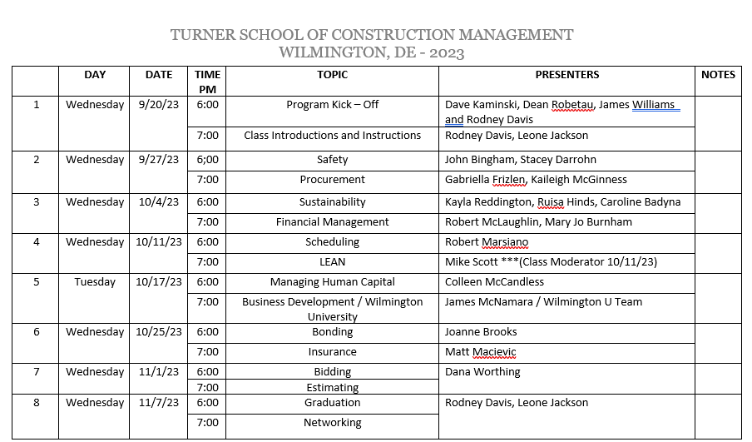
Building Capacity within the DBE Community:
Turner School of Construction Management began on September 20^{th.} The inaugural class welcomed participants to the Emergency Operations Center, led by Turner Construction’s Community and Citizenship manager Rodney Davis. The program concluded its 8-week program with a city-hosted graduation ceremony held on November 7th at the DoubleTree hotel for 14 graduates.
Press Release: https://www.wilmingtonde.gov/Home/Components/News/News/6666/225

Slide 6
DBE Analyst
The DBE Analyst position was filled in late October. The Analyst began on November 13. This position reports to the Department of Finance but works directly with OED on DBE activities such as DBE vendor registration, DBE certification processing, and assisting with enhancing communications about City Opportunities, and DBE matchmaking.

Slide 7
Increasing the pipeline of DBEs (Outreach)
Completed
Oct 3 – LECET: Contractor lunch and learn - Bidding Processes in DE
Oct 9th – Meeting with P2A/P2B
Oct 18th – Presented on SBA’s webinar: Overview of Contracting Certification Programs
Oct 30^{th –} OED presented and exhibited at a New Castle County’s “How to do business with…” procurement event at the Rt 9 Library.
Upcoming
Dec 6th - True Access Capital procurement Webinar
Dec 11th - New Castle County certification workshop at the Rt 9 Library
As a result of our outreach efforts, OED has certified or recertified 38 DBE businesses this calendar year – a 36% yoy increase!

Slide 8
Thank You

