Slide 1





Division of Services for Aging and Adults with Physical Disabilities (DSAAPD)
Promote dignity, respect, and inclusion for older adults and people with disabilities.

Slide 2
Core Services and Supports
Information and Assistance
Case Management/ Options Counseling
Community Nursing
Caregiver Supports
Adult Protective Services
Residential Care
Home and Community-Based Services

Slide 3

Services and Programs
Aging and Disability Resource Center (ADRC)
Adult Protective Services (APS)
Caregiver Resource Centers
Case Management
Chronic Disease Self-Management and Health Promotion
Congregate Meals
EPIC- Endless Possibilities in the Community and YMCA
Healthy Homes
Information and Assistance
Legal Services
Nursing Home Transition Program
Respite Care, including Lifespan Respite Program
Senior Community Service Employment Program
$tand By Me 50+
Village Volunteers
DSAAPD Supported and also Provided by Delaware Medicaid (DSHP+):
Adult Day
Assistive Devices
Community Living
Home-Delivered Meals
Home Modifications
Personal Attendant Services (PAS)
Personal Care
Personal Emergency Response System (PERS)

Slide 4
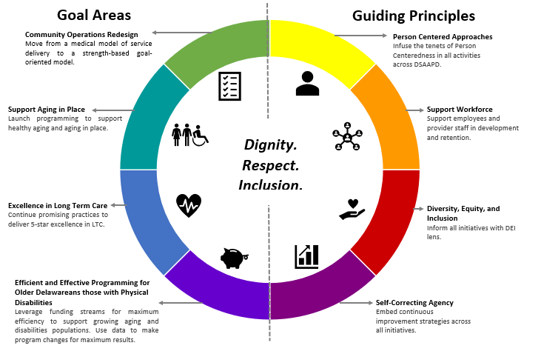
Division Strategic Initiatives

Slide 5
Contact Us
Aging and Disability Resource Center: 1-800-223-9074
Email: DelawareADRC@delaware.gov
Website: https://dhss.delaware.gov/dsaapd/
Aging and Disability Resource Center Website: www.delawareADRC.com
APS Report Line: 1-888-APS-4302
Melissa Smith, Director, Melissa.A.Smith@delaware.gov

