Slide 1
Wilmington Department of Land Use and Planning
Presentation to City Council’s Community Development and Urban Planning Committee on Proposed Amendments to Wilmington’s Downtown Development District Boundaries
March 9, 2023

Slide 2
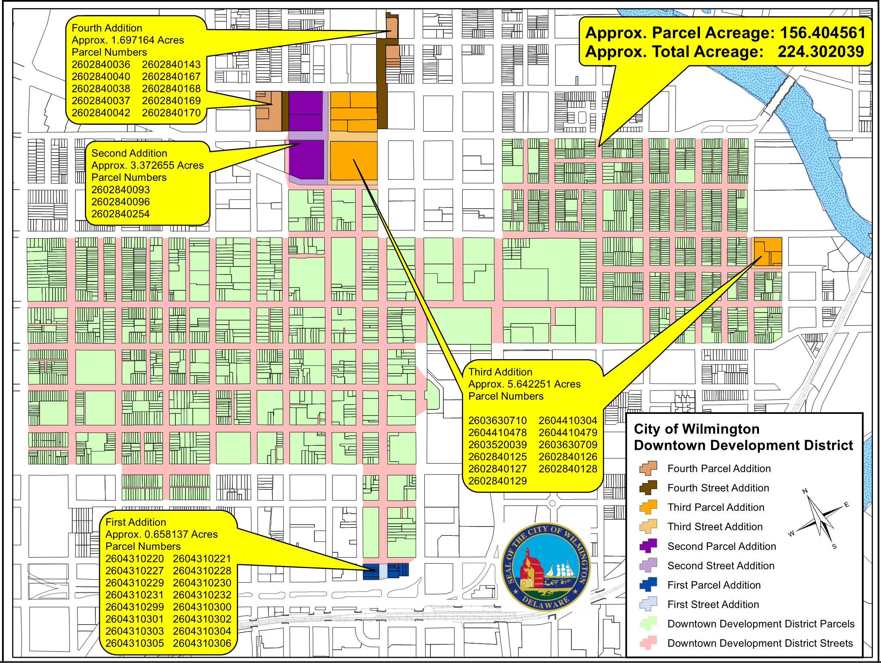
Map of Parcel Additions to DDD Map, 2016-2019

Slide 3
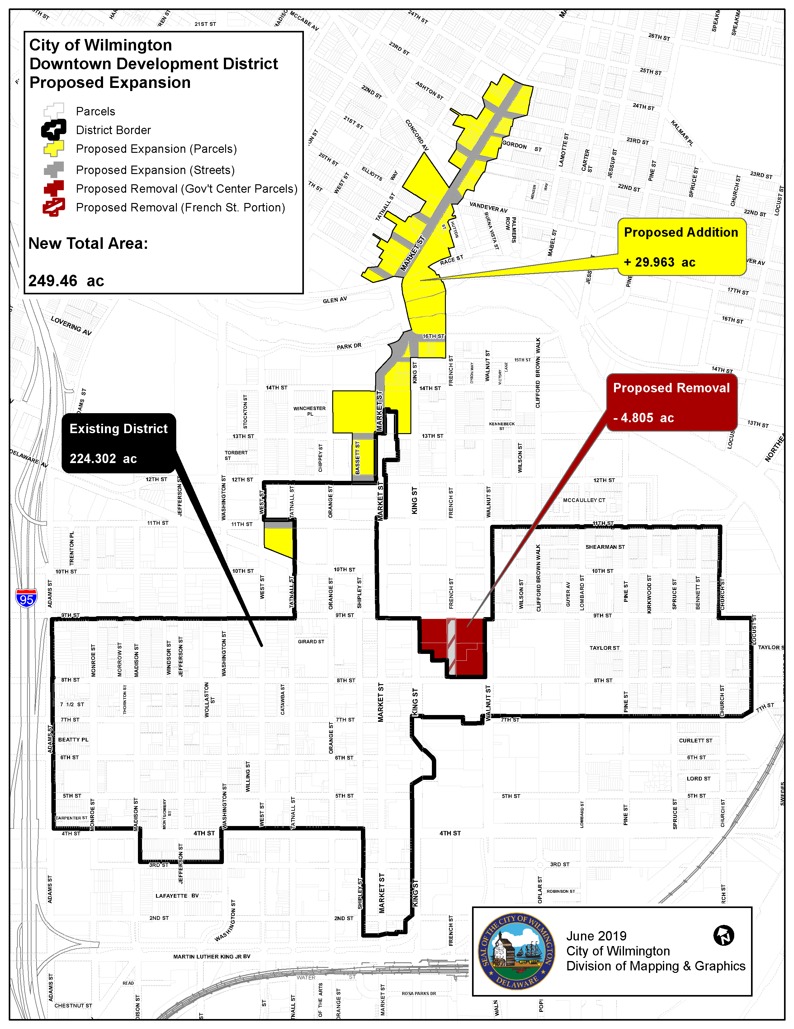
2019 DDD proposed boundary expansion in yellow, street surface area in gray, proposed governmental properties to be removed from boundaries in red

Slide 4
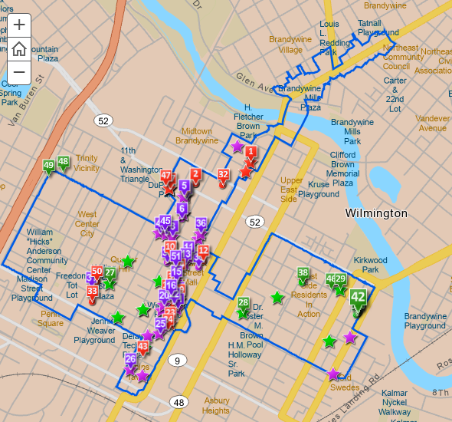
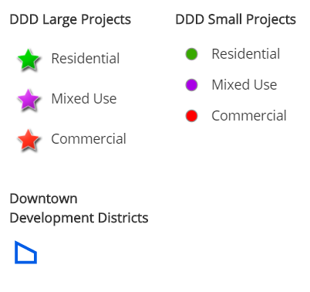
Rebated Projects in Wilmington FY 2015 – 2021

Slide 5
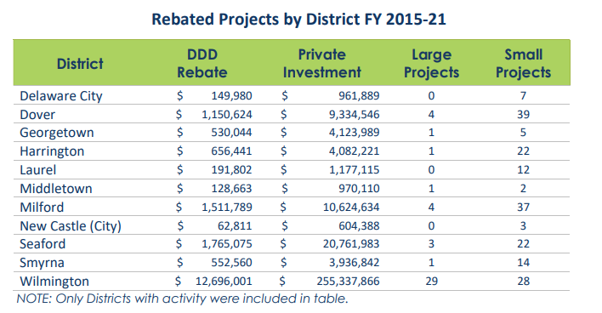
Rebated Projects in Wilmington FY 2015 – 2021
29 Large Projects and 28 Small Projects completed since its designation in 2015
$12.7 million of state DDD funds leveraged $255 million in private investment
Most of the Large Projects in Wilmington are the rehabilitation of existing buildings to incorporate commercial and residential spaces.

Slide 6
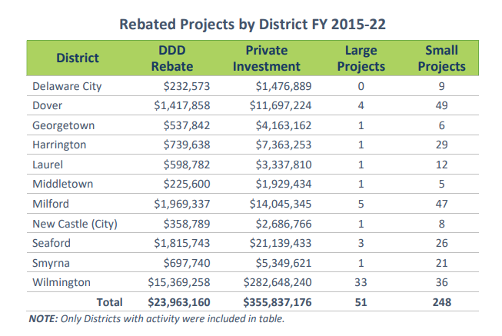
Rebated Projects in Wilmington FY 2015 – 2022
33 Large Projects and 36 Small Projects completed since its designation in 2015
$15.4 million of state DDD funds leveraged $283 million in private investment
Most of the Large Projects in Wilmington are the rehabilitation of existing buildings to incorporate commercial and residential spaces.

Slide 7
DDD Boundary Amendment Process
City Council Approval
The Delaware Office of State Planning Coordination (OSPC)
The Cabinet Committee on State Planning Issues (CCSPI)
City Council Approval
Review in accordance with 22 Del C. § 1907
Approval by the local legislative body must be after approval by the CCSPI. The change is not considered to be in effect for OSPC administrative purposes or rebate requests to DSHA until the proper documentation has been received and validated.
The local government shall provide documentation to the OSPC that the boundary amendment has been approved by the local legislative body

Slide 8
City Incentives
City Property Tax Abatements (mixed-use, market rate-multi family, residential, commercial)
Economic Development Strategic Fund
Housing Strategic Fund
City Capital Improvement Program
Acquisition and Disposition Program
Architecture and Engineering Feasibility Assistance
Grow Wilmington Fund
Head Tax Exemption Program
Technical Assistance

Slide 9

City of Wilmington DDD Marketing
  Data analysis of building permits and targeted outreach to permits over $25,000 that are within the DDD boundaries
  Partner education, i.e. Main Street Wilmington, True Access Capital, Wilmington Alliance, WEDCO
  Boots on the ground outreach

Slide 10
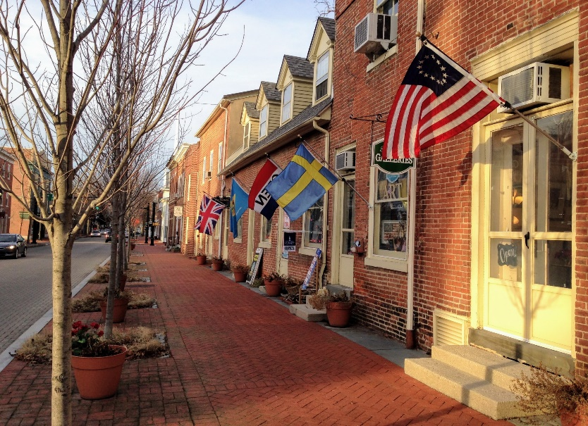
Program History
Downtown Development District (DDD) Act of 2014
Created to leverage state resources in designated downtown areas to:
Spur private investment
Improve commercial vitality
Build a stable community of long-term residents
Municipalities Apply for District Designation
Entitles District Investors Access to:
  DDD Rebate
  State Historic Preservation Tax Credits
  Municipal Incentives
  Partner Incentives

Slide 11
Roles and Responsibilities
Municipality
State Planning Office
Marketing and Technical
Assistance to Potential
Investors is Critical
Define District Boundary
Develop District Plan
Local Incentives
Market and TA to Potential Investors
Administer DDD Rebate
Annual DDD Report
Provide TA to Investors
Facilitate Designation Process
Staff Cabinet Committee
Provide TA to Districts
State Historic Preservation Office
Kent and Sussex Counties
Cinnaire
NCALL
Energize Delaware
Private Investor
DSHA
Other Partners

Slide 12
Marketing and Outreach
Districts Hold Primary Responsibility
Most knowledgeable of District Plan
Knows how local incentives work
Connections with local partners to reach targeted audiences
Working knowledge of other incentives
Provides technical assistance
But Everybody Helps!
DSHA
  Coordinates press events for new DDD Rebates
  Participates in Local Workshops
State Planning Office
  Hosts Central Incentive Website
  Participates in Local Workshops
Division of Small Business
  Incorporates into regional and statewide efforts
Notes:
It does not matter how many great things there are to offer if no one knows about them. A District Designation is a useful economic development tool only to the degree that potential investors and existing businesses are aware of the program with an understanding of how to participate. Building awareness and participation requires marketing. Each locality is responsible for marketing its District. There is a direct correlation between the level of marketing and the level of business participation. The most effective marketing efforts are guided by a plan.
Enlistment of local partners – Banks, realtors, Chamber of Commerce
Direct Correlation Between Level of Marketing and Level of Business Participation

Slide 13

District Rebate
Performance-based
Project complete BEFORE rebate
Real Property Investment
Rehabilitation
Expansion
New Construction
Eligible Use
Commercial
Industrial
Residential
Mixed-use
Qualified Investments
Hard construction costs
Structurally part of building/facility
Examples
  Carpentry
  Drywall
  Roofing
  HVAC
  Doors/windows
  Demolition – only if new construction results
Government-owned
buildings

Slide 14
Project Size
SMALL PROJECTS
LARGE PROJECTS
Qualified Investment
$15,000 to $350,000
Maximum Rebate
$70,000 (20% Rebate)
Submit Applications Anytime
Rebate based on fund availability
Signed Project Conformity Form
Copies of invoices/receipts and proofs of payment
Placed-in-Service documentation
Qualified Investment
Over $350,000
Minimum Investment
$25,000 (deductible)
Maximum Rebate
$2,000,000 (Up to 20%)
Must Apply for Reservation
Signed Project Conformity Form
3 years to complete project
CPA Attestation of Costs
Notes:
Small project minimum investment will be increased from $15,000 to $25,000 at the end of October.

Slide 15
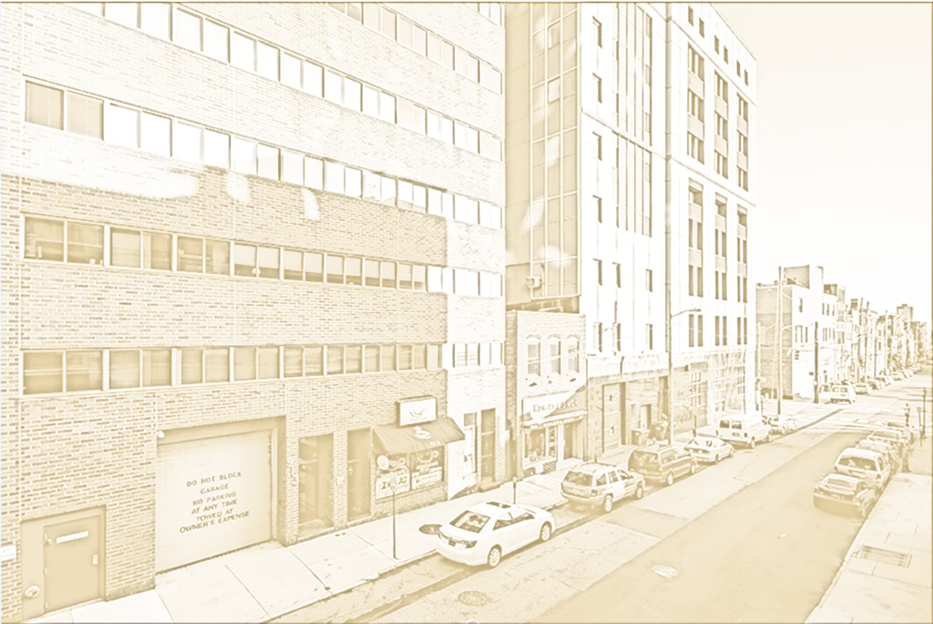
Summary
Data Collecting/Sharing
TOWNS
Marketing/Outreach Technical Assistance
Investor Info
Project Info
STATE PLANNING
District Reports
District Plan Progress
District Incentives
Interactive Maps
Central Incentive Site
DDD Boundary Map
DSHA
Applications
Investor Info
Project Info
Rebate Info
Conformity Form
Incentives
Determine Conformity with District Plan
Ensure Local Incentives
Effective Plan Implementation
Report on District Plan Progress
Effective Rebate Administration
Report on Program Impacts
Evaluate Plan Effectiveness
Report on Program Progress

Slide 16
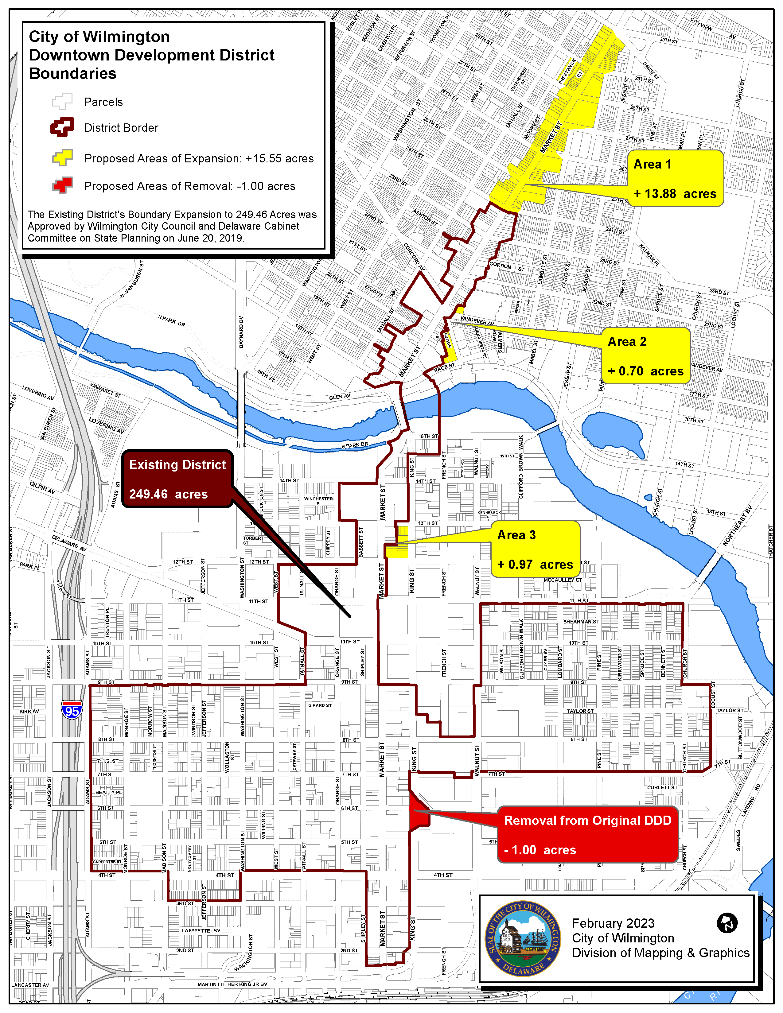
2023 DDD proposed boundary expansion in yellow (including street surface area), proposed governmental property to be removed in red

