Slide 1
Presentation on the Utility Billing System
City Council Finance Committee
October 9, 2023

Slide 2
Need to Convert to New Billing Solution
The MUNIS System utility billing module was instituted in 2006, with various upgrades over the last 17 years.
Shift to monthly billing has tripled the number of bills (from quarterly in 2018)
The MUNIS module does not provide the flexibility to change bills or to make adjustments to the system without significant manual effort.
The MUNIS module also limits payment processing, making it more difficult for customers to pay bills or get bills corrected.

Slide 3
New Billing and Payment System Benefits
A new utility billing system will provide greater automated bill generation, processing and payment interfaces.
Specifically designed for a utility, with state-of-the-art features allowing CSRs to access customer accounts more quickly.
Will provide customers a “one-look” portal for all utility, property tax and L&I fees
Customers will have payments credited in real-time, thereby reducing unintended interest charges for customers.
Customers can make payments on all accounts within the one-look system.

Slide 4
New Billing and Payment System Benefits
According to Black and Veatch (our consultant on the project), the City loses approximately $3.5 million in revenue due to unbilled consumption, errors in bills, post-payment adjustments, and lost interest.
A new system will save approximately $2.5 million per year.
Payback on the new system will be less than three years.
The remaining $1 million in lost revenue will be recovered in operational changes that will reduce appeals of bills and increase collection rates.

Slide 5
Selection of Vendor
The City recommends selecting Systems and Software for the design, development, and implementation of the new system.
The City spent 14 months performing analyses and market research on new systems.
A Request for Proposals yielded 12 potential vendors.
Interviews and demos were held with 6 vendors.

Slide 6
Cost of System Design and Implementation
The cost for building the utility billing system will be approximately $3.0 million.
An additional $1.0 million will be allocated for Black and Veatch project management support.
The annual support services costs for the system will be approximately $150,000 per year for six years.
Hosting services for the customer database will be approximately $80,000 per year.
These funds have already been approved in the FY 2020 Capital Improvements Program of $5.6 million

Slide 7
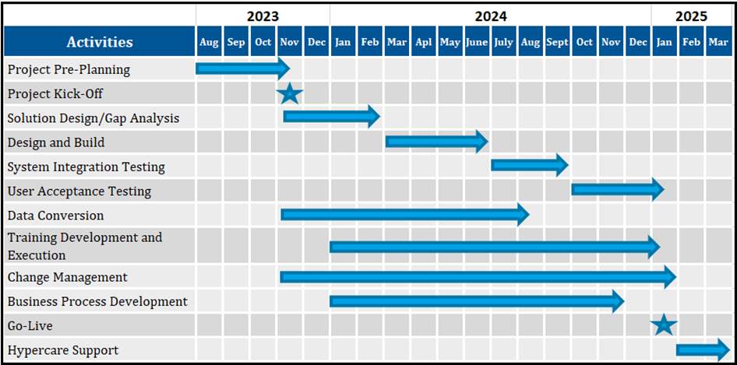
Timeline

Slide 8
Paymentus Multi-year Contract
The City’s payment processing provider, Paymentus, was awarded its contract in 2016.
The City recommends an extension of the contract for a period of three years with two optional one-year extensions.
This will allow continuity with the payment system as we integrate with the new billing system.
Systems and Software has worked with Paymentus on several projects and is familiar with the product.
The annual cost for Paymentus is approximately $300,000 per year.

