Slide 1
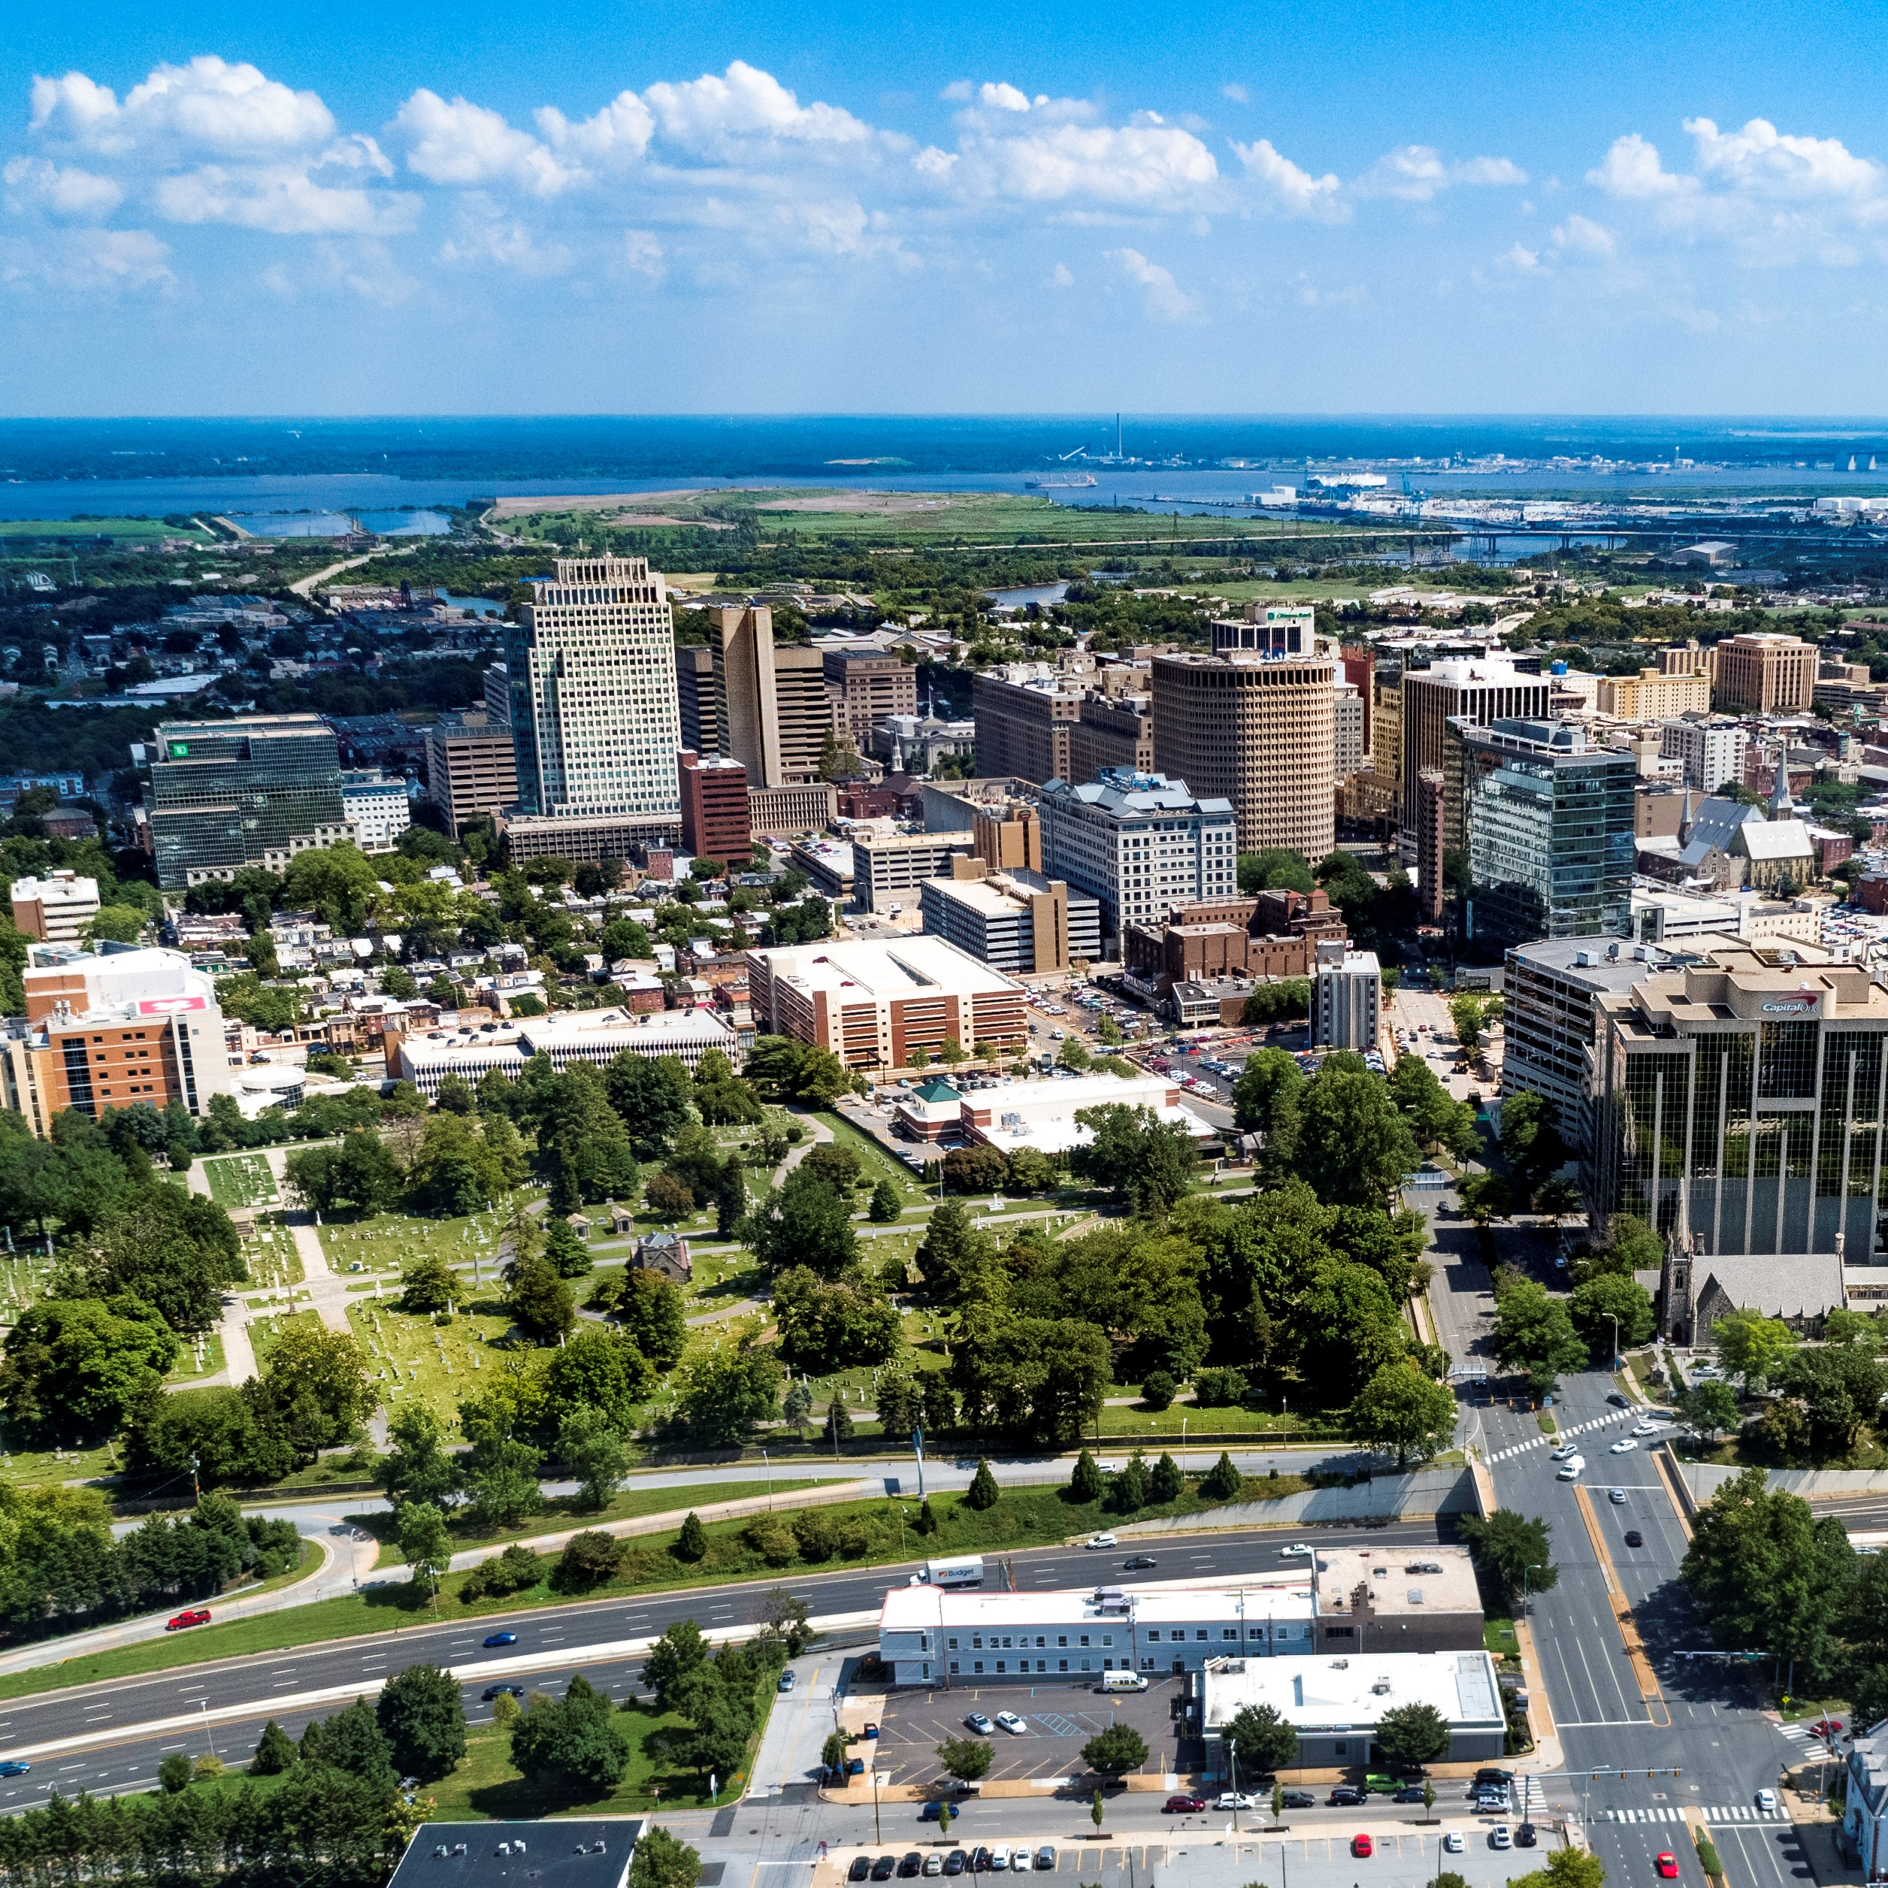
City of Wilmington ARPA Spending by Category
October 2023

Slide 2
Summary by Category
Summary Allocated by Category
Category | Budget | Total Allocated for Projects | Unallocated
Administrative Costs | $2,368,486 | $2,368,486 | $0
Building Safer Communities | $8,257,354 | $8,257,354 | $0
Community Investment | $5,093,371 | $5,093,371 | $0
Essential Pay for Essential Work | $2,664,318 | $2,664,318 | $0
Neighborhood Revitalization | $22,487,255 | $22,487,255 | $0
Revenue Replacement | $12,000,000 | $12,000,000 | $0
Workforce Development | $2,474,996 | $2,474,996 | $0
Total: | $55,345,780 | $55,345,780 | $0

Slide 3
Amount Spent by Category
Amount Spent by Category
Category | Budget | Total Spent | Total Remaining Unspent
Administrative Costs | $2,368,486 | $1,126,111 | $1,242,375
Building Safer Communities | $8,257,354 | $1,915,107 | $6,351,247
Community Investment | $5,093,371 | $3,852,102 | $1,241,269
Essential Pay for Essential Work | $2,664,318 | $2,664,318 | $0
Neighborhood Revitalization | $22,487,255 | $12,607,999 | $9,834,359
Revenue Replacement | $12,000,000 | $12,000,000 | $0
Workforce Development | $2,474,996 | $638,305 | $1,852,009
Total: | $55,345,780 | $34,803,942 | $20,521,259

Slide 4
Corrections and Changes Since Previous Month
Corrections to September 2023 Presentation:
We determined that we were overbudgeting for the outyears of the Community Public Safety Initiative by about $1.35 million
Those funds were reallocated to the following areas:
  Neighborhood Camera Initiative: $286k
  Outyear budget for Apricot case management software: $115k
  Land Bank: $900k $500k
  Delaware Affordable Housing Group: $400k
  NCC Vo-Tech “Wilmington’s Future Builders Program”: $60k
  Allied Construction: $60k
Changes Since Previous Month:
$1.13 million set aside for strategic acquisition has been reallocated as follows:
  $655,000 – Land Bank
  $250,000 – St. Francis Healthy Village program (new project in Community Investment)
  $229,000 – annual fee for automatic license plate reader cameras (2 years at $114k)
$105,000 for CPSI Mini Grants will be paid from General Fund Real Estate & Housing Budget
  Equivalent ARPA funds will be spent on non-HUD housing projects originally placed in Real Estate & Housing General Fund budget

Slide 5
Administrative Costs $2,368,486
ARPA Spending Category | Total Budget | Total Allocated for Projects | Total Unallocated
Administrative Costs | $2,368,486 | $2,368,486 | $0
Project Detail | Amount Allocated for Project | Amount Spent in Project | Project Balance
Administrative Expenses | $61,112 | $61,112 | $0
Disparity Study (Miller3) | $290,200 | $274,625 | $15,575
Disadvantaged Business Enterprise Analysis (Pope Consulting) | $60,000 | $57,000 | $3,000
Compliance (UHY Advisors Mid-Atlantic MD, Inc.) | $1,080,000 | $311,666 | $768,334
COVID-related Expenditures | $32,008 | $32,008 | $0
Construction Project Management (EDiS) | $264,167 | $264,167 | $0
Construction Project Management (Allied Construction) | $581,000 | $125,534 | $455,466

Slide 6
Building Safer Communities $8.3 million
ARPA Spending Category | Total Budget | Total Allocated for Projects | Total Unallocated
Building Safer Communities | $8,257,354 | $8,257,354 | $0
Project Detail | Amount Allocated for Project | Amount Spent in Project | Project Balance
WCAC/CSE/United Way - Community Violence Prevention Initiative | $500,000 | $436,571 | $63,429
DE DOJ - Violence Reduction Program | $90,000 | $19,698 | $70,302
Eastside Neighborhood Camera Initiative & Maintenance | $1,894,074 | $0 | $1,894,074
Community Public Safety Initiative: The Community Based Public Safety Collective | $400,000 | $233,333 | $166,667
Community Public Safety Initiative: United Way of Delaware - Fiscal Agent | $4,175,040 | $930,540 | $3,358,758
Community Public Safety Initiative: Debra Mason - Coordinator | $600,000 | $150,000 | $450,000
Community Public Safety Initiative: Apricot 360 Software | $153,240 | $38,484 | $114,756
Community Public Safety Initiative: WCAC Roundtables | $400,000 | $100,000 | $300,000
Community Public Safety Initiative: Admin Expenses | $45,000 | $6,480 | $38,520

Slide 7
Community Investment $4.8 million
ARPA Spending Category | Total Budget | Total Allocated for Projects | Total Unallocated
Community Investment | $4,842,667 | $4,842,667 | $0
Project Detail | Amount Allocated for Project | Amount Spent in Project | Project Balance
United Way of DE - Learning Pods | $150,000 | $150,000 | $0
Milk & Honey LLC | $25,000 | $25,000 | $0
Parking Garage Assistance | $500,000 | $500,000 | $0
DE Zoological Society | $150,000 | $150,000 | $0
Faithful Friends | $95,000 | $95,000 | $0
The Grand | $100,000 | $0 | $100,000
Reed's Refuge | $300,000 | $300,000 | $0
Latin American Community Center | $500,000 | $500,000 | $0
Culture Restoration Project | $150,000 | $34,515 | $115,484
Utility Payment Assistance Program | $300,000 | $300,000 | $0
The Juice Joint | $20,000 | $20,000 | $0
The Nomad | $41,000 | $41,000 | $0
Our Youth, Inc. | $30,000 | $30,000 | $0
St. Michael's School and Nursery | $100,000 | $100,000 | $0
NERDit Now | $200,000 | $200,000 | $0
Christina Cultural Arts Center | $500,000 | $83,175 | $416,825
The Challenge Program | $100,000 | $100,000 | $0
Central YMCA | $150,000 | $146,270 | $3,730
Delaware Children's Museum | $150,000 | $20,154 | $129,846
HBCU Week | $150,000 | $150,000 | $0
Jefferson Street Center | $150,000 | $50,000 | $100,000
Books and Bagels, LLC | $12,000 | $12,000 | $0
Dun Rite Cleaners | $12,000 | $12,000 | $0
Oath 84 | $40,000 | $40,000 | $0
It's Time - Tapp Networks | $230,667 | $230,667 | $0
It's Time - Venue Communications | $36,000 | $36,000 | $0
St. Francis Hospital – EMS Services | $100,000 | $100,000 | $0
I am My Sister's Keeper | $296,000 | $256,832 | $39,168
WCAC - Affordable Connectivity Program | $90,000 | $72,000 | $18,000
Apexx Bar & Restaurant | $40,000 | $40,000 | $0
St. Patrick's Center | $25,000 | $6,784 | $18,216
Go Make a Difference Corporation (Go MAD) | $100,000 | $50,000 | $50,000
St. Francis Hospital – Healthy Village Program | $250,000 | $0 | $250,000

Slide 8
Neighborhood Revitalization $22.3 million
ARPA Spending Category | Total Budget | Total Allocated for Projects | Total Unallocated
Neighborhood Revitalization | $22,457,676 | $22,457,676 | $0
Project Detail | Amount Allocated for Project | Amount Spent in Project | Project Balance
Habitat for Humanity - A Brush with Kindness | $2,000,000 | $1,817,519 | $182,481
Land Bank – Acquisition & Demolition | $5,782,200 | $5,534,396 | $247,804
Land Bank - Hilltop | $1,000,000 | $1,000,000 | $0
REACH Riverside | $1,000,000 | $1,000,000 | $0
Eastside Housing Partners, LLC | $100,000 | $100,000 | $0
DE Affordable Housing Group (WHA) | $318,955 | $179,520 | $139,435
Cornerstone West | $1,450,000 | $649,532 | $800,468
Todmorden Foundation | $2,000,000 | $0 | $1,000,000
Woodlawn Trustees | $1,000,000 | $800,000 | $200,000
Habitat for Humanity - Bennett Street Housing Construction | $2,000,000 | $10,607 | $1,989,393
WEDCO Revolving Loan Program | $2,000,000 | $2,000,000 | $0
Richard Dyton - Neighborhood Liaison | $189,000 | $42,000 | $147,000
Southbridge CDC | $250,000 | $7,708 | $242,292
RL Construction - Alleyway Cleanup Contract | $105,000 | $105,000 | $0
DE Affordable Housing Group - McMullen Square | $595,000 | $0 | $595,000
DE Affordable Housing Group - Bennett Street | $210,000 | $0 | $210,000
DE Affordable Housing Group – Elwyn Building | $400,000 | $0 | $400,000
Central Baptist CDC – Soft Costs | $120,000 | $0 | $120,000
Renovation of Eastside Properties Purchased from Inter-Neighborhood Community Builders | $1,750,000 | $0 | $1,750,000
CityFest – Urban Artists Exchange Amphitheater | $82,521 | $0 | $82,521
Real Estate & Housing – Non-HUD Housing Projects | $105,000 | $0 | $105,000

Slide 9
Workforce Development$2.5 million
ARPA Spending Category | Total Budget | Total Allocated for Projects | Total Unallocated
Workforce Development | $2,474,996 | $2,474,996 | $0
Project Detail | Amount Allocated for Project | Amount Spent in Project | Project Balance
NCC Vo-Tech School District | $1,887,517 | $435,648 | $1,451,869
Delaware Art Museum | $150,000 | $68,718 | $81,283
DETV | $250,000 | $62,500 | $187,500
Hilltop Lutheran Neighborhood Center | $70,000 | $54,991 | $15,009
HOPE Commission – Women’s Reentry Program | $75,000 | $16,448 | $58,552
CityFest – Urban Artists Exchange Teen Apprenticeship Program | $42,479 | $0 | $42,479

Slide 10
Other Categories
Revenue Replacement: $12 million
Essential Pay for Essential Workers: $2,664,318

