Slide 1
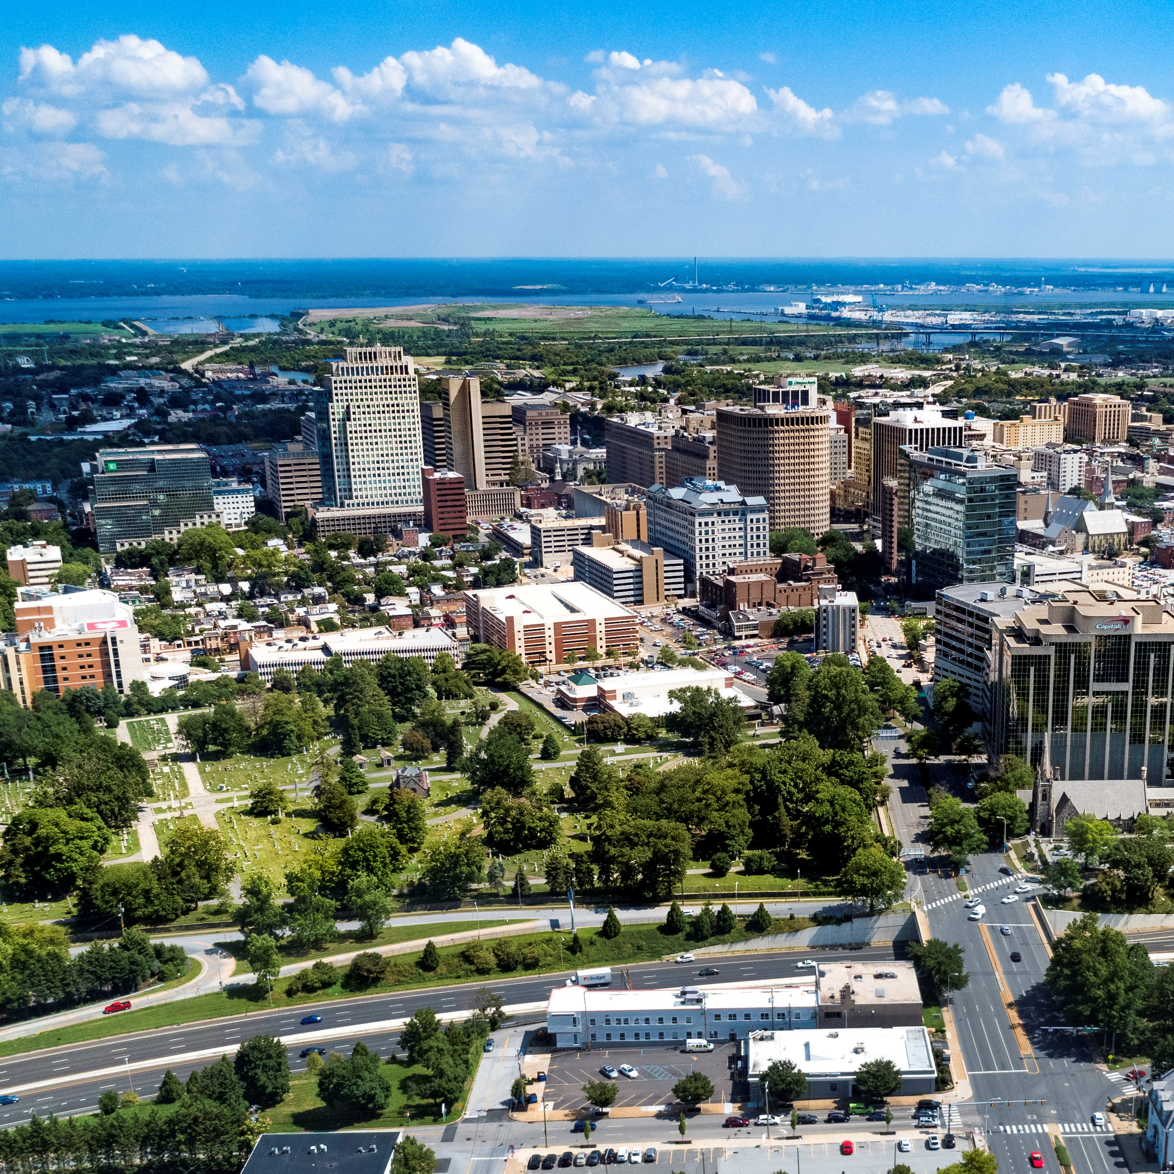
City of Wilmington ARPA Spending by Category
January 9, 2022

Slide 2
Summary by Category
Summary Allocated by Category
Category | Budget | Total Allocated for Projects | Unallocated
Administrative Costs | $1,831,462 | $1,831,462 | $0
Building Safer Communities | $8,000,000 | $2,958,000 | $5,042,000
Community Investment | $4,850,000 | $4,500,000 | $350,000
Essential Pay for Essential Work | $2,664,318 | $2,664,318 | $0
Neighborhood Revitalization | $22,000,000 | $22,000,000 | $0
Revenue Replacement | $12,000,000 | $12,000,000 | $0
Workforce Development | $4,000,000 | $2,204,240 | $1,795,760
Total: | $55,345,780 | $48,158,020 | $7,187,760

Slide 3
Administrative Costs $1,831,462
ARPA Spending Category | Total Budget | Total Allocated for Projects | Total Unallocated
Administrative Costs | $1,831,462 | $1,831,462 | $0
Project Detail | Amount Allocated for Project | Amount Spent in Project | Project Balance
Administrative Expenses | $81,086 | $60,844 | $20,242
Disparity Study (Miller3) | $290,200 | $260,125 | $30,075
Disadvantaged Business Enterprise Analysis (Pope Consulting) | $60,000 | $28,500 | $31,500
Compliance (UHY Advisors Mid-Atlantic MD, Inc.) | $480,000 | $157,996 | $322,004
COVID-related Expenditures | $132,009 | $21,332 | $110,678
Construction Project Management (EDiS) | $264,167 | $264,167 | $0
Construction Project Management (Allied Construction) | $524,000 | $10,916 | $513,084

Slide 4
Building Safer Communities $8 million
ARPA Spending Category | Total Budget | Total Allocated for Projects | Total Unallocated
Building Safer Communities | $8,000,000 | $2,958,000 | $5,042,000
Project Detail | Amount Allocated for Project | Amount Spent in Project | Project Balance
WCAC - Community Violence Prevention Initiative | $500,000 | $83,000 | $417,000
DE DOJ - Violence Reduction Program | $90,000 | $0 | $90,000
Eastside Neighborhood Camera Initiative (Contract in Process) | $1,200,000 | $0 | $1,200,000
The Community Based Public Safety Collective | $400,000 | $0 | $400,000
Community Public Safety Initiative: Center for Structural Equity (CSE) | $150,000 | $0 | $150,000
Community Public Safety Initiative: Youth Advocate Programs, Inc. (YAP) | $150,000 | $0 | $150,000
Community Public Safety Initiative: Network Connect | $150,000 | $0 | $150,000
Community Public Safety Initiative: Group Violence Intervention (GVI) | $150,000 | $0 | $150,000
Community Public Safety Initiative: United Way of Delaware - Fiscal Agent | $18,000 | $0 | $18,000
Community Public Safety Initiative: Debra Mason - Coordinator* | $150,000 | $150,000 | $0
*New project

Slide 5
Community Investment $4.85 million
ARPA Spending Category | Total Budget | Total Allocated for Projects | Total Unallocated
Community Investment | $4,850,000 | $4,500,000 | $350,000
Project Detail | Amount Allocated for Project | Amount Spent in Project | Project Balance
United Way of DE - Learning Pods | $150,000 | $150,000 | $0
Milk & Honey LLC | $25,000 | $25,000 | $0
Parking Garage Assistance | $500,000 | $500,000 | $0
DE Zoological Society | $150,000 | $150,000 | $0
Faithful Friends | $95,000 | $95,000 | $0
The Grand | $100,000 | $0 | $100,000
Reed's Refuge | $300,000 | $187,865 | $112,135
Latin American Community Center | $500,000 | $500,000 | $0
Culture Restoration Project | $150,000 | $6,224 | $143,776
Utility Payment Assistance Program | $300,000 | $300,000 | $0
The Juice Joint | $20,000 | $20,000 | $0
The Nomad | $41,000 | $41,000 | $0
Our Youth, Inc. | $30,000 | $30,000 | $0
St. Michael's School and Nursery | $100,000 | $100,000 | $0
NERDit Now | $200,000 | $200,000 | $0
Christina Cultural Arts Center | $500,000 | $1,950 | $498,050
The Challenge Program | $100,000 | $100,000 | $0
Central YMCA | $150,000 | $0 | $150,000
Delaware Children's Museum | $150,000 | $0 | $150,000
HBCU Week | $150,000 | $150,000 | $0
Jefferson Street Center | $150,000 | $50,000 | $100,000
I am My Sister's Keeper | $185,000 | $50,000 | $135,000
Books and Bagels, LLC | $12,000 | $12,000 | $12,000
Dun Rite Cleaners | $12,000 | $0 | $12,000
Oath 84 | $40,000 | $40,000 | $0
It's Time Campaign | $200,000 | $0 | $200,000
St. Francis Hospital (Contract in Process) | $100,000 | $0 | $100,000
WCAC – Broadband Access Program* | $90,000 | $0 | $90,000
*New project

Slide 6
Neighborhood Revitalization $22 million
ARPA Spending Category | Total Budget | Total Allocated for Projects | Total Unallocated
Neighborhood Revitalization | $22,000,000 | $22,000,000 | $0
Project Detail | Amount Allocated for Project | Amount Spent in Project | Project Balance
Habitat for Humanity - A Brush with Kindness | $2,000,000 | $721,760 | $1,278,240
Land Bank - Eastside | $4,060,045 | $3,108,138 | $901,907
Land Bank - Hilltop | $1,000,000 | $628,343 | $371,657
REACH Riverside | $1,000,000 | $1,000,000 | $0
Eastside Housing Partners, LLC | $100,000 | $100,000 | $0
DE Affordable Housing Group (WHA) | $318,955 | $20,320 | $298,635
Cornerstone West | $1,450,000 | $100,000 | $1,350,000
Todmorden Foundation | $1,000,000 | $0 | $1,000,000
Woodlawn Trustees | $2,000,000 | $300,000 | $1,700,000
Habitat for Humanity - Bennett Street Housing Construction | $2,000,000 | $0 | $2,000,000
WEDCO Revolving Loan Program | $2,000,000 | $2,000,000 | $0
Richard Dyton - Neighborhood Liaison | $21,000 | $10,500 | $10,500
Southbridge CDC | $250,000 | $0 | $250,000
RL Construction - Alleyway Cleanup Contract | $105,000 | $105,000 | $0
Cost Overruns and Change Orders | $2,000,000 | $0 | $2,000,000
DE Affordable Housing Group - McMullen Square | $600,000 | $0 | $600,000
DE Affordable Housing Group - Bennett Street | $210,000 | $0 | $210,000
Eastside Neighborhood Revitalization (Earmark) | $1,885,000 | $0 | $1,885,000

Slide 7
Workforce Development$4 million
ARPA Spending Category | Total Budget | Total Allocated for Projects | Total Unallocated
Workforce Development | $4,000,000 | $2,204,240 | $1,795,760
Project Detail | Amount Allocated for Project | Amount Spent in Project | Project Balance
NCC Vo-Tech School District | $1,804,240 | $183,206 | $1,610,427
Delaware Art Museum | $150,000 | $0 | $150,000
DETV | $250,000 | $62,500 | $187,500

Slide 8
Other Categories
Revenue Replacement: $12 million
Essential Pay for Essential Workers: $2,664,318

