Slide 1
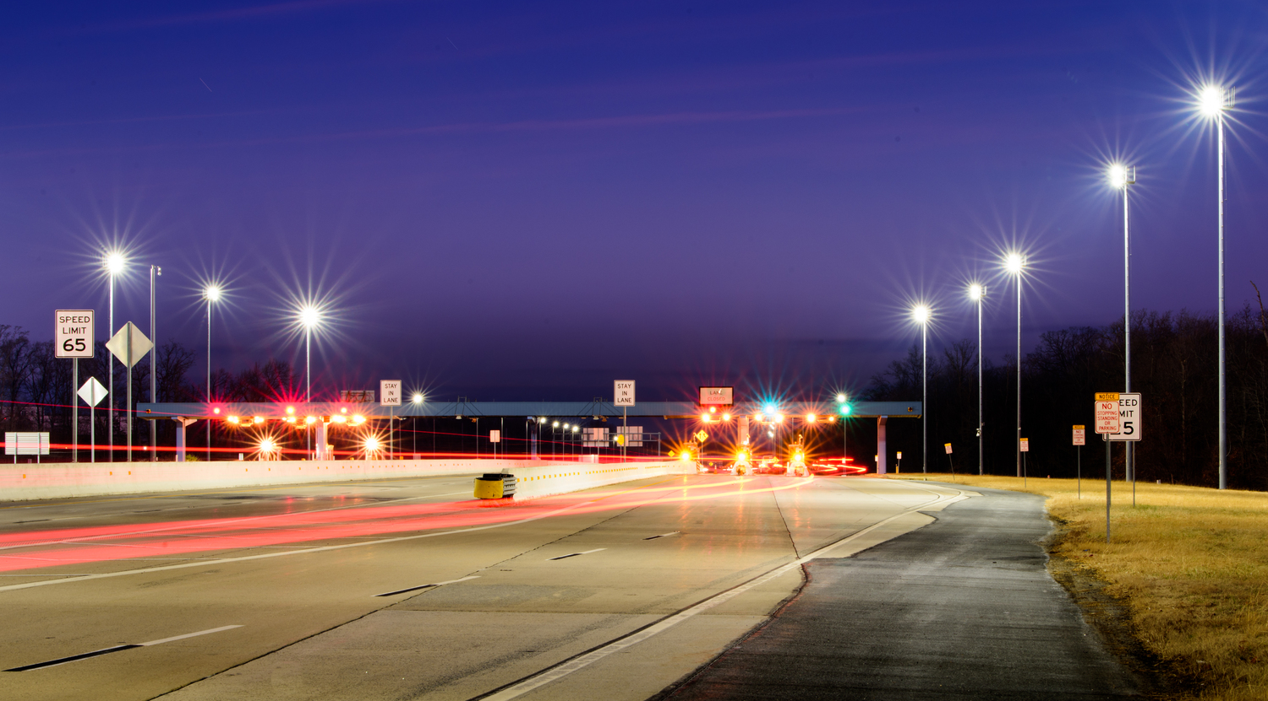

Nighttime Safety
September 18, 2023
Presented to: City of Wilmington
Notes:
Photo – Dover Toll Plaza

Slide 2
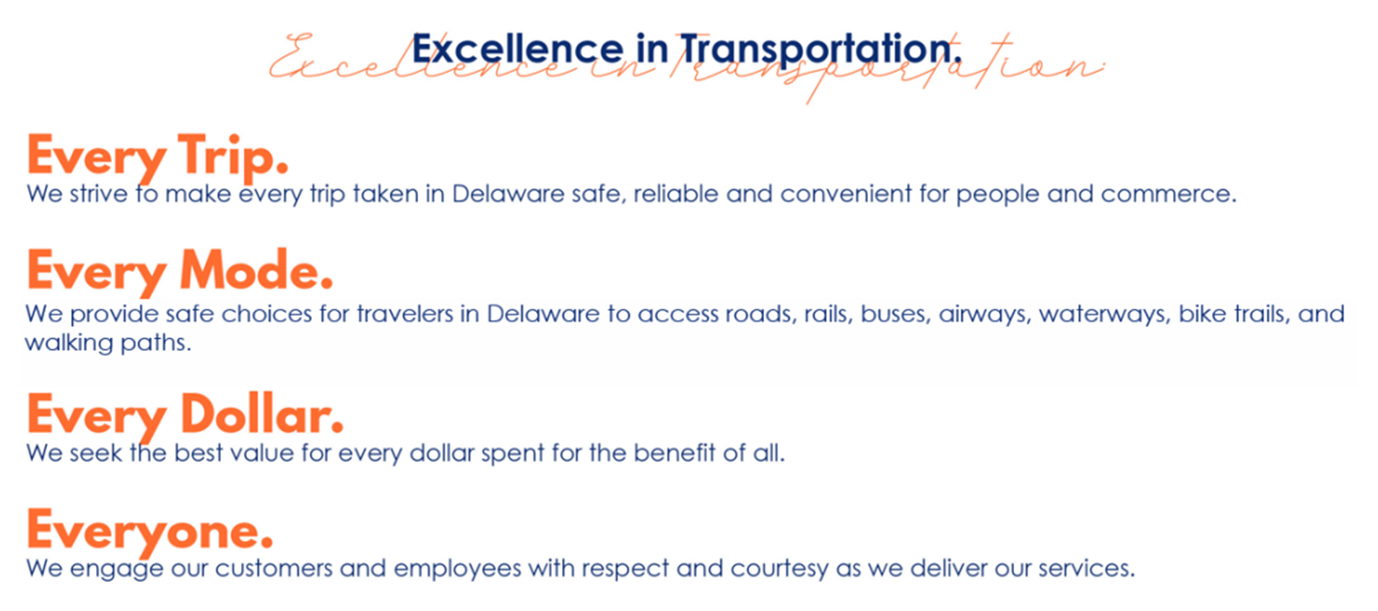

DelDOT’s Mission

Slide 3
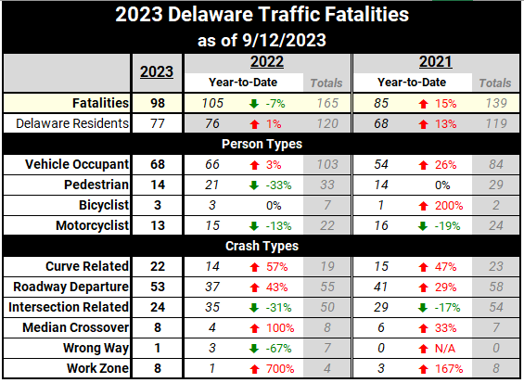
Delaware’s Crash Statistics

Slide 4
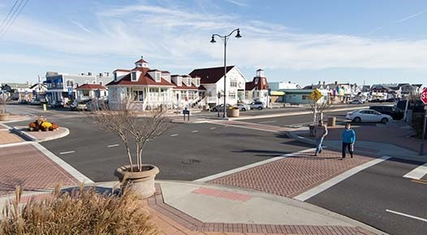
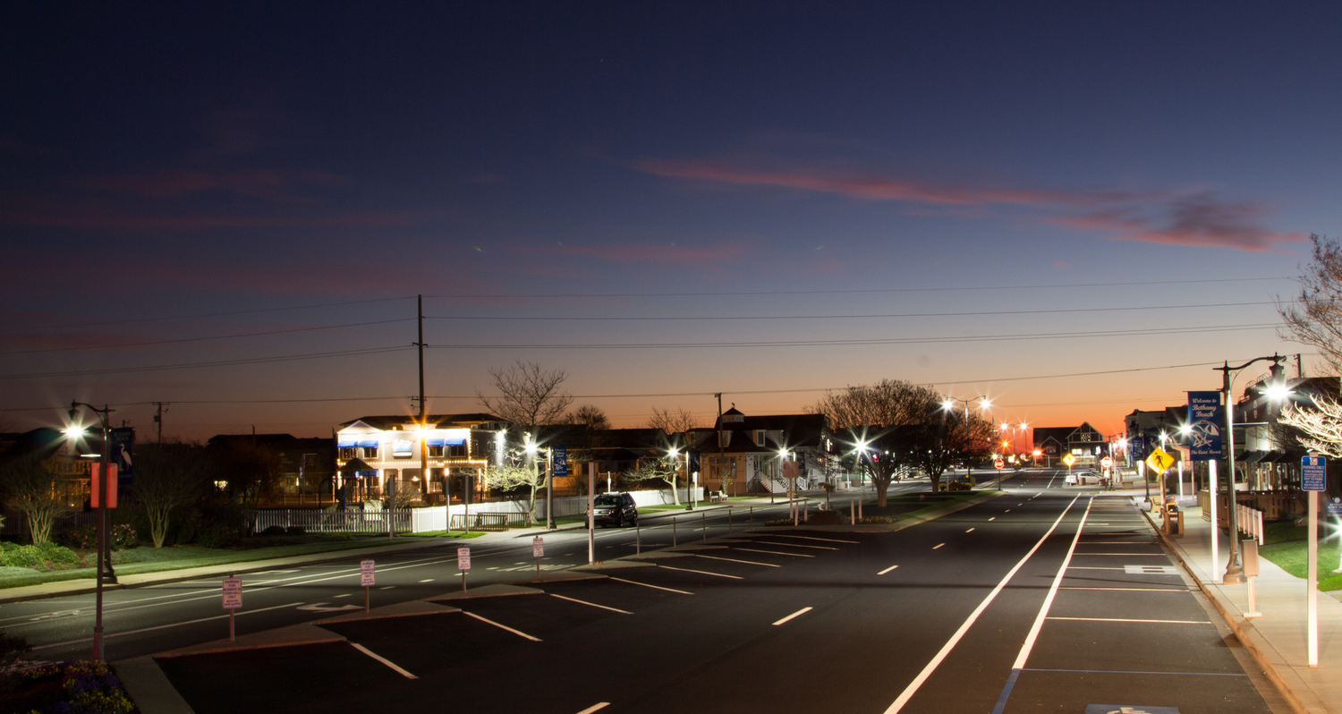
Benefits of Roadway Lighting
Driver Safety and Comfort
Increased visibility
Increased driver comfortability
Can see oncoming traffic at intersections
Vehicular safety
  Can reduce fatal nighttime crash rates by 65% ¹
    Nighttime fatalities are 3x that of daytime
  Can reduce nighttime injury crashes on rural and urban highways by 28% ²
  Can reduce nighttime crashes at rural and urban intersections by 33 – 38% ²
Pedestrians and Bicyclists safety
  Can reduce nighttime injury pedestrian crashes by 42% at intersections ²
¹Federal Highway Lighting Handbook
²Handbook of Road Safety Measures, Elvik, R. and Vaa, T.
Notes:
Top image is Garfield Parkway Lighting in daytime, bottom image is at night

Slide 5
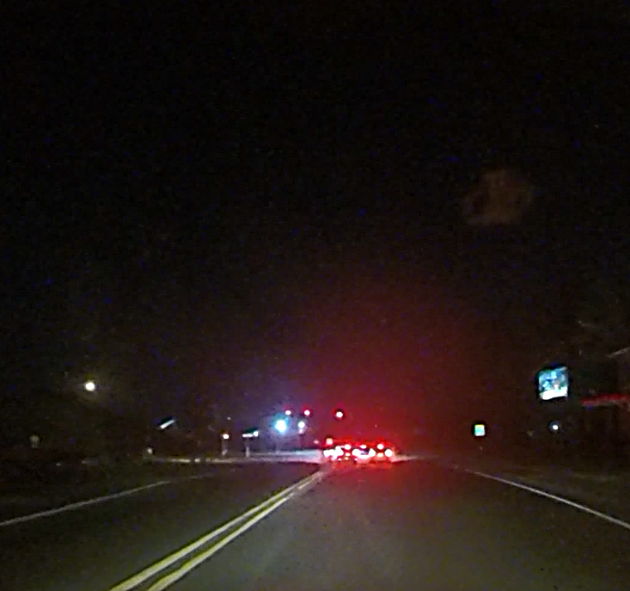
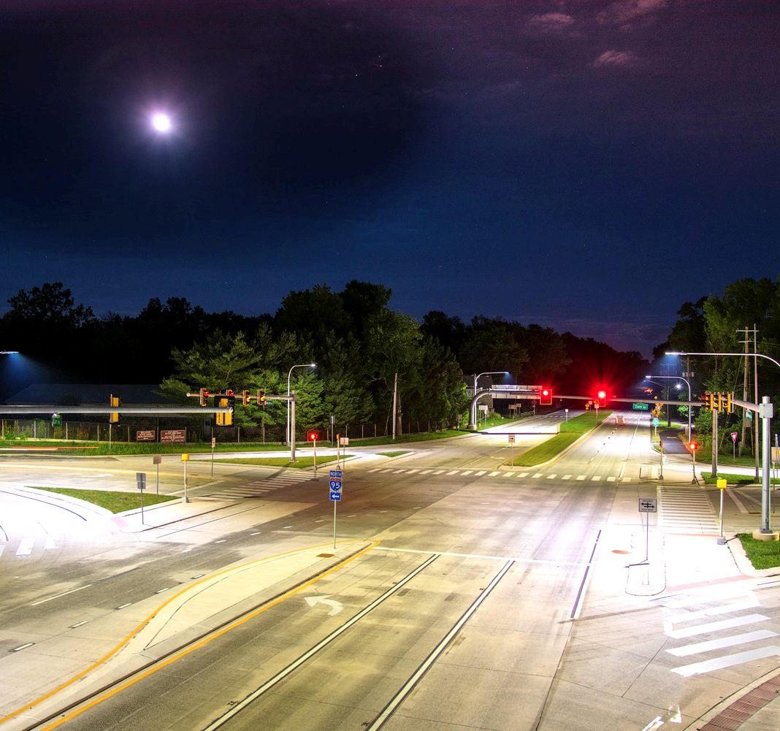
Bicyclist and Pedestrian Safety
Bicyclists and pedestrians are safer in well-lit areas.
Imagine driving down these two roads at night.
Would you be able to see someone on a bike? What about a pedestrian?
What if you were walking along one of these roads? Where would you feel safer?
Notes:
Point out the sidewalk on the right where pedestrians may be crossing. This righthand side picture is from Marsh & Carr (if presenting to local students, can mention the location as they may be familiar with it)

Slide 6
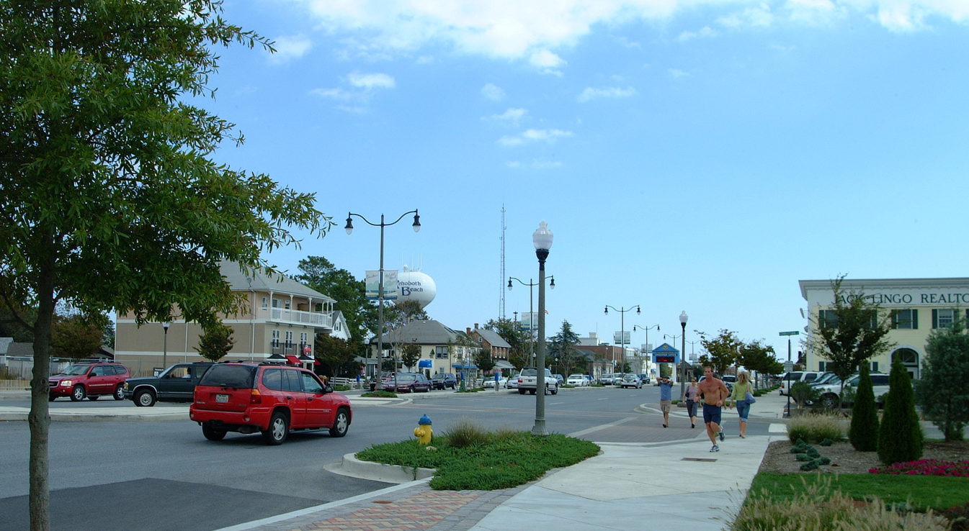
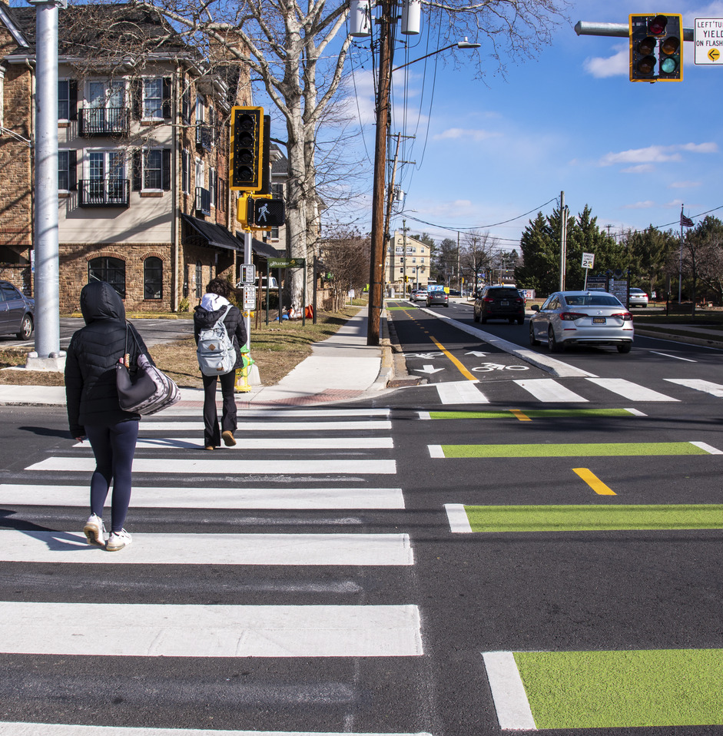
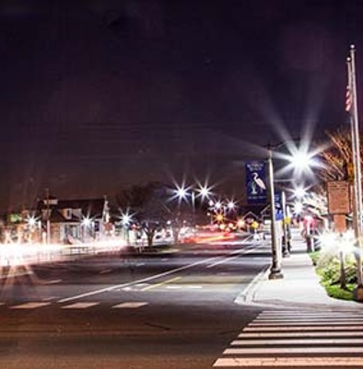
Additional Benefits: Personal Security & Aesthetics
Reduce Crime & Increase Comfort
Well-lit areas can discourage crime
Encourages socializing and community involvement
Contributes to the community aesthetic
Safer travels for all modes of transportation
Notes:
Top is Rehoboth Beach, bottom left photo is from Delaware Avenue in Newark, and bottom right is Garfield Parkway in Bethany Beach

Slide 7
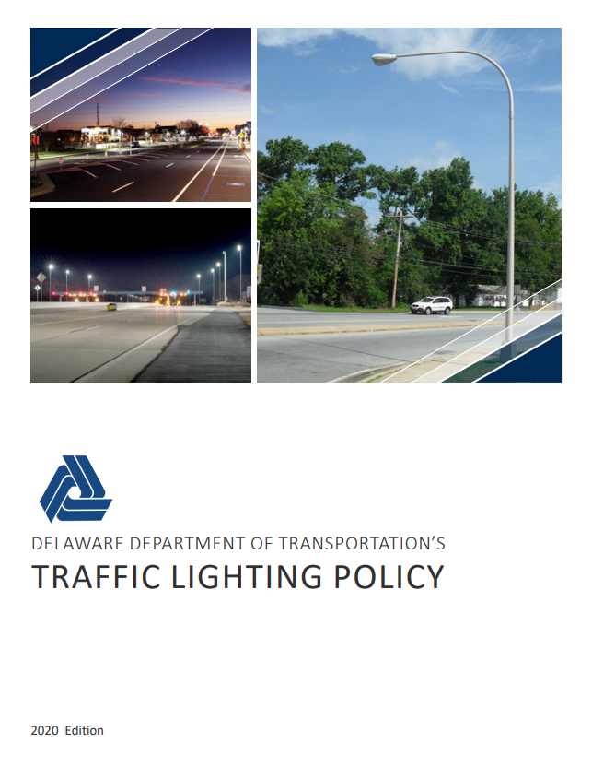
DelDOT Lighting Policy
The Engineering Perspective
Guidelines for an effective design
Balancing safety with light pollution, cost, and energy usage
Defines responsibility
Defines when lighting is needed
  Evaluation is done before design
DelDOT’s Lighting Policy: https://deldot.gov/Business/drc/pdfs/traffic/LightingPolicy.pdf?cache=1681472633659
Notes:
Use this slide to explain lighting warrants and that we do studies to determine if lighting is the best solution for nighttime safety (or if retroreflective signing/striping, raised pavement markings etc. are a better option). Can also list some of the design objectives here, ie: controlling spillback onto private property, electrical safety standards, and maintaining clear zone

Slide 8
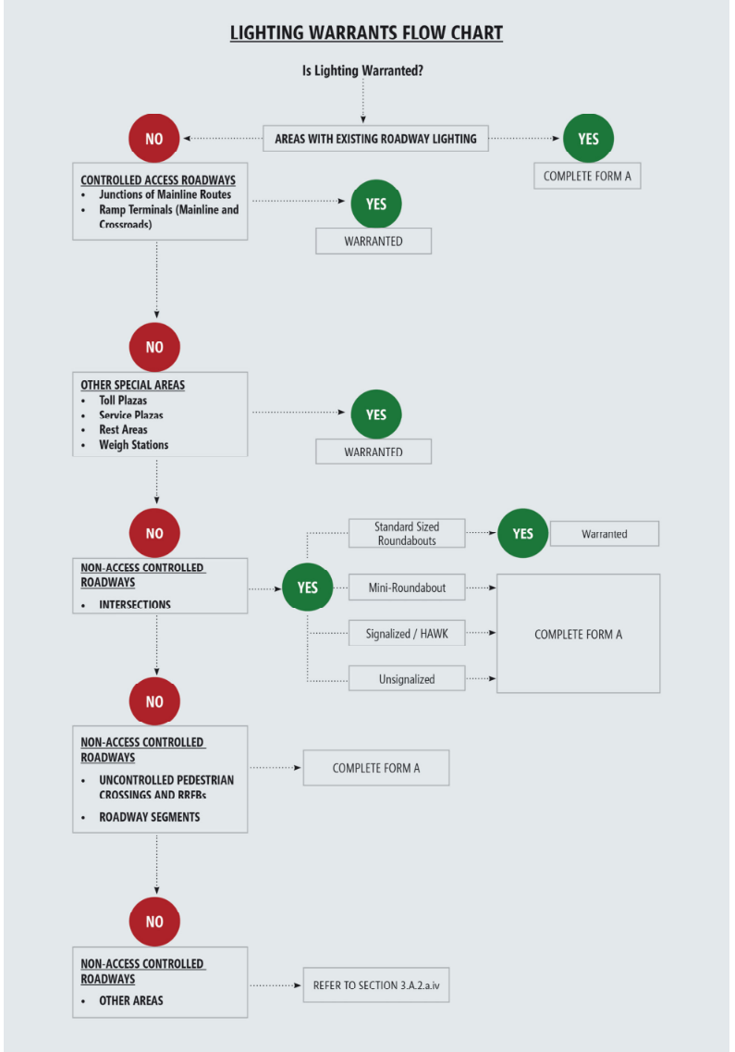
DelDOT Lighting Evaluation
Lighting Warrant Evaluation & Form A
Determines what locations require lighting
Look at speed limit, existing lighting, pedestrians, etc.
Crash history is taken into consideration
Notes:
Don’t go into the detail of the flowchart, just use it to illustrate that ramps, tolls, roundabouts etc automatically warrant lighting, whereas other areas we consider additional factors to decide

Slide 9
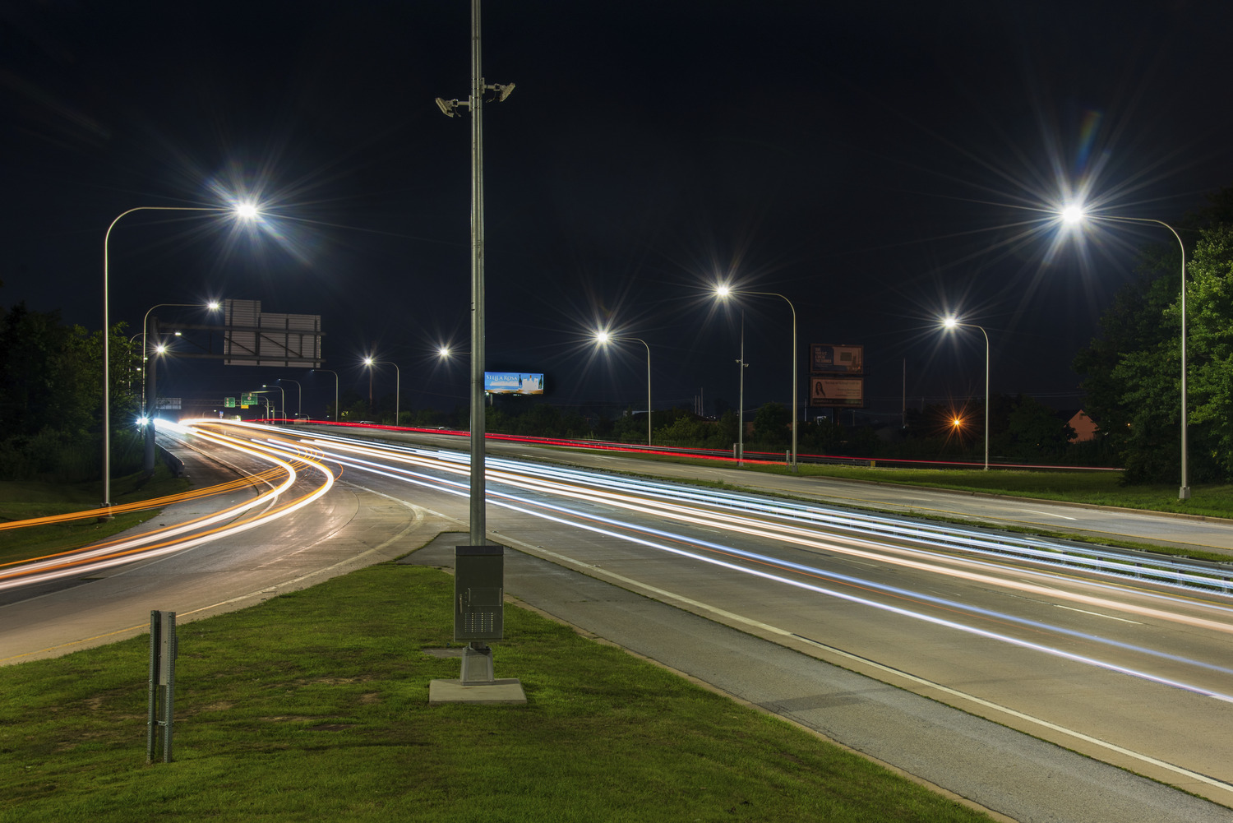
Lighting Design: Photometric calculations
Photometrics are how we determine where to put each light
We can see the footprint of what each light looks like
Average amount of brightness
Uniform throughout the area
  Uniform lighting is easier on the driver's eye
Mounting on utility poles v Standalone
Notes:
Discuss that with standalone lighting we have more flexibility with where we place lights, but we use utility pole mounted fixtures where possible. When we design stand alone lighting systems, we need to consider how to power the lights and any additional equipment needed. Image from Boxwood Road Interchange in DE.

Slide 10
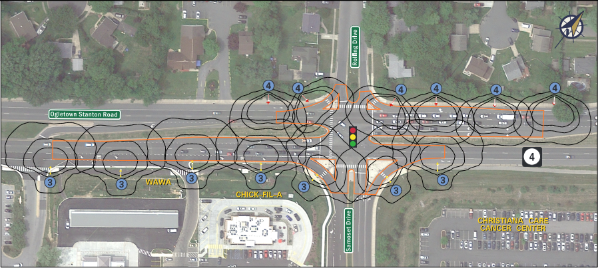
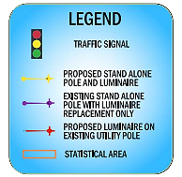
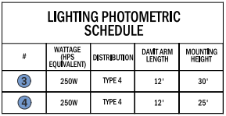

Sample Photometrics
Notes:
Images from SR 4 Corridor Lighting Photometric Analysis

Slide 11
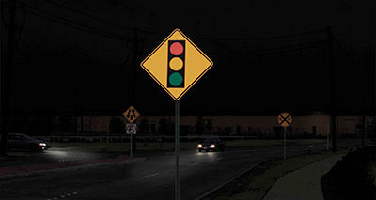
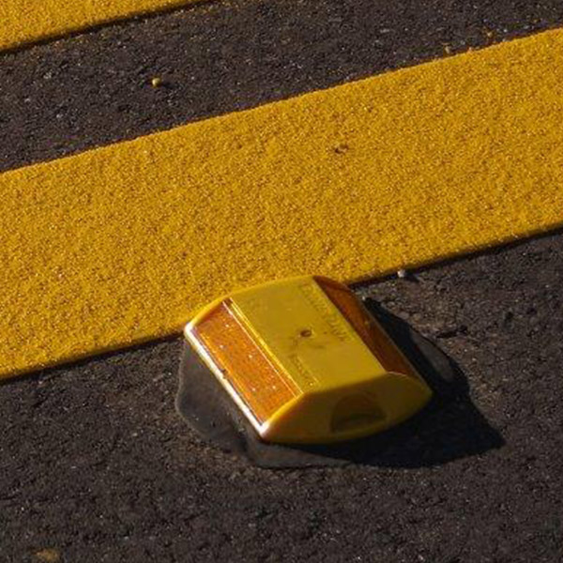
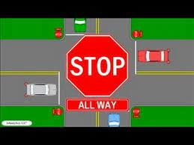

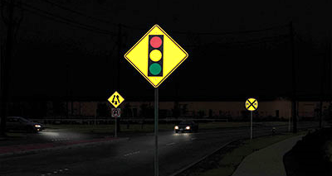
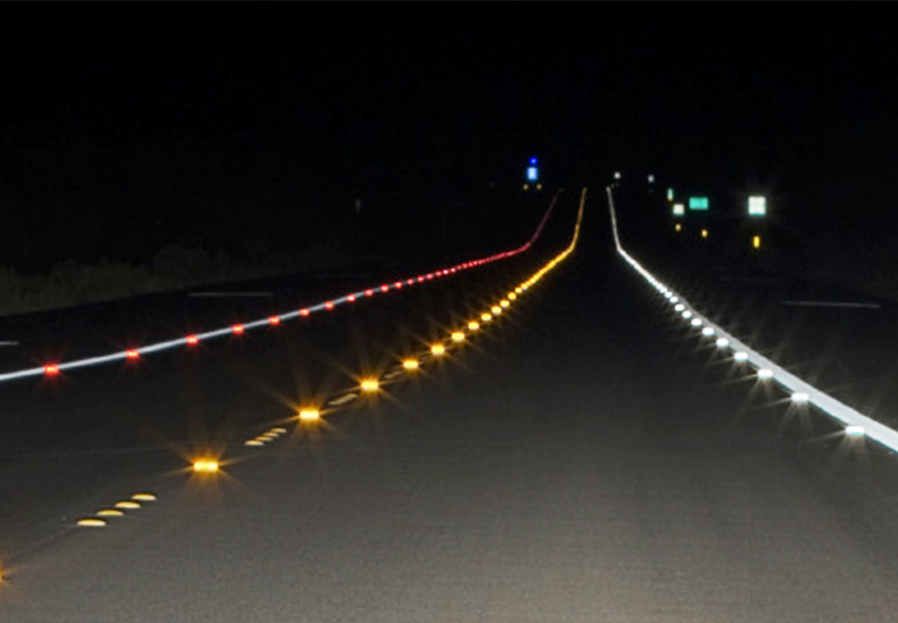
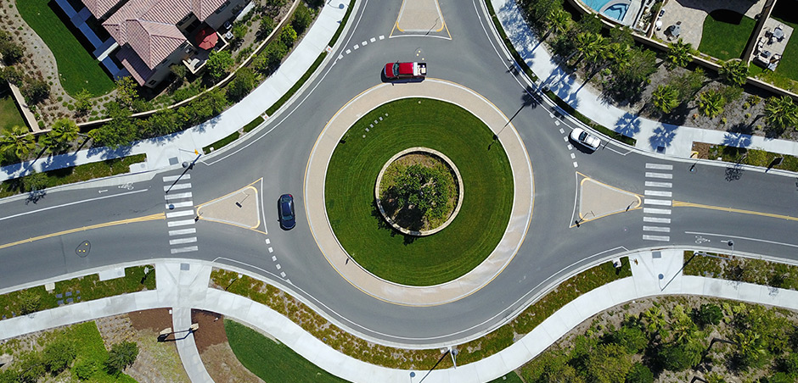
Other Proven Safety Countermeasures to Lighting
In addition to or as an alternative to lighting, the following countermeasures can also be utilized:
Signing and Striping
Reflectivity Programs
Intersection Control Changes
(All-Way Stops, Traffic Signals, Roundabouts)
Raised Pavement Markers
Standard Reflectivity
Improved Reflectivity
Notes:
Discuss that with standalone lighting we have more flexibility with where we place lights, but we use utility pole mounted fixtures where possible. When we design stand alone lighting systems, we need to consider how to power the lights and any additional equipment needed. Image from Boxwood Road Interchange in DE.

Slide 12
Questions
Thank you for your time and interest in safety on Delaware’s roadways.
Peter Haag, PE, PTOE
Chief of Traffic Engineering
Peter.Haag@delaware.gov
302-659-4084
To Report a Road Condition: https://deldot.gov/Traffic/ReportRoadCondition/index.shtml

