Slide 1
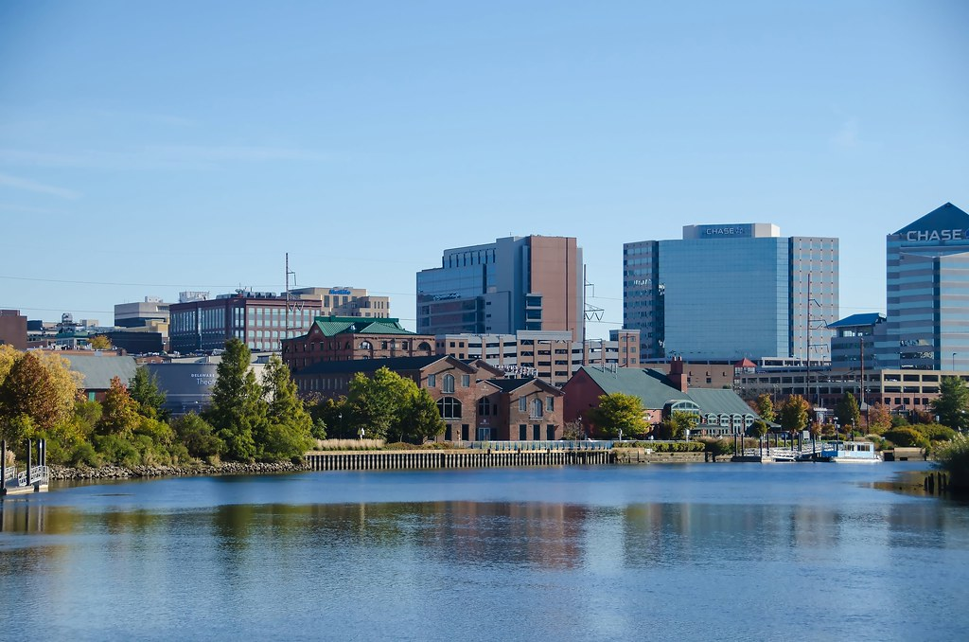
2022-2025 Revised Strategic Plan
Kendra Brumfield-NaWangna, MPA, Ph.D
Legislative & Policy Analyst
Gabriel A. Akinporoye
Strategy & Policy Analyst
Jorge E. Hernandez-Limon, MPP
Strategy & Policy Analyst

Slide 2
Purpose
Establish a Council-driven policy framework to guide engagement with a broad base of constituents, department leaders and administrative office staff,
Allow Council to focus on policy priorities while leaving space in the policy agenda for addressing unforeseen issues that may arise,
Ensure that Council’s core values are upheld and policy areas attached to those values are consistently and adequately addressed,
Demonstrate fiduciary responsibility and transparency through the establishment of a Strategic Plan for legislation where progress toward Council’s goals can be assessed and measured, and
Facilitate legislative continuity in the 108th session and beyond

Slide 3
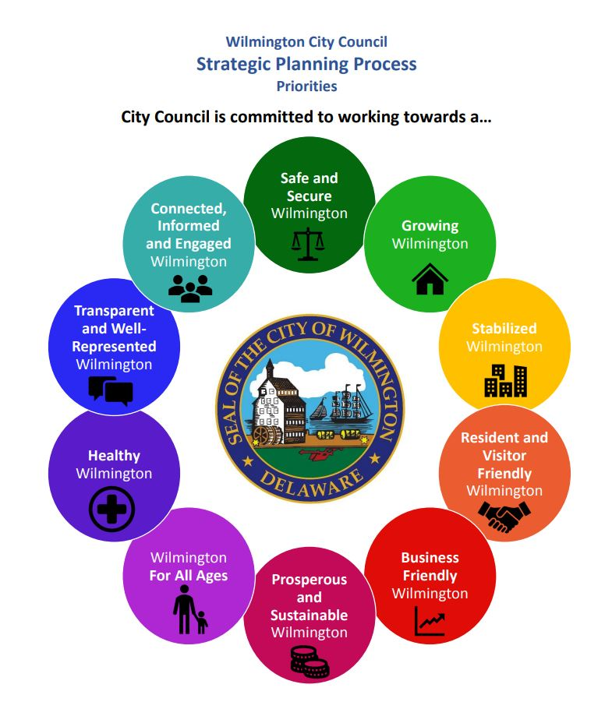
2017-2020 Recap
Goals:
  Safe and Secure
  Growing
  Stabilized
  Resident and Visitor Friendly
  Business Friendly
  Prosperous and Sustainable
  For All Ages
  Healthy
  Transparent and Well-Represented
  Connected, Informed and Engaged

Slide 4
1. Safe and Secure Wilmington
Crime Prevention and Suppression
Community Policing and Outreach
Implementing the Recommendations of the CDC and Prevention Report Related to Youth Firearm Violence

Slide 5
Safe and Secure Wilmington

Slide 6
2. Growing Wilmington
Neighborhood Revitalization Plans
Comprehensive Development Plan
Infrastructure Development and Revitalization (Repairs, Water, Sewer, Sidewalks, Roads)
Brownfields Remediation, Cleanup, and Redevelopment
Mixed Housing Development

Slide 7
Growing Wilmington

Slide 8
3. Stabilized Wilmington
Code Enforcement
Vacant Properties
Land Bank

Slide 9
Stabilized Wilmington

Slide 10
4. Resident & Visitor Friendly Wilmington
Trash and Recycling Services
Parking Enforcement
Parking Enhancements and Planning (Commercial, Residential, Downtown, Smart Meters, etc.)

Slide 11
Resident and Visitors Friendly Wilmington

Slide 12
5. Business Friendly Wilmington
Disadvantaged Business Enterprise and Minority Business Enterprise Development
Business Plan Development and Resources for Neighborhood Business Corridors

Slide 13
Business Friendly Wilmington

Slide 14
6. Prosperous & Sustainable Wilmington
Revenue Enhancements
Budget and Expenditure Controls
Policies and Strategies Regarding Risk Management, Workers Compensation, and Human Resources

Slide 15
Prosperous and Sustainable Wilmington

Slide 16
7. Wilmington for All Ages
Advocacy and Support for Wilmington's Youth in the Educational Process
Youth Master Plan
Adult and Youth Workforce Development
Implementing the Recommendation of the CDC and Prevention Report Related to Positive Youth and Family Development Activities

Slide 17
Wilmington For All Ages

Slide 18
8. Healthy Wilmington
Mental and Physical Health Services
Adult, Family, and Youth Homelessness
Senior Services

Slide 19
Healthy Wilmington

Slide 20
9. Transparent & Well-Represented Wilmington
Transparency of City Government
Redistricting

Slide 21
Transparent and Well-Represented Wilmington

Slide 22
10. Connected, Informed, & Engaged Wilmington
Constituent, Civic, and Community Engagement
Oversight of Franchise Agreement for Cable Services
Providing Access to PEG for Access to Television for Local Community, Schools, and Government

Slide 23
Connected, Informed and Well-Engaged Wilmington

Slide 24
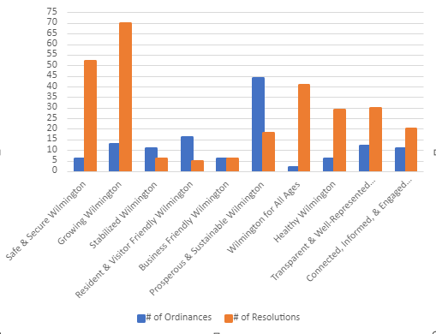
Ordinances and Resolutions

Slide 25
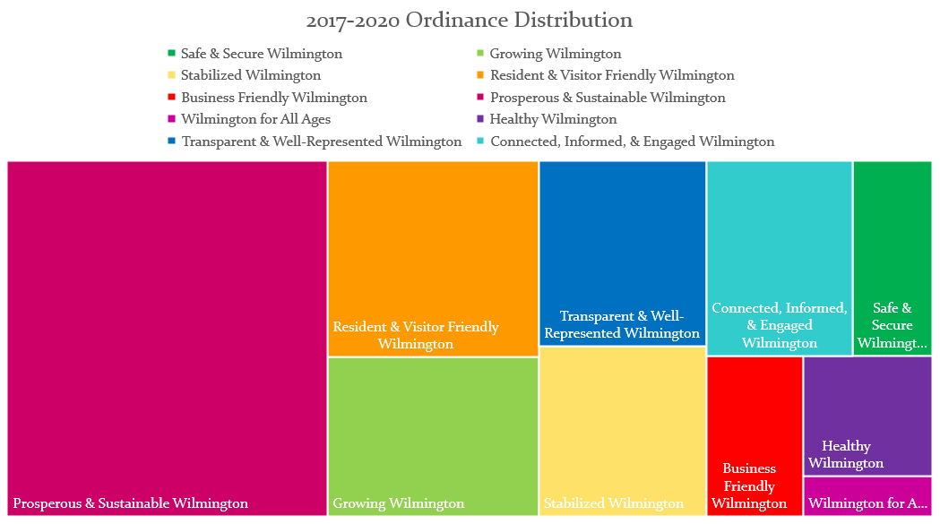

Slide 26
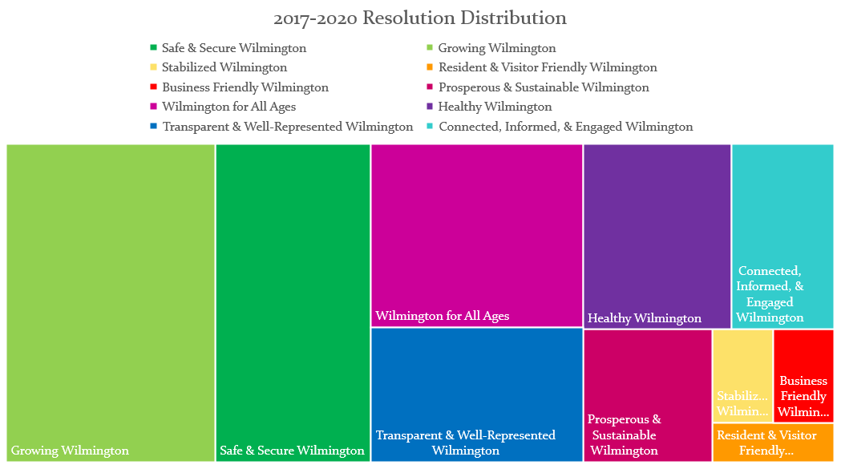

Slide 27
Revisions
Meeting Current Needs and Maintaining Relevance

Slide 28
Core Priorities
1 | Safe & Secure Wilmington
2 | Prosperous & Sustainable Wilmington
3 | Connected, Informed, & Engaged Wilmington
 | Growing Wilmington
 | Stabilized Wilmington

Slide 29
Combined Survey Responses
Safe & Secure Wilmington | VERY IMPORTANT
Crime Prevention and Suppression | Very Relevant
Community Policing and Outreach | Somewhat Relevant
Implementing the Recommendations of the CDC and Prevention Report Related to Youth Firearm Violence | Somewhat Relevant
Growing Wilmington | VERY IMPORTANT
Neighborhood Revitilization Plans | Very Relevant
Comprehensive Development Plan | Somewhat Relevant
Infrastructure Development and Revitlization (Repairs, Water, Sewer, Sidewalks, Roads) | Very Relevant
Brownfields Remediation, Cleanup, and Redevelopment | Somewhat Relevant
Mixed Housing Development | Somewhat Relevant
Stabilized Wilmington | IMPORTANT
Code Enforcement | Somewhat Relevant
Vacant Properties | Very Relevant
Land Bank | Somewhat Relevant

Slide 30
Resident & Visitor Friendly Wilmington | VERY IMPORTANT
Trash and Recycling Services | Somewhat Relevant
Parking Enforcement | Somewhat Relevant
Parking Enhancements and Planning (Commercial, Residential, Downtown, Smart Meters, etc.) | Somewhat Relevant
Business Friendly Wilmington | VERY IMPORTANT
Disadvantaged Business Enterprise and Minority Business Enterprise Development | Somewhat Relevant
Business Plan Development and Resources for Neighborhood Business Corridors | Very Relevant
Prosperous & Sustainable Wilmington | VERY IMPORTANT
Revenue Enhancements | Very Relevant
Budget and Expenditure Controls | Somewhat Relevant
Policies and Strategies Regarding Risk Management, Workers Compensation, and Human Resources | Somewhat Relevant

Slide 31
Wilmington for All Ages | IMPORTANT
Advocacy and Support for Wilmington's Youth in the Educational Process | Somewhat Relevant
Youth Master Plan | Somewhat Relevant
Adult and Youth Workforce Development | Somewhat Relevant
Implementing the Recommendations of the CDC and Prevention Report Related to Positive Youth and Family Development Activities | Somewhat Relevant
Healthy Wilmington | IMPORTANT
Mental and Physical Health Services | Very Relevant
Adult, Family, and Youth Homelessness | Somewhat Relevant
Senior Services | Somewhat Relevant
Transparent & Well-Represented Wilmington | IMPORTANT
Transparency of City Government | Very Relevant
Redistricting | Somewhat Irrelevant

Slide 32
Connected, Informed, & Engaged Wilmington | VERY IMPORTANT
Constituent, Civic, and Community Engagement | Very Relevant
Oversight of Franchise Agreement for Cable Services | Neutral
Providing Access to PEG for Access to Television for Local Community, Schools, and Government | Somewhat Relevant
Access to Television for Local Community, Schools and Government | Somewhat Relevant

Slide 33
Charting New Directions
Do you feel that "Implementing the Recommendations of the Community Based Public Safety Collective" (led by Aqueela Sherills) should be a sub-priority of the new strategic plan? | YES
Do you feel that "Neighborhood Stabilization" should be a sub-priority of the new strategic plan? | YES
Do you feel that "Implementing the Recommendations of the Study on Disadvantaged Business Enterprise Disparities in Contracting with City of Wilmington" should be a sub-priority of the new strategic plan? | YES
Do you feel that "Allocating American Rescue Plan Act (ARPA) Funding Responsibly" should be a sub-priority of the new strategic plan? | YES
Do you feel that "Working Alongside the Wilmington Learning Collaborative to Improve Learning Outcomes for Wilmington Students" should be a sub-priority of the new strategic plan? | YES

Slide 34
Do you feel that "Election Reform" should be a sub-priority of the new strategic plan? | NO
Do you feel that "Diversifying Franchising Agreements" should be a sub-priority of the new strategic plan? | YES

Slide 35

Questions?

